Slide 1
Deadlocks
Manish Shrivastava

Slide 2
System Model
A set of processes is in a deadlock state when every process in the set is waiting for an event that can be caused by another process in the set.
Events:
Resource acquisition and release.
Resource types R₁, R₂, . . ., R_{n}
Physical resources:CPU cycles, memory space, I/O devices
Logical resources: files, semaphores, and monitors
Each resource type R_{i} has W_{i} instances.
Each process utilizes a resource as follows:
Request: if the request is not granted , then it must wait.
Use: The process can operate on the resource.
Release: The process releases the resources.
Multi-threaded programs are good candidates for deadlock because multiple threads compete for shared resources.

Slide 3
Deadlock can arise if four conditions hold simultaneously.
Mutual exclusion: only one process at a time can use at least one resource. Resources are non sharable.
Hold and wait: a process holding at least one resource is waiting to acquire additional resources held by other processes.
No preemption: Resources can not be preempted; that is a resource can be released only voluntarily by the process holding it, after that process has completed its task.
Circular wait: there exists a set {P₀, P₁, …, P₀} of waiting processes such that P₀ is waiting for a resource that is held by P₁, P₁ is waiting for a resource that is held by
P₂, …, P_{n–1} is waiting for a resource that is held by P_{n}, and P₀ is waiting for a resource that is held by P₀.

Slide 4
Resource-Allocation Graph
A tool to describe the deadlock.
A set of vertices V and a set of edges E.
V is partitioned into two types:
P = {P₁, P₂, …, P_{n}}, the set consisting of all the processes in the system.
R = {R₁, R₂, …, R_{m}}, the set consisting of all resource types in the system.
request edge – directed edge P₁ → R_{j}
assignment edge – directed edge R_{j} → P_{i}

Slide 5
Resource-Allocation Graph
Process
Resource Type with 4 instances
P_{i} requests instance of R_{j}
P_{i} is holding an instance of R_{j}
P_{i}
R_{j}
P_{i}
R_{j}

Slide 6
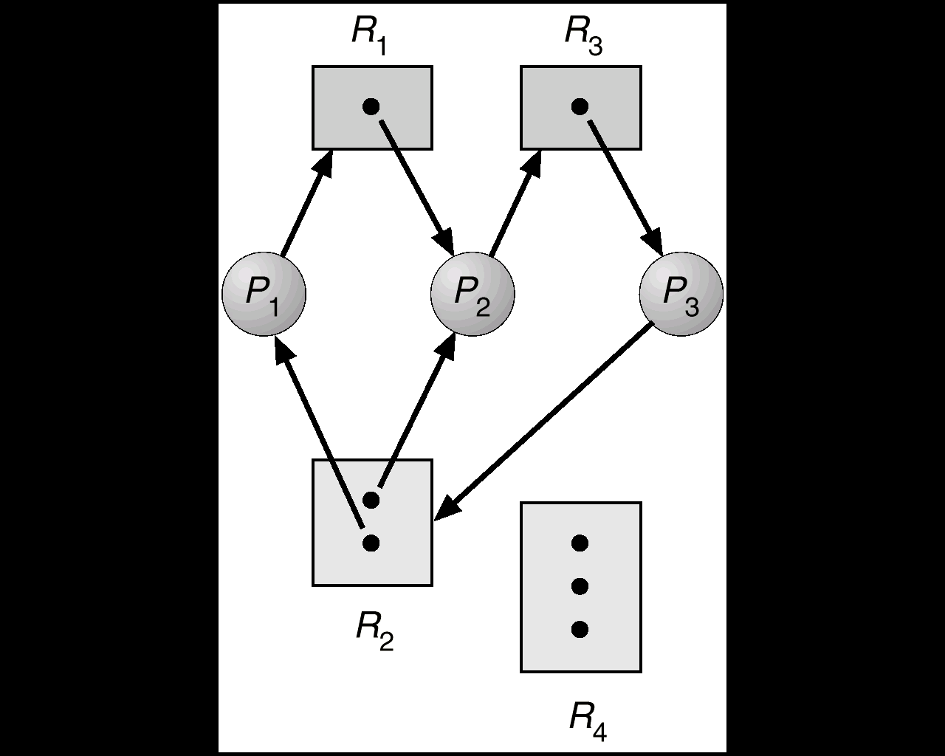
Resource Allocation Graph With A Deadlock

Slide 7
Basic Facts
If graph contains no cycles ⇒ no deadlock.
If graph contains a cycle ⇒
if only one instance per resource type, then deadlock.
if several instances per resource type, possibility of deadlock.

Slide 8
Methods for Handling Deadlocks
Three ways
Ensure that the system will never enter a deadlock state.
Allow the system to enter a deadlock state and then recover.
Ignore the problem and pretend that deadlocks never occur in the system; used by most operating systems, including UNIX.

Slide 9
Deadlock Prevention
Deadlock prevention is a set of methods for ensuring that at least one of the necessary conditions can not hold.
Restrain the ways request can be made.
Mutual Exclusion – It is not possible to prevent deadlocks through ME, as some resources are intrinsically non-sharable.
Hold and Wait – must guarantee that whenever a process requests a resource, it does not hold any other resources.
Protocol 1: Requires a process to request and be allocated all its resources before it begins execution.
System calls requesting resources for a process precede all other system calls.
Protocol 2: Allow process to request resources only when the process has none.
A process can request some resources and use them. Before, it can request additional resources, it must release all the resources that it is currently allocated.

Slide 10
Deadlock Prevention
Hold and Wait – Example
Consider a process that copies data from tape drive to a disk file and then prints the results to the printer.
Protocol1: If all the resources are requested at the beginning of a process, the process must request the tape drive, disk file, and printer.
It will the printer during entire execution, even though it needs at the end.
Protocol 2: It copies data from tape drive to disk file and releases them. It gain requests disk file and printer.
Disadvantages:
Resource utilization is very low
Resource may be allocated but unused for a long time.
Starvation is possible
A process that needs several resources may have to wait indefinitely, at least one of the resources that it needs is always allocated to another process.
Inefficient
Delays process initiation
Future resource requirements must be known

Slide 11
Deadlock Prevention (Cont.)
No Preemption –
Protocol: If a process that is holding some resources requests another resource that cannot be immediately allocated to it, then all resources currently being held are released.
Preempted resources are added to the list of resources for which the process is waiting.
Process will be restarted only when it can regain its old resources, as well as the new ones that it is requesting.
Possible for CPU registers and memory space whose state can be restored later, but not possible for printers and tape drives.

Slide 12
Deadlock Prevention (Cont.)
Circular Wait –
F:R→N is a one-to-one function, where N is a set of natural numbers.
Protocol 1: impose a total ordering of all resource types, and require that each process requests resources in an increasing order of enumeration.
A process initially can request any number of instances of type Ri. Then the process can request instances of a resource type Rj if and only if F(Rj) >F(Ri).
Protocol 2: Whenever a process requests an instance of resource type Rj, it has released any other resources Ri such that F(Ri) >=F(Rj).
Ordering

Slide 13
Deadlock prevention
Circular Wait:
“witness” system call is implemented in BSD UNIX for lock order verifier
“witness” uses mutual-exclusion locks to protect critical regions and maintains the relationship of lock orders in the system
Suppose thread_one aquires locks in the order first_mutex and second_mutex. Then witness records that first_mutex should be obtained before second_mutex. If thread_two later aquires locks out of order, witness generates a warning message.
thread_one { lock(first_mutex); lock(second_mutex); . . } | thread_two: { lock(second_mutex); lock (first_mutex); . . }

Slide 14
Deadlock Avoidance
Deadlock prevention algorithms
Low device utilization, and reduced system throughput.
Alternative method is get additional information about the processes
Resources currently available, resources currently allocated to a process, and future requests and releases of each process.
Various algorithms differ about amount and type of information required.

Slide 15
Deadlock Avoidance
Requires that the system has some additional a priori information available.
Simplest and most useful model requires that each process declare the maximum number of resources of each type that it may need.
The deadlock-avoidance algorithm dynamically examines the resource-allocation state to ensure that there can never be a circular-wait condition.
Resource-allocation state is defined by the number of available and allocated resources, and the maximum demands of the processes.

Slide 16
Safe State
When a process requests an available resource, system must decide if immediate allocation leaves the system in a safe state.
System is in safe state if there exists a safe sequence of all processes.
Sequence <P₁, P₂, …, P_{n}> is safe if for each P_{i}, the resources that Pi can still request can be satisfied by currently available resources + resources held by all the P_{j}, with j<I.
If P_{i} resource needs are not immediately available, then P_{i} can wait until all P_{j} have finished.
When P_{j} is finished, P_{i} can obtain needed resources, execute, return allocated resources, and terminate.
When P_{i} terminates, P_{i+1} can obtain its needed resources, and so on.

Slide 17
If a system is in safe state ⇒ no deadlocks.
If a system is in unsafe state ⇒ possibility of deadlock.
Avoidance ⇒ ensure that a system will never enter an unsafe state.

Slide 18
Two algorithms for Deadlock Avoidance
Resource-Allocation Graph algoritm
Bankers algoritm

Slide 19
Resource-Allocation Graph Algorithm
If we have a resource-allocation (RA) system with one instance of each resource type, we can use this approach.
Claim edge P_{i} → R_{j} indicated that process P_{j} may request resource R_{j}; represented by a dashed line.
Claim edge converts to request edge when a process requests a resource.
When a resource is released by a process, assignment edge reconverts to a claim edge.
Resources must be claimed a priori in the system.
Before the process starts executing, all its claim edges must appear in the RA graph.
Suppose a process Pi requests a resource Rj. The request can be granted if converting the request edge Pi → Rj to an assignment edge Rj →Pi does not result in the formation of a cycle in the RA graph.

Slide 20
Resource-Allocation Graph Algorithm
Cycle detection algorithm is used to detect a cycle.
If there are n processes detecting a cycle requires an order of n*n operations.

Slide 21
Banker’s Algorithm
Bank never allocates its available cash such that it no longer satisfy the needs of all customers.
Multiple instances.
Each process must a priori claim maximum use.
When a process requests a resource it may have to wait.
When a process gets all its resources it must return them in a finite amount of time.

Slide 22
Data Structures for the Banker’s Algorithm
Let n = number of processes, and m = number of resources types.
Available: Vector of length m. If available [j] = k, there are k instances of resource type R_{j} available.
Max: n x m matrix. If Max [i,j] = k, then process P_{i} may request at most k instances of resource type R_{j}.
Allocation: n x m matrix. If Allocation[i,j] = k then P_{i} is currently allocated k instances of R_{j.}
Need: n x m matrix. If Need[i,j] = k, then P_{i} may need k more instances of R_{j} to complete its task.
Need [i,j] = Max[i,j] – Allocation [i,j].
Notation:
Let X and Y be vectors of length n.
We say X <= Y if and only if X[i] <= Y[i] for all i=1,2,…,n.
For example, if X=(1,7,3,2) and Y=(0,3,2,1) then Y<= X.
Y < X if Y<=X and Y # X.

Slide 23
Resource-Request Algorithm for Process P_{i}
Request = request vector for process P_{i}. If Request_{i} [j] = k then process P_{i} wants k instances of resource type R_{j.}
1. If Request_{i} ≤ Need_{i} go to step 2. Otherwise, raise error condition, since process has exceeded its maximum claim.
2. If Request_{i} ≤ Available, go to step 3. Otherwise P_{i} must wait, since resources are not available.
3. Pretend to allocate requested resources to P_{i} by modifying the state as follows:
Available = Available = Request_{i};
Allocation_{i} = Allocation_{i} + Request_{i};
Need_{i} = Need_{i} – Request_{i;;}
If safe ⇒ the resources are allocated to P_{i}.
If unsafe ⇒ P_{i} must wait, and the old resource-allocation state is restored

Slide 24
Safety Algorithm
Let Work and Finish be vectors of length m and n, respectively. Initialize:
Work = Available
Finish [i] = false for i - 1,3, …, n.
Find and i such that both:
(a) Finish [i] = false
(b) Need_{i} ≤ Work
If no such i exists, go to step 4.
Work = Work + Allocation_{i} Finish[i] = true go to step 2.
If Finish [i] == true for all i, then the system is in a safe state.
Safety algorithm may require an order of m*n² operations.

Slide 25
Deadlock Detection
Allow system to enter deadlock state
Detection algorithm
Resource allocation graph algorithm
Detection algorithm (similar to Banker’s algoritm)
Recovery scheme

Slide 26
Single Instance of Each Resource Graph based approach
Maintain wait-for graph
Nodes are processes.
P_{i} → P_{j} if P_{i} is waiting for P_{j}.
Periodically invoke an algorithm that searches for a cycle in the graph.
An algorithm to detect a cycle in a graph requires an order of n² operations, where n is the number of vertices in the graph.

Slide 27
Several Instances of a Resource Type
Available: A vector of length m indicates the number of available resources of each type.
Allocation: An n x m matrix defines the number of resources of each type currently allocated to each process.
Request: An n x m matrix indicates the current request of each process. If Request [i_{j}] = k, then process P_{i} is requesting k more instances of resource type. R_{j}.

Slide 28
Detection Algorithm
1. Let Work and Finish be vectors of length m and n, respectively Initialize:
(a) Work = Available
(b) For i = 1,2, …, n, if Allocation_{i} ≠ 0, then Finish[i] = false;otherwise, Finish[i] = true.
2. Find an index i such that both:
(a) Finish[i] == false
(b) Request_{i} ≤ Work
If no such i exists, go to step 4.

Slide 29
Detection Algorithm (Cont.)
3. Work = Work + Allocation_{i} Finish[i] = true go to step 2.
4. If Finish[i] == false, for some i, 1 ≤ i ≤ n, then the system is in deadlock state. Moreover, if Finish[i] == false, then P_{i} is deadlocked.
Algorithm requires an order of O(m x n²⁾ operations to detect whether the system is in deadlocked state.

Slide 30
Detection-Algorithm Usage
When, and how often, to invoke depends on:
How often a deadlock is likely to occur?
How many processes will need to be rolled back?
one for each disjoint cycle
If detection algorithm is invoked arbitrarily, there may be many cycles in the resource graph and so we would not be able to tell which of the many deadlocked processes “caused” the deadlock.
Invoking for every request is expensive
Invoke once per hour; when CPU utilization drops below 40 %.

Slide 31
Recovery from Deadlock: Process Termination
Several alternatives exist.
Inform the operator
Automatic: system will recover from the deadlock automatically
Two options exist for automatically breaking a deadlock
Process termination
Resource preemption

Slide 32
Recovery from Deadlock: Process Termination
Abort all deadlocked processes.
More expensive
Abort one process at a time until the deadlock cycle is eliminated.
Overhead: after the abort of each process detection algorithm have to be invoked.
Aborting a process is not easy.
Printing or updating a file
In which order should we choose to abort? (should incur minimum cost)
Priority of the process.
How long process has computed, and how much longer to completion.
Resources the process has used.
Resources process needs to complete.
How many processes will need to be terminated.
Is process interactive or batch?

Slide 33
Recovery from Deadlock: Resource Preemption
We preempt some resources from one process and give it to other processes. Until the deadlock cycle is broken.
For preemption three issues are to be addressed
Selecting a victim – minimize cost.
Number of resources the deadlocked process is holding, time consumed by it for execution.
Rollback – return to some safe state, restart process for that state.
Rollback as far as necessary to break the deadlock.
Starvation – same process may always be picked as victim,
Solution: include number of rollbacks in cost factor.

Slide 34
Deadlock Handling: summary
Three basic approaches
Prevention: Use some protocol to prevent deadlocks, ensuring the system will never enter a deadlock state.
Low resource utilization
Avoidance: Use a priori information; do not allow the system to enter unsafe state.
Needs a priori information about future requests.
Detection: Allow the system to enter deadlock state: then recover.
Select the victim based on the cost factors.

