Slide 1
Semaphores
Manish Shrivastava

Slide 2
Semaphores: Dijkstra; 1965
Two and more processes can cooperate by means of simple signals, such that a process is forced to stop at a specified place until it has received a specific signal.
For signaling, special variables called semaphores are used
A semaphore is a synchronization tool.
A semaphore is an integer variable that is accessed only through two standard atomic operations: wait and signal.
To transmit a signal to semaphore S, a process executes the primitive signal(S) primitive.
To receive a signal via semaphore S, the process executes wait(S) primitive.

Slide 3
Semaphores: Dijkstra 1965 Classical or first definition
A semaphore is initialized to a non-negative value
The wait operation decrements the semaphore value. If the integer value is negative the process waits.
The signal operation increments the semaphore value. If the value is not positive, then process which is blocked by a wait operation is gets the access to CS.
The wait and signal are assumed to be atomic.
Semaphore S – integer variable
Can only be accessed via two indivisible (atomic) operations
wait (S):
while S≤ 0 do no-op; S--;
signal (S):
S++;

Slide 4
Critical Section of n Processes
Shared data:
semaphore mutex; // initially mutex = 1
Process Pi: do { wait(mutex); critical section
signal(mutex); remainder section } while (1);
Modifications to the integer value of the semaphore in the wait and signal operations must be executed indivisibly.

Slide 5
Semaphore Implementation
The classical definition requires busy waiting.
While a process is in CS, the other process must loop continuously in the entry code.
Busy waiting wastes CPU cycles.
This type of semaphore is called spinlock: process spins while waiting for a lock.
Advantage of spinlock: no context switch
When locks are expected to be held for short times, spinlocks are useful.
To overcome the need for busy waiting, we can modify the definition of the wait and signal semaphore operations.
If a process executes wait operation and finds the semaphore operation is not positive, it must wait.
Rather than busy waiting it must block itself.
The block operation puts the process into waiting queue of semaphore and process is switched to waiting state.
A process that is blocked waiting on a semaphore S, should be restarted when some other process executes signal operation.
The process is restarted with wakeup operation.

Slide 6
Semaphore Implementation
Define a semaphore as a record
typedef struct {
int value; struct process *L; } semaphore;
Assume two simple operations:
block suspends the process that invokes it.
wakeup(P) resumes the execution of a blocked process P.

Slide 7
Implementation
Semaphore operations now defined as
wait(S): S.value--;
if (S.value < 0) {
add this process to S.L; block;
}
signal(S): S.value++;
if (S.value <= 0) {
remove a process P from S.L; wakeup(P);
}
Wait and signal operations are system calls.

Slide 8
Semaphore as a General Synchronization Tool
Execute B in P_{j} only after A executed in P_{i}
Use semaphore flag initialized to 0
Code:
P_{i} P_{j}
 
A wait(flag)
signal(flag) B

Slide 9
Deadlock and Starvation
Deadlock – two or more processes are waiting indefinitely for an event that can be caused by only one of the waiting processes.
Let S and Q be two semaphores initialized to 1
P₀ P₁
wait(S); wait(Q);
wait(Q); wait(S);
 
signal(S); signal(Q);
signal(Q) signal(S);
Starvation – indefinite blocking. A process may never be removed from the semaphore queue in which it is suspended.

Slide 10
Two Types of Semaphores
Counting semaphore – integer value can range over an unrestricted domain.
Binary semaphore – integer value can range only between 0 and 1; can be simpler to implement.

Slide 11
Binary Semaphores
A binary semaphore is a semaphore with an integer value that can range only between 0 and 1
It is simple to implement.
Type binary semaphore =record
value:(0,1)
queue: list of processes
end;
var s: binary semaphore
waitB(s):
If s.value=1 then
s.value=0
else
begin
place this process in s.queue;
block this process;
end;
signalB(s):
If s.queue is empty then
s.value=1
else
begin
remove a process from s.queue;
place this process in the ready list.
end;

Slide 12
Implementing S as a Binary Semaphore
Can implement a counting semaphore S as a binary semaphore.
Data structures:
binary-semaphore S1, S2;
int C:
Initialization:
S1 = 1
S2 = 0
C = initial value of semaphore S
wait operation
wait(S1);
C--;
if (C < 0) {
signal(S1);
wait(S2);
}
signal(S1);
signal operation
wait(S1);
C ++;
if (C <= 0)
signal(S2);
else
signal(S1);
Counting semaphores
wait(S): S.value--;
if (S.value < 0) {
add this process to S.L;
block;
}
signal(S): S.value++;
if (S.value <= 0) {
remove a process P from S.L;
wakeup(P);
}

Slide 13
Implementing wait() and signal() in Multi-processor Systems
Disabling interrupts will not work.
Spinlock is the solution
With this we have moved busy waiting from entry section to critical sections of application programs.

Slide 14
Classical Problems of Synchronization
Bounded-Buffer Problem
Readers and Writers Problem
Dining-Philosophers Problem

Slide 15
Bounded-Buffer Problem
Used to to illustrate the power of synchronization techniques
We assume that the buffer consists of n buffers, each capable of holding an item.
The mutex semaphore provides mutual exclusion access to buffer which is initialized to the value 1.
The empty and full semaphores count the number of empty and full buffers which are initialized to n and zero respectively.
Shared data semaphore full, empty, mutex;
Initially: full = 0, empty = n, mutex = 1

Slide 16
Bounded-Buffer Problem Producer Process
do {
…
produce an item in nextp
…
wait(empty);
wait(mutex);
…
add nextp to buffer
…
signal(mutex);
signal(full);
} while (1);

Slide 17
Bounded-Buffer Problem Consumer Process
do {
wait(full)
wait(mutex);
…
remove an item from buffer to nextc
…
signal(mutex);
signal(empty);
…
consume the item in nextc
…
} while (1);
Producer is producing full buffers for the consumer and consumer is producing empty buffers for the consumer.

Slide 18
Readers-Writers Problem
Problem: A data object (file or record) is shared among several concurrent processes.
Some want to read and others want to update it.
Readers: processes interested in reading.
Writers: processes interested in writing.
Two readers can access shared data object simultaneously.
But a writer and reader can access shared data object simultaneously
problems may occur!
To protect from these problems, writers should have an exclusive access to the shared object.
This synchronization problem is referred to as readers-writers problem.
It is a different kind of synchronization problem.
The readers-writers problem has several variations.
Simple one: No reader will be kept waiting unless writer has obtained permission to write.

Slide 19
Readers-Writers Problem
Semaphores used: mutex and wrt
The semaphore wrt is common to reader and writer.
Semaphore mutex is used to update readcount.
readcount keeps track of how many are reading the object.
Shared data semaphore mutex, wrt; Initially mutex = 1, wrt = 1, readcount = 0

Slide 20
Readers-Writers Problem Writer Process
wait(wrt);
…
writing is performed
…
signal(wrt);

Slide 21
Readers-Writers Problem Reader Process
wait(mutex);
readcount++;
if (readcount == 1)
wait(wrt);
signal(mutex);
…
reading is performed
…
wait(mutex);
readcount--;
if (readcount == 0)
signal(wrt);
signal(mutex):
Writers can be starved if there is a continuous sequence of readers.

Slide 22
Readers-Writers Problem
Can the producer/consumer problem is considered as case of the readers/writers problem with a writer is a producer and reader is a consumer ?
The answer is no
The producer is not just a writer
It must read queue pointers to determine where to write the next item and it must determine if the buffer is full.
Similarly the consumer is not a reader
It must adjust queue pointers to show that it has removed a unit from the buffer.

Slide 23
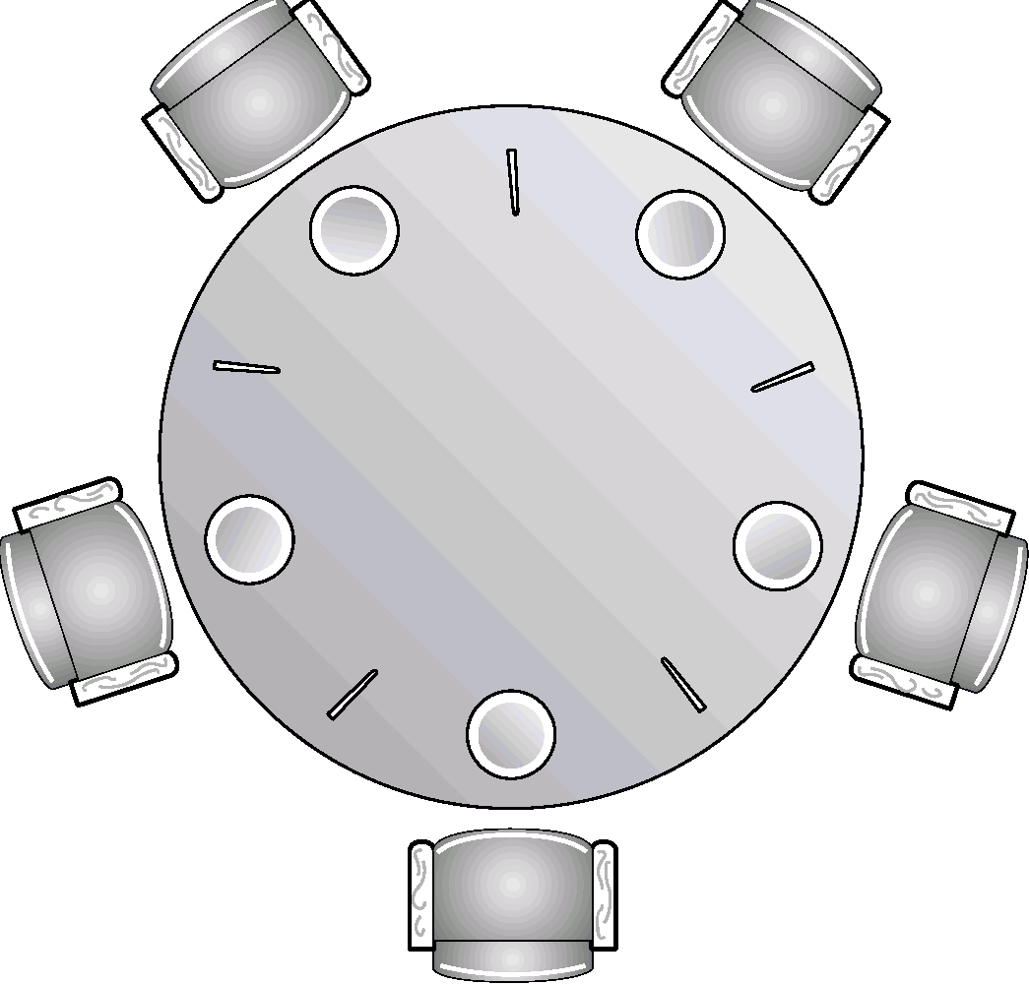
Dining-Philosophers Problem
Five philosophers spend their lives thinking and eating.
They share a common circular table surrounded by five chairs.
Five single chopsticks are available.
Whenever a philosopher wants to eat, he tries to pick up two chopsticks that are closest to him/her.
A philosopher can not pick the chopstick in the hand of neighbor.
After finishing, the philosopher puts back the chopsticks and starts thinking.
It is simple representation of the need to allocate several resources among several processes in a deadlock and starvation free manner.

Slide 24
Dining-Philosophers Problem
Shared data
semaphore chopstick[5];
Initially all values are 1
Philosopher i:
do {
wait(chopstick[i])
wait(chopstick[(i+1) % 5])
…
eat
…
signal(chopstick[i]);
signal(chopstick[(i+1) % 5]);
…
think
…
} while (1);
The solution creates a deadlock

Slide 25
Barbershop Problem
3 barbers, each with a barber chair
Haircuts may take varying amounts of time
Sofa can hold 4 customers, max of 20 in shop
Customers wait outside if necessary
When a chair is empty:
Customer sitting longest on sofa is served
Customer standing the longest sits down
After haircut, go to cashier for payment
Only one cash register
Algorithm has a separate cashier, but often barbers also take payment
This is also a critical section

Slide 26
Barbershop Problem
The main body of the program activates 50 customers, 3 barbers, and the cashier process. Synchronization operators.
Shop and sofa capacity: the capacity of shop and the capacity of the sofa are governed by the semaphores max_capacity and sofa.
When customer enters max_capacity decremented by one.
When a customer leaves it is incremented.
Wait and signal operations are surround the actions of sitting and getting_up from sofa.
Barber chair capacity:
There are three barber chairs; the semaphore barber_chair assures that no more than three customers attempt to obtain service at a time.
A customer will not get up from the sofa until at least one chair is free.
Ensuring customers are in the barber chair: The semaphore cust_ready provides a wakeup signal for a sleeping barber indicating that the customer has just taken the chair.
Holding customers in barber chair: once seated the customer remain in the chair until the barber gives the signal that haircut is complete, using the semaphore finished.
Limiting one customer to a barber chair: the semaphore barber_chair is intended to limit the number of customers in barber chairs to three. The semaphore leave_b_chair is used to synchronize sitting.
Paying and receiving: payment and receipt semaphores are used to synchronize the operations.
Coordinating barber and cashier functions: To save money the barber shop does not employ a separate cashier. Each barber is required to perform that task when not cutting hair. The semaphore coord ensures the barbers perform only one task at a time.

Slide 27
Barbershop Problem
Semaphore | Wait operation | Signal operation
max_capacity | Customer waits for a room to enter shop. | Exiting customer signals customer waiting to enter
sofa | Customer waits for seat on sofa | Customer leaving sofa signals customer waiting for sofa
barber_chair | Customer waits for empty barber chair | Barber signals when that barber’s chair is empty
Cust_read | Barber waits until customer is in the chair | Customer signals barber that customer is in the chair
finished | Customer waits until his haircut is complete. | Barber signals when done cutting hair of his customer.
leave_b_chair | Barber waits until customer gets up from the chair | Customer signals barber when customer gets up from chair.
payment | Cashier waits for a customer to pay | Customer signals cashier that he has paid.
receipt | Customer waits for a receipt for a payment | Cashier signals that payment has been accepted.
coord | Wait for a barber resource to be free to be free perform either the hair cutting or cashiering function. | Signal that a barber resource is free.

Slide 28
Barbershop
program barbershop1;
var max_capacity: semaphore (:=20);
sofa: semaphore (:=4);
barber_chair, coord: semaphore (:=3);
cust_ready, leave_b_chair, payment, receipt: semaphore (:=0)
procedure customer; procedure barber; procedure cashier;
var custnr: integer; var b_cust: integer begin
begin begin repeat
wait (max_capacity ); repeat wait( payment );
enter shop; wait( cust_ready ); wait( coord );
accept payment;
signal( coord );
signal( receipt );
wait( coord ); forever
wait( sofa ); cut hair; end;
sit on sofa; signal( coord );
wait( barber_chair ); signal( finsihed[b_cust] );
get up from sofa; wait( leave_b_chair );
signal( sofa ); signal( barber_chair );
sit in barber chair; forever
wait( mutex2 ); end;
signal( cust_ready );
wait( finished[custnr] );
leave barber chair;
signal( leave_b_chair );
pay;
signal( payment );
wait( receipt );
exit shop;
signal( max_capacity );
end;
Void main()
{
count=0;
Parbegin {customer… 50 times,…customer,
Barber, barber,barber, cashier)
}

Slide 29
Barbershop Problem
The preceding solution is unfair.
The customers are servers in the order they enter the shop.
If one barber is very fast and one of the customer is quite bald.
The problem can be solved with more semaphores.
We assign unique customer number is to each customer.
The semaphore mutex1 protects access to global variable count.
The semaphore finished is refined to be an array of 50 semaphores.
Once a customer seated in a barber chair, he executes wait(finished[custnt]) to wait in his own unique semaphore.
Please see the solution in Willium Stallling book (pp 229-234)

Slide 30
Fair Barbershop
program barbershop2;
var max_capacity: semaphore (:=20);
sofa: semaphore (:=4);
barber_chair, coord: semaphore (:=3);
mutex1, mutex2: semaphore (:=1);
cust_ready, leave_b_chair, payment, receipt: semaphore (:=0)
finished: array [1..50] of semaphore (:=0);
count: integer;
procedure customer; procedure barber; procedure cashier;
var custnr: integer; var b_cust: integer begin
begin begin repeat
wait (max_capacity ); repeat wait( payment );
enter shop; wait( cust_ready ); wait( coord );
wait( mutex1 ); wait( mutex2 ); accept payment;
count := count + 1; dequeue1( b_cust ); signal( coord );
custnr := count; signal( mutex2 ); signal( receipt );
signal( mutex1 ); wait( coord ); forever
wait( sofa ); cut hair; end;
sit on sofa; signal( coord );
wait( barber_chair ); signal( finsihed[b_cust] );
get up from sofa; wait( leave_b_chair );
signal( sofa ); signal( barber_chair );
sit in barber chair; forever
wait( mutex2 ); end;
enqueue1( custnr );
signal( cust_ready );
signal( mutex2 );
wait( finished[custnr] );
leave barber chair;
signal( leave_b_chair );
pay;
signal( payment );
wait( receipt );
exit shop;
signal( max_capacity );
end;
Void main()
{
count=0;
Parbegin {customer… 50 times,…customer,
Barber, barber,barber, cashier)
}

Slide 31
Implementation of Semaphores
wait and signal operations are atomic.
Good Solution: implement through hardware or firmware.
Other solutions
Ensure that only process manipulates “wait” and “signal” operations.
One can use Dekker’s algorithm or Peterson’s algorithm
Substantial processing overhead
Use one of the hardware supported schemes
Test and set
disabling interrupts (single processor)
The wait and signal code is very short the amount of busy waiting involved is short.

Slide 32
Two possible implementations of Semaphores
Wait(s)
{
while(!testset(s.flag)
/* do nothing */
s.count--;
if (s.count <0)
{
place this process in s.queue;
block this process (set s.flag to 0)
}
else
s.flag=0;
}
Wait(s)
{
Inhibit interrupts
s.count--;
if (s.count <0)
{
place this process in s.queue;
block this process allow interrupts
}
else
allow interrupts;
}
Signal(s)
{
Inhibit interrupts;
s.count++;
if (s.count <= 0)
{
remove a process P from s.queue;
Place a process P in the ready list
}
allow interrupts;
}
Signal(s)
{
while(!testset(s.flag)
/* do nothing */
s.count++;
if (s.count <= 0)
{
remove a process P from s.queue;
Place a process P in the ready list
}
s.flag=0;
}
With Interrupts
With TestSet Instruction

Slide 33
Problem with semaphores
Incorrect use may result in timing errors
These errors are difficult to detect as these occur if only particular sequence occurs.
Missing or reverse order.
It is difficult to produce correct program using semaphores.
The wait and signal operations are scattered throughout the program and it is difficult to see overall effect of these operations on the semaphores.

Slide 34
Problem with semaphores (cont.)
Problems
Suppose a process interchanges the order in which wait and signal operations on the semaphore are executed
signal (mutex)
CS
wait (mutex)
Several processes may be executing in their CS simultaneously.
Suppose that a process replaces signal(mutex) with wait(mutex)
signal (mutex) wait(mutex)
CS CS
signal (mutex) wait(mutex)
Deadlock will occur.
Suppose a process omits wait(mutex) or signal(mutex) or both.
ME is violated or deadlock occurs.
A critical region and monitor concept is introduced to address this problem

