Slide 1
CH3150 – MASS TRANSFER II
GROUP 2

Slide 2
OVERVIEW FOR PHASE I
Solving Counter Current using Graphical Method
Solving Cross Current using Graphical Method
Creation of Data in the form of input/output for above two processes
Fitting a neural network model which can predict the percentage removal

Slide 3
OVERVIEW FOR PHASE I
INPUT
SOLVENT RATE
INPUT COMPOSITION
NO. OF STAGES
CROSS CURRENT OPERATON FOR A PARTICULAR INPUT
GENERATION OF DATA FROM RANDOM INPUT FOR BOTH OPTERATIONS
FITTNG THS DATA TO NEURAL NETWORK MODEL
COUNTER CURRENT OPERATON FOR A PARTICULAR INPUT
OUTPUT
PERCENTAGE OVERALL REMOVAL
MATLAB
EXCEL
PYTHON

Slide 4
Solving Counter current using Graphical Method
Polyfit returns the coefficients for a polynomial p(x) of degree n that is a best fit (in a least-squares sense) for the data in y. The coefficients in p are in descending powers, and the length of p is n+1
p(x)=p1xn+p2xn−1+...+pnx+pn+1.
Polyval evaluates the polynomial p at each point in x. The argument p is a vector of length n+1 whose elements are the coefficients (in descending powers) of an nth-degree polynomial:
p(x)=p1xn+p2xn−1+...+pnx+pn+1.
Poly2sym(c) creates the symbolic polynomial expression p from the vector of coefficients c. The polynomial variable is x. If c = [c1,c2,...,cn], then p = poly2sym(c) returns c1xn−1+c2xn−2+...+cn.
S = vpasolve(eqn,var) numerically solves the equation eqn for the variable var. If you do not specify var, vpasolve solves for the default variable determined by symvar. For example, vpasolve(x + 1 == 2, x) numerically solves the equation x + 1 = 2 for x.
By default, vpasolve finds the solutions to 32 significant digits. To change the number of significant digits, use the digits function.

Slide 5
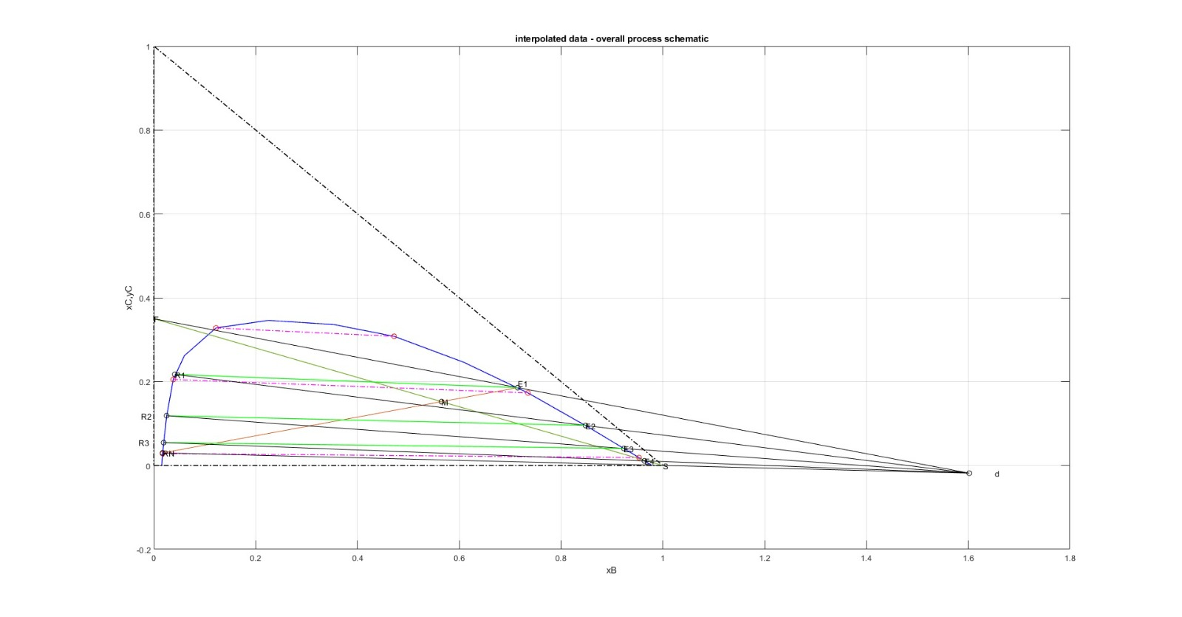

Slide 6
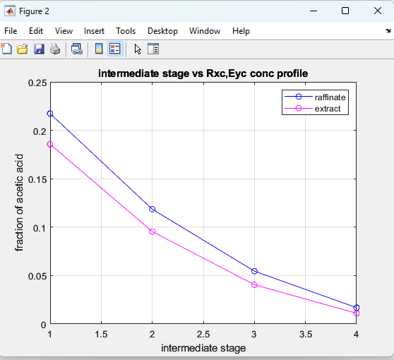
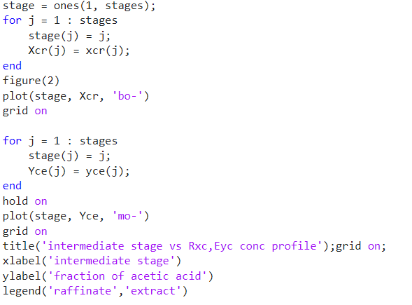
Plot of intermediate stage vs Rxc, Eyc conc Profile
CODE
PLOT

Slide 7
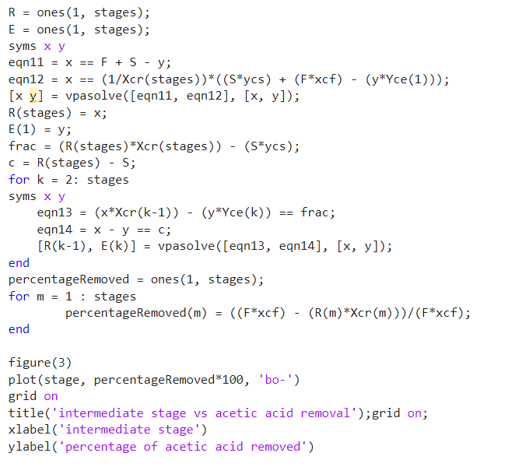
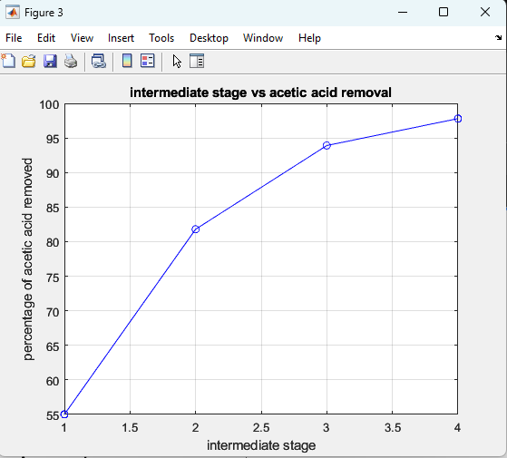
Plot of intermediate stage vs acetic acid removal
CODE
PLOT

Slide 8
Solving Cross current using Graphical Method
Polyfit returns the coefficients for a polynomial p(x) of degree n that is a best fit (in a least-squares sense) for the data in y. The coefficients in p are in descending powers, and the length of p is n+1
p(x)=p1xn+p2xn−1+...+pnx+pn+1.
Polyval evaluates the polynomial p at each point in x. The argument p is a vector of length n+1 whose elements are the coefficients (in descending powers) of an nth-degree polynomial:
p(x)=p1xn+p2xn−1+...+pnx+pn+1.
Poly2sym(c) creates the symbolic polynomial expression p from the vector of coefficients c. The polynomial variable is x. If c = [c1,c2,...,cn], then p = poly2sym(c) returns c1xn−1+c2xn−2+...+cn.
S = vpasolve(eqn,var) numerically solves the equation eqn for the variable var. If you do not specify var, vpasolve solves for the default variable determined by symvar. For example, vpasolve(x + 1 == 2, x) numerically solves the equation x + 1 = 2 for x.
By default, vpasolve finds the solutions to 32 significant digits. To change the number of significant digits, use the digits function.

Slide 9
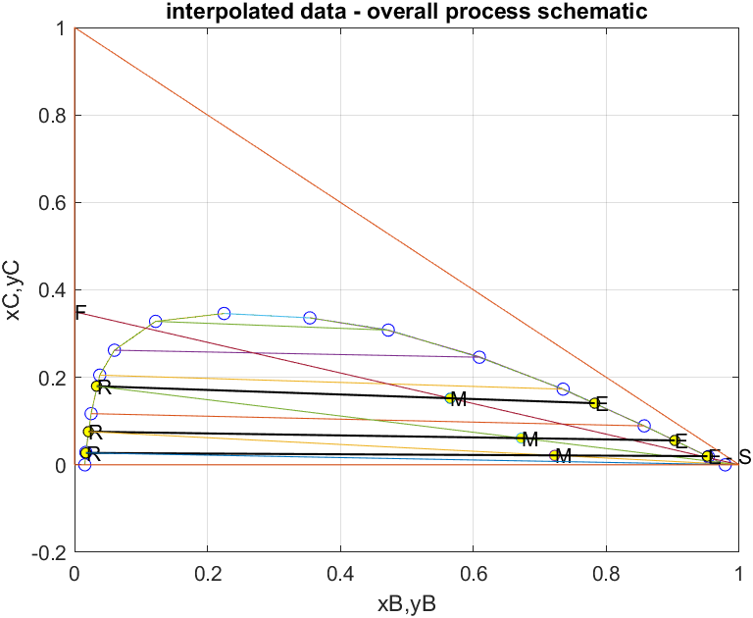

Slide 10
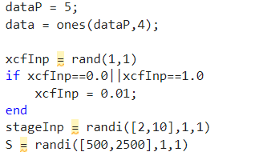
Data Generation
Using the code given in the previous slides, generate data with random input( i.e., solvent rate, number of stages, input composition) to get percentage removal and store them in .xlsx file or .csv file .
We use this data to train a neural network

Slide 11
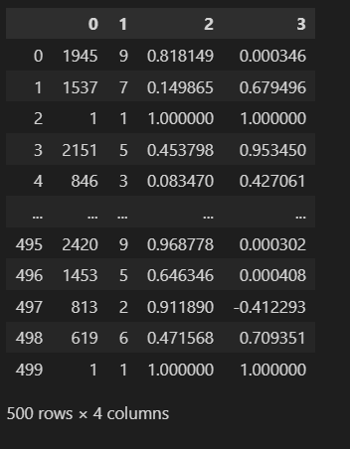
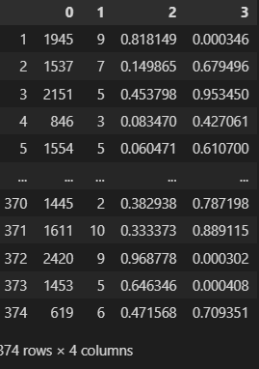

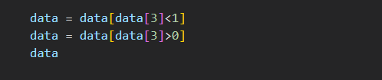
Cleaning the Data
Since the some of the values of percentage removal are negative and some are greater than one, we should remove them.

Slide 12
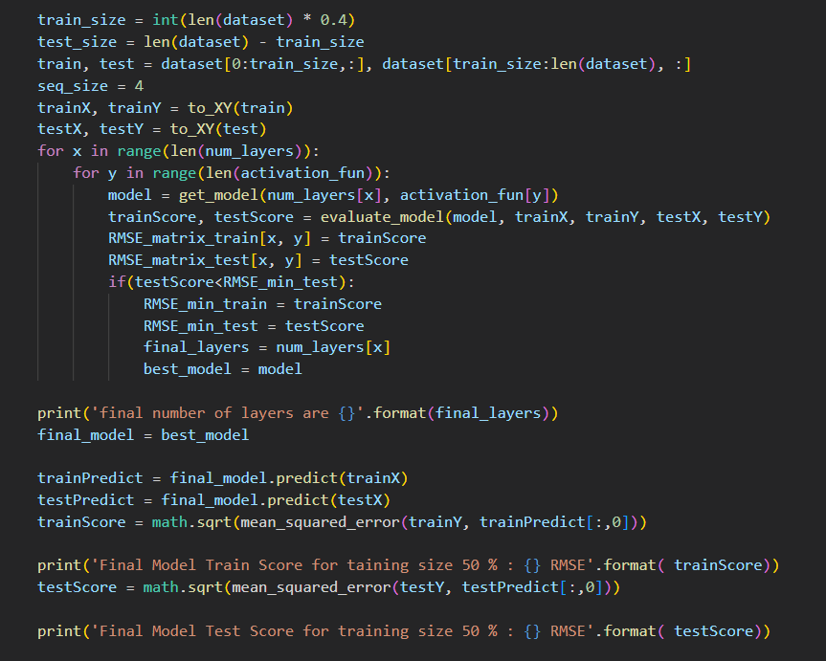
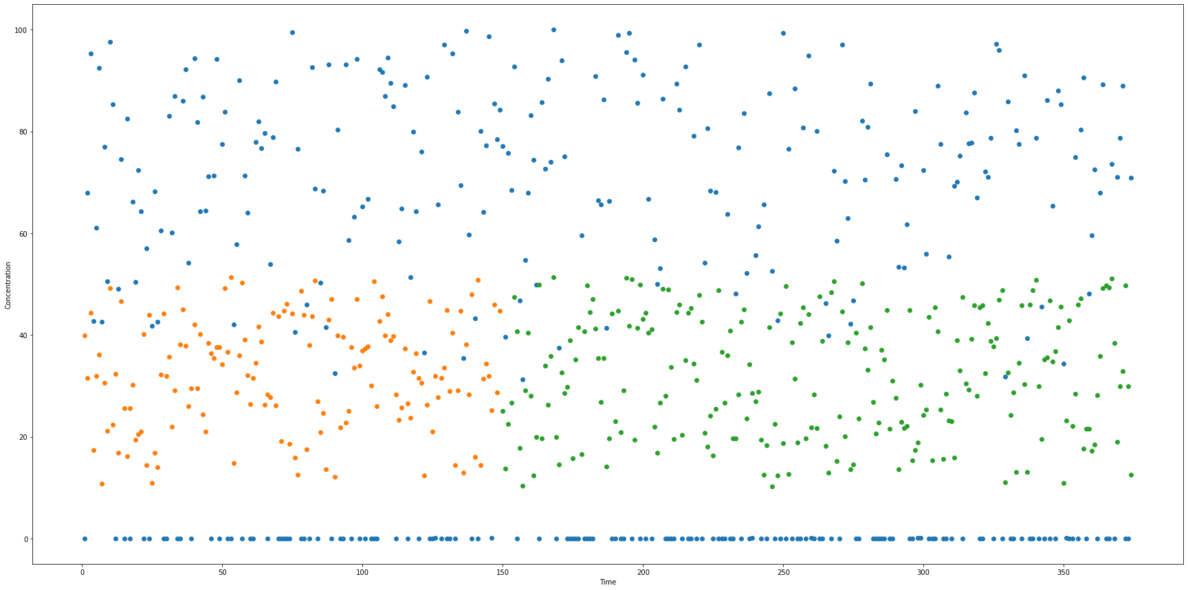
Fitting data to a neural network model(Cross Current)
CODE
PLOT

Slide 13
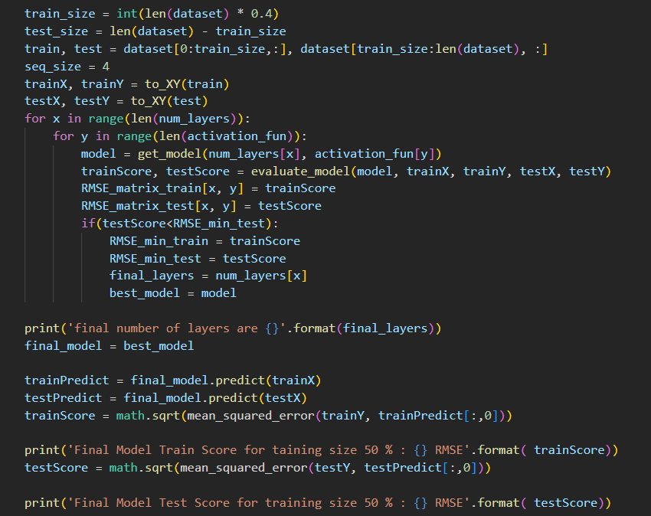
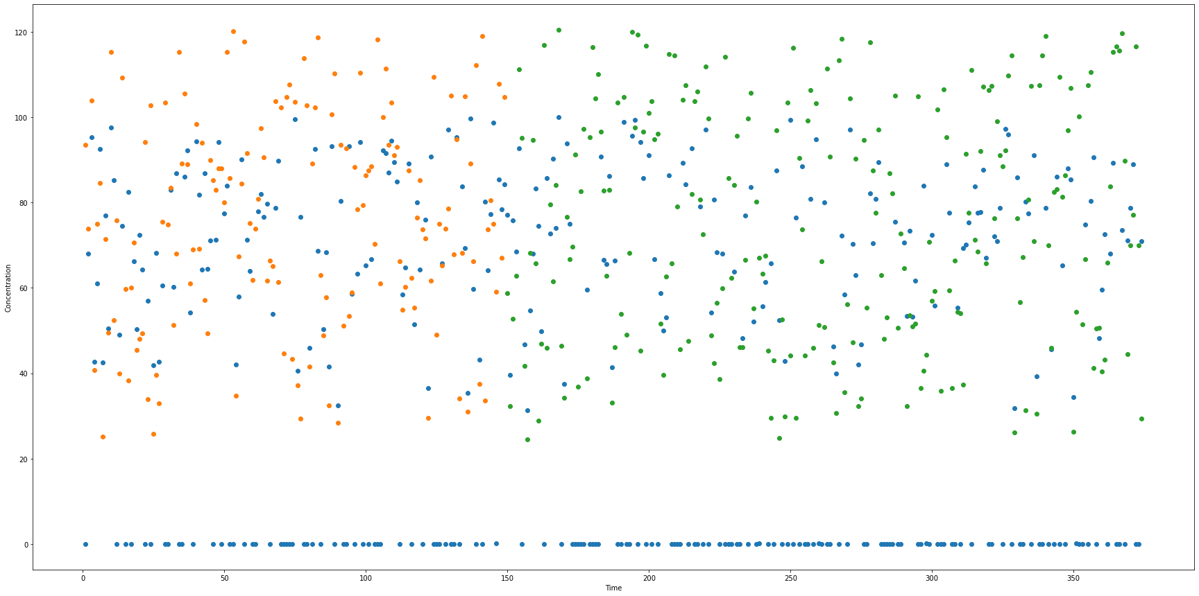
Fitting data to a neural network model (Counter current)
CODE
PLOT

Slide 14
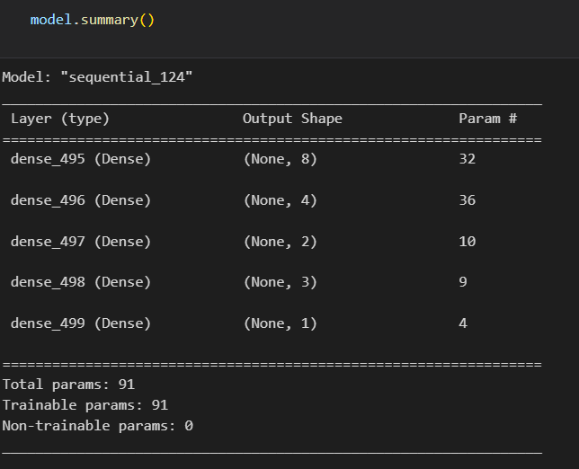
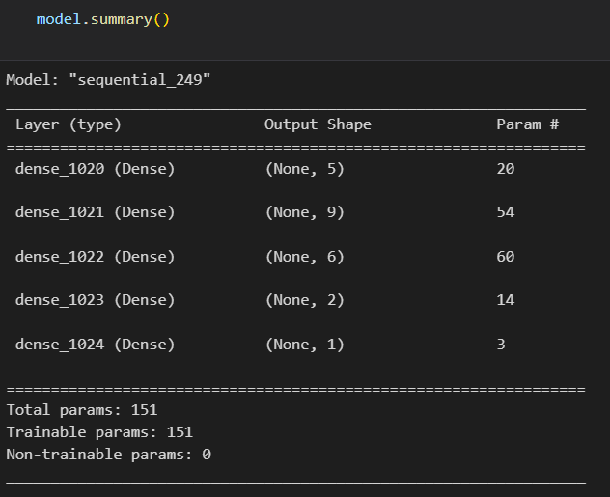
Model Summary
CROSS CURRENT
COUNTER CURRENT

Slide 15
Future Work
Solving the cases using equilateral triangle system
Solving using fsolve like functions, fully analytically, without graphs
Making the model more informative by giving additional features
Tuning hyperparameters such as learning rate, optimizer, momentum, and many more
Building a UserInterface so as to provide visual(graphical) results of countercurrent and crosscurrent operation, and minimum solvent rate.

Slide 16
Thank you
Data Generation - ANUMULA ABHILASH
Model Fitting and Training - ARPIT PAIDA
Presentation - AYUSH DADHEECH
CounterCurrent Solving - CHIKKALAWAR SREEVANI
CrossCurrent Solving - DEVANG ASHVIN SARDAL

