Slide 1
CH3150 – MASS TRANSFER II
GROUP 2

Slide 2
OVERVIEW FOR PHASE I
Solving Counter Current using Graphical Method
Solving Cross Current using Graphical Method
Creation of Data in the form of input/output for above two processes
Fitting a neural network model which can predict the percentage removal

Slide 3
OVERVIEW FOR PHASE I
INPUT
SOLVENT RATE
INPUT COMPOSITION
NO. OF STAGES
CROSS CURRENT OPERATON FOR A PARTICULAR INPUT
GENERATION OF DATA FROM RANDOM INPUT FOR BOTH OPTERATIONS
FITTNG THS DATA TO NEURAL NETWORK MODEL
COUNTER CURRENT OPERATON FOR A PARTICULAR INPUT
OUTPUT
PERCENTAGE OVERALL REMOVAL
MATLAB
EXCEL
PYTHON

Slide 4
Solving Counter current using Graphical Method
Polyfit returns the coefficients for a polynomial p(x) of degree n that is a best fit (in a least-squares sense) for the data in y. The coefficients in p are in descending powers, and the length of p is n+1
p(x)=p1xn+p2xn−1+...+pnx+pn+1.
Polyval evaluates the polynomial p at each point in x. The argument p is a vector of length n+1 whose elements are the coefficients (in descending powers) of an nth-degree polynomial:
p(x)=p1xn+p2xn−1+...+pnx+pn+1.
Poly2sym(c) creates the symbolic polynomial expression p from the vector of coefficients c. The polynomial variable is x. If c = [c1,c2,...,cn], then p = poly2sym(c) returns c1xn−1+c2xn−2+...+cn.
S = vpasolve(eqn,var) numerically solves the equation eqn for the variable var. If you do not specify var, vpasolve solves for the default variable determined by symvar. For example, vpasolve(x + 1 == 2, x) numerically solves the equation x + 1 = 2 for x.
By default, vpasolve finds the solutions to 32 significant digits. To change the number of significant digits, use the digits function.

Slide 5
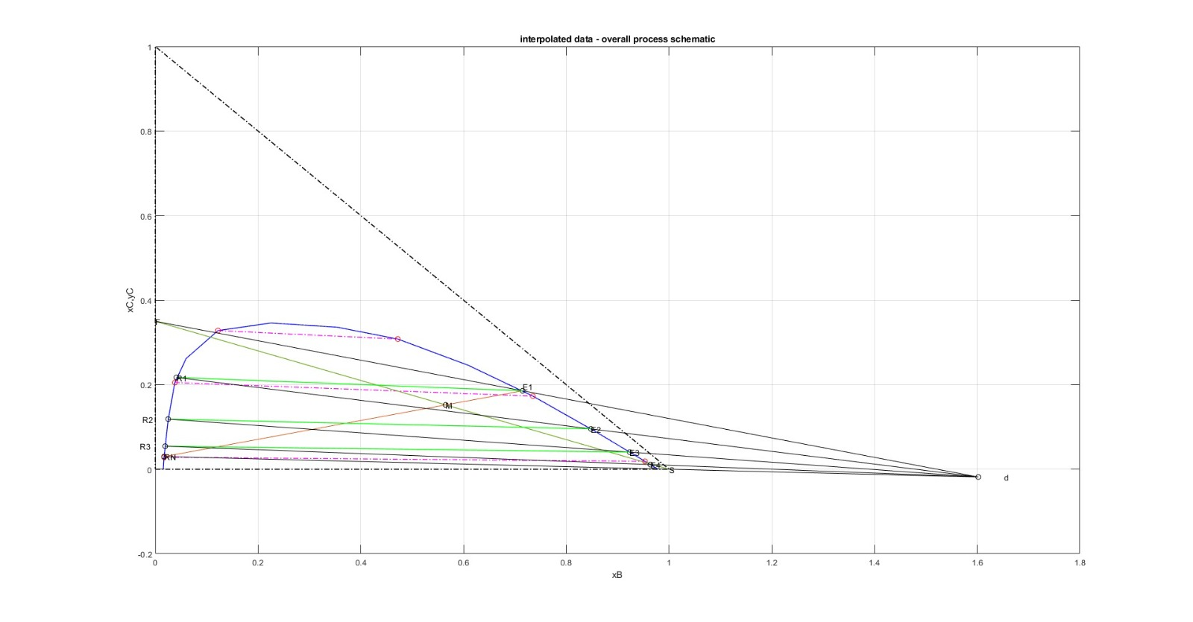

Slide 6
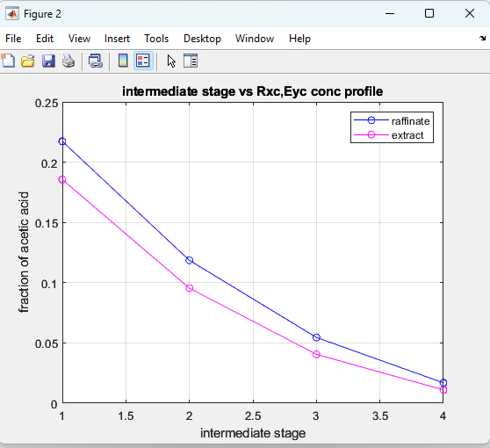
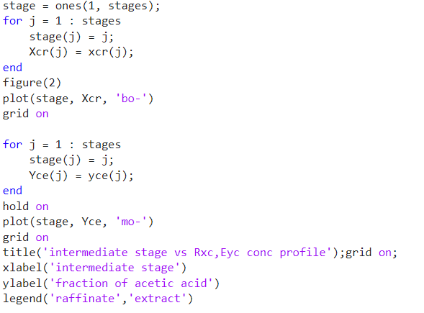
Plot of intermediate stage vs Rxc, Eyc conc Profile
CODE
PLOT

Slide 7
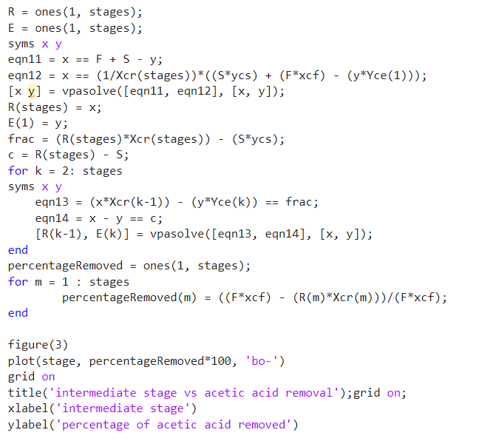
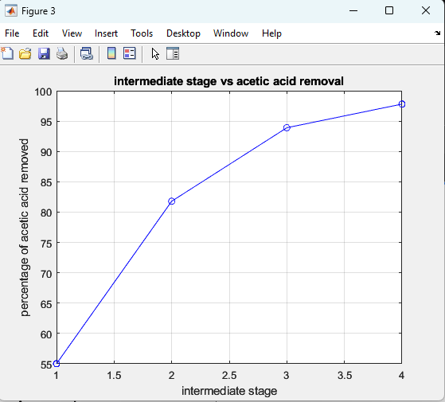
Plot of intermediate stage vs acetic acid removal
CODE
PLOT

Slide 8
Solving Cross current using Graphical Method
Polyfit returns the coefficients for a polynomial p(x) of degree n that is a best fit (in a least-squares sense) for the data in y. The coefficients in p are in descending powers, and the length of p is n+1
p(x)=p1xn+p2xn−1+...+pnx+pn+1.
Polyval evaluates the polynomial p at each point in x. The argument p is a vector of length n+1 whose elements are the coefficients (in descending powers) of an nth-degree polynomial:
p(x)=p1xn+p2xn−1+...+pnx+pn+1.
Poly2sym(c) creates the symbolic polynomial expression p from the vector of coefficients c. The polynomial variable is x. If c = [c1,c2,...,cn], then p = poly2sym(c) returns c1xn−1+c2xn−2+...+cn.
S = vpasolve(eqn,var) numerically solves the equation eqn for the variable var. If you do not specify var, vpasolve solves for the default variable determined by symvar. For example, vpasolve(x + 1 == 2, x) numerically solves the equation x + 1 = 2 for x.
By default, vpasolve finds the solutions to 32 significant digits. To change the number of significant digits, use the digits function.

Slide 9
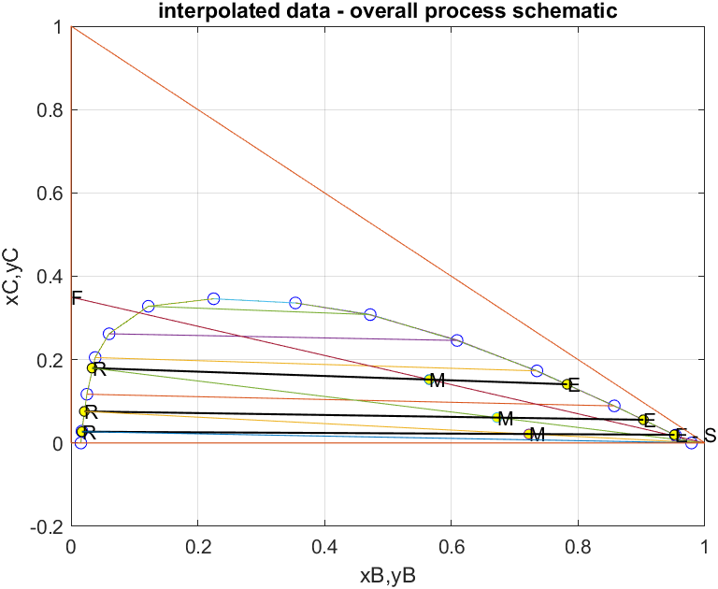

Slide 10
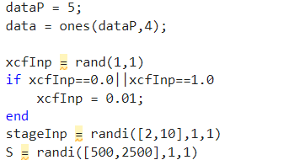
Data Generation
Using the code given in the previous slides, generate data with random input( i.e., solvent rate, number of stages, input composition) to get percentage removal and store them in .xlsx file or .csv file .
We use this data to train a neural network

Slide 11
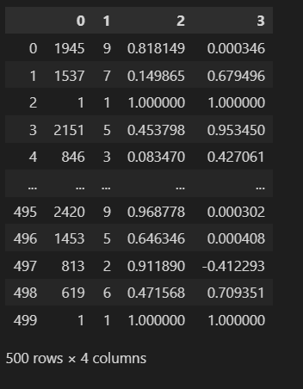
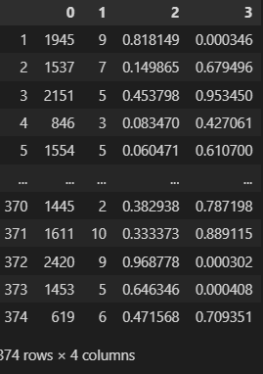

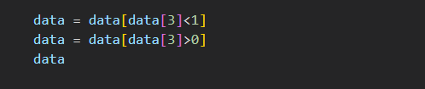
Cleaning the Data
Since the some of the values of percentage removal are negative and some are greater than one, we should remove them.

Slide 12
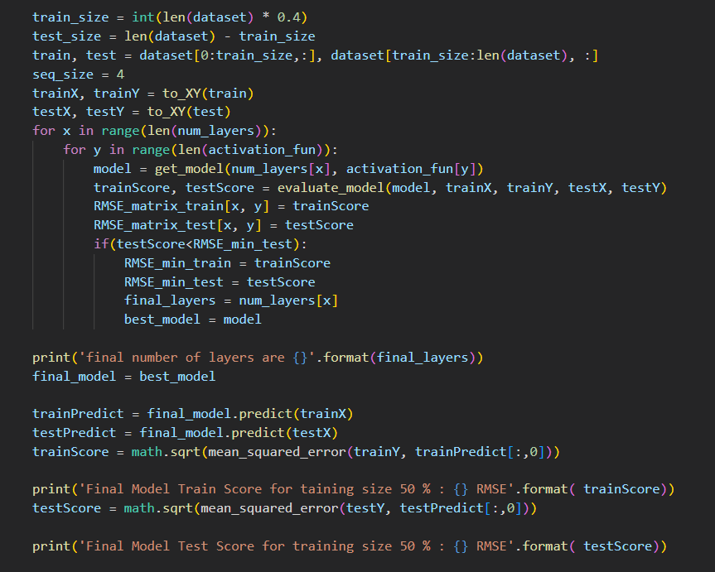
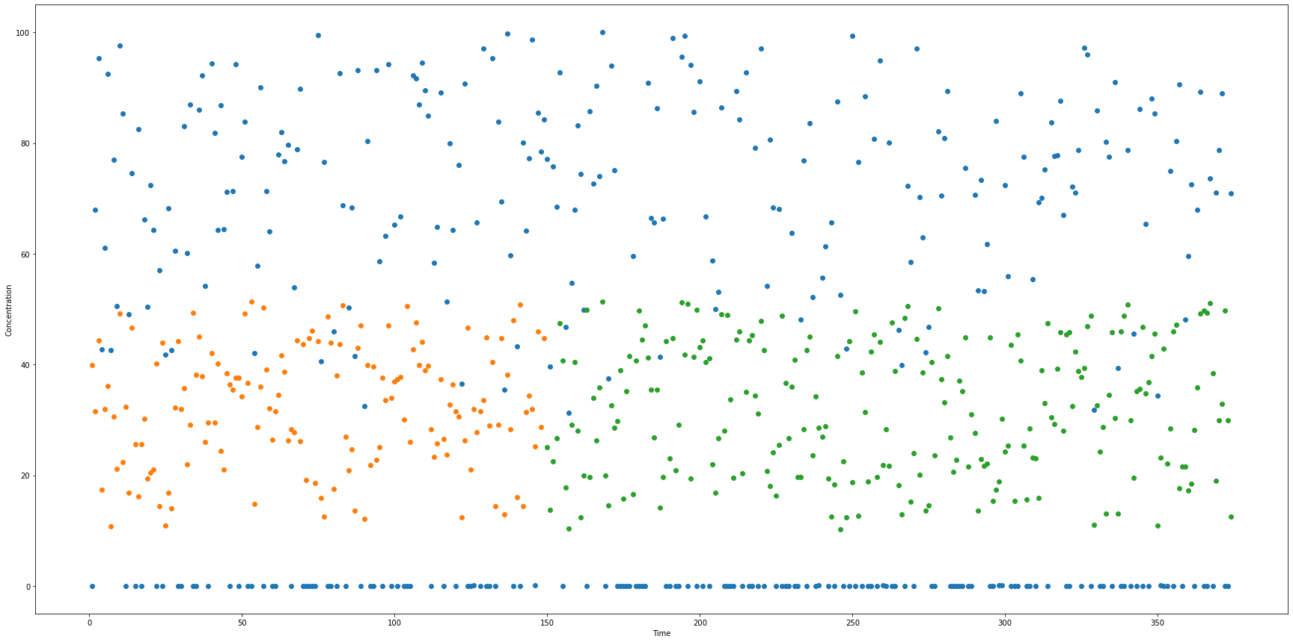
Fitting data to a neural network model(Cross Current)
CODE
PLOT

Slide 13
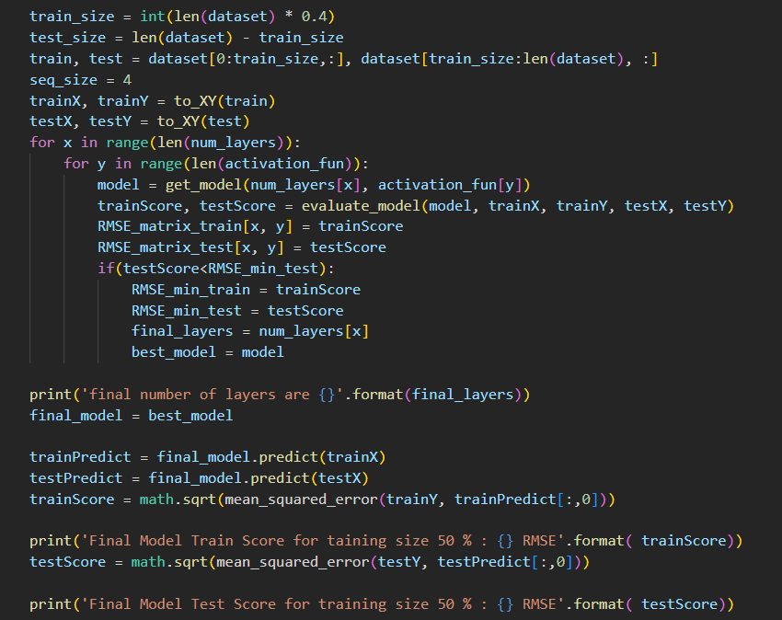
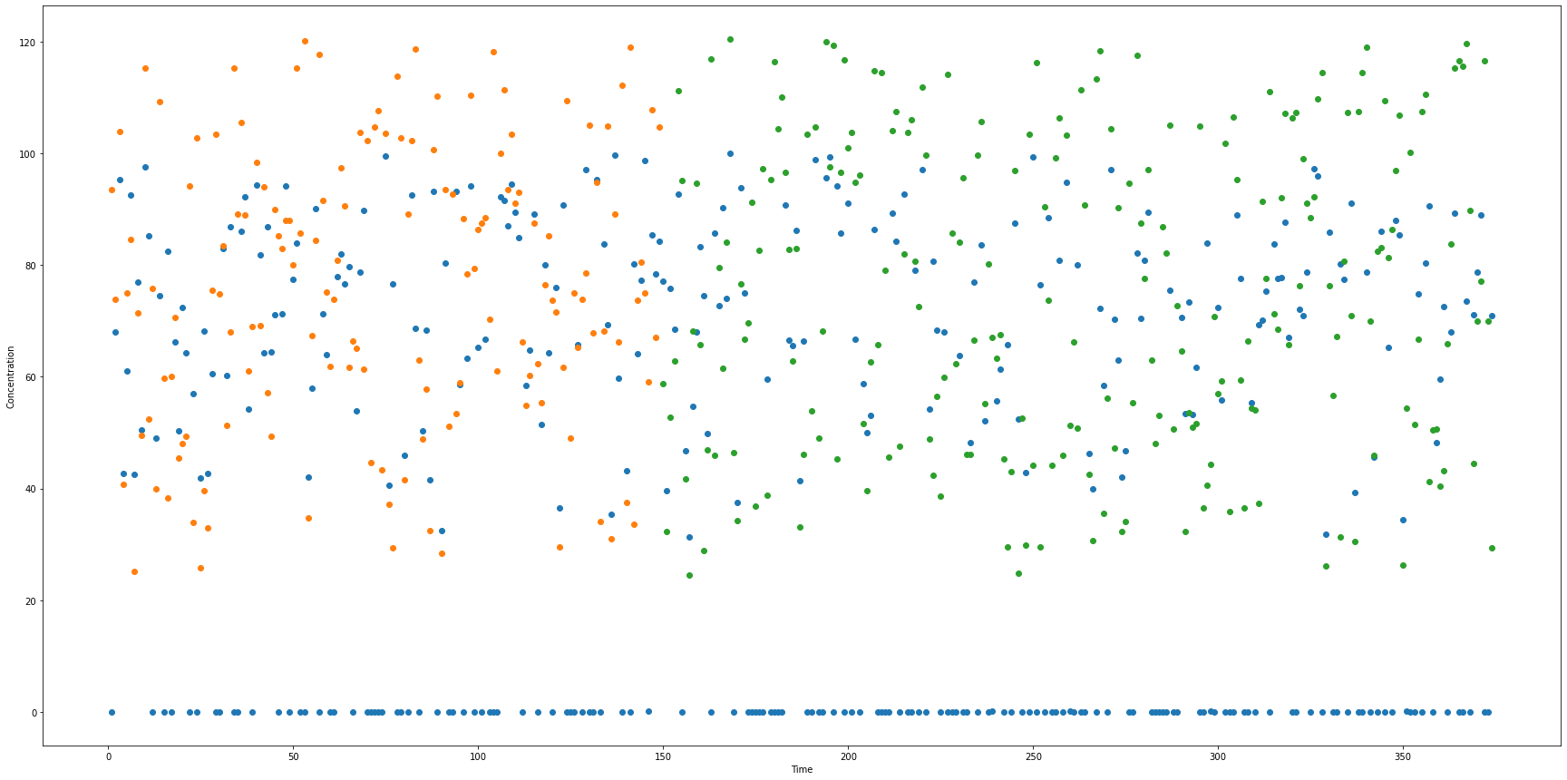
Fitting data to a neural network model (Counter current)
CODE
PLOT

Slide 14
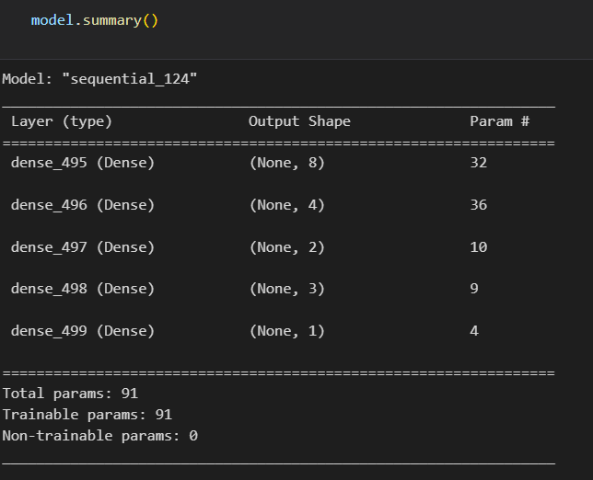
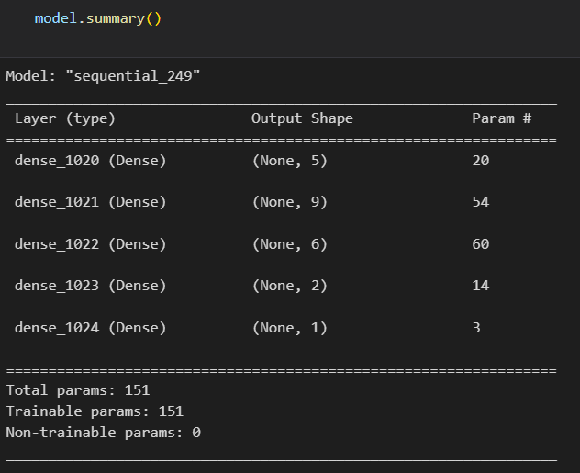
Model Summary
CROSS CURRENT
COUNTER CURRENT

Slide 15
Future Work
Solving the cases using equilateral triangle system
Solving using fsolve like functions, fully analytically, without graphs
Making the model more informative by giving additional features
Tuning hyperparameters such as learning rate, optimizer, momentum, and many more
Building a UserInterface so as to provide visual(graphical) results of countercurrent and crosscurrent operation, and minimum solvent rate.

Slide 16
PHASE II
IMPROVEMENTS MADE IN PHASE II:
Replaced right angled ternary phase diagram by equilateral ternary phase diagram.
Made a Graphical User Interface in python programming language which takes all the inputs and displays an equilateral triangle ternary phase diagram.

Slide 17




FLOWCHART FOR PHASE II
CALL THE MATLAB FUNCTIONS WHICH PLOTS BOTH CROSS AND COUNTER CURRENT FLOW IN EQUILATERAL TRIANGULAR SYSTEM
STORE THE VALUES OF % REMOVAL AND NO. OF STAGES INTO AN EXCEL FILE.
DISPLAY THE PLOT AND FINAL REMOVAL PERCENTAGE IN GUI.
INPUT THE PARAMETERS IN THE GUI

Slide 18
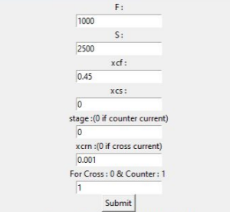
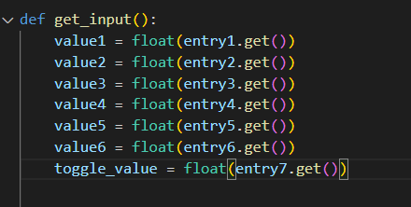
Input the parameters in the GUI
CODE

Slide 19
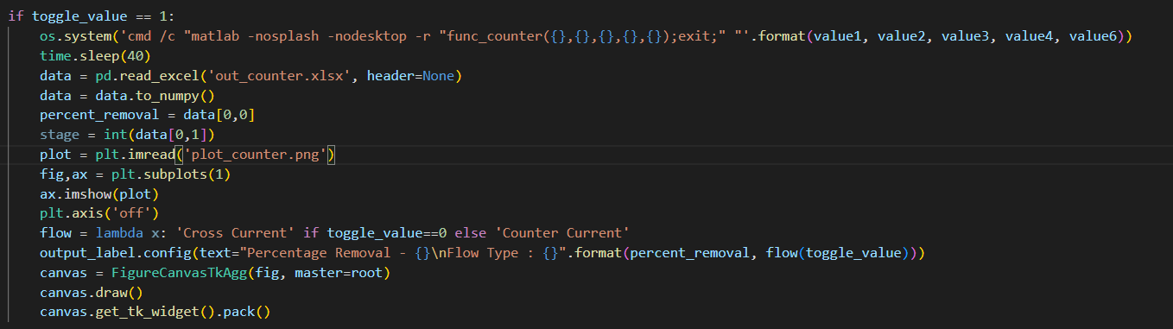
Calling Matlab Functions 1. COUNTER CURRENT
Using OS module in python, we call the matlab functions with input given through GUI, using the MATLAB’s command window functionality.
These MATLAB functions will generate the corresponding Equilateral Triangular Ternary Phase Diagrams and store the output in an excel file.

Slide 20
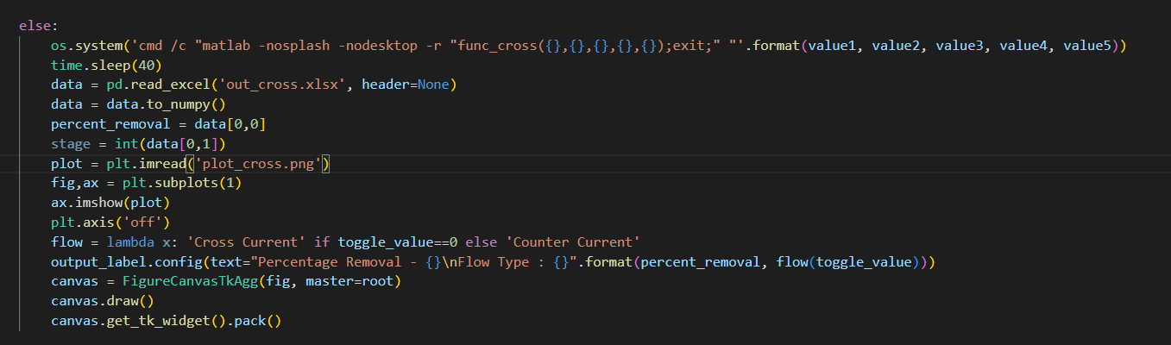
Calling Matlab Functions 2. CROSS CURRENT
Using OS module in python, we call the matlab functions with input given through GUI, using the MATLAB’s command window functionality.
These MATLAB functions will generate the corresponding Equilateral Triangular Ternary Phase Diagrams and store the output in an excel file.

Slide 21

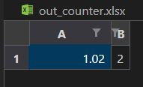
READING FROM THE EXCEL FILE
CODE:
Here we wait for 40 sec, for the generation of plot and excel.
Overall Percentage Removed
No. of Stages

Slide 22
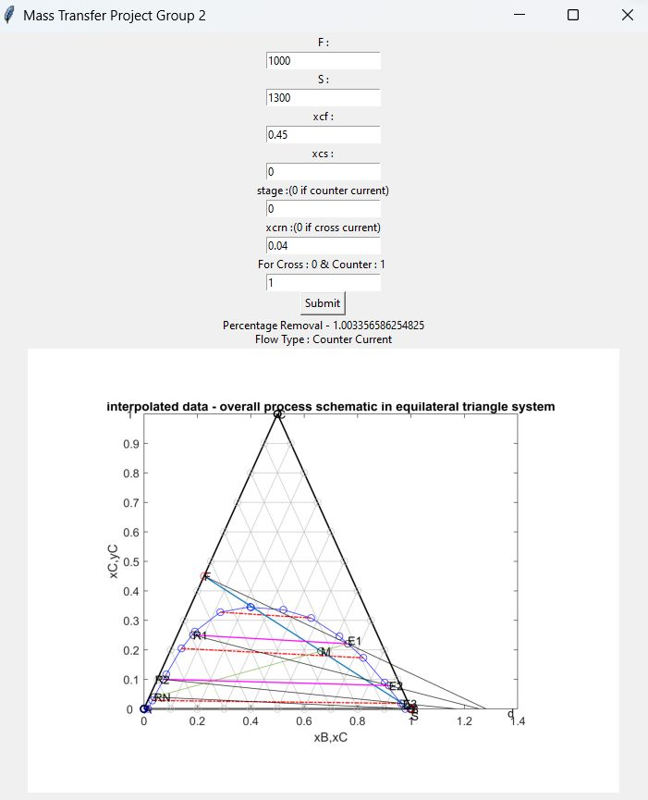
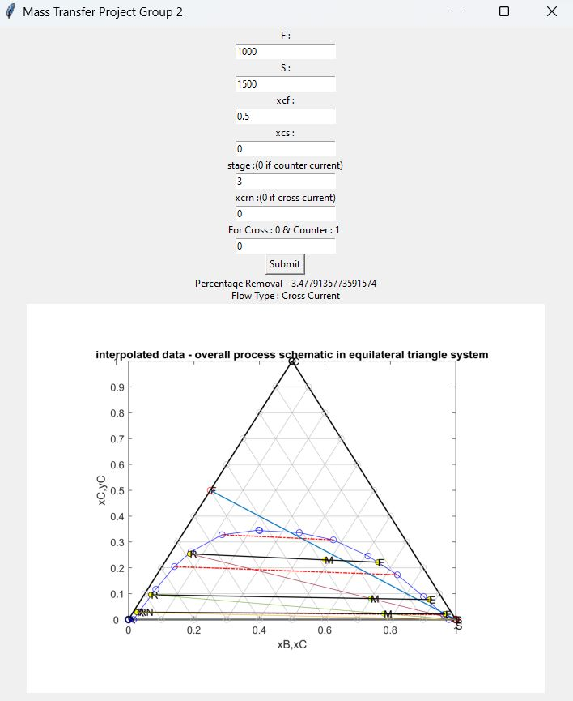
Displaying Output
Counter Current solving in Equilateral system
Cross Current solving in Equilateral System

Slide 23
Thank you
ANUMULA ABHILASH - Data Generation, GUI
ARPIT PAIDA - Model Fitting and Training, GUI, Equilateral
AYUSH DADHEECH - Presentation and GUI
CHIKKALAWAR SREEVANI - CounterCurrent Solving in Equilateral Ternary System
DEVANG ASHVIN SARDAL - CrossCurrent Solving in Equilateral Ternary System

