Slide 1


DISH ADVISER DBMS MINI PROJECT
PREPARED BY :
VATSAL JAJADIYA ( 21DCE034)
DIVY JANI ( 21DCE036)
GUIDED BY:
BINAL MA’AM

Slide 2
TABLE OF CONTENTS
1
2
3
4
6
5
Our Project
Our Team
Technology
Goal
7
8
Project Flow
Implementation
Future scopes
References

Slide 3
WHAT WE ARE WORKING ON
DISH ADVISER

Slide 4
OUR
PROJECT
1
Dish Adviser is a Js program which aims to provide suitable Food Dishes on the basis of ingredients which are selected by the user as input .

Slide 5
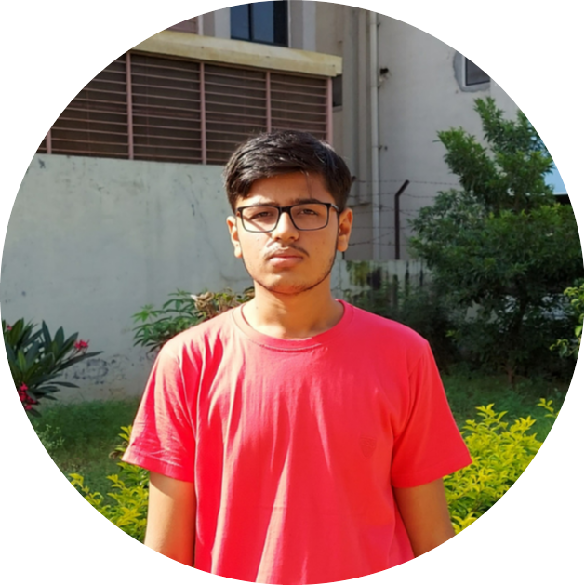

OUR TEAM
2
VATSAL JAJADIYA
DIVY JANI

Slide 6
TECHONOLOGY USED :
3
JAVASCRIPT TO WRITE LOGIC
CREATED DATABASE USING myphpadmin USING SQL through XAMPP control panel.
FRONTEND WRITTEN IN HTML,CSS.

Slide 7
GOAL
4
Our goal is to make a program that satisfies the need of a individual who is indecisive about what to make from the ingredients he/she has.
Dish Adviser for now provides few common pre-defined ingredients list from which a user can select and is then advised suitable dishes on the data provided if possible.

Slide 8
PROJECT FLOW:
5
Loading database
Asking user input
Fetching data on the basis of input.
Displaying Dishes.
Asking user for any updates regarding ingredients.

Slide 9
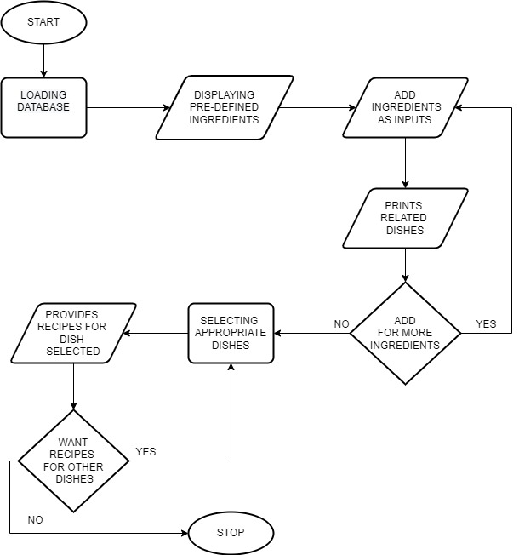

Slide 10
IMPLEMENTATION OF PROJECT :
6

Slide 11
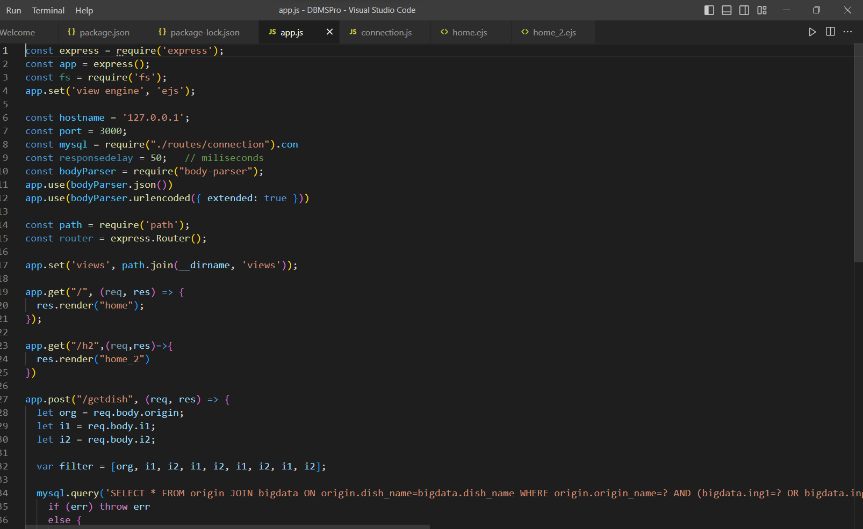
App.js File where the logic is written to manipulate the user inputs and searching in db

Slide 12
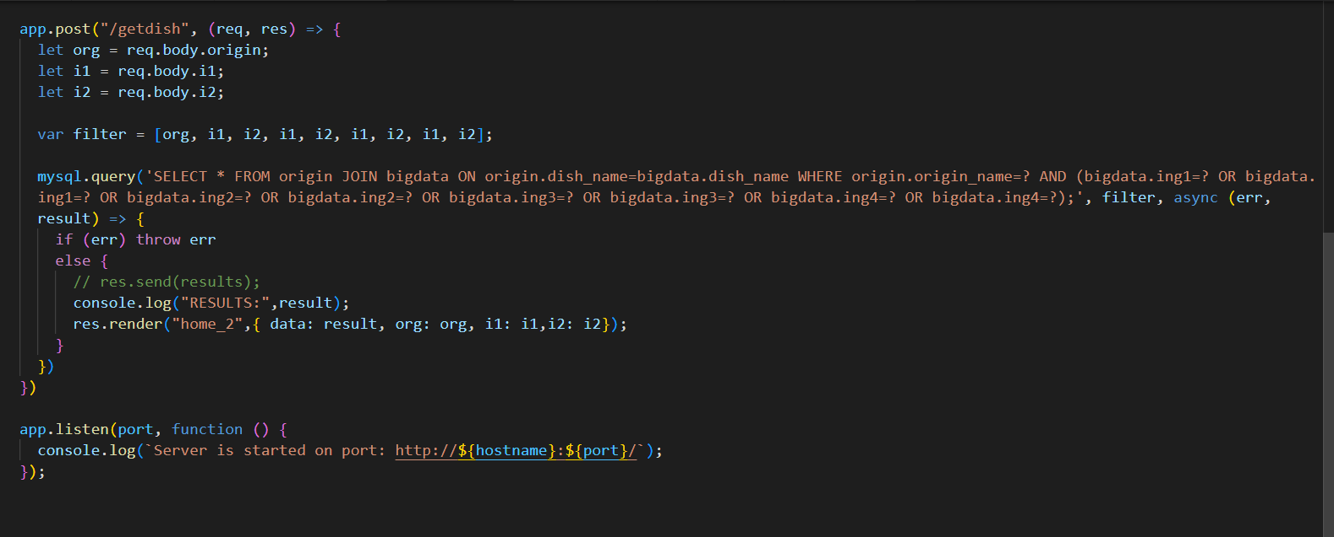
SQL query for filtering data from the database

Slide 13
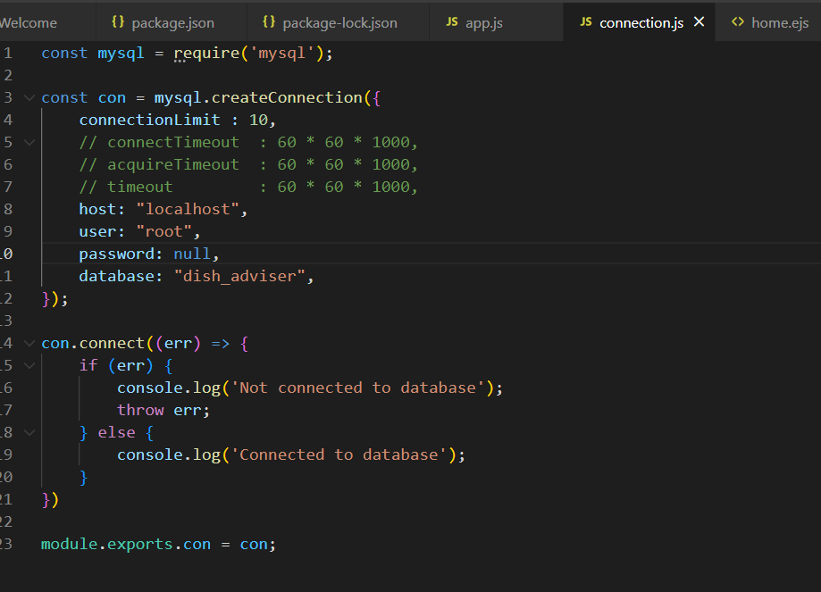
Connection.js file which joins database to the JS App. Our Database Name Is
‘dish_adviser’.

Slide 14
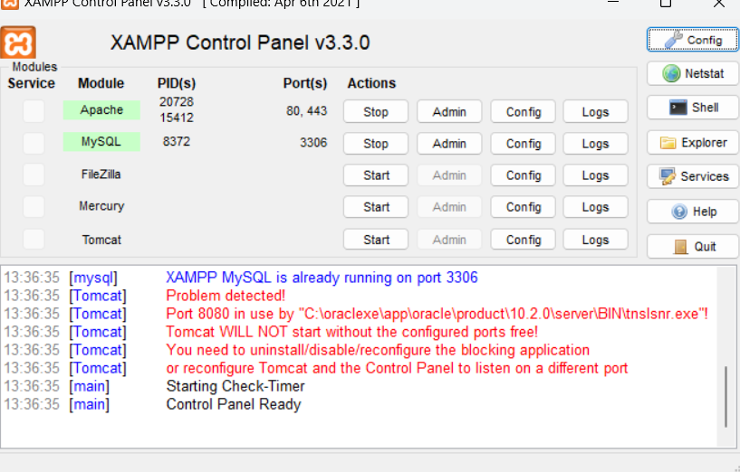
Xampp starting the mysql server
http://localhost/phpmyadmin/

Slide 15
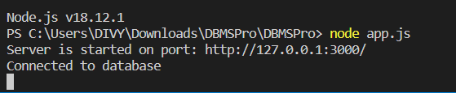
Running
Node app.js
Server started at
Given port

Slide 16
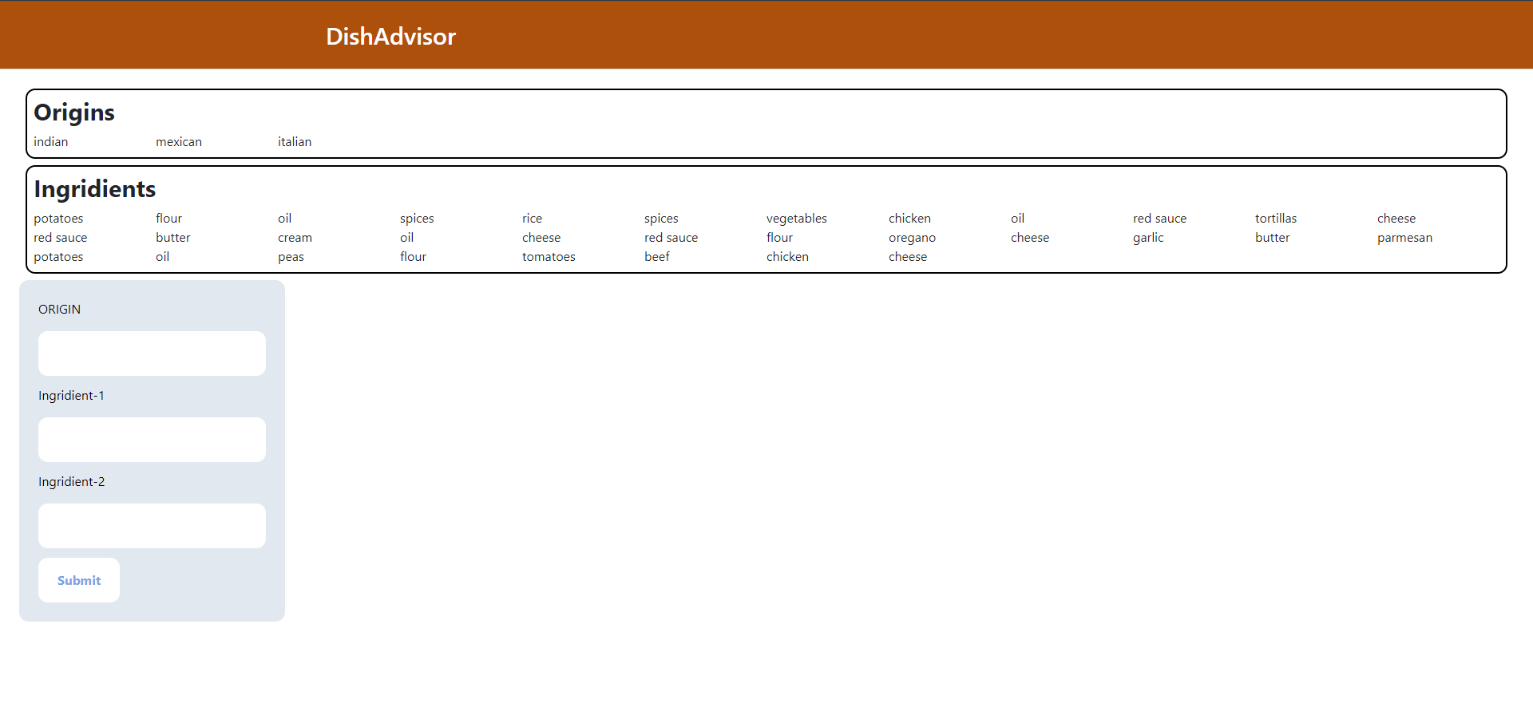
Home page

Slide 17
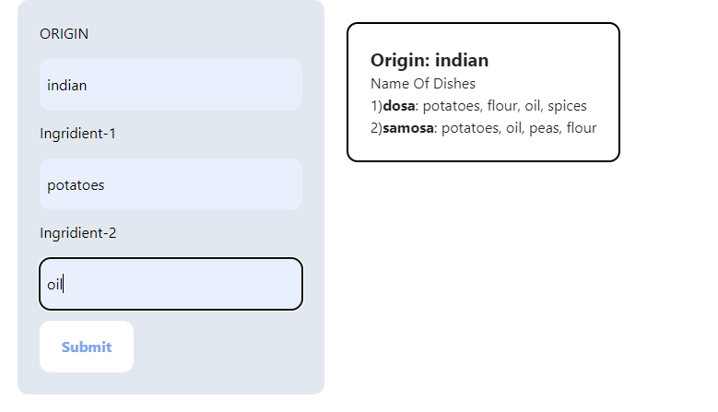
Home page

Slide 18
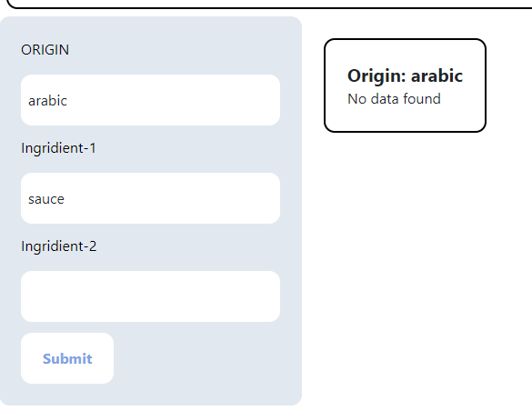

Slide 19
FUTURE SCOPES :
7
Covering All dishes on the basis of minimum 2 ingredients provided as inputs.
Updating data on daily basis on user-recommendations.
Modifying data on regional basis, seeking user attention on the program.
Adding and maintaining features.

Slide 20
REFERENCES :
8
https://developer.mozilla.org/en-US/docs/Web/JavaScript
https://dev.mysql.com/doc/
https://www.apachefriends.org/docs/

Slide 21
THANK YOU ☺

