Slide 1


DISH ADVISER JAVA MINI PROJECT
PREPARED BY :
VATSAL JAJADIYA ( 21DCE034)
DIVY JANI ( 21DCE036)
GUIDED BY:
SACHI MA’AM

Slide 2
TABLE OF CONTENTS
1
2
3
4
6
5
Our Project
Our Team
Technology
Goal
7
8
Project Flow
Example
Modules
Implementation
9
10
References
Future scopes

Slide 3
WHAT WE ARE WORKING ON
DISH ADVISER

Slide 4
OUR
PROJECT
1
Dish Adviser is a console-based program which aims to provide suitable Food Dishes on the basis of ingredients which are selected by the user as input .

Slide 5
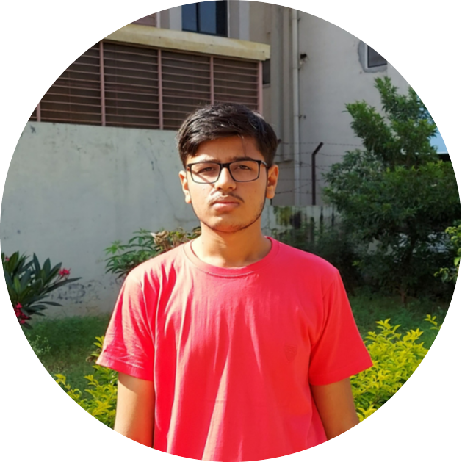

OUR TEAM
2
VATSAL JAJADIYA
DIVY JANI

Slide 6
TECHONOLOGY USED :
3
JAVA PROGRAMMMING LANGUAGE
Array
Collection framework – ArrayList
Classes and functions
Loops
File I/O

Slide 7
GOAL
4
Our goal is to make a program that satisfies the need of a individual who is indecisive about what to make from the ingredients he/she has.
Dish Adviser for now provides few common pre-defined ingredients list from which a user can select and is then advised suitable dishes on the data provided if possible.

Slide 8
PROJECT FLOW:
5
Loading database
Asking user input
Fetching data on the basis of input.
Displaying Dishes.
Asking user for any updates regarding ingredients.
Choosing Dish from the provided list.
7. User receives recipe links regarding the selected dish.

Slide 9
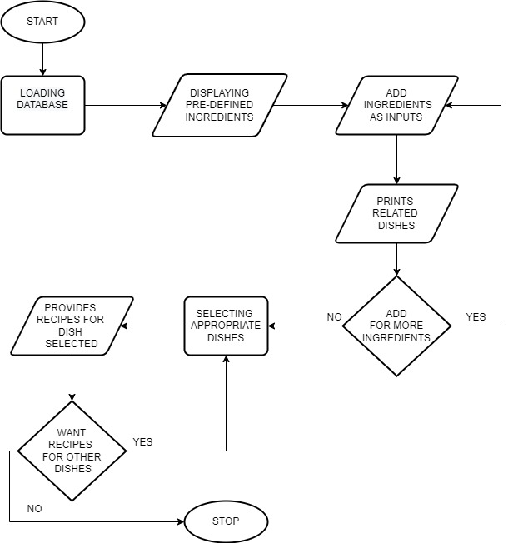

Slide 10
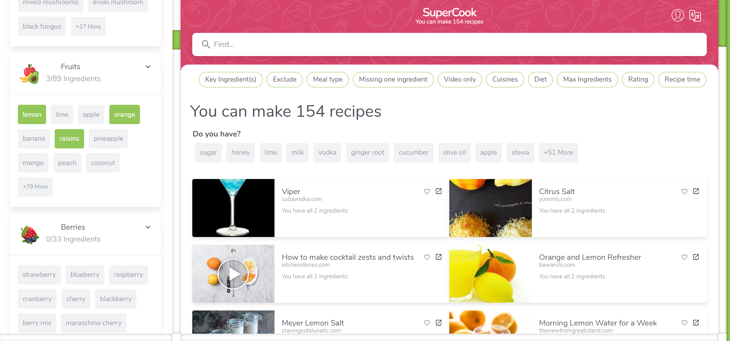
ALIKE EXAMPLE :
6
SuperCook Website

Slide 11
MODULES :
7
ADMIN
Database management
Working on Future scopes and user-end recommendations.
USER
Input data and receiving related data
Add up new recipes and dishes from client-end to help admin side to be updated.
Adding features
Proctoring user activites and modifications of data.
Can add reviews and ask for modifications.

Slide 12
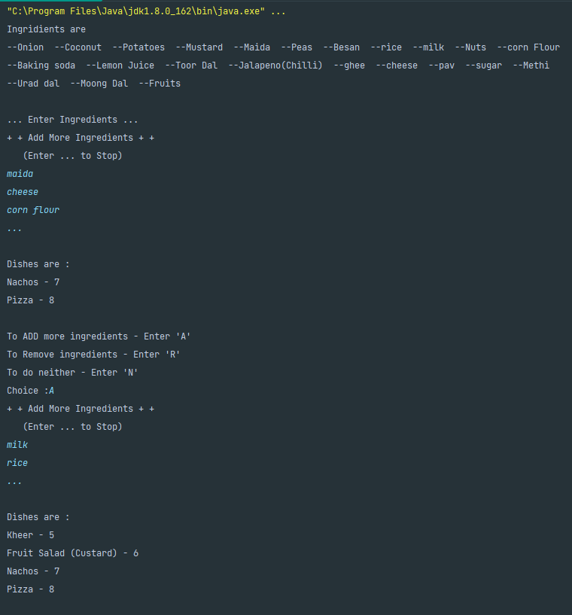
IMPLEMENTATION OF PROJECT :
8

Slide 13
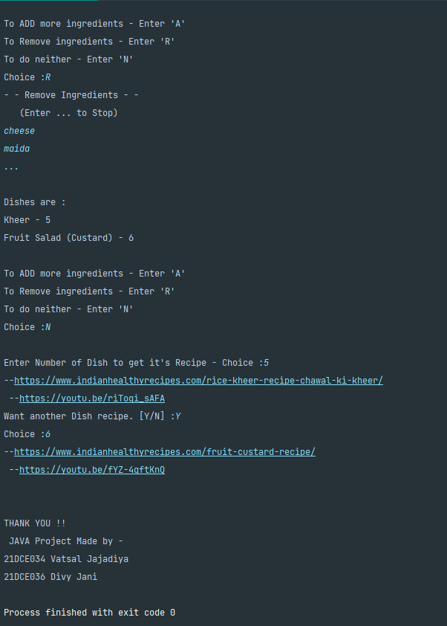

Slide 14
FUTURE SCOPES :
9
Covering All dishes on the basis of minimum 2 ingredients provided as inputs.
Updating data on daily basis on user-recommendations.
Modifying data on regional basis, seeking user attention on the program.
Adding and maintaining features.

Slide 15
REFERENCES :
10
https://www.supercook.com/
https://realfood.tesco.com/what-can-i-make-with.html

Slide 16
THANK YOU ☺

