Slide 1
Datathon 2026 · Akshara Foundation × ACSEL
Exploring the Akshara Dataset: Descriptive Analysis and Cross-Dataset Insights
TEAM
Outliers
MEMBERS
Lilekh N
Shorab Nazeer
Vatsal Vaghasiya
Track chosen
Data insights & visualisation
for foundational learning
REPO
A diagnosis that names the gap at the level a teacher can act on.
github.com/vatsal057/outliers
01
Notes:
Framing for the whole deck: every finding is stated as headroom — where there is room to gain — rather than as a failure of a district, a school or a child.

Slide 2
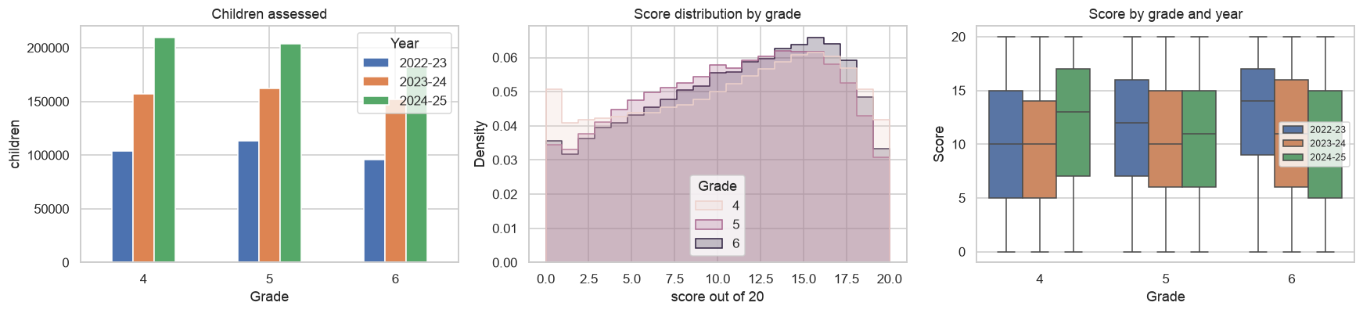
DATASET UNDERSTANDING
Understanding the data
13,79,087
9
11
5,034
children assessed,
grades 4 to 6
papers across
2022-23 to 2024-25
competencies, 7 on
every single paper
gram panchayats,
2,360 in all nine papers
Cohort size and score distribution by grade and year
CLEANING AND ASSUMPTIONS
Row-level IDs rebuilt · a zero can mean skipped, so everything here is demonstrated mastery · the nine papers are different instruments, so item-level comparisons carry the weight · secondary context: Karnataka At A Glance 2024-25 and ASER 2024 rural.
03

Slide 3
THE PROBLEM STATEMENT
Three in five children clear half their paper. Two in five have not yet.
41.8%
6.45
43%
of children assessed are still
below half their own paper
score points of headroom between
the highest and lowest district
mastery on division, the shared
competency with the most room
OBJECTIVES
KEY QUESTIONS
Locate the gap precisely enough that the teaching faculty can act on it
Separate what a district can change from what a classroom must
Show which gaps are curricular and which are about delivery
Is the gap between places, or inside them?
Which competencies, which questions, which children?
How much of the district pattern does context explain?
02
Notes:
Why it matters: Karnataka already assesses every child in these grades. The opportunity is in reading that assessment down to the level where teaching happens.

Slide 4
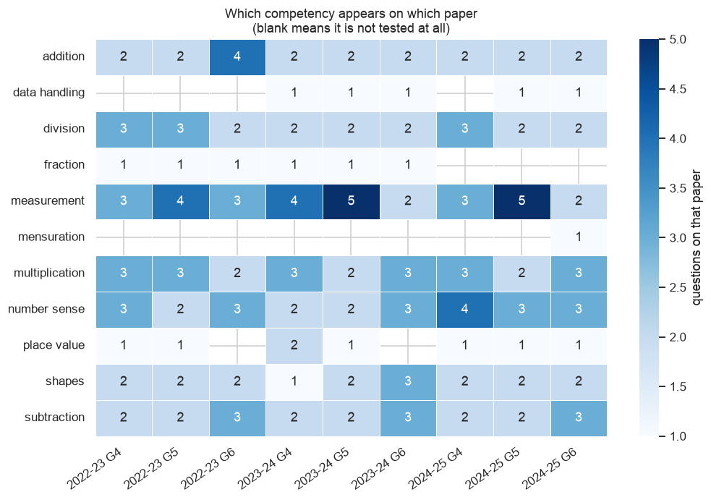
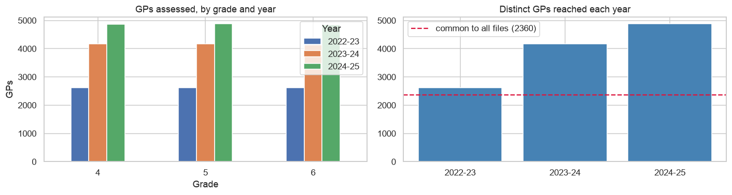
DATASET UNDERSTANDING · COVERAGE
What every paper covers and what changes between them
Gram panchayats reached each year, and the 2,360 present in every paper ·
REACH HAS GROWN FAST
2,613 panchayats in 2022-23, about 4,870 by 2024-25. That is good news for coverage and it means a raw year-on-year comparison partly measures who newly joined, so every trend claim here is either restricted to the 2,360 constant panchayats or made at item level.
Questions per competency on each of the nine papers — blank means it is not tested that year
THE SHARED CORE
Seven of eleven competencies appear on every paper and form the core used throughout this deck. Fraction is not tested after 2023-24, data handling enters in 2023-24, and mensuration appears once. Measurement carries anywhere between two and five questions depending on the paper — so a competency can look stronger or weaker simply because it was asked more or fewer times.
04

Slide 5
ANALYTICAL APPROACH
Methodology of Our Analysis
01
02
03
04
Audit
Decompose
Isolate
Contextualise
Coverage, naming, geography hierarchy, scope rules.
9 files, 3 sheets each — mapping and question names differ per file
70 question names normalised to 65; a renamed item is a different item
11 competencies → 7 present on every paper form the comparable core
Geography validated State → District → Block → Cluster → GP
Where score variance sits across five admin levels.
Variance split across five admin levels, run separately on each paper
Nine estimates, never pooled — grade and year mix can't leak in
Learning floor read as both rate and headcount, since budgets are headcount
Mean against between-district spread separates curriculum from delivery
Gender and district cuts taken at competency level, not total score
Same skill, one variable moved: presentation, regrouping
Question names parsed into skill, presentation format, regrouping
Presentation: same skill, same paper, one format changed
Regrouping: presentation held identical; 3 of 6 pairs dropped as confounded
Gender on complex problems: word problem against its plain twin
Trailing zeros measured separately - running out of time is a speed gap
Two questions, one skill: agreement caps the weight any single item carries
Skill gates test whether one competency conditions another
Two district indices from KAG 2024-25, min-max scaled, equal weights
Infrastructure: all-weather road habitations, mobile per 1,000 enrolled
Education districts kept separate, inheriting parent district values
Explicit join audit — no fuzzy name matching anywhere
Residual against context flags who under- and over-performs their own conditions
ASER 2024 rural as an external check, grade bands matched to ours
05

Slide 6
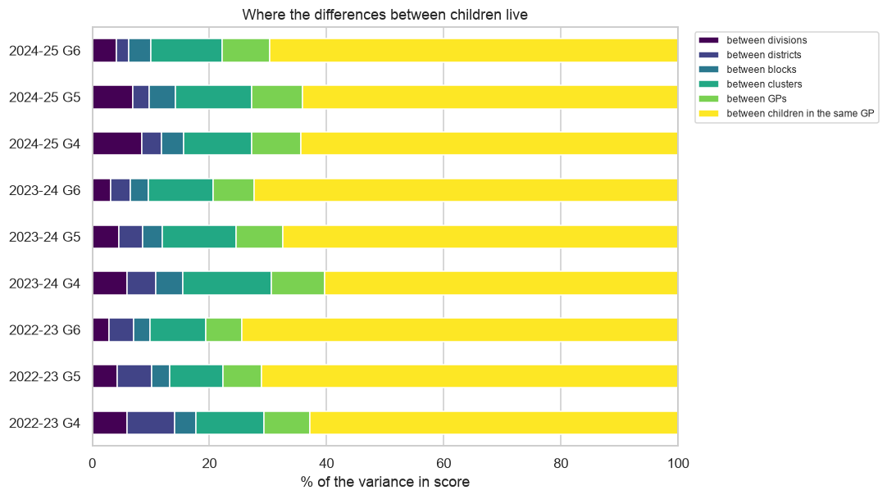
KEY INSIGHT 1 · WHERE THE GAP SITS
Two thirds of the gap sits inside the gram panchayat itself
67%
of score variance sits between children
who share a village and a school
Division, district, block, cluster and GP together account for about a third of the difference between children. The remaining two thirds is inside the classroom, where a district-level map cannot see it.
WHAT THIS OPENS UP
Choosing districts well is worth roughly a third of the available gain. The larger share is reachable only by something that differentiates between children in the same room — which is what the rest of this deck tries to name.
Nested variance decomposition, one row per paper
06

Slide 7
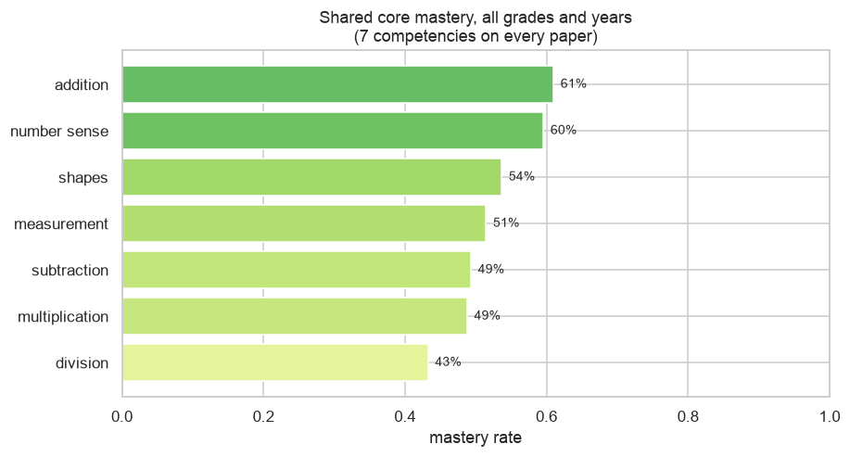
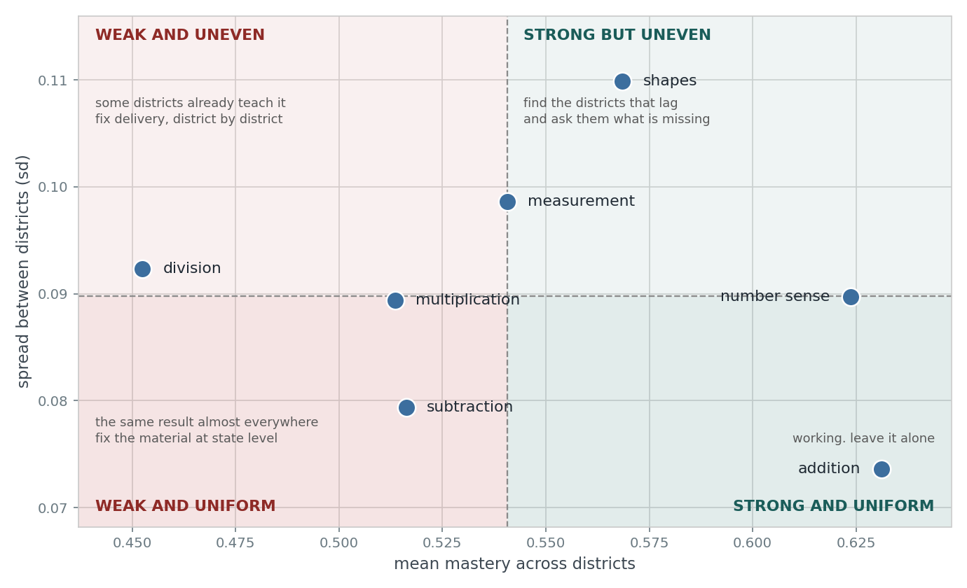
KEY INSIGHT 2 · COMPETENCY ANALYSIS
Two kinds of gap: curriculum, and delivery
Mastery on the seven competencies common to all nine papers
Mastery against how much it varies between districts
WEAK AND UNIFORM → CURRICULUM
WEAK AND UNEVEN → DELIVERY
Multiplication (49%) and subtraction (49%) sit low almost everywhere. When a gap is the same size in every district, the lever is what is taught and how it is sequenced, not who delivers it.
Division sits at 43% but the spread between districts is wide, and some districts are already well above it. That variation is itself the evidence that the gap is closable with resources already in the system.
07
Notes:
Grade view: multiplication, number sense and measurement barely move between grade 4 and grade 6. Different children sat each paper, so this is a cohort comparison and not a trajectory for any one child.

Slide 8
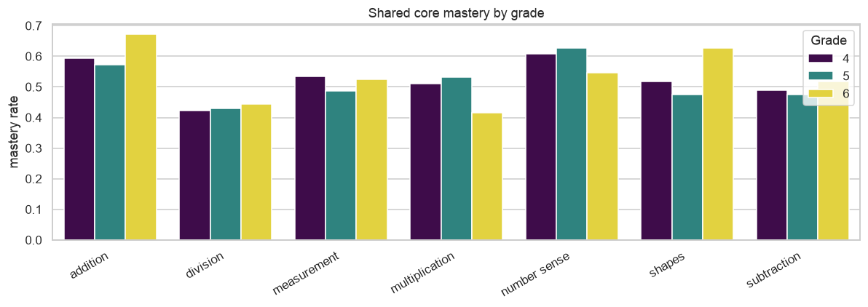
KEY INSIGHT 3 · COMPETENCY ACROSS GRADES
Grade Wise Core Competency Variation
WHAT TWO MORE YEARS ADD MOST TO
Shapes gains about 11 points between grade 4 and grade 6, and addition about 8. Where the curriculum returns to a skill, the gap does narrow on its own.
WHAT SITS STILL
Measurement, multiplication and number sense end grade 6 within a point or two of where grade 4 started, and division holds near 43% throughout. These are the places where a targeted intervention has the most to add, because time alone is not adding it.
Shared core mastery by grade
HOW TO READ THIS
Different children sat each paper, so this compares cohorts rather than following one child through two years of schooling. It is a picture of where the system currently stands at each grade, not a trajectory.
08

Slide 9
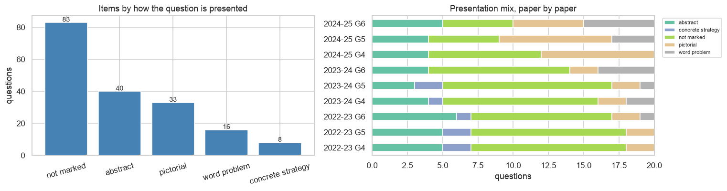
KEY INSIGHT 4 · QUESTION PAPER ANALYSIS
Part of the gap is where the question sits
How each paper is built: the balance of abstract, pictorial and word-problem items changes from year to year ·
THE PAPER IS NOT A CONSTANT
WHICH IS WHY WE READ ITEMS, NOT SCORES
65 distinct question types appear across the nine papers, and the presentation mix shifts between them — the 2024-25 papers carry far more pictorial items than 2022-23 did. A paper heavier on word problems is harder whatever children know, so raw scores between years are not fully comparable.
Several question combinations appear in more than one year. Those are immune to relabelling and to a changing mix, and they are the comparisons every trend claim in this deck rests on.
09

Slide 10
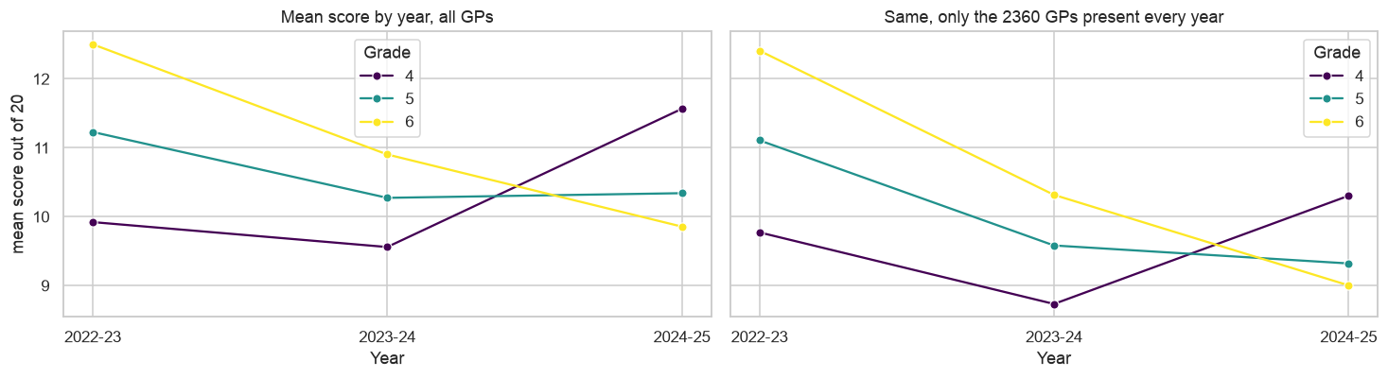
KEY INSIGHT 5 · READING TRENDS SAFELY
Mean Score Trends
Mean score by year for all panchayats, and for only the 2,360 present every year · notebook 01, section 5.2
THE COMPOSITION CHECK
Both panels move together. Restricting to the panchayats present in all three years leaves the shape of the trend unchanged, so what looks like movement is not simply the effect of newly assessed places joining the average.
10

Slide 11
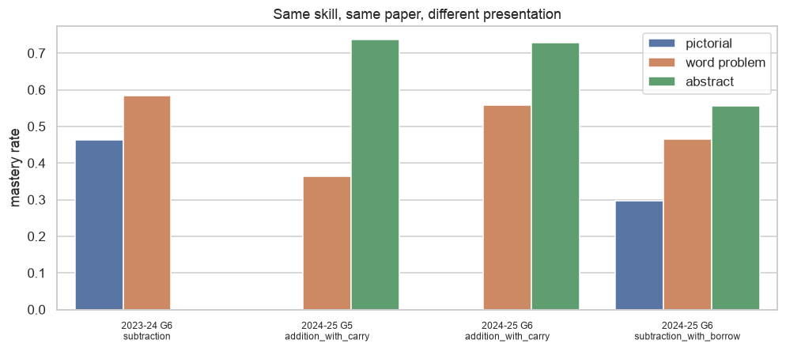
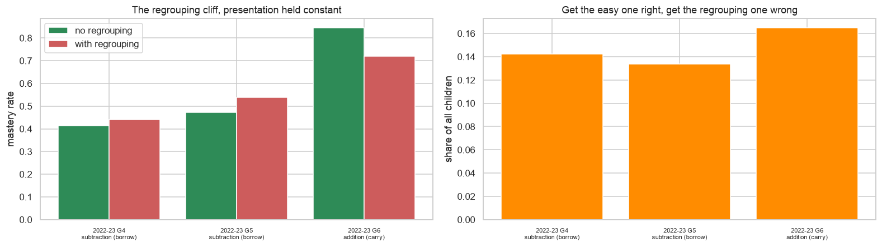
KEY INSIGHT 6 · LANGUAGE AND REGROUPING
Two narrow, teachable gaps inside one score
The same operation with and without a carry or borrow · section 7.4
One skill, one paper, one cohort — only the presentation changes
LANGUAGE
REGROUPING
Addition with carry, 2024-25 grade 5: 74% of children solve it as a number sentence and 36% when the same arithmetic is wrapped in a sentence. Part of what reads as an arithmetic gap is a reading gap, which points at language support rather than more drill math learning.
14.7% of children — about one in seven — answer the plain question correctly and then miss the same operation the moment it needs a carry or a borrow. They already have the operation. What is missing is one procedure, and it is the narrowest gap anywhere in this dataset.
11
Notes:
Presentation is held identical inside every regrouping pair, so the only thing changing between the two questions is the carry or the borrow. Three of six candidate pairs were excluded because presentation moved as well.

Slide 12
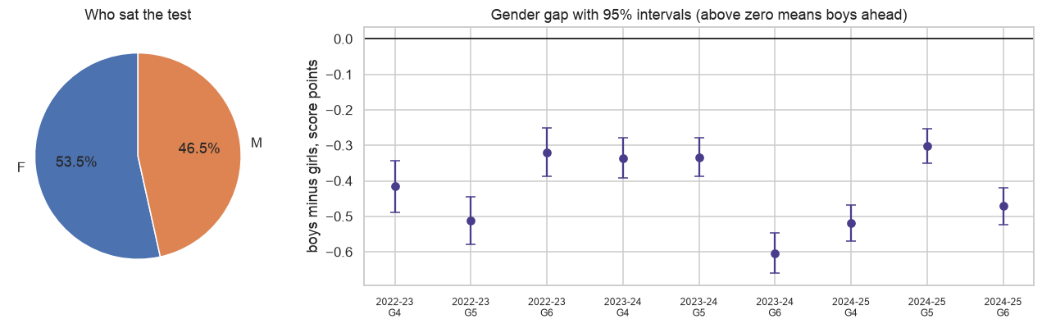
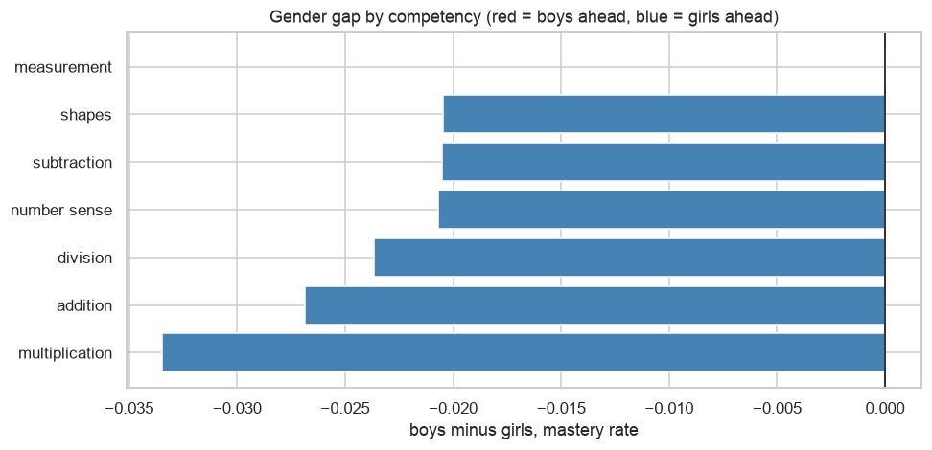
KEY INSIGHT 7 · GENDER ANALYSIS
The gender gap is small, and it does not point one way
Mean score and the boys-minus-girls gap with confidence intervals · section 5.3
The same gap read competency by competency · section 6.4
WHAT A SINGLE STATE NUMBER HIDES
WHERE IT WIDENS, AND WHAT TO DO WITH IT
Girls lead by 0.3 to 0.6 score points in every grade and year, and the interval never crosses zero. Read competency by competency the picture is more useful: girls lead on multiplication, addition and division by 2 to 3 points, and boys and girls are level on measurement.
The gap is wider on abstract items than on word problems, so it moves with item type rather than with subject. Support is better targeted by question format than reported as one state-level figure that averages the differences away.
12

Slide 13
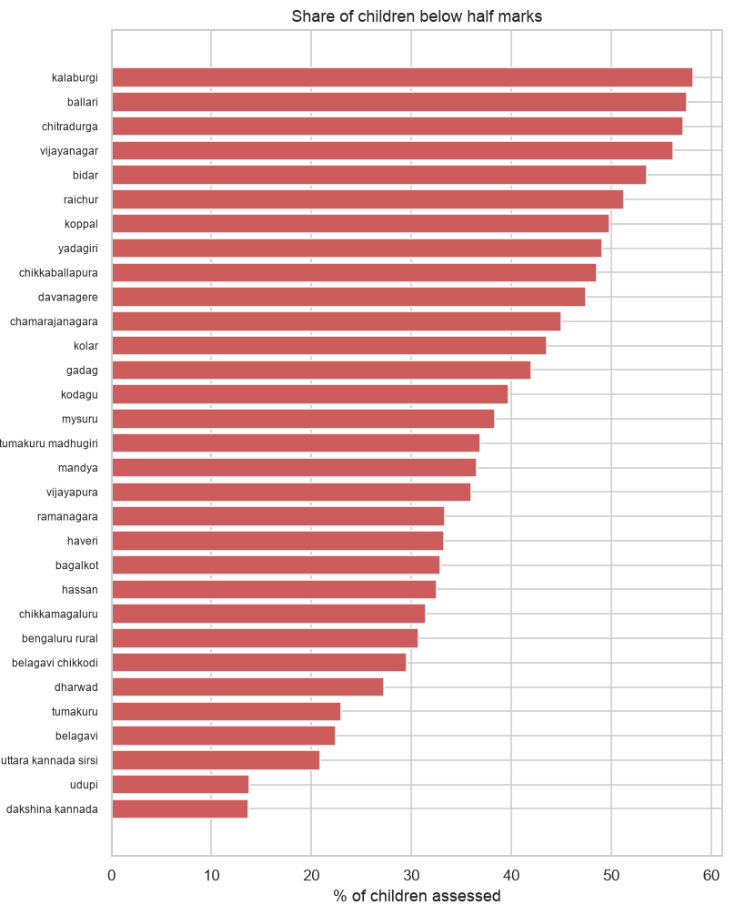
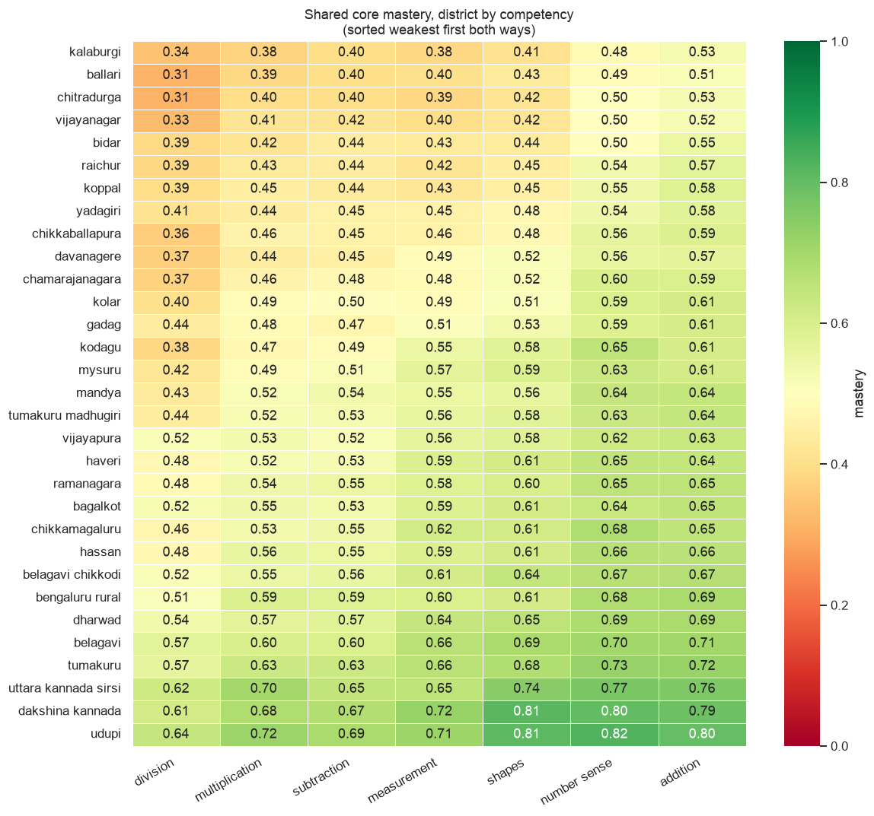
KEY INSIGHT 8 · DISTRICT-LEVEL ANALYSIS
District Level Competency Analysis
Children below half the paper, by rate and by headcount ·
District by competency — read a row to find that district's own opening · section 6.5
13

Slide 14
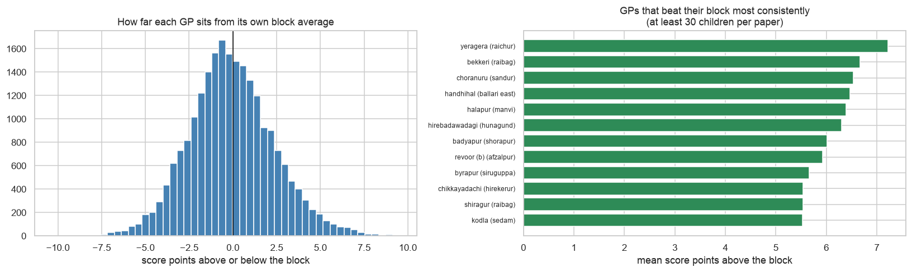
KEY INSIGHT 9 · BLOCK AND GRAM PANCHAYAT ANALYSIS
Comparing GPs Within Their Block
COMPARING SIMILAR GPs
Ranking GPs by raw score mostly highlights better-off districts. Comparing each GP within its own block keeps local conditions similar, and Yeragera in Raichur, along with Choranuru and Handhihal in Ballari, performs above its block on all nine papers. Those are the GPs worth studying and learning from.
A CAUTION ON BLOCK TRENDS
Because the assessment papers also changed between years, these trends should be interpreted with caution and used to guide further investigation...
14

Slide 15
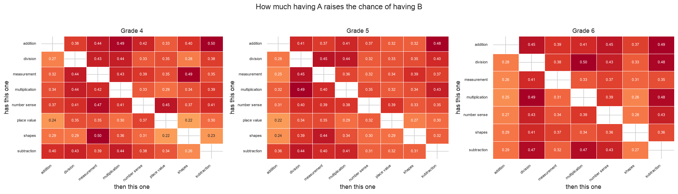
PREDICTIVE & DIAGNOSTIC ANALYSIS
What to teach first
How one skill precedes another
How much having one competency raises the chance of having another, by grade
DIAGNOSTIC · TEACHING ORDER
Priority combines how much a competency gates the others with how much room it still has.
Grade 4 opens with division, then multiplication and measurement;
grade 5 opens with measurement and division.
15

Slide 16
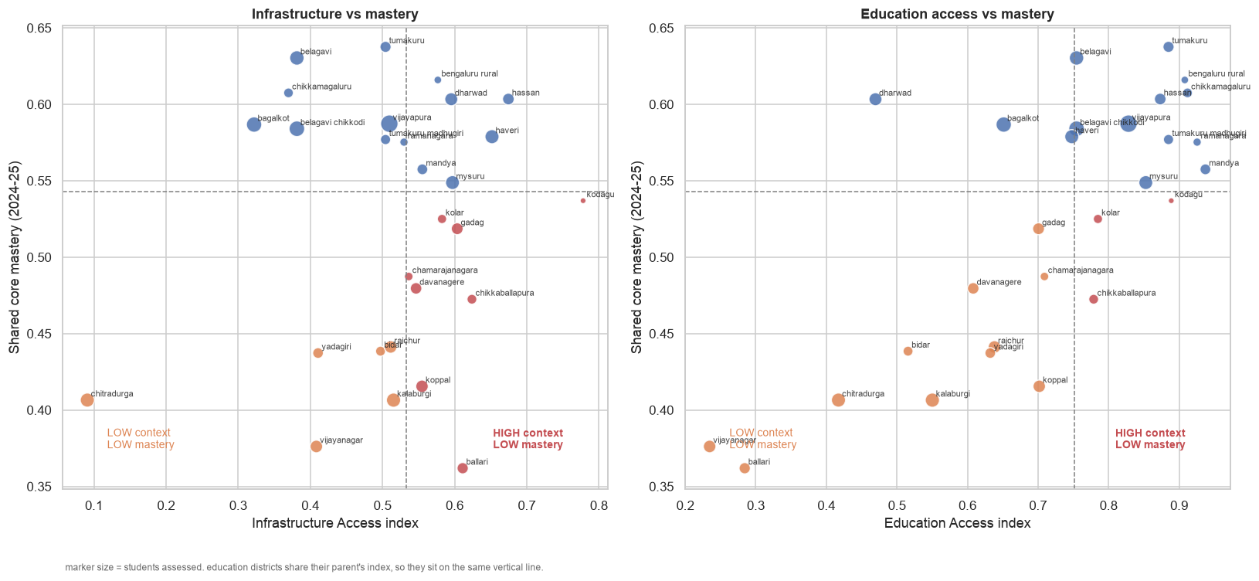
CROSS-DATASET CHECK · SECONDARY SOURCES
Context accounts for about half the pattern
56%
of the differences between districts can be explained by the two context indices.
Education access is positively associated with student mastery, while infrastructure shows little relationship.
The remaining 44% is likely explained by local teaching practices and school-level factors.
WHERE THE HEADROOM IS LARGEST
District mastery against Infrastructure Access and Education Access
Koppal, Yadgir, Chikkaballapura, Kalaburagi, and Raichur perform below what their context predicts, suggesting they have the greatest potential to improve through better practices. Districts above the prediction line are worth studying for what they’re already doing well.
16
Notes:
Descriptive, not causal, and n = 28. Both indices are equal-weighted and min-max scaled within Karnataka. Three districts report zero out-of-school children, so their Education Access value rests on one component and is flagged wherever it appears.

Slide 17
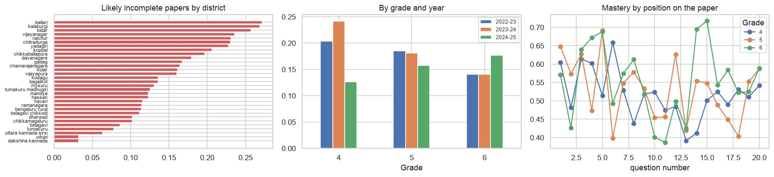
Non Attempts.
234,761 children (17.0%) have a run of 4 or more zeros at the end of the paper while scoring something earlier.
zeros at the end likely mean running out of time. measuring the size of this issue and which competencies sit at the end.
16
Notes:
Descriptive, not causal, and n = 28. Both indices are equal-weighted and min-max scaled within Karnataka. Three districts report zero out-of-school children, so their Education Access value rests on one component and is flagged wherever it appears.

Slide 18
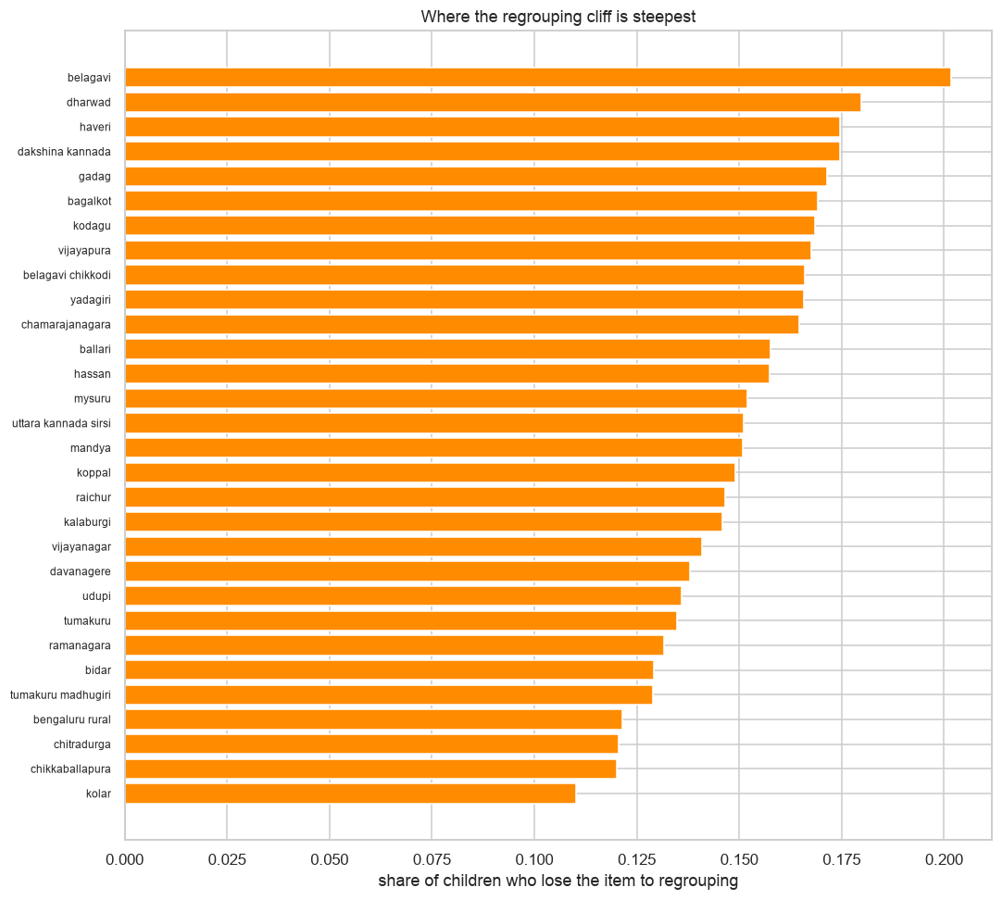
Recommendations
Teach Regrouping as a Separate Skill
Teach regrouping as a separate skill for the 14.7% of students who already understand the operation.
The data shows that many students understand the arithmetic operation but lose marks only when regrouping is involved.
Instead of reteaching the whole topic, we should teach regrouping as a separate skill
Districts where children hold the operation but lose the regrouping step ·
A district high on this list but not on the overall list has children who already know the operation. That is a different lesson from a district with room on both.
18

Slide 19
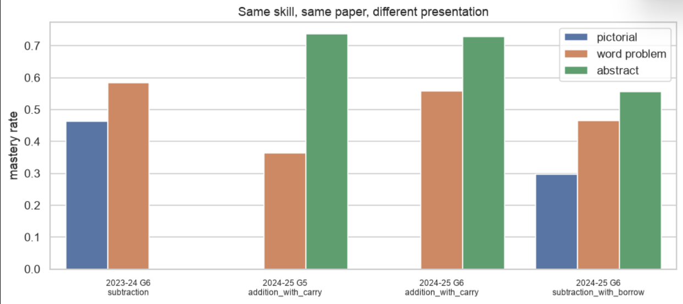
Recommendations
2. Pair arithmetic with language support
Pair arithmetic instruction with language support where word-problem performance is the weakest.
Many students solve numerical calculations correctly but struggle when the same concept appears in a word problem.
This suggests that language comprehension is limiting mathematical performance.
Teaching vocabulary, question interpretation, and arithmetic together can reduce this gap.
18

Slide 20
Recommendations
3. Prioritize competencies by grade
Adjust the teaching sequence based on competency relationships.
Grade 4: prioritize division, followed by multiplication and measurement.
Grade 5: prioritize measurement, followed by division.
18

Slide 21
Recommendations
4. Learn from successful GPs
Learn from high-performing gram panchayats within the same block.
Compare GPs within the same block to account for similar local conditions.
Some GPs consistently outperform others despite facing similar circumstances.
Their teaching practices can be adapted elsewhere.
18

Slide 22
Thank you
20

