Slide 1
Weather-Driven Business Impact: A Multi-Source EDA & Econometric Analysis
Course Project Review 1
Exploratory Data Analysis
Team Members: [Insert Names]

Slide 2
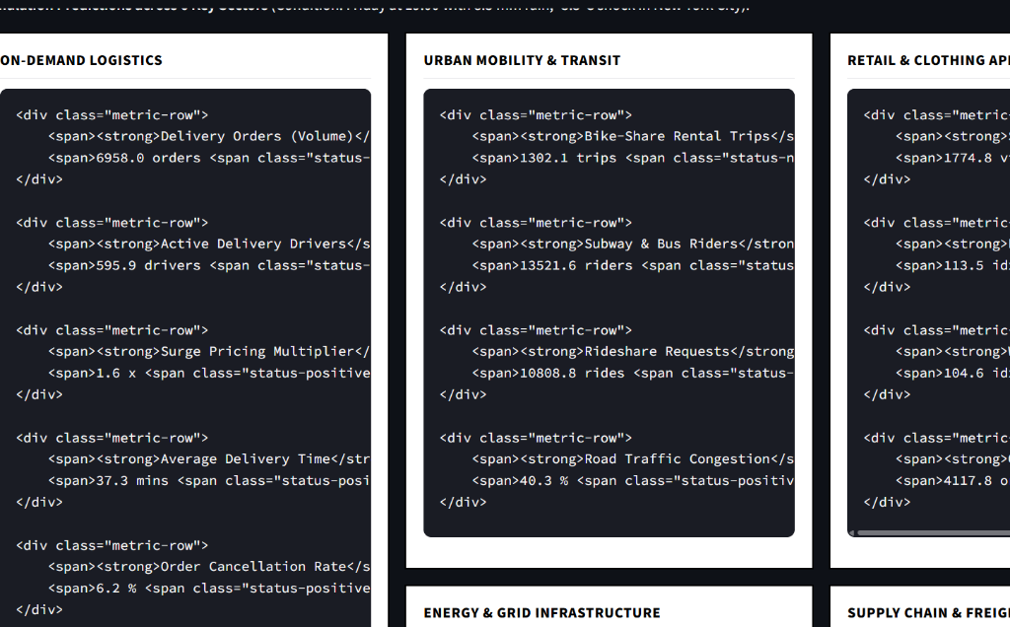
Abstract: Problem & Solution
The Problem:
  Standard business analysis often confuses normal calendar trends (like busy weekends) with actual weather impacts.
The Solution:
  We are building an interactive Exploratory Data Analysis (EDA) platform to isolate the true financial impact of weather across 16+ commercial sectors.
The Goal:
  To visually map the 'Domino Effect' of weather (e.g., proving how heavy rain suppresses bike-sharing, surges rideshare apps, lowers dine-in restaurant traffic, and spikes food delivery).

Slide 3
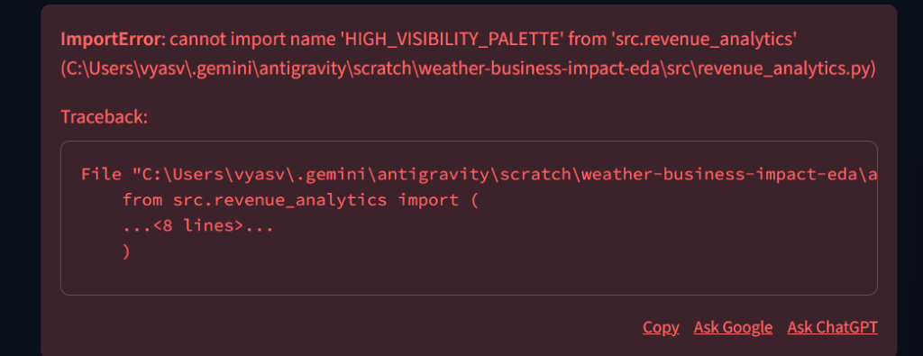
Dataset Details: Sources & Metrics
Weather & Climate Data (The Cause):
  Sources: NOAA and OpenWeather APIs.
  Metrics: Hourly dry bulb temperature, precipitation (mm/hr), wind speed, and snowfall.
Business & Economic Data (The Effect):
  Sources: Stochastic Data Synthesis (creating highly realistic mock datasets based on real-world logic since corporate data is confidential).
  Coverage: 16+ sectors including Logistics (Uber/DoorDash), Hospitality, Retail, and Infrastructure (Power Grid).

Slide 4
EDA Challenges & Data Wrangling
The Clock Problem (Timezones):
  Weather sensors record in global UTC time, while businesses record in local time. We programmatically aligned these, accounting for Daylight Saving Time.
The Stopwatch Problem (Granularity):
  Business sales log every 15 minutes, but weather is hourly. We utilized Pandas resampling to stack 15-minute chunks into 1-hour blocks for side-by-side analysis.
The Broken Thermometer (Missing Data):
  When weather sensors drop offline, we used cubic spline interpolation (mathematical dot-connecting) to safely estimate missing temperatures without breaking our time-series.

Slide 5
Implementation RoadMap
Phase 1: Data Sourcing (Completed) - Setup API integrations and synthesize proxy business datasets.
Phase 2: Data Wrangling (Completed) - Cleanse data, align timezones, handle missing values, and merge into Parquet files.
Phase 3: Exploratory Data Analysis (In Progress) - Visualize non-linear tipping points and cross-sector ripple effects.
Phase 4: Econometric Modeling (Upcoming) - Apply Two-Way Fixed Effects (TWFE) to separate calendar trends from weather anomalies.
Phase 5: Dashboard Deployment (Upcoming) - Finalize the interactive Streamlit dashboard with a live scenario simulator.

