Slide 1
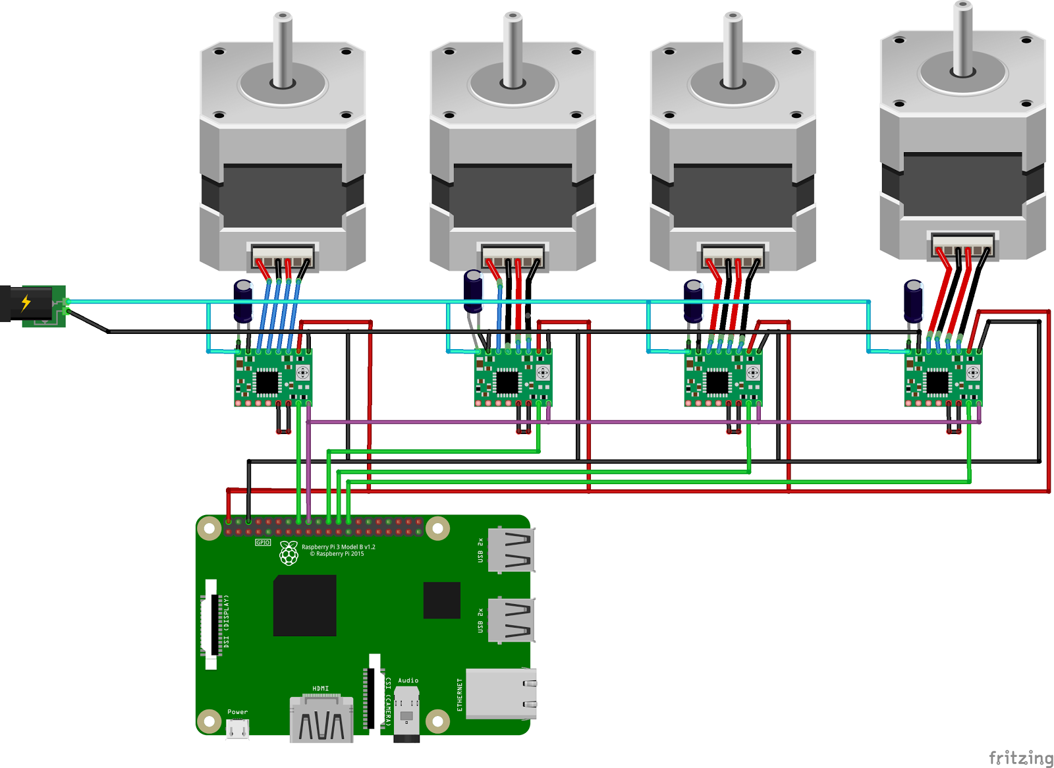
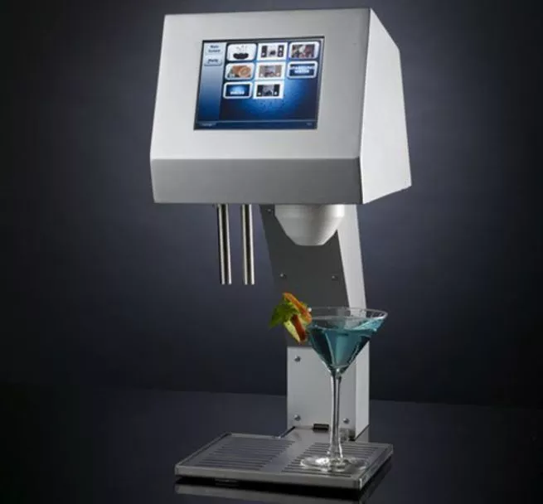
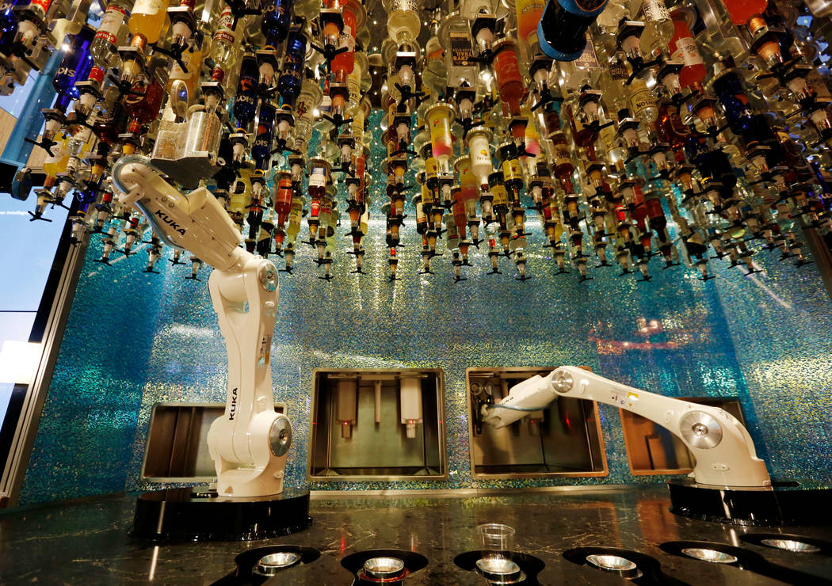
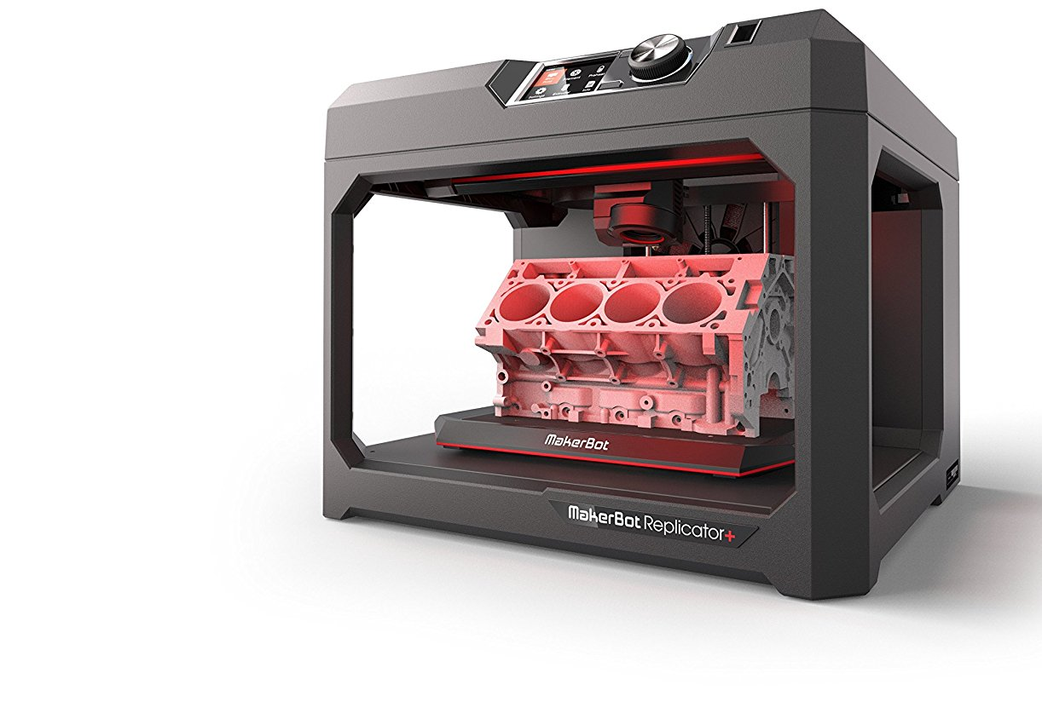
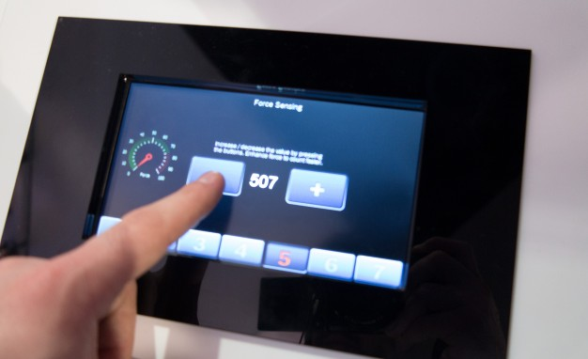
BarBot: An Automated Cocktail Maker
MOTIVATION & BACKGROUND
METHODOLOGY
Having experienced slow service at crowded Rutgers bars all too often, we wondered if there was a way to expedite the drink-making process, with the aid of a robot
While solutions exist, most are extremely expensive and/or occupy a large surface area
Our solution aims to create some of the most requested drinks, reducing wait time for most customers
Determine the most requested drinks and average number of ingredients associated with them
Determine the optimal number and type of pumps, while adhering to the budget
Develop the hardware/software for the pumping subsystem and its controller
Build the physical encasement
Current Solutions
GOALS & DESIGN OBJECTIVES
Build an automated cocktail making machine that is low cost (< $300), scalable by design, precise and accurate in its pouring, and faster than the manual approach. The machine must be small enough to be placed on a tabletop
Create a visual interface, using an LCD screen, for users to select a cocktail from a predetermined drink menu
Design Objectives:
Simultaneously dispense liquids from multiple bottles into a singular vessel
Dispense the correct amount of liquid within 5 -10% tolerance
Select the cocktails in a user-friendly manner
Research Challenges
Designing a system and selecting hardware to optimize speed and accuracy of the pouring, while on a limited budget
Developing the codebase for the control mechanism of the pumping sub-system, using Raspberry Pi, so that it confines to the fixed tolerance of excess fluids
Constructing the physical encasement for the apparatus
FUTURE WORK
In the future, we hope to build iOS/Android apps for an improved user experience and swifter selection times. The app would also suggest new recipes and the estimated time to make a particular recipe
An alert notification when a particular bottle is low in volume
LCD Interface
Reference Size for Apparatus
Acknowledgements
References
We would like to thank our advisor, Prof. Hana Godrich, for guiding us with insightful feedback and suggestions
[1] https://tinyurl.com/ycw8stu4
[2] https://tinyurl.com/yb6aawfr
[3] https://www.raspberrypi.org/documentation/
Created By: Zachary Csorny, Stephen Innis, Michael Lacsamana, Vatsal Pandya

