Slide 1
APAARSetu
Intelligent student data management, enrolment compliance and academic verification
SIH26263
Smart India Hackathon 2026
Synthetic demonstration
Non-official SIH template draft 1/6

Slide 2
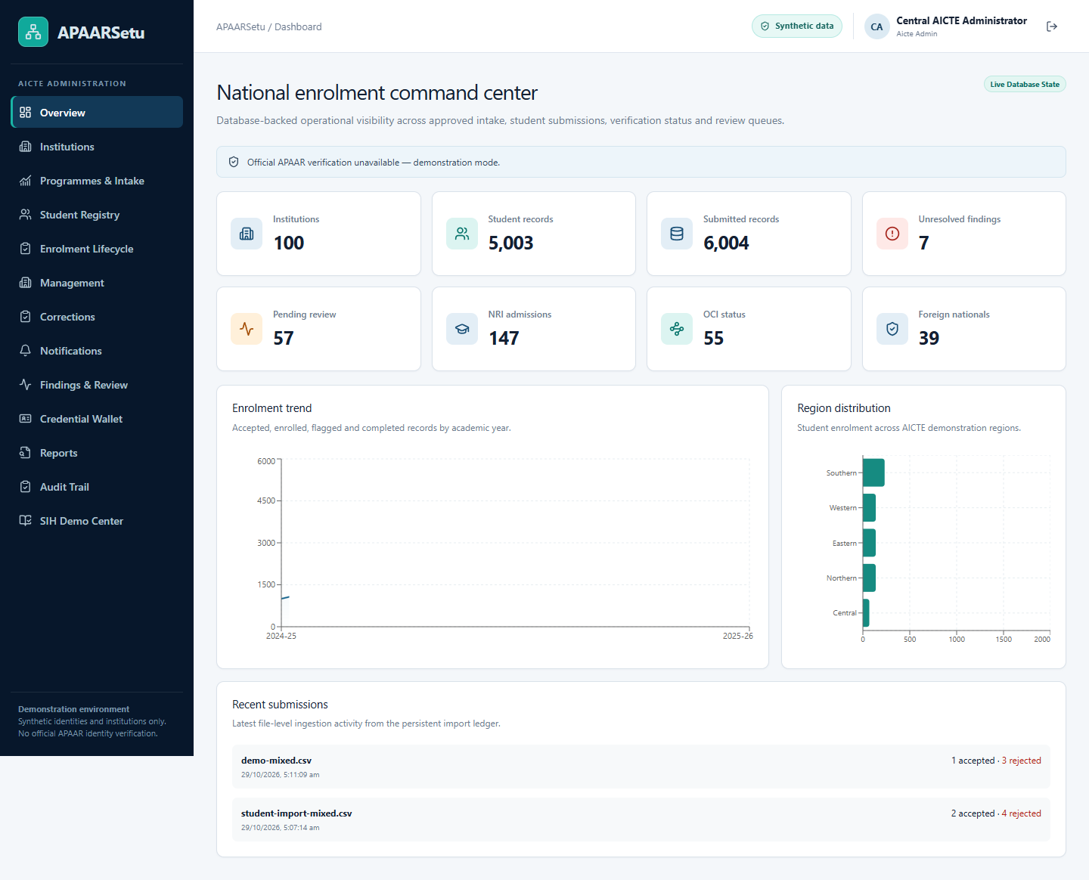
Proposed solution and uniqueness
One repository connects institutional submissions with accountable review
Identify duplicate and inconsistent records
Apply centrally authorized intake policies
Explain every finding with stored evidence
Let students control credential disclosure
Non-official SIH template draft 2/6

Slide 3
Technical approach
Four portals share a versioned API and persistent records
Next.js and strict TypeScript
FastAPI, SQLAlchemy and Alembic
SQLite locally with relational constraints
Rule validation and Isolation Forest
Ed25519 signatures with scoped consent
Non-official SIH template draft 3/6

Slide 4
Feasibility and viability
Native Windows operation without paid AI services
100 fictional institutions and 5,000 identities
CSV/XLSX preview and transactional ingestion
Automated authorization and signature tests
Synthetic hold-out precision 0.80 and recall 1.00
Production requires approved integrations and security assessment
Non-official SIH template draft 4/6

Slide 5
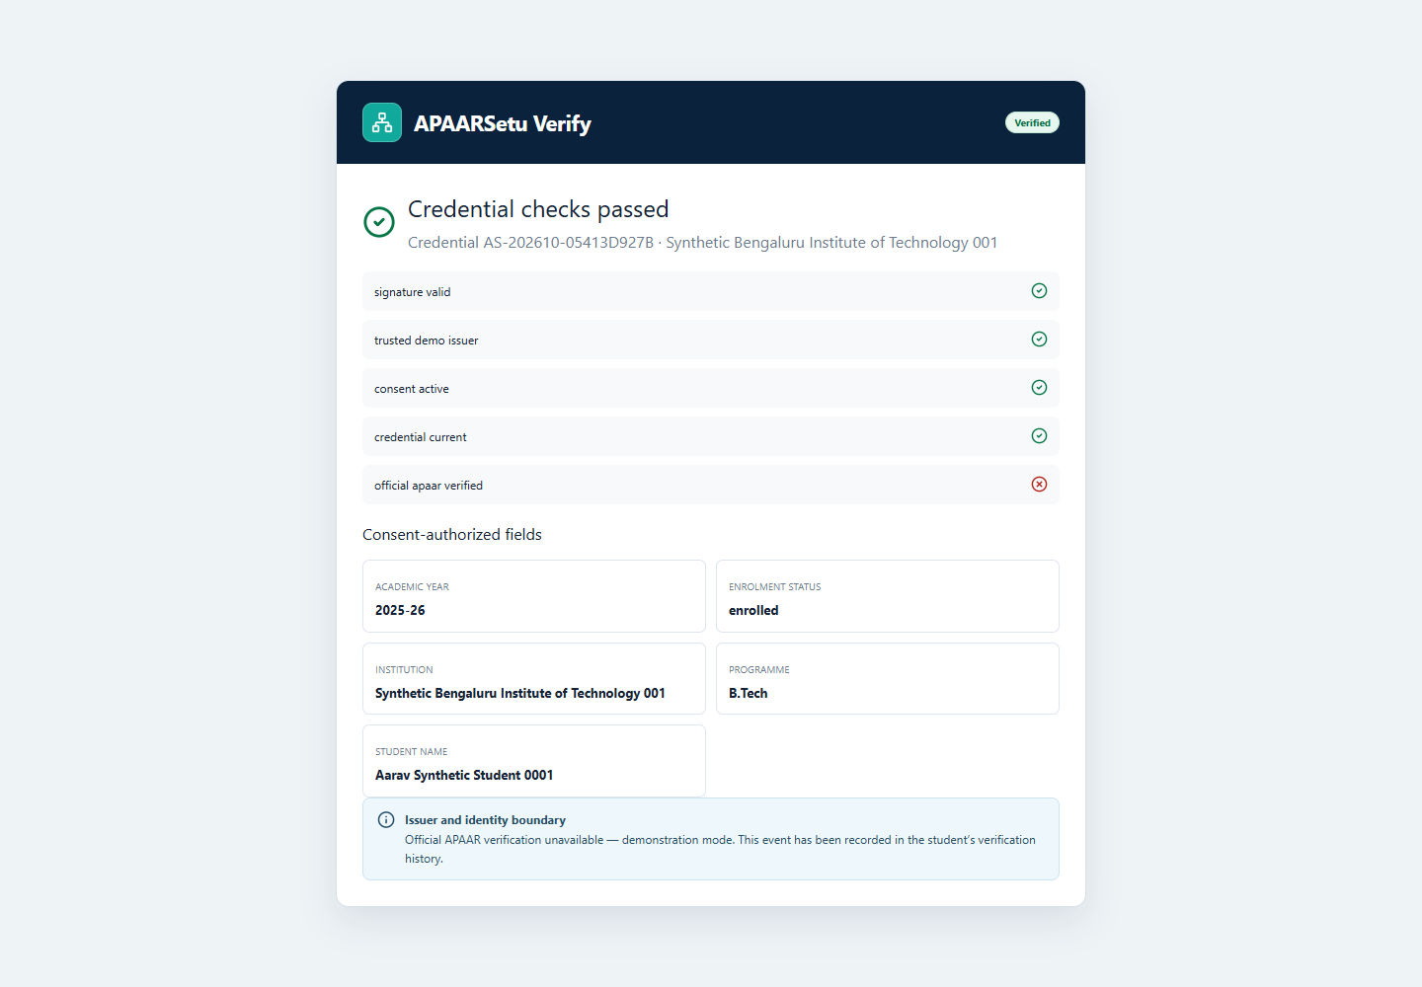
Impact and expected benefits
Administrative visibility with student-controlled disclosure
Earlier visibility of intake discrepancies
Traceable correction and review decisions
Limited disclosure to verification recipients
Measured workflow evidence from synthetic data
Non-official SIH template draft 5/6

Slide 6
Research and references
Official identity evidence remains a separate trust boundary
APAAR FAQ: apaar.education.gov.in/faqs
Isolation Forest: scikit-learn.org
Ed25519: cryptography.io
FastAPI and SQLAlchemy documentation
Project evaluation and actual application screenshots
Official APAAR verification unavailable in demonstration mode
Non-official SIH template draft 6/6

