Slide 1
Social Network Analysis
Group 16 - Project
Title: Network Evolution Analysis
Group Members:
IIT2022004 - Vatsal Bhuva
IIT2022112 - Aayush Aeron
IIT2022235 - Kotesh Boyina

Slide 2
Introduction
Analyzing how hoax call networks evolve over time is crucial for threat detection.
Our project focuses on modeling dynamic network behavior using temporal graph analytics.
It is also used to analyze behaviour between certain words, and how influential are they by using certain measures.

Slide 3
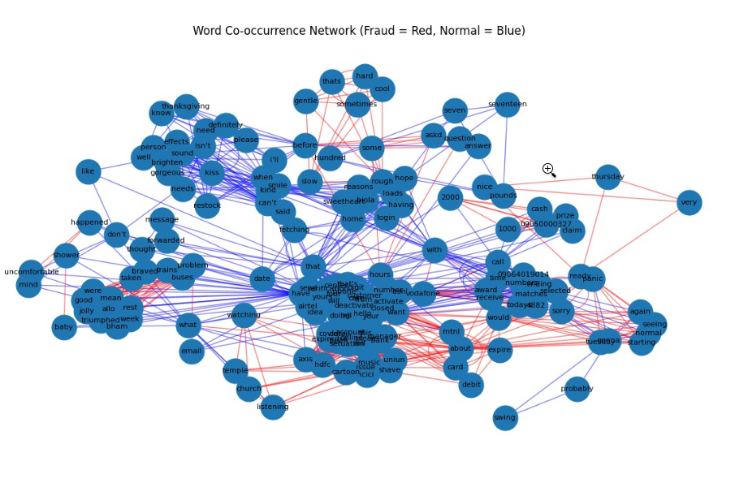
Objectives
Detect structural changes in evolving networks.
Identify emerging influencers and anomalous activity.
Model and simulate network growth and dynamics.
Obtain accurate analytics of nodes and edges for analysis.
Provide interactive visual analytics to aid investigation.
A network of sample words

Slide 4
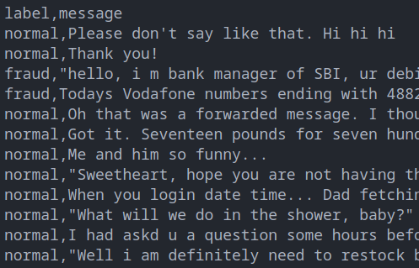
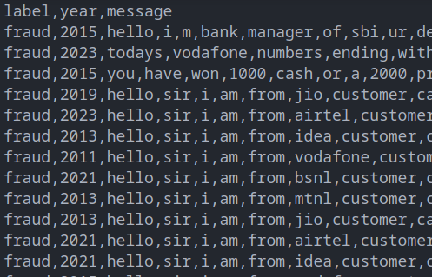
Data Preprocessing
We used the Fraud-Call Detection Dataset available on Kaggle for performing analysis.
The dataset contained data formatted in a way that was not easy to handle and perform calculation on.
For example, the messages were a single string with words separated by spaces.
This was then converted to messages separated by commas, effectively converting it to a CSV file.
Original dataset
After preprocessing

Slide 5
Key Features Implemented
Community detection algorithm (Greedy Modularity Algorithm)
Network Visualization using Networkx, Matplotlib, and Plotly.
Temporal Analysis using Dynetx for word network evolution over the years.
Web-based dashboard for interactive visualization using Bokeh.
Change-detection plots on time-series using Ruptures.
Implement and contrast networks simulated by classical growth models such as Watts-Strogatz (WS) Model.
Computed key centrality measures and other statistical measures for analyzing the evolution of the network.

Slide 6
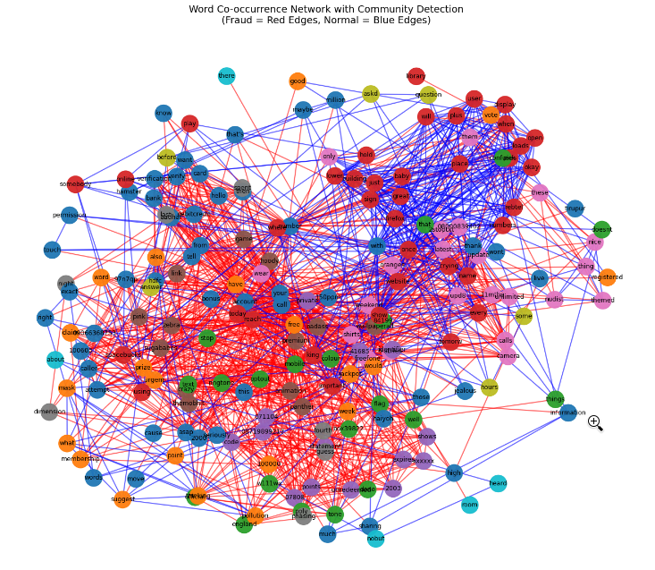
Community Detection Algorithms
We applied community detection methods (specifically Greedy Modularity) to understand structure and clustering.
Tracked the community evolution across time windows.
Colour-coded the communities for easy identification and visualization.
Temporal Network Libraries
DyNetX, igraph – dynamic network modeling.
NetworkX extensions and tnetwork for time-based edges.
Colour-coded communities of a sample dataset. Red edges indicate part of fraud call, while blue edges indicate normal calls.

Slide 7
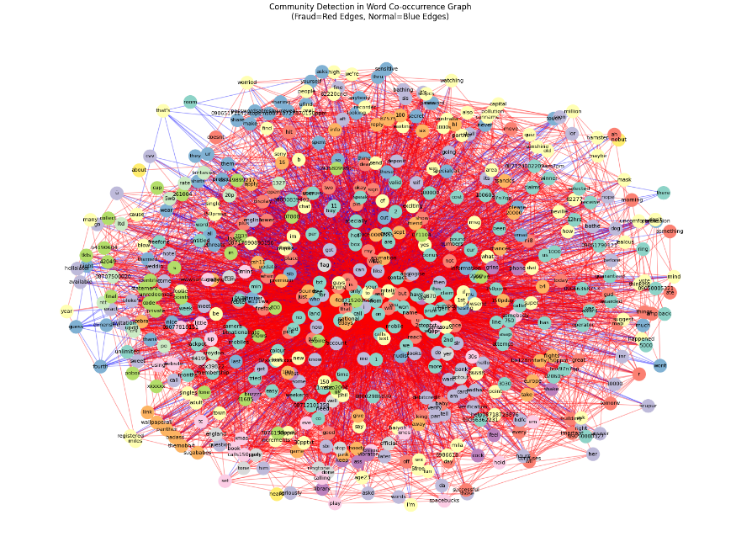
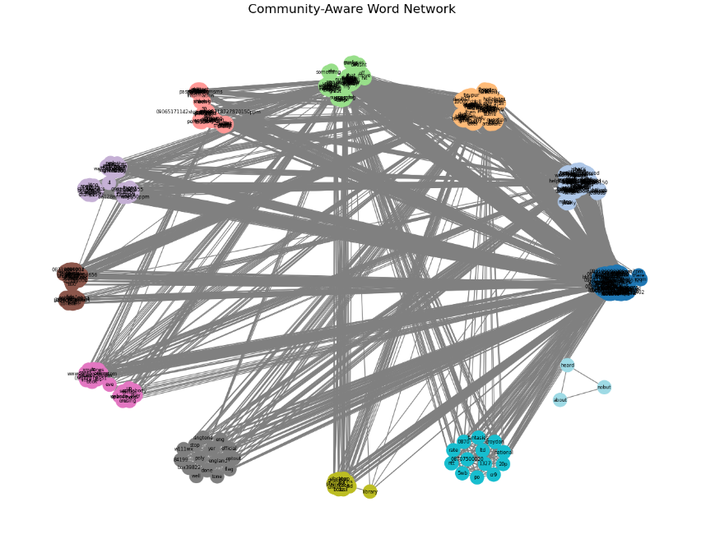
Community Detection Algorithms
Community 3:
i, now, for, like, me, can, get, do, account, then
Community 1:
you, the, your, call, have, on, or, from, mobile, free
Community 2:
to, text, new, if, of, 150, send, win, uk, chat
Algorithm on a larger dataset. Many colours of the nodes indicate many different communities formed.
An attempt to isolate communities on a sampled dataset. This results in the formation of approximately 12 communities.

Slide 8
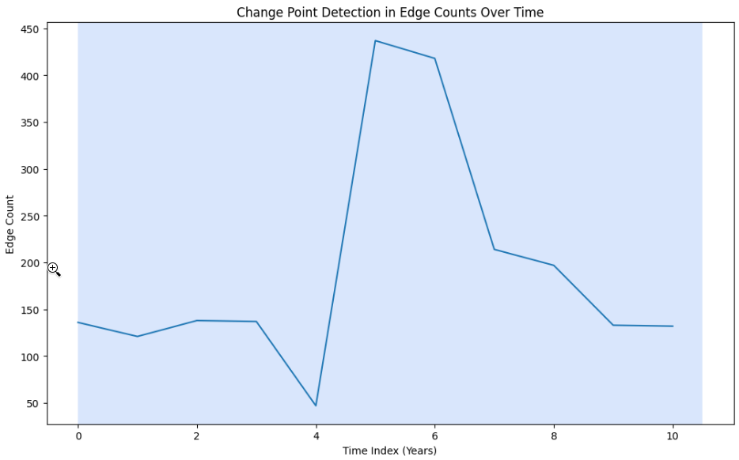
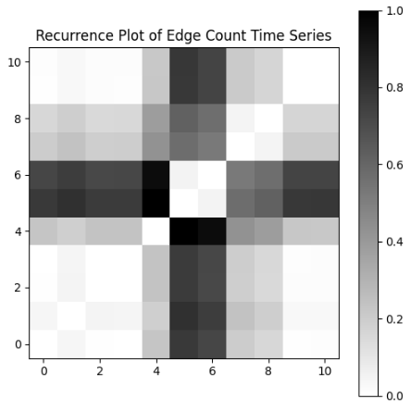
Change Point Detection
Libraries used: ruptures, pyts, scikit-learn
Generated time-series of edge-count using Numpy
Detected points of sudden activity changes or structural shifts utilizing ruptures.
Plotted a recurrence plot to compare how the network edge-counts compare with the other years
.
Change in the edge-count over the course of 10 years.
Comparing network edge counts of each year with every other year.

Slide 9
Sentence Embeddings
Used Sentence-BERT to convert each message into a vector (384 dimensions)
Captures meaning of the full sentence, grouping actual fraud calls by their meaning and not by just analyzing pattern among words.
Helps us:
Compare messages
Cluster similar messages
Train a classifier to detect hoax content
Used UMap to map down the large number of dimensions to just 2, allowing easier visualization.

Slide 10
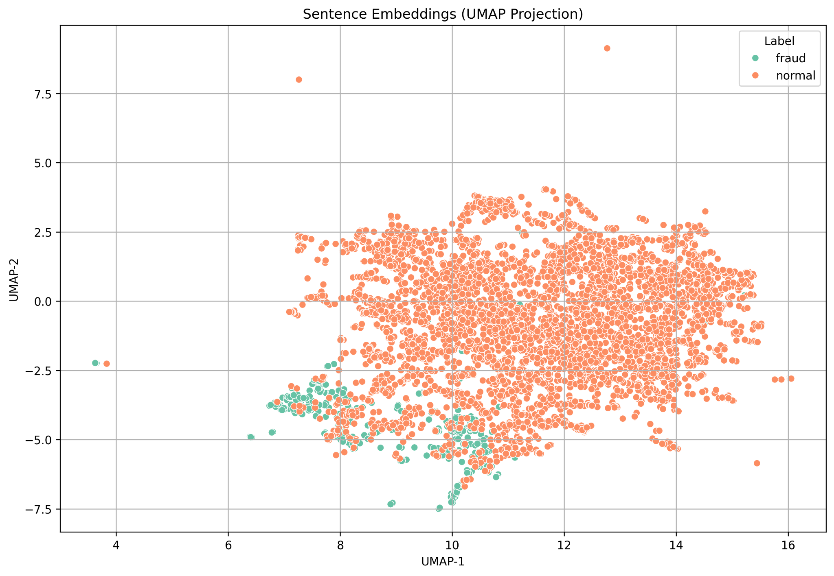
Sentence Embeddings
Observations:
2 clusters formed of the sentences (after cleaning, tokenization, etc.) using K-Means clustering
Slight overlap present between the clusters, but majorly separated.
Intuition of overlap: in real-world, some sentences may both be intended in a fraudulent manner, or may not (eg: customer care)
Separation between clusters means a classifier can be trained for predicting if a call message is fraud.
Sentence embeddings plotted to visualize their relationship semantically.

Slide 11
Word Embeddings
Trained Word2Vec model on all messages
Each word becomes a vector based on its context. We experimented with different dimensions of vectors for representing the words.
Words used similarly are placed close together in vector space
Visualized using a graph network showing how likely the words are to be used in the same context (where each word is labelled as fraud/normal based on the dominant usage in the dataset).
Example:
“otp”, “verify”, “account” → cluster near each other
“thanks”, “talk”, “sure” → another cluster

Slide 12
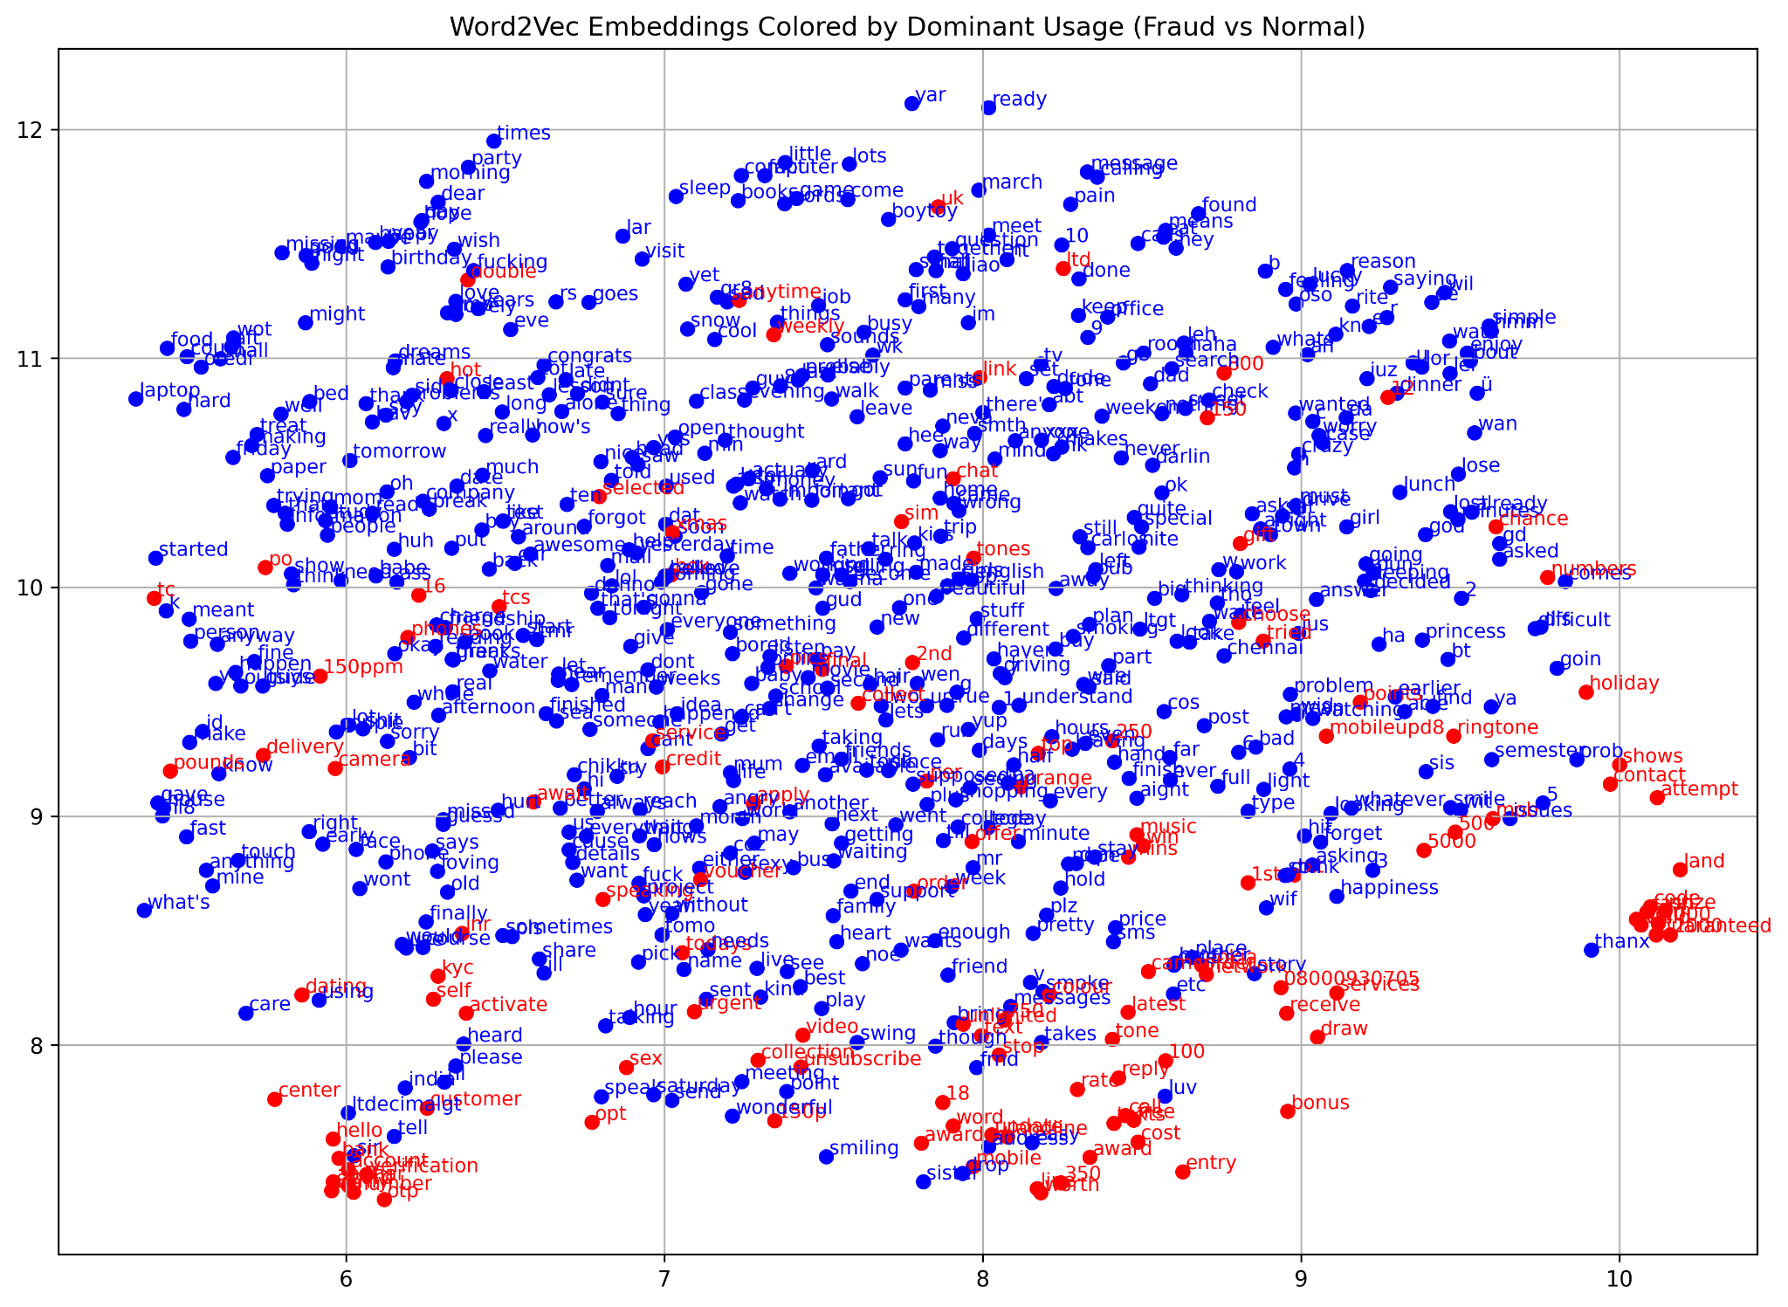
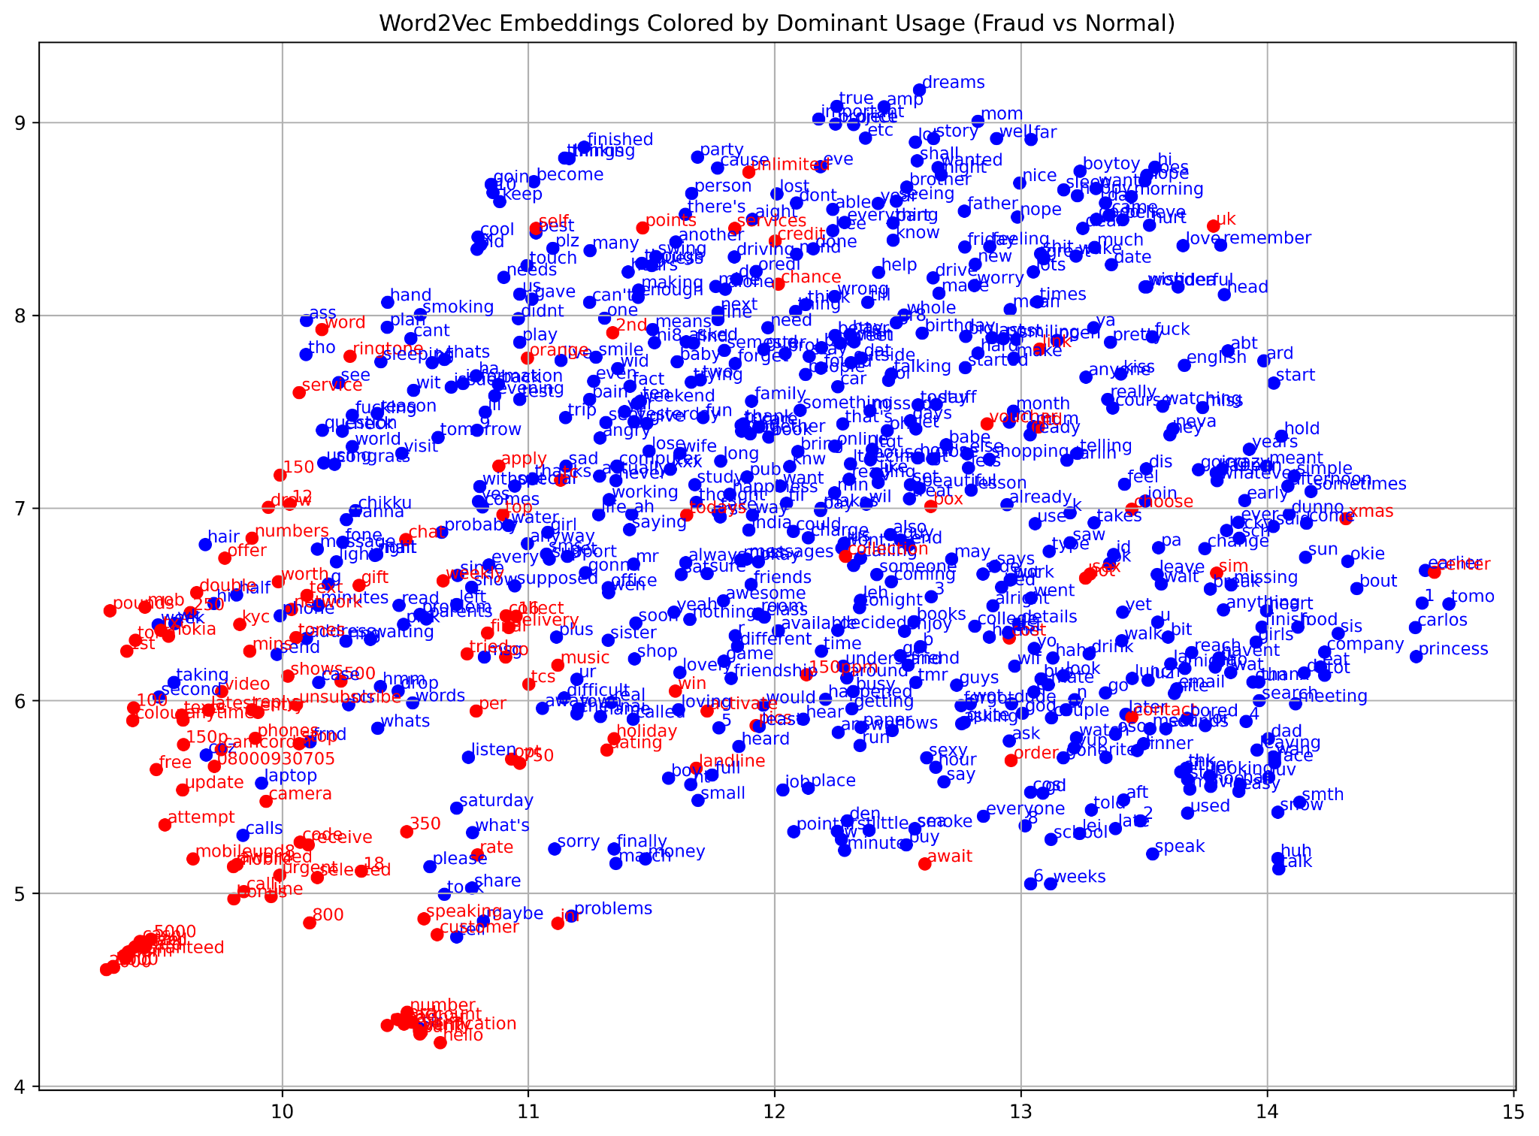
Word Embeddings
Word embeddings visualized (Vector size = 100)
Word embeddings visualized (Vector size = 200)
Observation:
Upon increasing the vector size, the Word2Vec model captures more contextual information for each word, allowing for better segregation.
This resulted in the model identifying more words as fraud based on their contextual usage (which can be observed by the increased density of fraud words)

Slide 13
Classifier
Used the semantic meaning of the message (sentence embedding) to train a model to learn patterns of scam language.
Converted each message into a 384-dimensional vector using Sentence-BERT (NLP Model), and used a Logistic Regression model for classification
Model evaluated using precision, recall, F1-score, and generated a confusion matrix for visual insights
The dashboard includes graphs, results, and a real-time classifier which allows the user to test different sentences and check the probability of them being fraudulent or not (with the confidence percent as well)
Since our dataset has more "normal" than "fraud" messages, we used balanced class weights to:
Give more importance to fraud examples
Prevent the model from being biased toward "normal"

Slide 14
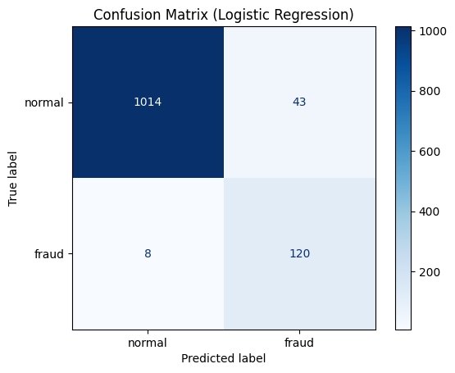
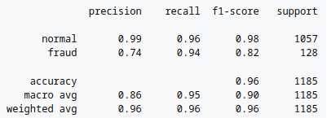
Classifier
The evaluation metrics of the Logistic Regression model suggest that it managed to learn a pattern for detecting whether a sentence could be a hoax one or not.
The relatively high values of precision, recall, and f1-score are also indicative of the success of the model.

Slide 15
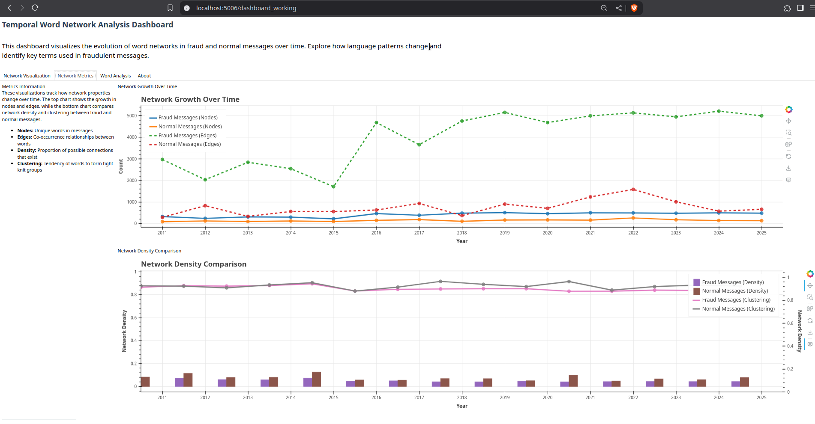
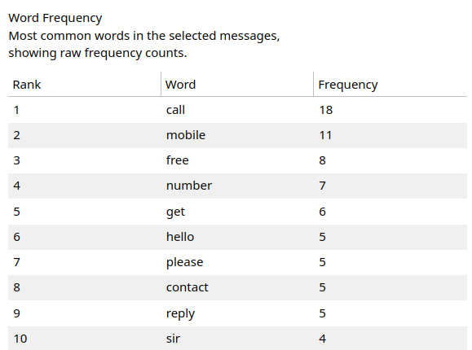
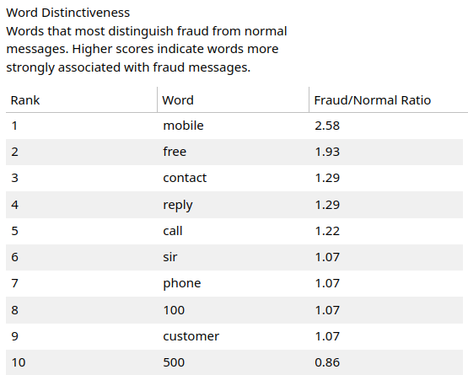
Bokeh for temporal visualization
Bokeh server was used to allow for interactive temporal visualization.
It allows us to visualize the graph characteristics for any particular year, such as the word network, degree centrality, etc.
Also provides a trend of how the fraud/normal calls nodes and edges change over the years, providing useful insights.
.

Slide 16
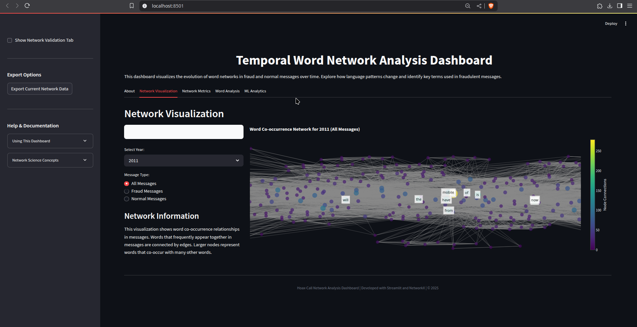
Bokeh for temporal visualization
Can view the word network for different kind of messages for any particular year

Slide 17
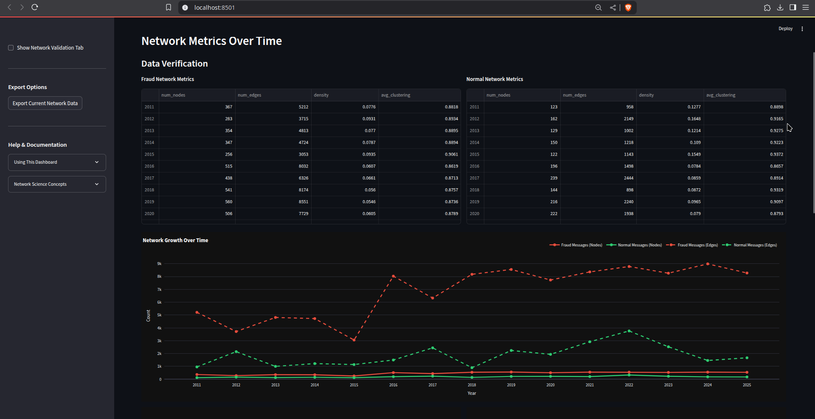
Bokeh for temporal visualization
View the trends in the type of messages over the year, providing a temporal insight.

Slide 18
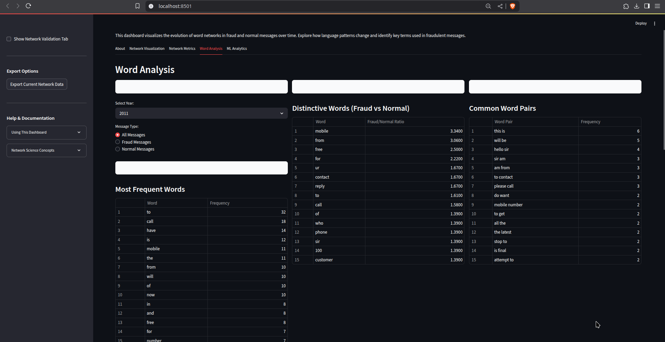
Bokeh for temporal visualization
View growth trends of each word specifically

Slide 19
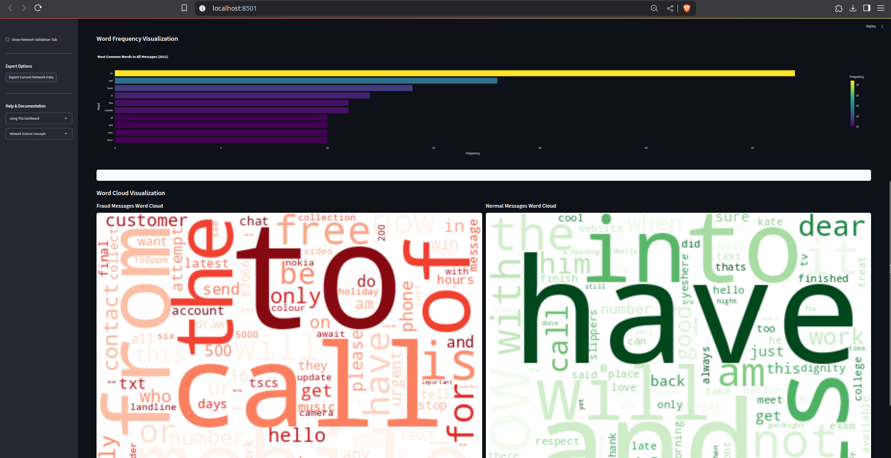
Bokeh for temporal visualization
Word clouds and word frequency visualized - frequent words are bigger

Slide 20
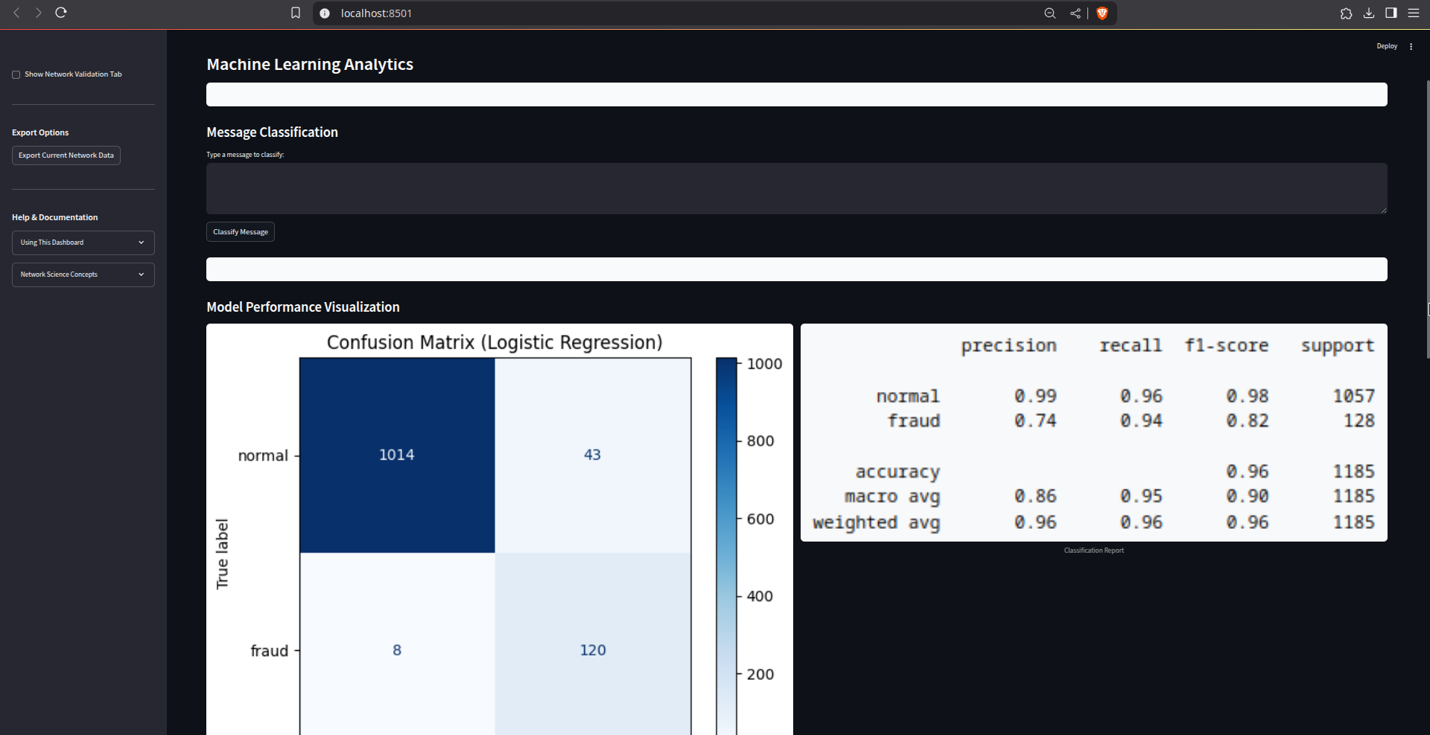
Bokeh for temporal visualization
Classification metrics visualized, as well as a live classification input field.

Slide 21
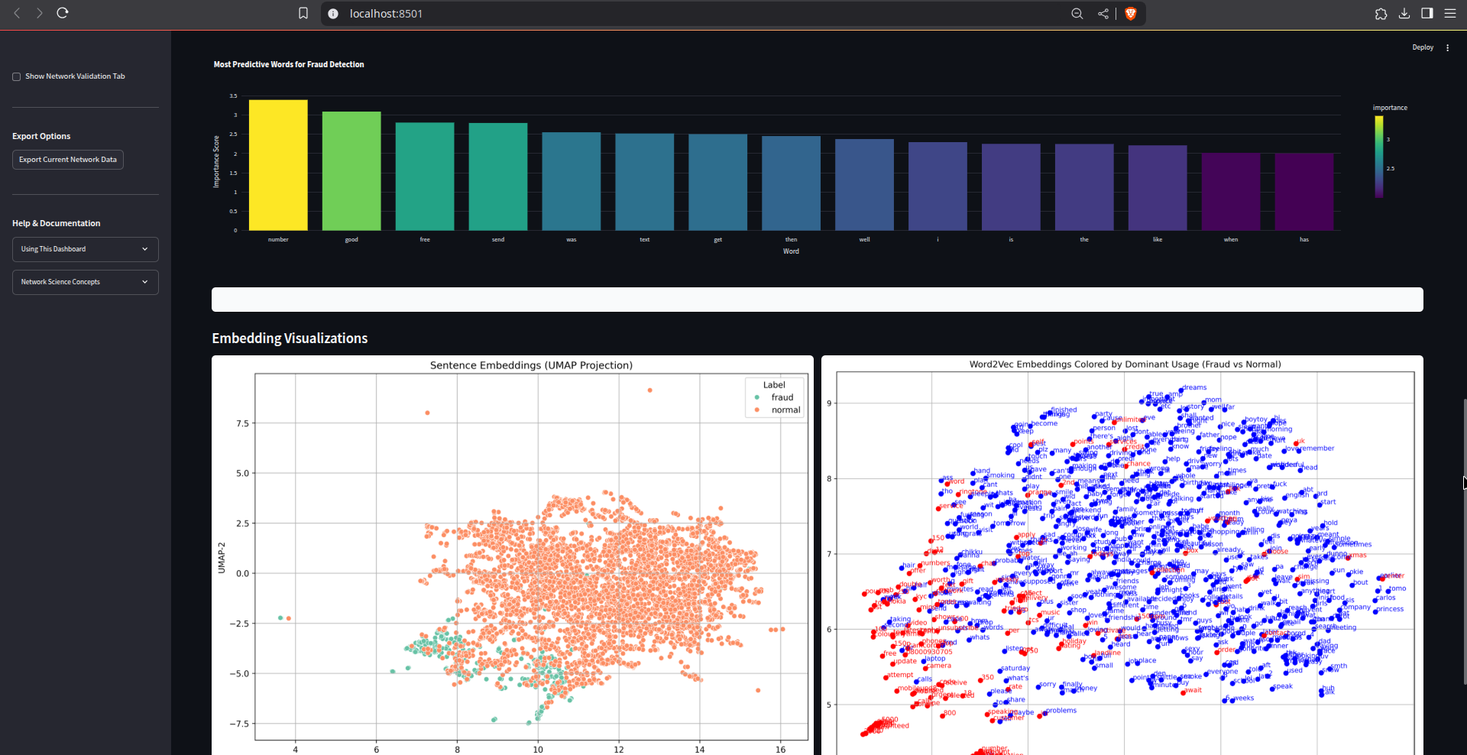
Bokeh for temporal visualization
Sentence and word embeddings visualized

Slide 22
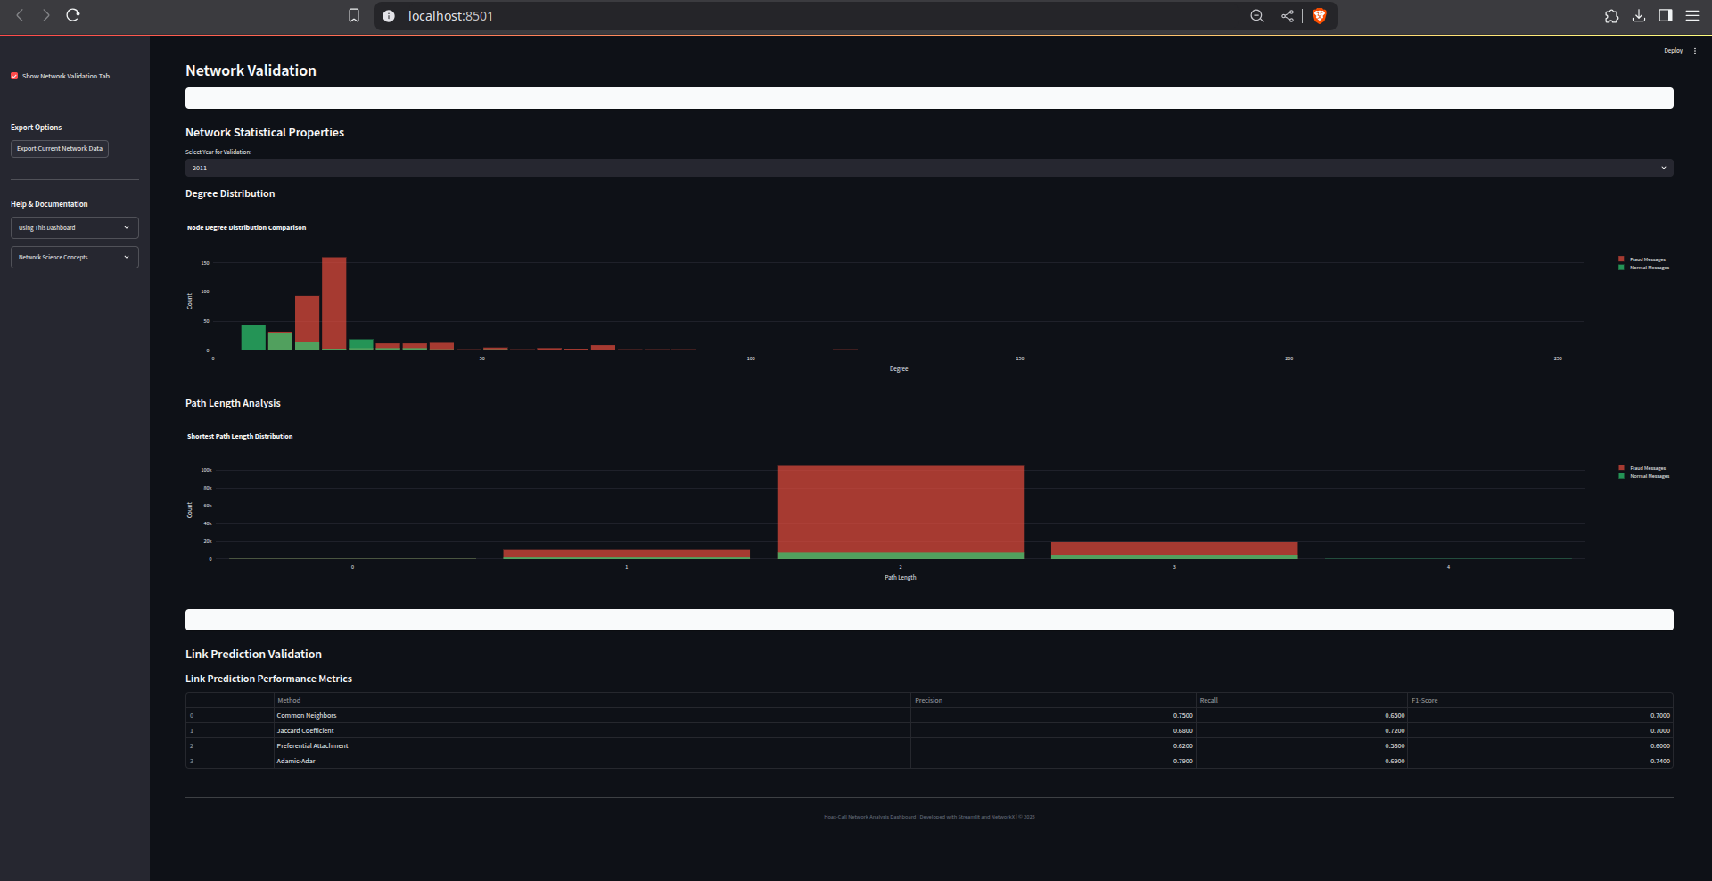
Bokeh for temporal visualization
Network validation and link prediction output

Slide 23
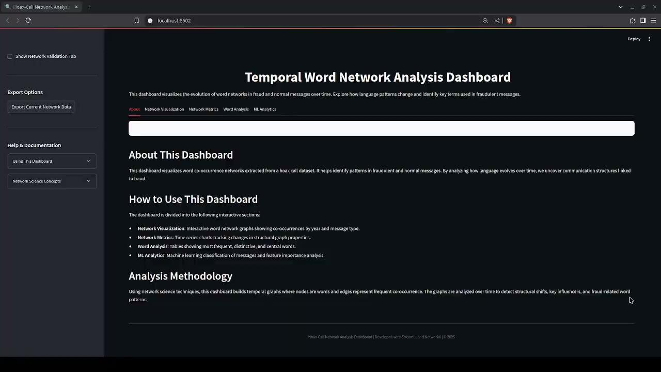
Bokeh for temporal visualization
(video attached)

Slide 24
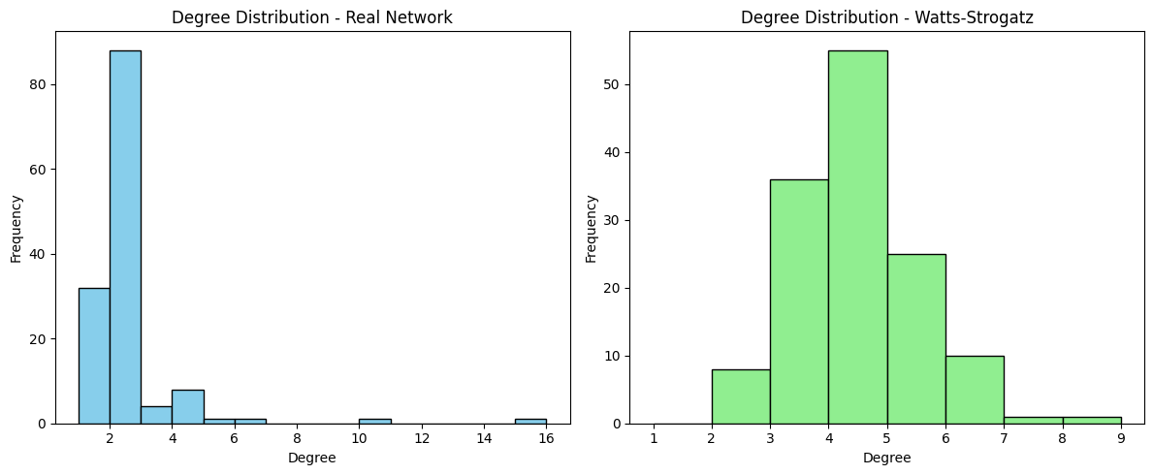
Classical Growth Models : Watts-Strogatz
Models small-world networks with high clustering and short path lengths
Mimics real-world networks like social, biological, or word networks, allowing simpler analysis.
How it works:
Start with a ring lattice (each node connects to k nearest neighbors)
Rewire each edge randomly with probability p
Avoid duplicate edges and self-loops

Slide 25
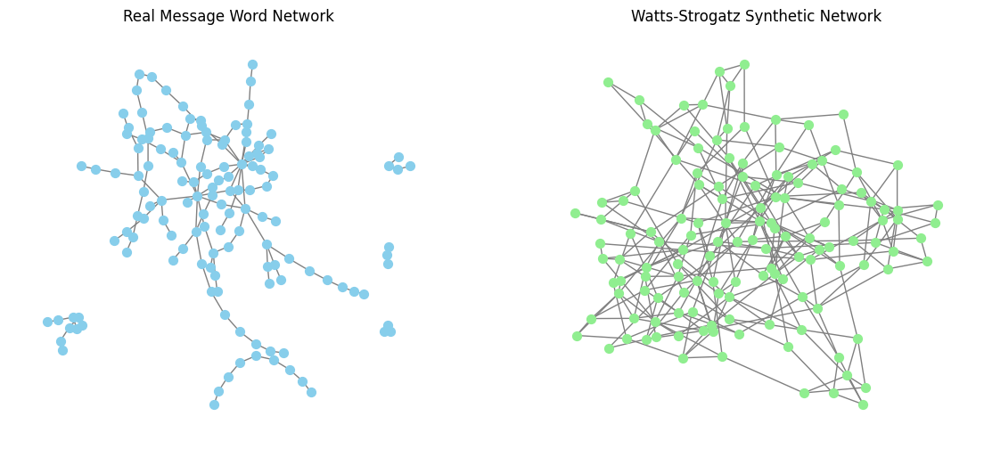
Some Comparisons
Real Network:
Nodes: 120
Clustering Coefficient: 1.0311
Average Path Length: 1.76153
Watts-Strogatz Network
Clustering Coefficient: 0.2098
Average Path Length: 4.0667

Slide 26
Key Highlights:
The clustering coefficient measures how likely it is that the neighbors of a node are also connected to each other.
C_{v}=2×number of links between neighbors of v/(k_{v}(k_{v}−1)
where k_{v} is the degree (number of neighbors) of node v.
The average clustering coefficient is the mean of C_{v} across all nodes.
The average number of steps along the shortest paths for all possible pairs of network nodes.
Formally:
L = 1/(n(n−1)2) ∑ i≠j d(i,j)
where d(i,j)is the shortest path between node i and node j. n is the total number of nodes

Slide 27
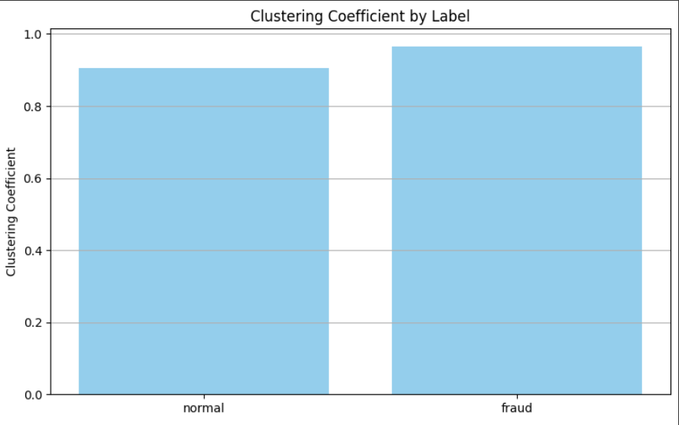
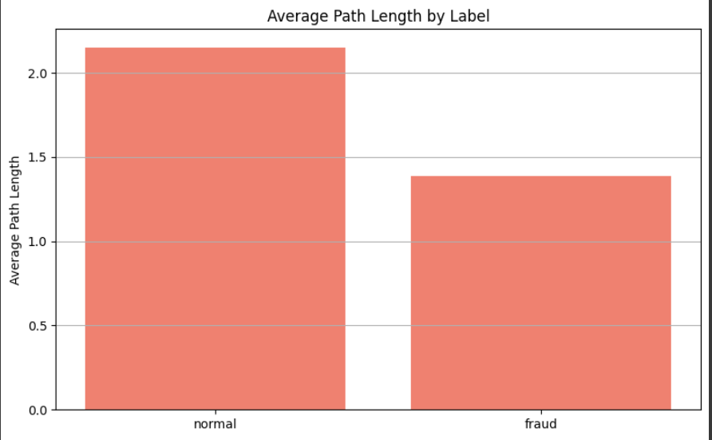
Visualizations

Slide 28
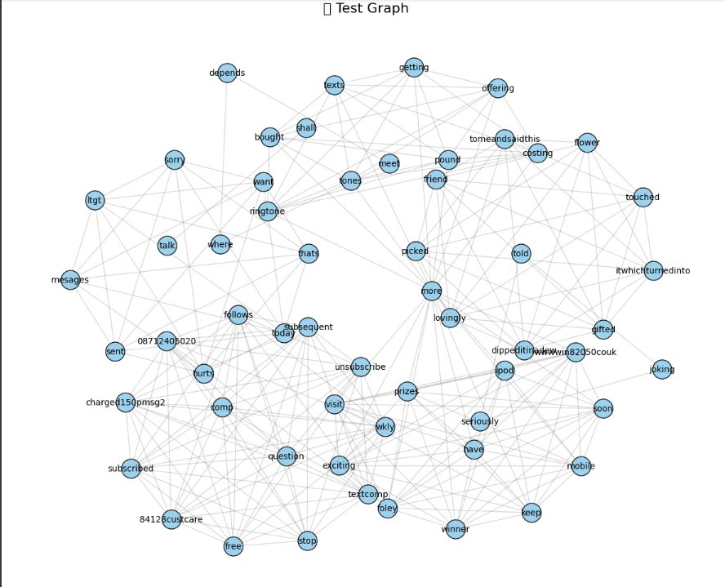
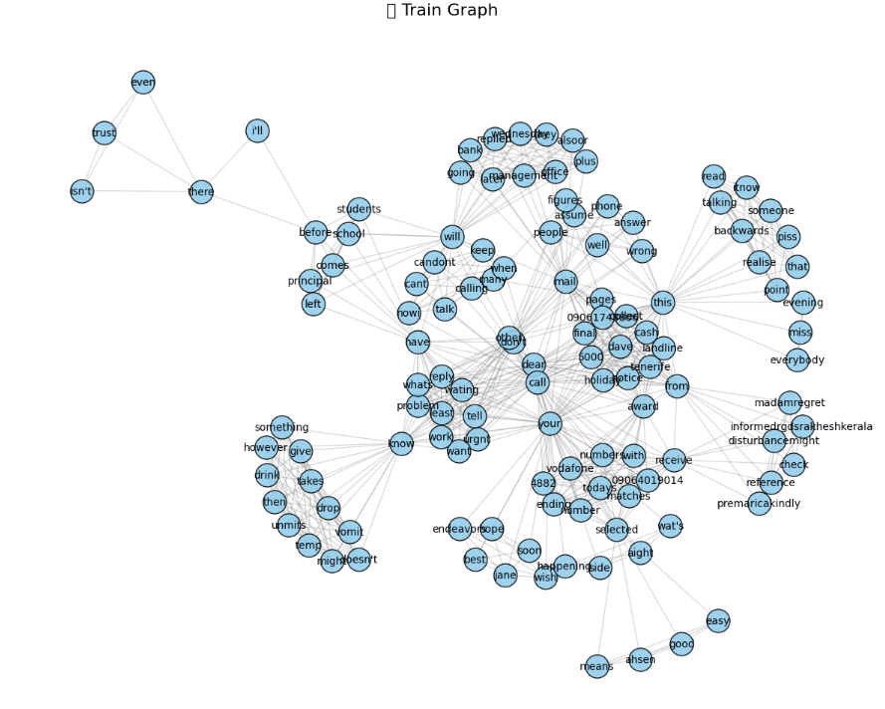
Future Link Prediction between Nodes
Predicts new or missing connections in a network
Based on topological features, node similarity, or learning-based models
Helps in understanding network evolution over time.

Slide 29
Overview
Techniques Used: - Measures how many common nodes (neighbors) two nodes share. - Idea: If two nodes share many neighbors, they are more likely to be connected in the future.
Formula: Let x and y be two unconnected nodes (words) in the current Network. Let Γ(x) represent the set of neighbors of node x. For nodes x and y: CN(x, y) = |Γ(x) ∩ Γ(y)|
Advantages:
Simple and fast to compute
Works well in dense networks
Limitations:
Ignores the importance of neighbors
May not work well in sparse graphs

Slide 30
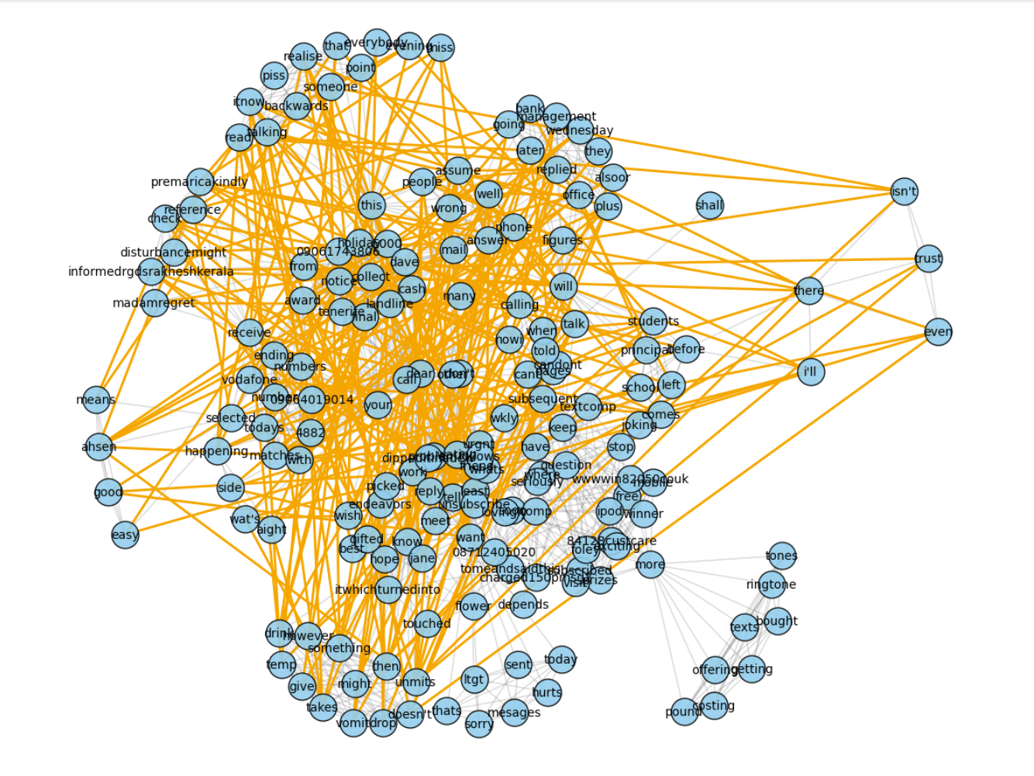
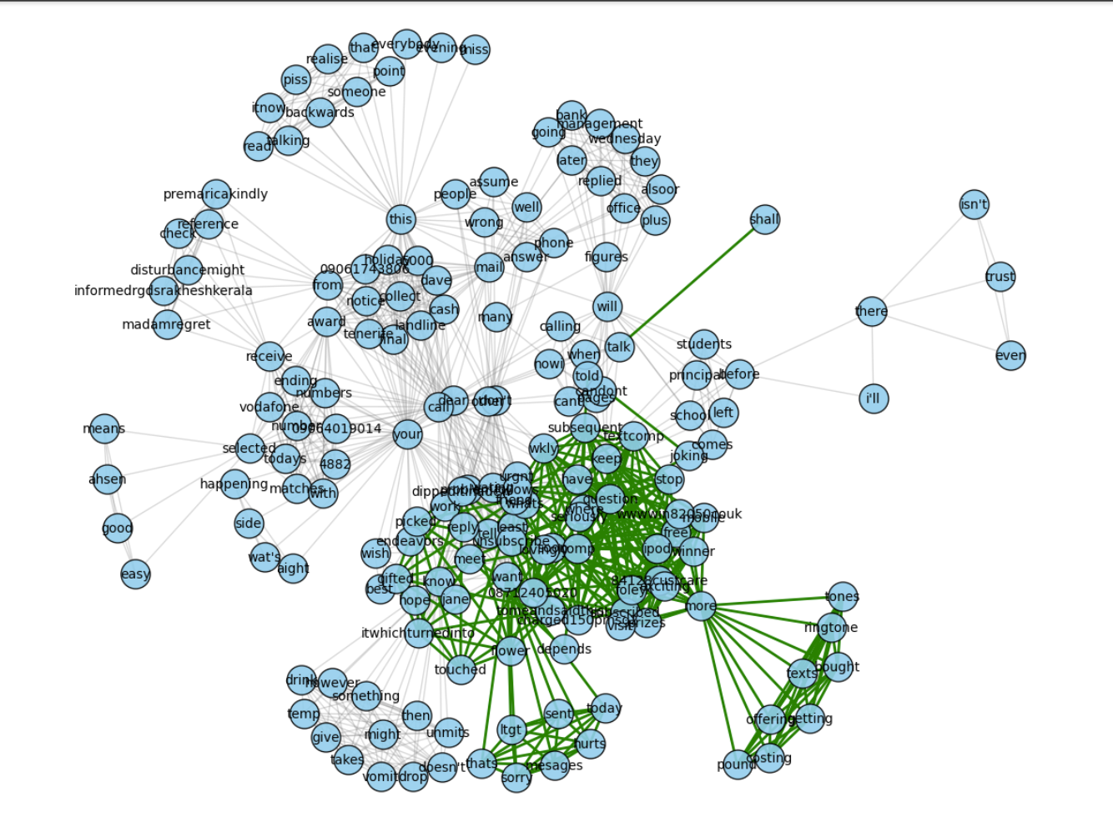
Predicted vs Actual

Slide 31
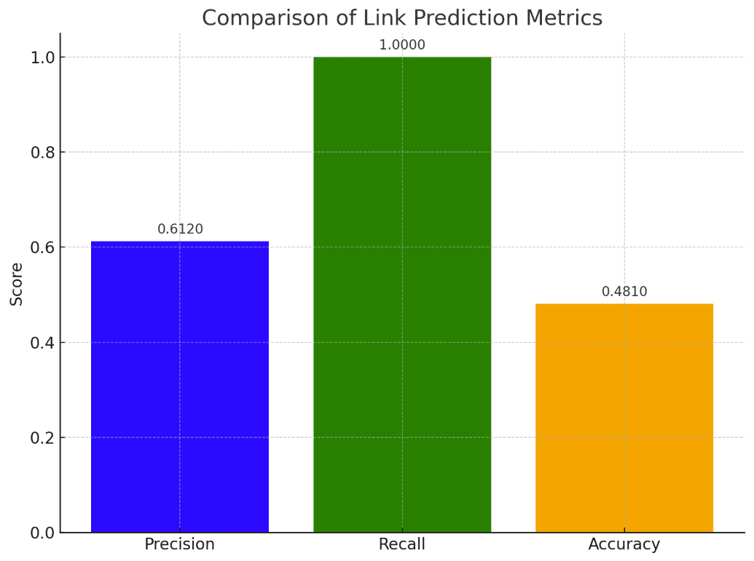
Validation Methods
1. Train-Test Split (Temporal Hold-Out)
Split the network by time (e.g., train on 2020, test on 2021)
Predict future links using past structure
2. Precision & Recall
Precision: % of predicted links that are correct.
Recall: % of actual links that were correctly predicted.
3. Accuracy
Measures total correctness (both link and no-link predictions)

Slide 32
Challenges Faced
Dataset was not formatted correctly and also included many NULL values for the messages. Data preprocessing had to be done multiple times to ensure that the data was in a format that was easy to read and process.
Plotting using Bokeh and Dynetx required going through documentation, since it was the first time we used the tool.
Large size of the dataset made it complex to model all of the data in the form of a network every time we rendered it. So we ran our tests on a smaller sample, and the final code run was on the full dataset.
Community-detection resulted in the communities being cluttered together, making it visually unappealing.

Slide 33
Future Work
Enhanced Community Detection Approaches and comparison with other algorithms.
Implementing and comparing other classical growth models such as Barabási–Albert.
Use historical data to predict future word associations or emerging fraud templates using methods like Jaccard Similarity.
Improvement of the web dashboard UI

Slide 34
Thank you!

