Slide 1
Analysis on the impact of Airbnb's Dynamic Price Prediction Model
Group 3 (5 Feb 2024)
Apoorv Sharma
Himanshu Sharma
Nava Bhargav Gedda
Ompal Singh Bhati
Vatsal Vipul Doshi

Slide 2
Introduction – The Hospitality Industry : Overview
Vast and Multifaceted Sector
Provides services to guests and travelers.
Encompasses a diverse range of accommodations.
Types of Accommodations
1. Hotels
2. Resorts
3. Hostels
4. Dormitories
5. Bed and Breakfasts (B&Bs)
Akbar, Y.H. and Tracogna, A. (2018) ‘The sharing economy and the future of the hotel industry: Transaction cost theory and platform economics’, International Journal of Hospitality Management,
Beyond accommodations, includes:
Dining options
Entertainment services
Various amenities

Slide 3
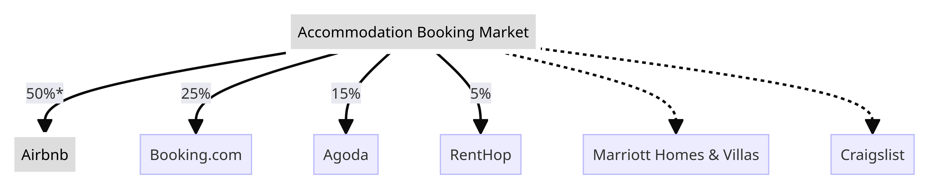
Market players in the hospitality industry:
Key details:
Airbnb has an estimated 50% market share
Booking.com is second largest with 25% share
Agoda, RentHop, and others have single digit shares
Marriot and Craigslist currently have a smaller market share
Curry, D. (2024) Airbnb revenue and Usage Statistics (2024), Business of Apps. Available at: https://www.businessofapps.com/data/airbnb-statistics/

Slide 4

Airbnb's Impact on the Hospitality Industry:
Innovative Approach
Revolutionized perceptions and access to accommodations.
User-Friendly Interface
Facilitates seamless transactions for hosts and guests.
Transparent Reviews
Builds trust and transparency for informed decisions.
Diverse Listings
Appeals to travelers seeking authentic experiences.
Expanding Hospitality's Definition
Shifted focus beyond traditional hotels.
Introduced flexibility and choice.
Rise of "BnB" Category
Birth of vacation rentals and boutique guesthouses.
Encouraging Industry Adaptation
Prompts hostels and dormitories to innovate.
Challenging Conventional Norms
Airbnb challenges established hospitality norms
Significant influencer in the industry.

Slide 5
Challenges faced by the Sharing Economy
Unlike Hotels, the short-term rentals in sharing economy lack trained professionals, industry benchmarking reports and technical tools to help set pricing for rooms.
Unlike other sharing economy platforms, like Lyft and Uber, where an algorithm controls prices, Airbnb and other short-term rentals allows its individual hosts to decide whether they want to act on the inbuilt pricing tools or do it themselves. This creates a situation whereby the host's characteristics and skills are as important as the listing and market dynamics.
Supply is unpredictable as it depends on the hosts to control the allocation for their listings on the platform.
(Chris Gibbs and Daniel Guttentag en at. 2017, Use of Dynamic pricing strategies by Airbnb Hosts, International Journal of Contemporary Hospitality Management Vol.36 Issue.1, https://www.emerald.com/insight/publication/issn/0959-6119)

Slide 6
Data & properties of data used to tackle the challenges
1. Data being used
Property Details: Location, size, amenities, type, bedrooms, and bathrooms.
Pricing History: Previous rental prices, trends, and seasonality.
Calendar Info: Availability, booked dates, upcoming reservations.
Geospatial Data: Neighborhood, attractions, transportation, amenities.
User Reviews: Guest feedback and ratings.
Host Details: Host information, history, and responsiveness.
Seasonal Trends: External factors affecting demand and pricing.
(Kalehbasti, P. R., Nikolenko, L., & Rezaei, H. (2021, February 5). Airbnb Price Prediction Using Machine Learning and Sentiment Analysis. SpringerLink. https://link.springer.com/chapter/10.1007/978-3-030-84060-0_11)

Slide 7
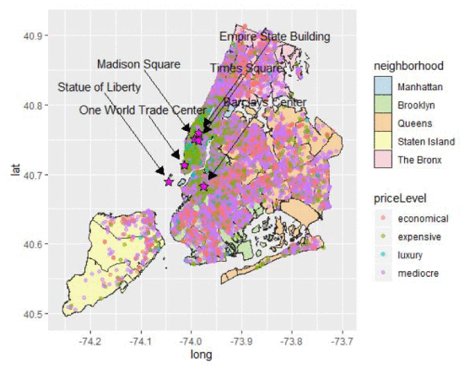
Data & properties of data used to tackle the challenges
2. Properties of the data
Structured Data: Numerical (e.g., bedrooms) and categorical (e.g., property type) features.
Temporal Data: Historical pricing trends, seasonality, and booking calendars.
Geospatial Data: Location-based data influences property attractiveness and pricing.
Text Data: User reviews and host descriptions, contributing to price prediction.
(Machine Learning Prediction of New York Airbnb Prices. (n.d.). IEEE Xplore. https://ieeexplore.ieee.org/abstract/document/9253078)

Slide 8
Data & properties of data used to tackle the challenges
3. Variables used typically
Property Features: Size, bedrooms, bathrooms, amenities, property type.
Location: Coordinates, neighborhood, proximity to landmarks and transportation.
Temporal: Dates, seasonality, historical pricing.
User-Generated: Ratings, reviews, overall reputation.
Host: Experience, responsiveness, reliability.
External: Local events, holidays, economic indicators.
(Tang, E., & Sangani, K. Neighborhood and Price Prediction for San Francisco Airbnb Listings. https://cs229.stanford.edu/proj2015/236_report.pdf)

Slide 9
Types of methods
Descriptive Method : Analyzes spatial data – Data aggregation & Data Mining.
Implementation process in Airbnb: Involves analyzing booking trends, popular destinations, property characteristics that attract guests.
( Adamiak C, Szyda B, Dubownik A, García-Álvarez D. Airbnb Offer in Spain—Spatial Analysis of the Pattern and Determinants of Its Distribution. ISPRS International Journal of Geo-Information. 2019; 8(3):155. https://doi.org/10.3390/ijgi8030155 )
Predictive Method : Forecast future outcomes, risks & opportunities – Statistical models and ML models.
Implementation process in Airbnb: Involves forecasting demand of specific cities and properties during upcoming holidays, calendar availability, events & market trends.
( A. Garlapati, K. Garlapati, N. Malisetty, D. R. Krishna and G. Narayana, "Price Listing Predictions and Forthcoming Analysis of Airbnb," 2021 12th International Conference on Computing Communication and Networking Technologies (ICCCNT), Kharagpur, India, 2021, pp. 1-7, doi: 10.1109/ICCCNT51525.2021.9579773 )
Prescriptive Method : Recommends optimal actions – Optimization models
Implementation process in Airbnb: Involves optimal actions to maximize revenue, improve user satisfaction & enhance optimal efficiency.
( Gibbs, C., Guttentag, D., Gretzel, U., Yao, L. and Morton, J. (2018), "Use of dynamic pricing strategies by Airbnb hosts", International Journal of Contemporary Hospitality Management, Vol. 30 No. 1, pp. 2-20. https://doi.org/10.1108/IJCHM-09-2016-0540 )

Slide 10
Data & Analytics used in Airbnb
Statistical Methods - Dynamic Pricing
Method: Regression Models – linear regression.
Example: Statistical regression models used to adjust property prices based on factors like demand, seasonality, and competitor pricing.
(Peng et al. 2018. Customized Regression Model for Airbnb Dynamic Pricing. In Proceedings of the 24th ACM SIGKDD International Conference on Knowledge Discovery & Data Mining (KDD '18). Association for Computing Machinery, New York, NY, USA, 932–940. https://doi.org/10.1145/3219819.3219830)
Machine Learning - Recommendation Systems
Method: Tree based models, Support vector regression, neural networks and Hybrid models
Example: Employing machine learning algorithms helps to recommend properties by analyzing user preferences, search history, and similar users' behavior.
(Rezazadeh Kalehbasti, P., Nikolenko, L., Rezaei, H. (2021). Airbnb Price Prediction Using Machine Learning and Sentiment Analysis. In: Holzinger, A., Kieseberg, P., Tjoa, A.M., Weippl, E. (eds) Machine Learning and Knowledge Extraction. CD-MAKE 2021. Lecture Notes in Computer Science(), vol 12844. Springer, Cham. https://doi.org/10.1007/978-3-030-84060-0_11 )

Slide 11
Data & Analytics used in Airbnb
Computational Methods - Fraud Detection
Method: Anomaly Detection using computational algorithms.
Example: Utilizing computational techniques to identify and prevent fraudulent activities, such as fake listings or unauthorized transactions.
( Le Zhang, Qiang Yan, Leihan Zhang, A computational framework for understanding antecedents of guests perceived trust towards hosts on Airbnb, Decision Support Systems, Volume 115, 2018, Pages 105-116, ISSN 0167-9236, https://doi.org/10.1016/j.dss.2018.10.002. https://www.sciencedirect.com/science/article/pii/S0167923618301593 )
Mathematical Models - Marketplace Dynamics
Method: Game Theory, Supply-Demand Modeling (Mathematical Optimization).
Example: Applying mathematical models to balance the number of hosts and guests, ensuring a marketplace equilibrium that meets user needs.
( Rocco Antonio Curto, Irene Rubino & Antonella Verderosa (2022) Investigating Airbnb evolution in an urban tourism context: the application of mathematical modelling and spatial analysis, Current Issues in Tourism, 25:10, 1666-1681, DOI: 10.1080/13683500.2021.1932767 )

Slide 12
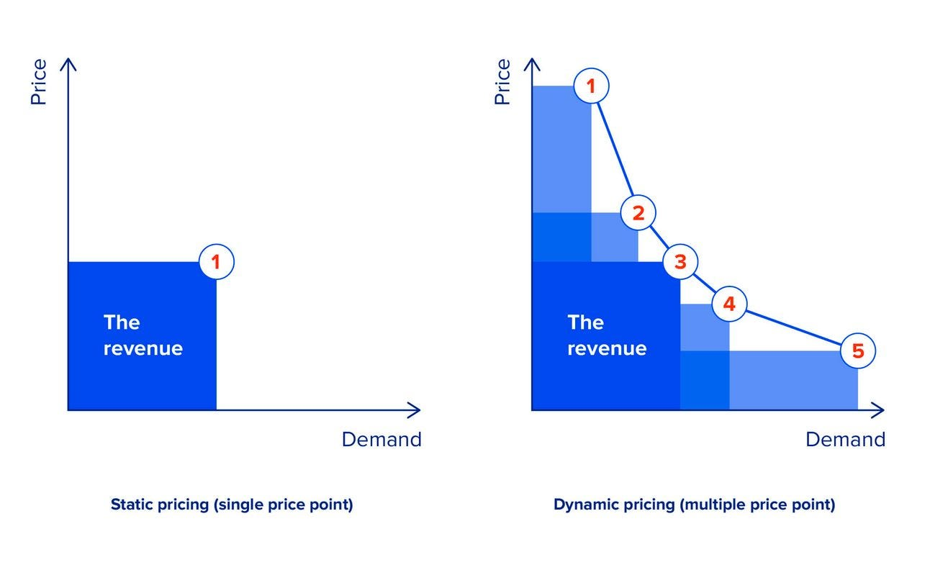
Benefits of Analytics on House Sharing and Hospitality Domain:
Dynamic Pricing according to the availability of the rooms and seasonality.
Adaptability as consumer price preferences are dynamic which changes over the period according to lifestyle, roles, psychological states, income and events.
Personalised recommendations as to the individual consumer’s needs.
Faulty and fraudulent activities can be detected and prevented.
Property performance can be measured with the help of analytics and can improve guest experiences.
Guo, Wenhao, et al. “Price-Aware Enhanced Dynamic Recommendation Based on Deep Learning.” Journal of Retailing and Consumer Services, vol. 75, 1 Nov. 2023, p. 103500, www.sciencedirect.com/science/article/pii/S0969698923002473?casa_token=i3YcO8fDBeMAAAAA:c-lVGwdIaCIgFVxSLZGjRDr-V-Jj9qicShPF0icx4TO1UAzPgYpkZ6utZoyXeeF44eqzLohloQ, https://doi.org/10.1016/j.jretconser.2023.103500. Accessed 12 Aug. 2023.
(Guo et al., 2023)

Slide 13
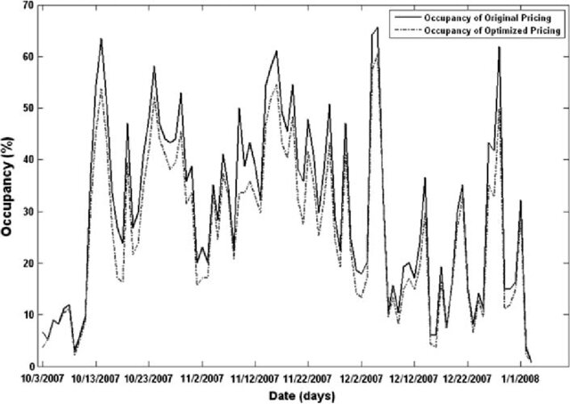
E.g.1: Monte Carlo Simulation for Hotel Services
This study was successfully implemented in Plaza Hotel, Alexandria, Egypt.
The Optimization Model algorithm uses Monte-Carlo simulation for all hotel’s processes like reservation arrivals, cancellations, duration of stay, no show and seasonality.
The model uses Price Multipliers that provide discounts and premiums over a seasonal reference price.
The model uses four influencing variables: time of arrival, hotel occupancy, length of stay and group size (these serve as control variable for price prediction).
The study emphasises on the importance of dynamic pricing as the internet reservations come to a boom.
Reservation chart
Bayoumi, Abd El-Moniem, et al. “Dynamic Pricing for Hotel Revenue Management Using Price Multipliers.” Journal of Revenue and Pricing Management, vol. 12, no. 3, 23 Nov. 2012, pp. 271–285, https://doi.org/10.1057/rpm.2012.44.
(Bayoumi et al., 2012)

Slide 14
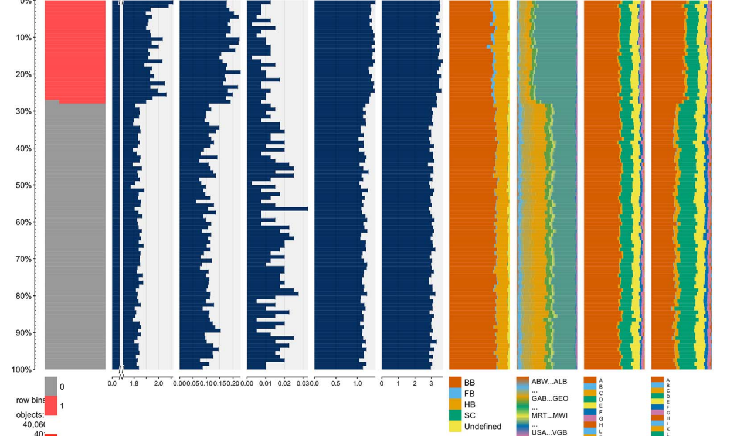
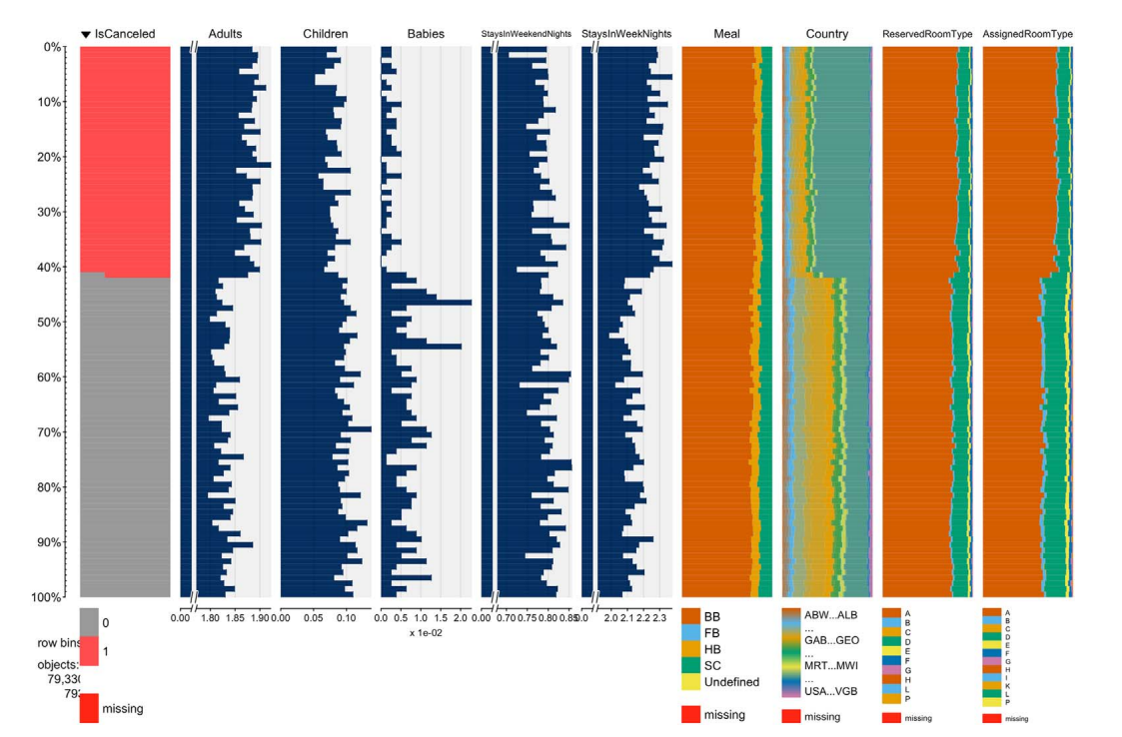
E.g. 2: Machine Learning and Data Mining for Hotel Booking Cancellations
This study is done by collecting data from two hotels, to predict the hotel booking cancellations.
The analysis and data mining has been done on the variables of Booking Changes, Days in Waiting List, Repeated Guest, Previous Cancellations, etc.
The characteristics of the variables allows to be useful in other cases as well apart from this specific problem.
This problem indicates that the analytics can also be used for the problems can be solved in the domain, like booking cancellations and frauds that occur during the booking of a stay.
Hotel 1: Bookings and Cancellations
Antonio, Nuno, et al. “Hotel Booking Demand Datasets.” Data in Brief, vol. 22, Feb. 2019, pp. 41–49, https://doi.org/10.1016/j.dib.2018.11.126.
Hotel 2: Bookings and Cancellations

Slide 15
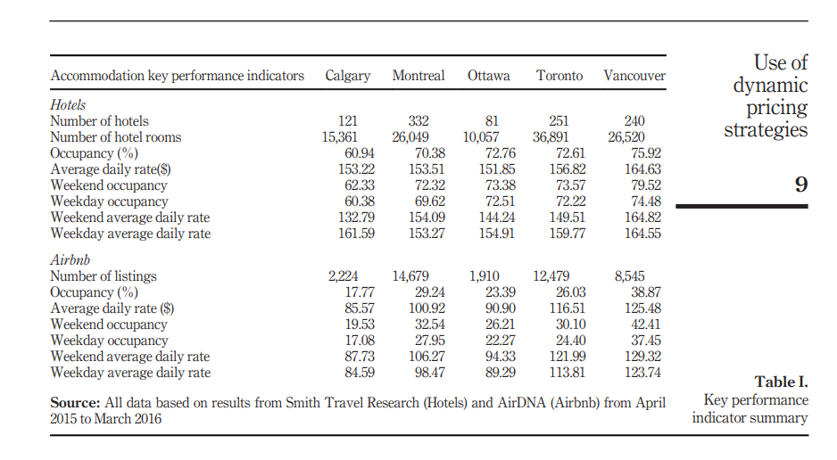
Implementation of Dynamic Pricing Strategy and Analytics
Airbnb is dominated by leisure travelers looking for a place to stay at a good price. Only 10 percent of its customers are using the platform for business travels which creates a gap which can be captured by niche host attributes effectively helping in generating more revenue and reducing lead time.
Airbnb Price fluctuation is dependent on factors like-
Demand and Supply
Marketplace
Type of accommodation
Category of Hosts
Experience of Hosts
(Chris Gibbs and Daniel Guttentag en at. 2017, Use of Dynamic pricing strategies by Airbnb Hosts, International Journal of Contemporary Hospitality Management Vol.36 Issue.1, https://www.emerald.com/insight/publication/issn/0959-6119)

Slide 16

Data Challenges and Ethical Issues for Airbnb :
Privacy has become a concern in the B2B marketing of the home-sharing economy.
Home-sharing providers are subject to both digital and physical privacy risks.
Home-sharing platforms' privacy management affects their providers' commitment.
Platforms should enhance their institutions of privacy management.
(Shijao Chen et al. 2022. How privacy practices affect customer commitment in the sharing economy: A study of Airbnb through an institutional perspective. Elsevier Journa, Industrial Marketing Management 107 (2022) 161-175,https://www.sciencedirect.com/science/article/pii/S0019850122002279)

