Slide 1



VISHWANIKETAN'S INSTITUTE OF MANAGEMENT ENTREPRENEURSHIP AND ENGINEERING TECHNOLOGY (VIMEET)
(Affiliated to University of Mumbai/Approved by DTE/AICTE/NAAC at A+ Grade in 1st Cycle)
HACK TO CRACK 2.O
CODE . . CONQUER
CREATE

Slide 2

HACK TO CRACK 2.O
1.0
Team Details
Team Name : FutureFounders
Team Leader Name : Jeel Doshi
Team Members : Vatsal Kotha, Meet Chavan
Problem Statement : Student Innovation
PS No: Student Innovation

Slide 3
Hack To Crack
HACK TO CRACK 2.O
Problem Statement Description
In today’s rapidly evolving market landscape, entrepreneurs and innovators face significant challenges in accurately assessing the potential of their groundbreaking ideas. Despite the abundance of creativity, many promising concepts lack the rigorous validation needed to predict market success. Traditional evaluation methods often fall short by relying on subjective judgment and limited data insights, leading to high risks and missed opportunities.
Moreover, with increasing awareness of ethical and sustainability concerns, there is a growing need to ensure that innovations not only succeed commercially but also adhere to responsible practices. The absence of a systematic, data-driven approach leaves innovators without clear, actionable guidance on refining their ideas to align with current market trends and ethical standards.
“Innovise” is designed to address these challenges by leveraging advanced Artificial Intelligence to provide:
Accurate Success Predictions: Utilizing robust data analysis to forecast the market potential of business ideas with high precision.
Ethical Integration: Embedding ethical considerations into the evaluation process to promote responsible and sustainable innovation.
Actionable Insights: Delivering clear recommendations that empower innovators to make informed, strategic decisions.

Slide 4
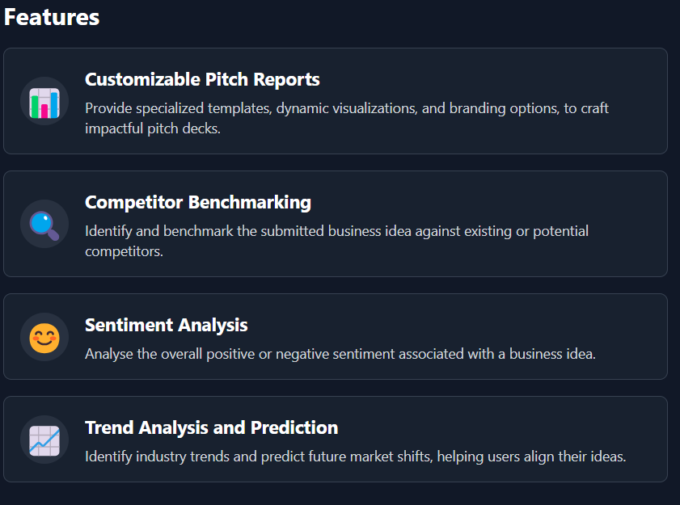
HACK TO CRACK 2.O
Idea Details
Innovise is an AI-driven platform designed to evaluate and predict the potential success of business ideas. It leverages advanced data analysis, competitor benchmarking, and market trend insights to deliver actionable recommendations. By integrating ethical considerations and sustainability metrics, Innovise ensures responsible innovation while empowering decision-makers with clear, data-backed guidance. Use Cases:
● Startups and entrepreneurs:
Evaluate new business ideas, identify potential pitfalls and opportunities, increase the success rate of ventures.
● Corporations and established businesses:
Innovate within existing product lines, explore new markets, identify potential acquisitions or partnerships, optimize current processes.
● Investors and venture capitalists:
Analyze potential investments, identify promising startups, gain deeper insights into market trends and potential risks.
● Academic researchers and educators:
Develop new research initiatives, improve the quality of academic proposals, foster innovation within classrooms.

Slide 5
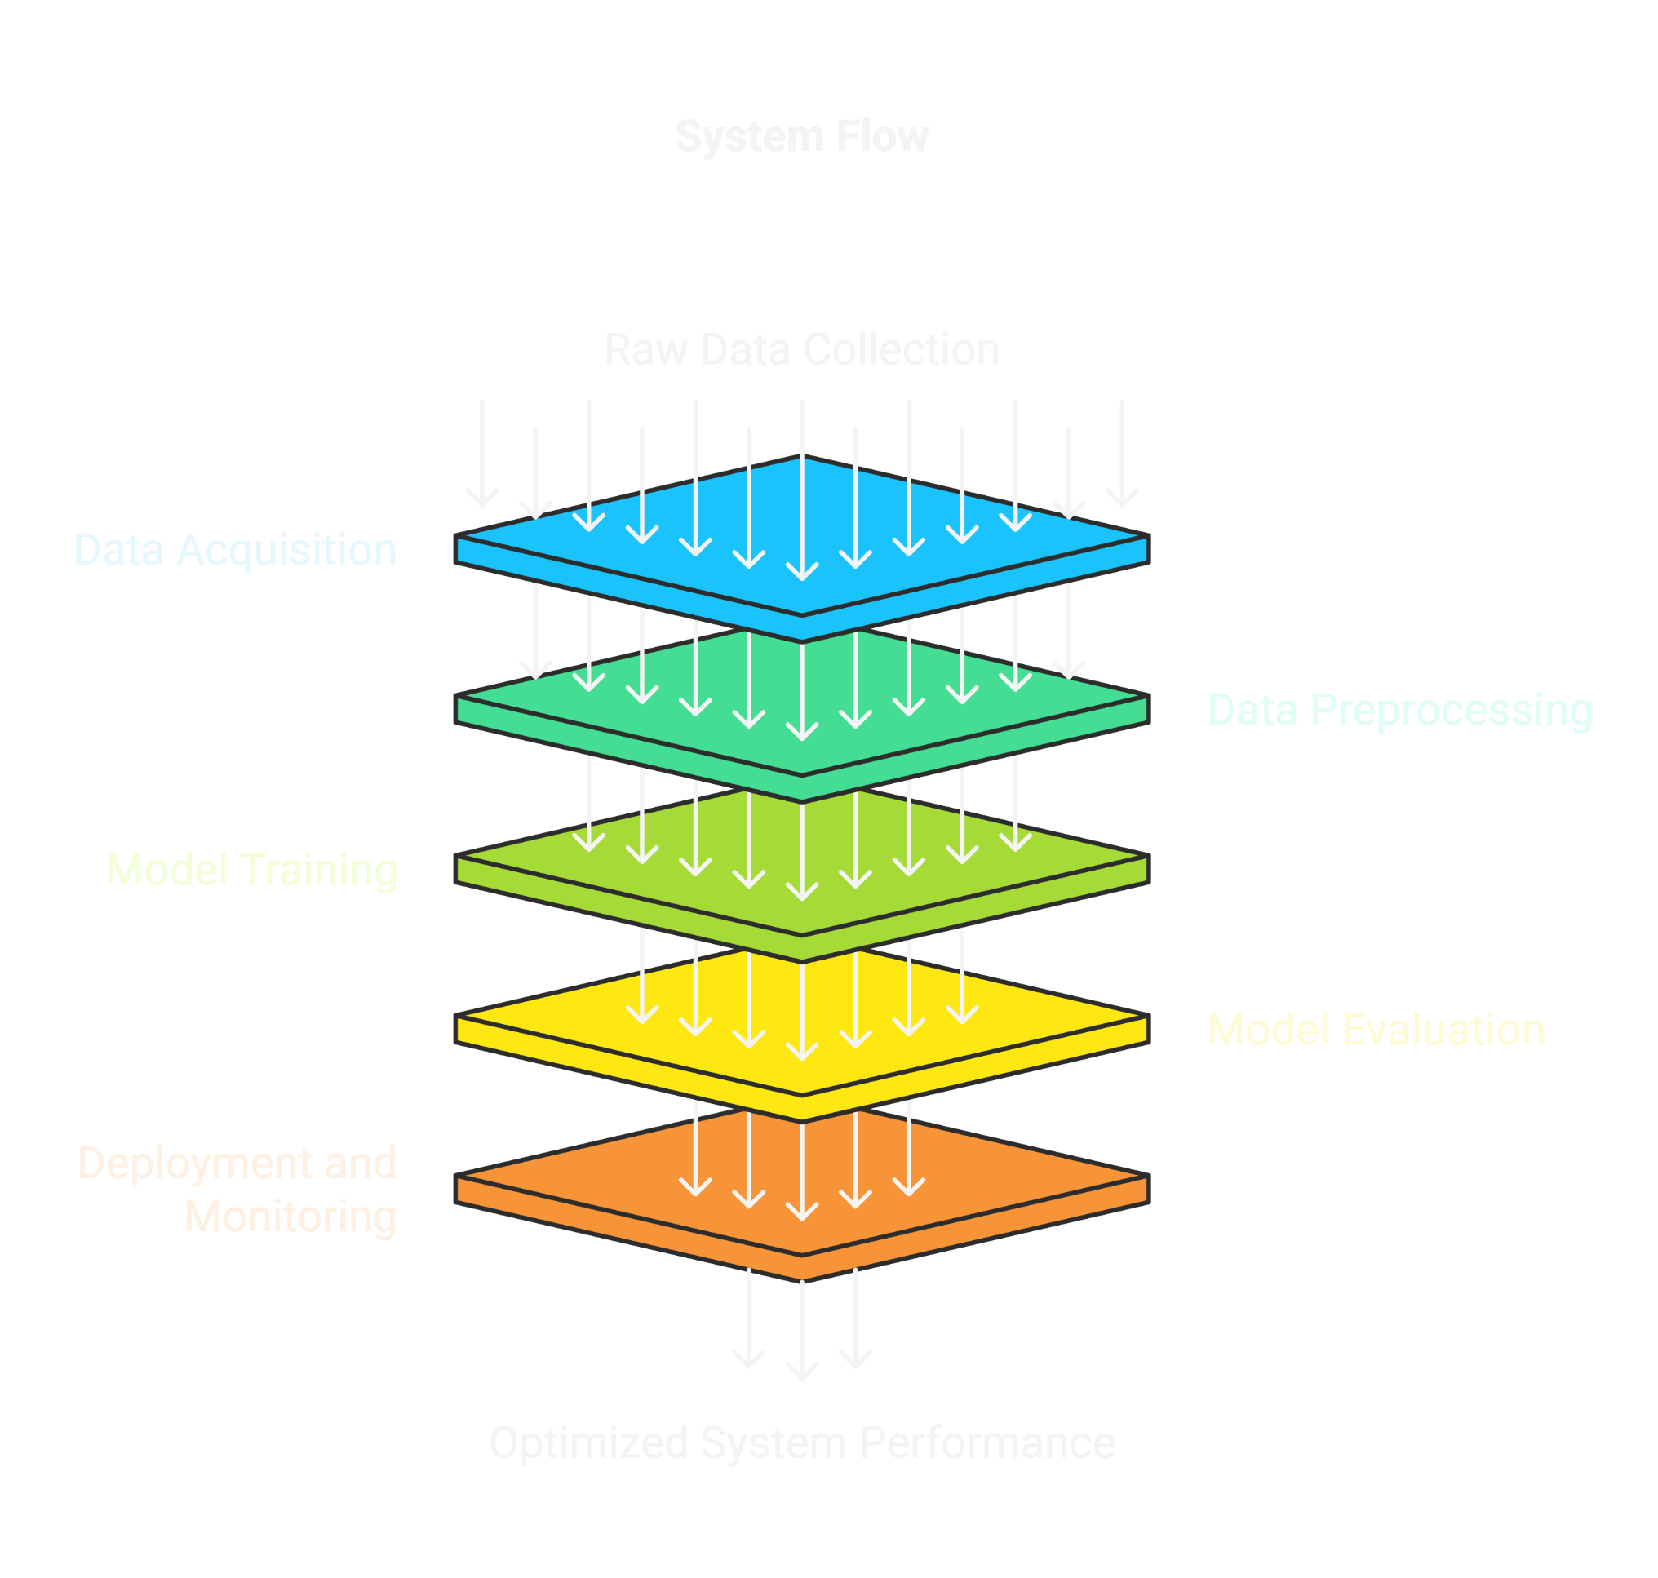
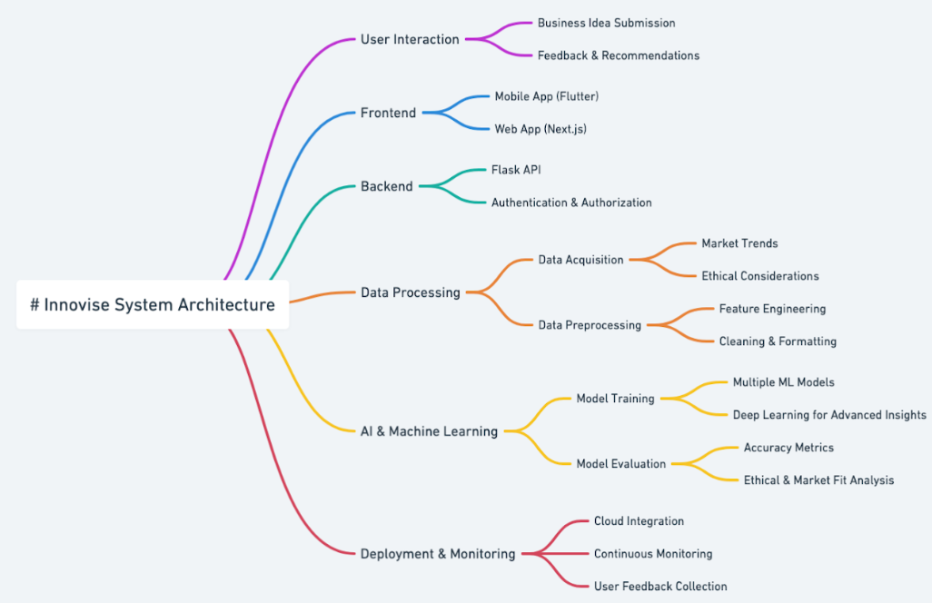
HACK TO CRACK 2.O
Flowchart / Architecture

Slide 6
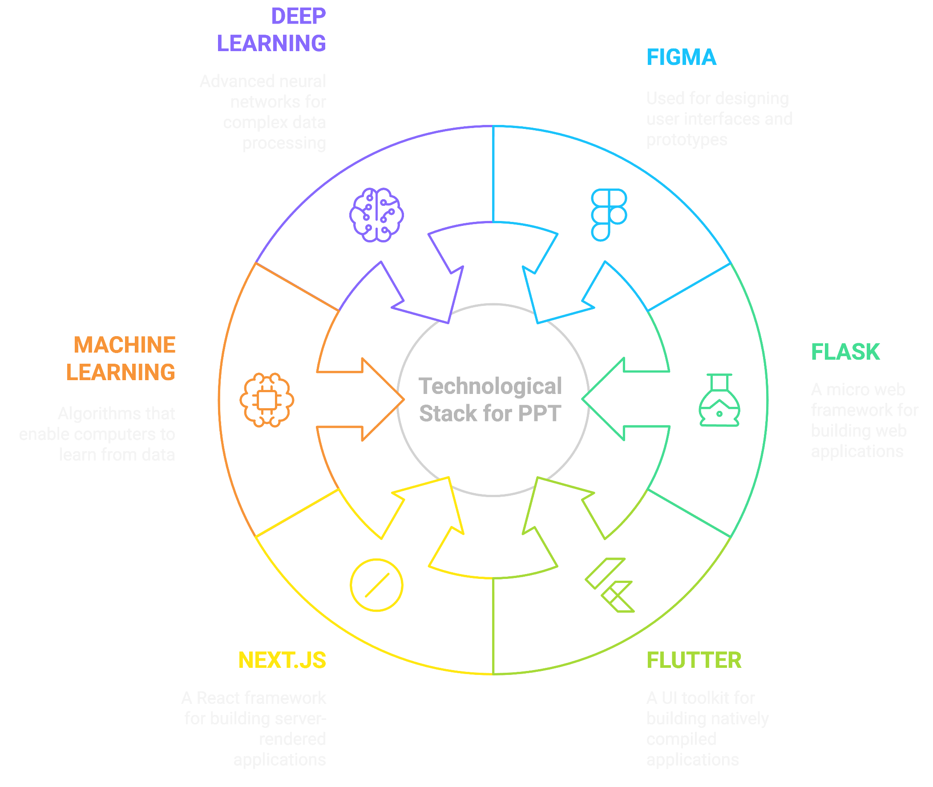
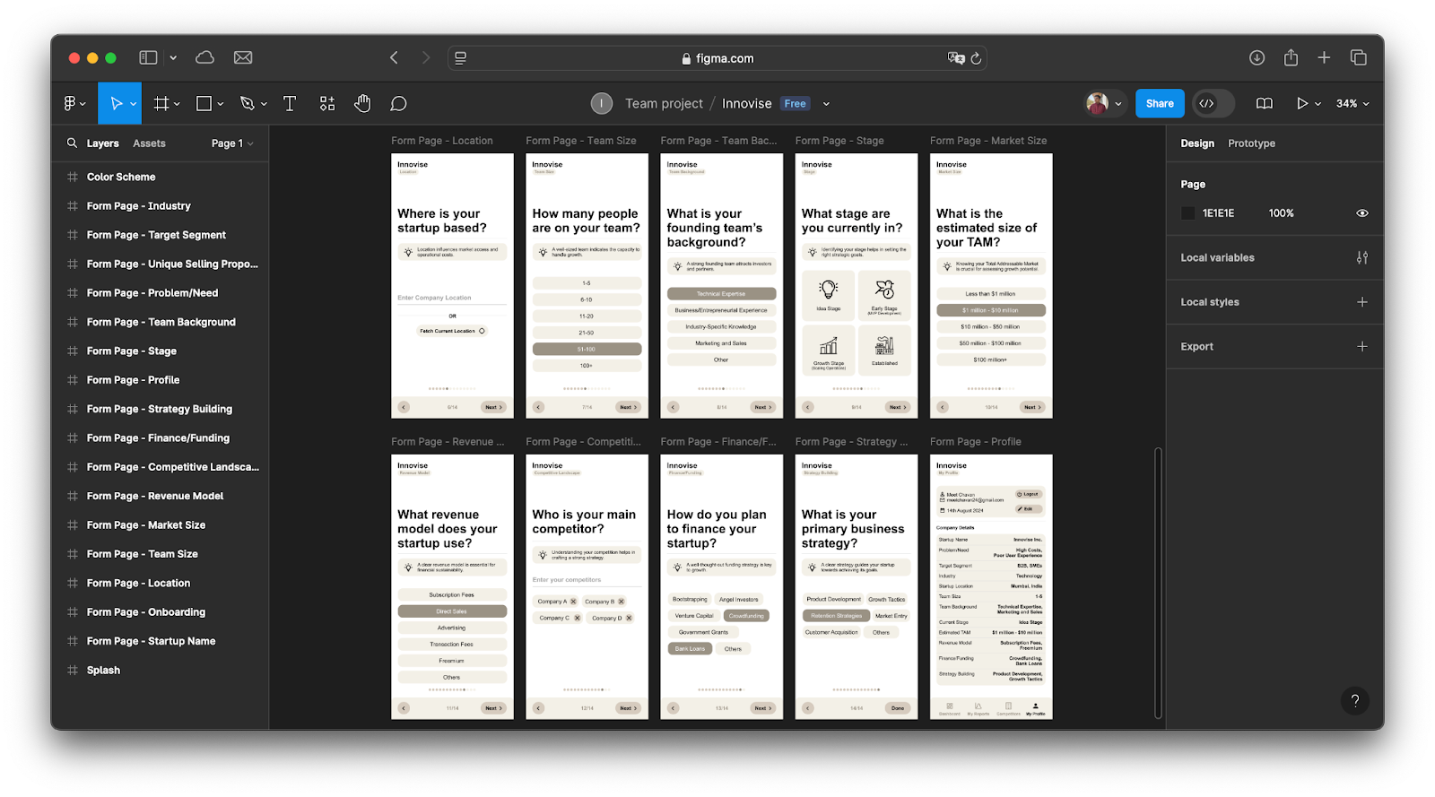
HACK TO CRACK 2.O
Tech Stack Used
Figma Design:
https://www.figma.com/design/50pqYDBxnHZGVJMhbmDb1O/Innovise?node-id=0-1&t=JS2c3bzLLnmodPhQ-1

