Slide 1

The Future of Finance is Automated: Embracing Algorithmic Trading in Blockchain Markets
Vatsal Parikh

Slide 2

MARKET EXPLORATION
Key Trends
Decentralized Exchanges (DEXs): Peer-to-peer trading, ideal for bots.
Lending Protocols: Earn interest on digital assets with bots.
Stablecoins: Provide stability in volatile markets for arbitrage bots.
Challenges
Scalability, security, and regulations pose challenges. Clear regulations and collaboration can foster innovation.

Slide 3

TRADING STRATEGIES
Cross-chain Arbitrage: Exploit price discrepancies between blockchains for quick profits.
Market-making: Provide liquidity on DEXs and earn fees from buy/sell orders.
Trend-following: Use technical indicators to identify and ride market trends.
Additional Strategies: High-frequency trading, statistical arbitrage, etc.

Slide 4

REGULATORY INSIGHTS
Key Regulatory Bodies: SEC, FINRA, FATF, etc.
Relevant Regulations: KYC/AML, Securities Laws, Tax Implications.
Challenges and Opportunities: Balancing innovation with investor protection is crucial.

Slide 5
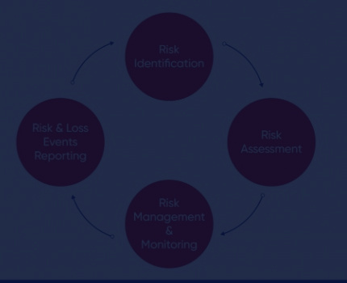
RISK MANAGEMENT FRAMEWORK
Identify Risks: Operational, Financial, Technological.
Measure Risk Exposure: Qualitative scoring, quantitative methods like VaR.
Mitigation Controls: Diversification, Stop-Loss mechanisms , data protection, Smart Contract Audits and Operational Protocols.
Reporting: Create thorough reports outlining all risk management operations, including as risk assessments, mitigation plans, and monitoring findings

Slide 6
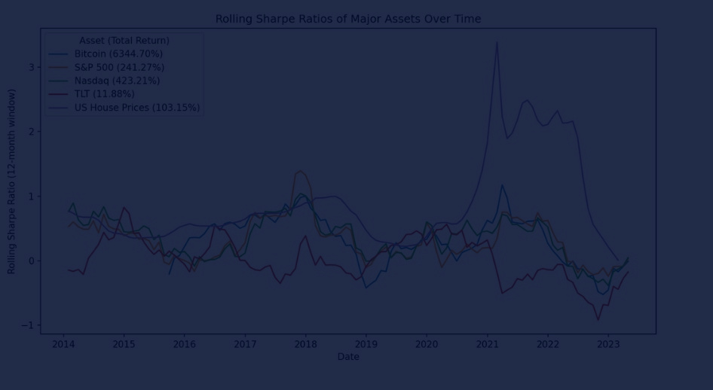
PERFORMANCE METRIC OUTLINE
Choose Key KPIs: Sharpe Ratio, Sortino Ratio, Annualized Return, Win/Loss Ratio, Average Trade Duration.
Calculation and Data Sources: Define formulae and identify reliable sources.
Relevance to Strategies: Align KPIs with chosen strategies for meaningful insights.

Slide 7
THANK
YOU

