Slide 1
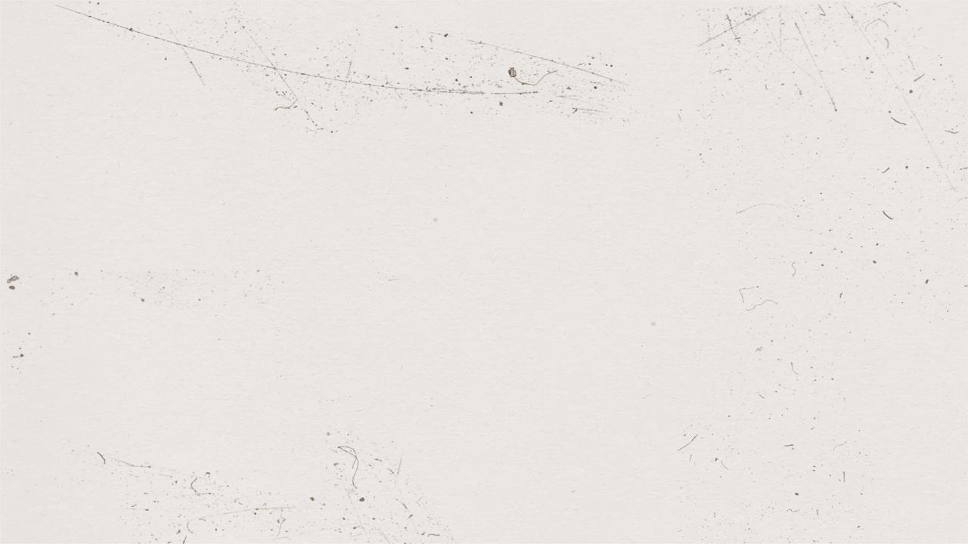


E-health-Care-Management-System

Slide 2
Table of contents
01
02
03
04
About the Project
Requirements
OOPs Concepts Used
Demonstration
05
06
Aid of OOP to build the project
Lessons Learnt
07
Team Contributions

Slide 3

01
About The Project

Slide 4
E-Health Management system provides comprehensive, effective and efficient solution for carrying out management of hospitals and clinics fulfilling the needs and requirements of all stakeholders such as doctors, patients and staffs.
With the increase in volume of patients in
the health care institutes, traditional method
of management has gone out of phase. As
a result of this, an advanced Health Care
Management System has been the demand
of time.
There are many advantages of E-HMS :
>Reduction in Errors
>Data storage and security
>Improved Patient Care
>Cost efficient

Slide 5
We in this project have made an E-HMS which provides functionalities such as :
>Appointment system
> Patient record facility
>Doctor’s details and
>Printing patients bill.

Slide 6
02
What We Have Used

Slide 7
To get a clear understanding of what we have covered, we will present a class diagram of our project. This will give us an Idea of the program distribution and flow as well.

Slide 8
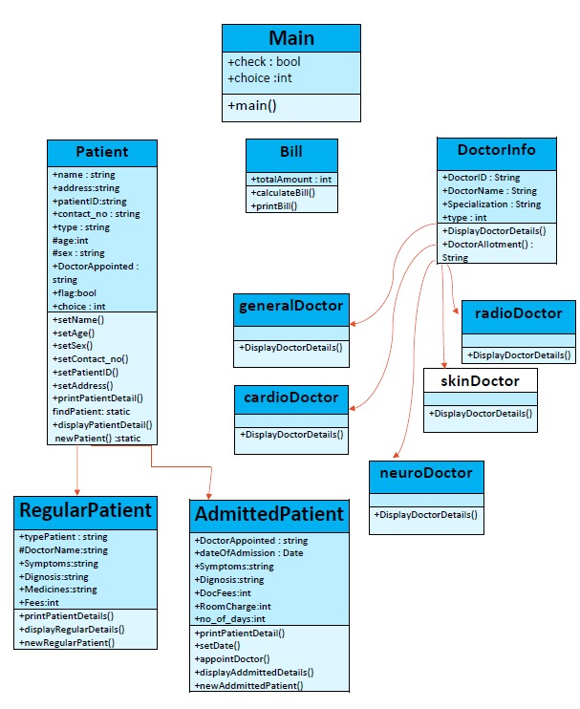

Slide 9

03
OOPs Concepts Used

Slide 10
In Patient Class
Encapsulation using Access Specifiers:-
→name,address,patientID,contact_no,type,DoctorAppointed – are defined to be public to make it access throughout the entire program
→age,sex – are defined to be protected which will be accessible throughtout the package.
Inheritance:-
→class RegularPatient extends Patient the code defined in the parent class can be used without re-writing it.
→Similarly, AddmittedPatient extends Patient class.

Slide 11
In Patient Class
Polymorphism : Method Overriding(runtime polymorphism):-
→Abstract method printPatientDetail is overrided in both child class.
Exception Handling : -
→Exception handling on method setAge( ) using try-catch block for taking valid inputs only.

Slide 12
In DoctorInfo Class
Polymorphism: Method overloading(compile time polymorphism)-
→ Overloading DisplayDoctorDetails( ) method in its subclasses.
this Keyword:-
→String DoctorID, DoctorName, Specialization is called in the constructor using this keyword which helps to use same variable name for both local and instance variables

Slide 13
super keyword:-
→Super keyword is used to access entities of parent class from the sub-class.
→Thus variables DoctorID, DoctorName, Specialization are called in each subclass.
Inheritance:-
→cardioDoctor extends DoctorInfo class to reuse the code of parent class.
→Similarly, skinDoctor extends DoctorInfo, neuroDoctor extends DoctorInfo, generalDoctor extends DoctorInfo, radioDoctor extends DoctorInfo..
static block:-
→If one needs to do the computation in order to initialize the static variables, one can declare a static block that gets executed exactly once, when the class is first loaded.
→Thus l1, l2, l3, l4, l5 lists are used according to the type of doctors required.

Slide 14
04
Demonstration
We’ll now run our code and see its output !

Slide 15


Slide 16
05
How OOP helped us to develop the EHMC

Slide 17
Advantages of OOP and its role in building the E-HMS
Code Reusability:
Through inheritance, the same attributes of a class are not required to be written repeatedly, they can be inherited by another class by simply extending the class. In doing so, time is saved, and the need for extra coding is eliminated as similar features can be inherited. For example:

Slide 18
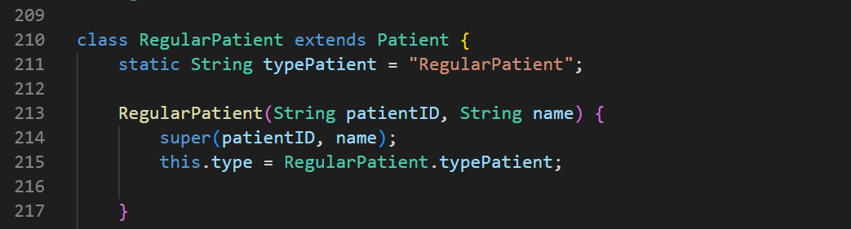
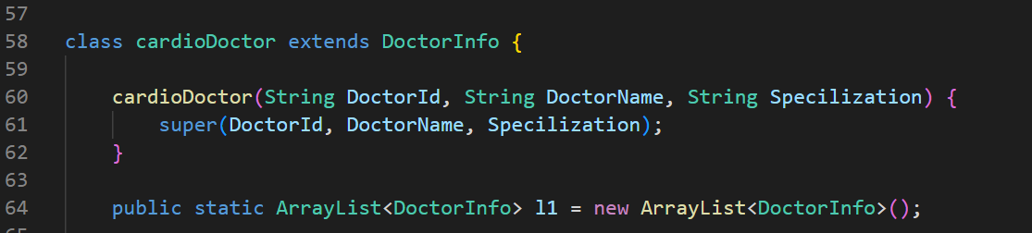
RegularPatient extends Patient class
cardioDoctor extends DoctorInfo class

Slide 19
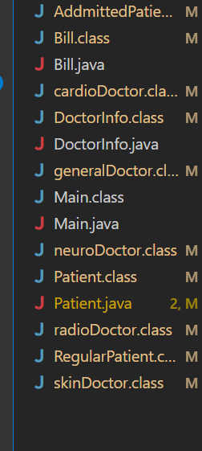
2. Efficient Problem Solving:
If a complex problem is broken down into smaller pieces or components, it becomes a good programming practice. Classes helps us to do so. This also makes the code clean & understandable. For example in our E-HMS we’ve divided our whole program into:
Main class
Bill class
DoctorInfo class
Patient class

Slide 20
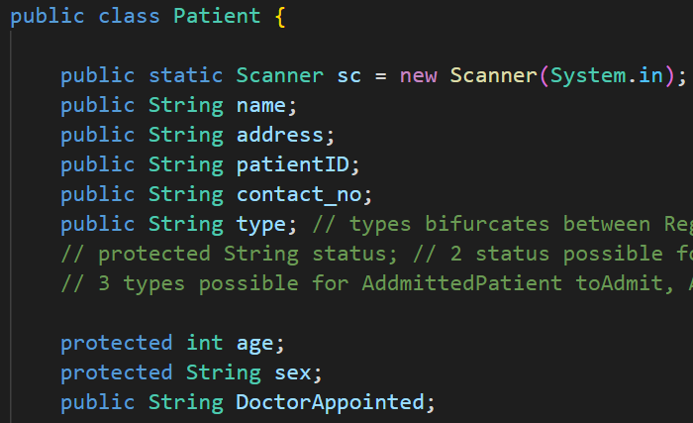
3. Security:
Because of the concept of Encapsulation in OOPS and use of access modifiers , it helps us to control what part of a program can access the members of a class. So that misuse of data can be prevented.

Slide 21
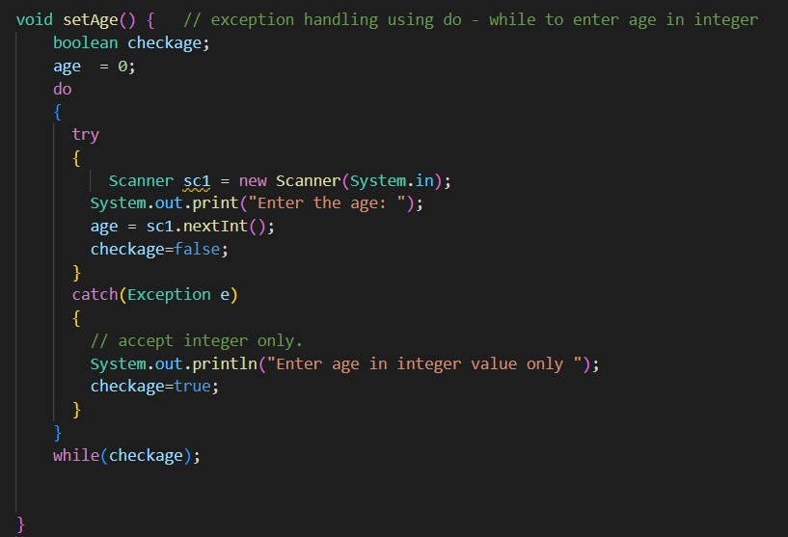
4. Error handling:
Using the concept of Exception Handling in OOPS we separate code that detects and handles exceptional circumstances from the rest of the program.

Slide 22
06
Lessons Learnt

Slide 23
By the completion of the E-HMS…
We got to know about a model of the actual E-HMS, which helped us to think of how data management is done in large hospitals. This made us excited to dive into the real world problems associated with the HMS.
We knew the importance of Data Management in any field of occupation.
The landscape of healthcare is ever changing. We must have an analytical eye and a willingness to adapt for the betterment of existing E-HMS.
We knew the importance of comments in any Programme.

Slide 24
By the completion of the E-HMS…
In short, a good hospital management system would make it easier to scale up the hospital network by easily managing the resources, avoiding wastage, making an efficient workforce, and a better management of data.
Since this was a group project, it helped us identify the strengths and weaknesses of each member and, consequently, distribute work accordingly, enabling us to produce the best results possible. Later, by working together, the weaknesses were also overcome.
After finishing the project, we realized how OOP could be used to solve real-world problems, which encouraged us to examine other topics in depth.

Slide 25
07
Team Contribution

Slide 26
Pranav Patel(202103040)- Developed the Patient class and the Bill class, implemented all the required functions and checked for errors in the code.
Dhruv Shah(202103017)- Developed the Main class, and ensured that all other classes are being called from the Main class, and resolved the encountered errors. Designed the output console.
Parag Sharma(202103004)- Developed the Doctor class and its methods , which includes hard-coding the required data of Doctors into the class, and resolved errors in the Doctor class.
Vatsal Shah(202103022)- Developed required functions/methods of the Doctor class. Made the Project Presentation including all the details of the project.
Shruti Verma(202103027)- Developed functions/methods of the Patient class. Made the Project Presentation including all the details of the project.

Slide 27
Thank You!
For The E-HMS code click on the following link
Group 1
Vatsal Shah - 202103022
Dhruv Shah - 202103017
Parag Sharma - 202103004
Pranav Patel -202103040
Shruti Verma - 202103027

