Slide 4
Group – II

Slide 5
Group – II
Predicting Potential Revenue Grid

Slide 6
Project Overview

Slide 7
Project Overview

Slide 8

Project Overview

Slide 9
Project Overview
A Bank is on a massive digital transformation for increasing its revenue as well as customer base. The Bank has a wide customer base where the classes are bifurcated as:-
High Revenue (1)
Low Revenue (2)

Slide 10


Project Overview
A Bank is on a massive digital transformation for increasing its revenue as well as customer base. The Bank has a wide customer base where the classes are bifurcated as:-
High Revenue (1)
Low Revenue (2)

Slide 11
Project Overview

Slide 12
Project Overview
The Bank wants to run a campaign that offers the high revenue customers some attractive deals on these new digital platforms
By earning new customers through the existing customer base whose family members may have accounts in other banks. Offering them attractive offers and deals for different products.

Slide 13
Data Cleaning

Slide 14
brown jumps over The lazy quick fox the dog

Slide 15
The quick brown fox jumps over the lazy dog

Slide 16
Imputation

Slide 17
Imputation

Slide 18
Imputation
Some features are imputed using Mode where the missing values are less than 5%

Slide 19
Imputation
Some features are imputed using Mode where the missing values are less than 5%
Some features are imputed on basis of logic like:

Slide 20
Imputation
Some features are imputed using Mode where the missing values are less than 5%
Some features are imputed on basis of logic like:
Occupation of a person age above than 65, have a higher chance of being “Retired”

Slide 21
Imputation
Some features are imputed using Mode where the missing values are less than 5%
Some features are imputed on basis of logic like:
Occupation of a person age above than 65, have a higher chance of being “Retired”
Some features are imputed with another dataset like: post_area

Slide 22
Imputation
Some features are imputed using Mode where the missing values are less than 5%
Some features are imputed on basis of logic like:
Occupation of a person age above than 65, have a higher chance of being “Retired”
Some features are imputed with another dataset like: post_area
All the left features, the “Unknown” value is treated like a missing value itself

Slide 23
Encoding

Slide 24
Encoding
Nominal Encoding

Slide 25
Encoding
Nominal Encoding

Slide 26
Encoding
Nominal Encoding
When a feature does not show any order or when the subcategories are less we use Nominal Encoding aka One Hot Encoding

Slide 27
Encoding
Nominal Encoding
When a feature does not show any order or when the subcategories are less we use Nominal Encoding aka One Hot Encoding
Color
Red
Blue
Yellow
Color_Red | Color_Blue | Color_Yellow
1 | 0 | 0
0 | 1 | 0
0 | 0 | 1

Slide 28
Encoding
Nominal Encoding
When a feature does not show any order or when the subcategories are less we use Nominal Encoding aka One Hot Encoding
When drop_first = True
Color
Red
Blue
Yellow
Color_Red | Color_Blue
1 | 0
0 | 1
0 | 0

Slide 29
Encoding
Nominal Encoding
When a feature does not show any order or when the subcategories are less we use Nominal Encoding aka One Hot Encoding
Nominal Encoded Features:-
Gender
Children
Self Employed
Self Employed Partner

Slide 30
Encoding
Ordinal Encoding

Slide 31
Encoding
Ordinal Encoding

Slide 32
Encoding
Ordinal Encoding
When a feature shows a form of order or has a good frequency distribution, we can assign a rank to it

Slide 33
Encoding
Ordinal Encoding
When a feature shows a form of order or has a good frequency distribution, we can assign a rank to it
Ordinal Encoded Features:-
Family Income
Occupation
Occupation_partner

Slide 34
Encoding
Mean Encoding

Slide 35
Encoding
Mean Encoding

Slide 36
Encoding
Mean Encoding

Slide 37
Encoding
Mean Encoding
When we rank or assign a probability value according to the distribution of its feature with respect to one of the subcategories with respect to dependent column

Slide 38
Encoding
Mean Encoding
When we rank or assign a probability value according to the distribution of its feature with respect to one of the subcategories with respect to dependent column
Mean Encoded Features:-
Region
Post_Code
Post_Area
Age_band
TV_Area

Slide 39
Transformation

Slide 40
Transformation

Slide 41
Transformation

Slide 42
Transformation

Slide 43
Transformation
Makes record comparable within itself in a feature

Slide 44
Transformation
Benefits of Transformation

Slide 45
Transformation
Benefits of Transformation
Handles Outliers
Better Model Performance
Tries to maintain Normal Distribution.

Slide 46
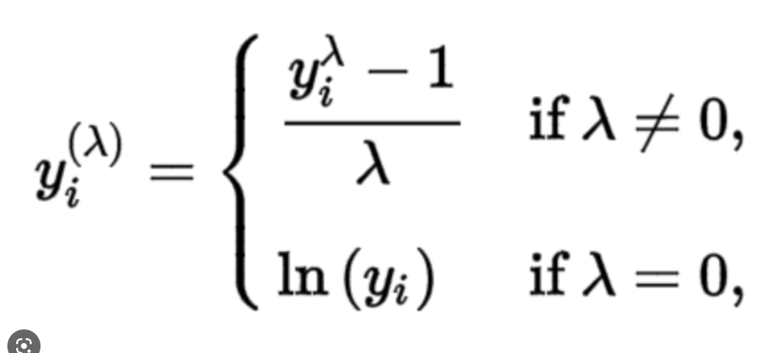
Transformation
Benefits of Transformation
Handles Outliers
Better Model Performance
Tries to maintain Normal Distribution.
Transformation Used:-
Box Cox,

Slide 47
Scaling

Slide 48
Scaling

Slide 49
Scaling

Slide 50
Scaling
When you scale different features to make them comparable to each other

Slide 51
Feature Selection

Slide 52
Feature Selection

Slide 53
Feature Selection

Slide 54
Feature Selection

Slide 55
Feature Selection
When you select features on the basis of decrease in node impurity, weighted by the probability of reaching that node

Slide 56
Feature Selection
Selected Features :-
['family_income', 'year_last_moved', 'Average.Credit.Card.Transaction’,
'Balance.Transfer', 'Term.Deposit', 'Life.Insurance', 'Medical.Insurance’,
'Average.A.C.Balance', 'Personal.Loan', 'Investment.in.Mutual.Fund’,
'Investment.Tax.Saving.Bond', 'Home.Loan', 'Online.Purchase.Amount’,
'Investment.in.Commudity', 'Investment.in.Equity', 'Investment.in.Derivative’,
'Portfolio.Balance', 'Investment_Portfolio', 'Total_Debt', 'Investment_Debt_Ratio']

Slide 57
Feature Construction

Slide 58
Feature Construction

Slide 59
Feature Construction
Introducing new parameters in dataset to increase model performance,
and find indirect relationship of features

Slide 60
Feature Construction
Introducing new parameters in dataset to increase model performance,
and find indirect relationship of features
Features Introduced:-

Slide 61
Feature Construction
Introducing new parameters in dataset to increase model performance,
and find indirect relationship of features
Features Introduced:-
Total Debt (Personal_loan + Home_Loan + Avg_Credit_Card_balance + Balance to transfer)

Slide 62
Feature Construction
Introducing new parameters in dataset to increase model performance,
and find indirect relationship of features
Features Introduced:-
Total Debt (Personal_loan + Home_Loan + Avg_Credit_Card_balance + Balance to transfer)
Total Investment (Term Deposit + Equity + Debentures + Tax Rate Bonds )

Slide 63
Feature Construction
Introducing new parameters in dataset to increase model performance,
and find indirect relationship of features
Features Introduced:-
Total Debt (Personal_loan + Home_Loan + Avg_Credit_Card_balance + Balance to transfer)
Total Investment (Term Deposit + Equity + Debentures + Tax Rate Bonds )
Total Investment / Total Debt ratio

Slide 64
Analysis

Slide 65
Statistical Analysis

Slide 66
Statistical Analysis

Slide 67
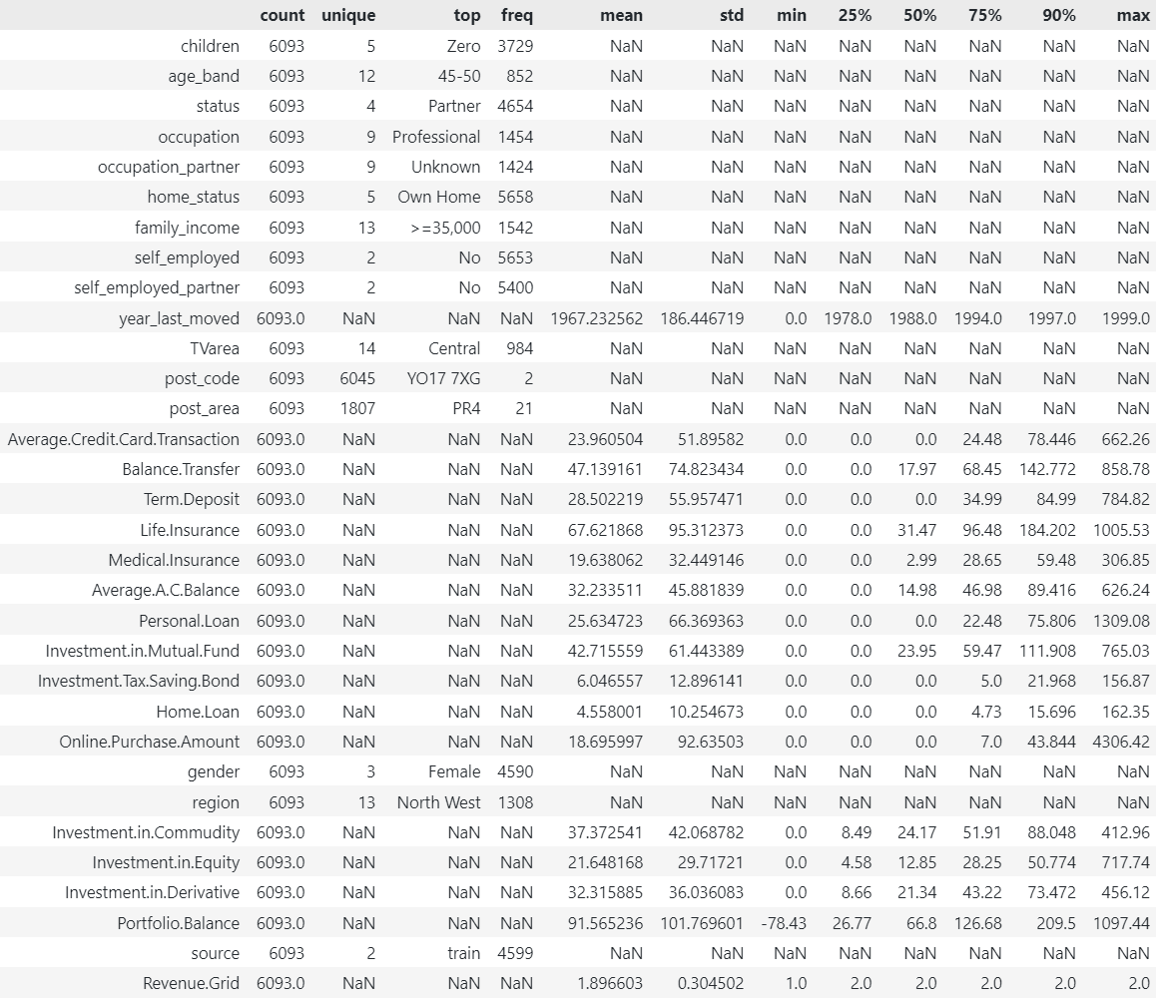
Statistical Analysis
stats_df =
Bi_Analysis.train.describe(
include="all",
percentiles=[0.25,0.5,0.75,0.9]
).T

Slide 69
High Standard Deviation

Slide 71
Upper bound Outliers

Slide 73
Most Frequent

Slide 75
Negative Value

Slide 76
Correlation Analysis

Slide 77
Correlation Analysis

Slide 78
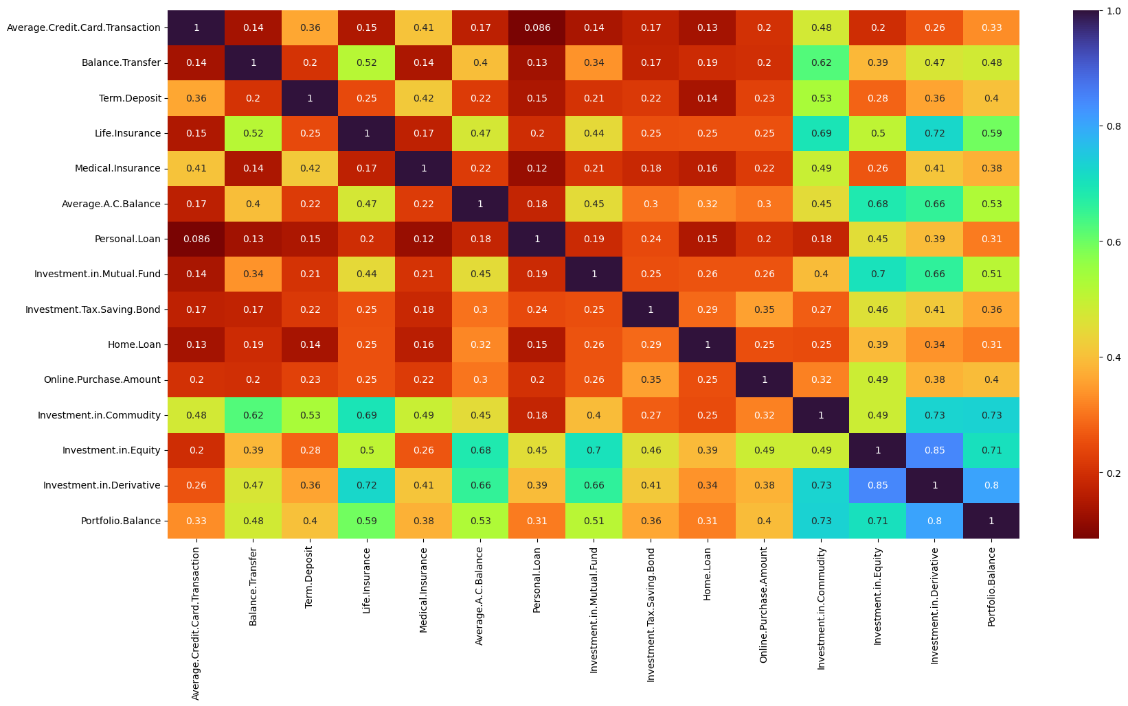
Correlation Analysis

Slide 79
Correlation Analysis

Slide 80
Correlation Analysis
High Multicollinearity
Issue

Slide 81
Family Analysis

Slide 82
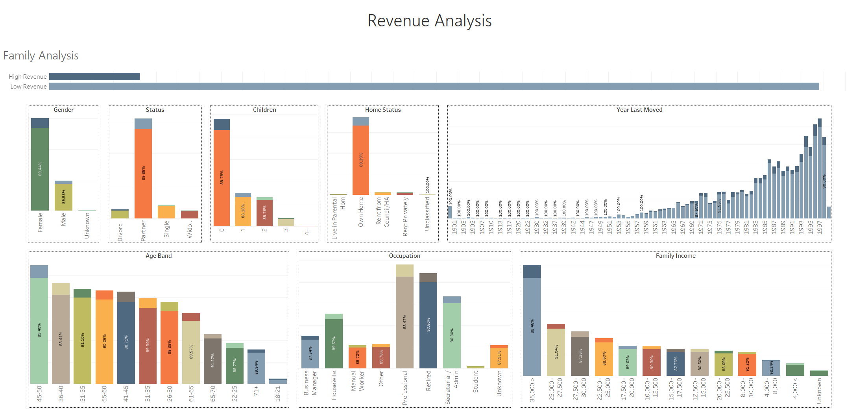
Family Analysis

Slide 83
Family Analysis

Slide 84
Family Analysis
Contributes mostly under Low Revenue

Slide 85
Family Analysis
Higher Distribution of
High Revenue
Contributes mostly under Low Revenue

Slide 86
Family Analysis

Slide 87
Family Analysis

Slide 88
Region Analysis

Slide 89
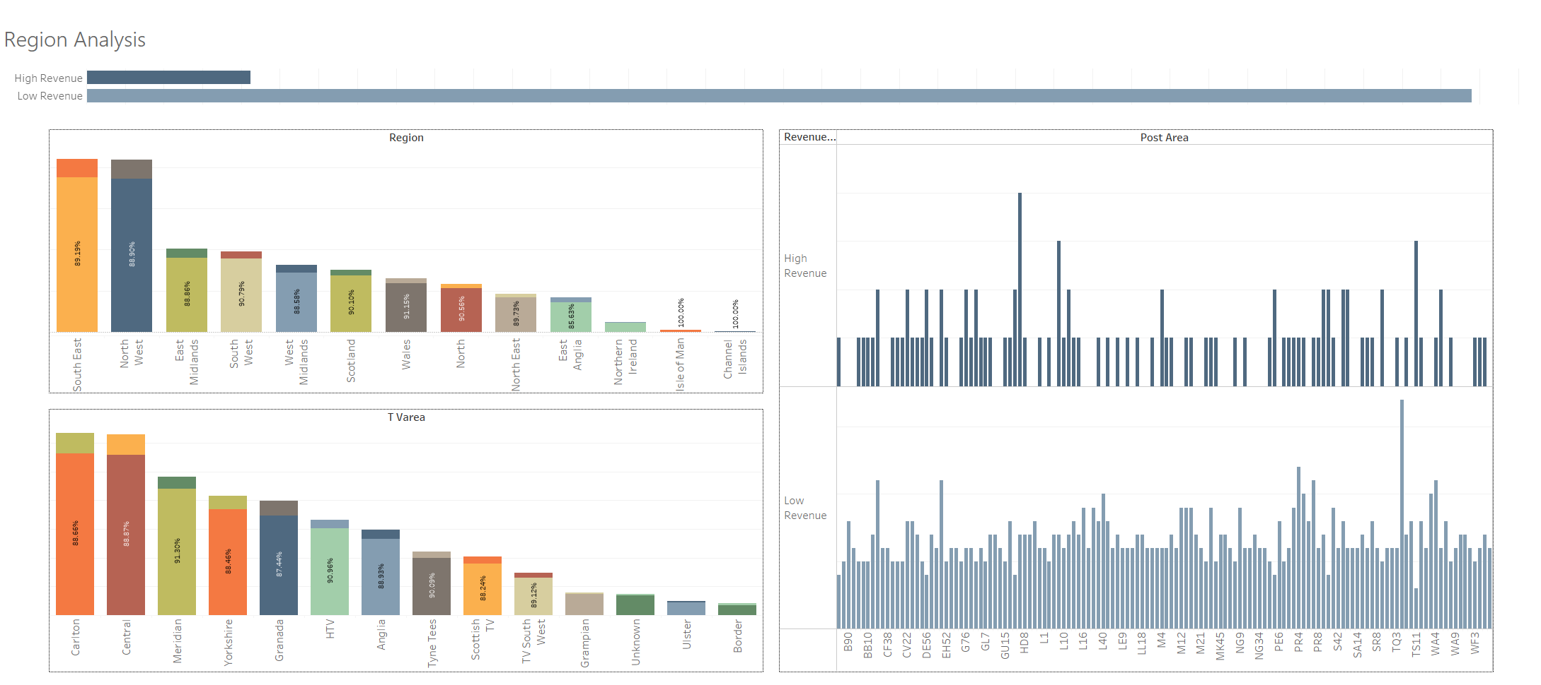
Region Analysis

Slide 90
Region Analysis

Slide 94
Region Analysis

Slide 95
Region Analysis

Slide 96
Insurance & Account Analysis

Slide 97
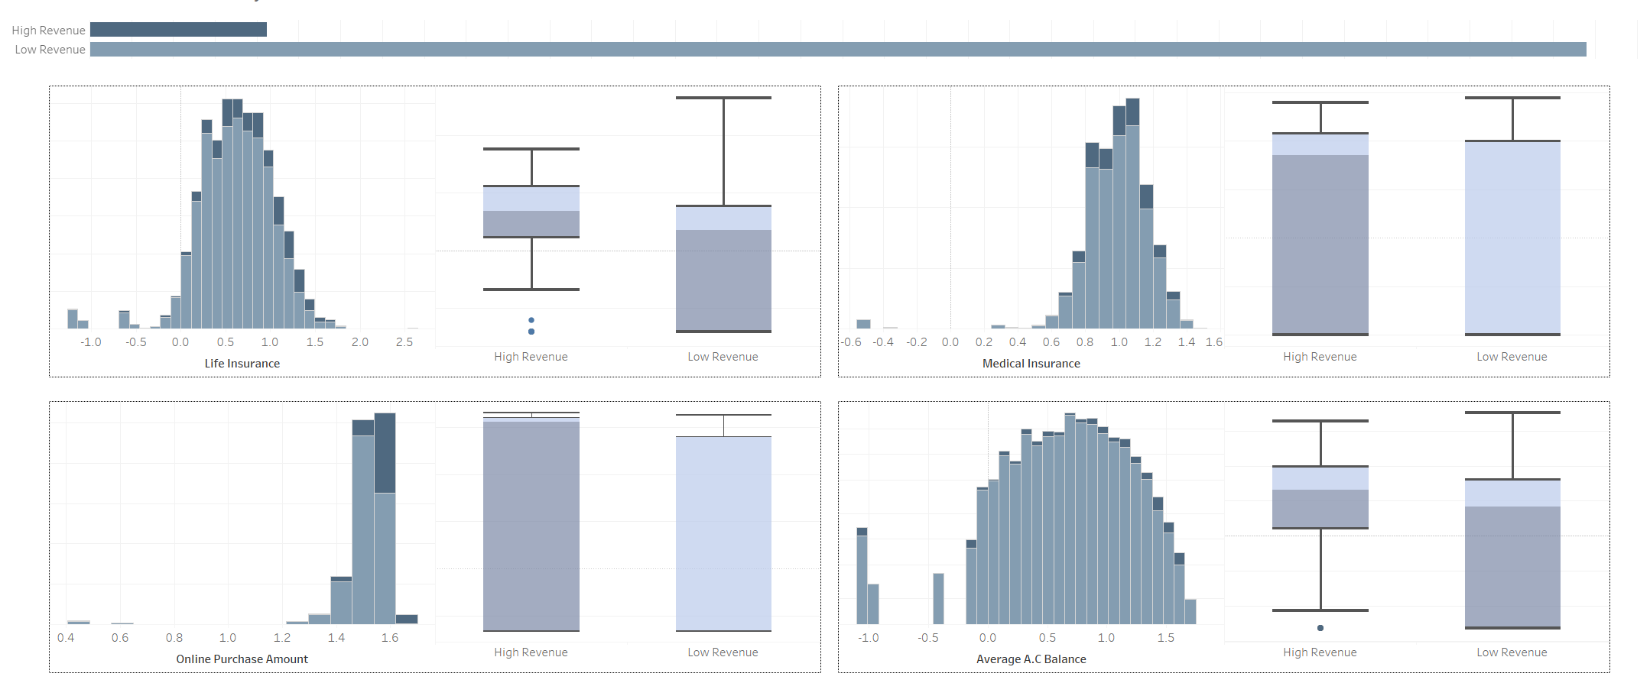
Insurance & Account Analysis

Slide 98
Loan Analysis

Slide 99
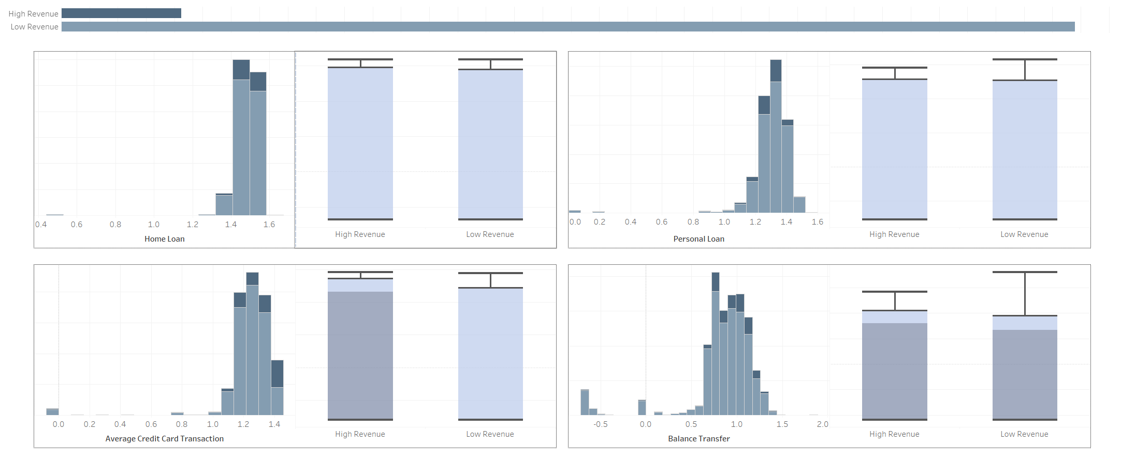
Loan Analysis

Slide 100
Loan Analysis
Indistinguishable Features

Slide 101
Loan Analysis

Slide 102
Investment Analysis

Slide 103
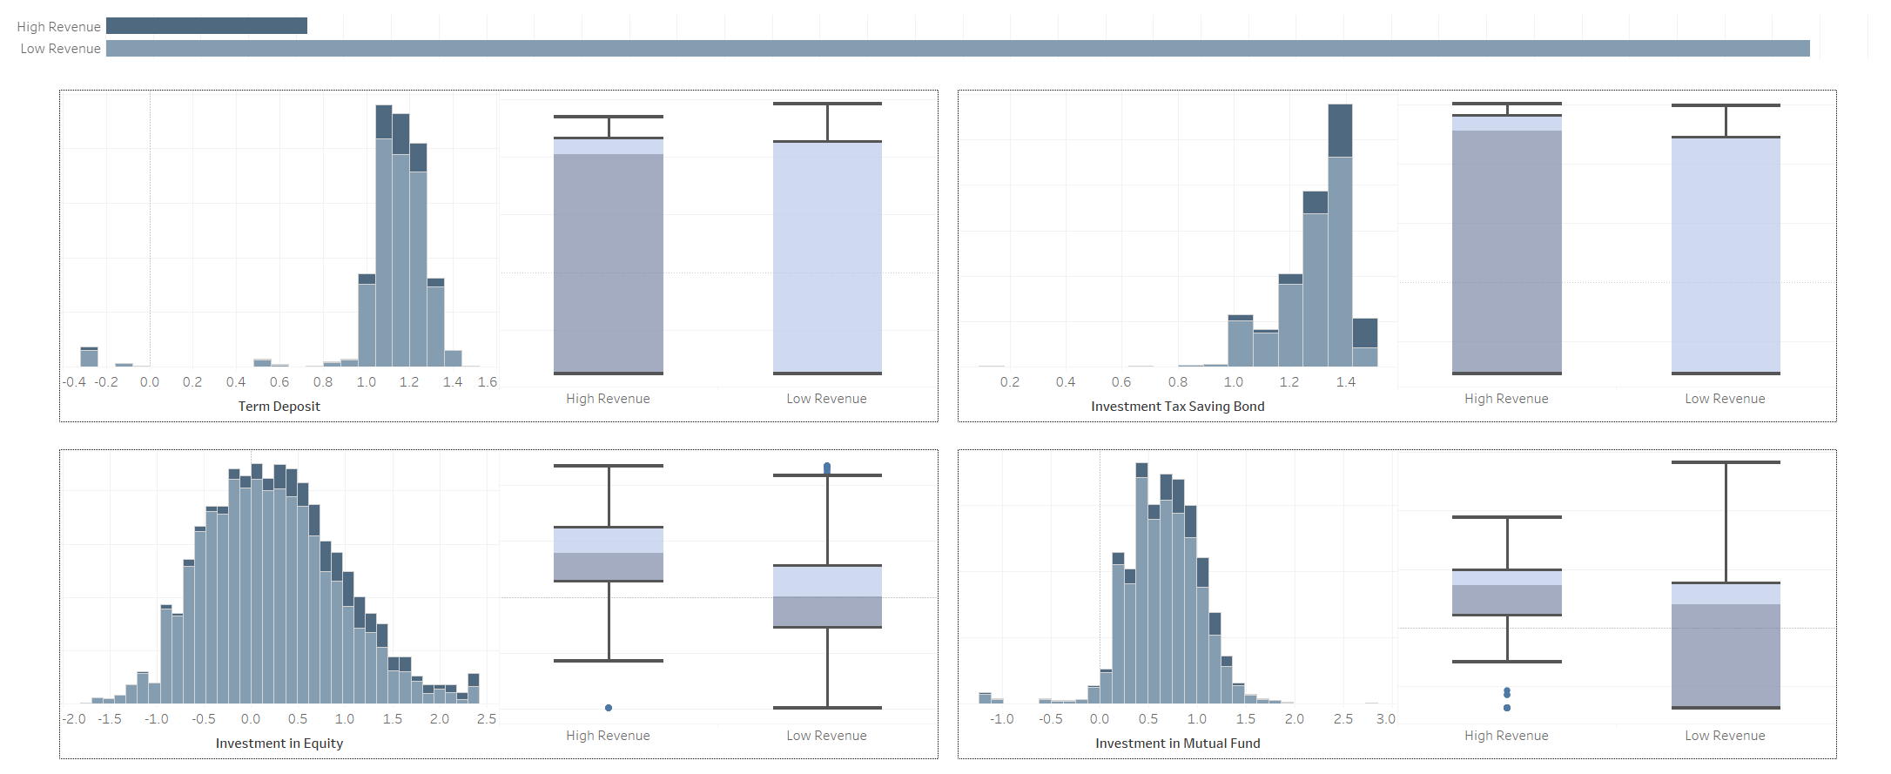
Investment Analysis

Slide 104
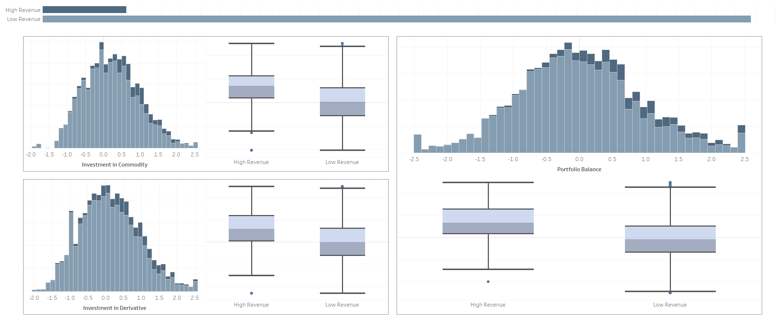
Investment Analysis

Slide 105
Model Development

Slide 106
Logistic Regression

Slide 107
Logistic Regression

Slide 108
Logistic Regression

Slide 109
Logistic Regression
1
Revenue Grid
0
Data Points for Binary Classification

Slide 110
Logistic Regression
1
Sigmoid Function forces
all values to lie
In range 0-1
Revenue Grid
0

Slide 111
Logistic Regression
1
Revenue Grid
0

Slide 112
Logistic Regression
Classification Report
1
precision recall f1-score support
0.0 0.96 0.34 0.51 233
1.0 0.92 1.00 0.96 1798
accuracy 0.92 2031
macro avg 0.94 0.67 0.73 2031
Revenue Grid
0

Slide 113
Logistic Regression
Classification Report
1
precision recall f1-score support
0.0 0.96 0.34 0.51 233
1.0 0.92 1.00 0.96 1798
accuracy 0.92 2031
macro avg 0.94 0.67 0.73 2031
Revenue Grid
0

Slide 114
Logistic Regression
Classification Report
1
precision recall f1-score support
0.0 0.96 0.34 0.51 233
1.0 0.92 1.00 0.96 1798
accuracy 0.92 2031
macro avg 0.94 0.67 0.73 2031
Revenue Grid
0

Slide 115
Logistic Regression
Classification Report
1
precision recall f1-score support
0.0 0.96 0.34 0.51 233
1.0 0.92 1.00 0.96 1798
accuracy 0.92 2031
macro avg 0.94 0.67 0.73 2031
Revenue Grid
Higher False Negatives in 0 classification
0

Slide 116
Random Forest

Slide 117
Random Forest

Slide 118
Random Forest
Similar to Decision Tree

Slide 119
Random Forest
Multiple Trees drawn with
random rows & column

Slide 120
Random Forest
Decision taken on Majority voting

Slide 121
Random Forest

Slide 122
Random Forest
0
1
1
0
1
0
0
1

Slide 123
Random Forest
0
1
1
0
1
0
0
1
precision recall f1-score support
0.0 0.78 0.78 0.78 233
1.0 0.97 0.97 0.97 1798
accuracy 0.95 2031
macro avg 0.88 0.87 0.87 2031
weighted avg 0.95 0.95 0.95 2031
Classification Report

Slide 124
Random Forest
0
1
1
0
1
0
0
1
precision recall f1-score support
0.0 0.78 0.78 0.78 233
1.0 0.97 0.97 0.97 1798
accuracy 0.95 2031
macro avg 0.88 0.87 0.87 2031
weighted avg 0.95 0.95 0.95 2031
Classification Report

Slide 125
Random Forest
Higher
False Negatives
Higher
False Positives
0
1
1
0
1
0
0
1
precision recall f1-score support
0.0 0.78 0.78 0.78 233
1.0 0.97 0.97 0.97 1798
accuracy 0.95 2031
macro avg 0.88 0.87 0.87 2031
weighted avg 0.95 0.95 0.95 2031
Classification Report

Slide 126
Support Vector Machines

Slide 127
Support Vector Machines

Slide 128
Support Vector Machines
Data Points for Binary Classification

Slide 129
Support Vector Machines
Support Vectors are chosen

Slide 130
Support Vector Machines
Marginal Planes are drawn

Slide 131
Support Vector Machines
On the basis of Marginal Planes, a hyperplane is chosen

Slide 132
Support Vector Machines
Soft marginal Plane, Most ideal situation

Slide 133
Support Vector Machines

Slide 134
Support Vector Machines
Hyper tuned

Slide 135
Support Vector Machines
Hyper tuned
C

Slide 136
Support Vector Machines
Hyper tuned
C

Slide 137
Support Vector Machines
Hyper tuned
C

Slide 138
Support Vector Machines
Hyper tuned
C
Kernel

Slide 139
Support Vector Machines
Hyper tuned
C
Kernel
Gamma

Slide 140
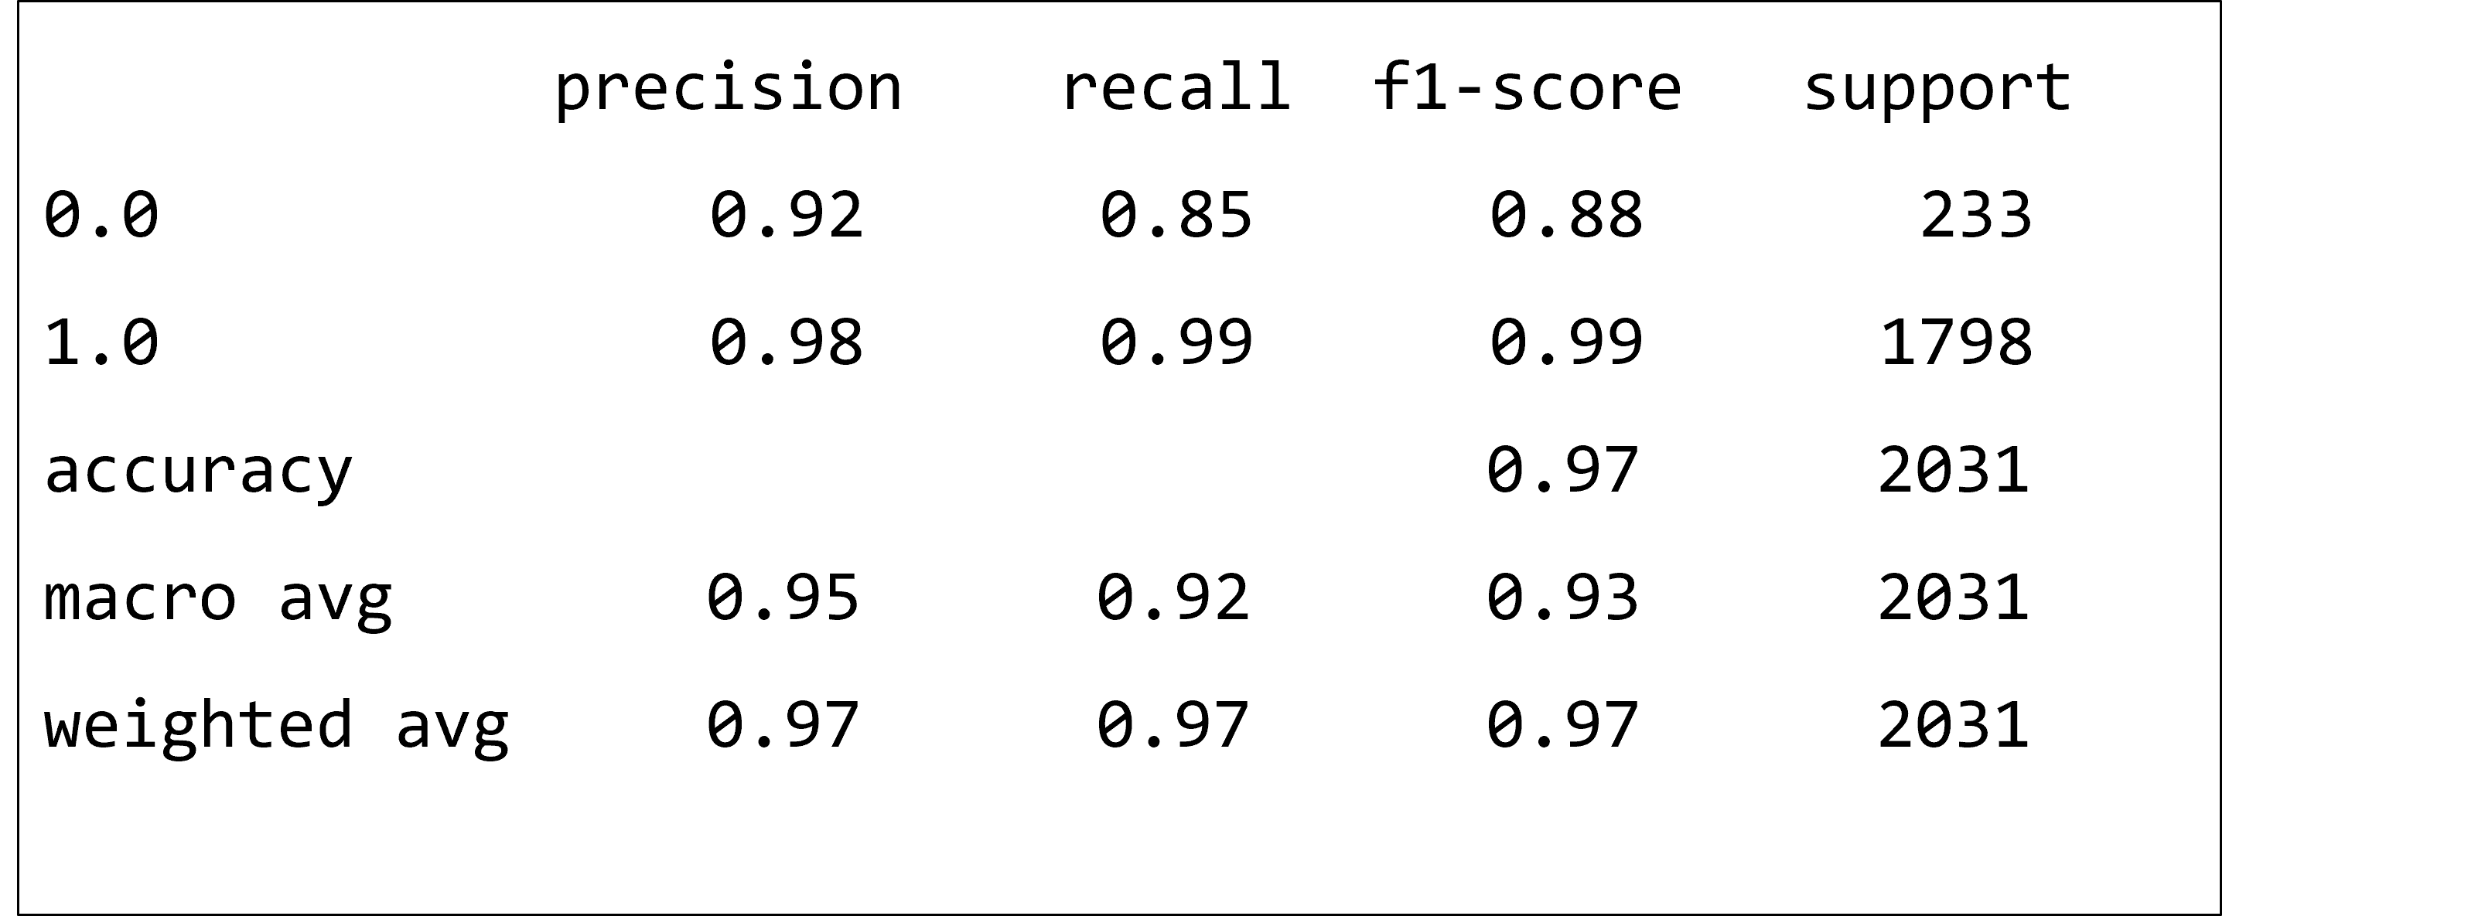
Support Vector Machines
Hyper tuned
Classification Report

Slide 141
Support Vector Machines
Hyper tuned
Classification Report
There are some False Negatives, but overall performance seems good
precision recall f1-score support
0.0 0.92 0.85 0.88 233
1.0 0.98 0.99 0.99 1798
accuracy 0.97 2031
macro avg 0.95 0.92 0.93 2031
weighted avg 0.97 0.97 0.97 2031

Slide 142
Support Vector Machines
Hyper tuned
Classification Report
There are some False Negatives, but overall performance seems good
Model is normally fitted with a Training Accuracy of 99%
precision recall f1-score support
0.0 0.92 0.85 0.88 233
1.0 0.98 0.99 0.99 1798
accuracy 0.97 2031
macro avg 0.95 0.92 0.93 2031
weighted avg 0.97 0.97 0.97 2031

Slide 143
Decile Analysis

Slide 144
Decile Analysis

Slide 145
Decile Analysis

Slide 146
Decile Analysis

Slide 147
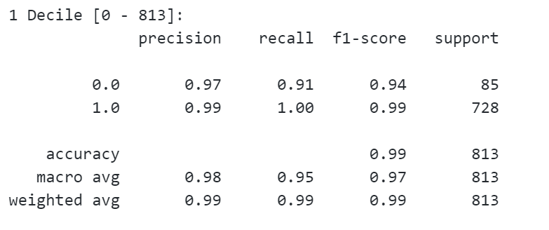
Decile Analysis

Slide 148
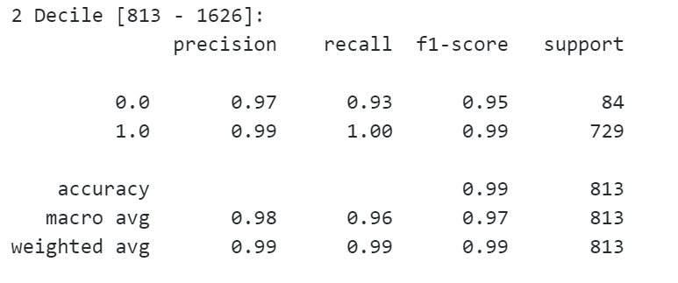
Decile Analysis

Slide 149
Decile Analysis

Slide 150
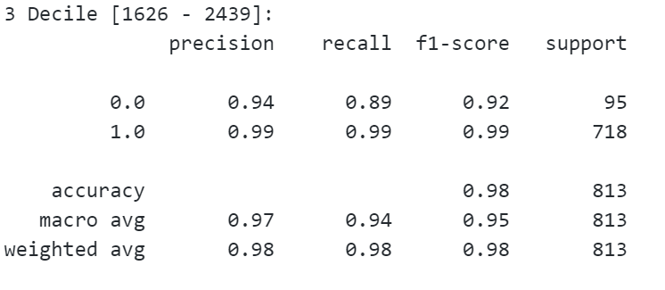
Decile Analysis

Slide 151
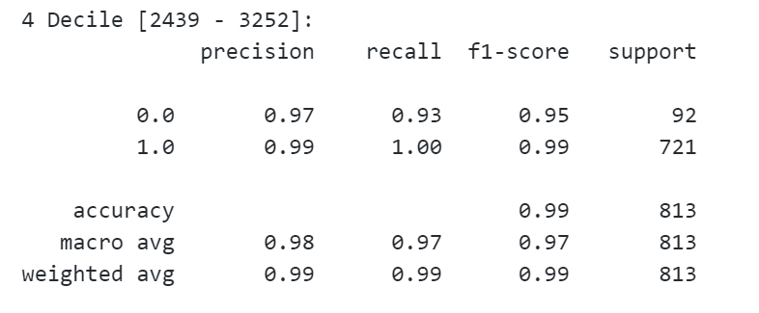
Decile Analysis

Slide 152
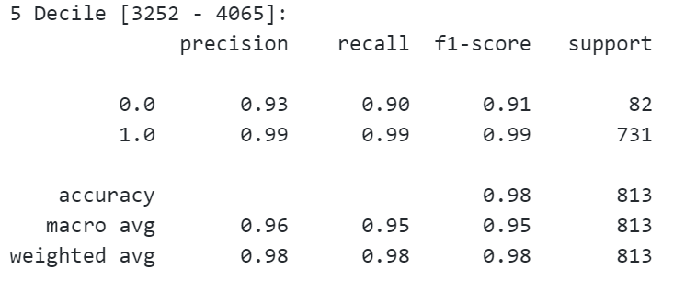
Decile Analysis

Slide 153
Decile Analysis

Slide 154
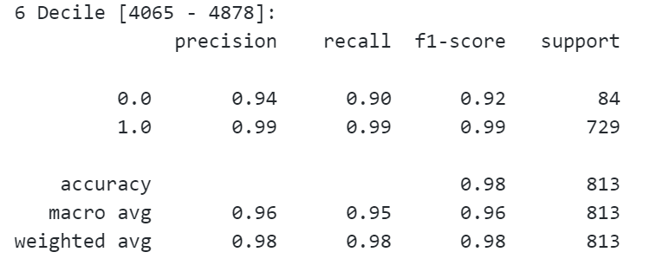
Decile Analysis

Slide 155
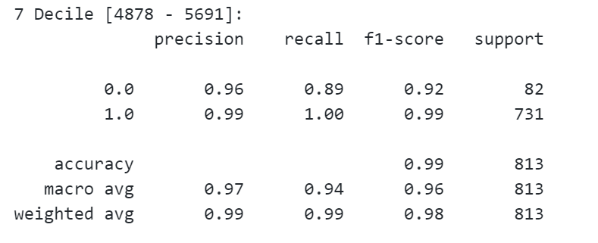
Decile Analysis

Slide 156
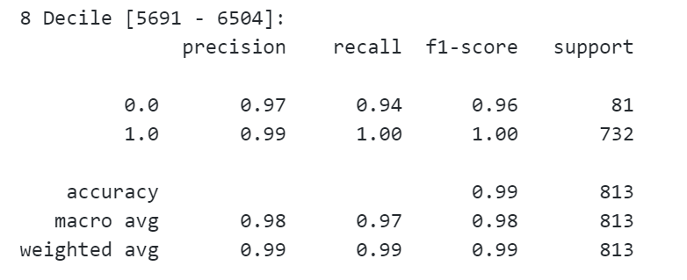
Decile Analysis

Slide 157
Decile Analysis

Slide 158
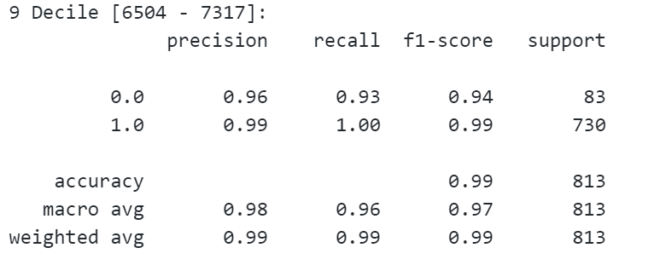
Decile Analysis

Slide 159
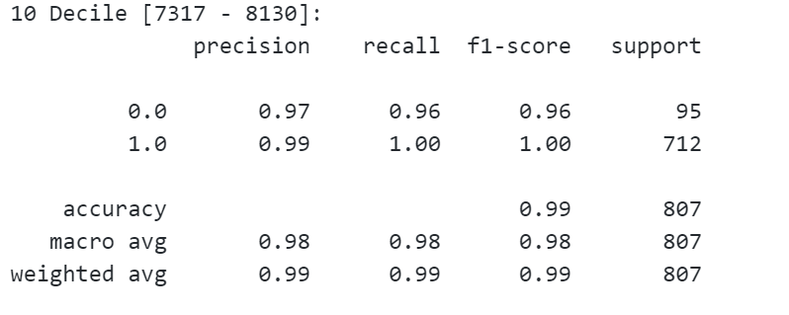
Decile Analysis

Slide 160
Decile Analysis

Slide 161
Decile Analysis
8th & 10th decile are performing best

Slide 162
Thank You

