Slide 1
Project CS322/CS321
Simulating X86 on Gem5

Slide 2
Aim:-
To use Gem5 to simulate X86 processor in System Call Emulation Mode(SE) and conduct the following 3 experiments:-
Observe how IPC, No. of CPU cycles, L1 cache miss rate and miss latency change as we vary the size of L1 cache keeping everything else constant.
Observe how IPC and No. of CPU cycles change as we vary the number of physical int register keeping everything else constant.
Observe how No. of CPU cycles, No. of L1 Miss and AVG. Miss latency changes as we vary L1 cache associativity keeping everything else constant.

Slide 3
Steps to install gem5

Slide 4
Installation Without Docker
Setup scons
Download from here
cd scons-3.1.0 in my case
python setup.py install
Install zlib
apt-get install zlib1g-dev
Install Boost, issues faced on some machine
apt-get install libboost-all-dev
Installing m4 Macro Processor on Ubuntu Linux
wget ftp://ftp.gnu.org/gnu/m4/m4-latest.tar.gz
tar -xvzf m4-latest.tar.gz
cd m4-1.4.17 in my case
./configure
make
make install
Good to Delete m4-latest.tar.gz
git clone http://www.github.com/gem5
cd gem5
scons build/X86/gem5.opt

Slide 5
Installation Using Docker
Download and install docker on your system.
Download the docker image from https://github.com/harshkasyap/Gem5
Just Run this command
docker run --name gem5 -it gem5/gem5 /bin/bash
scons build/X86/gem5.opt
Commands of docker:-
docker stop gem5
docker start gem5

Slide 6
Various Benchmarks Used:-
SPEC CPU2000 (Bzip2)
MiBench (BitCount)
SciMark2.0 (Monte Carlo, LU, SOR, SparseMat_Mul)
Splash2 (FFT)

Slide 7
Experiment 1

Slide 8
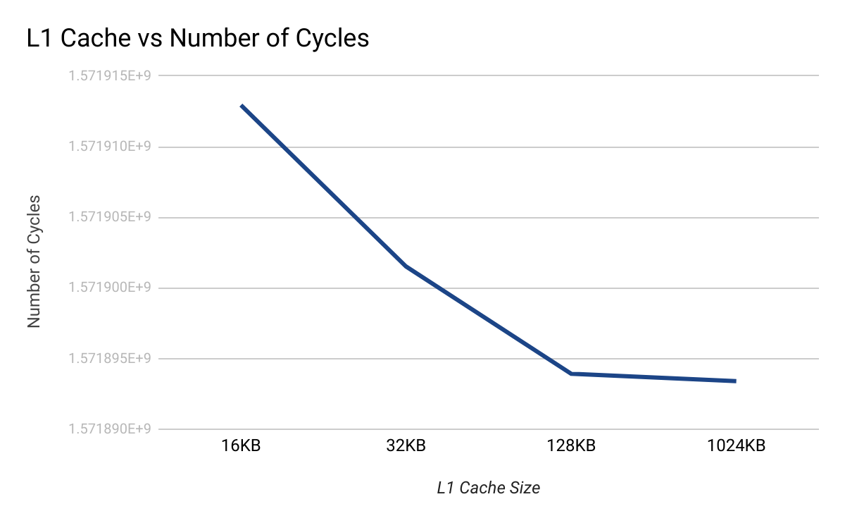
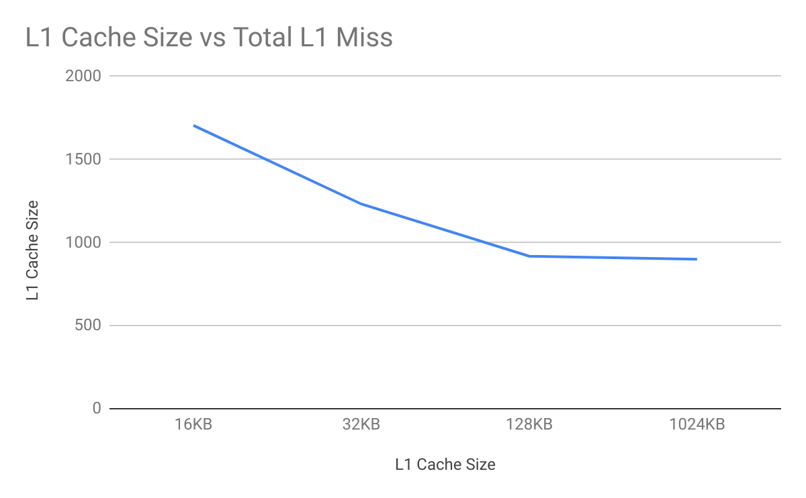
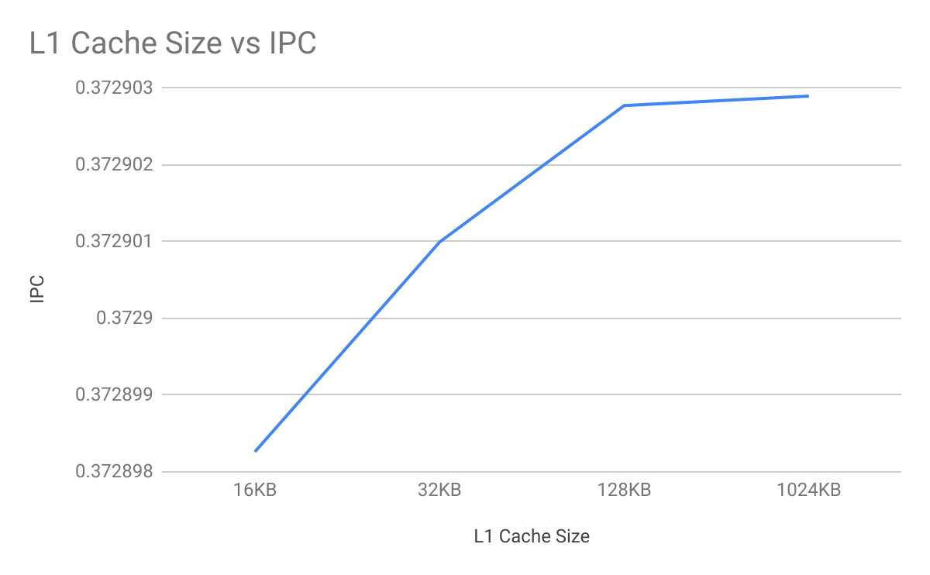
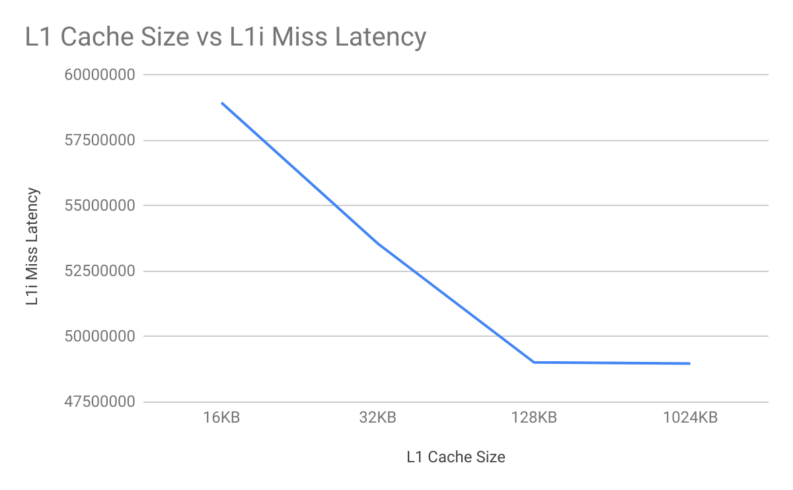
MiBench (BitCount):-

Slide 9
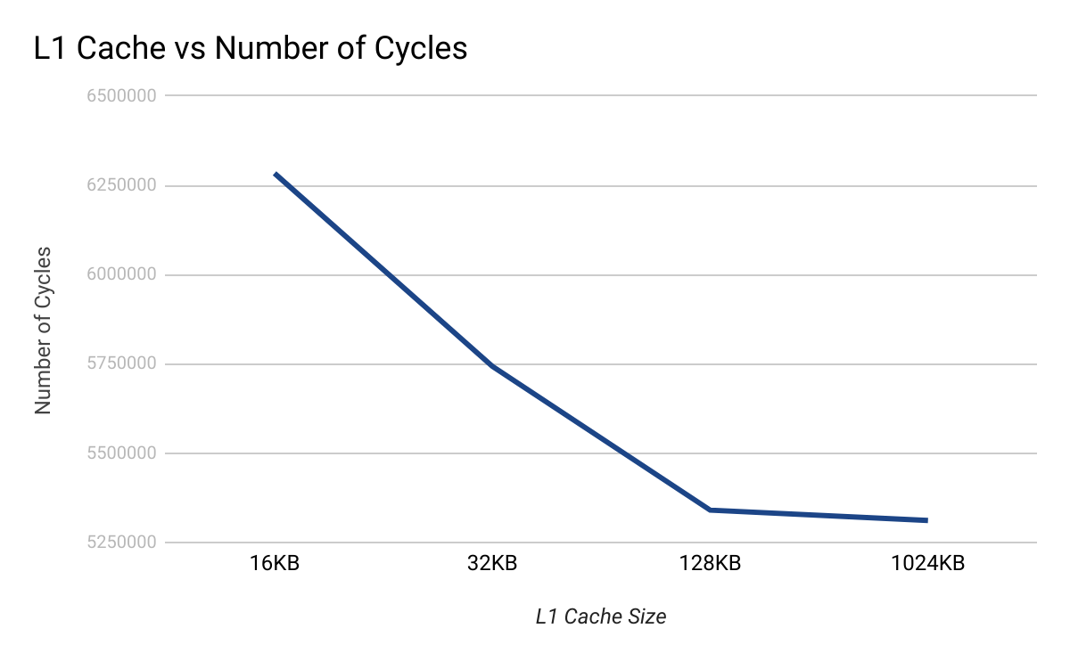
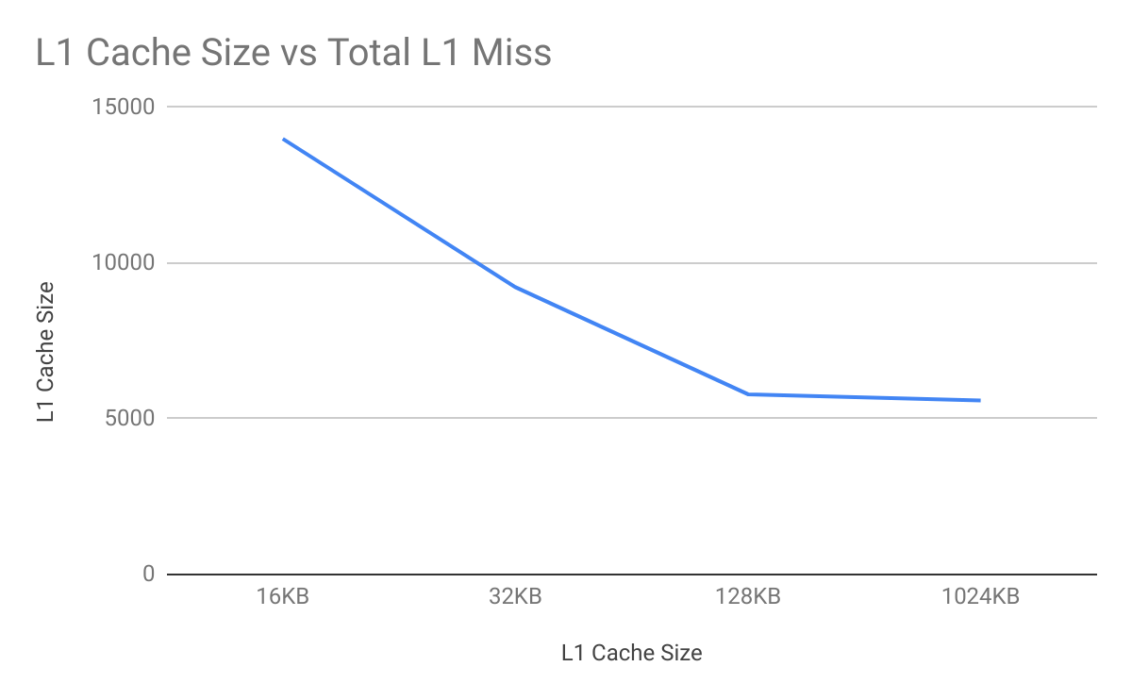
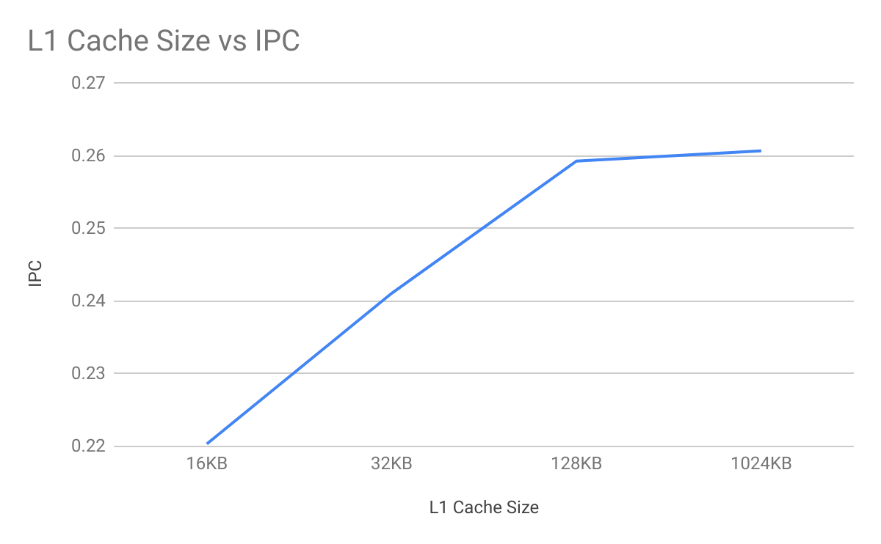
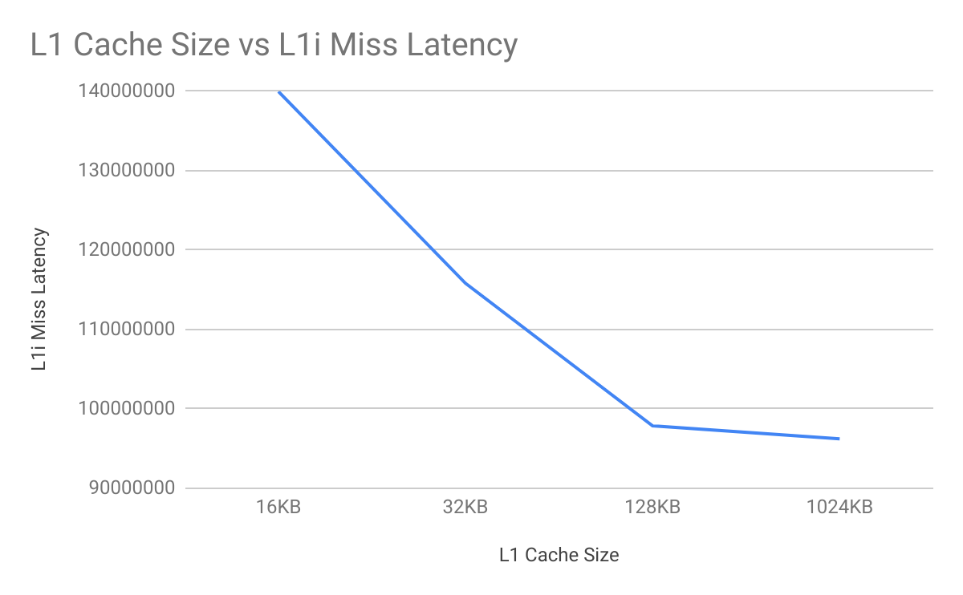
Splash2 (FFT):-

Slide 10
MiBench (BitCount):-
L1 Cache Size | Total CPU Cycles | Avg. IPC | Total L1 Miss | Overall L1i miss latency
16KB | 1571912939 | 0.37289826138 | 1705 | 58948000
32KB | 1571901515 | 0.37290099373 | 1232 | 53562500
128KB | 1571893919 | 0.37290277347 | 918 | 49017500
1024KB (1MB) | 1571893395 | 0.37290289778 | 899 | 48975500
Splash2 (FFT):-
L1 Cache Size | Total CPU Cycles | Avg. IPC | Total L1 Miss | Overall L1i miss latency
16KB | 6283776 | 0.2203504708 | 13993 | 139968000
32KB | 5743338 | 0.24109098228 | 9227 | 115811500
128KB | 5340448 | 0.25930315209 | 5786 | 97858000
1024KB (1MB) | 5311612 | 0.26071162577 | 5587 | 96216000

Slide 11
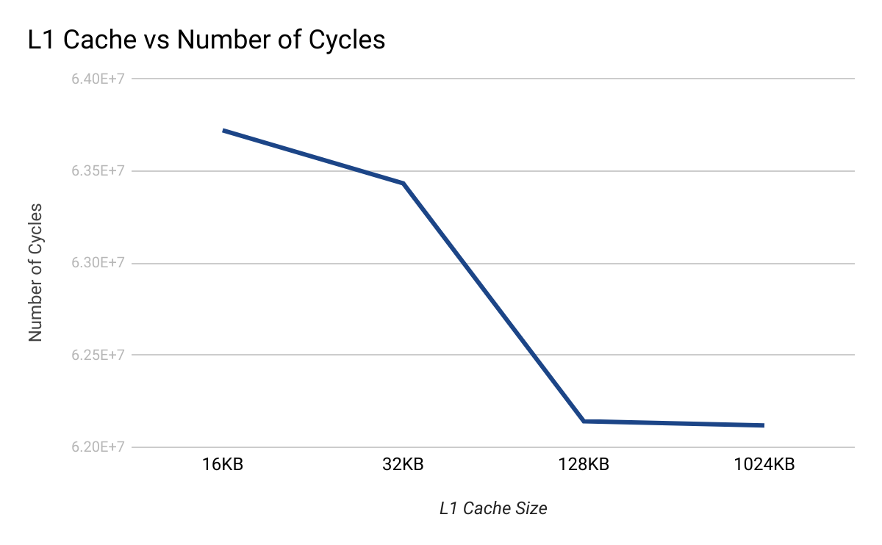
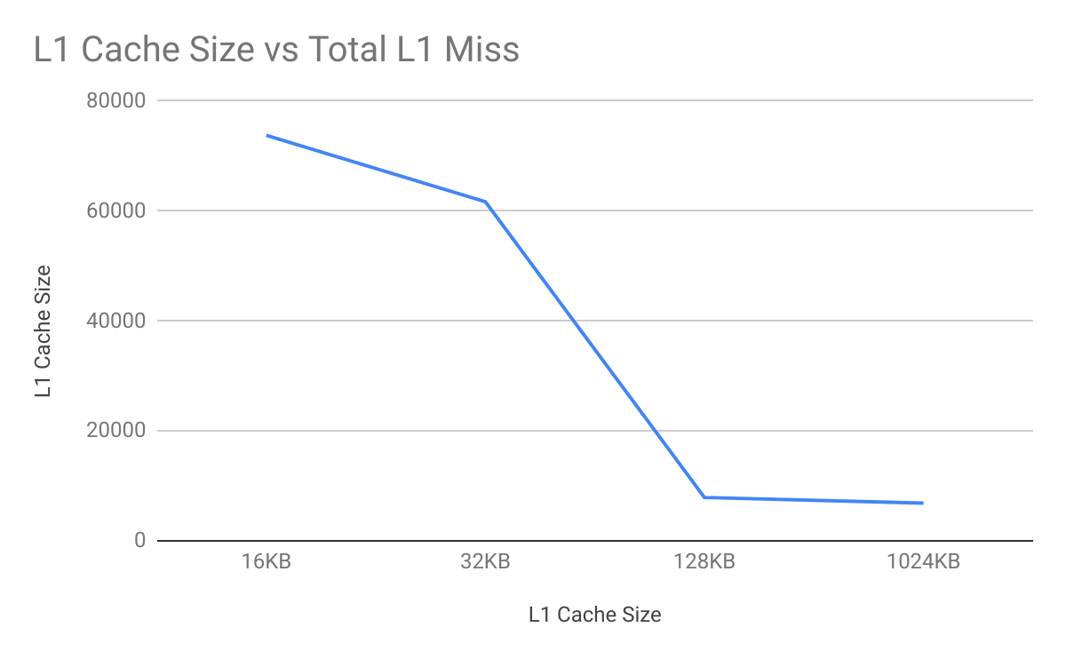
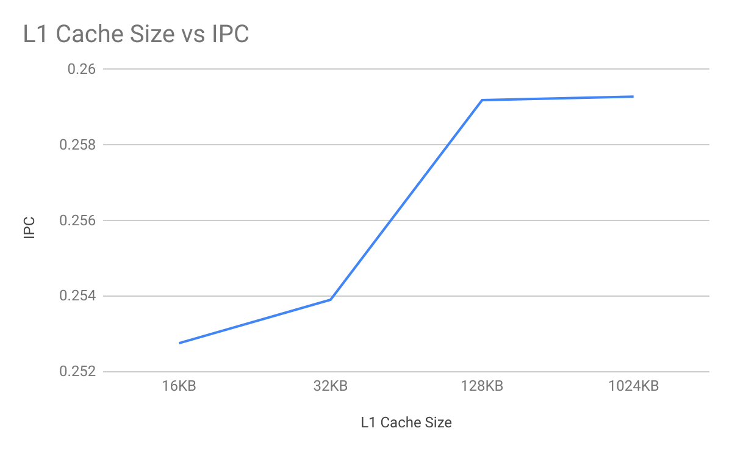
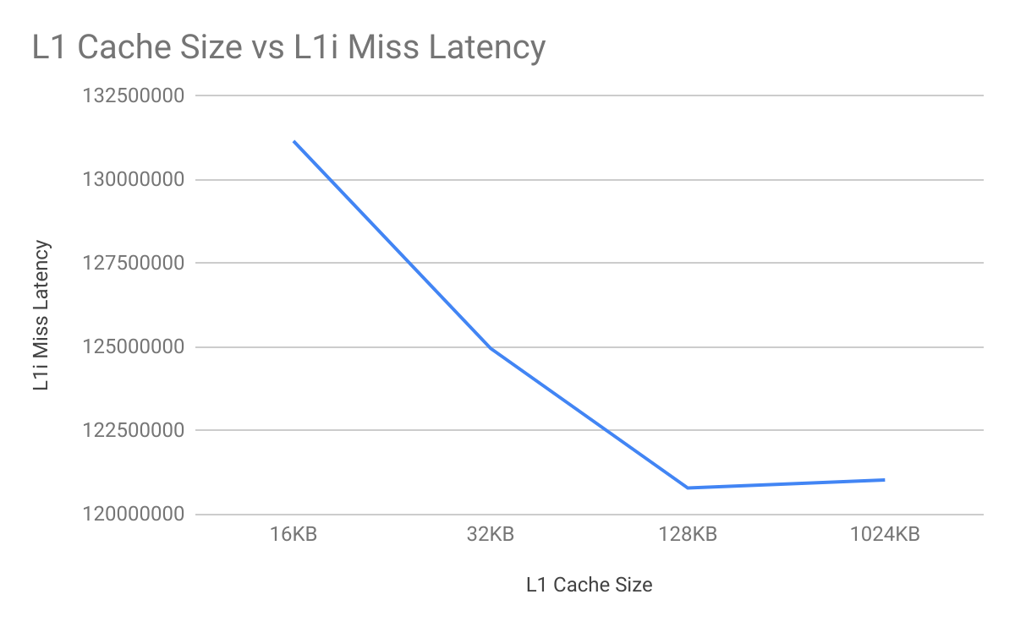
SciMark2.0 (Monte Carlo, LU, SOR, etc):-

Slide 12
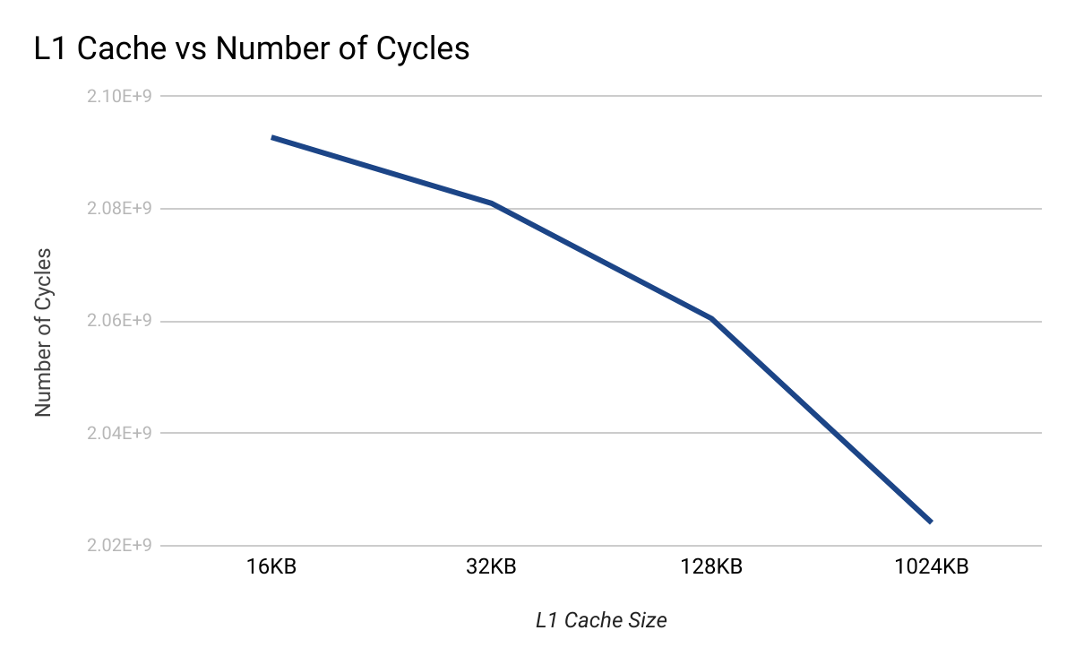
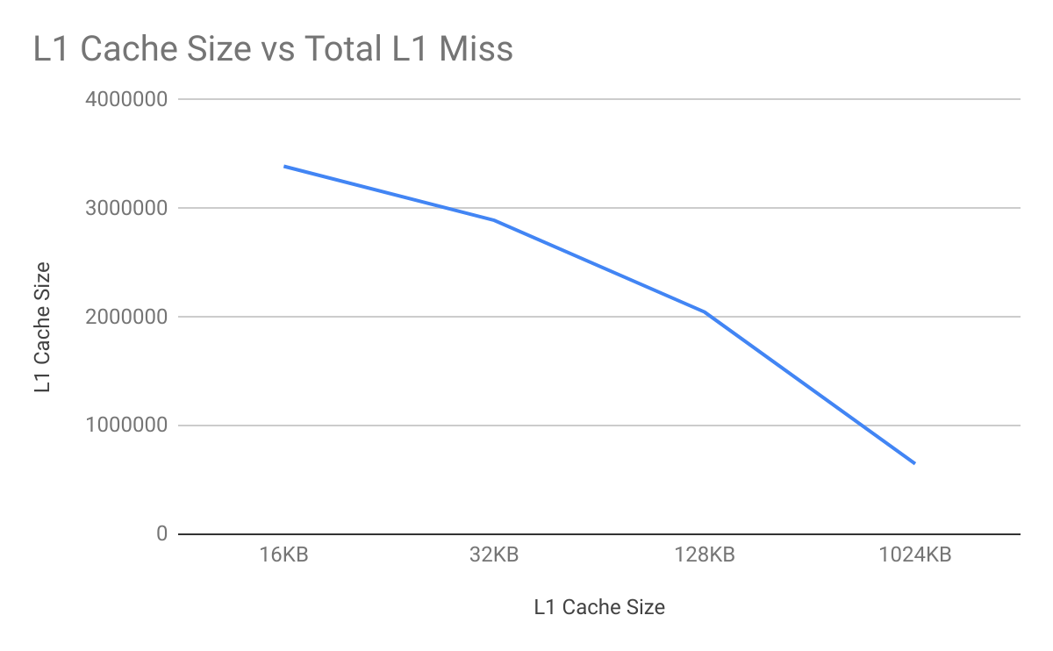
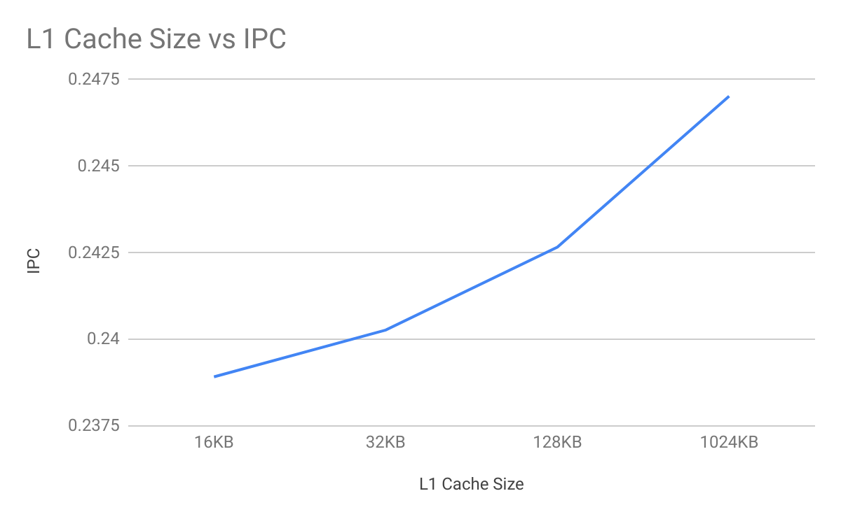
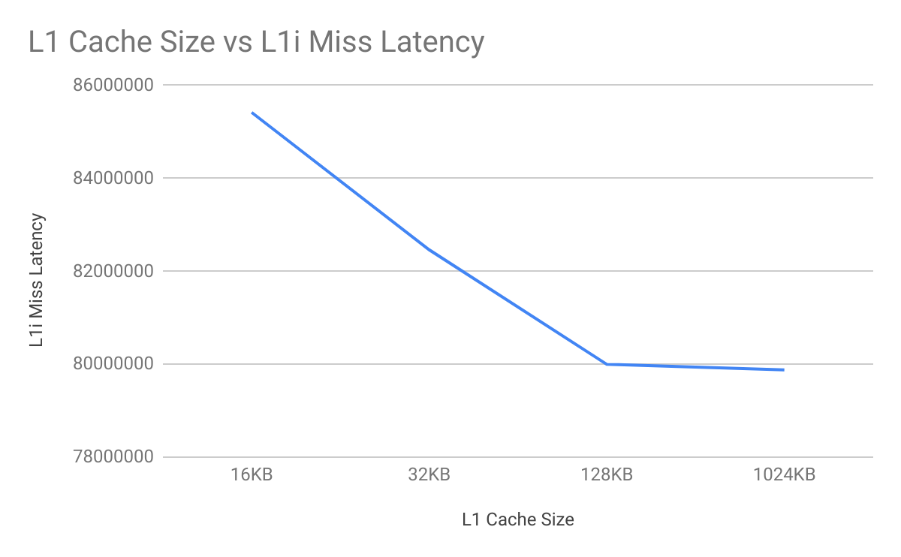
SPEC CPU2000 (bzip2):-

Slide 13
SciMark2.0 (Monte Carlo, LU, SOR, etc):-
L1 Cache Size | Total CPU Cycles | Avg. IPC | Total L1 Miss | Overall L1i miss latency
16KB | 63722293 | 0.2527567393 | 73777 | 131159500
32KB | 63433867 | 0.25390662372 | 61694 | 124963500
128KB | 62140827 | 0.2591882789 | 7879 | 120792000
1024KB (1MB) | 62118713 | 0.25928083861 | 6838 | 121033500
SPEC CPU2000 (bzip2):-
L1 Cache Size | Total CPU Cycles | Avg. IPC | Total L1 Miss | Overall L1i miss latency
16KB | 2092784367 | 0.23891615776 | 3388867 | 85420000
32KB | 2081007563 | 0.24026822818 | 2891178 | 82462000
128KB | 2060465019 | 0.24266366834 | 2045337 | 79996500
1024KB (1MB) | 2024103231 | 0.24702297409 | 647996 | 79875500

Slide 14
General Observations:-
Parameter Under Observation | Observed Change (with increase in L1 cache size) | Possible Reasons
Total CPU Cycles | Decrease | As size of L1 cache increases, it is more probable that data will be found in L1 cache and since extra cycles need not be spent accessing L2 Cache or main memory the number of total execution cycles decreases.
Average IPC | Increase | Since more memory operations can be completed through L1 cache, on average it takes less cycles to complete a single instruction.
L1(inst. + data) Miss Rate | Decrease | Since more data can be stored in the L1 cache, it is more likely that the data requested will already be present in the cache, hence chances of miss decreases.
L1i miss latency (number of overall miss cycles) | Decrease | As size of L1 cache increases, number of miss decreases but cycles to search in cache increases. In general the increase in cycles is less than decrease in miss.

Slide 15
Unusual Observation:-
Overall L1i Miss Latency increases when L1 cache size increases (in case of SciMark2.0 benchmark)
Number of overall Miss Cycles = Number of Miss x Miss Penalty(Per Miss)
Probable Reason:-
As the size of cache increases though the number of miss decreases, the number of cycles to search the cache increases, as now the CPU has a larger search space. Till we reach an optimal size of cache the decrease in miss in more than the increase in number of cycles required to search the cache. But after that optimum cache size if we increase the cache size it will lead to more increase in search cycles leading to negative results.

Slide 16
Experiment 2

Slide 17
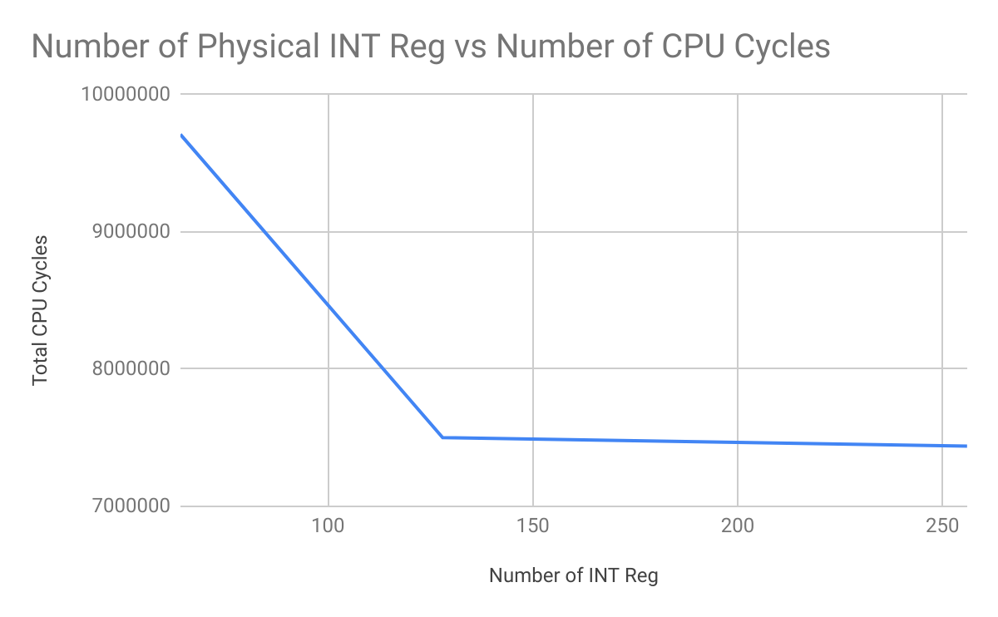
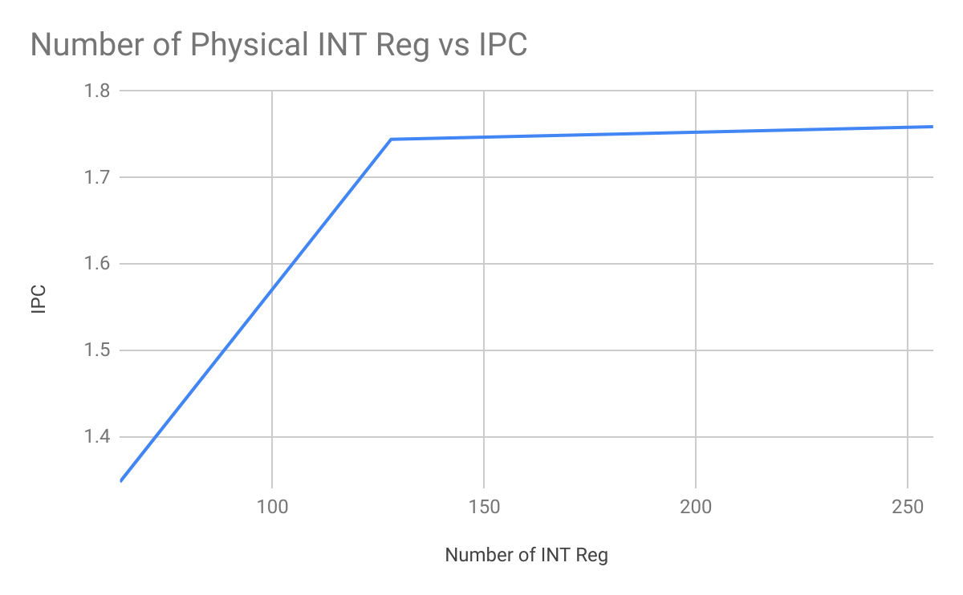
SciMark (Monte Carlo, LU, SOR, etc):-

Slide 18
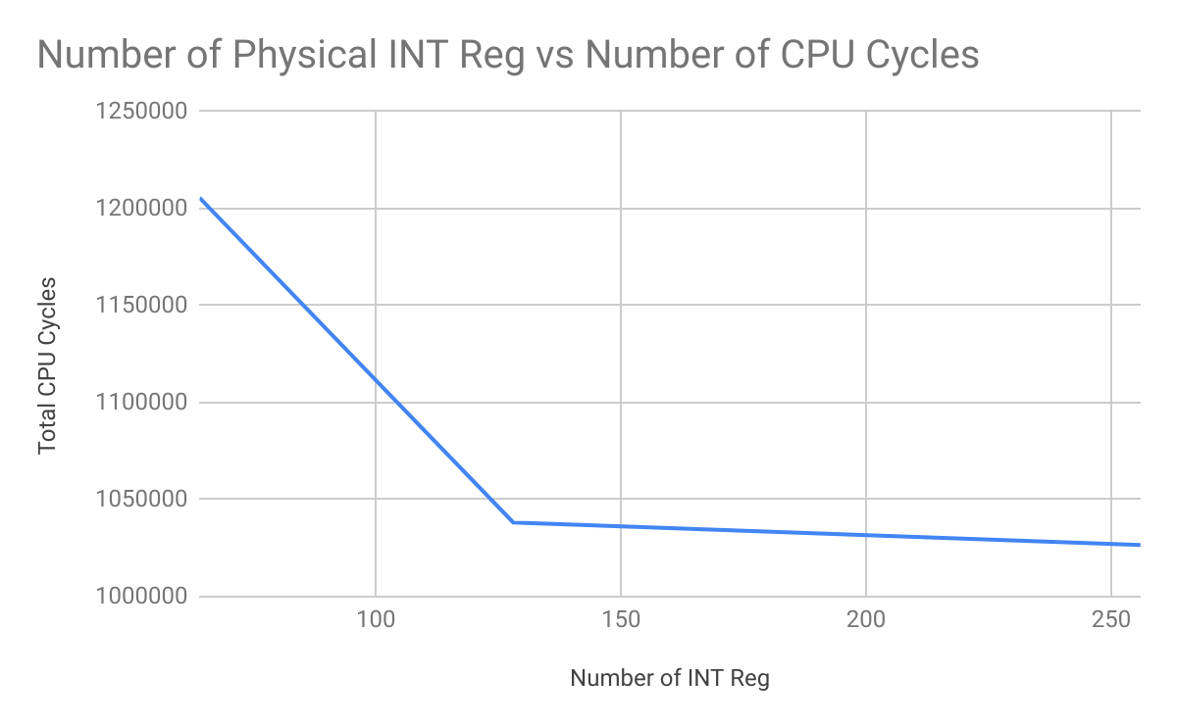
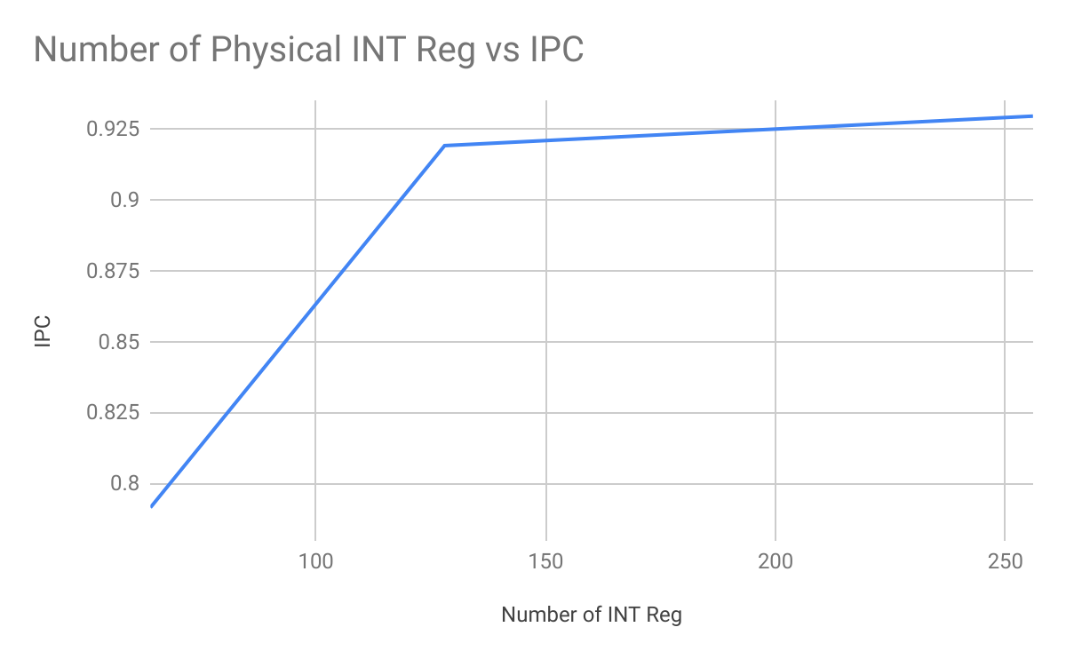
Splash2 (FFT):-

Slide 19
SciMark (Monte Carlo, LU, SOR, etc):-
Number of Physical Int Registers | Total CPU Cycles | Avg. IPC
64 | 9710254 | 1.347429
128 | 7500782 | 1.744339
256 | 7438230 | 1.759003
Splash2 (FFT):-
Number of Physical Int Registers | Total CPU Cycles | Avg. IPC
64 | 1205510 | 0.791711
128 | 1038216 | 0.919331
256 | 1026640 | 0.929697

Slide 20
General Observations:-
Interesting Observation:-
Parameter Under Observation | Observed Change (with increase in number of physical Registers) | Possible Reasons
Total CPU Cycles | Decrease | As the number of integer registers increases, the number of writes to cache, and writes to main memory to free register space is lower. Hence there are lower number of execution cycles.
Average IPC | Increase | As the number of integer registers increases, more data can be maintained in registers causing less long writes and reads to cache and main memory. This increases the IPC.
As we increase the number of Physical Integer Register, the effect of increase diminishes. This is mainly due to the process of register renaming. Hence increasing the number of registers beyond a particular number doesn’t give any significant advantage.

Slide 21
Experiment 3

Slide 22
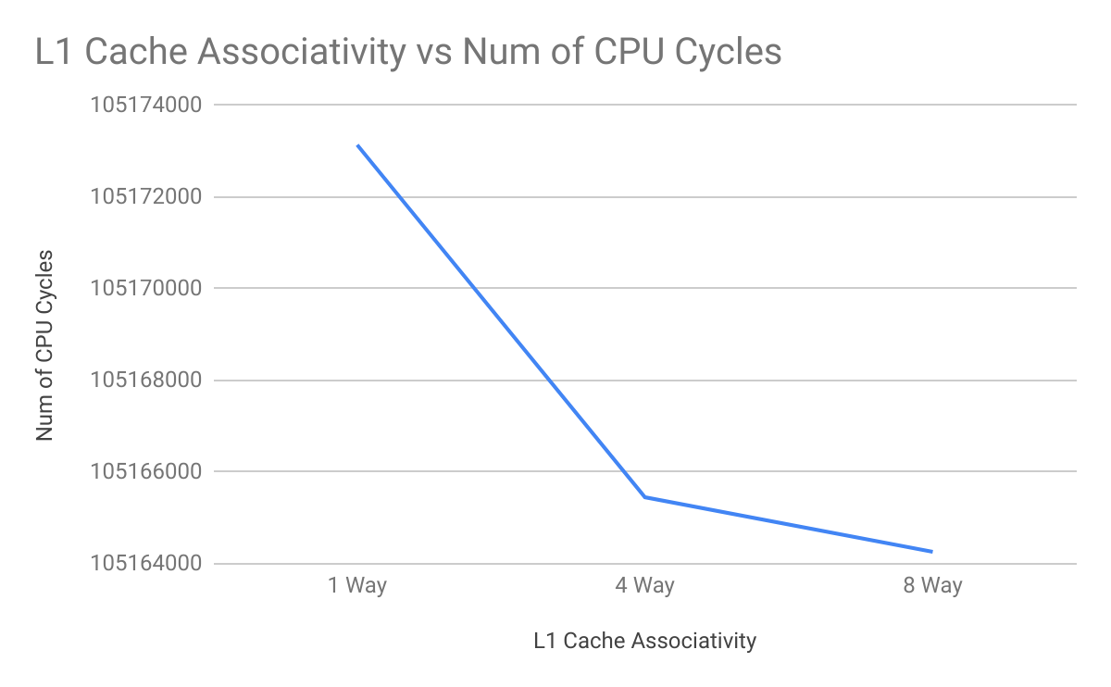
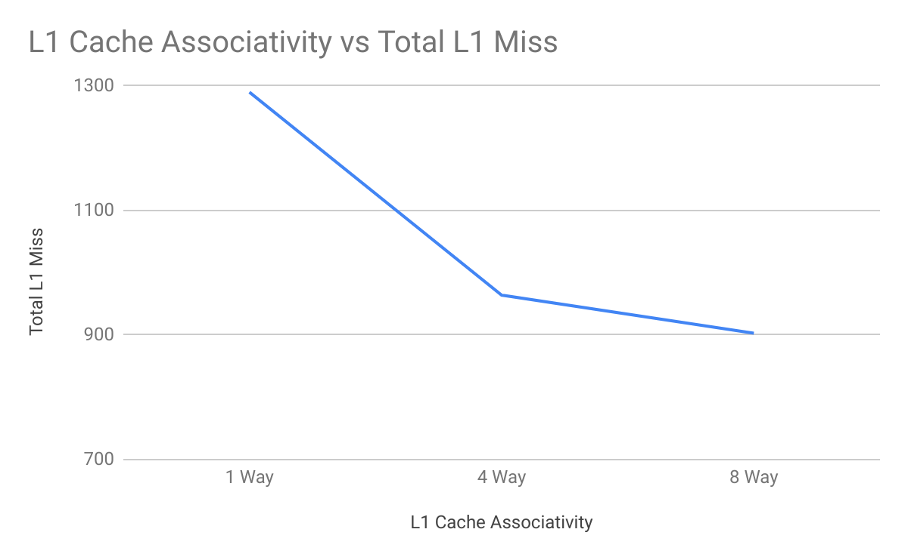
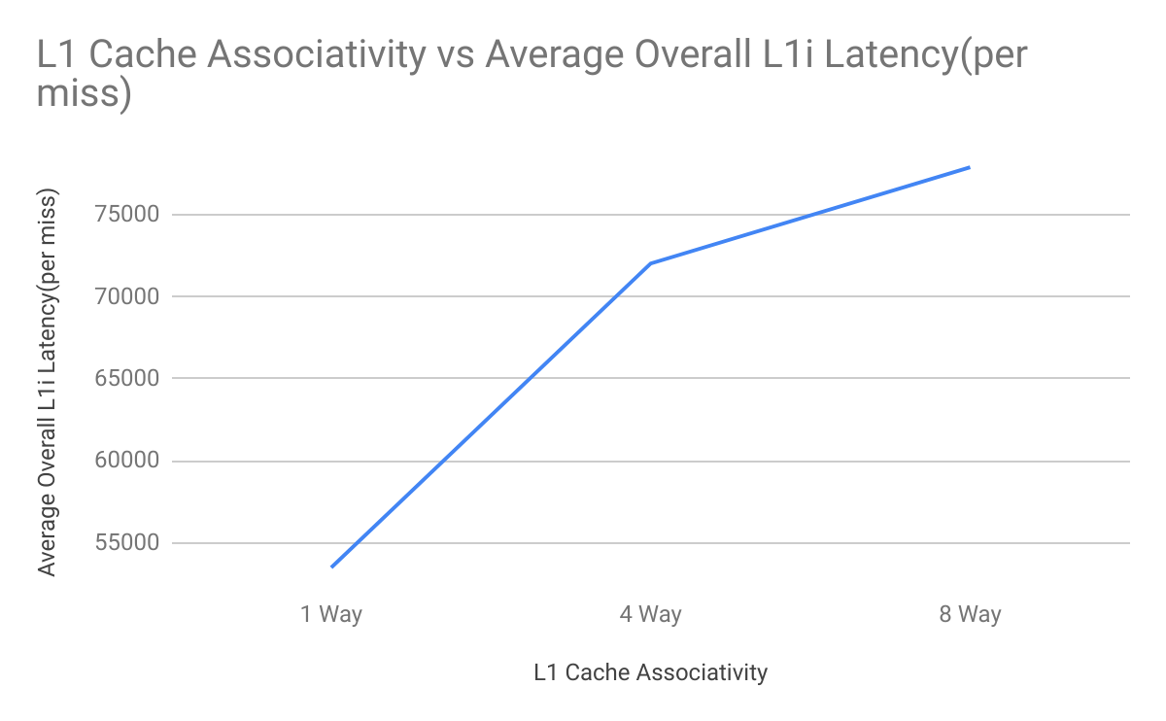
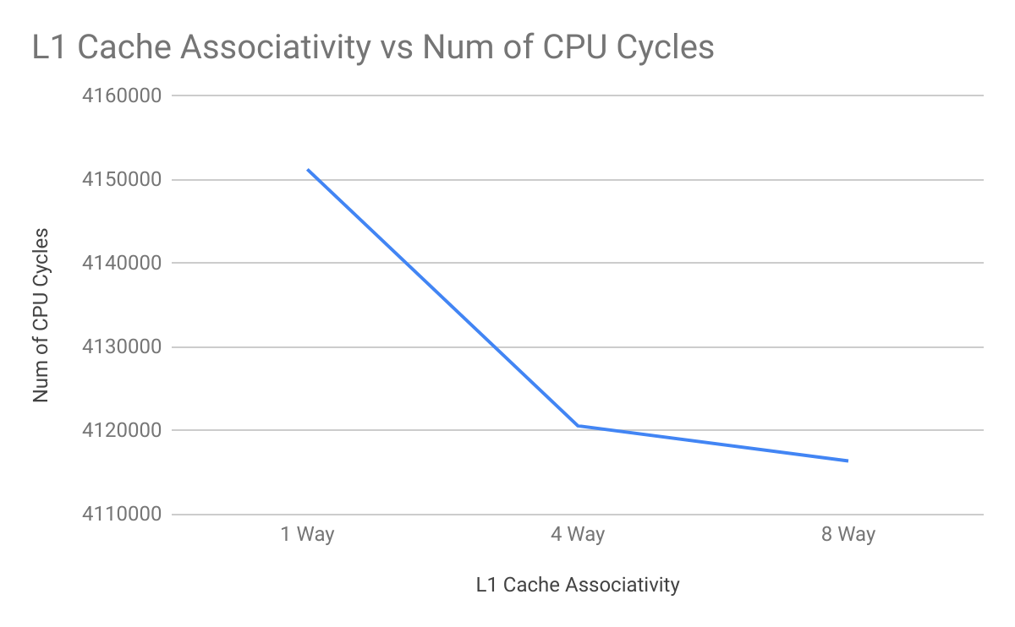
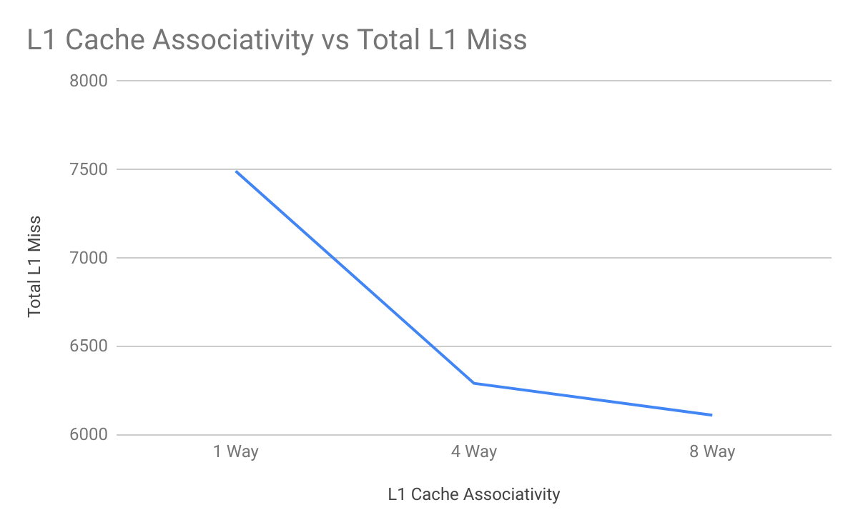
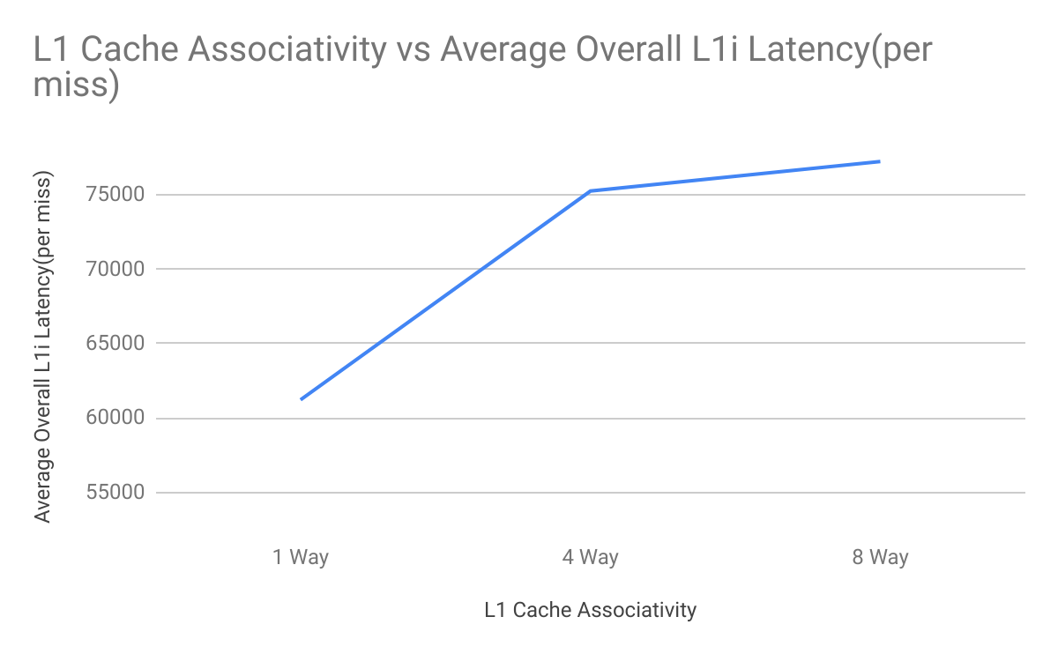
MiBench (BitCount):-
Splash2 (FFT):-

Slide 23
MiBench (BitCount):-
Associativity of Cache | Total CPU Cycles | Total L1 Miss | Average Overall L1i miss latency (Per Miss)
1 Way | 105173137 | 1290 | 53467.124632
4 Way | 105165451 | 964 | 72038.239538
8 Way | 105164259 | 903 | 77915.348101
Splash2 (FFT):-
L1 Associativity of Cache | Total CPU Cycles | Total L1 Miss | Average Overall L1i miss latency (Per Miss)
1 Way | 4151259 | 7492 | 61206.954436
4 Way | 4120601 | 6292 | 75264.017252
8 Way | 4116413 | 6112 | 77258.349086

Slide 24
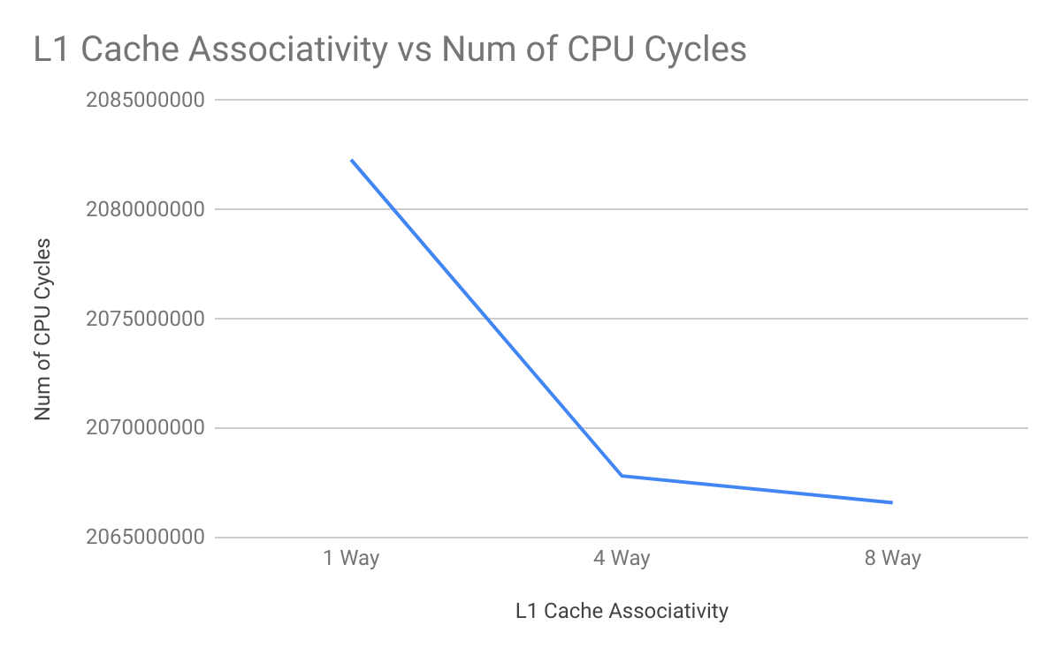
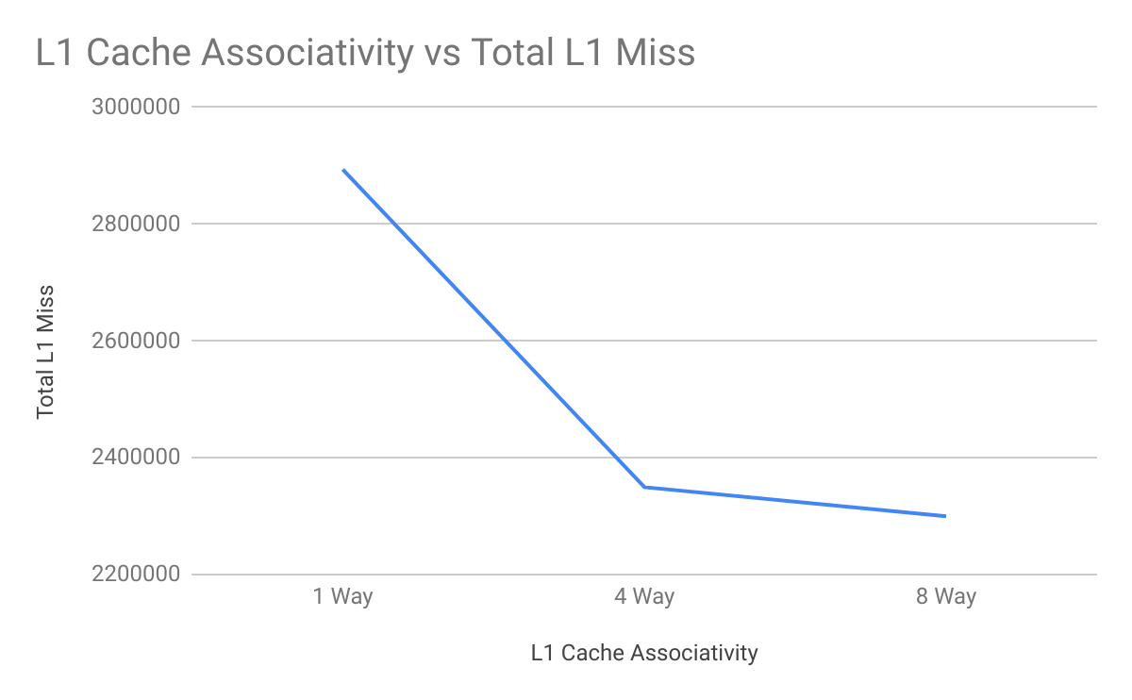
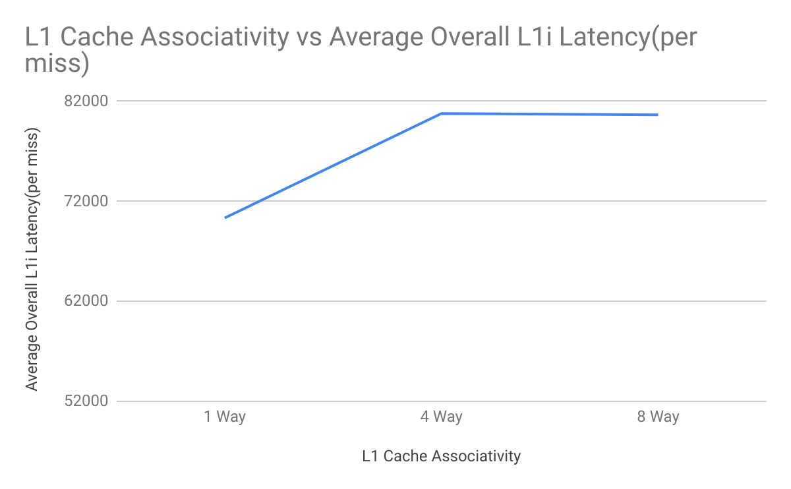
SPEC CPU2000 (bzip2):-
Associativity of Cache | Total CPU Cycles | Total L1 Miss | Overall L1i miss latency (Per Miss)
1 Way | 2082291049 | 2893644 | 70336.683417
4 Way | 2067816051 | 2349446 | 80786.422200
8 Way | 2066593677 | 2299558 | 80648.851149

Slide 25
General Observations:-
Parameter Under Observation | Observed Change (with increase in L1 cache Associativity) | Possible Reasons
Total CPU Cycles | Decrease | As associativity of L1 cache increases, number of conflicts decreases and the probability that the data will be found in L1 cache also increases and since extra cycles need not be spent accessing L2 Cache or main memory the number of total execution cycles decreases.
L1(inst. + data) Miss Rate | Decrease | As associativity of L1 cache increases, number of conflicts decreases and the probability that the data will be found in L1 cache also increases, hence chances of miss decreases.
Average Overall L1i miss latency (Cycle/Miss) | Increase | set associative caches are usually slower and somewhat more expensive to build because of the output multiplexer and additional comparators which adds some overhead cycles.

Slide 26
Observation on Benchmarks(workloads):-
The average number of cycles required to run a SPEC CPU2000 and MiBech are significantly large as compared to Splash2.0 and SciMark2.0. This shows that MiBench and SPEC CPU2000 are heavier to process.
The L1 Cache miss shows drastic decrease when the cache size was increased in case of SPEC CPU2000 and SciMark2.0. This shows that these two benchmarks were more dependent on L1 cache size.
SciMark2.0 shows a more drastic decrease in number of CPU cycles as compared to Splash2.0 benchmark. This shows that SciMark2.0 is more sensitive to number of Physical Integer Registers.

Slide 27
Other Benchmarks
http://euler.slu.edu/~fritts/mediabench/
http://groups.csail.mit.edu/cag/streamit/shtml/benchmarks.shtml
http://axbench.org/
https://asc.llnl.gov/CORAL-benchmarks/
http://math.nist.gov/scimark2/

Slide 28
Overall Conclusion
The Gem5 simulator is a modular platform for computer system architecture research. In the above experiments we have built an X86 system architecture and simulated it’s performance after making changes to various of it’s key parameters. This helps us to study how the CPU performance is affected by these key parameters and also helps us to find the optimal value of these parameters, which in turn will help us to design highly optimised CPU architectures.

