Slide 1


Loan
Approval
Amount Prediction
Capstone Interim Presentation
- Group I

Slide 2





The Paycheck Protection Program (PPP) loan is a type of loan established by the US Small Business Administration (SBA) as part of the Coronavirus Aid, Relief, and Economic Security (CARES) Act in response to the COVID-19 pandemic. The purpose of the PPP loan is to help small businesses keep their workers on the payroll during the pandemic. The PPP loans are made through SBA-approved lenders and are fully guaranteed by the federal government.
The aim of the program is to help these businesses keep their employees on the payroll, cover eligible expenses such as rent, mortgage interest, and utilities, and keep their operations running during the crisis.
By providing PPP loans to eligible small businesses, the federal government aims to prevent widespread layoffs, preserve jobs, and support the economy during a time of crisis.
In addition to helping businesses stay afloat, the PPP loan also offers the potential for loan forgiveness if certain conditions are met. This provides an added incentive for small businesses to participate in the program and helps ensure that the funds are being used effectively.
Pre processing
EDA
Problem Statement
Algorithm
About

Slide 3
PROBLEM STATEMENT :-
The objective is to develop a predictive model for PPP loan approval amounts.
The model will consider essential borrower and loan characteristics.
The goal is to help lenders make informed decisions and distribute funds efficiently.
The pandemic's impact on small businesses is a key consideration.
Algorithm
EDA
Pre processing
About
Problem Statement

Slide 4
Following Steps are taken for data preprocessing :
Replaced missing values of forgiveness amount, all proceeds columns with 0.
Dummied all the categorical columns (significant or relevant).
Cleaned and binned the Borrower State, Borrower City,
Business type and Originating lender state.
Frequency encoding through nunique of SBA Office code,
Borrower State, originating lender ID(city, state),
Project county name, Business type and CD.
LoanNumber, Undisbursed Amount, Zip Codes,all Servicing Geographical columns, SBA Guaranty percentage, columns deleted as they are inconsequential for the model.
Algorithm
EDA
About
Problem Statement
Preprocessing

Slide 5
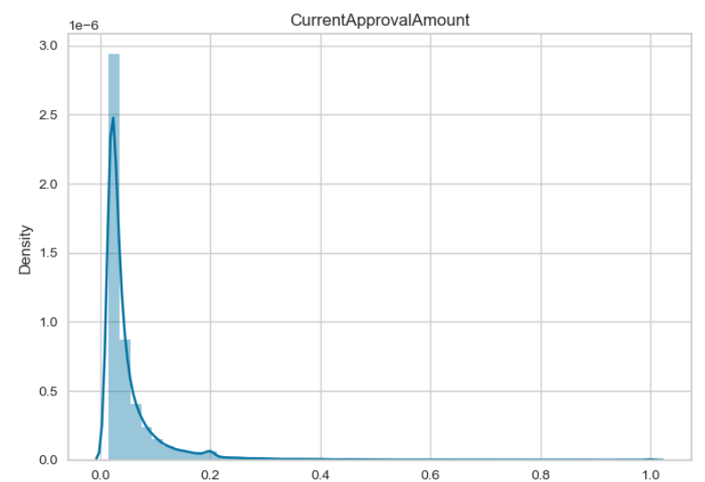
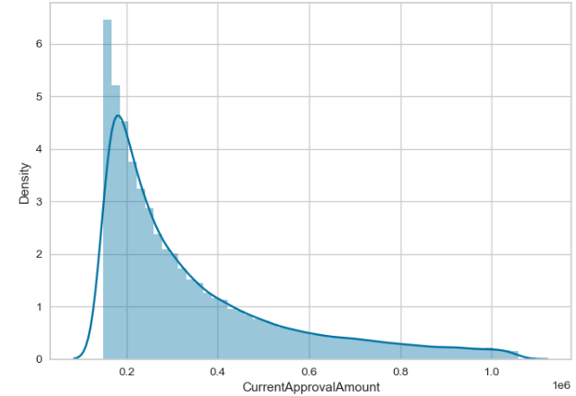
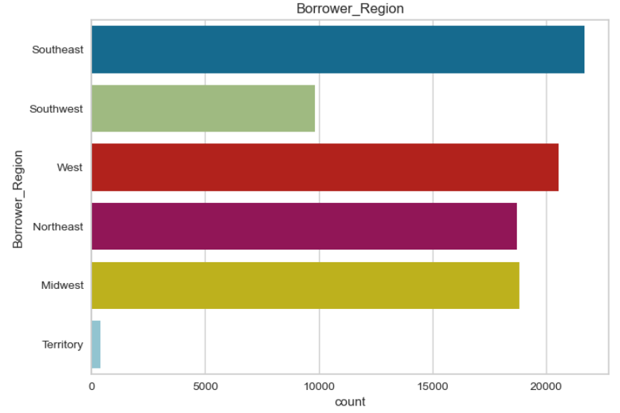
We Conclude the following based on our observations:
The graph on the left side is data with outliers as we can see that it is highly right skewed .
In the graph on it’s right side, we have data without outliers, it has reduced the skewness.
Most numbers of borrowers are from Southeast region whereas the borrowers from Territories are negligible
Algorithm
EDA
Pre processing
About
Problem Statement

Slide 6
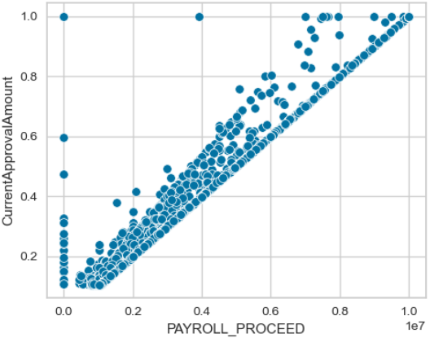
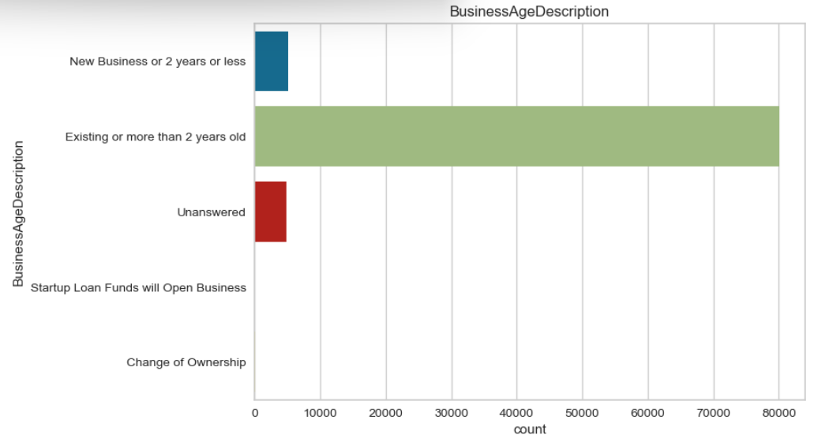
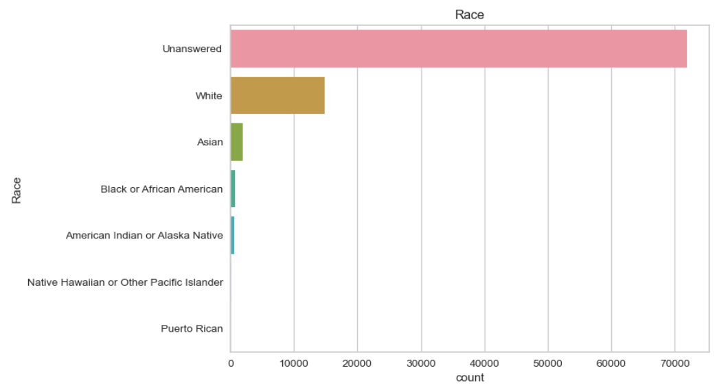
We can see that the Payroll proceed has good relation with Current Approval Amount. Some value also contain zero in the current approval amount.
Maximum number of business are older than 2 years. The loan amount provided to Start-ups and Businesses changing ownership is negligible.
Algorithm
Pre processing
About
Problem Statement
EDA
Majority of borrowers have not disclosed their Race and those who have disclosed are white people.

Slide 7
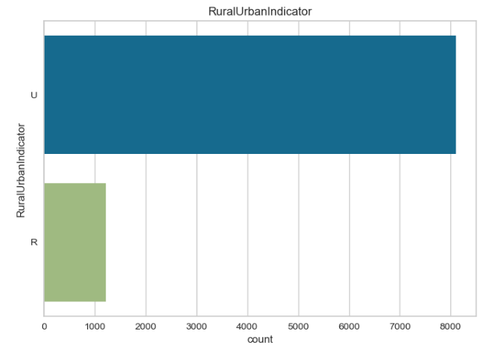
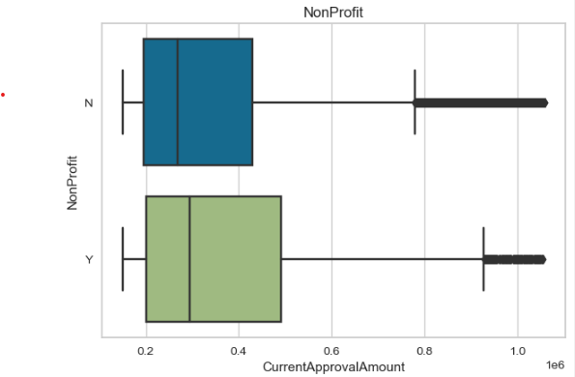
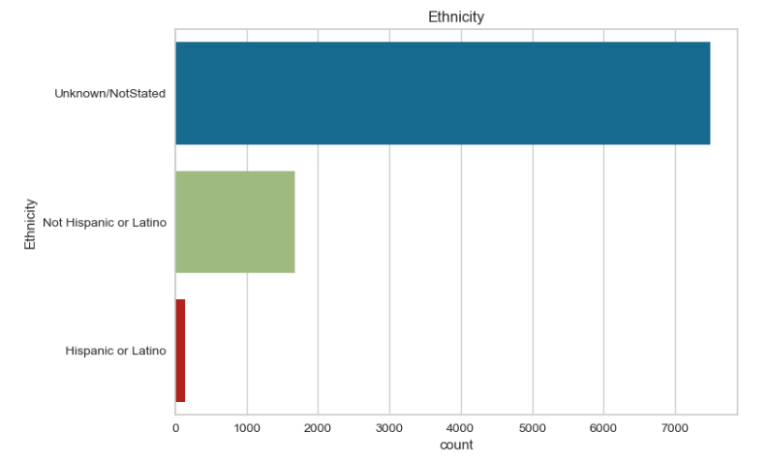
Most of the businesses are based in Urban areas.
Non-Profit have large amount approved in general. The Corporations have Large no. of outlier loan amounts .
Pre processing
Algorithm
EDA
About
Problem Statement
Most of the business owners have not declared their Ethnicity. Among the ones who declared, Not Hispanic or Latino have the largest share.

Slide 8
Feature Engineering done in the data:
We used K Means Clustering to cluster similar columns and getting Labels for the same. All the PROCEEDS columns were related to the loan amount and also inter-related. Therefore we created the Proceeds_label. It also proved to be useful after applying the statistical test.
We also clustered all the predictors derived from the dates regarding the loans i.e., Date Approved, Forgiveness Date, and the Loan Status Date. It proved to be useful under the statistical test.
We extracted Industry Group, Sector, SubSector of the given business using its NAICS Code
Algorithm
Pre processing
About
Problem Statement
EDA

Slide 9

To build the model we will use the following approach:
Though the data contains many outliers (highly skewed), we are restrained to not remove the records, we capped the highly skewed data to overcome the issue of outliers so we build two Random Forest model one with outliers another without outliers.
The Base Model of outliers data is giving an RMSE of $6904.05 on an average loan value of $2124669.40, that is rmse is approx. 0.33% of the average loan value, and without outliers we have an RMSE of $7060.13 on an average loan value of $348096.76 that is rmse is approx. 1.89% of the average loan value.
Pre processing
About
Algorithm
Problem Statement
EDA

Slide 10
Our Future Approach :-
We will build a decision tree, Gradient Boosting models as well.
For accuracy measures we will build a model using bagging technique.
Since the data has many features, so to overcome the curse of dimensionality, we will use PCA to reduce multicollinearity in the data.
Pre processing
About
Algorithm
Problem Statement
EDA

Slide 11
Thank You

