Slide 1
Modern Data Dashboard
Presented By:
Vatsalya Sahu (301411023115)

Slide 2
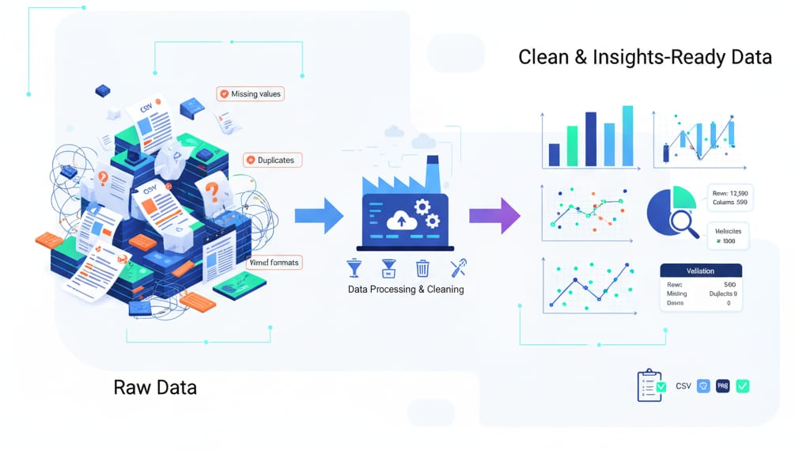
TABLE OF CONTENTS
Introduction
Literature Review
Problem Statement
Key Technologies Used
Objectives
Proposed Methodology
Data Flow Diagram
Proposed Algorithms
Expected Outcomes
Conclusion & Future Scope
References

Slide 3
Introduction
The “DATA DASHBOARD” is a desktop application built in Python.
It provides a user-friendly Graphical User Interface (GUI) for end-to-end data analysis.
It empowers users to load, clean, filter, and visualize datasets (CSV/Excel) without writing any code.
Applications:
Exploratory Data Analysis (EDA): Quickly get statistics, previews, and column information.
Data Preprocessing: Preparing datasets for machine learning by handling missing values, duplicates, and types.
Academic/Business Reporting: Filtering data to find insights and exporting plots for presentations.

Slide 4
Literature Review
This Python project is a data analysis tool built with a combination of libraries. The front end, or user interface, is powered by CustomTkinter, which provides a modern, customizable graphical environment. On the backend, Pandas is the core engine for data manipulation and cleaning. It handles tasks like loading data from various file formats, removing duplicates, and filling in missing values using methods like mean, median, or mode.
For data visualization, the project utilizes Matplotlib, a powerful plotting library, which is integrated into the CustomTkinter GUI using FigureCanvasTkAgg. This allows users to create and view various charts directly within the application. The project's strength lies in its ability to combine these well-known libraries to create a user-friendly application that simplifies common data science tasks.

Slide 5
Problem Statement
Problem: Raw data from real-world sources is almost always "dirty." It contains missing values, duplicate entries, incorrect data types, and irrelevant information.
Challenge: Before any meaningful analysis or visualization can be done, this data must be systematically cleaned and preprocessed.
Identified Gaps:
Accessibility: Non-programmers struggle to perform data cleaning tasks that are simple with code but complex with GUI tools like Excel.
Fidelity: It is difficult to explore a dataset, clean it, and then filter it for visualization without overwriting the original data.
Integration: A lack of tools that seamlessly connect the cleaning phase (modifying data) with the visualization phase (viewing data).

Slide 6
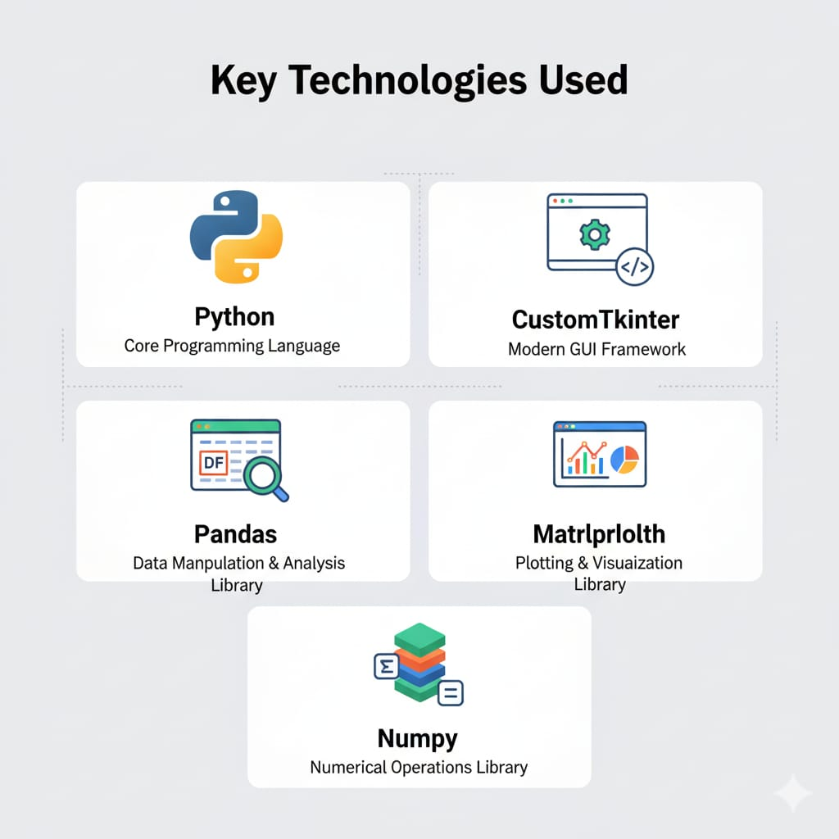
Key Technologies Used
Python: The core programming language.
CustomTkinter: A modern Python UI library used to build the entire responsive interface.
Pandas: The primary library for all data manipulation, including loading, cleaning, and filtering.
Matplotlib: The plotting library used to generate all charts (Bar, Line, Pie, etc.) which are then embedded within the GUI.
NumPy: Used for numerical operations, especially during data cleaning and type conversion.

Slide 7
Objectives
Objective 1: Data Ingestion & Exploration
To develop a robust system for loading CSV and Excel files, providing users with an immediate data overview including key statistics, a data preview, and a summary of column properties.
Objective 2: Data Cleaning & Filtering
To implement a comprehensive toolkit for data cleaning and filtering, allowing users to remove duplicates, handle missing values with various imputation methods, convert data types, and query the dataset using both column-specific and global search functions.
Objective 3: Visualization & Exporting
To integrate a powerful visualization module with Matplotlib to create a variety of charts (e.g., Bar, Line, Heatmap) and enable users to export their cleaned data, filtered results, and generated charts for external use.

Slide 8
Proposed Methodology
Our methodology for this project follows a structured, three-phase approach to build a robust data analysis tool.
Phase 1: Foundation focuses on establishing the core data-handling capabilities, including the GUI framework and data ingestion functions. We will design the user interface and implement file loading for CSV and Excel formats, along with a data overview to display key statistics.
Phase 2: Core Functionality involves building the primary data manipulation features. This phase will implement the cleaning module (handling duplicates, missing values, and type conversion) and the powerful filtering and search capabilities.
Phase 3: Refinement and Delivery will focus on integrating the visualization module, enabling interactive plotting with Matplotlib, and adding the export functions for cleaned data and charts. This systematic process ensures that we build a stable, functional, and user-friendly application that meets all project objectives.

Slide 9
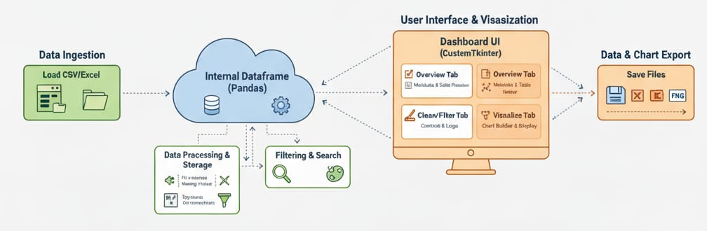
Data Flow Diagram

Slide 10
Proposed Algorithms
The application's logic is built on a data flow model that uses two primary DataFrames to separate cleaning and filtering operations.
Ingestion: When a user loads a file, the application reads the data into a master DataFrame. A separate copy is then made for a view DataFrame. This ensures the original data remains unaltered for permanent cleaning actions.
Manipulation: Cleaning actions (like filling missing values or removing duplicates) are applied directly to the master DataFrame. The view DataFrame is then refreshed to a new copy of the updated master. In contrast, filtering and searching are applied only to the view DataFrame. This non-destructive process lets users easily experiment with data subsets without affecting the cleaned master data.
Visualization & Export: All plots are generated using data from the view DataFrame, so they always reflect the current filters. Users can export either the cleaned master DataFrame, the filtered view DataFrame, or the generated chart to a file.

Slide 11
Expected Outcomes
This project is expected to deliver a fully functional, user-friendly desktop application that simplifies data analysis. The key outcomes include:
Seamless Data Workflow: A user will be able to load CSV/Excel files, clean and filter the data using intuitive tools, and generate a variety of charts without writing any code.
Accurate Insights: The application will provide reliable data overviews and visualizations, empowering users to make better-informed decisions based on clean, validated data.
Accessible Tooling: The project will make powerful data manipulation and visualization capabilities, typically found in programming environments, accessible to a wider audience, including those without a technical background.
Flexible Exports: Users will be able to easily save their cleaned data, filtered views, and generated charts for use in other reports or applications.

Slide 12
Conclusion
The project successfully delivers a functional data analysis application by integrating CustomTkinter, Pandas, and Matplotlib. It provides a complete, user-friendly workflow for loading, cleaning, filtering, and visualizing data.
By making complex data operations accessible through a simple GUI, the application democratizes data analysis, demonstrating a strong grasp of Python's data ecosystem.

Slide 13
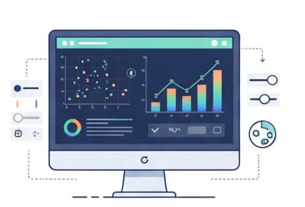
Future Scope
Advanced Data Cleaning: Integrate sophisticated imputation methods and features for categorical encoding and data scaling.
Enhanced Visualization: Add interactive plots, a wider range of chart types, and more customization options.
Automated Insights: AI will automatically find patterns and anomalies, generating natural language summaries.
Intelligent Automation: AI will automate tasks like chart selection and data cleaning for greater efficiency.

Slide 14
References
Book References:
"Python for Data Analysis" by Wes McKinney.
"Hands-On Data Analysis with Pandas" by Stefanie Molin.
Website References:
Pandas Official Documentation: https://pandas.pydata.org/docs/
Matplotlib Official Documentation: https://matplotlib.org/
CustomTkinter Official Documentation:
https://customtkinter.tomschimansky.com/

Slide 15
Thank you

