Slide 1


LandSlide Segmentation Using Deep Learning Models
Department of Information Technology
V R Siddhartha Engineering College
Deep Learning
B.Tech in Information Technology
MAJOR Project Review Presentation
Presented by
Ch.Vatsalya Gayatri (228W1A1211)
N.Pallavi (228W1A1242)
Under the guidance of
T. Sujith Kumar, Asst.Professor

Slide 2
AGENDA
Introduction and Problem Statement
Objectives and Outcomes
Literature review and Summary
Datasets and Requirements
Algorithms used in the project
Architecture diagram
Implementation Steps and Execution
Results Obtained
Results Analysis & Observations
Conclusion & Future Work
References

Slide 3
INTRODUCTION
Landslides are one of the most destructive natural disasters, causing loss of life, infrastructure damage, and environmental imbalance.
Early detection and accurate mapping of landslide-prone areas are critical for risk management and disaster mitigation.
Traditional image analysis techniques often fail to precisely identify landslide boundaries due to spectral similarity, noise, and complex terrain conditions.
To address this, our project uses transformer based semantic segmentation models to automatically detect and segment landslide regions from satellite imagery.
Transformer-based models overcome these limitations by capturing both local and global features, enabling more accurate and efficient landslide segmentation.

Slide 4
PROBLEM STATEMENT
Landslides are frequent in hilly regions and cause major loss of life, property, and infrastructure. Manual mapping of landslide areas using satellite images is slow, subjective, and error-prone and complex terrain and varying image quality make accurate detection difficult.
Traditional models struggle with low recall and poor boundary segmentation. Need for automated, scalable, and reliable segmentation of landslide-prone regions.
Delayed or inaccurate detection increases Higher risk to life, property, and infrastructure. A robust solution can support early warning systems and improve disaster management.
Use satellite imagery dataset with preprocessing to enhance feature visibility. Train and compare transformer based semantic segmentation models for segmentation and estimate the affected area in square kilometers and calculate the severity of the landslide region.

Slide 5
Objectives
Outcomes
Apply transformer-based architectures , namely SegFormer and MobileViT, to detect landslides precisely and pixel-wisely.
Apply and evaluate transformer-based to detect landslides on a pixel-by-pixel basis correctly.
Train and models to improve recall, accuracy, and boundary detection.
Accurate segmentation masks highlighting landslide-prone regions from satellite images.
Estimate the landslide area, classifies severity levels.
A decision-support tool to aid authorities in early warning systems and disaster risk reduction.

Slide 6
LITERATURE REVIEW
Paper Title | Publication Year | Algorithm | Dataset | Result | Limitation
LandslideSegNet: an effective deep learning network for landslide segmentation using remote sensing imagery. (Earth Science Informatics) | Year: 2024 | LandslideSegNet – Custom encoder-decoder CNN model Other Comparative Segmentation Models: Unet,PSPNet,DeepLabV3,Enet,FCN8,ICNet | Landslide4Sense , additional Datasets used in comparative studies:RapidEye,Sentinel-1 and Sentinel-2 Landsat-8 GVLM | Accuracy: 97.60% Mean Intersection over Union (mIoU): 73.65% Dice Similarity Score (DSS): 66.46% Precision: 71.48% Recall: 62.10% Total Parameters: 648,457 Training Time: 33.68 minutes | No Transfer Learning Used. Occasionally struggles with precise delineation of landslide edges, especially in complex terrain.
Detection and segmentation of loess landslides via satellite images: a two-phase framework (Landslides, 19(3), 673-686) | Year:2022 | Detection Faster-RCNN Segmentation U-Net with Data Fusion | Loess Landslide Dataset | FCN Score: 0.57 DSC: 0.44 ASSD: 100.3 Vanilla U-Net Score: 0.68 DSC: 0.59 ASSD: 97.1 | Homogeneous Visual Features Boundary Uncertainty Lack of Sub-Region Differentiation

Slide 7
Publication Details | Publication Year | Algorithm | Dataset | Result | Limitation
Efficient and automatic extraction of slope units based on multi-scale segmentation method for landslide assessments (Landslides 18 3715-3731) | Year :2022 | Multi-Scale Segmentation (MSS) Hydrological Method (GIS-based) | Digital Elevation Models (DEMs) with 8.9m spatial resolution | MSS Method (Chongyi County) Asymmetry: 81.42% units had < 0.7 (more regular shapes) Compactness: 87.31% units had < 1.80 Hydrological Method (Chongyi County) | Limited Environmental Factors Parameter Sensitivity
Landslide Inventory Mapping From Bitemporal High-Resolution Remote Sensing Images Using Change Detection and Multiscale Segmentation (IEEE Journal of Selected Topics in Applied Earth Observations and Remote Sensing) | Year: 2018 | Change Magnitude Image (CMI) Multithresholds to generate binary maps Majority Voting (MV) to combine binary maps of post-event image Object-Based Voting (OBV) | Pre- and post-event high-resolution aerial images | Area A:90.7 AreaB:80.1 Area C:60.06 | Lower Accuracy in Forested Areas: Sensitivity Noise Sensitivity in High-Resolution Images

Slide 8
LITERATURE SUMMARY
Deep learning models such as LandslideSegNet and U-Net variants have
shown high accuracy in landslide segmentation but often struggle with precise boundary detection in complex terrains.
• Two-stage frameworks combining Faster R-CNN and U-Net improve detection and segmentation performance but face challenges in low-contrast and heterogeneous regions.
• Traditional methods like multi-scale segmentation and GIS-based approaches rely on terrain features (DEM) but lack pixel-level accuracy and automation.
• Many existing methods suffer from class imbalance, poor generalization, and difficulty in detecting small or irregular landslides.
• Recent advancements highlight the need for transformer-based models, which can capture both local and global features, improving segmentation accuracy and boundary delineation.

Slide 9
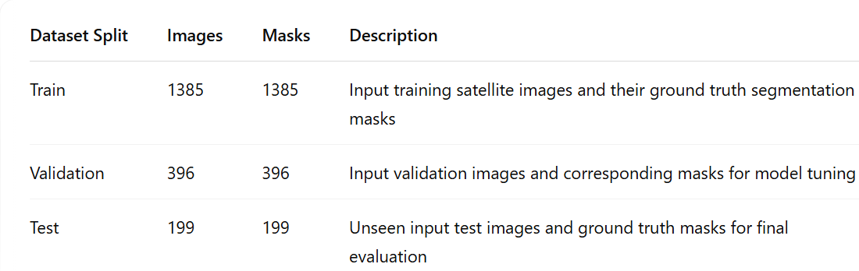
DATASETS AND REQUIREMENTS
LandslideDetectionDataset
Purpose: Used for identifying and classifying landslide-prone areas using image-based deep learning techniques.
This Project uses the Landslide4Sense dataset. This dataset contains satellite imagery for landslide segmentation tasks.
KaggleSource: https://www.kaggle.com/code/sreedevd/seg-land-1/input

Slide 10
Software Requirements:
Programming Language : Python 3.7
Framework : TensorFlow, Keras
Libraries : scikit-learn, NumPy, Pandas
Visualization : Matplotlib, SeabornDevelopment
Environment : Google Colab / Kaggle Notebooks
Hardware Requirements:
Processor (CPU) : Intel i5
RAM : Minimum 8 GB
Storage : Minimum 10 GB
Graphics Card (GPU)

Slide 11
ALGORITHMS USED
1. SegFormer is a deep learning segmentation model that uses a transformer-based encoder to capture global contextual information from the input image and a lightweight convolution-based decoder to generate accurate pixel-level predictions.
Components:
Patch Embedding
Transformer Encoder
Decoder (Upsampling)
2. MobileViT is a hybrid deep learning architecture that combines Convolutional Neural Networks (CNNs) with transformer-based attention mechanisms. It improves segmentation performance by capturing both local spatial features and global contextual relationships, making it effective for complex tasks like landslide detection.
Components:
Mobile ViT Block
U-Net Contracting Path (Encoder)
Bottleneck Expanding Path
Decoder (UpSampling Path)

Slide 12
Algorithm: SegFormer for Landslide Segmentation
Input: Satellite image (256×256×3) Output: Binary mask (256×256) of landslide regions
Steps:
Input satellite image of size 256×256×3
Apply Patch Embedding using Conv2D (stride = 4) to reduce spatial dimensions
Convert feature maps into sequences (flattening)
Pass features through multiple Transformer Blocks
Extract multi-scale hierarchical features through encoder stages (64, 128, 256, 512 channels)
Generate deep contextual feature representation at bottleneck
Apply MLP projection to encoder outputs
Perform upsampling and fuse multi-scale features from all stages
Refine features using lightweight decoder
Apply 1×1 convolution + sigmoid activation to produce binary mask
Generate final segmentation output (256×256×1)
Train model using Binary Cross-Entropy loss and Adam optimizer

Slide 13
Algorithm: SegFormer for Landslide Segmentation
Input: Satellite image (256×256×3) Output: Binary mask (256×256) of landslide regions
Steps:
Apply Convolutional layers (Conv → ReLU → Pooling) to extract local spatial features
Generate multi-level feature maps from encoder
Apply MobileViT Blocks – Perform local feature extraction using convolutions – Convert feature maps into sequences (flattening) – Apply lightweight multi-head self-attention to capture global dependencies – Use feed-forward layers to refine features – Reshape sequence back to spatial feature maps
Create bottleneck representation combining local and global features
Perform decoder operations – Upsampling using Conv2DTranspose – Fuse encoder features using skip connections – Restore spatial resolution progressively
Apply 1×1 convolution + sigmoid activation
Generate final binary segmentation mask (256×256×1)
Train model using Binary Cross-Entropy loss and Adam optimizer

Slide 14
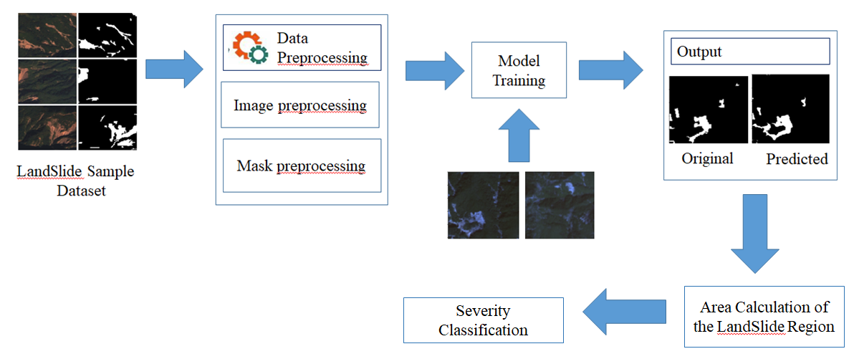
ARCHITECTURE DIAGRAM

Slide 15
IMPLEMENTATION
Step 1:Dataset Collection
Use Landslide4Sense dataset which contains satellite images and corresponding masks.
Step 2: Data Preprocessing
Resize images to 256×256
Normalize pixel values
Apply data augmentation
Step 3: Build the Model
Construct transformer-based architectures: SegFormer and MobileViT
Configure encoder–decoder structure for semantic segmentation
Initialize model parameters and input shape (256×256×3)
Integrate transformer blocks to capture global context and spatial features

Slide 16
Step 4: Model Training
Train models using preprocessed images and masks using training dataset
Use Binary Cross-Entropy loss and Adam optimizer
Step 5: Prediction & Segmentation
Generate pixel-wise segmentation masks (landslide vs non-landslide)
Identify landslide and non-landslide regions
Step 6: Performance Evaluation
Evaluate using Accuracy, Precision, Recall, F1-score, IoU, Dice Coefficient
Step 7: Area Calculation
Compute landslide area from predicted masks (pixel counting)
Step 8: Severity Classification
Classify landslides into Low, Medium, High based on area

Slide 17
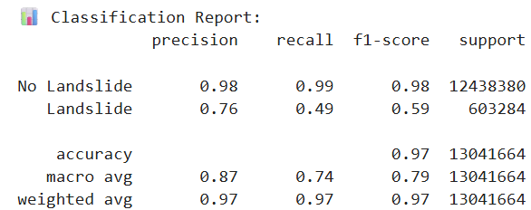
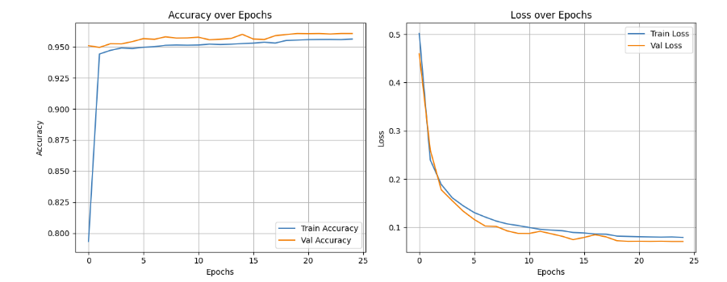

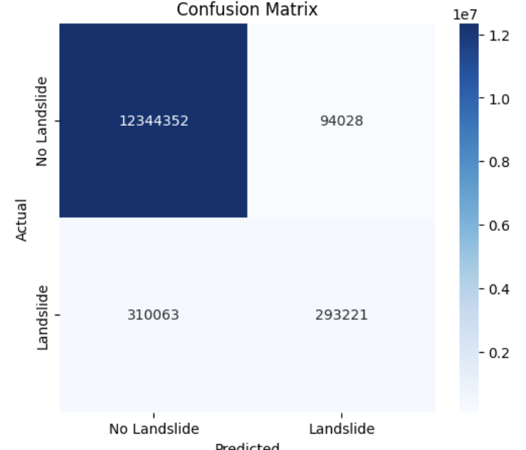
RESULTS
Figure.1. SegFormer Model

Slide 18
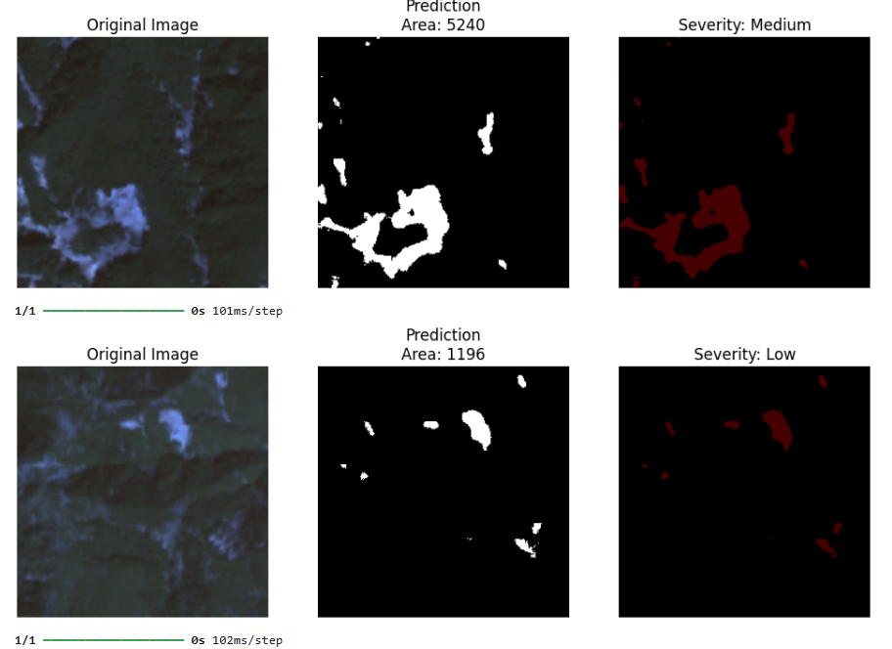
Figure.2. Prediction, Area Calculation and Severity Analysis of SegFormer

Slide 19
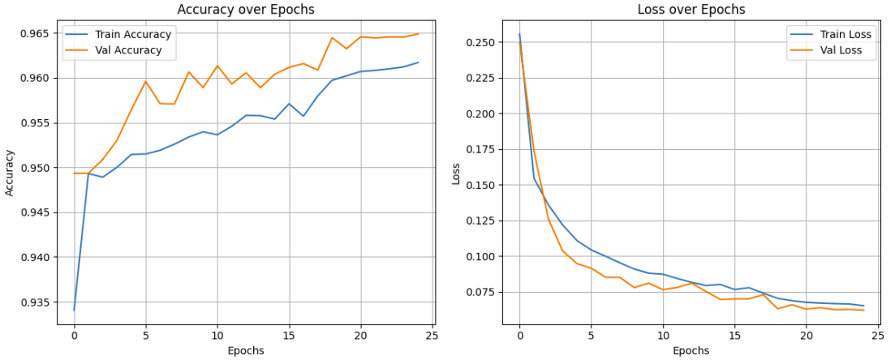
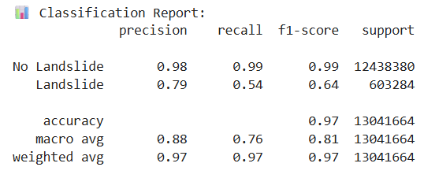

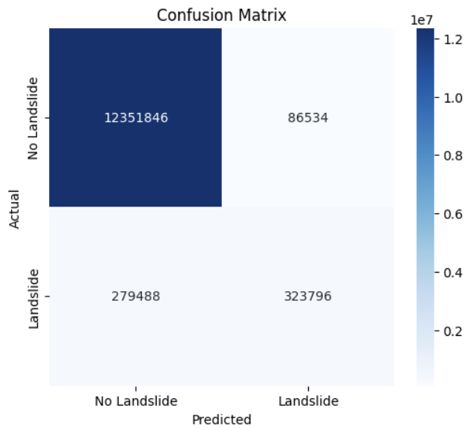
Figure.3. Mobile ViT Model

Slide 20
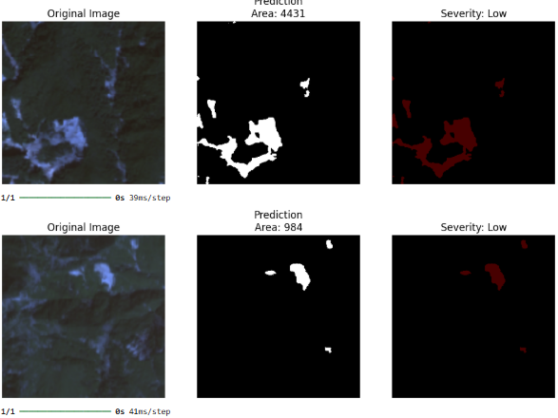
Figure.4. Prediction, Area Calculation and Severity Analysis of MobileViT

Slide 21
RESULT ANALYSIS
High accuracy is mainly due to dominance of non-landslide pixels.
Lower recall occurs because landslide regions are small and irregular.
MobileViT performs better in precision due to local + global feature learning.
SegFormer shows stable performance due to strong contextual understanding.
Misclassification occurs in complex terrain and vegetation regions.
Transformer models improve segmentation by capturing long-range dependencies.
Metric | Seg Former | Mobile ViT
Accuracy | 0.96666 | 0.9719
Precision | 0.6805 | 0.7891
Recall | 0.5226 | 0.5367
F1-Score | 0.5912 | 0.6389
IoU | 0.4197 | 0.4694
Dice Coefficient | 0.5912 | 0.6389

Slide 22
OBSERVATIONS
Both SegFormer and MobileViT achieved high accuracy (>96%), showing strong segmentation capability.
MobileViT performs better in precision and produces sharper boundaries for landslide regions.
SegFormer effectively captures global context, helping in understanding large-scale terrain patterns.
Transformer-based models outperform traditional CNN models in feature extraction.
The system successfully calculates landslide area and performs severity classification.

Slide 23
CONCLUSION
This project presents a transformer-based approach for landslide segmentation using SegFormer and MobileViT models on the Landslide4Sense dataset. Both models demonstrate strong performance in identifying landslide and non-landslide regions with high accuracy and effective pixel-wise segmentation. MobileViT shows better precision and boundary detection due to its combination of local and global feature learning, while SegFormer efficiently captures large-scale contextual information with a lightweight architecture. The integration of area calculation and severity classification further enhances the practical usefulness of the system. Overall, the proposed framework proves to be reliable and efficient for automated landslide detection and can be effectively applied in disaster management, environmental monitoring, and geospatial risk assessment.

Slide 24
FUTURE SCOPE
Improve landslide detection by addressing class imbalance using advanced loss functions.
Integrate additional data sources like DEM, rainfall, and SAR imagery for better accuracy.
Develop lightweight and optimized models for real-time applications.
Apply post-processing techniques to refine segmentation boundaries.
Test the models on different geographical regions to improve robustness.
Build a real-time web or mobile system for practical deployment.

Slide 25
REFERENCES
[1]ZŞener, Abdullah, and Burhan Ergen. "LandslideSegNet: an effective deep learning network for landslide segmentation using remote sensing imagery." Earth Science Informatics 17.5 (2024): 3963-3977.
[2]Xiao Feng, Juan Du, Minghua Wu, Bo Chai, Fasheng Miao, Yang Wang,
"Potential of synthetic images in landslide segmentation in data-poor scenario: a framework combining GAN and transformer models ", Landslides 21, 2211–2226 (2024).
[3] Li H., He Y., Xu Q. "Semantic segmentation of loess landslides with STAPLE mask and fully connected conditional random field“, Landslides 20, 367–380 (2023).
[4] Huang, Faming, et al. "Efficient and automatic extraction of slope units based on multi-scale segmentation method for landslide assessments." Landslides 18 (2022): 3715-3731.

Slide 26
[5]Xinran Liu, Yuexing Peng , Zili Lu , Wei Li , Junchuan Yu,Daqing Ge, and Wei Xiang,"Feature-Fusion Segmentation Network for Landslide Detection Using High-Resolution Remote Sensing Images and Digital Elevation Model Data," in IEEE Transactions on Geoscience and Remote Sensing, vol. 61, pp. 1-14, 2023.
[6] Huajin Li, Yusen He, Qiang Xu, Jiahao Deng, Weile Li , Yong Wei (2022), "Detection and segmentation of loess landslides via satellite images: A two-phase framework" Landslides, 19(3), 673-686 (2022).
[7] L. Bragagnolo, L.R. Rezende, R.V. da Silva, J.M.V. Grzybowski, "Convolutional neural networks applied to semantic segmentation of landslide scars ",CATENA, Volume 201,2021,105189,ISSN 0341-8162.
[8] Lv, W. Shi, X. Zhang and J. A. Benediktsson, "Landslide Inventory Mapping From Bitemporal High-Resolution Remote Sensing Images Using Change Detection and Multiscale Segmentation," in IEEE Journal of Selected Topics in Applied Earth Observations and Remote Sensing, vol. 11, no. 5, pp. 1520-1532, May 2018.

