Slide 1
Design and Analysis of Cryptographic Technique for Communication System
Under the Supervision of
Dr. Raza Abbas Haidri
Presented By:
Shivam Vatshayan
1613101690
Galgotias University, Greater Noida, U.P.

Slide 2
Contents at a Glance
Abstract
Cryptography Definition
Merits and Demerits
Issues and Challenges in Communication System
Literature Survey
Diffie Hellman exchange Algorithm
Vigenere Cipher
Polybius Cipher
Hybrid Cipher
Proposed Work
Conclusion
References

Slide 3
Abstract
Secure Communication of message from sender to receiver is one of the main security concern of Internet users across world.
It is because of the regular attacks and threats and most Important Data Privacy. In order to sort out these issues, we use cryptographic algorithm which encrypts data in some cipher and transfers it over the internet and again decrypted to original data.
Thus, lightweight cryptography methods are proposed to overcome many of the problems of conventional cryptography
Ciphers act as encapsulating system for message. Hybrid Algorithm will be formed from use of different types of ciphers.
The cryptosystem performs its encryption by encrypting the plaintext using Vigenere Cipher and further again processing though Polybius Cipher.

Slide 4
Cryptography Definition
Cryptography is the science of protecting information by transforming it into a secure format. This process, called encryption, has been used for centuries to prevent handwritten messages from being read by unintended recipients.
Today, cryptography is used to protect digital data. It is a division of computer science that focuses on transforming data into formats that cannot be recognized by unauthorized users.
Two Types of Cryptography:
Symmetric Cryptography
Asymmetric Cryptography

Slide 5
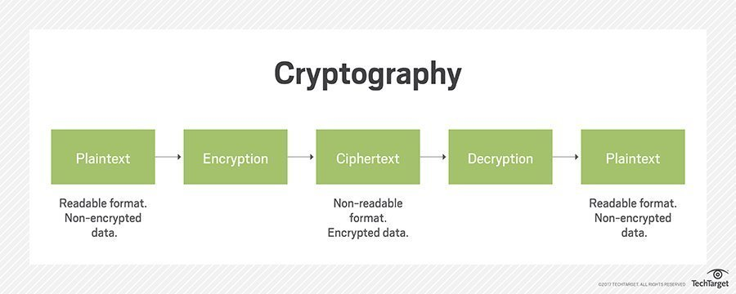
Pictorial View of Cryptography

Slide 6
Merits
Highly Secure
Confidentiality
Authentication
Data Integrity
Non-repudiation

Slide 7
Demerits
Less use of hybrid algorithms
Selective access control also cannot be realized through the use of cryptography. Administrative controls and procedures are required to be exercised for the same.
Cryptography comes at cost and time
Less deployment of system through Deep Learning (Neural Networks)
Difficult to access even for a legitimate user at a crucial time of decision-making.
Threats that emerge from the poor design of systems.

Slide 8
Issue and Challenges in Communication System
State of Insecurity – Increase in Adaption and Development of fragmented attached attack on daily basis on communication system.
Data Replication – Re-writing and Copying of data from Back End server even It is protected by Data saving applications.
Sense of Message Stealing- Important Message of huge Key length stealing or blocking & Jamming of server.
New threats and Attacks such as Eavesdroping, DOS attack and kasiski attacks
Congestion – Message overlapping and re accessing receiver channel without their knowledge.
Wireless Spoofing attacks- attacker uses information obtained by a wireless sniffer to impersonate another machine on the network.

Slide 9
Literature and Survey
In [1], modified version of vigenere algorithm was proposed in which diffusion is provided by adding a random bit to each byte before the message is encrypted using Vigenere. This technique fails kasiski attack to find the length of key because the padding of message with random bits. The main drawback of this technique is that the size of the encrypted message will be increased by around 56%.
In [2], the Caesar Cipher and Vigenere Cipher have been modified and expanded by including alphabets, numbers and symbols and at the same time introduced a complete confusion and diffusion into the modified cipher developed. It was concluded that cipher text generated by proposed hybrid technique is very difficult to break using a frequency method, brute force attack etc.
Vigenere cipher is one of the most popular ciphers in the past because of its simplicity and resistance to the frequency analysis test of letters that can crack simple ciphers like Caesar cipher. But with the increase in the cryptanalytic skills, Vigenere cipher is no longer taken as secure cipher and is not popularly used. The most weak point of Vigenere cipher is the use of repeated words as key-streams that causes repetition of certain patterns in cipher texts at intervals equal to the length of the keyword used [3].

Slide 10
DIFFIE HELLMAN KEY EXCHANGE ALGORITHM
The Diffie–Hellman Key Exchange Method (hereafter called the D-H method) allows two parties agree upon a shared secret number, a symmetric key, over an insecure communications channel/medium, where attackers/hackers might be listening in.
The benefit of using a symmetric key over public key cryptography lies in the fact that encryption of a plaintext message into a ciphertext message and decryption of the ciphertext message back to the original plaintext message happens much faster using a symmetric key.

Slide 11
Vigenere Cipher
Vigenere Cipher is a method of encrypting alphabetic text. It uses a simple form of polyalphabetic substitution.
The encryption of the original text is done using the Vigenère square or Vigenère table.
The table consists of the alphabets written out 26 times in different rows, each alphabet shifted cyclically to the left compared to the previous alphabet, corresponding to the 26 possible Caesar Ciphers.
At different points in the encryption process, the cipher uses a different alphabet from one of the rows.
The alphabet used at each point depends on a repeating keyword.

Slide 12
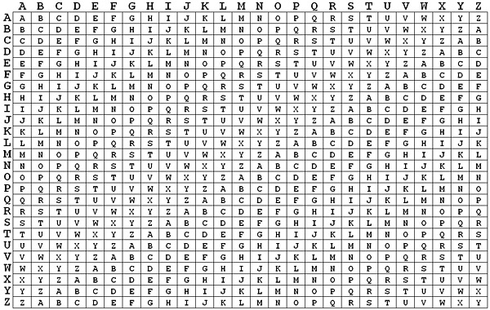
Vigenere Table

Slide 13
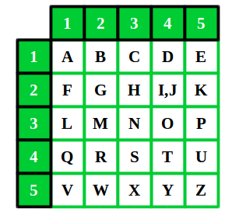
Polybius Cipher
A Polybius Square is a table that allows someone to convert letters into numbers. To make the encryption little harder, this table can be randomized and shared with the recipient.
In order to fit the 26 letters of the alphabet into the 25 cells created by the table, the letters ‘i’ and ‘j’ are usually combined into a single cell.

Slide 14
Proposed Work
The method employs use of both Vegenere Cipher and Polybius Square Cipher in its encryption process.
The ciphertext will first be operated on using Vegenere. A chosen key out of random will initiate the process.
At the end of the process, the resulting ciphertext then becomes a message as Input for the Polybius Square Cipher process.
This process will end up making the final ciphertext more difficult to be broken using existing cryptanalysis processes.
A software program will be written to demonstrate the effectiveness of the algorithm using Python programming language and cryptanalysis will be performed on the ciphertext.

Slide 15
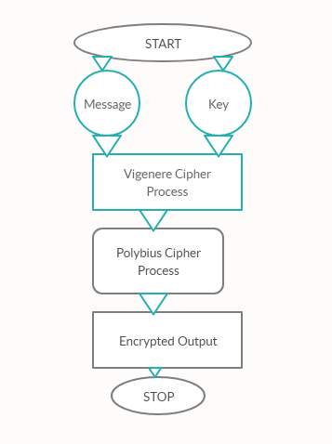
Pictorial View

Slide 16
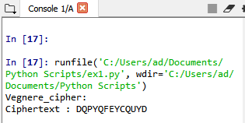
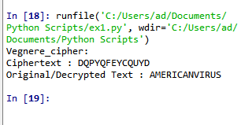
Vegenere Cipher Output

Slide 17
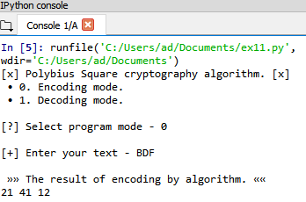
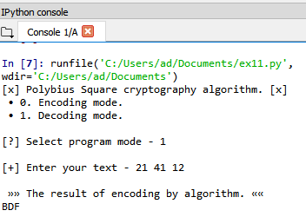
Polybius Cryptography Output

Slide 18
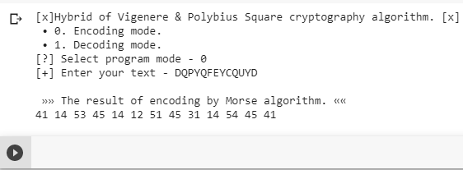
Hybrid Cipher
Hybrid Process though Combination of Vigenere and Polybius Square Cipher takes Encoding Mode where it governs on [A-Z] Aplhabetic letters and Numerical Both in the System.
This Hybrid Cipher makes the System tough and unbreakable for any Assaults and attacks from Outside

Slide 19
Conclusion
Cryptography is the widely used method for the security of data.
Diffie Hellman Exchange Key Algorithm will determine numbers of secret message to transfer.
Vigenere cipher is one of the cryptographic method that is considered simplest and weakest due to many limitations.
To overcome the limitations of Vigenere cipher we proposed Summation of Polybius Cipher that makes much secure against Kasiski and Friedman attacks. Cryptanalysis, frequency analysis, pattern prediction and brute attack on proposed technique are also much difficult due to use of Combination of two Cipher for encryption.
Although there are many cryptographic methods but this domain still requires serious attention of research community for the improvement of data security. In future our aim is to provide validation of proposed approach by performing security and performance analysis.

Slide 20
References
Chaudhari, Swapnil. (2018). A Research Paper on New Hybrid Cryptography Algorithm.
Jakimoski, Kire, "Security Techniques for Data Protection in Cloud Computing." International Journal of Grid and Distributed Computing 9.1 (2016): 49-56.
https://en.wikipedia.org/wiki/Vigen%C3%A8re_cipher
https://en.wikipedia.org/wiki/Polybius_square
Puneet Kumar, Shashi B. Rana, Development of modified AES algorithm for data security, Optik - International Journal for Light and Electron Optics, Volume 127, Issue 4, 2016, Pages 2341-2345, ISSN 0030-4026, http://dx.doi.org/10.1016/j.ijleo.2015.11.188. (http://www.sciencedirect.com/science/article/pii/S0030402615018215)
Encryption. Wellesley college Computer Science Department lecture note retrieved from : http://cs110.wellesley.edu/lectures/L18-encryption/.

Slide 21
Reference Cont.
7. Classical cipher, Transposition ciphers, Retrieved from http://en.wikipedia.org/wiki/Classical_cipher
Transposition ciphers, columnar transposition Retrieved from http://en.wikipedia.org/wiki/Transposition_cipher
C. Sanchez-Avila and R. Sanchez-Reillo, "The Rijndael block cipher (AES proposal): a comparison with DES," in Security Technology, 2001 IEEE 35th International Carnahan Conference on, 2001, pp. 229-234.
Q.-A. Kester, "A cryptosystem based on Vigenère cipher with varying key," International Journal of Advanced Research in Computer Engineering & Technology (IJARCET), vol. 1, pp. pp: 108-113, 2012.
C. Bhardwaj, "Modification of Vigenère Cipher by Random Numbers, Punctuations & Mathematical Symbols," Journal of Computer Engineering (IOSRJCE) ISSN, pp. 2278-0661, 201
F. H. S. Fairouz Mushtaq Sher Ali, "Enhancing Security of Vigenere Cipher by Stream Cipher," International Journal of Computer Applications, vol. 100, pp. 1-4, 2014

Slide 22
Reference Conti.
13 P. Gutmann, ―Cryptographic Security Architecture: Design and Verification‖. Springer-Verlag,2004.
14 Jakimoski, Kire, "Security Techniques for Data Protection in Cloud Computing." International Journal of Grid and Distributed Computing 9.1 (2016): 49-56.
15 M. Abror, “Pengertian dan Aspek-Aspek Keamanan Komputer,” 2018. [Daring]. Tersedia pada:https://www.ayoksinau.com/pengertian-dan-aspek-aspek-keamanan-komputer-lengkap/. [Diakses: 01-Okt-2018].
16 V. Beal. (2009, Encryption. Available: http://www.webopedia.com/TERM/E/encryption.ht ml

Slide 23
Hi there
IEEE Research Paper based Project
Project is Implemented on Python Programming
Mail me at vatshayan007@gmail.com for Project Code, Project Report, project PPT and Research Paper of this Project
-Shivam Vatshayan
(Software Engineer)

