Slide 1
Virtual uskuna yaratishda takrorlanish va tarmoqlanish jarayonlari.
M.N.Ikromova

Slide 2
Reja
1. For Loop strukturasi
2. While Loop strukturasi
Case strukturasi

Slide 3
Tsikl-bu ko'rsatmalar to'plamining takroriy bajarilishini tashkil qilish uchun mo'ljallangan boshqaruv konstruktsiyaning bir turi.
Takroriy bajarish uchun mo'ljallangan ko'rsatmalar ketma-ketligi tsikl tanasi deb ataladi va tsikl tanasining bir marta bajarilishi iteratsiya deb ataladi.

Slide 4
LabVIEW-da tsikllarning ikki turi mavjud:
For Loop –takrorlanishlar soni berilgan (yoki ma'lum sonli) tsikl.
While Loop- shart bo'yicha tsikl. Avvaldan tsikl davomiyligi shartini tekshirish hamda iteratsiyasi noma’lum bo’lgan tsikl.
Tsikllarda ma'lumotlarni olish va chiqarish uchun cheksiz kirish va chiqish terminallariga ega bo'lishi mumkin.

Slide 5
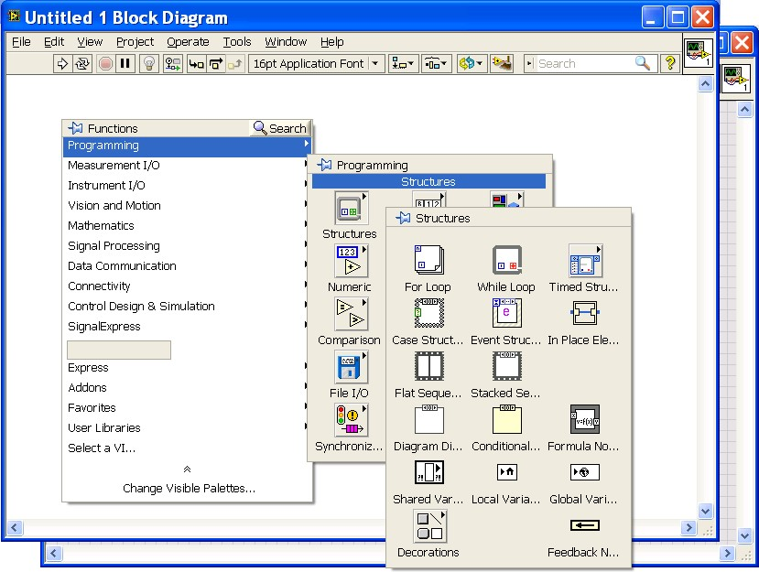
Dasturni muayyan tartibda bajarish yoki ma’lum shartlar asosida uning alohida qismlarini takrorlash Funktions palitrasining Programming – Structures bo'limidagi funktsiyalari yordamida amalga oshiriladi

Slide 6
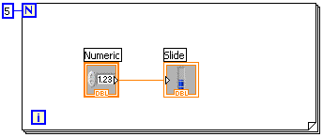
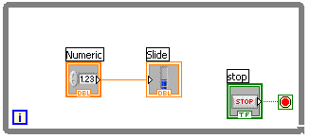
Tsikllar
For Loop
Takororlanish soni bo’yicha
i joriy iteratsiya indikatori
N terminalda berilgan schyotchik qiymatiga ko’ra bajariladi
While Loop
Shart bo’yicha
i joriy iteratsiya indikatori
-Terminalga chiqish sharti berilguncha bajariladi
Notes:
Both the While and For Loops are located on the Functions»Structures palette. The For Loop differs from the While Loop in that the For Loop executes a set number of times. A While Loop stops executing the subdiagram only if the value at the conditional terminal exists.
While Loops
Similar to a Do Loop or a Repeat-Until Loop in text-based programming languages, a While Loop, shown at the top right, executes a subdiagram until a condition is met. The While Loop executes the sub diagram until the conditional terminal, an input terminal, receives a specific Boolean value. The default behavior and appearance of the conditional terminal is Stop If True. When a conditional terminal is Stop If True, the While Loop executes its subdiagram until the conditional terminal receives a TRUE value. The iteration terminal (an output terminal), shown at left, contains the number of completed iterations. The iteration count always starts at zero. During the first iteration, the iteration terminal returns 0.
For Loops
A For Loop, shown above, executes a subdiagram a set number of times. The value in the count terminal (an input terminal) represented by the N, indicates how many times to repeat the subdiagram. The iteration terminal (an output terminal), shown at left, contains the number of completed iterations. The iteration count always starts at zero. During the first iteration, the iteration terminal returns 0.
Introduction to LabVIEW Hands-On 36 ni.com

Slide 7
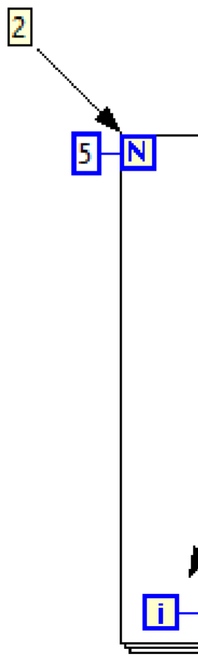
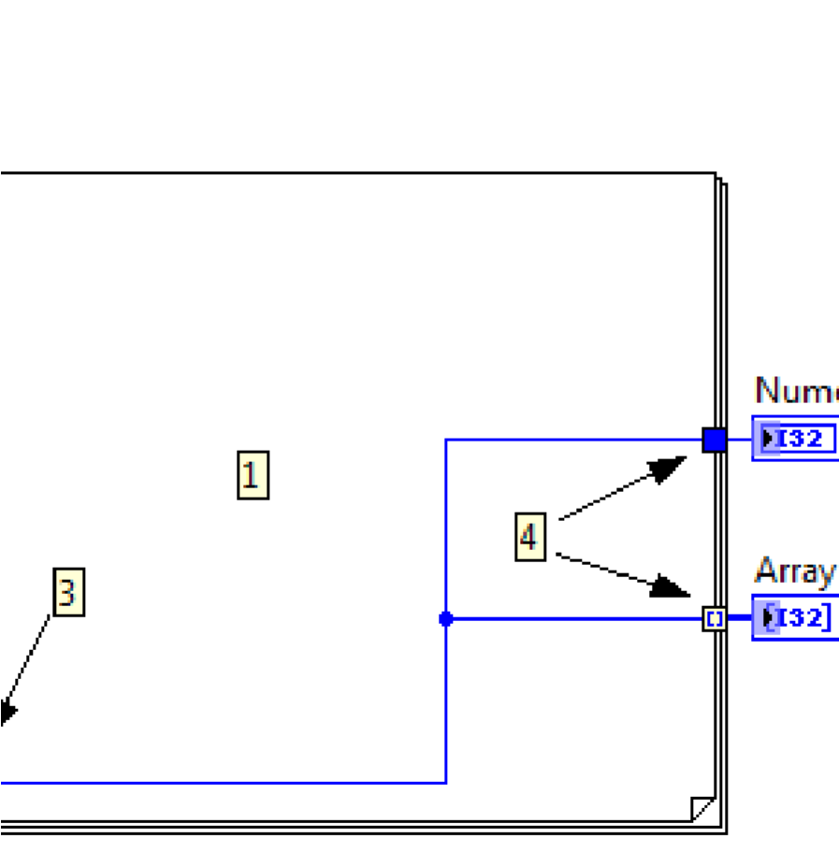
For Loop tsikli.
Tsikl tanasi (1), takorlanishi kerak bo’lgan ko’rsatmalar o’rni;
N Iteratsiyalar soni terminaali (2) – tsiklning takrorlanish soni beriladigan terminal;
i Iteratsiyalar schyotchigi (3), joriy iteratsiyalar sonini hisoblovchi;
Chiqish terminallari (4), unda tsikl ishi tugaganidan so’ng qiymatlar paydo bo’ladi.
Odatiy holda, belgilangan sonli iteratsiyalar bilan tsikl tuzilishining chiqishida qiymatlar massivini o'z ichiga olgan terminal yaratiladi.

Slide 8
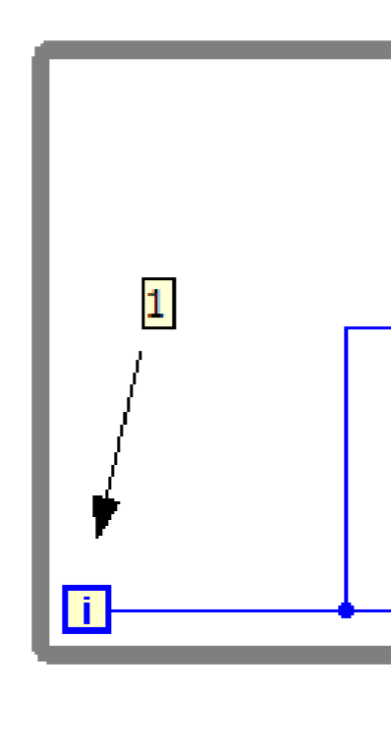
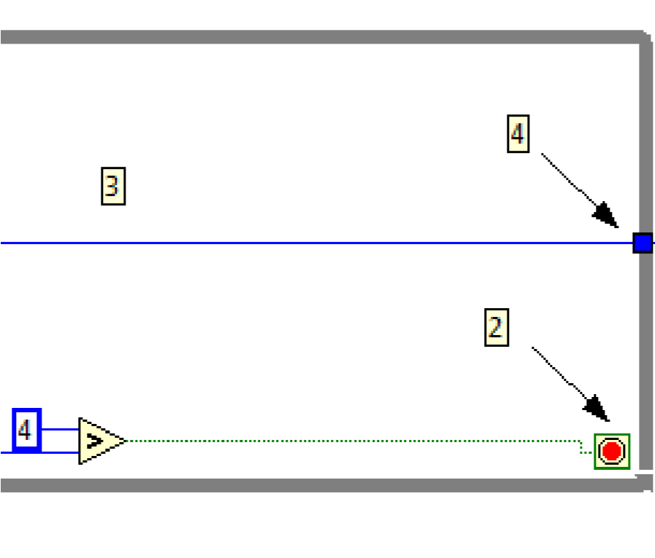

While Loop shart tsikli
Tsikl tanasi (3), takorlanishi kerak bo’lgan ko’rsatmalar o’rni;
i iteratsiyalar schyotchigi (1), joriy iteratsiyalar sonini hisoblovchi;
Yakunlanish sharti terminali (2) , u ikki xil rejimda ishlaydi – agar terminal kirishida Rost va agar Yolg’on bo’lganda to’xtash (rejimlarni o’zgartirish SO’T(sichqoncha o’ng tugmasida (stop if true/false) amalga oshiriladi;
Chiqish terminallari (4), unda tsikl ishi tugaganidan so’ng qiymatlar paydo bo’ladi.

Slide 9
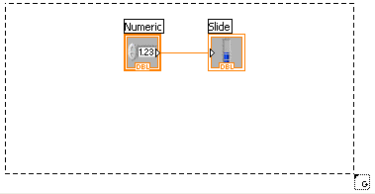
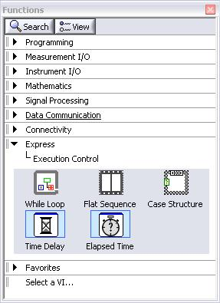
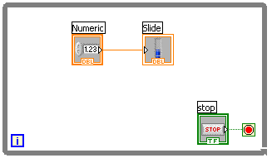
Tsiklga ulash jarayoni
2. Berilgan kodni ichiga olish
1. Programming/ “Struktura”yoki Express/While Loop dan olish
3. Yoki avval tsikl ramkasini qo’yib ichiga kodni kiritish
Notes:
Place loops in your diagram by selecting them from the Structures palette of the Functions palette:
When selected, the mouse cursor becomes a special pointer that you use to enclose the section of code you want to repeat.
Click the mouse button to define the top-left corner, click the mouse button again at the bottom-right corner, and the While Loop boundary is created around the selected code.
Drag or drop additional nodes in the While Loop if needed.
© National Instruments Corporation 37 Introduction to LabVIEW Hands-On

Slide 10
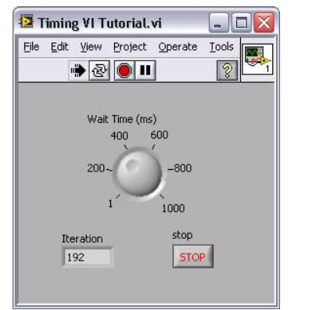
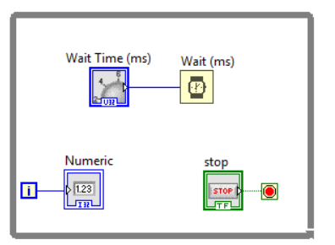
Tsiklni bajarilishini vaqt bilan boshqarish
1. Vaqtni ushlab turishni, yani kutishni amalga oshirish
Задержка времени
Временной цикл
Notes:
Time Delay
The Time Delay Express VI delays execution by a specified number of seconds. Following the rules of Data Flow Programming, the while loop will not iterate until all tasks inside of it are complete, thus delaying each iteration of the loop.
Timed Loops
Executes each iteration of the loop at the period you specify. Use the Timed Loop when you want to develop VIs with multi-rate timing capabilities, precise timing, feedback on loop execution, timing characteristics that change dynamically, or several levels of execution priority.
Double-click the Input Node or right-click the Input Node and select Configure Timed Loop from the shortcut menu to display the Loop Configuration dialog box, where you can configure the Timed Loop. The values you enter in the Loop Configuration dialog box appear as options in the Input Node.
Wait Until Next ms Multiple
Waits until the value of the millisecond timer becomes a multiple of the specified millisecond multiple. Use this function to synchronize activities. You can call this function in a loop to control the loop execution rate. However, it is possible that the first loop period might be short. This function makes asynchronous system calls, but the nodes themselves function synchronously. Therefore, it does not complete execution until the specified time has elapsed.
Functions»Programming»Timing»Wait Until Next ms Multiple
Introduction to LabVIEW Hands-On 58 ni.com

Slide 11
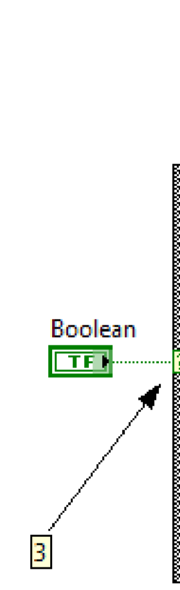
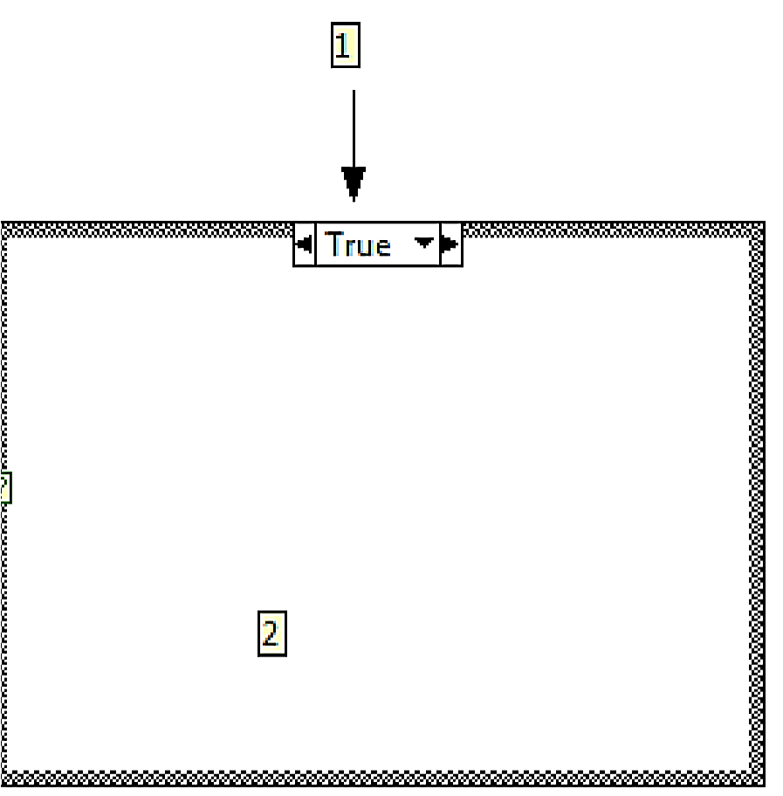
Varianta strukturasi (Case strukture)
Case strukturasi shartli operator vazifasini bajaradi. True va False shartlari asosida ishlaydi.
True bo‘lganda: bir amal bajariladi;
False bo‘lganda: ikkinchi amal bajariladi.
Case strukturasining tuzilishi:
2-dastur tanasi;
1-selector, qiymatni aks ettirilishi True yoki False, tashqaridan kiritilgan ma’lumot qaysi qiymatga mos bo’lsa, dastur tanasidagi amal bajariladi;
3- terminal, qaysi blok-diagramma bajarilishini aniqlaydi.
-ma’lumotlar selektorining terminali, qaysi amal bajarilishini belgilaydi, True holatidagi mi yoki False dagimi

Slide 12
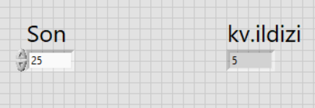
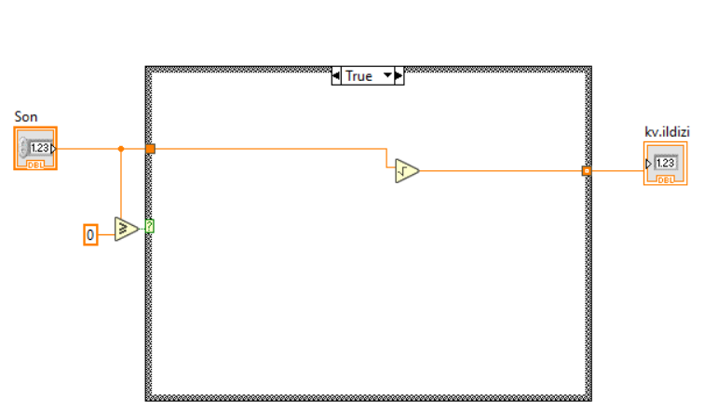
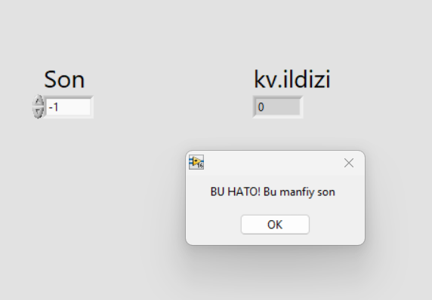
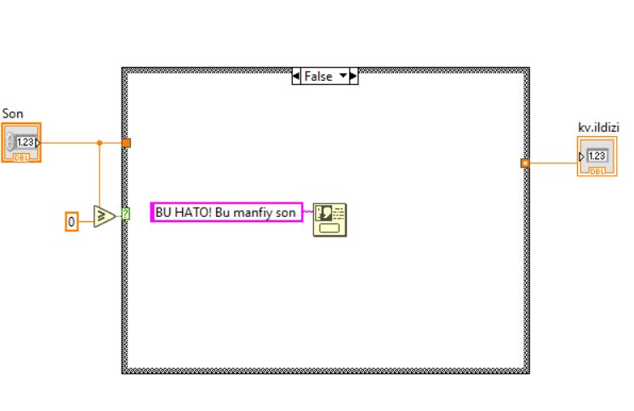
Sonni kvadrat ildizini hisoblash

Slide 13
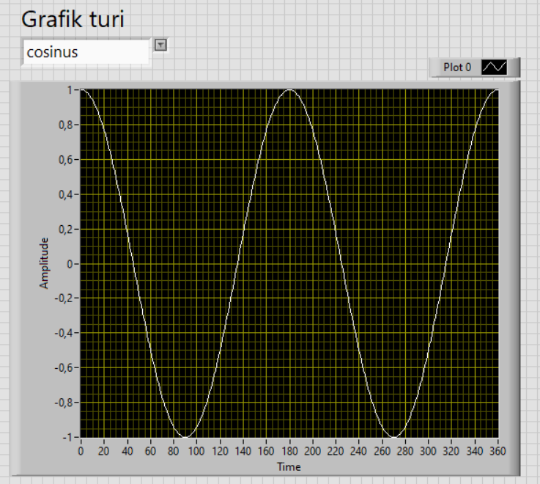
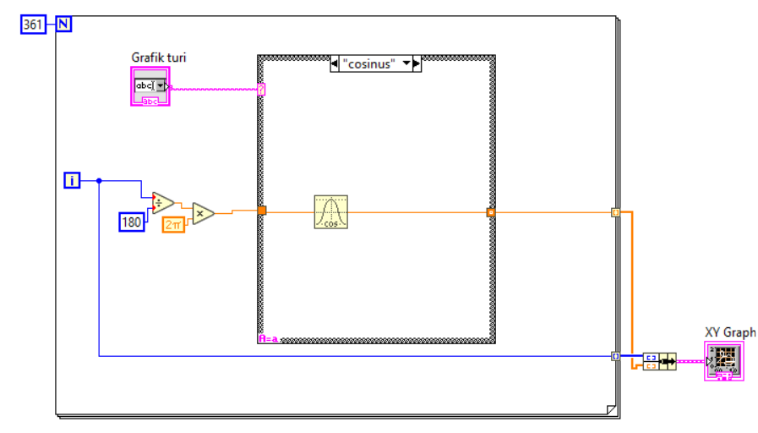
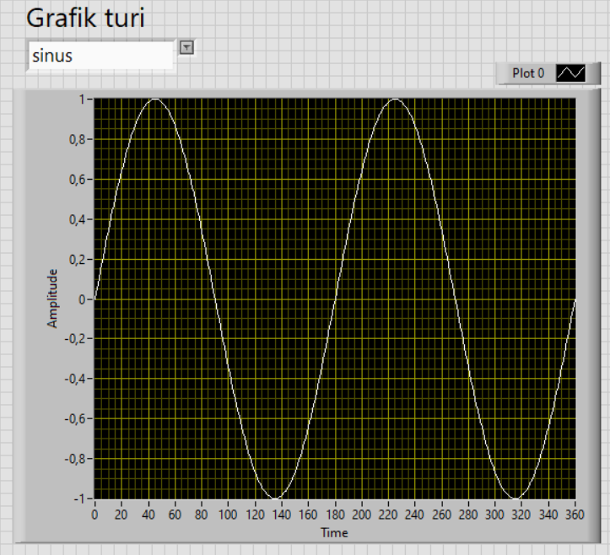
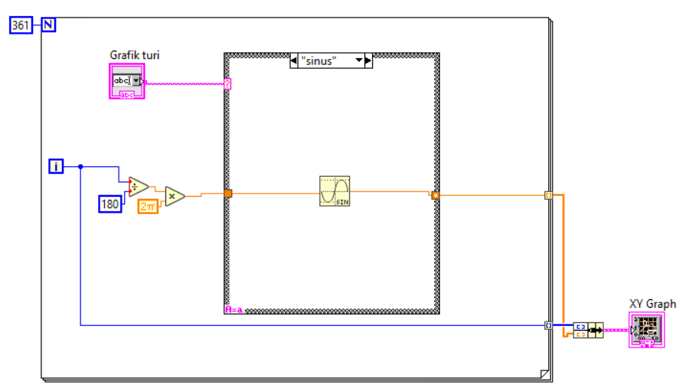
Grafik qurish
Combobox
XY Graf
Bir davrda bajarilishi uchun qadamlar soni
Bundle funktsiyasi

