Slide 1
Labview dasturida tarmoqlanish jarayoni. Case strukturasi

Slide 2
Reja
1. Sonni kvadrat ildizdan chiqarish.
2. Kalkulyator yaratish.
3. Grafik qurish.

Slide 3
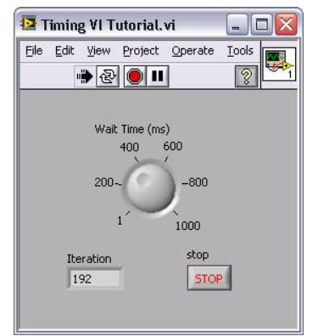
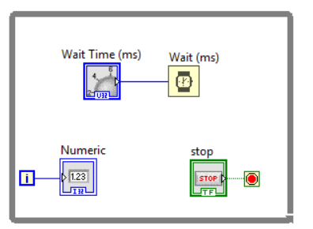
Tsiklni bajarilishini vaqt bilan boshqarish
1. Vaqtni ushlab turishni, yani kutishni amalga oshirish
Задержка времени
Временной цикл
Notes:
Time Delay
The Time Delay Express VI delays execution by a specified number of seconds. Following the rules of Data Flow Programming, the while loop will not iterate until all tasks inside of it are complete, thus delaying each iteration of the loop.
Timed Loops
Executes each iteration of the loop at the period you specify. Use the Timed Loop when you want to develop VIs with multi-rate timing capabilities, precise timing, feedback on loop execution, timing characteristics that change dynamically, or several levels of execution priority.
Double-click the Input Node or right-click the Input Node and select Configure Timed Loop from the shortcut menu to display the Loop Configuration dialog box, where you can configure the Timed Loop. The values you enter in the Loop Configuration dialog box appear as options in the Input Node.
Wait Until Next ms Multiple
Waits until the value of the millisecond timer becomes a multiple of the specified millisecond multiple. Use this function to synchronize activities. You can call this function in a loop to control the loop execution rate. However, it is possible that the first loop period might be short. This function makes asynchronous system calls, but the nodes themselves function synchronously. Therefore, it does not complete execution until the specified time has elapsed.
Functions»Programming»Timing»Wait Until Next ms Multiple
Introduction to LabVIEW Hands-On 58 ni.com

Slide 4

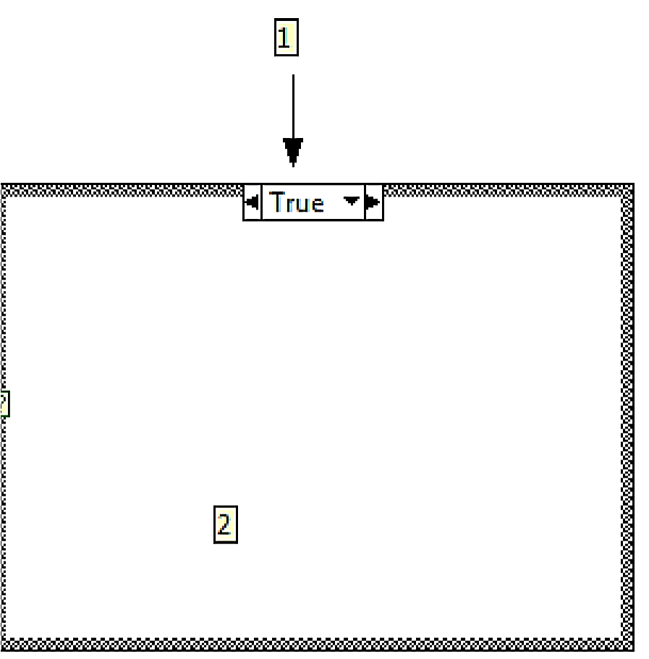
Varianta strukturasi (Case strukture)
Case strukturasi shartli operator vazifasini bajaradi. True va False shartlari asosida ishlaydi.
True bo‘lganda: bir amal bajariladi;
False bo‘lganda: ikkinchi amal bajariladi.
Case strukturasining tuzilishi:
2-dastur tanasi;
1-selector, qiymatni aks ettirilishi True yoki False, tashqaridan kiritilgan ma’lumot qaysi qiymatga mos bo’lsa, dastur tanasidagi amal bajariladi;
3- terminal, qaysi blok-diagramma bajarilishini aniqlaydi.
-ma’lumotlar selektorining terminali, qaysi amal bajarilishini belgilaydi, True holatidagi mi yoki False dagimi

Slide 5
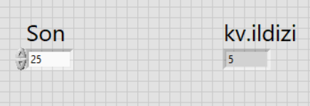
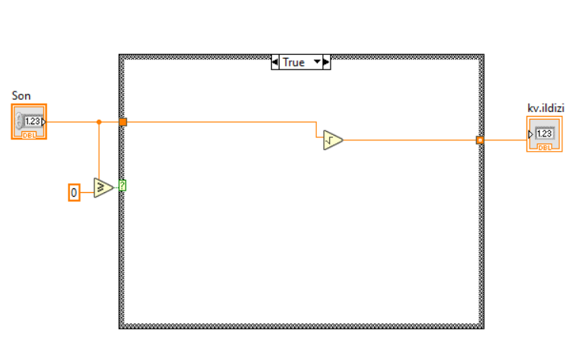
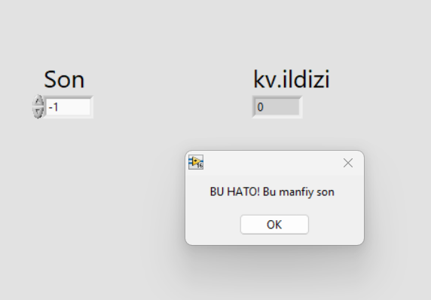
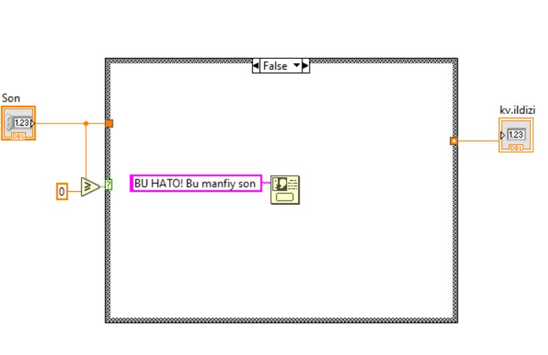
Sonni kvadrat ildizini hisoblash

Slide 6
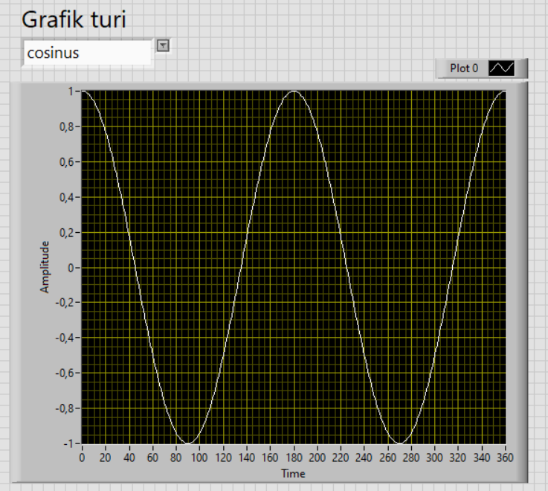
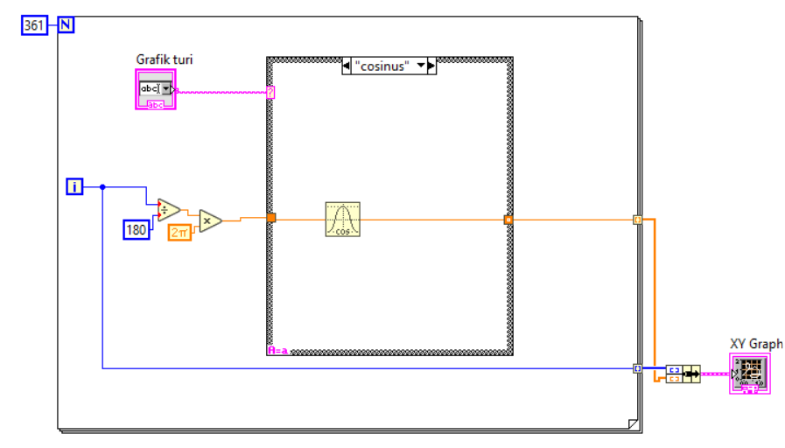
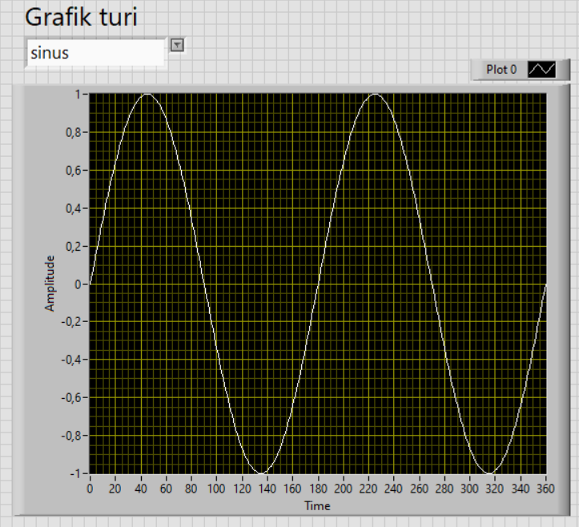
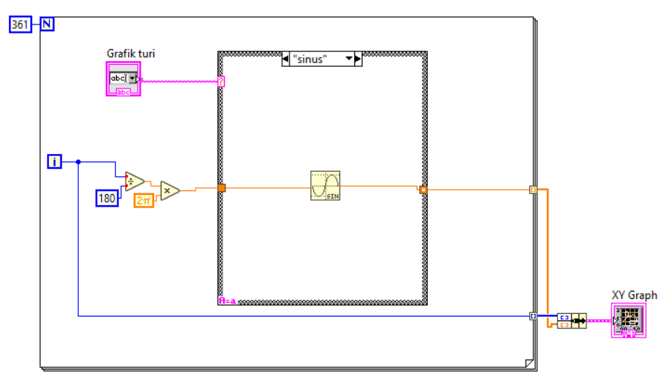
Grafik qurish
Combobox
XY Graf
Bir davrda bajarilishi uchun qadamlar soni
Bundle funktsiyasi

