Slide 1

Reactive Programming
Asynchronous Champion
Kantien @ Utrecht

Slide 2
So, what is Reactive Programming?
From Wikipedia:
”Reactive Programming is an asynchronous programming paradigm concerned with data streams and the propagation of change. “

Slide 3


Slide 4
So, what is Reactive Programming?
Data is seen as streams
Strong focus on change propagation
Isn’t shy of some good old FP
Examples: Verilog, ReactiveX, Spring Reactor, Akka, Vert.x

Slide 5

Let’s dive into ReactiveX
API based on Reactive Programming
RxJS, RxJava, Rx.Net, RxCpp, RxRust, RxPY, RxKotlin
Familiarity with streams helps understanding of Rx
Everything is a stream
Streams Observer pattern ON STEROIDS

Slide 6
ReactiveX vs Java Streams
Observables are push-based
Observables can emit to multiple observers
Larger range of executable functions (zip)
More control of threading model
More integrative in the entire system

Slide 7
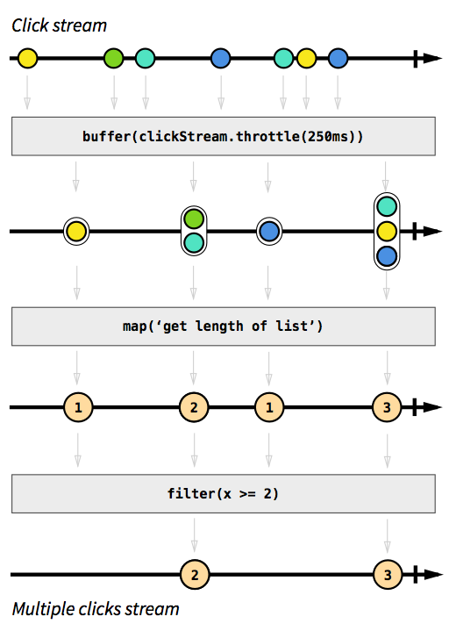
Some live examples
Thank you,
github.com/staltz!
https://rxviz.com/examples
https://rxmarbles.com

Slide 8
Let’s go RxJS!

