Slide 1

Seasonal Agriculture Performance Analysis
STUDENT NAME : AKSHIT VAUTREY
COLLEGE NAME : ST. mary’s centenary college of management
AICTE STU ID : STU6927e3191c35b1764221721

Slide 2

PROBLEM STATEMENT
Agricultural activities are influenced by seasonal variations in environmental conditions, farming practices, resource availability and market conditions. As a result, agricultural performance may differ from one season to another. However, raw agricultural data does not clearly explain how agricultural performance changes across seasons or what patterns can be observed in different seasonal conditions. The problem is to analyze the given agricultural dataset and investigate seasonal differences in agricultural performance by identifying meaningful patterns, trends, relationships and variations within the available data.

Slide 3
Project Description
This project performs an end-to-end data analytics study on a seasonal agriculture performance dataset of 4,000 farm-level records across 28 variables, covering location, crop, season, environmental conditions, farming practices, resource usage and economic outcomes.
The workflow includes data cleaning (missing values, duplicates), descriptive statistics, univariate/bivariate/multivariate analysis, IQR-based outlier investigation, correlation analysis, and structured seasonal comparisons across crop, irrigation method, region and risk level.
The analysis explains why performance changes across seasons — e.g. crop selection driving profitability more than season alone, Drip irrigation outperforming other methods, and the Zaid season being the only unprofitable one — and translates these findings into evidence-based recommendations.

Slide 4

WHO ARE THE END USERS?
Farmers — to choose crops, irrigation methods and timing that improve yield and profitability in their local season.
Agricultural policy makers / government bodies — to design season-specific subsidy, credit and water-resource programs.
Agricultural extension officers / advisors — to give region- and season-specific guidance to farmers.
Agribusiness and crop insurance companies — to assess seasonal risk patterns for pricing and planning.
Researchers and students — as a reference case study for applying data analytics to agricultural decision-making.

Slide 5

Technology Used
Language : Python
Data handling : Pandas, NumPy
Data visualization : Matplotlib, Seaborn
Development environment : Jupyter Notebook / vs code
Analytical techniques : descriptive stats, IQR outlier detection, correlation analysis, univariate/bivariate/multivariate analysis, seasonal comparisons.

Slide 6
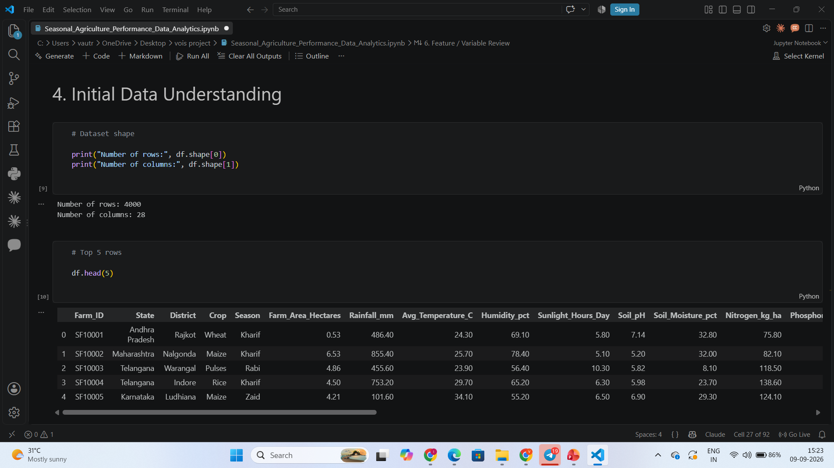
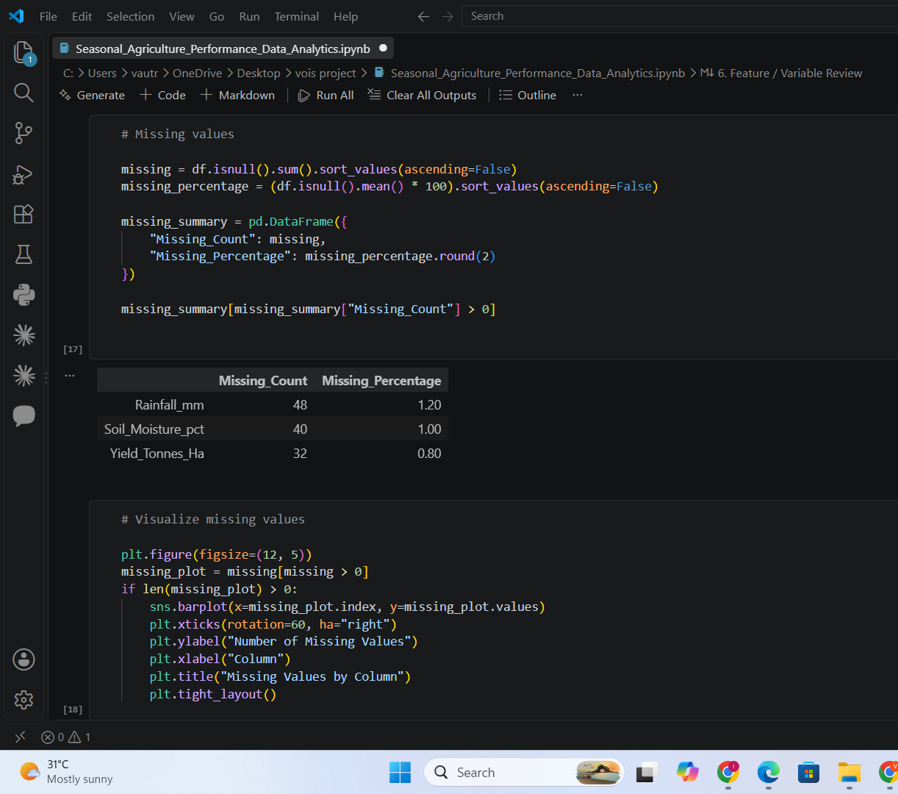
RESULTS

Slide 7
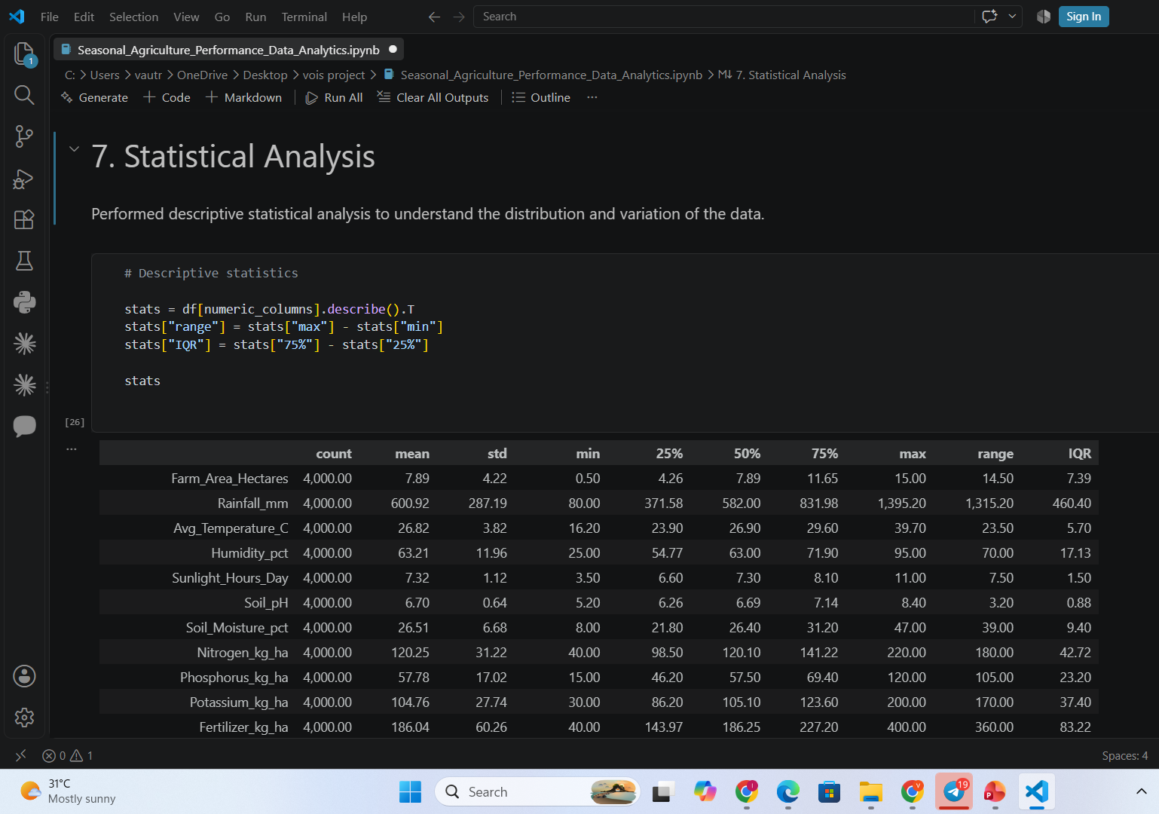
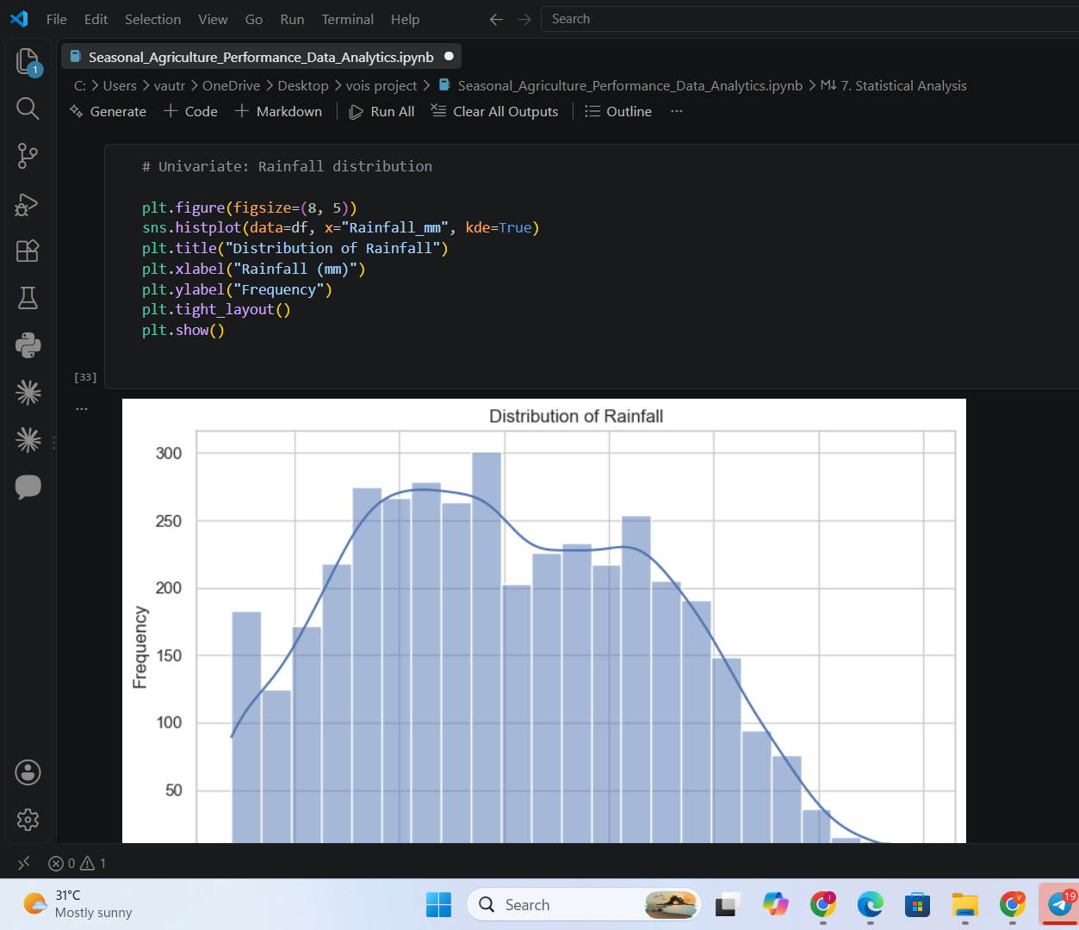
RESULTS

Slide 8
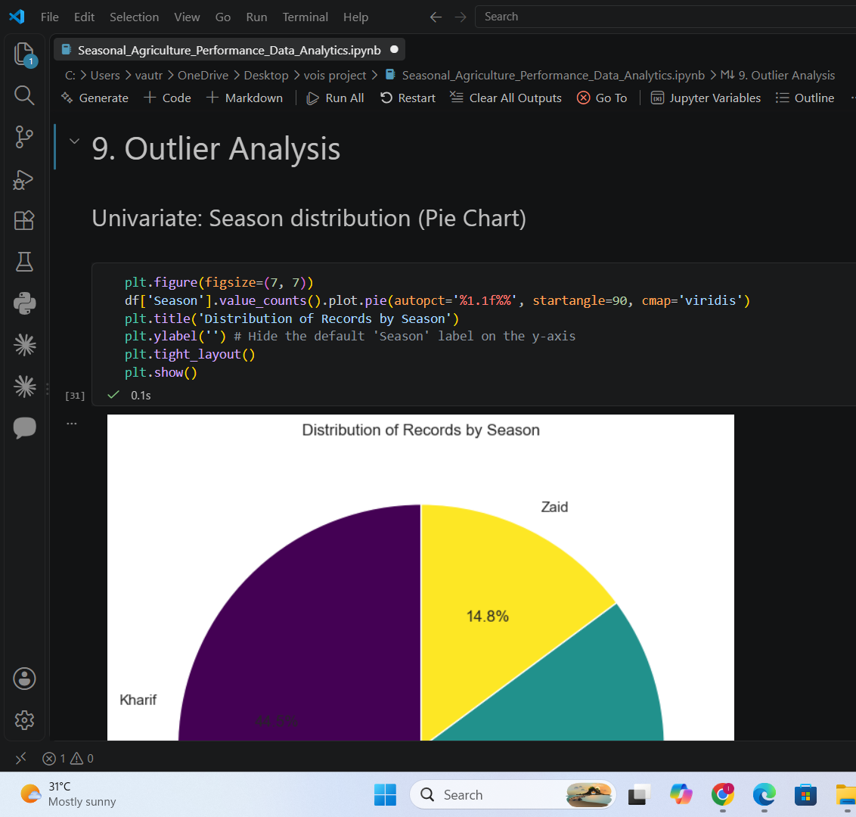
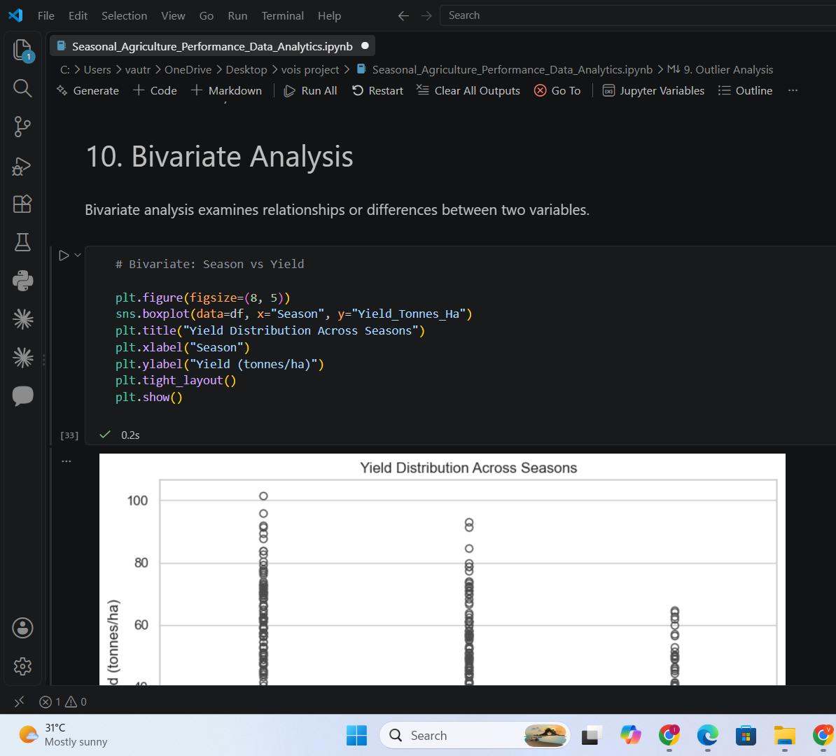
RESULTS

Slide 9
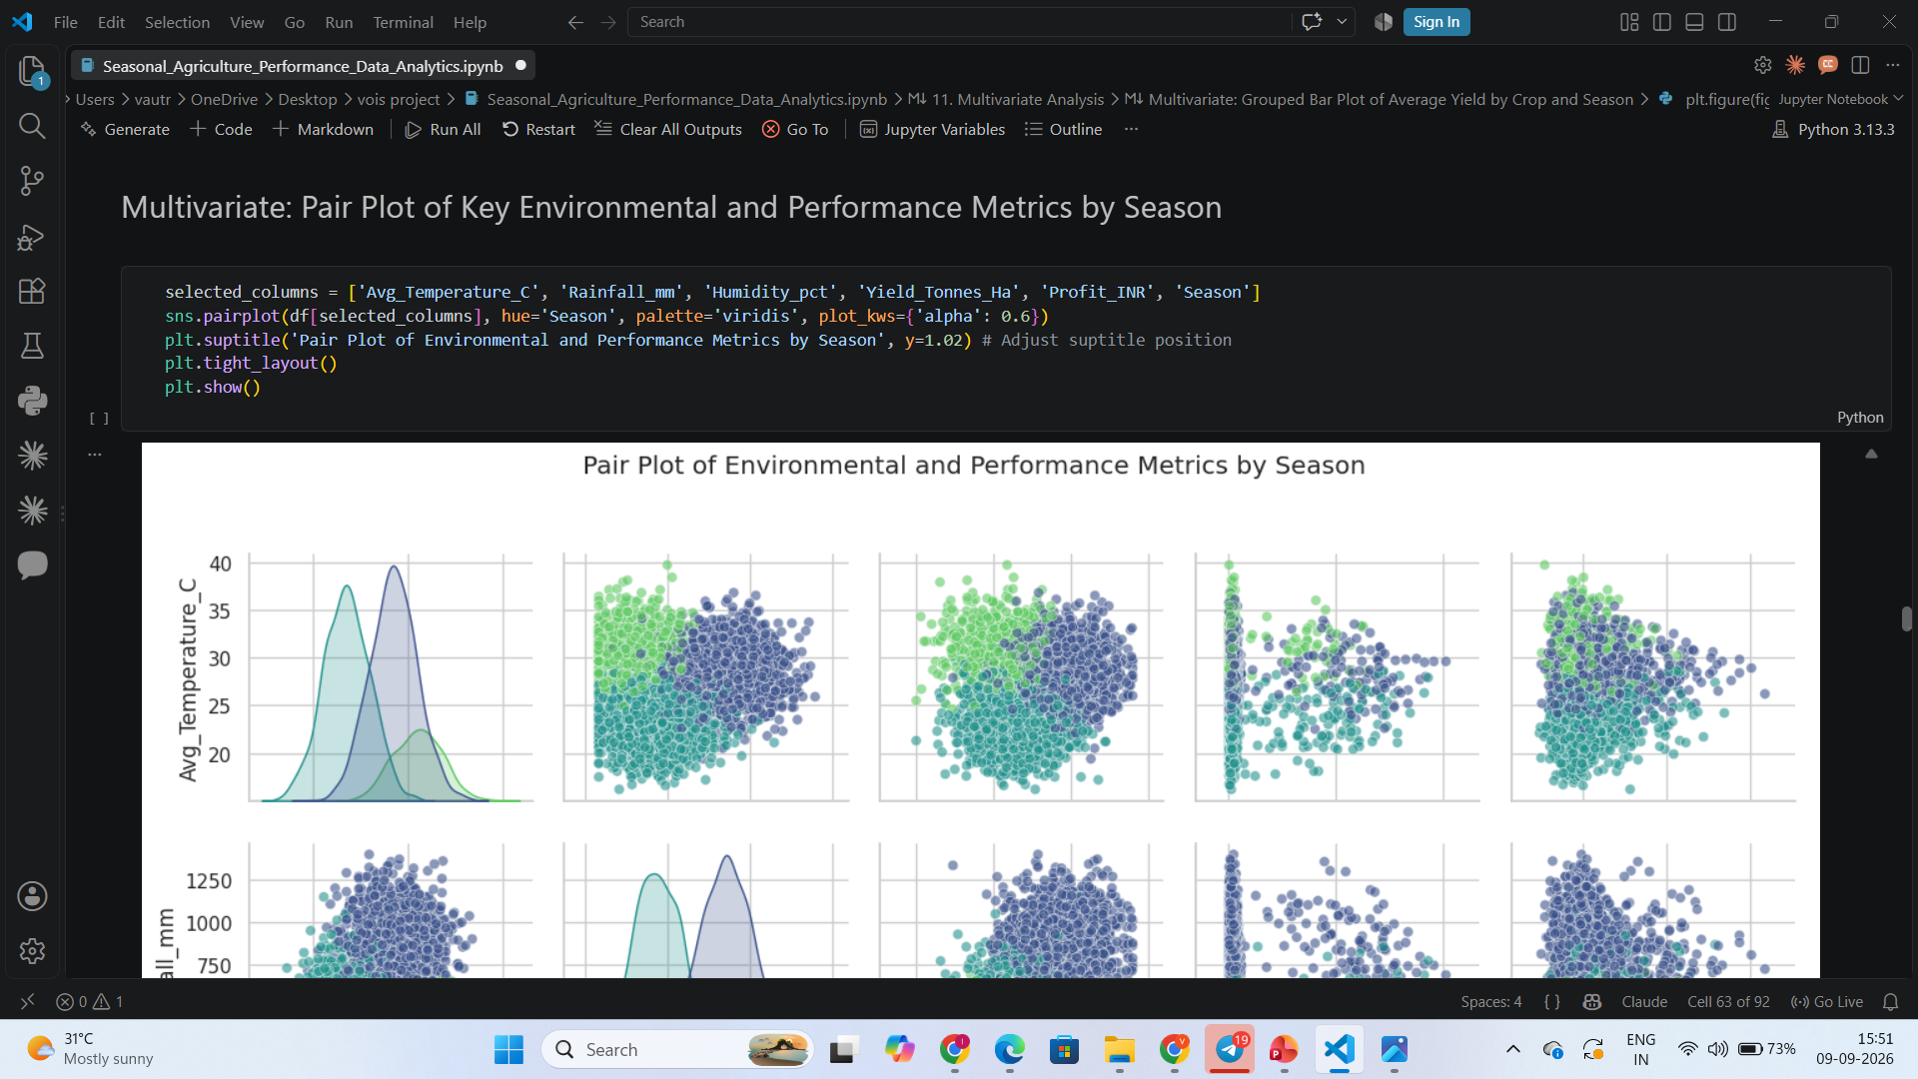
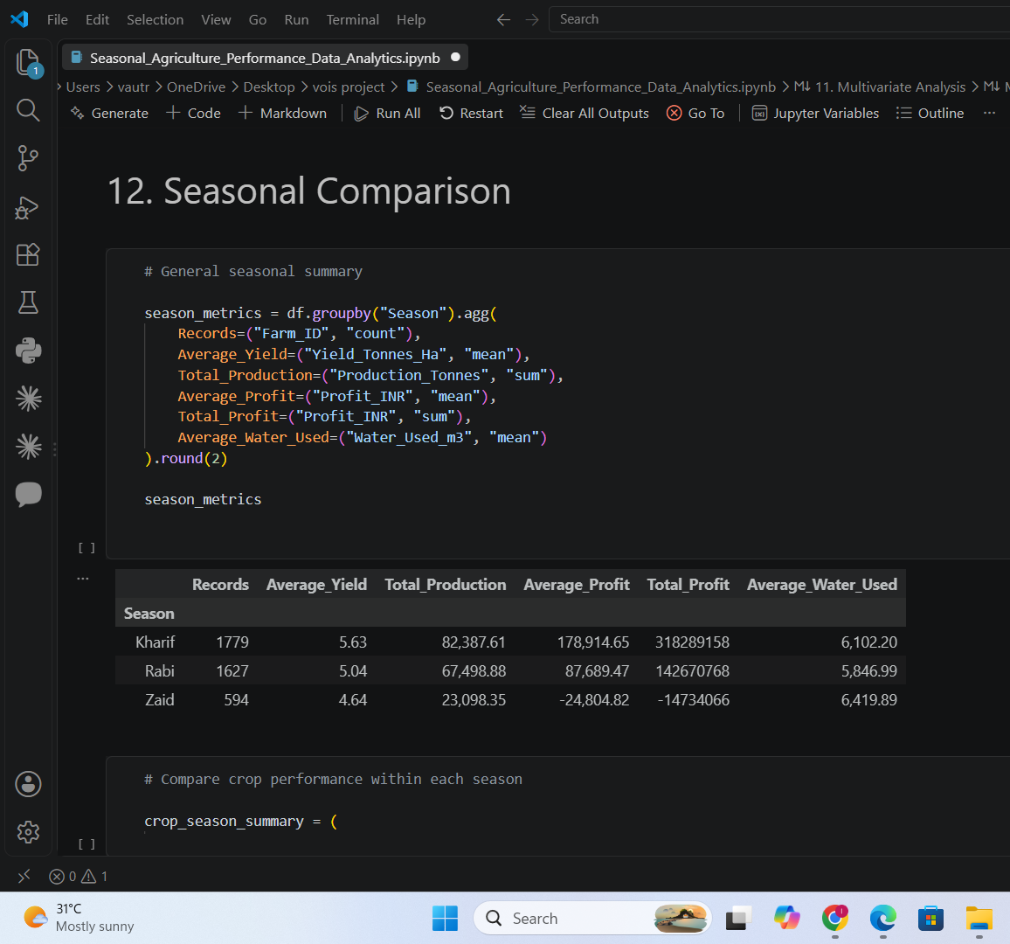
RESULTS

Slide 10
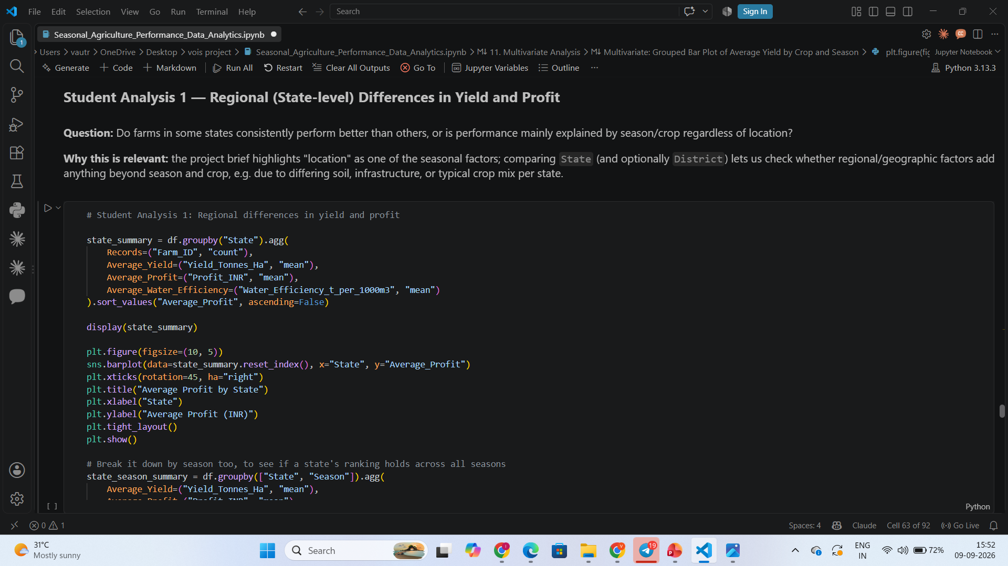
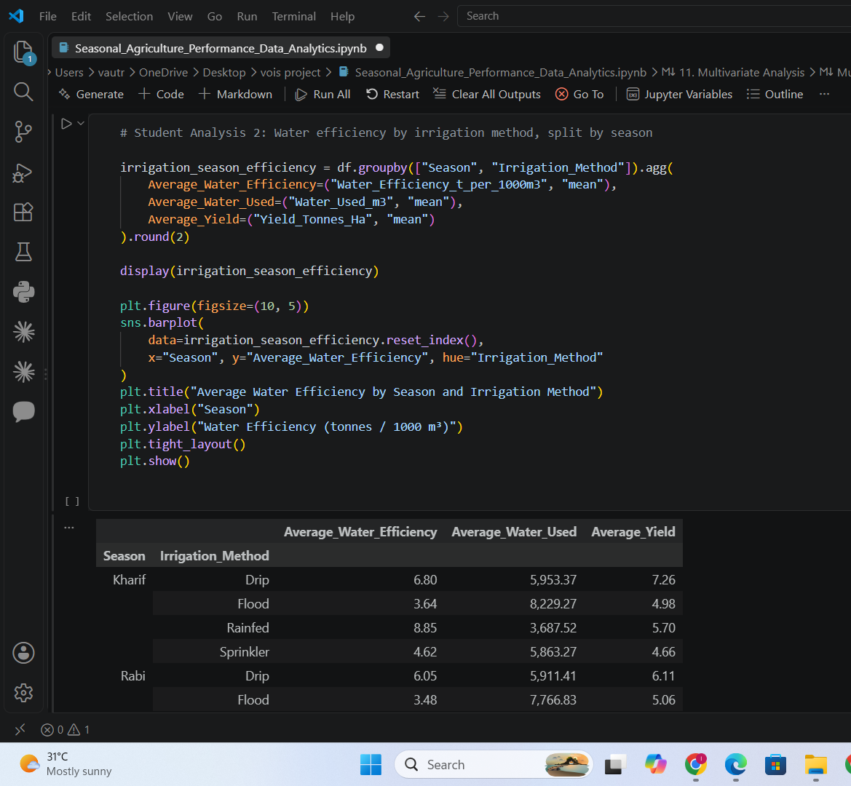
RESULTS

Slide 11
Future scope
Build predictive models (regression / machine learning) to forecast yield and profit based on season, crop, irrigation method and environmental conditions
Incorporate real-time weather and soil-sensor data (via APIs) for more accurate, up-to-date seasonal predictions.
Extend the analysis to a multi-year dataset to study year-over-year and climate-change-driven seasonal trends, not just a single-year snapshot.
Develop a farmer-facing advisory dashboard that recommends the best crop and irrigation method for a given region and season.
Add deeper regional analysis (district-level, soil-type-level) to explain why certain states like Punjab and Karnataka stay profitable even in the Zaid season.
Integrate market-price forecasting to help farmers time their sales for better revenue, since this analysis showed price — not just yield — is a major profit driver.

Slide 12
GitHub Link
https://github.com/Vautrey-Akshit-123/Seasonal-Agriculture-Performance-Analysis.git

Slide 13
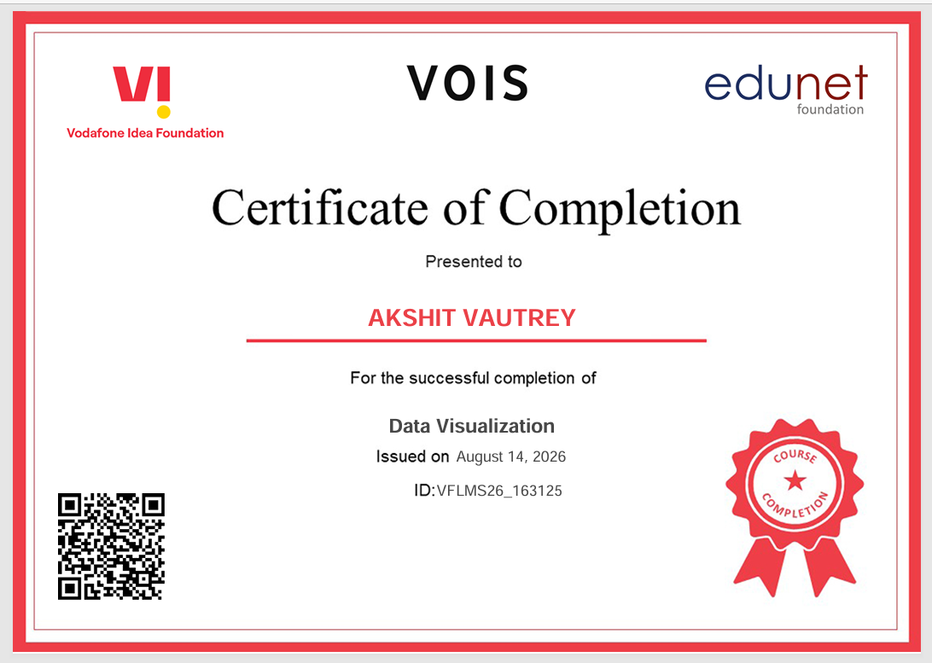
VOIS Course completion certificate -
Course name- Data Visualization

Slide 14
Thank you
.
.

