Slide 1
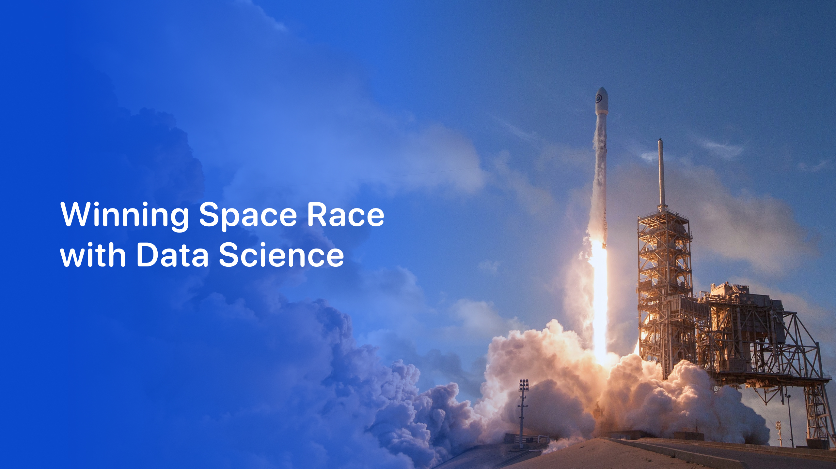

Vavan Farizzaman
20 October 2026
Notes:
IBM Applied Data Science Capstone. Original IBM template imagery retained. Historical course datasets, not a statement about current launch prices.

Slide 2
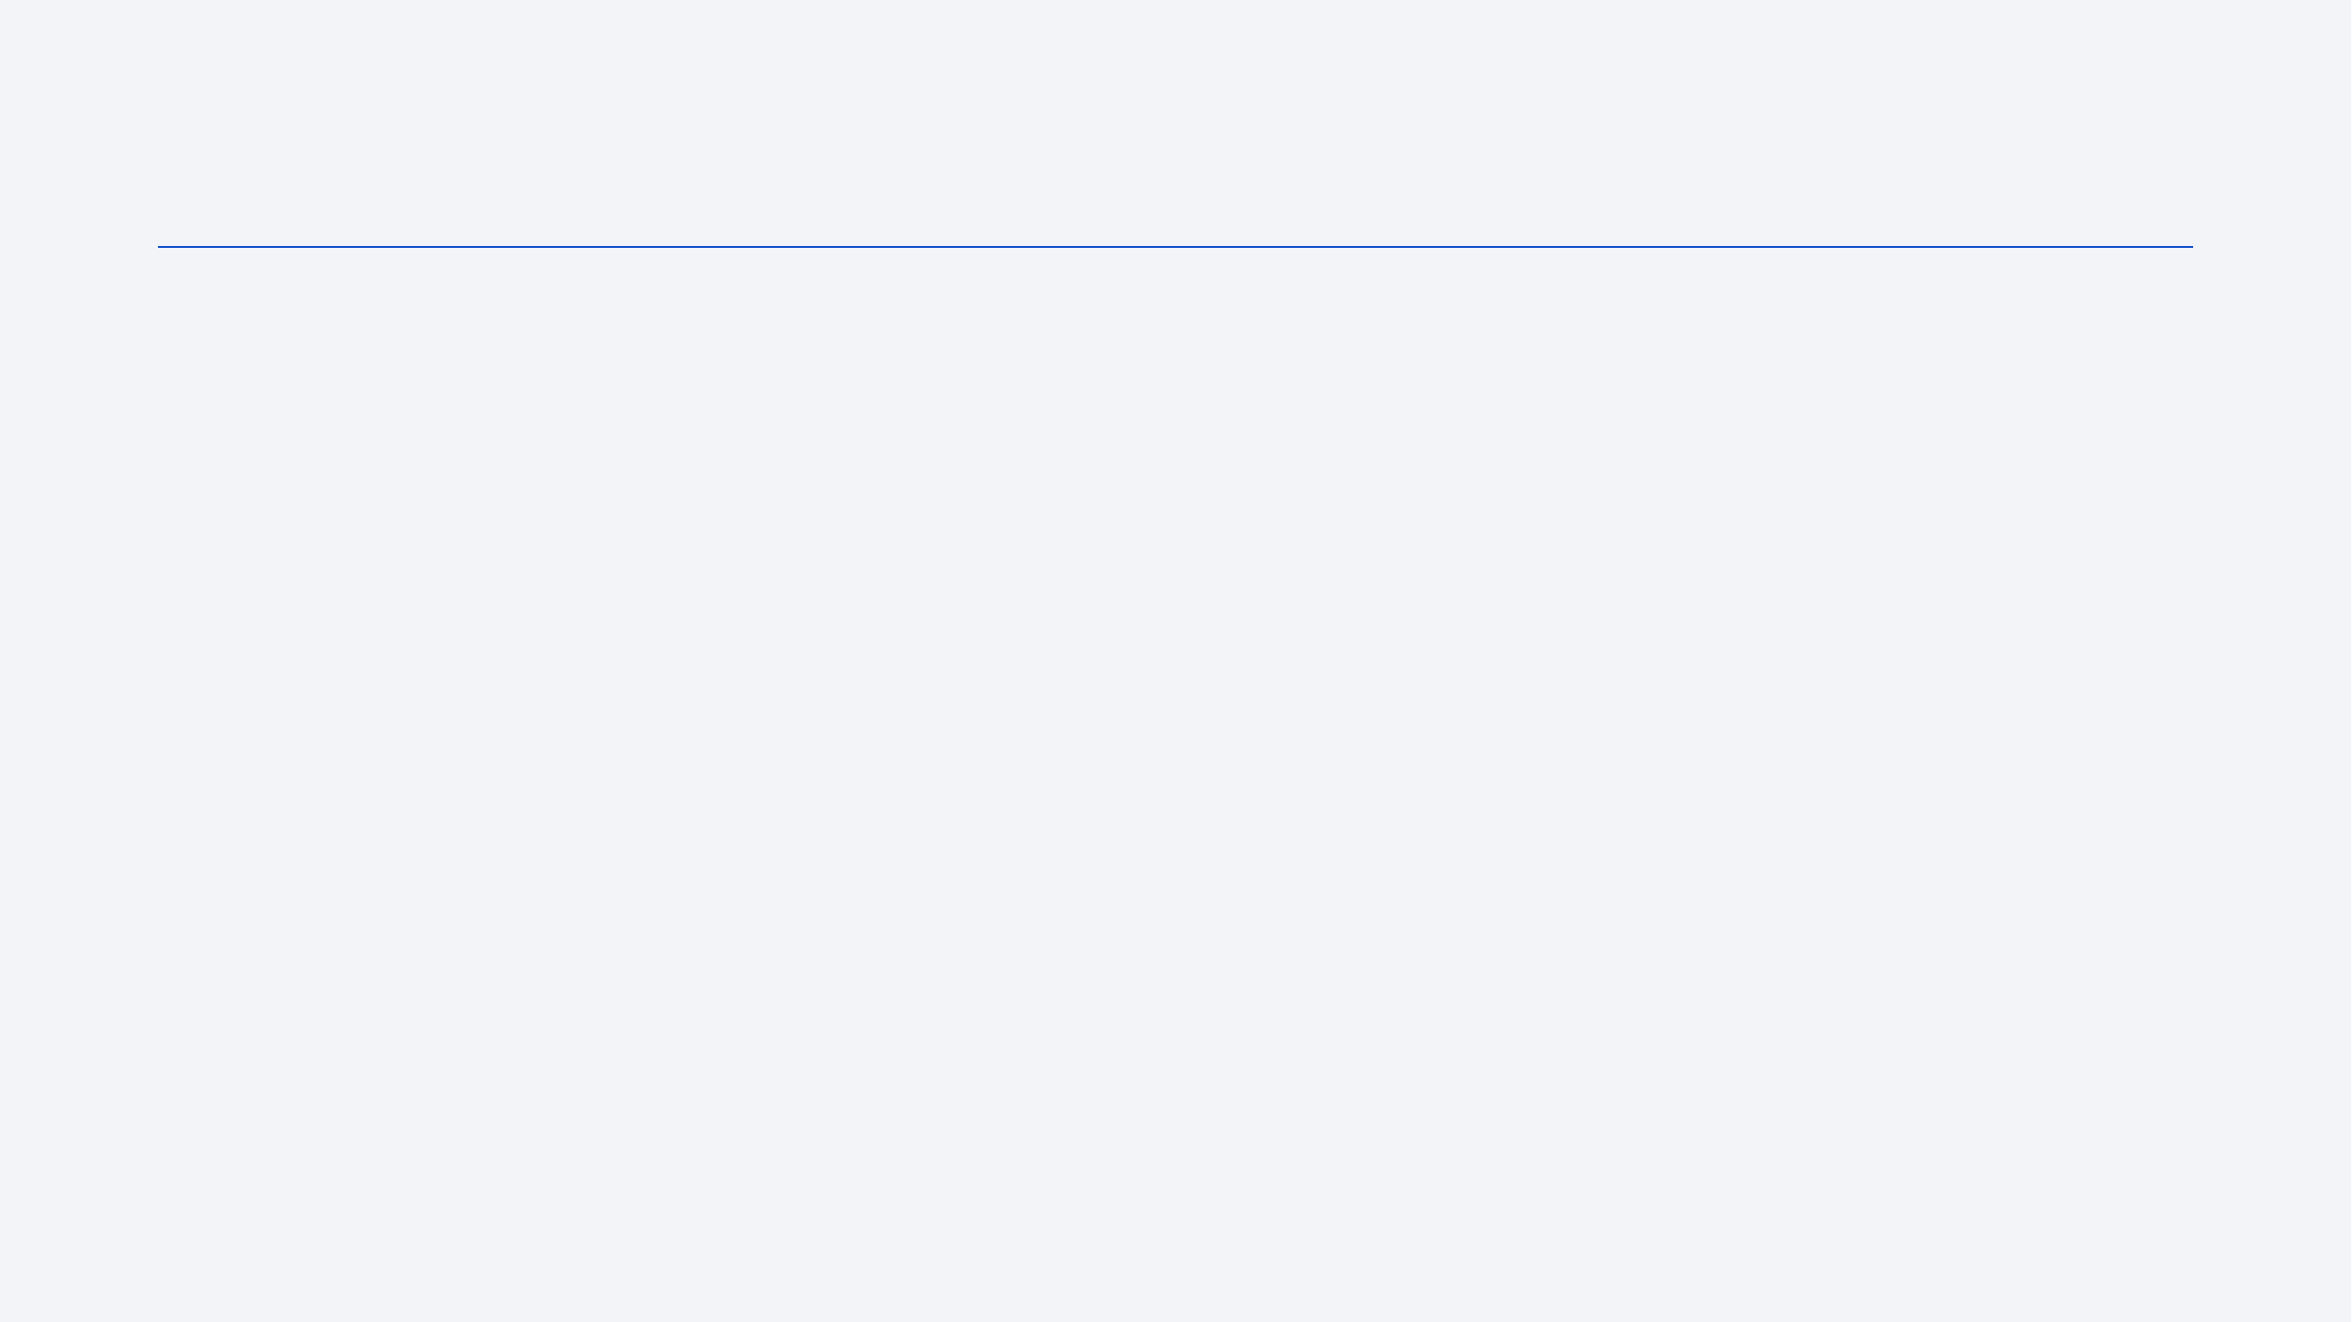
Outline
Project question and executive summary
Data collection, preparation and analytical methods
Visualization and SQL findings
Folium maps and the Plotly Dash dashboard
Classification results, conclusions and technical appendix
2

Slide 3
Executive Summary
90 Falcon 9 launches support the main analysis. The course label marks 60 successful outcomes (66.7%).
Collection combines an API snapshot with documented enrichment. Scraping and the SQL/dashboard labs use separate datasets.
KSC LC-39A leads the dashboard sample: 10 successes from 13 launches (76.9%).
SVM, logistic regression and KNN each classify 15 of 18 test launches correctly. Training CV selects SVM.
Source: ML lab. Detailed references in speaker notes.
3
Notes:
Sources: SpaceX-Machine-Learning-Prediction-Part-5-v1.ipynb; ml_outputs/course_model_comparison.csv; ml_outputs/fold_scaled_model_comparison.csv; ml_outputs/course_test_predictions.csv

Slide 4
Introduction
Business context: first-stage recovery can support reuse and influence launch economics.
Question: which observed launch characteristics are associated with successful first-stage outcomes?
Approach: inspect payload, orbit, launch site and time, then compare four binary classifiers.
Scope: a historical learning exercise. Landing classification alone does not estimate launch cost or guarantee future recovery.
Source: Wrangling lab. Detailed references in speaker notes.
4
Notes:
Sources: labs-jupyter-spacex-Data wrangling-v2.ipynb; dataset_part_2.csv

Slide 5

5
Notes:
Original IBM Skills Network template section artwork retained.

Slide 6
Methodology
1. Collect and reconcile launch data, resource IDs and source provenance.
2. Clean fields, label outcomes and encode 80 numerical features.
3. Explore patterns through Python charts, SQL queries and interactive maps.
4. Filter dashboard views by site and payload mass.
5. Tune four classifiers with 10-fold CV and evaluate a fixed 18-row test sample.
6

Slide 7
Data Collection
Source | Records | Use
API-derived Falcon 9 sample | 90 | Wrangling, EDA and classification
Wikipedia historical revision | 121 | Independent scraping exercise
Course SQL dataset | 101 | SQL aggregation and filters
Course map/dashboard datasets | 56 each | Interactive analytics
Different scopes and labels produce different totals. These datasets are not pooled.
Source: API lab. Detailed references in speaker notes.
7
Notes:
Sources: jupyter-labs-spacex-data-collection-api-v2.ipynb; dataset_part_1.csv; data/spacex_lab_metadata.json
Source paths: data/API_call_spacex_api.json; spacex_web_scraped.csv; data/Spacex.csv; data/spacex_launch_geo.csv; data/spacex_launch_dash.csv.

Slide 8
Data Collection: SpaceX API
Launch JSON supplies resource IDs, not all enrichment fields.
Step | Output
1. Read launch snapshot | 94 retained launch rows
2. Resolve resource IDs | Rockets, payloads, cores, pads
3. Keep Falcon 9 | 90 rows, excluding 4 Falcon 1
4. Export | dataset_part_1.csv
Archived API records and course reference data supply documented historical metadata.
Timeouts and caching keep requests explicit and repeatable.
Source: API lab. Detailed references in speaker notes.
8
Notes:
Sources: jupyter-labs-spacex-data-collection-api-v2.ipynb; dataset_part_1.csv; data/spacex_lab_metadata.json
Live API retrieval timed out. No fabricated enrichment values were used. Resource-level provenance is retained in data/spacex_lab_metadata.json.

Slide 9
Data Collection: Web Scraping
Step | Method
1. Retrieve | Read the 9 June 2021 Wikipedia revision
2. Parse | BeautifulSoup extracts Falcon 9 launch tables
3. Normalize | Clean dates, payloads, sites and outcomes
4. Filter and export | 121 numeric-flight rows in spacex_web_scraped.csv
The lab's numeric flight-number rule excludes Falcon Heavy rows labelled FH. Unknown payload masses remain missing.
Source: Scraping lab. Detailed references in speaker notes.
9
Notes:
Sources: jupyter-labs-webscraping.ipynb; spacex_web_scraped.csv; https://en.wikipedia.org/wiki/Special:PermanentLink/1027686922

Slide 10
Data Wrangling
Stage | Implementation
Clean | Keep Falcon 9, normalize fields and impute missing payload mass with the mean
Label | Class 1: True ASDS, True RTLS or True Ocean. Other listed outcomes: class 0
Check | 90 launches: 60 class 1 and 30 class 0. True ASDS contributes 41
Encode | One-hot encode orbit, site, landing pad and serial. Produce 80 float64 features
Outcome and Class are excluded from the feature matrix. Successful ocean outcomes remain included in the course target.
Source: Wrangling lab. Detailed references in speaker notes.
10
Notes:
Sources: labs-jupyter-spacex-Data wrangling-v2.ipynb; dataset_part_2.csv

Slide 11
EDA with Data Visualization
Plot | Analytical purpose
Flight number vs. site and orbit | Inspect historical progression and category coverage
Payload vs. site and orbit | Compare operating ranges and overlapping outcomes
Success rate by orbit | Compare outcome proportions with sample counts
Yearly average success rate | Describe change over time without assuming causality
Color encodes Class. Counts accompany rates so small categories do not look as reliable as large samples.
Source: EDA lab. Detailed references in speaker notes.
11
Notes:
Sources: jupyter-labs-eda-dataviz-v2.ipynb; dataset_part_2.csv; dataviz_outputs/

Slide 12
EDA with SQL
SQLite stores 101 rows in a cleaned SPACEXTABLE, with dates and labels trimmed.
DISTINCT and LIKE identify sites. SUM and AVG aggregate payload mass.
MIN and MAX locate milestones and payload extremes. A subquery retains all maximum-payload boosters.
CASE separates mission outcomes. GROUP BY counts landing outcomes within an inclusive date window.
Source: SQL lab. Detailed references in speaker notes.
12
Notes:
Sources: jupyter-labs-eda-sql-coursera_sqllite.ipynb; my_data1.db, SPACEXTABLE; data/Spacex.csv

Slide 13
Interactive Map Methodology
Folium markers and circles identify launch sites. Popups preserve site names and counts.
Green/red markers show class 1/0. MarkerCluster groups overlapping launch coordinates.
Mouse coordinates, click popups and distance lines support proximity inspection.
OpenStreetMap features provide coastline, internal rail spur, major road and town-centre reference points.
Source: Folium lab. Detailed references in speaker notes.
13
Notes:
Sources: lab-jupyter-launch-site-location-v2.ipynb; location_outputs/; data/spacex_launch_geo.csv; data/launch_site_osm_features.json; https://www.openstreetmap.org/copyright

Slide 14
Plotly Dash Methodology
A searchable launch-site dropdown filters both charts.
All Sites shows successful outcome counts by site. A selected site shows its success/failure split.
A 0-10,000 kg range slider filters the scatter plot, including both endpoints.
Scatter points use payload mass and class, with a consistent color for each booster category.
Source: Dash lab. Detailed references in speaker notes.
14
Notes:
Sources: spacex_dash_app.py; data/spacex_launch_dash.csv; DASHBOARD_INSIGHTS.txt

Slide 15
Predictive Analysis Methodology
Stage | Specification
Inputs | 90 rows, 80 numerical features and binary Class labels
Holdout | 72 train / 18 test. test_size=0.2, random_state=2
Models | Logistic regression, SVM, decision tree and KNN
Tuning | GridSearchCV, 10 folds, accuracy scoring
Scaling check | Repeat with StandardScaler inside each training-fold pipeline
The course sequence scales before splitting. The extra comparison addresses this scaling leakage while retaining the same test rows.
Source: ML lab. Detailed references in speaker notes.
15
Notes:
Sources: SpaceX-Machine-Learning-Prediction-Part-5-v1.ipynb; ml_outputs/course_model_comparison.csv; ml_outputs/fold_scaled_model_comparison.csv; ml_outputs/course_test_predictions.csv
Hyperparameter grids and exact split indices are in the notebook and ml_outputs/run_summary.json. Upstream imputation and category generation still precede the split.

Slide 16
Results Overview
Analysis | Finding
Python EDA, 90 launches | 60 successful course labels. Orbit and year patterns differ
SQL, 101 launches | 100 mission successes and 1 mission failure
Dashboard, 56 launches | KSC LC-39A leads in count and success rate
Classification, 18 test rows | Three methods tie at 83.3% accuracy
The following sections preserve each dataset's denominator and outcome definition.
16

Slide 17

17
Notes:
Original IBM Skills Network template section artwork retained.

Slide 18
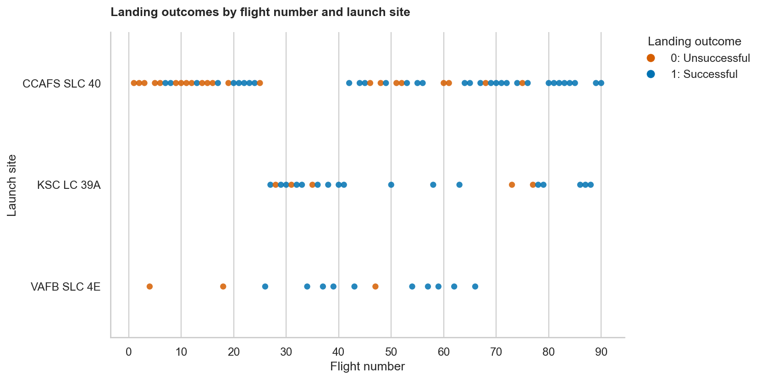
Flight Number vs. Launch Site
CCAFS SLC 40 contributes 55 of 90 launches.
KSC: 17/22 successes. VAFB: 10/13. CCAFS: 33/55.
Sites operate over different periods. A site effect is not isolated.
Source: EDA lab. Detailed references in speaker notes.
18
Notes:
Sources: jupyter-labs-eda-dataviz-v2.ipynb; dataset_part_2.csv; dataviz_outputs/

Slide 19
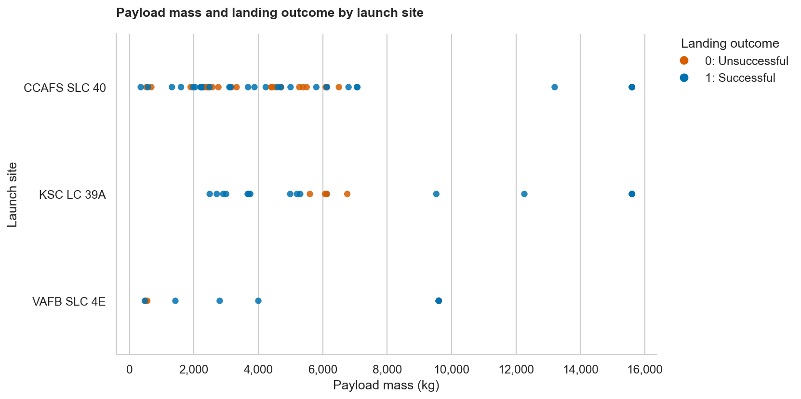
Payload vs. Launch Site
Payload ranges overlap across launch sites.
Both classes occur at similar masses. Mass alone does not separate outcomes.
Site comparisons should account for orbit and booster generation.
Source: EDA lab. Detailed references in speaker notes.
19
Notes:
Sources: jupyter-labs-eda-dataviz-v2.ipynb; dataset_part_2.csv; dataviz_outputs/

Slide 20
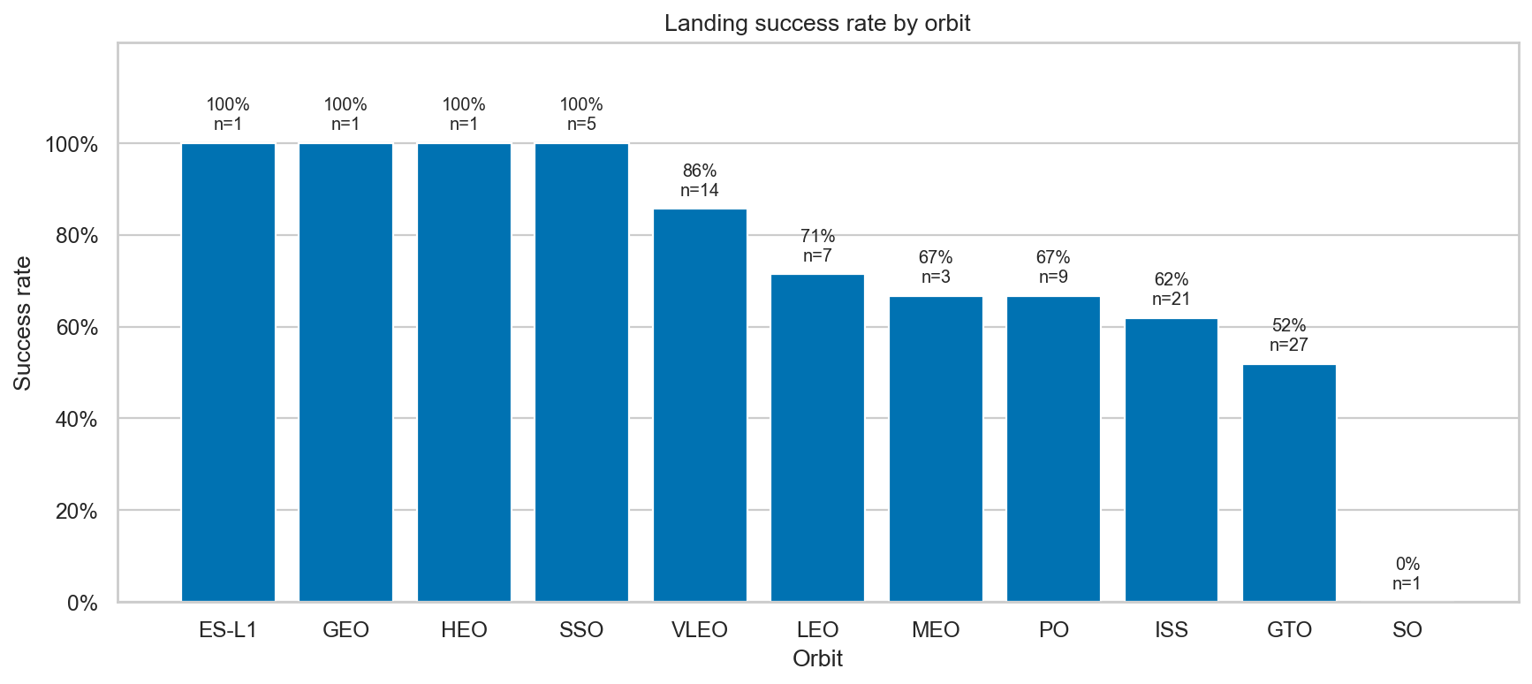
Success Rate by Orbit
VLEO: 12/14 successes (85.7%). GTO: 14/27 (51.9%).
SSO: 5/5. GEO, HEO and ES-L1 each have only one launch.
A 100% rate from one launch has very little supporting evidence.
Source: EDA lab. Detailed references in speaker notes.
20
Notes:
Sources: jupyter-labs-eda-dataviz-v2.ipynb; dataset_part_2.csv; dataviz_outputs/

Slide 21
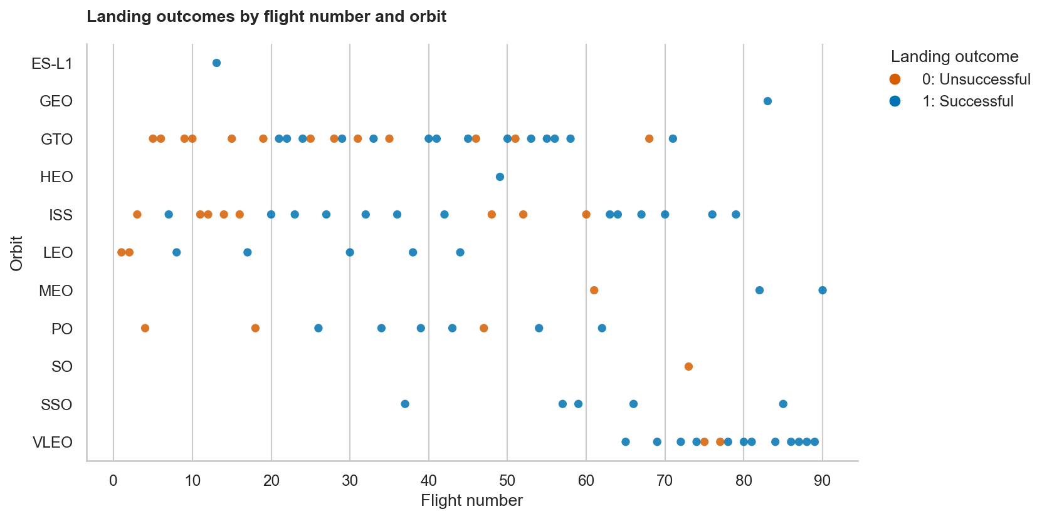
Flight Number vs. Orbit
Orbit categories occur at different stages of the launch history.
Later VLEO missions coincide with a more mature launch program.
Time and mission mix can confound an apparent orbit effect.
Source: EDA lab. Detailed references in speaker notes.
21
Notes:
Sources: jupyter-labs-eda-dataviz-v2.ipynb; dataset_part_2.csv; dataviz_outputs/

Slide 22
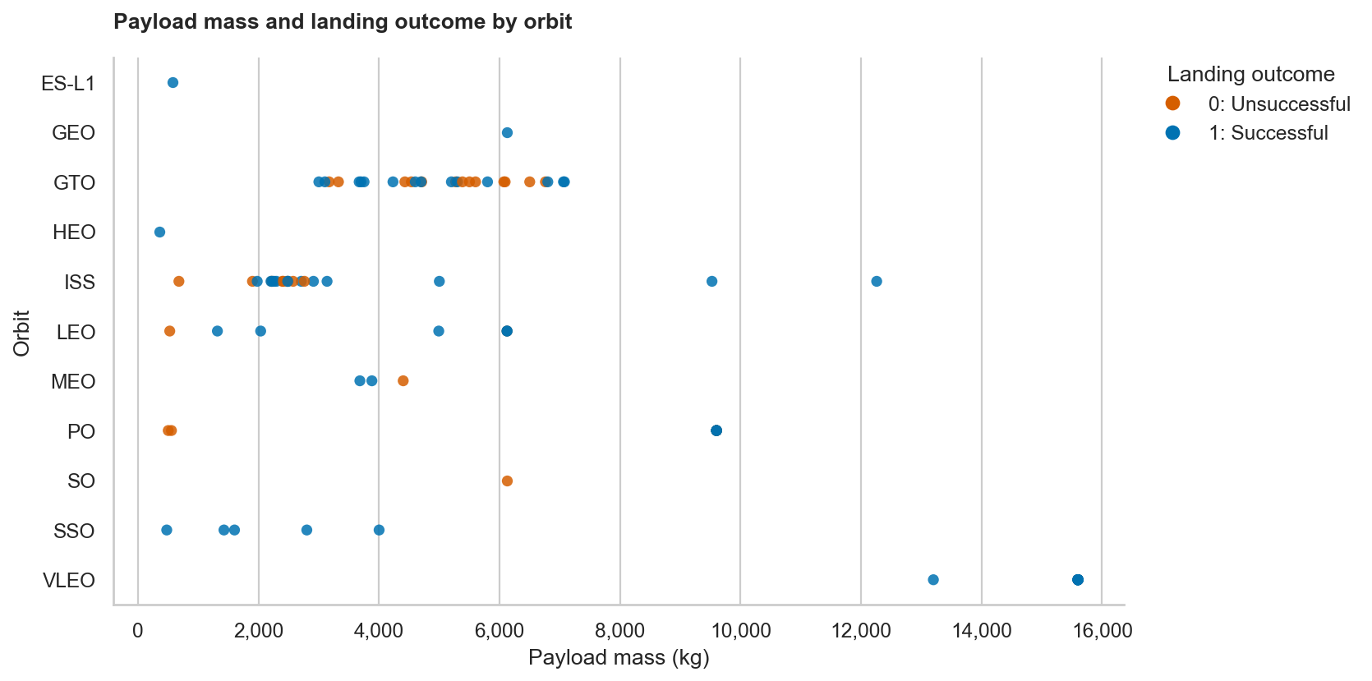
Payload vs. Orbit
Orbit constrains the payload range represented in the data.
GTO has 27 launches with mixed outcomes.
The scatter plot supports joint analysis of payload and orbit.
Source: EDA lab. Detailed references in speaker notes.
22
Notes:
Sources: jupyter-labs-eda-dataviz-v2.ipynb; dataset_part_2.csv; dataviz_outputs/

Slide 23
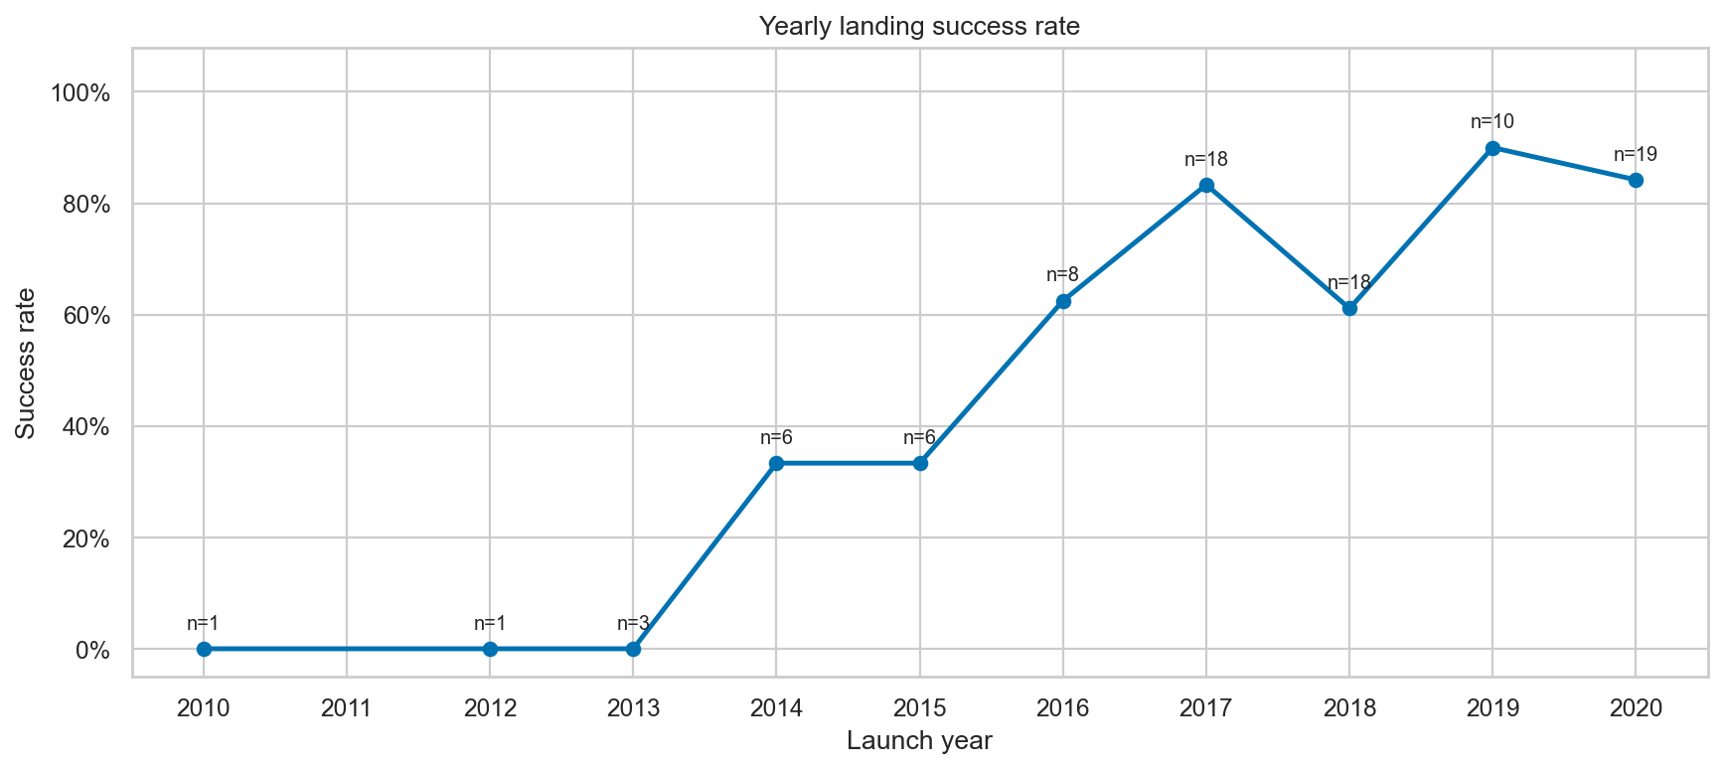
Yearly Success Trend
2013: 0/3. 2017: 15/18. 2020: 16/19 successful labels.
The rate generally improves but drops to 11/18 in 2018.
No 2011 record appears in this sample. Missing years are not zero rates.
Source: EDA lab. Detailed references in speaker notes.
23
Notes:
Sources: jupyter-labs-eda-dataviz-v2.ipynb; dataset_part_2.csv; dataviz_outputs/

Slide 24
Unique Launch Sites
SELECT DISTINCT Launch_Site
FROM SPACEXTABLE ORDER BY Launch_Site;
Launch site
CCAFS LC-40
CCAFS SLC-40
KSC LC-39A
VAFB SLC-4E
Four labels appear in the SQL source. This spelling differs from the 90-row API-derived sample.
Source: SQL lab. Detailed references in speaker notes.
24
Notes:
Sources: jupyter-labs-eda-sql-coursera_sqllite.ipynb; my_data1.db, SPACEXTABLE; data/Spacex.csv
SQL query:
SELECT DISTINCT Launch_Site
FROM SPACEXTABLE ORDER BY Launch_Site;
Four labels appear in the SQL source. This spelling differs from the 90-row API-derived sample.

Slide 25
First Five Records Matching CCA
SELECT Date, Booster_Version, Launch_Site
FROM SPACEXTABLE WHERE Launch_Site LIKE 'CCA%'
ORDER BY Date, "Time (UTC)" LIMIT 5;
Date | Booster | Launch site
2010-06-04 | F9 v1.0 B0003 | CCAFS LC-40
2010-12-08 | F9 v1.0 B0004 | CCAFS LC-40
2012-05-22 | F9 v1.0 B0005 | CCAFS LC-40
2012-10-08 | F9 v1.0 B0006 | CCAFS LC-40
2013-03-01 | F9 v1.0 B0007 | CCAFS LC-40
An explicit chronological order makes LIMIT 5 reproducible.
Source: SQL lab. Detailed references in speaker notes.
25
Notes:
Sources: jupyter-labs-eda-sql-coursera_sqllite.ipynb; my_data1.db, SPACEXTABLE; data/Spacex.csv
SQL query:
SELECT Date, Booster_Version, Launch_Site
FROM SPACEXTABLE WHERE Launch_Site LIKE 'CCA%'
ORDER BY Date, "Time (UTC)" LIMIT 5;
An explicit chronological order makes LIMIT 5 reproducible.

Slide 26
Total Payload for NASA (CRS)
SELECT SUM(PAYLOAD_MASS__KG_) AS Total_Payload_Mass_KG
FROM SPACEXTABLE WHERE Customer = 'NASA (CRS)';
Customer filter | Total payload mass
NASA (CRS), exact label | 45,596 kg
This total covers the NASA (CRS) category only. It does not combine other NASA customer labels.
Source: SQL lab. Detailed references in speaker notes.
26
Notes:
Sources: jupyter-labs-eda-sql-coursera_sqllite.ipynb; my_data1.db, SPACEXTABLE; data/Spacex.csv
SQL query:
SELECT SUM(PAYLOAD_MASS__KG_) AS Total_Payload_Mass_KG
FROM SPACEXTABLE WHERE Customer = 'NASA (CRS)';
This total covers the NASA (CRS) category only. It does not combine other NASA customer labels.

Slide 27
Average Payload for F9 v1.1
SELECT AVG(PAYLOAD_MASS__KG_) AS Average_Payload_Mass_KG
FROM SPACEXTABLE WHERE Booster_Version = 'F9 v1.1';
Booster filter | Average payload mass
F9 v1.1, exact label | 2,928.4 kg
Serial-number variants are separate strings and do not match this exact filter.
Source: SQL lab. Detailed references in speaker notes.
27
Notes:
Sources: jupyter-labs-eda-sql-coursera_sqllite.ipynb; my_data1.db, SPACEXTABLE; data/Spacex.csv
SQL query:
SELECT AVG(PAYLOAD_MASS__KG_) AS Average_Payload_Mass_KG
FROM SPACEXTABLE WHERE Booster_Version = 'F9 v1.1';
Serial-number variants are separate strings and do not match this exact filter.

Slide 28
First Successful Ground-Pad Landing
SELECT MIN(Date) AS First_Successful_Ground_Pad_Landing
FROM SPACEXTABLE
WHERE Landing_Outcome = 'Success (ground pad)';
Landing outcome | Earliest date in dataset
Success (ground pad) | 22 December 2015
The result follows the SQL dataset's date field.
Source: SQL lab. Detailed references in speaker notes.
28
Notes:
Sources: jupyter-labs-eda-sql-coursera_sqllite.ipynb; my_data1.db, SPACEXTABLE; data/Spacex.csv
SQL query:
SELECT MIN(Date) AS First_Successful_Ground_Pad_Landing
FROM SPACEXTABLE
WHERE Landing_Outcome = 'Success (ground pad)';
The result follows the SQL dataset's date field.

Slide 29
Drone-Ship Successes at 4,000-6,000 kg
SELECT DISTINCT Booster_Version FROM SPACEXTABLE
WHERE Landing_Outcome = 'Success (drone ship)'
AND PAYLOAD_MASS__KG_ > 4000 AND PAYLOAD_MASS__KG_ < 6000;
Matching booster versions
F9 FT B1021.2
F9 FT B1031.2
F9 FT B1022
F9 FT B1026
Strict bounds exclude payloads equal to 4,000 or 6,000 kg.
Source: SQL lab. Detailed references in speaker notes.
29
Notes:
Sources: jupyter-labs-eda-sql-coursera_sqllite.ipynb; my_data1.db, SPACEXTABLE; data/Spacex.csv
SQL query:
SELECT DISTINCT Booster_Version FROM SPACEXTABLE
WHERE Landing_Outcome = 'Success (drone ship)'
AND PAYLOAD_MASS__KG_ > 4000 AND PAYLOAD_MASS__KG_ < 6000;
Strict bounds exclude payloads equal to 4,000 or 6,000 kg.

Slide 30
Mission Outcomes in the SQL Dataset
SELECT CASE WHEN Mission_Outcome LIKE 'Success%' THEN 'Success'
WHEN Mission_Outcome LIKE 'Failure%' THEN 'Failure' END AS Result,
COUNT(*) FROM SPACEXTABLE GROUP BY Result;
Mission outcome | Count | Share
Success | 100 | 99.0%
Failure | 1 | 1.0%
Mission success concerns the mission objective. Booster landing outcomes are a different field.
Source: SQL lab. Detailed references in speaker notes.
30
Notes:
Sources: jupyter-labs-eda-sql-coursera_sqllite.ipynb; my_data1.db, SPACEXTABLE; data/Spacex.csv
SQL query:
SELECT CASE WHEN Mission_Outcome LIKE 'Success%' THEN 'Success'
WHEN Mission_Outcome LIKE 'Failure%' THEN 'Failure' END AS Result,
COUNT(*) FROM SPACEXTABLE GROUP BY Result;
Mission success concerns the mission objective. Booster landing outcomes are a different field.

Slide 31
Boosters Carrying the Maximum Payload
SELECT DISTINCT Booster_Version FROM SPACEXTABLE
WHERE PAYLOAD_MASS__KG_ = (SELECT MAX(PAYLOAD_MASS__KG_) FROM SPACEXTABLE);
Maximum payload mass: 15,600 kg. Twelve distinct booster-version records match.
Booster version | Booster version
F9 B5 B1048.4 | F9 B5 B1051.4
F9 B5 B1048.5 | F9 B5 B1051.6
F9 B5 B1049.4 | F9 B5 B1056.4
F9 B5 B1049.5 | F9 B5 B1058.3
F9 B5 B1049.7 | F9 B5 B1060.2
F9 B5 B1051.3 | F9 B5 B1060.3
Source: SQL lab. Detailed references in speaker notes.
31
Notes:
Sources: jupyter-labs-eda-sql-coursera_sqllite.ipynb; my_data1.db, SPACEXTABLE; data/Spacex.csv
Rows are displayed in two columns for compactness. All 12 result records are included.

Slide 32
Drone-Ship Landing Failures in 2015
SELECT Date, Booster_Version, Launch_Site FROM SPACEXTABLE
WHERE SUBSTR(Date, 1, 4) = '2015'
AND Landing_Outcome = 'Failure (drone ship)' ORDER BY Date;
Month | Booster | Launch site
January | F9 v1.1 B1012 | CCAFS LC-40
April | F9 v1.1 B1015 | CCAFS LC-40
Both records have Landing_Outcome = Failure (drone ship).
Source: SQL lab. Detailed references in speaker notes.
32
Notes:
Sources: jupyter-labs-eda-sql-coursera_sqllite.ipynb; my_data1.db, SPACEXTABLE; data/Spacex.csv
SQL query:
SELECT Date, Booster_Version, Launch_Site FROM SPACEXTABLE
WHERE SUBSTR(Date, 1, 4) = '2015'
AND Landing_Outcome = 'Failure (drone ship)' ORDER BY Date;
Both records have Landing_Outcome = Failure (drone ship).

Slide 33
Landing Outcomes: June 2010 to March 2017
SELECT Landing_Outcome, COUNT(*) FROM SPACEXTABLE
WHERE Date BETWEEN '2010-06-04' AND '2017-03-20'
GROUP BY Landing_Outcome ORDER BY COUNT(*) DESC;
Landing outcome | Count
No attempt | 10
Failure (drone ship) | 5
Success (drone ship) | 5
Controlled (ocean) | 3
Success (ground pad) | 3
Failure (parachute) | 2
Uncontrolled (ocean) | 2
Precluded (drone ship) | 1
31 launches match the inclusive date window. Counts are in descending order.
Source: SQL lab. Detailed references in speaker notes.
33
Notes:
Sources: jupyter-labs-eda-sql-coursera_sqllite.ipynb; my_data1.db, SPACEXTABLE; data/Spacex.csv

Slide 34

34
Notes:
Original IBM Skills Network template section artwork retained.

Slide 35
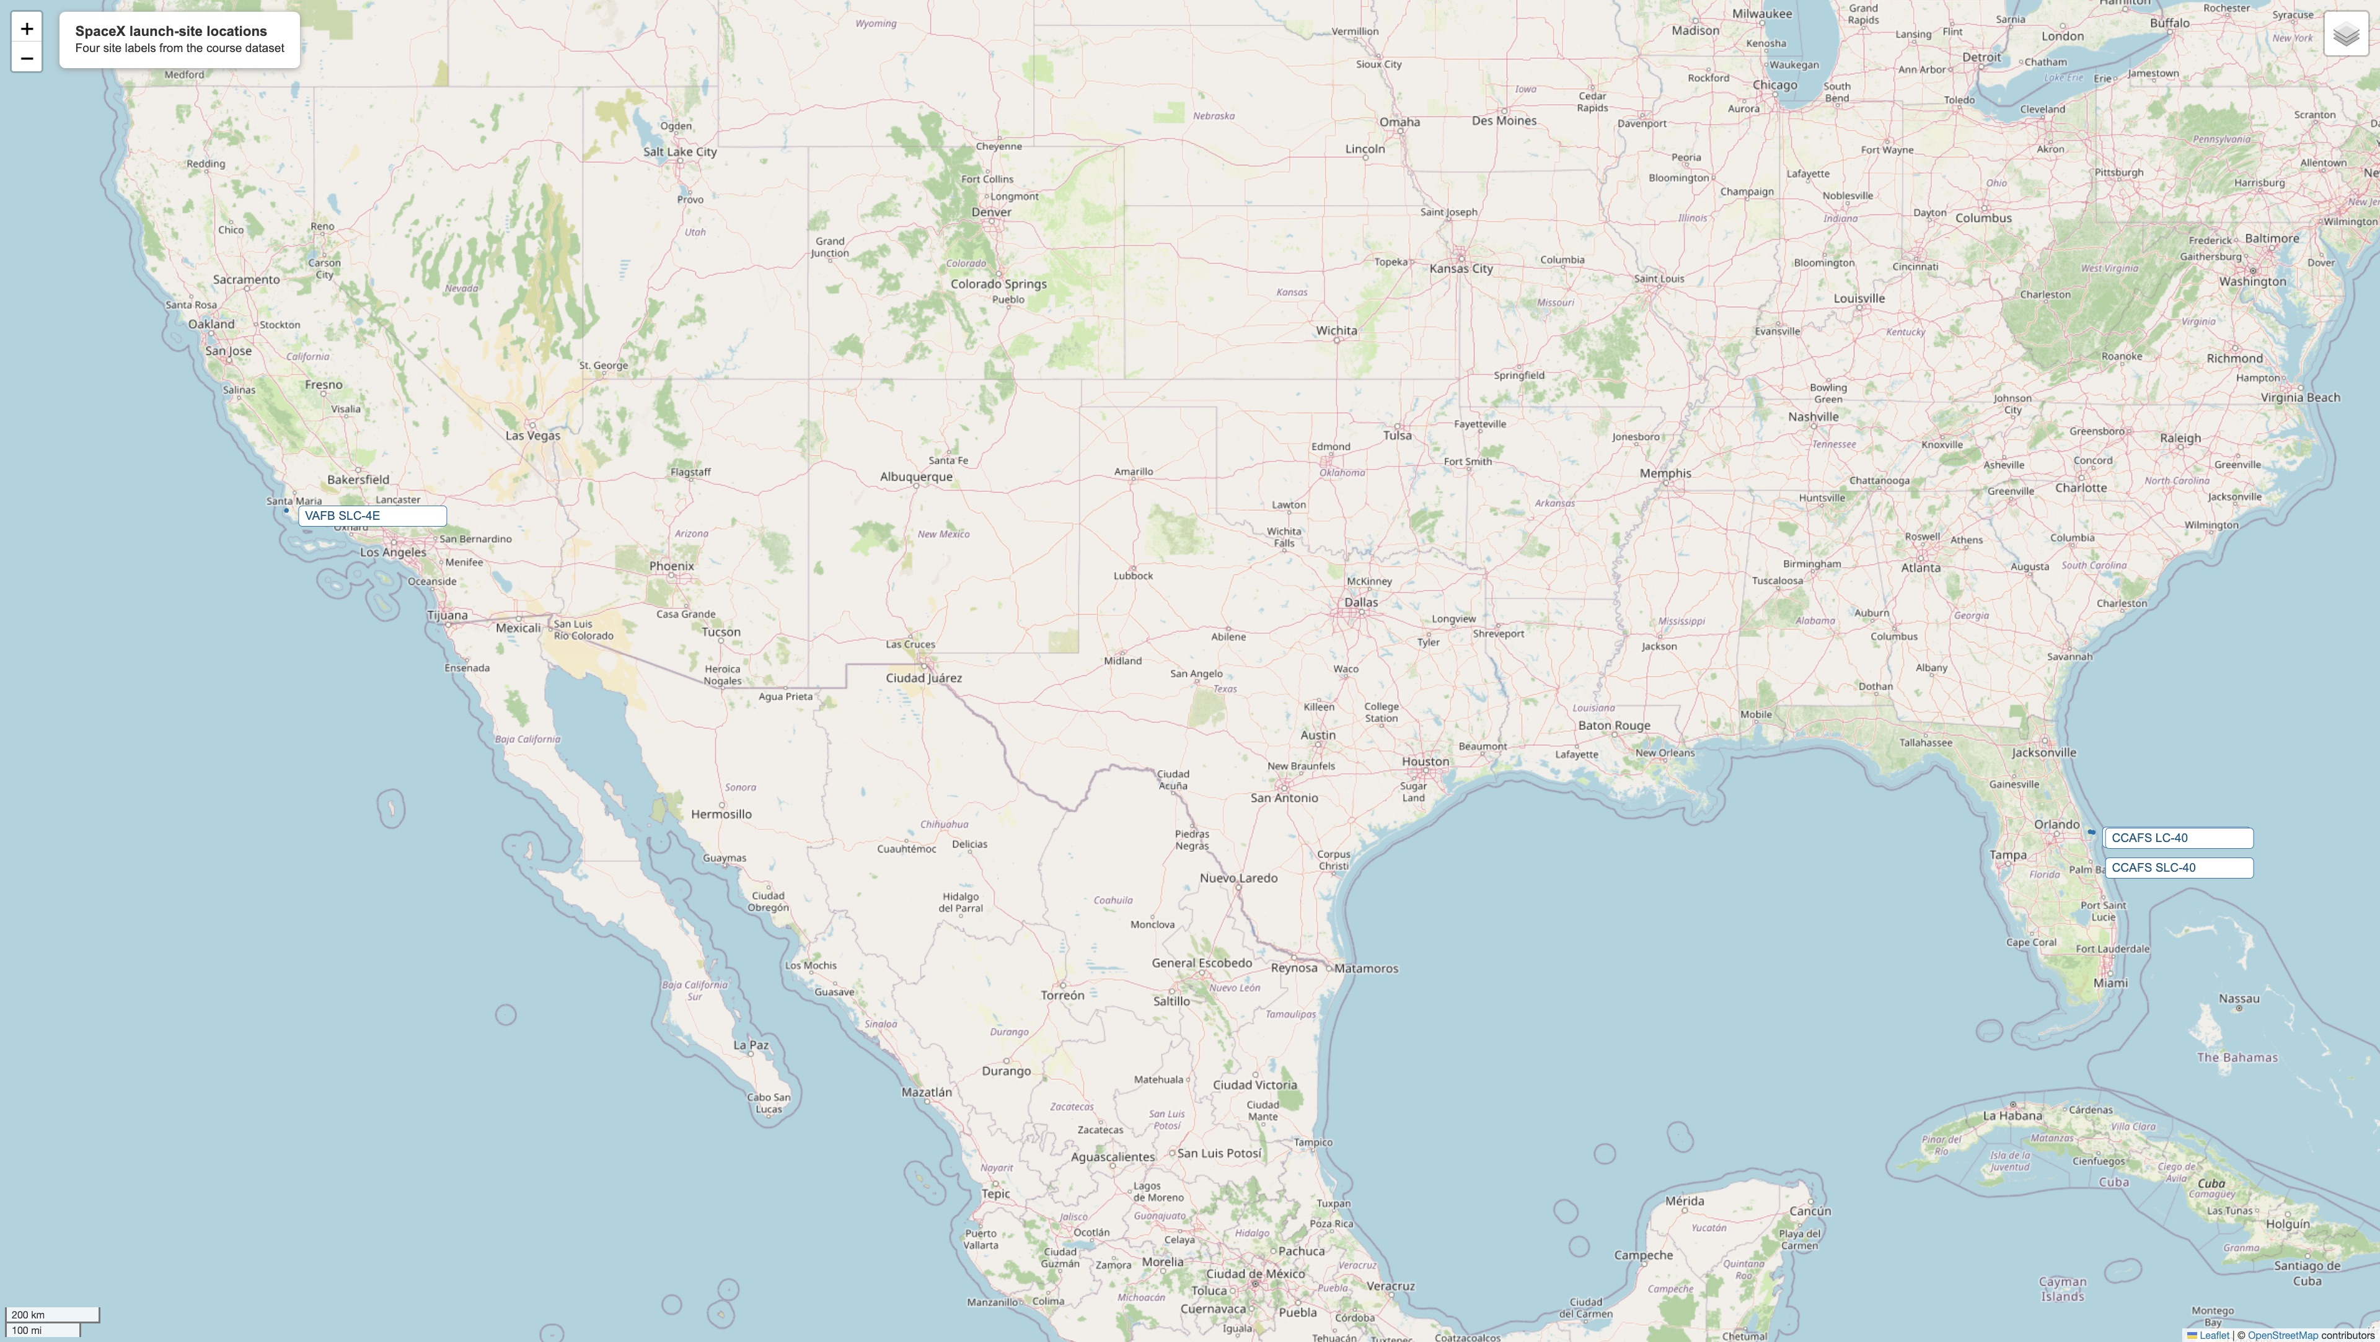
Launch Sites on the US Coasts
The course data identifies four labels at coastal launch facilities.
VAFB is in California. The other three labels are in Florida.
Nearby Florida sites overlap at this map scale.
Source: Folium lab. Detailed references in speaker notes.
35
Notes:
Sources: lab-jupyter-launch-site-location-v2.ipynb; location_outputs/; data/spacex_launch_geo.csv; data/launch_site_osm_features.json; https://www.openstreetmap.org/copyright

Slide 36
Launch Outcomes Behind the Folium Markers
Launch site | Launches | Successes | Success rate
CCAFS LC-40 | 26 | 7 | 26.9%
CCAFS SLC-40 | 7 | 3 | 42.9%
KSC LC-39A | 13 | 10 | 76.9%
VAFB SLC-4E | 10 | 4 | 40.0%
The map encodes each launch as green (class 1) or red (class 0). Clusters group repeated site coordinates. This table makes the underlying rates explicit.
Source: Folium lab. Detailed references in speaker notes.
36
Notes:
Sources: lab-jupyter-launch-site-location-v2.ipynb; location_outputs/; data/spacex_launch_geo.csv; data/launch_site_osm_features.json; https://www.openstreetmap.org/copyright
Counts from location_outputs/launch_site_summary.csv. This slide reports the map's underlying records as an editable table.

Slide 37
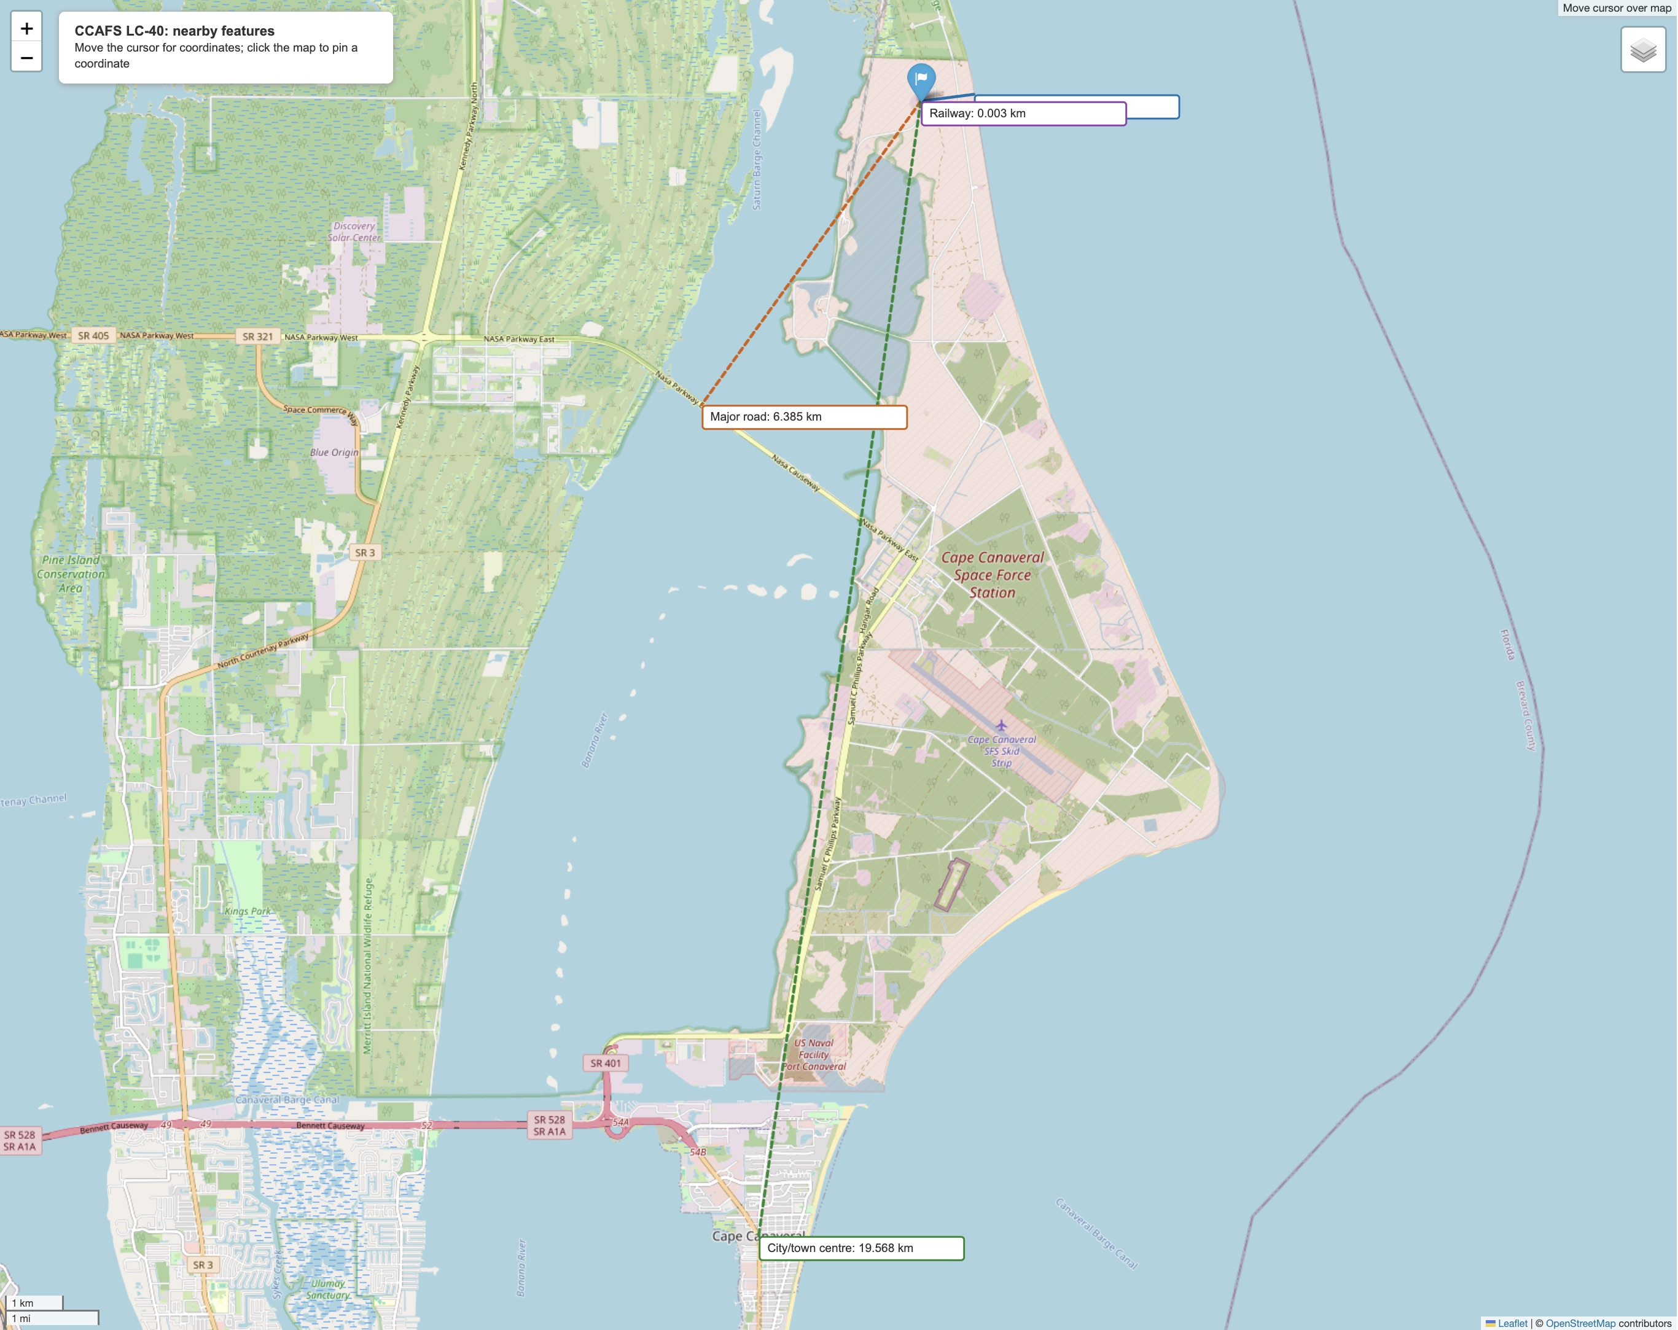
CCAFS LC-40 Proximity Analysis
Coastline: 0.922 km. Major road: 6.385 km.
Cape Canaveral centre: 19.568 km. Internal rail spur: about 3 m.
Distances use mapped reference points. Rail is a local spur, not the external network.
Source: Folium lab. Detailed references in speaker notes.
37
Notes:
Sources: lab-jupyter-launch-site-location-v2.ipynb; location_outputs/; data/spacex_launch_geo.csv; data/launch_site_osm_features.json; https://www.openstreetmap.org/copyright

Slide 38

38
Notes:
Original IBM Skills Network template section artwork retained.

Slide 39
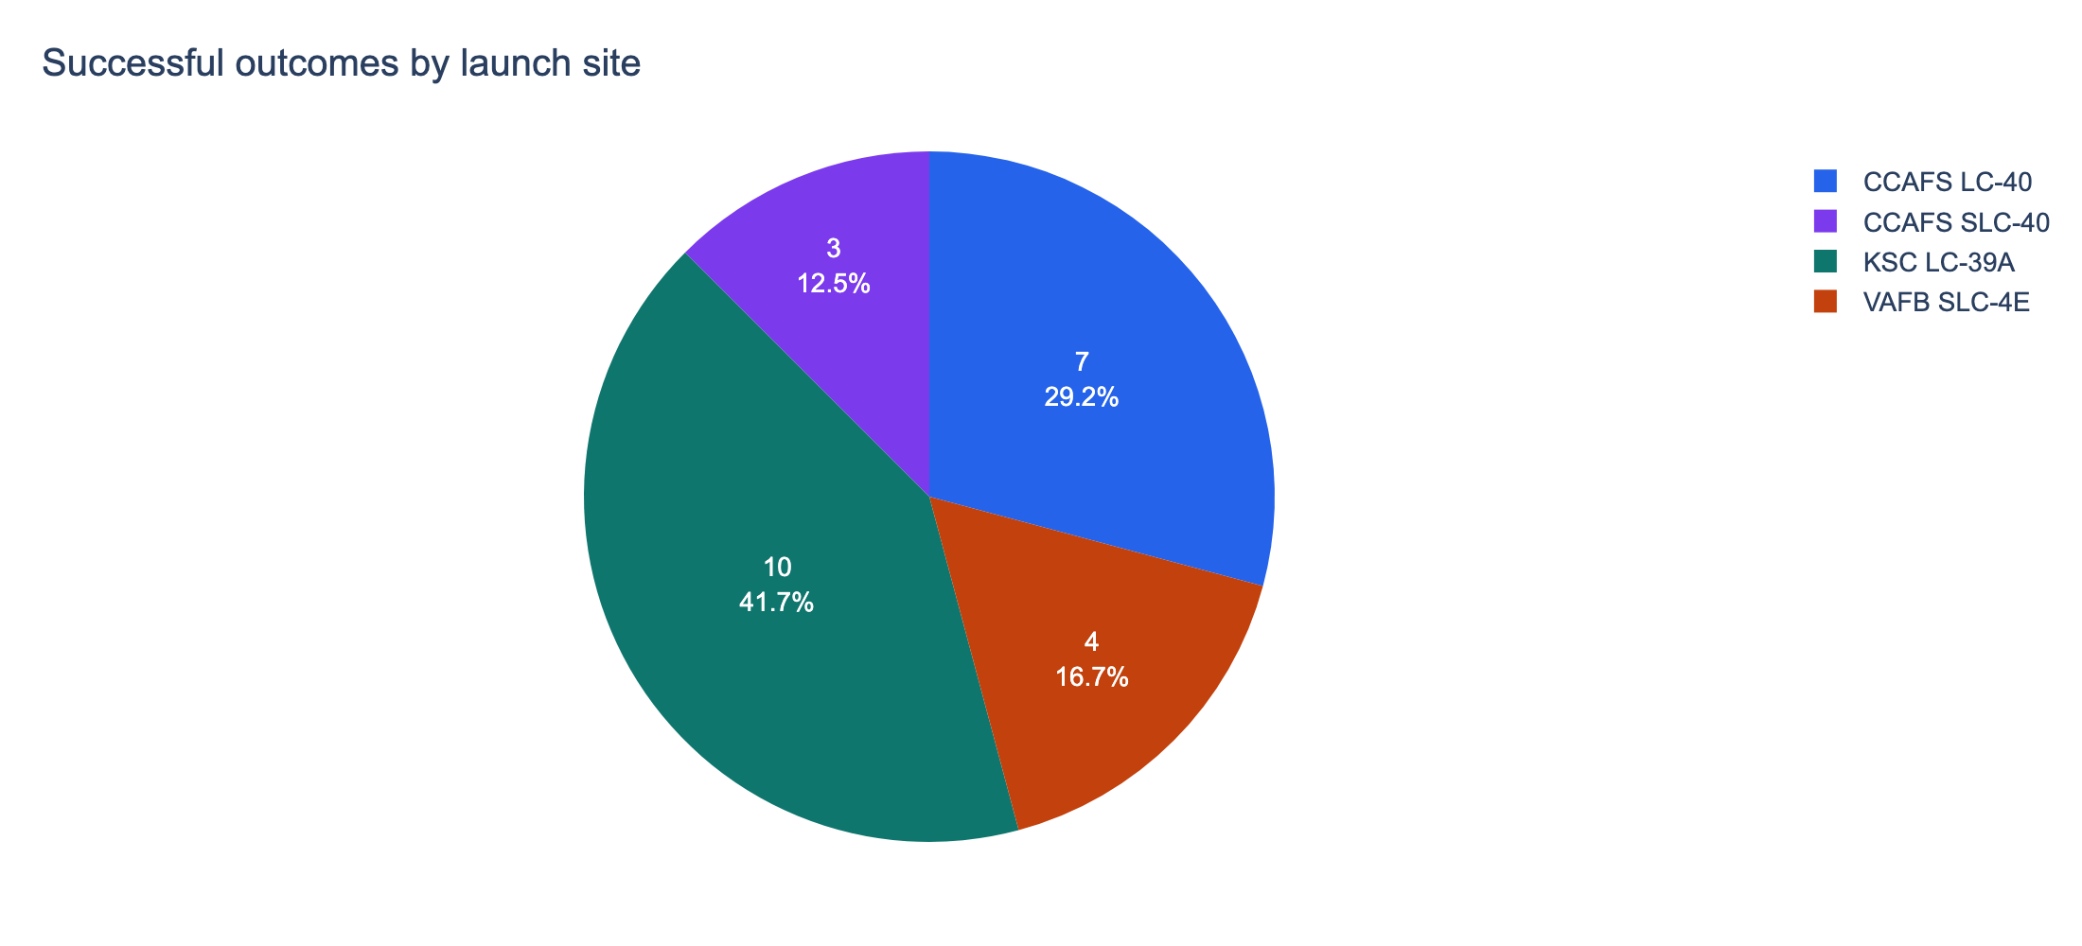
Successful Outcomes Across All Sites
The 56-row dashboard sample contains 24 successful outcomes.
KSC LC-39A contributes 10, or 41.7% of all successes.
A pie share is different from a site's success rate.
Source: Dash lab. Detailed references in speaker notes.
39
Notes:
Sources: spacex_dash_app.py; data/spacex_launch_dash.csv; DASHBOARD_INSIGHTS.txt

Slide 40
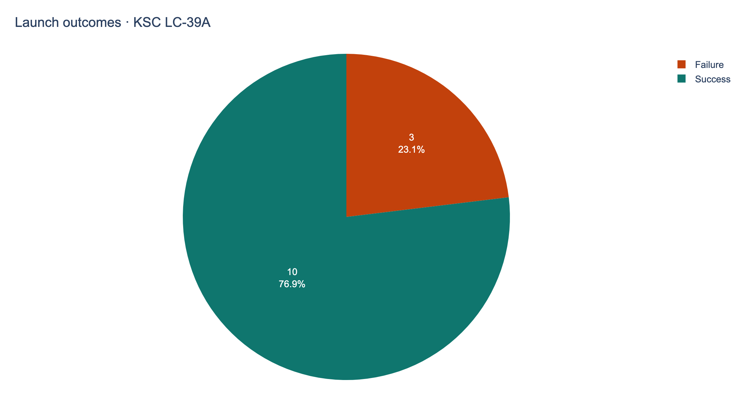
KSC LC-39A Has the Highest Site Rate
10 successful and 3 unsuccessful outcomes.
Success rate: 10/13 = 76.9%, the highest in this sample.
The selected-site pie changes the denominator to that site's launches.
Source: Dash lab. Detailed references in speaker notes.
40
Notes:
Sources: spacex_dash_app.py; data/spacex_launch_dash.csv; DASHBOARD_INSIGHTS.txt

Slide 41
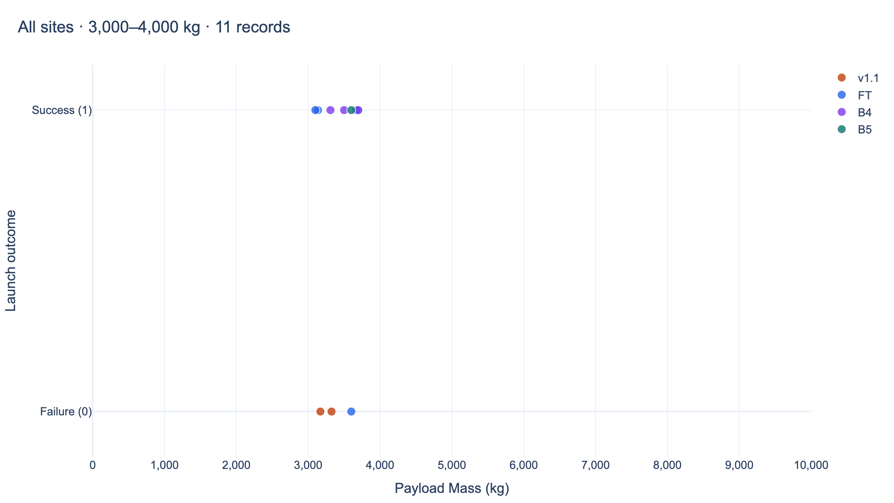
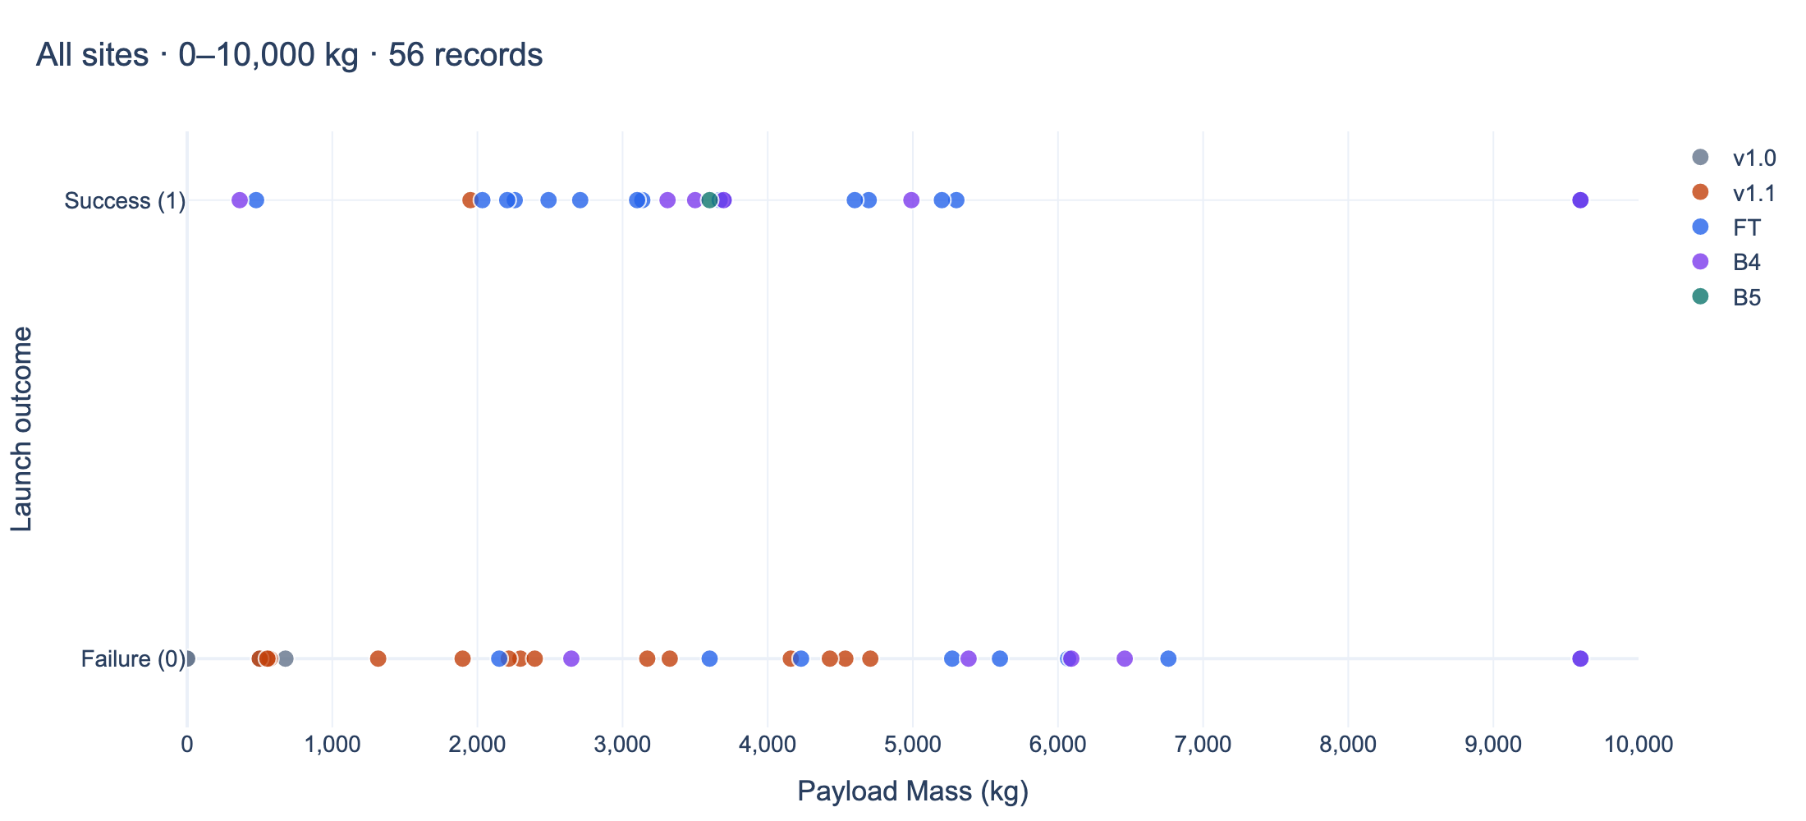
Payload Filters Reveal Different Outcome Mixes
Full payload range
Filtered payload range
Using fixed 1,000 kg bins: 3,000 to under 4,000 kg has 8/11 successes (72.7%). The 6,000 to under 7,000 kg bin has 0/4.
B5 has 1/1 success. FT has 16/24, providing more evidence than a single B5 observation.
Source: Dash lab. Detailed references in speaker notes.
41
Notes:
Sources: spacex_dash_app.py; data/spacex_launch_dash.csv; DASHBOARD_INSIGHTS.txt
The charts are exported directly from dashboard callbacks. Left: ALL sites, 0-10,000 kg. Right: ALL sites, 3,000-4,000 kg, inclusive. Bin endpoints differ from the dashboard's inclusive slider endpoints. See DASHBOARD_INSIGHTS.txt for the complete bin table.

Slide 42

42
Notes:
Original IBM Skills Network template section artwork retained.

Slide 43
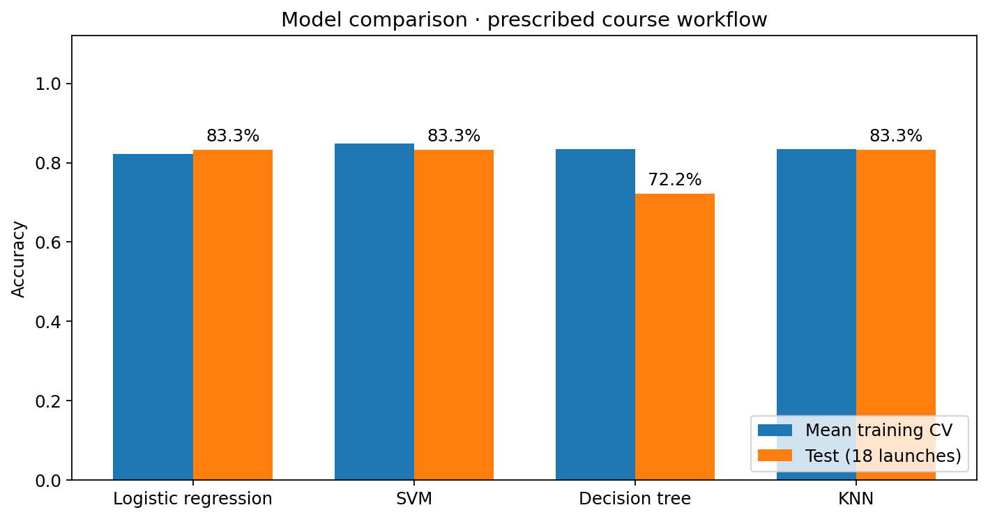
Classification Accuracy
Logistic regression, SVM and KNN tie: 15/18 correct (83.3%).
Decision tree: 13/18 (72.2%). Majority baseline: 12/18 (66.7%).
Fold-fitted scaling selects SVM by CV: 83.6% CV, 83.3% test.
Source: ML lab. Detailed references in speaker notes.
43
Notes:
Sources: SpaceX-Machine-Learning-Prediction-Part-5-v1.ipynb; ml_outputs/course_model_comparison.csv; ml_outputs/fold_scaled_model_comparison.csv; ml_outputs/course_test_predictions.csv

Slide 44
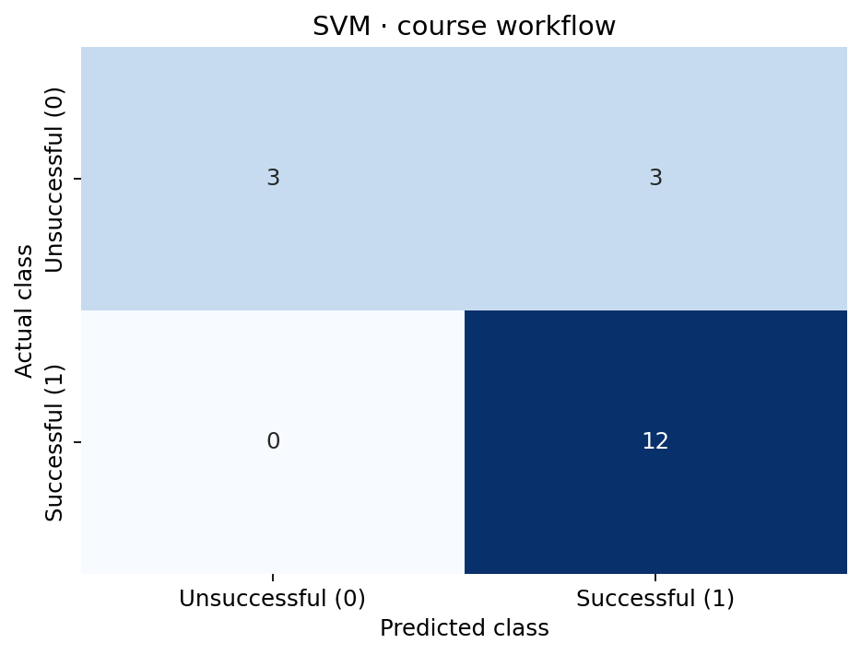
SVM Confusion Matrix
True negatives: 3. False positives: 3. False negatives: 0. True positives: 12.
Success recall: 100%. Success precision: 80%. Specificity: 50%.
All three errors predict success for an unsuccessful launch.
Source: ML lab. Detailed references in speaker notes.
44
Notes:
Sources: SpaceX-Machine-Learning-Prediction-Part-5-v1.ipynb; ml_outputs/course_model_comparison.csv; ml_outputs/fold_scaled_model_comparison.csv; ml_outputs/course_test_predictions.csv

Slide 45
Conclusions
Historical outcome rates differ by orbit, year and site. Their effects overlap and are not causal estimates.
The dashboard's strongest site is KSC LC-39A at 10/13 successful outcomes.
Three classifiers achieve 83.3% test accuracy. Training cross-validation favors SVM.
Next steps: use a future-time holdout, rebuild preprocessing on training data, and audit feature availability before launch.
Source: ML lab. Detailed references in speaker notes.
45
Notes:
Sources: SpaceX-Machine-Learning-Prediction-Part-5-v1.ipynb; ml_outputs/course_model_comparison.csv; ml_outputs/fold_scaled_model_comparison.csv; ml_outputs/course_test_predictions.csv

Slide 46
Appendix: Dataset and Label Register
Analysis | Rows | Positive outcome definition
API / EDA / ML | 90 | True ASDS, True RTLS or True Ocean
SQL | 101 | Mission success and landing outcome are separate fields
Folium / Dash | 56 each | Supplied binary class in each course file
Wikipedia scraping | 121 | Source outcome text, not merged into ML labels
The main 90-row sample has 41 successful drone-ship outcomes. Including 14 ground and 5 ocean successes produces 60 positive labels.
46

Slide 47
Additional Insights and Evaluation Limits
Observation | Implication
15 correct predictions out of 18 | Approximate 95% Wilson interval: 60.8%-94.2%
3 of 6 class-0 launches predicted as class 1 | Accuracy conceals a 50% false-positive rate for this class
Five True Ocean outcomes count as positive | Excluding ocean outcomes gives 55/90 = 61.1%, not 66.7%
Scaling inside CV changes model tuning | KNN chooses k=5 instead of k=6, despite the same test accuracy
These checks sharpen the interpretation. They do not justify claiming deployment readiness.
Source: ML lab. Detailed references in speaker notes.
47
Notes:
Sources: SpaceX-Machine-Learning-Prediction-Part-5-v1.ipynb; ml_outputs/course_model_comparison.csv; ml_outputs/fold_scaled_model_comparison.csv; ml_outputs/course_test_predictions.csv
Wilson interval uses 15 successes / 18 trials, z=1.96. This binomial interval does not account for model selection, temporal dependence or upstream preprocessing.

Slide 48
Code and Reproducibility
GitHub project repository
https://github.com/VavanZaa/IBM-Capstone
Artifact | Local location
Completed notebooks and Python files | capstone/
Dataset snapshots and provenance | capstone/data/
Charts, maps and model predictions | dataviz_outputs/, location_outputs/, ml_outputs/
Dashboard entry point | spacex_dash_app.py
Run instructions and dependencies | RUN_INSTRUCTIONS.txt and requirements.txt
Reproduce the dashboard with Python and rerun notebooks from top to bottom. This report uses the saved historical inputs.
48
Notes:
Project repository supplied by the author: https://github.com/VavanZaa/IBM-Capstone. The artifact table lists the local project locations.

Slide 49
Sources and Technical References
IBM Skills Network course datasets: API_call_spacex_api.json, dataset_part_1.csv, Spacex.csv, spacex_launch_geo.csv and spacex_launch_dash.csv.
Wikipedia historical launch tables: revision 1027686922, dated 9 June 2021.
Archived SpaceX API metadata: resource URLs and field provenance in data/spacex_lab_metadata.json.
OpenStreetMap contributors: extracted features dated 20 October 2026. ODbL attribution applies to the map data.
scikit-learn: model selection and preprocessing guidance. Plotly Dash and Folium: interactive visualization libraries.
49
Notes:
Dataset base: https://cf-courses-data.s3.us.cloud-object-storage.appdomain.cloud/IBM-DS0321EN-SkillsNetwork/
API snapshot: datasets/API_call_spacex_api.json
SQL: labs/module_2/data/Spacex.csv
Geo: datasets/spacex_launch_geo.csv
Dashboard: datasets/spacex_launch_dash.csv
Wikipedia: https://en.wikipedia.org/wiki/Special:PermanentLink/1027686922
OpenStreetMap: https://www.openstreetmap.org/copyright
scikit-learn: https://scikit-learn.org/1.6/common_pitfalls.html#data-leakage
Dash: https://dash.plotly.com/basic-callbacks
Folium: https://python-visualization.github.io/folium/
All numerical findings derive from local executed notebooks and associated CSV exports.
Template and template imagery: supplied IBM Skills Network ds-capstone-template-coursera.pptx.

Slide 50

50
Notes:
Original IBM Skills Network template section artwork retained.

