Slide 1
analysis of expeditions for 2017
Vojtěch Vávra

Slide 2
Background
Client information:
100 customers
3 sites – Z1, Z2, Z3
2 ways of delivery – train or truck
Only 1 material – M1
Reason for action:
Expansion by 2 new sites.
Can we
improve
efficiency?

Slide 3
YES!

Slide 4
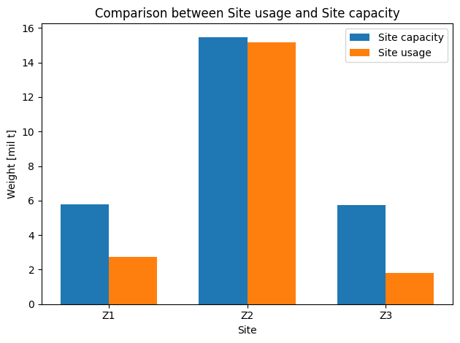
Used solution so far
So called Ad-hoc solution.
This is reality.
Cost of: 4.7 billion tons/km.

Slide 5
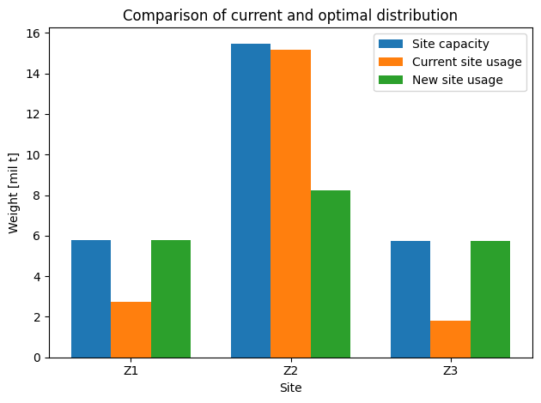
New proposed solution
Optimized for min amount of tons/km.
This could be the future.
Cost of: 2.2 billion tons/km.

Slide 6

To compare
 | Current solution | Proposed solution
Cost [tons/km] | 4.7 billions | 2.2 billions
Decrease of costs by 54 %
But how?

Slide 7
The solution and impact
We used mathematical programming to minimize costs.
Costs saved on delivery distances.
Other impact:
Lower carbon footprint (better ESG)
Lower time required to travel
Lower the workload at site S2

Slide 8
Additional analysis
109 records are delivered by unknown site.
In the new solution this is met from existing sites.
810 records have 0 weight. Ineffectiveness.
Example of improvement:
Actual solution: from Z2 to Customer 50 (495 km)
Proposed solution: from Z1 to Customer 50 (271 km)
List of preferred routes with capacity to deliver is available in Optimal_deliveries.xlsx
Warehouse capacity restriction is met.

Slide 9
Information to improve the analysis
Cost of tons/km in €.
For truck and for train. It could be different.
Cost of truck/train per km in €.
GEO coordinates of sites and/or customers.
GDPR is the problem?
For visualization on a map to see and feel the difference of improved deliveries.
For better management information per month/week. Calculation could be improved.
Additional years of expedition for predictions
Optimistic/basic/negative scenario

Slide 10
Discussion open

