Slide 1
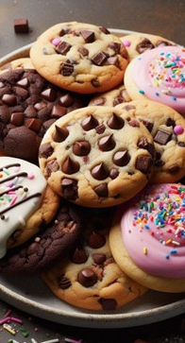
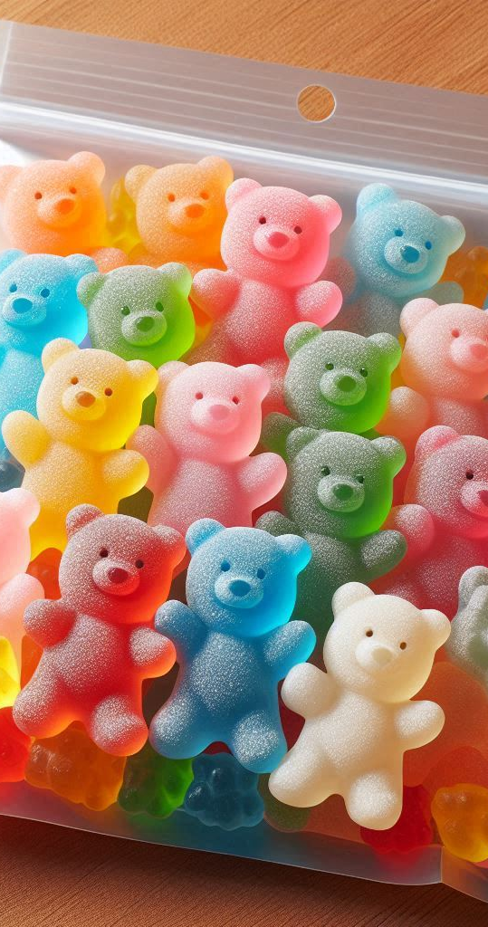
Why?
Expansion of candy offering:
Innovation
Quantification
Orchestration
Cookies
Gummies
Data driven decision

Slide 2
How?
Data sanity
Check
- CHECK missing
- Outliers
- Inconsistencies
- (standardize)
Visual
Inspection
- Scatterplot
- Histograms
- boxplots
Assumptions
- New features
- Independence
- homoskedasticity
Machine
Learning
- OLS
- Random tree
- Cross validation
- Make predictions

Slide 3
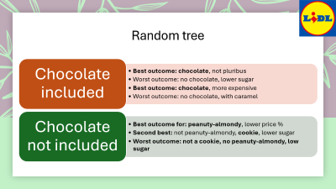
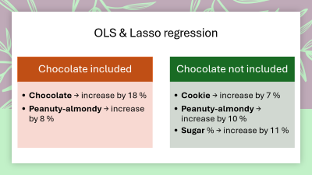
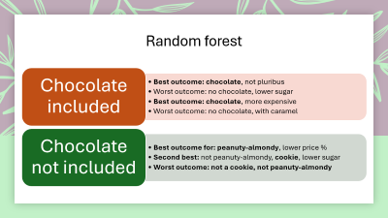
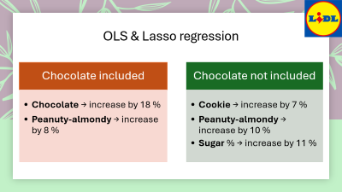
What?
 | Lasso (Ch) | Lasso | OLS (Ch) | OLS | Random forest (Ch) | Random forest
1. | Chocolate | Cookie | Chocolate | Sugar % | Chocolate | Peanuty-almondy
2. | Peanuty-almondy | Peanuty-almondy | Sugar % | Peanuty-almondy | Price % | Cookie
3. | Sugar % | Pluribus | Peanuty- almondy | Cookie | Peanuty- almondy | Sugar %
4. | Gummies | Hard | Crisped rice wafer | (-) Hard | - | Price %
*(Ch) stays for chocolate
included in the analysis

Slide 4
OLS & Lasso regression
Chocolate included
Peanuty-almondy → increase by 8 %
Chocolate not included
Cookie → increase by 7 %
Peanuty-almondy → increase by 10 %
Sugar % → increase by 11 %
Chocolate → increase by 18 %

Slide 5
Random forest
Chocolate included
Best outcome: chocolate, not pluribus
Worst outcome: no chocolate, lower sugar
Best outcome: chocolate, more expensive
Worst outcome: no chocolate, with caramel
Chocolate not included
Best outcome for: peanuty-almondy, lower price %
Second best: not peanuty-almondy, cookie, lower sugar
Worst outcome: not a cookie, not peanuty-almondy

