Slide 1

Case study: Time series of sales and investments
Vávra Vojtěch

Slide 2

1. Visualizations

Slide 3
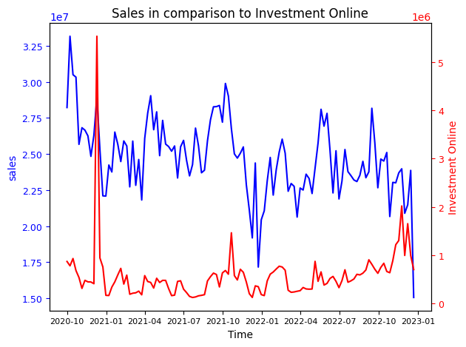
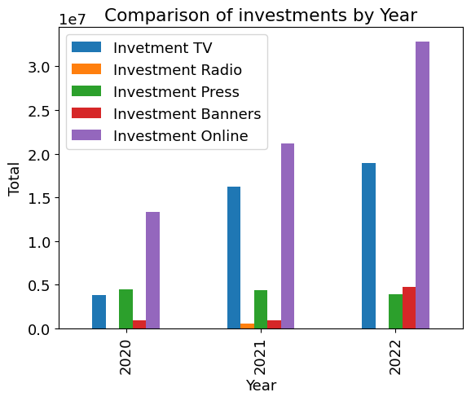
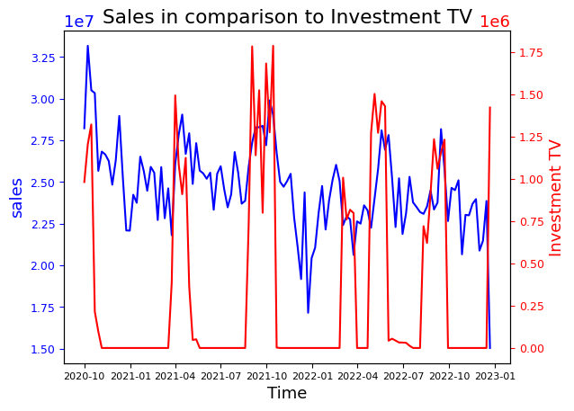
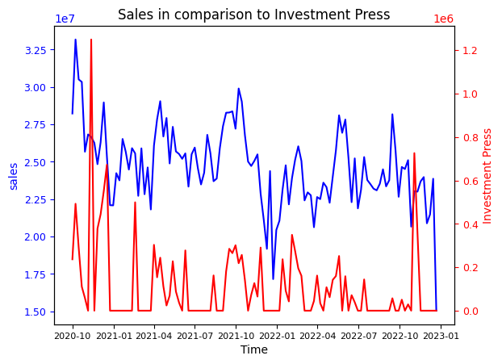
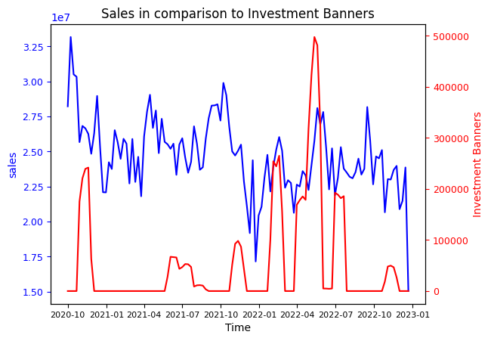
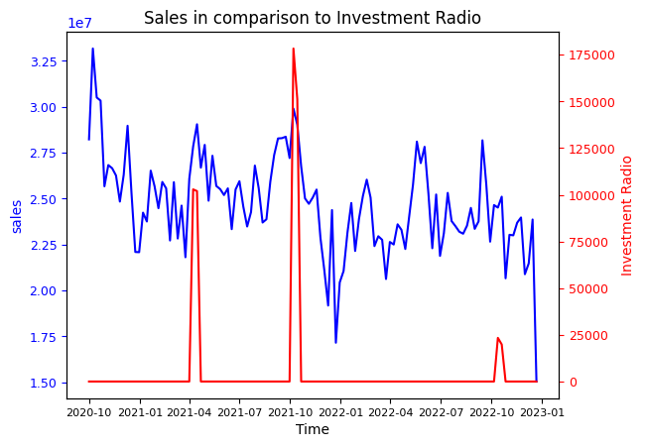
Notes:
- Each investment seems to have positive impact. However, which are clearly important?

Slide 4

2. Join data
Yes, 2 options.
Left join monthly data by yyyymm to weekly data.
+ Easy to perform.
The same values in the same yyyymm.
+- Be aware of lagged data problems.
+ GDP and Unemployment lagged data inspection.
Vice versa
+ Unique values for each month.
- Loosing weekly information.
- Need to sum/avg/min/max up values by month.
- Loosing significant number of observations.

Slide 5
3. Preselection of variables
Correlation matrix
Stores opened dropped
Visual inspection
Visual inspection with lags for GDP and Unemployment
Unemployment – just current
GDP – also lagged by 6 months
Stacionarity test (If field doesn‘t pass, then make differences)
Granger Causality (with lags)

Slide 6
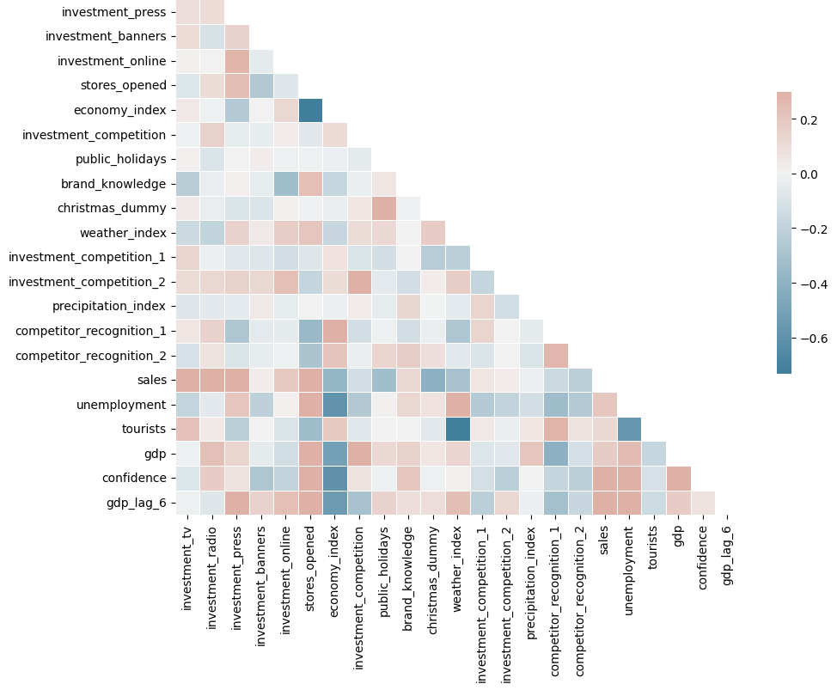
ADF test results:
non-stationary fields
'investment_banners‘
'economy_index‘
'weather_index‘
'unemployment‘
'gdp‘
'confidence‘
'gdp_lag_6‘
…
Differences performed to create stationary fields

Slide 7

4. Scale of fields
Need to normalize values of money. Changed to millions CZK.
Natural logarithm for number of turists.
Summarization of competitors to decrease volatility.
Differencing of non-stationary fields.
Why?
To increase prediction power.
Get rig of large scales.

Slide 8
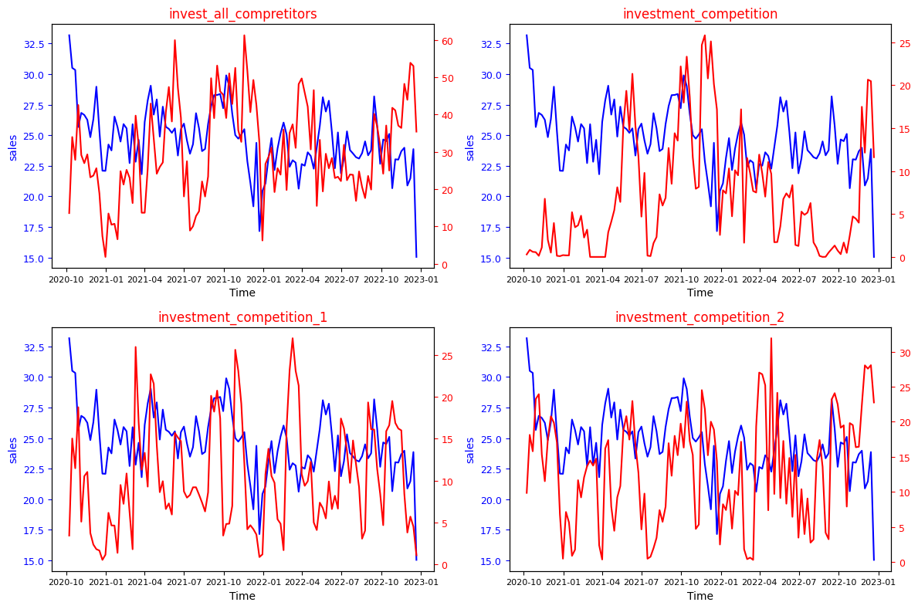

Slide 9
5. Final dataset
Target: Sales
Investment: TV, radio, press, online, banners diff
Our strong side: brand knowledge
Competitors: invest all competitors
Expectations: precipitation, index weather index diff
Special occasions: holidays, christmas
Macro economy: GDP, GDP 6 lag, Unemployment diff
People: economy index diff, tourists, confidence diff

Slide 10

6. How to determine impact of investments
Used model with differences
all investments and target variable performer
Additional options, that need more insight information:
Non-linear effects
Segmentation by origination of sales (age, family status, business related, …)
Optimization of budget (leads to LP problem)

Slide 11

7+8. Impact of marketing activities
According to LRM analysis (just preprocessed data) important factors are:
1
Investment: TV, Radio, Press, Online
Other values: Brand knowledge, Christmas
---> Keep working on these factors
According to LRM analysis (differences) + (other factors):
2
Investment diff: Radio
Other values: Weather, Christmas
---> High potencial for more investments into Radio marketing
---> Weather and Christmas decrease sales

Slide 12
9. Additional steps
Check Bias-Variance tradeoff
Check R², MSE, MAS and/or for different models
Perform cross validation (k-fold CV)
Other approaches: Lasso r., Backward r., Ridge r., VAR, ARIMA
Compare to machine learning algorithms (Decision Three, Random forest)
AUC-ROC curve, Gini Index
Residual analysis
Visual inspection

Slide 13
10 Client presentation
10 – Next 2 slides presentation

Slide 14
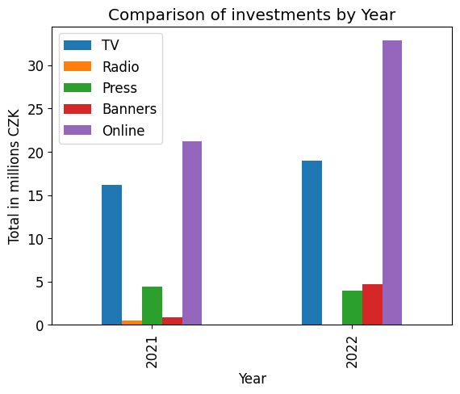

Analysis of investments into marketing
Find opportunities where to invest into marketing
Determine over-saturated investments
Data from October 2020 to December 2022

Slide 15



Investment analysis: key output
Radio marketing has the biggest potential for growth!
Online marketing is important but saturated, low opportunity.
Additional advice
Increase brand knowledge
Key global factors
Christmas – decrease of sales → unexpected
Weather – the higher temperature the lower sales → unexpected
TV marketing is overrated and saturated! Decrease!
Press marketing has positive impact, but it is not significant.
Banners are not important. Waste of time!

Slide 16
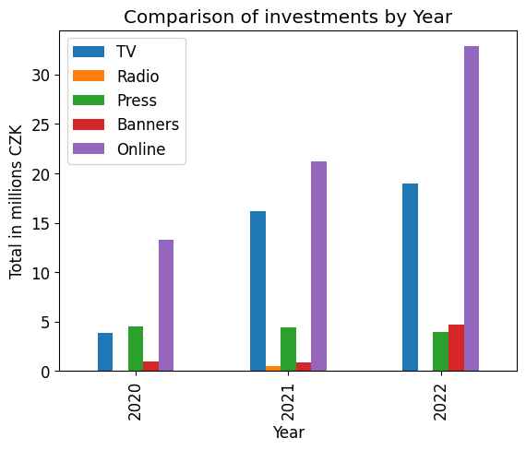
11. Compare contribution
Variable | Coefficient | P-value
Tv (diff) | -0.0160 | 0.970
Radio (diff) | 9.6642 | 0.174
Press (diff) | 1.0826 | 0.157
Online (diff) | 0.8941 | 0.001
Banners (diff) | 0.00000121 | 0.691
With every 1 invested CZK into given {variable} we will increase sales by {coefficient}. In terms of between weeks and for ceteris paribus.
If {coefficient} is <1, then opportunity is saturated.
For example: Radio investment
14.5.2024 invest 10000 CZK
21.5.2024 invest 20000 CZK
diff(20000-10000)= 10000 CZK
10000 * 9.6642 = 96642 CZK (increse sales by)
But it is not statistically significant!

Slide 17

12. Optimal marketing mix
Define goals (not only sales) – KPI
Customer retention
Good product driven advertisement
Understand audience – suited advertisement for given channel (on-line marketing for younger people)
Budget allocation and distribution
On-line marketing: track see/visit/buy at on-line shop.

