Slide 1


RxJS: Thinking reactively and positively
How overcome the pain
August, 2017

Slide 2
Our bright async future
As more and more data is received, the amount of memory that your application consumes or requires will grow linearly or, in worst cases, exponentially

Slide 3
Our bright async future
Functional programming (FP) and reactive programming (RP). This exhilarating composition is what gives rise to functional reactive programming (FRP), encoded in a library called RxJS

Slide 4
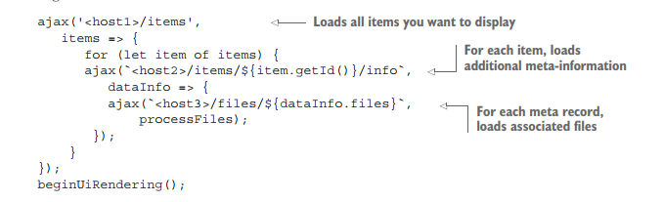
Our bright async future - Callbacks
Callback Hell
Callbacks can run more than once
Callbacks change error semantics.
Concurrency gets increasingly complicated.

Slide 5
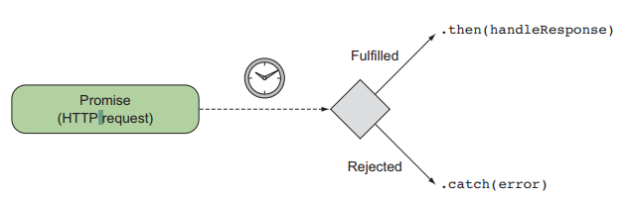
Our bright async future - Promises
unable to handle data sources that produce more than one value
lack the ability to retry from failure

Slide 6
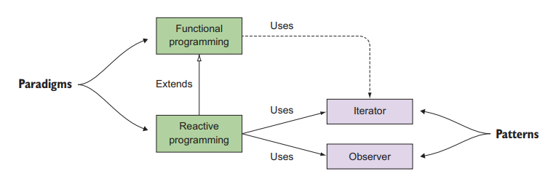
RxJS – Combination of best
Built on top of the pillars of
functional and reactive programming
design patterns such as observer and iterator

Slide 7
Functional programming
Declarative
Immutable
Side effect–free

Slide 8
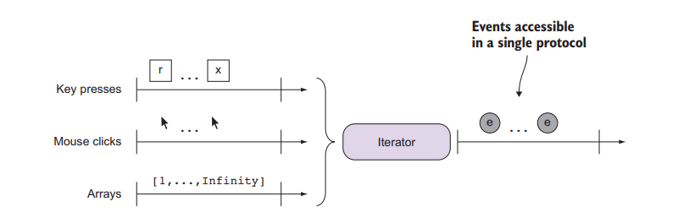
The iterator pattern
Decoupling the business logic applied at each element from the iteration itself
Provide a single protocol for accessing each element and moving on to the next

Slide 9
Data Streams
We’re dealing with thousands of
key presses
movement events
remote HTTP calls
Websocket connections
… we can think as data streams

Slide 10
Change your mindset
let a = 20;
let b = 22;
let c = a + b; //-> 42
a = 100;
c = ?
Reactive programming is oriented around data flows and propagation.

Slide 11
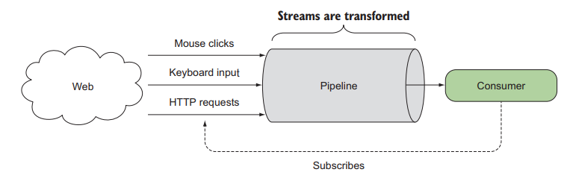
Change your mindset
A stream is nothing more than a sequence of events over time.

Slide 12
Streams
Streams are lazy
vs
Promises execute their operations as soon as they’re created

Slide 13
Streams
RxJS abstracts over time under the same programming model regardless of source

Slide 14
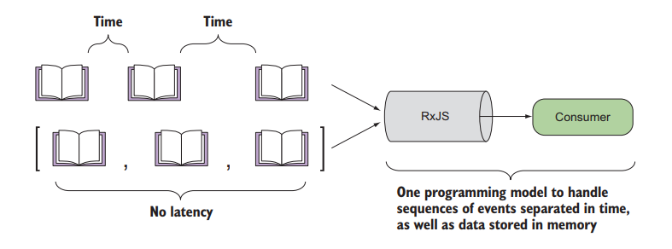
Magazines Example

Slide 15
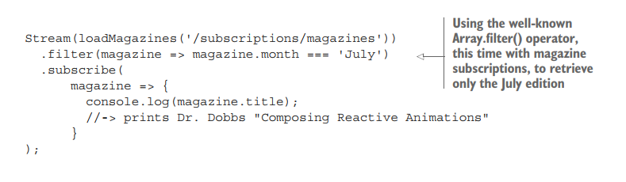
Magazines Example

Slide 16
Components of an Rx stream
Producers
Consumers
Data pipeline
Time

Slide 17
PRODUCERS
Producers are the sources of your data
The observer pattern defines producers as the subject
in RxJS, we call them observables, as in something that’s able to be observed

Slide 18
CONSUMERS
Accept events from the producer and process them
Stream is begin functioning only after consumer starts to listen
Streams travel only from the producer to the consumer
It is AKA observer

Slide 19
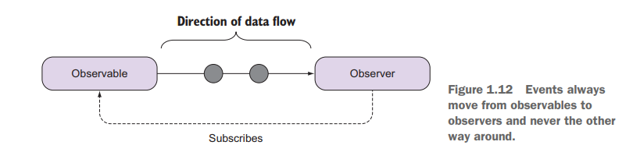
Direction of data flow

Slide 20
DATA PIPELINE
Manipulates or edits the data as it passes from the producer to the consumer
Adapt the output of the producer to match the expectations of the consumer (separation of concerns)

Slide 21
Rx Principles
Declarative (code expresses the what and not the how)
No need of variables to track the progress
No side effects (by corrupting outer state)
No mutation of a system’s state
Stream is the fundamental unit of work.
Approach problems as a sequence of data
Lazy evaluation

Slide 22
Different sources of data
EMITTED DATA (user interactions etc.)
STATIC DATA (presented in memory)
GENERATED DATA (with time)

Slide 23
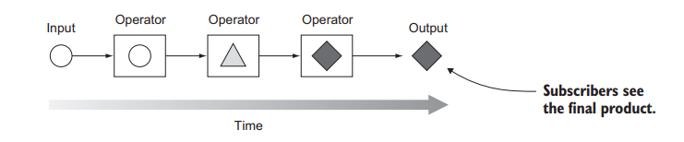
Creating RxJS observables

Slide 24
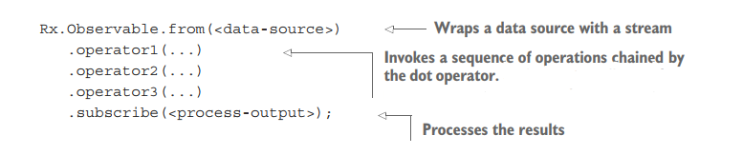
Creating RxJS observables

Slide 25
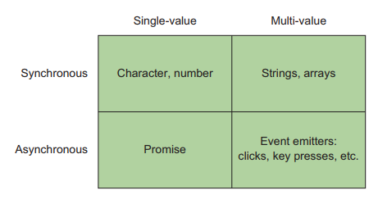
Types of data sources

Slide 26
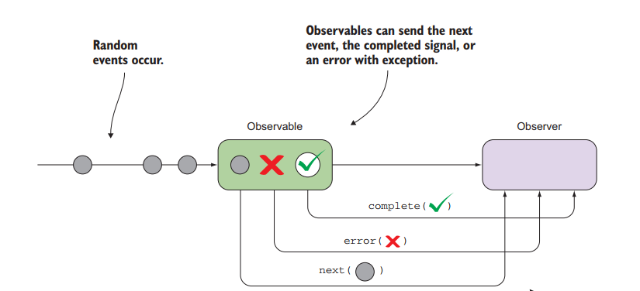
Observer API

Slide 27
Operators
Operators take your observable and
return a new observable

Slide 28
Error Handling
Observer will no longer pass along values after:
error() is called
complete() is called
unsubscribe

Slide 29
Links
https://github.com/tc39/ecma262

