Slide 1
This isToooooooooooooooooloooooooogg-
Sheeeeeeeeeeeeeeeeeeeeeeeeeeeeeesh
This is a paragraph test Par2 check the x length
This is a paragraph test Par3
This is a paragraph test Par4
This is a paragrapst Par5 to test what we see in text when the sentence h tecontinues below

Slide 2
This is a paragraph test Par one SECOND SLIDE
This is a paragraph test Par2 check the x length
Sheesh
This is a paragraph test Par3 SECOND SLIDE
This is a paragraph test Par to check if the length is represented correctly as it shoulddddddddddddddddd.
This is a paragraph test Par5 to test what we see in text when the sentence continues below.

Slide 3
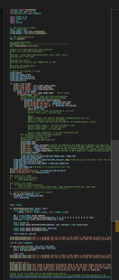
Test to see middle pixel length of pillow and get the values
Test to see middle pixel length of pillow and get the values2
Με λένε Στέλιο

