Slide 1

AGRITECH MACHINE LEARNING · INTERNSHIP PROJECT 2026
Mushroom Yield Forecast
Predicting daily oyster mushroom yield in a controlled polyhouse
from temperature, humidity, and CO₂ sensor data.
Vazeem Basheer
Product Development / Data Science Internship — Zellbytes

Slide 2



THE PROBLEM
Mushroom growth is a climate-sensitive guessing game
Goal: shift harvest planning from reactive to predictive
Oyster mushrooms are highly sensitive to their microclimate. Without predictive insight, harvest planning has stayed reactive — causing supply-chain inefficiencies, market stockouts, or wasted product.
Temperature
Relative Humidity
Carbon Dioxide
Drives metabolic rate, growth speed, and fruiting triggers.
Prevents mycelium drying; supports fruiting body expansion.
High CO₂ boosts mycelial growth but stunts cap development.
Mushroom Yield Forecast
2

Slide 3






DATA & PIPELINE
One year of polyhouse telemetry, cleaned into a model-ready dataset
→
→
→
→
→
Ingest
Clean
Explore
Engineer
Train
Select
Raw CSV → Parquet
Validate, fill, dedupe
Stats & correlations
Scale features
Fit & evaluate
Champion model
365
0
0
4
Daily records
Missing values
Duplicates removed
Core features
Validation rules: Temperature 10–35°C · Humidity 50–100% · CO₂ 400–2000 ppm · forward-fill for short gaps · latest-timestamp deduplication.
Mushroom Yield Forecast
3

Slide 4
EXPLORATORY ANALYSIS
Temperature and humidity help yield; CO₂ holds it back
Low collinearity
Sensor variables barely correlate with each other (|r| < 0.03), so regression coefficients stay reliable.
Tight climate control
All features show coefficient of variation under 10% — a stable, well-managed polyhouse.
Near-symmetric distributions
Mean and median align closely across temperature, humidity, CO₂, and yield.
Mushroom Yield Forecast
4

Slide 5

FEATURE ENGINEERING
Scaled features, validated the way a forecaster actually works
Min-Max Scaling
Chronological 80 / 20 Split
x_scaled = (x − x_min) / (x_max − x_min)
Why not random K-fold?
Adjacent days are highly correlated — a random split leaks future information into training and inflates test scores.
Brings temperature, humidity, and CO₂ onto a common [0, 1] range so no single sensor scale dominates the model — fitted only on training data to avoid leakage.
Interaction feature tested:
Train · 292 days (Jan 1 – Oct 18)
Test · 73 days
temp_humid_interaction = (temperature_c × humidity_pct) / 100
Safeguards
Raw inputs alone gave more stable cross-validation than the interaction term — so the final model kept it simple.
assert test_start_date > train_end_date enforced in code
MinMaxScaler fitted only on training data, then applied to test
Mushroom Yield Forecast
5

Slide 6

MODELING
Three models, one clear winner on held-out data
Model | CV MAE (kg) | Test MAE (kg) | Test RMSE (kg) | Test R²
Linear Regression ♦ Champion | 0.441 | 0.419 | 0.535 | 0.427
Random Forest (Tuned) | 0.466 | 0.445 | 0.562 | 0.369
Random Forest (Default) | 0.475 | 0.450 | 0.580 | 0.327
Random Forest tuning
Best hyperparameters
max_depth: 8 · min_samples_leaf: 5 · n_estimators: 100
TimeSeriesSplit (3 folds) + GridSearchCV across n_estimators, max_depth, min_samples_leaf.
Despite tuning, Random Forest still trailed the simpler linear baseline on every test metric.
Mushroom Yield Forecast
6

Slide 7

CHAMPION MODEL
Linear Regression wins — on accuracy and trust
Selected because it has the lowest Test MAE, lowest Test RMSE, the highest R², and is far easier for growers and stakeholders to interpret and maintain.
TEST PERFORMANCE
0.419 kg
Tie-breaking rule
Test MAE
If the gap in Test MAE between a complex and a simple model is under 0.05 kg, the simpler model wins.
42.7%
0.445 − 0.419 = 0.026 kg → well under threshold
of yield variance explained (R² = 0.427)
Scaled coefficients — direct, interpretable drivers of yield
+1.894
+0.959
−1.213
0.535 kg
Temperature
Humidity
CO₂
Test RMSE
Mushroom Yield Forecast
7

Slide 8
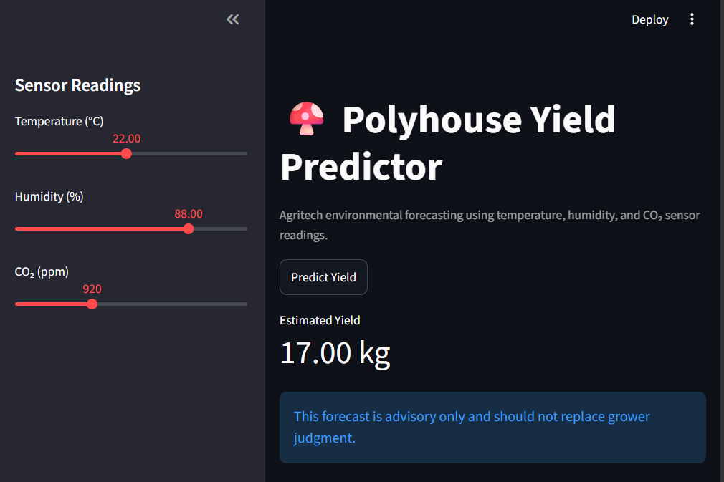

LIVE DEPLOYMENT
From model to dashboard: the Polyhouse Yield Predictor
Interactive sliders
Temperature (10–35°C), humidity (50–100%), CO₂ (400–2000 ppm).
Real-time prediction
One click on “Predict Yield” returns an estimate in kilograms.
Advisory boundary warnings
Flags inputs outside training ranges so growers know when to trust it less.
What-if sensitivity chart
Shows predicted yield as humidity varies, holding other inputs fixed.
Mushroom Yield Forecast
8

Slide 9
WORKED EXAMPLE
A live reading: 22°C, 88% humidity, 920 ppm CO₂
Temperature
Humidity
CO₂
22.00 °C
88.00 %
920 ppm
↓
ESTIMATED YIELD
Advisory only
17.00 kg
This forecast should not replace grower judgment — it's a decision-support signal, not a guarantee.
This input sits well inside the training envelope, so the model's confidence here is high relative to out-of-range readings.
Mushroom Yield Forecast
9

Slide 10

DEPLOYMENT & MONITORING
Shipped to the cloud, with logging to catch drift early
Live Cloud Deployment
Logging & Monitoring
Platform: Streamlit Community Cloud
Verified cloud predictions match local results within floating-point tolerance
Sliders for temperature, humidity, and CO₂ drive one-click predictions
Every prediction request is logged to logs/predictions.csv:
timestamp_utc
temperature_c
humidity_pct
co2_ppm
Live demo link
predicted_kg
vazeem-internship-2026‑
5yryfkqukyvqh9zgefpj7z
.streamlit.app
Watch for: drift in sensor distributions, predicted yield exceeding historical max by 20%+, missing or invalid readings.
Mushroom Yield Forecast
10

Slide 11

LIMITATIONS & ROADMAP
Where the model is honest about its limits — and what's next
LIMITATIONS
FUTURE IMPROVEMENTS
Small dataset
More features
365 daily records rules out deep sequence models like LSTMs.
Light intensity, soil moisture, ventilation rate, growth-stage indicators.
Linearity assumption
Automated retraining
Real biology has thresholds — growth doesn't scale linearly past ~32°C.
Scheduled pipeline using new production data every 3–6 months.
Missing sensor coverage
Drift detection dashboard
No light intensity, airflow, or substrate moisture data yet.
Automated alerts for sensor drift, seasonal drift, and prediction anomalies.
Synthetic data
Multi-polyhouse support
Generated for development; may lack real-world sensor noise.
Separate forecasting models for multiple cultivation environments.
Mushroom Yield Forecast
11

Slide 12
From sensor data to harvest-ready forecasts
Thank you
Vazeem Basheer
Product Development / Data Science Internship — Zellbytes, 2026
vazeem-internship-2026-5yryfkqukyvqh9zgefpj7z.streamlit.app
Mushroom Yield Forecast
12

