Slide 1
FLOATING POINT ARITHEMATICS
by –
1]Vaibhav barsaiyan (2023csm1019)
2] Shubham thawait (2023csm1015)
3] Prashant Yadav (2023csm1025)

Slide 2
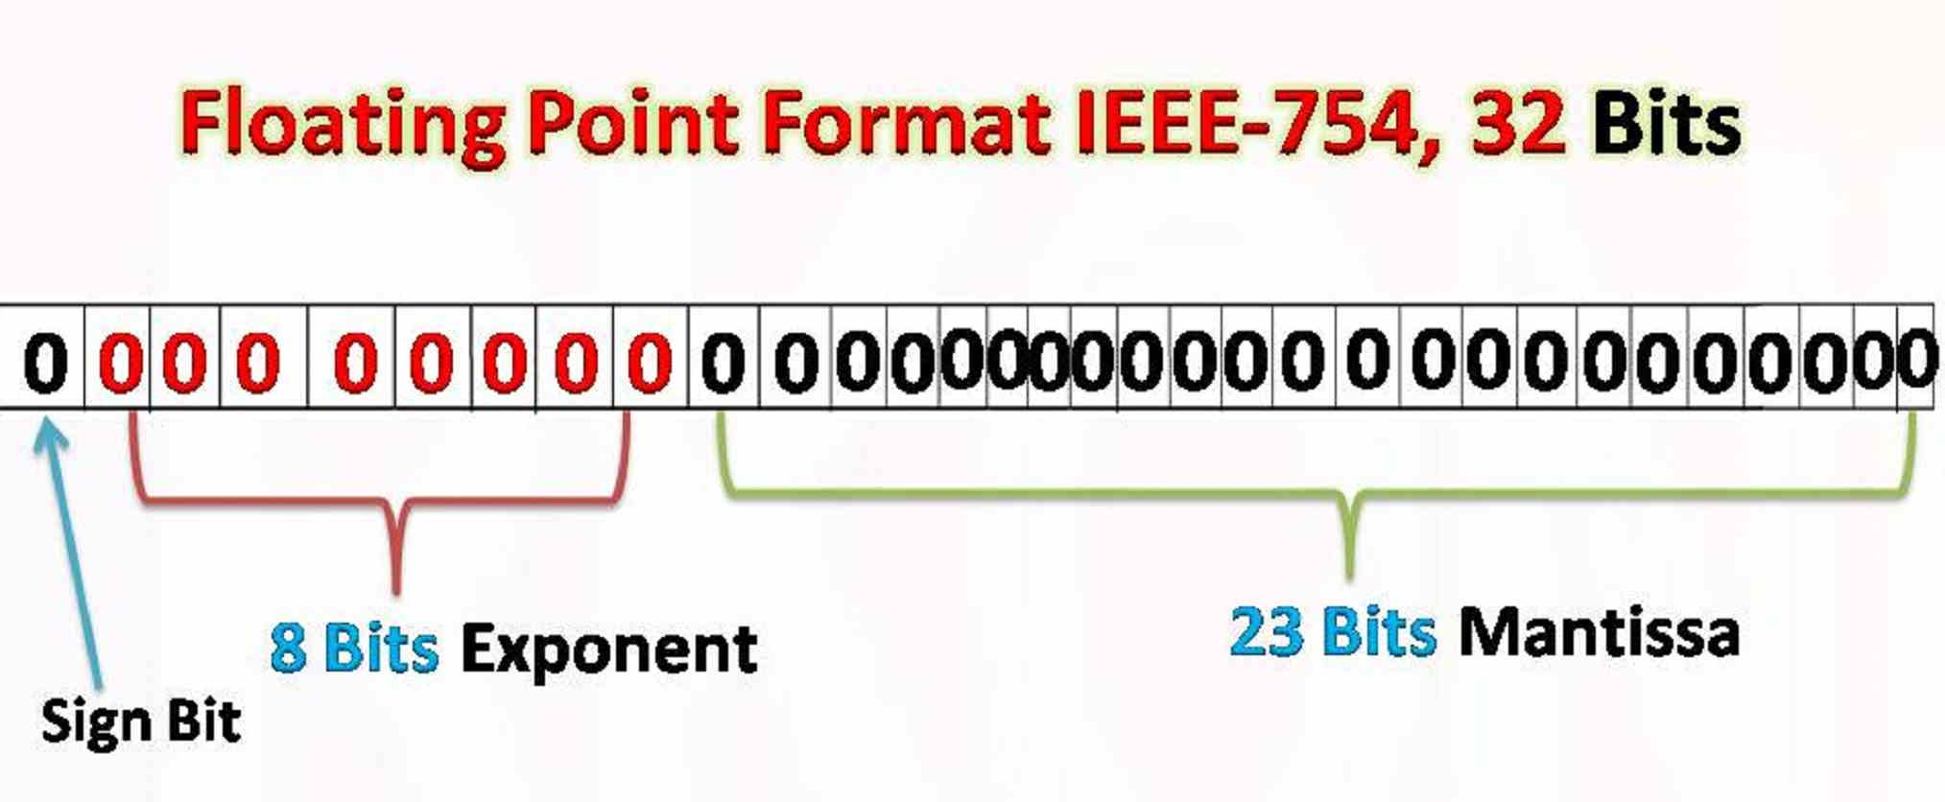

Slide 3
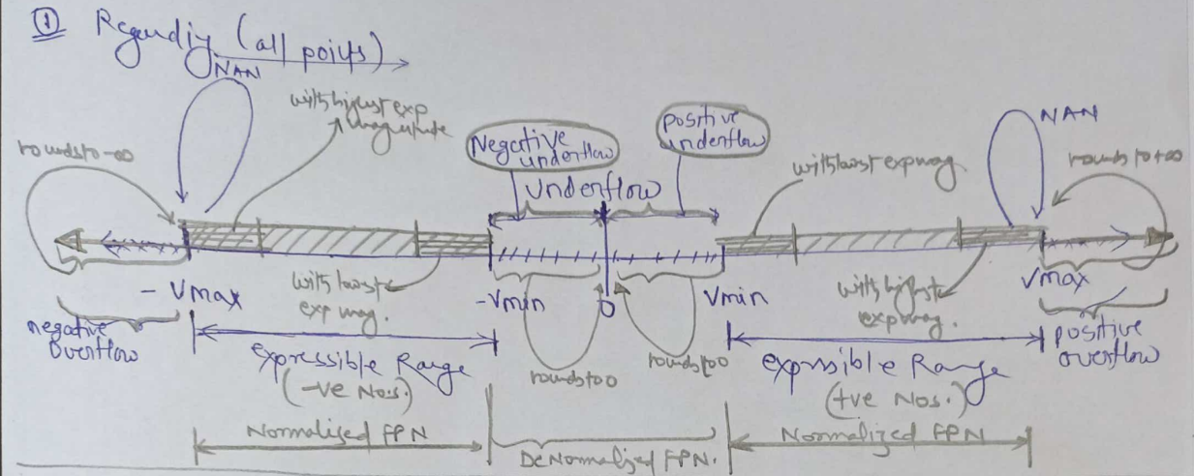

Slide 4
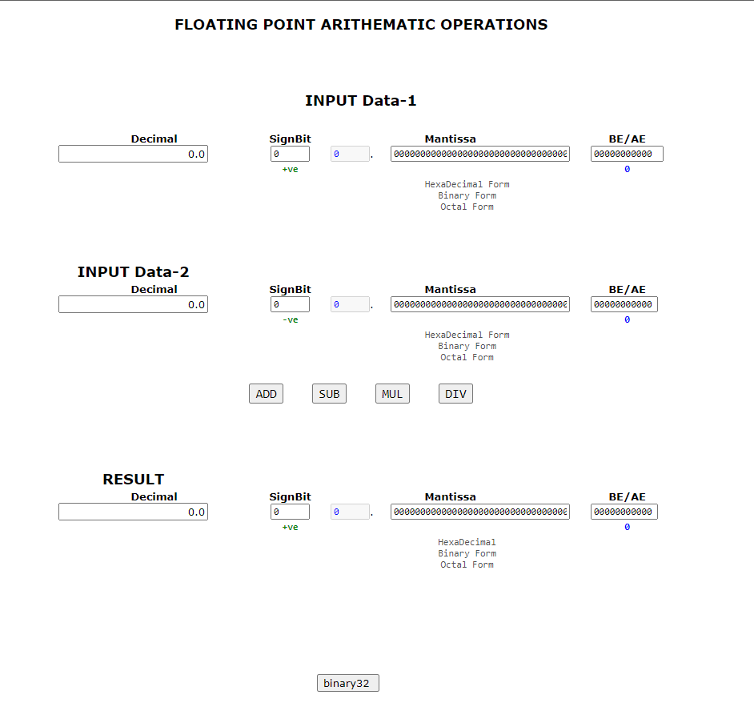

Slide 5
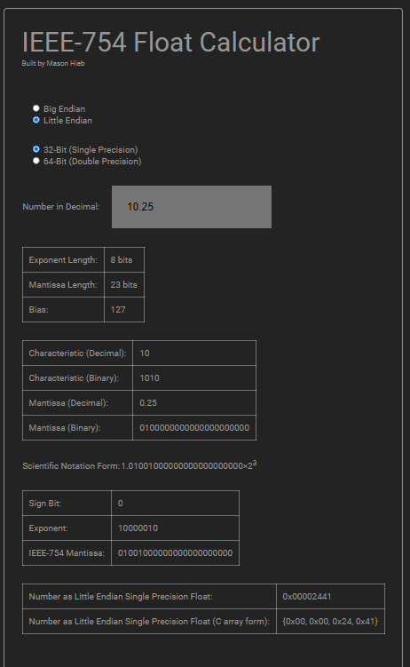

Slide 6


