Slide 1
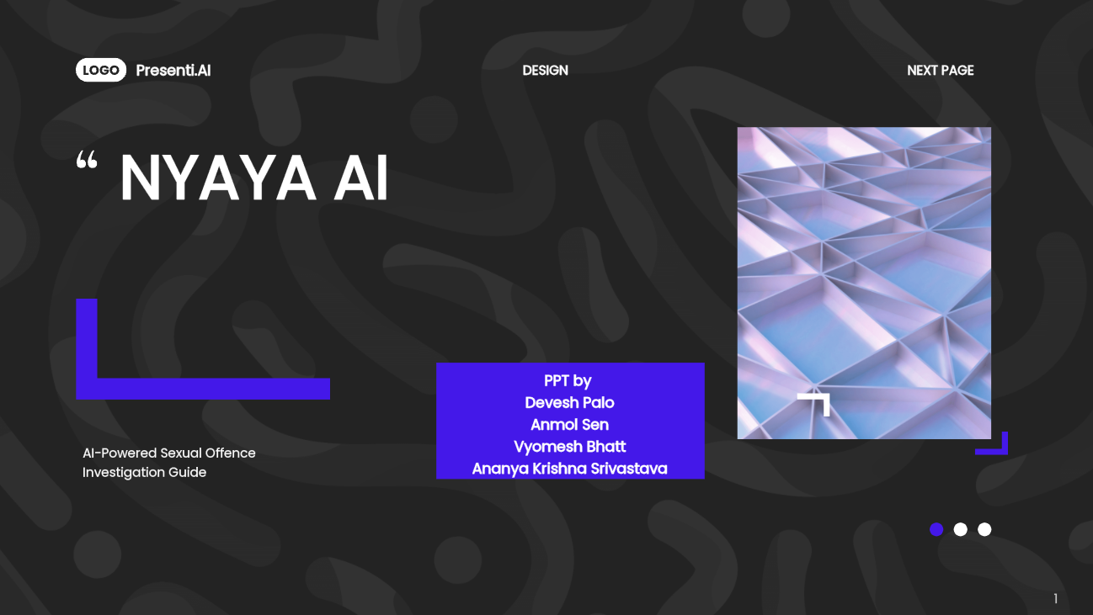
NYAYA AI
AI-Powered Sexual Offence Investigation Guide
Goa Police Hackathon 2025 – Team Sisyphus

Slide 2
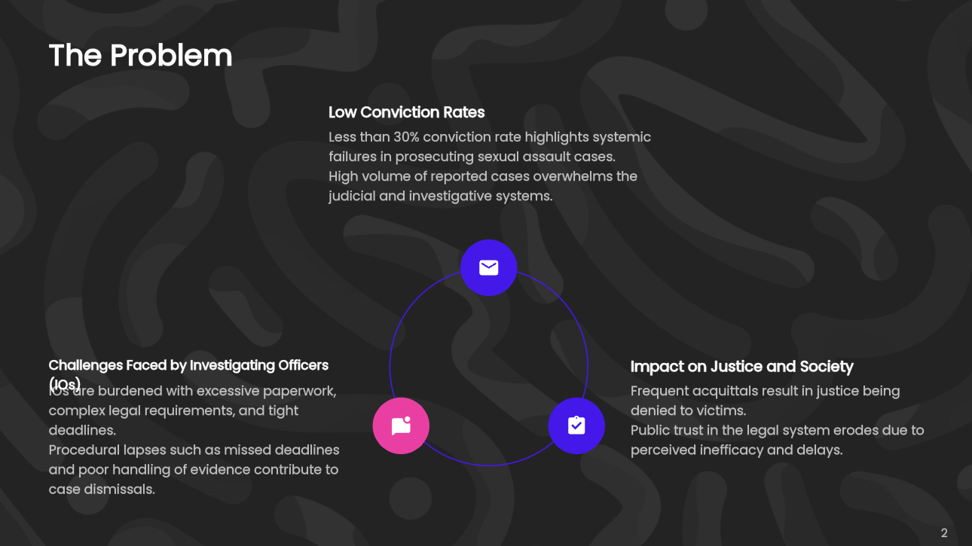
The Problem
• Sexual assault conviction rate in India: <30%
• 31,000+ reported cases annually, most fail in court
• IOs face overload of paperwork, legal complexity & strict deadlines
• Procedural lapses (missed deadlines, poor evidence) → Acquittals
• Justice denied, public trust eroded

Slide 3
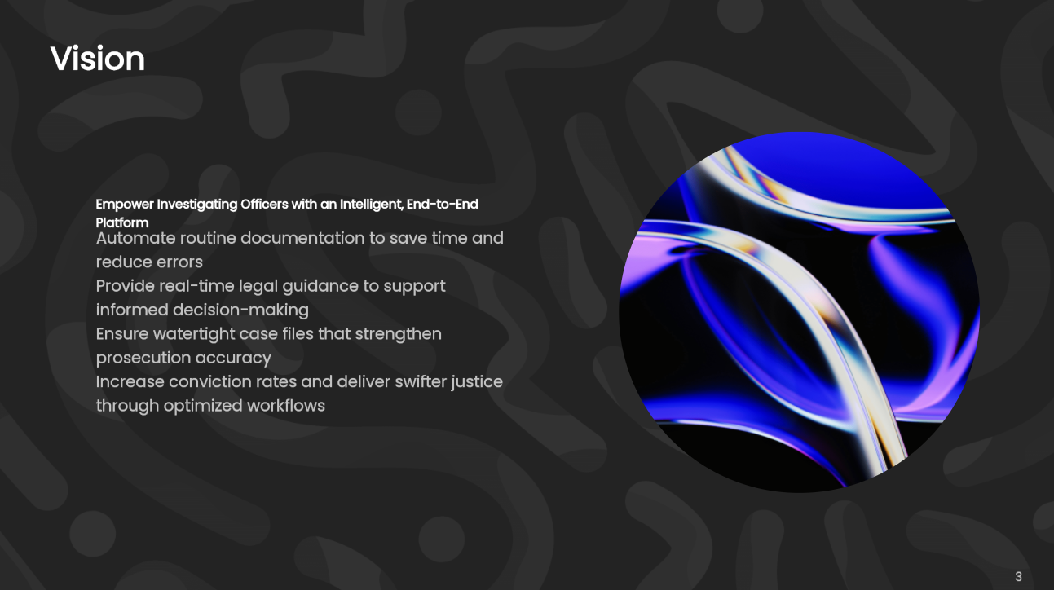
Vision
Empower Investigating Officers with an intelligent, end-to-end platform
• Automate documentation
• Provide real-time legal guidance
• Ensure watertight case files
• Increase conviction rates & deliver swifter justice

Slide 4
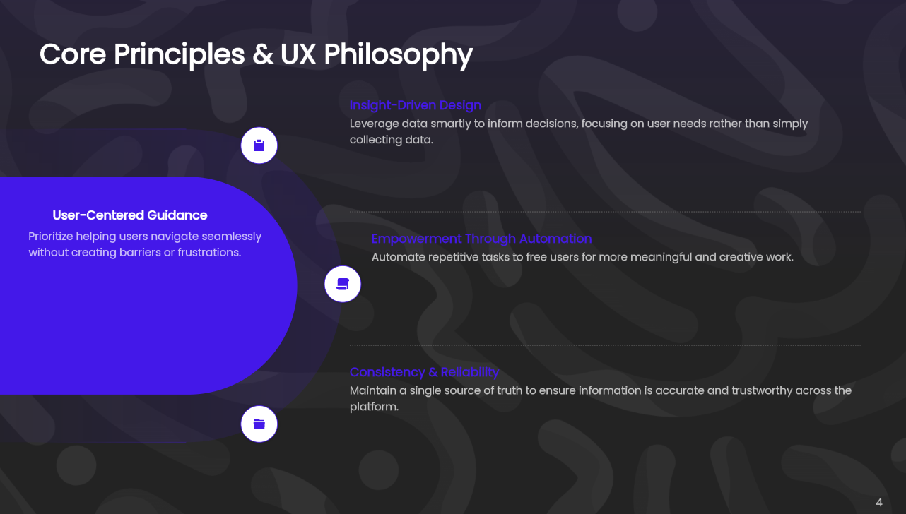
Core Principles & UX Philosophy
• Guidance, Not Obstruction
• Single Source of Truth
• Automate the Mundane, Empower the Human
• Data-Driven, Not Data-Entry-Driven

Slide 5
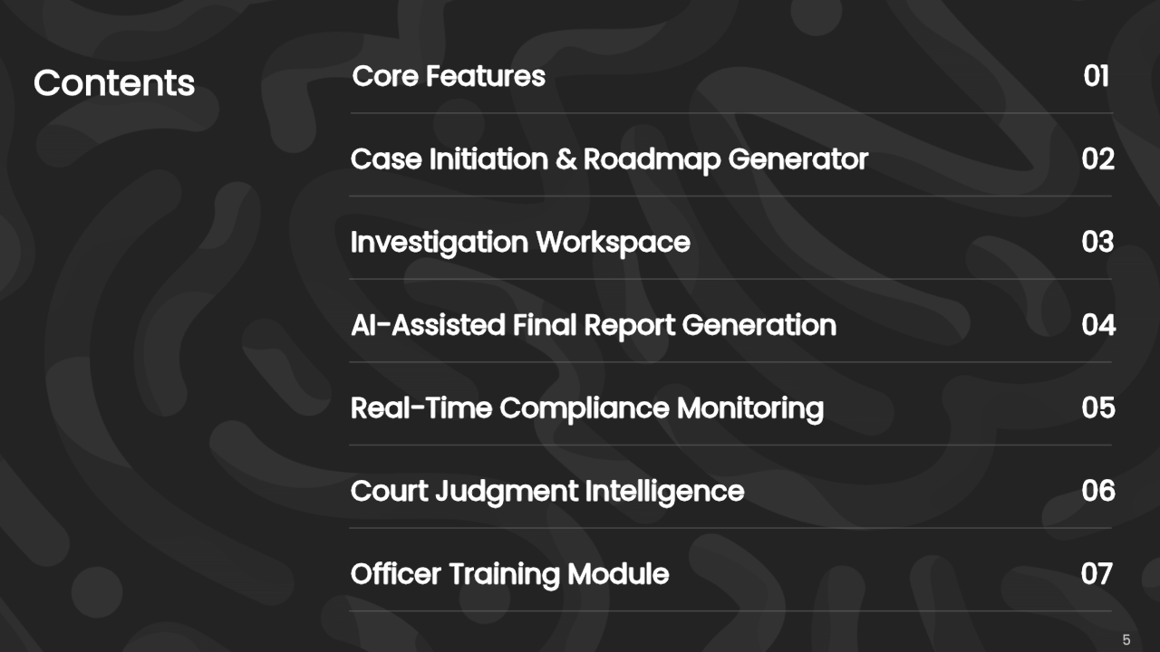
Core Features
1. Case Initiation & Roadmap Generator
2. Investigation Workspace
3. AI-Assisted Final Report Generation
4. Real-Time Compliance Monitoring
5. Court Judgment Intelligence
6. Officer Training Module

Slide 6
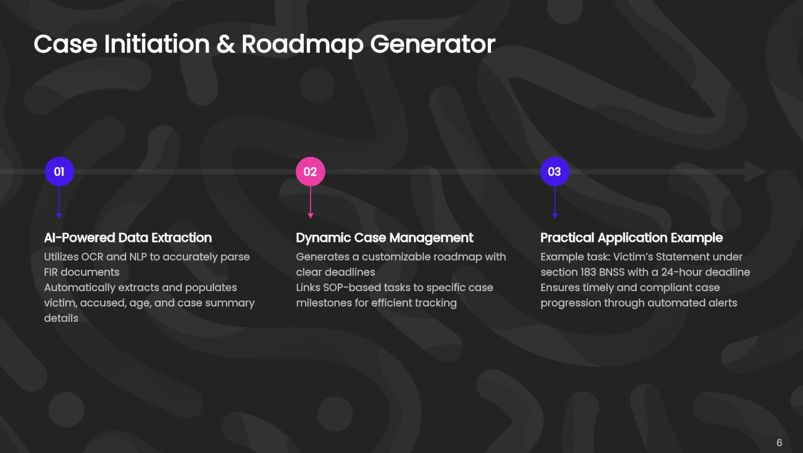
Case Initiation & Roadmap Generator
• AI Intake Wizard parses FIR using OCR & NLP
• Auto-fills victim details, age, accused, summary
• Dynamic roadmap with deadlines & SOP-linked tasks
• Example: Victim’s Statement u/s 183 BNSS – 24 hours

Slide 7
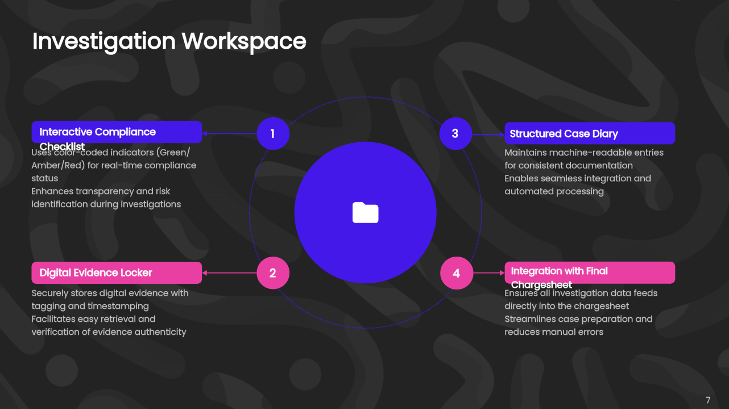
Investigation Workspace
• Interactive Compliance Checklist (Green/Amber/Red)
• Digital Evidence Locker with tagging & timestamping
• Structured Case Diary → machine-readable entries
• Feeds directly into final chargesheet

Slide 8
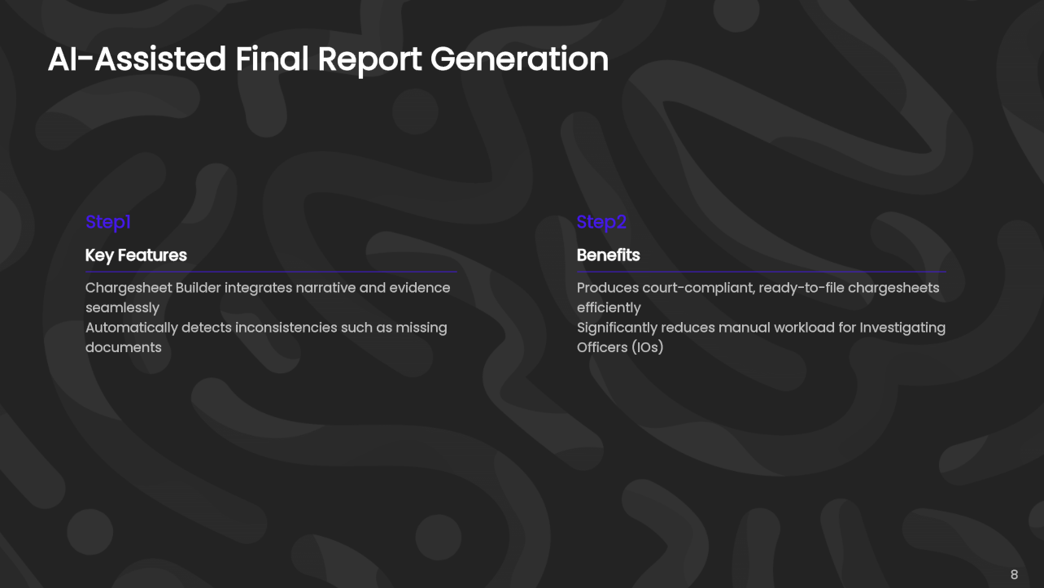
AI-Assisted Final Report Generation
• Chargesheet Builder compiles narrative + evidence
• Auto-checks inconsistencies (e.g., missing seizure memo)
• Generates ready-to-file, court-compliant chargesheet
• Saves IOs days of manual work

Slide 9
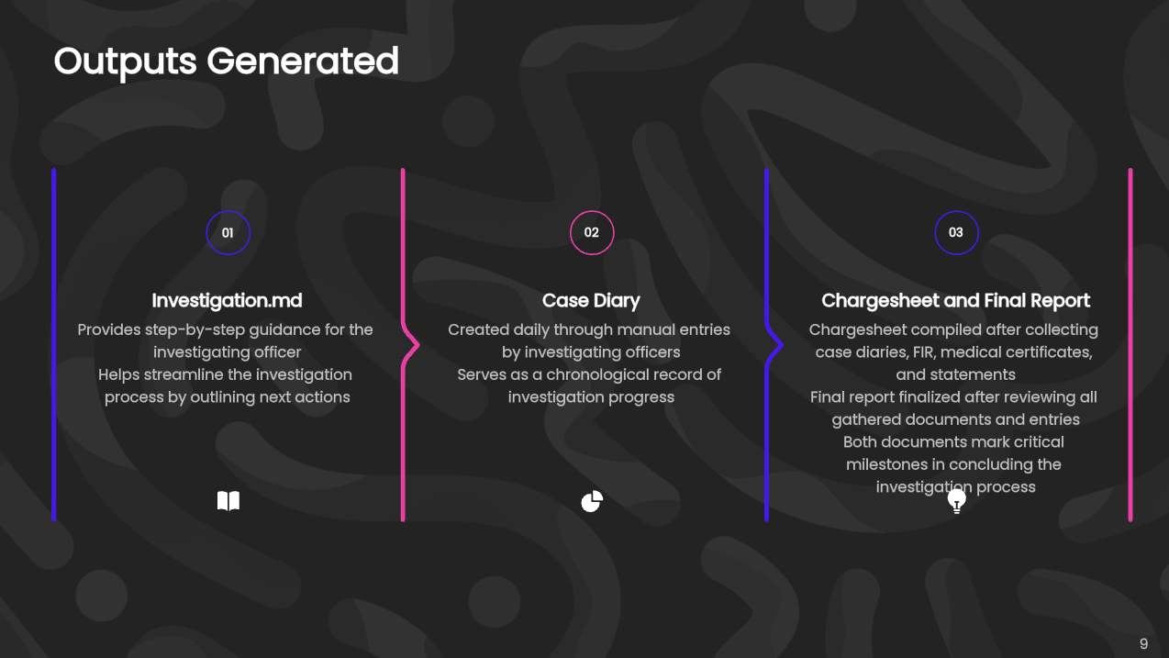
Outputs Generated
Investigation.md: Guides the investigating officer about the next steps
Case Diary: Daily generated by the manual entry of the investigating officers.
Chargesheet: Generated at the end after case diaries, fir, medical certificates and statements.
Final Report: Generated at the end after the all the entries of case diaries, chargesheets, fir, medical certificates and statements.

Slide 10
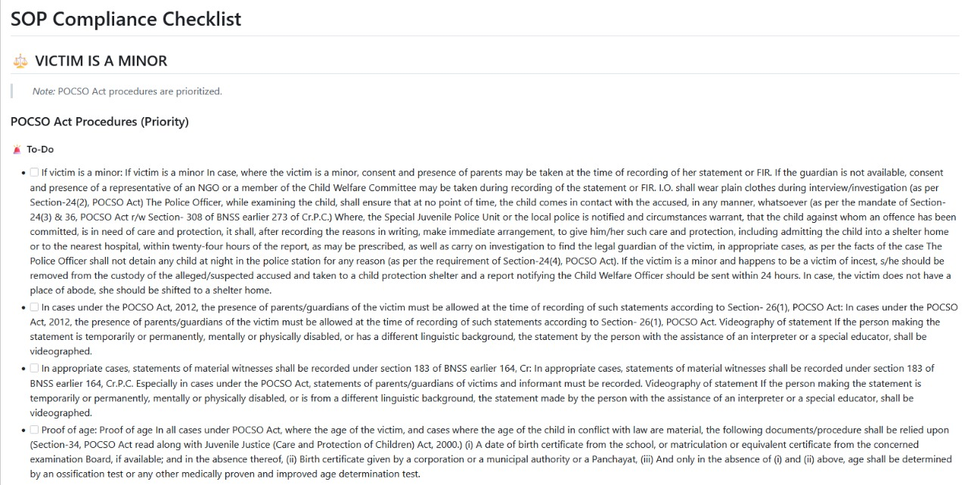

Slide 11
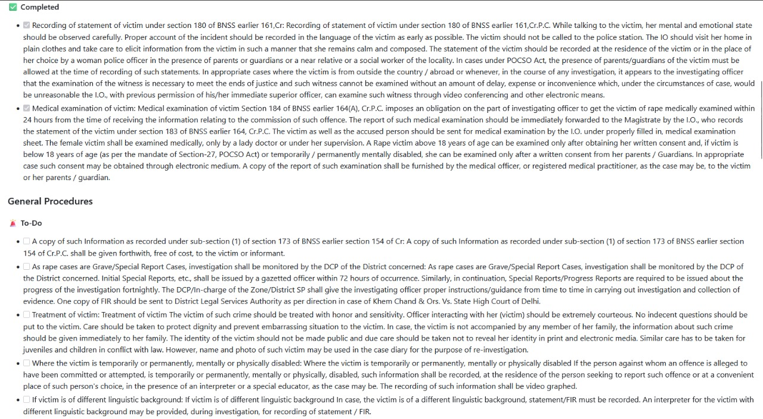

Slide 12
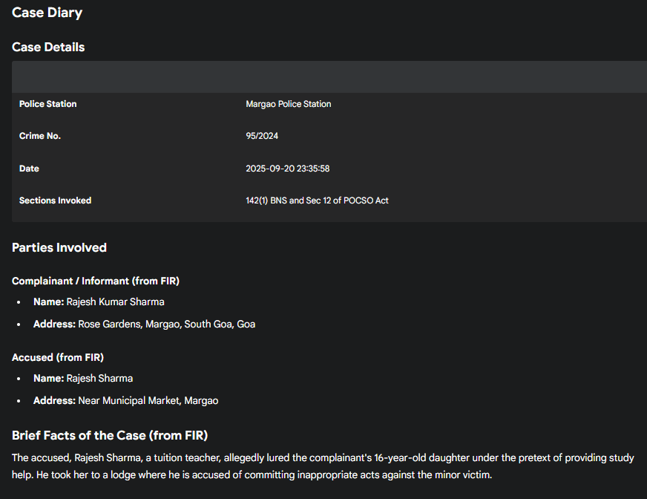
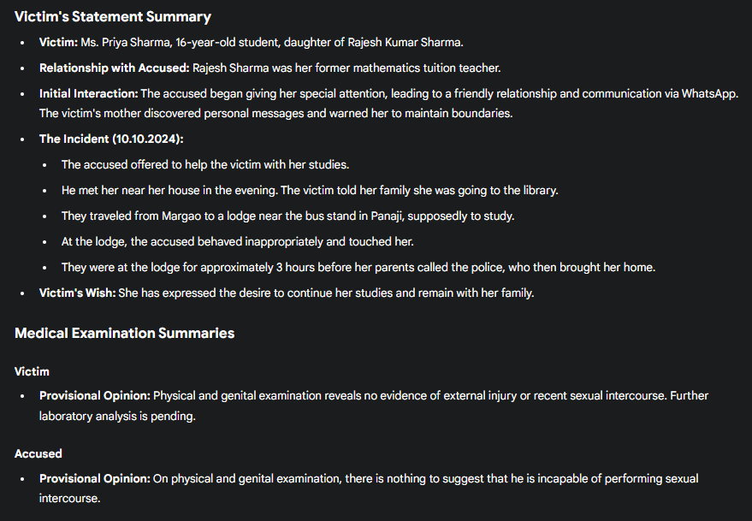

Slide 13
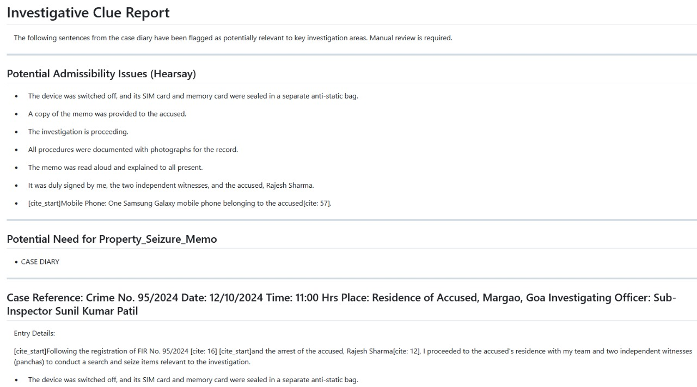
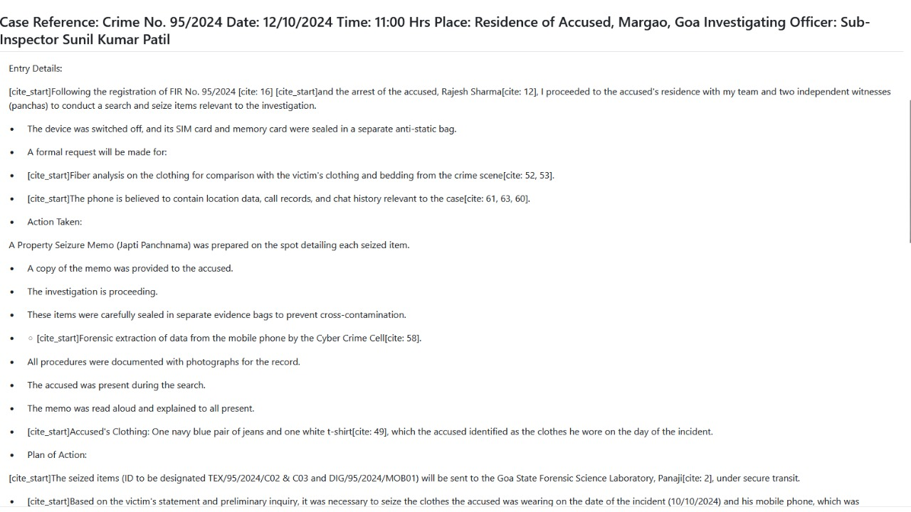

Slide 14
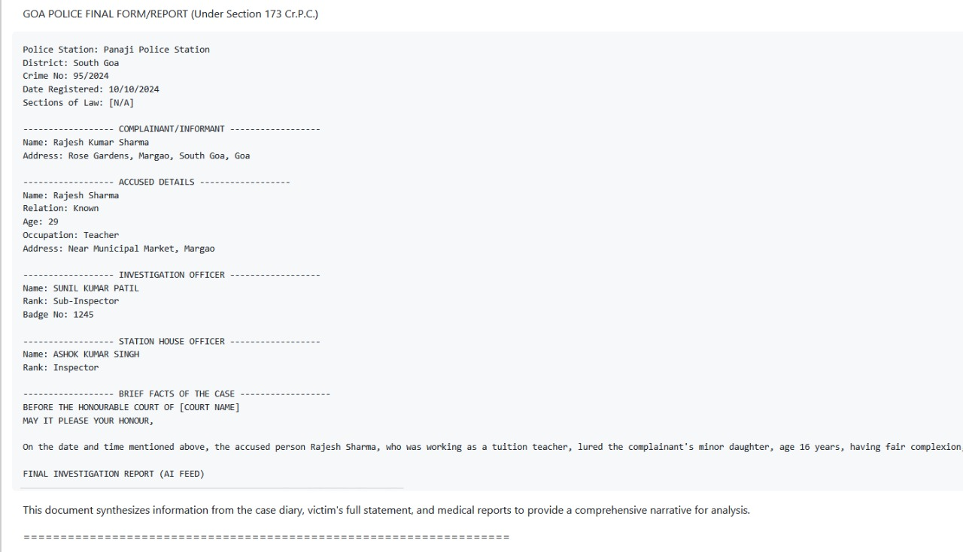

Slide 15
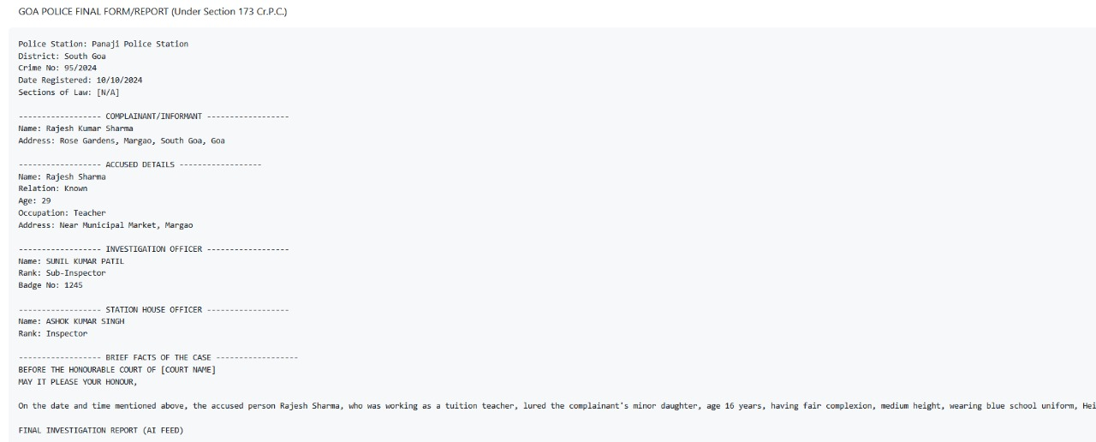
Chargesheet

Slide 16
