Slide 1
CV Project Mid-Eval Topic - IMAGE COLORING
Topic ID: 24
Prof: Dr. Anoop Namboodiri
Mentor: Pulkit Gera
Reference Paper: https://openreview.net/pdf/78a5d32c72990e792f87ef30e712f9b1f0c6ede8.pdf
Group Name: ProVision
Group Members:
Navaneet Kumar Singh - 2020201064
Vaibhav Gupta - 2020201040
Suman Mitra - 2020202018
Rohit Jamuar - 2020900035

Slide 2
CONTENTS
Introduction
Colorization Methods
Scribble Based
Reference Image Based
Automatic Colorization
Current Progress
Methodology
System Requirements
Further Timeline

Slide 3
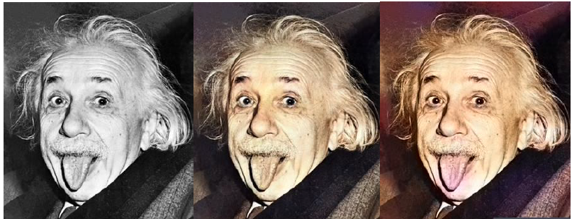
INTRODUCTION
Image Colorization is the process of taking an input grayscale image and then producing an output colorized image that represents the semantic colors and tones of the input.

Slide 4
COLORIZATION METHODS
Scribbles-based
Levin et al. 2004
Simple colorization method that requires neither image segmentation, nor region tracking.
Based on a simple premise: neighboring pixels have similar intensities should have similar colors.
Formalize this premise using a quadratic cost function and obtain an optimization problem that can be solved efficiently using standard techniques
Hunang et al. 2005
Improve Levin’s cost function for more sensitive to edge information, prevent the color bleeding over object boundaries

Slide 5
COLORIZATION METHODS (contd…)
Reference Image-based
Exploit the colors of a reference image.
Inspired by the color transfer techniques that are widely used for recoloring a color image.
Welsh et al. 2002
Proposed a general technique to colorize grayscale images by matching the luminance and texture information between images.
Aim minimize the amount of human labor required for this task.
Further, the procedure is enhanced by allowing the user to match areas of the two images with rectangular swatches.
Gupta et al. 2012
Matching super-pixels between the input image and the reference image using feature matching
Space voting to perform the colorization
Liuet al. 2008
Reference images that are obtained directly from web search.
Its applicability is, however limited to famous landmarks where exact matches can be found.
Chia et al. 2011
Requires user to provide a semantic text label and segmentation cues for the foreground object.

Slide 6
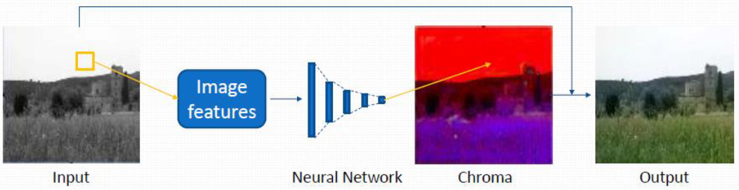
COLORIZATION METHODS (contd…)
Automatic Colorization
Aim to remove user interaction.
Cheng et al. 2015
Group these images into different clusters adaptively
Uses existing multiple image feature
Computes chrominance via shallow neural network
Depend on the performance of semantic segmentation
Only handles simple outdoor scenes

Slide 7
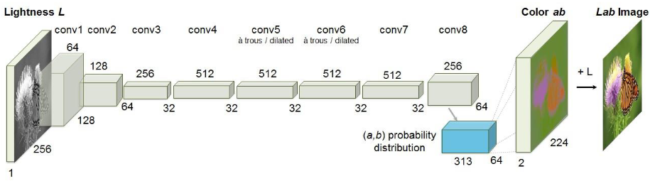
COLORIZATION METHODS (contd…)
Automatic Colorization (contd…)
Zhang et al. 2016
Given the lightness channel L, our system predicts the corresponding a and b color channels of the image in the CIE Lab color space.
Color prediction is inherently multimodal-many objects can take on several plausible colorizations.
To appropriately model the multimodal nature of the problem, we predict a distribution of possible colors for each pixel.

Slide 8
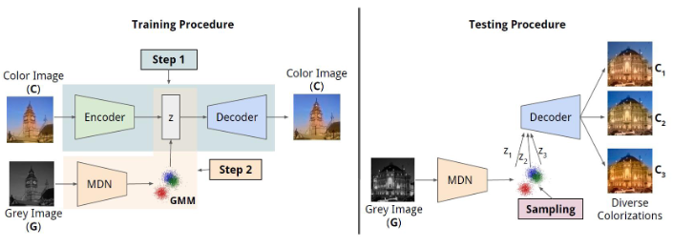
COLORIZATION METHODS (contd…)
Automatic Colorization (contd…)
Deshpande et al. 2017
Previous methods only produce the single most probable colorization. Their goal is to model the diversity intrinsic to the problem of colorization and produce multiple colorizations

Slide 9
PROJECT OVERVIEW
We are using the “Zhang et al.” automatic colorization method.
MIT places dataset of places, landscapes and buildings is being used currently.
Later we will train our model on other datasets downloaded from Kaggle and ImageNet.
Converting the dataset images into LAB colorspace and 256*256 size.
We are using a CNN model.
For feature extraction and image classification, we are using 6 convolutional layers currently.
For upscaling, we are currently using 5 de-convolutional layers.
We will try with different combination of layers later.
Loss function currently used is MSE.

Slide 10
METHODOLOGY
Creation of CNN model using PyTorch and torchvision:
Using sklearn to change dataset images from RGB to LAB colorspace.
We have used the first 6 convolutional layers of ResNet-18, and modified the first layer to take grayscale images as input.
For upscaling, we have used 5 de-convolutional layers so far.
Batch normalization done in each layer.
Activation function used in each layer is ReLU.
We will try with other activation functions like leaky-ReLU, Sigmoid and Tanh later.
Training our model:
Currently using MSE loss function. We will try with other loss functions like MSLE, MAE, cross-entropy etc. later.
Currently using Adam Optimizer from PyTorch to optimize our loss function. We will try with other optimizers like stochastic gradient descent, mini-batch gradient descent and gradient descent with momentum later.

Slide 11
EXPERIMENT DETAILS
Dataset details:
A sample subset of the MIT dataset has been taken currently.
1000 training images and 300 validation images.
Trained on 4 epochs first, then on 100 epochs.
Functions Used:
For ResNet-18: torchvision.models.resnet18(num_classes)
For convolution: torch.nn.Conv2d(in_channels, out_channels, kernel_size, stride, padding)
For batch normalization: nn.BatchNorm2d(num_features)
Activation function: nn.ReLU()
Upsampling: nn.Upsample(scale_factor)
Loss function: nn.MSELoss()
Optimizer: torch.optim.Adam(model.parameters(), lr=1e-2, weight_decay)

Slide 12
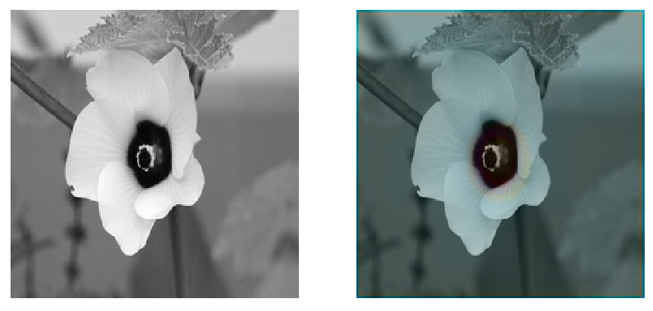
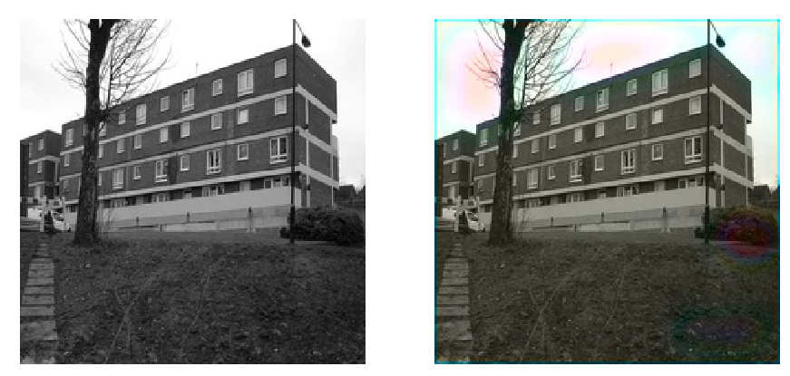
RESULTS OBTAINED
4 epoch: a)
b)

Slide 13
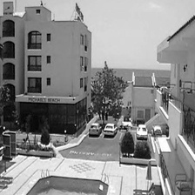
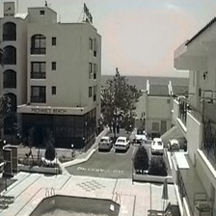
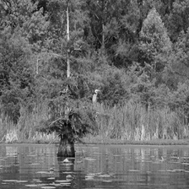
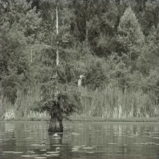
RESULTS OBTAINED (Continued..)
100 epoch: a)
b)

Slide 14
SYSTEM REQUIREMENTS
Operating System(s):
Windows 10
Linux(Ubuntu 14.04+)
Working Environment:
Platform(s): Jupyter Notebook, Google colab, PyCharm etc.
Programming Language(s): Python 3
Libraries: CV2, PyTorch, torchvision, NumPy, SciPy, matplotlib, keras, tensorflow, sklearn etc.
Datasets: Kaggle, MNIST, MIT places etc.
Minimum Processing Capabilities:
Processor: Intel i3 (4th Gen) or equivalent.
RAM: 4GB
Graphic Card: 2GB

Slide 15
FURTHER TIMELINE
PHASE-1: (Workdays: 12-14 days)
Training and testing our model on different datasets.
Using different loss functions and optimization methods for better results.
PHASE-2: (Workdays: 8-10 days)
Final modifications and testing.
Error handling and maintenance.

Slide 16
THANK YOU

