Slide 1
CV Project Outline Topic - IMAGE COLORING
Topic ID: 24
Prof: Dr. Anoop Namboodiri
Mentor: Pulkit Gera
Reference Paper: https://openreview.net/pdf/78a5d32c72990e792f87ef30e712f9b1f0c6ede8.pdf
Group Name: ProVision
Group Members:
Navaneet Kumar Singh - 2020201064
Vaibhav Gupta - 2020201040
Suman Mitra - 2020202018
Rohit Jamuar - 2020900035

Slide 2
CONTENTS
Introduction
Colorization Methods
Scribble Based
Reference Image Based
Automatic Colorization
Automatic Colorization
System Requirements
Timeline Estimation

Slide 3
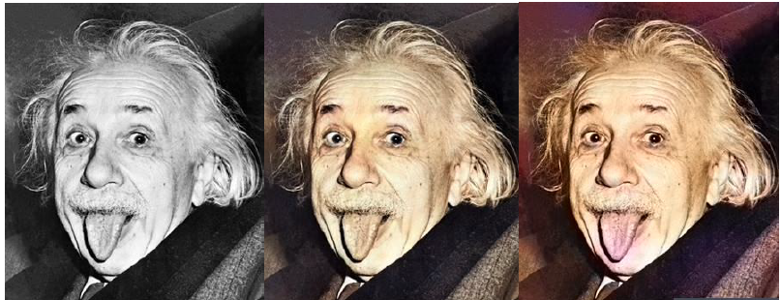
INTRODUCTION
Image Colorization is the process of taking an input grayscale image and then producing an output colorized image that represents the semantic colors and tones of the input.

Slide 4
COLORIZATION METHODS
Scribbles-based
Levin et al. 2004
Simple colorization method that requires neither image segmentation, nor region tracking.
Based on a simple premise: neighboring pixels have similar intensities should have similar colors.
Formalize this premise using a quadratic cost function and obtain an optimization problem that can be solved efficiently using standard techniques
Hunang et al. 2005
Improve Levin’s cost function for more sensitive to edge information, prevent the color bleeding over object boundaries

Slide 5
COLORIZATION METHODS (contd…)
Reference Image-based
Exploit the colors of a reference image.
Inspired by the color transfer techniques that are widely used for recoloring a color image.
Welsh et al. 2002
Proposed a general technique to colorize grayscale images by matching the luminance and texture information between images.
Aim minimize the amount of human labor required for this task.
Further, the procedure is enhanced by allowing the user to match areas of the two images with rectangular swatches.
Gupta et al. 2012
Matching super-pixels between the input image and the reference image using feature matching
Space voting to perform the colorization
Liuet al. 2008
Reference images that are obtained directly from web search.
Its applicability is, however limited to famous landmarks where exact matches can be found.
Chia et al. 2011
Requires user to provide a semantic text label and segmentation cues for the foreground object.

Slide 6
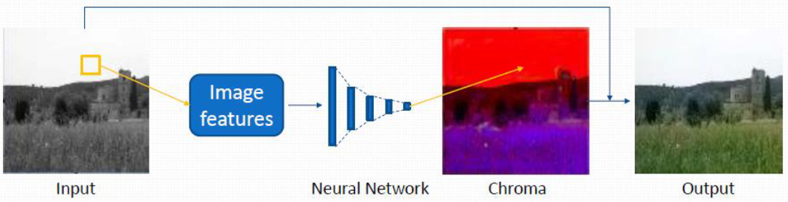
COLORIZATION METHODS (contd…)
Automatic Colorization
Aim to remove user interaction.
Cheng et al. 2015
Group these images into different clusters adaptively
Uses existing multiple image feature
Computes chrominance via shallow neural network
Depend on the performance of semantic segmentation
Only handles simple outdoor scenes

Slide 7
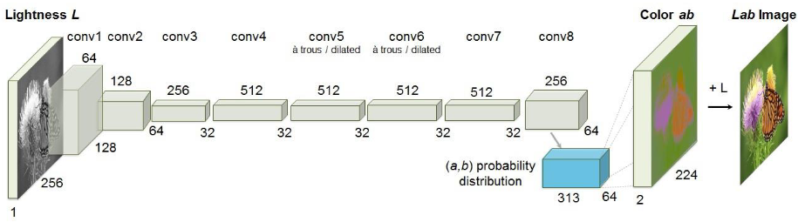
COLORIZATION METHODS (contd…)
Automatic Colorization (contd…)
Zhang et al. 2016
Given the lightness channel L, our system predicts the corresponding a and b color channels of the image in the CIE Lab color space.
Color prediction is inherently multimodal-many objects can take on several plausible colorizations.
To appropriately model the multimodal nature of the problem, we predict a distribution of possible colors for each pixel.

Slide 8
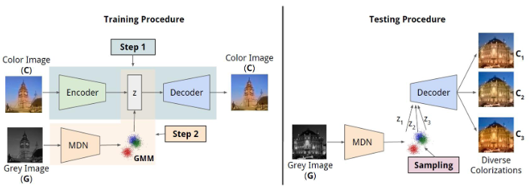
COLORIZATION METHODS (contd…)
Automatic Colorization (contd…)
Deshpande et al. 2017
Previous methods only produce the single most probable colorization. Their goal is to model the diversity intrinsic to the problem of colorization and produce multiple colorizations

Slide 9
AUTOMATIC COLORIZATION
Joint Global and Local Model
Deep Networks
Fusing Global and Local Features for Colorization
Shared Low-Level Features
Global Image Features
Mid-Level Features
Fusing Global and Local Features
Colorization Network
Colorization with Classification
Optimization and learning.

Slide 10
SYSTEM REQUIREMENTS
Operating System(s):
Windows 10
Linux(Ubuntu 14.04+)
Working Environment:
Platform(s): Jupyter Notebook, Google colab, PyCharm etc.
Programming Language(s): Python 3
Libraries: CV2, numpy, Scipy, matplotlib, keras, tensorflow, sklearn etc.
Datasets: Kaggle, MNIST etc.
Minimum Processing Capabilities:
Processor: Intel i5 (5th Gen) and equivalent.
RAM: 8GB
Graphic Card: 2GB

Slide 11
TIMELINE ESTIMATION
PHASE-1: (Workdays: 8-10 days)
Feasibility study of the Automatic Colorization method.
Understanding and analyzing the following research paper:
https://openreview.net/pdf/78a5d32c72990e792f87ef30e712f9b1f0c6ede8.pdf
PHASE-2: (Workdays : 18-20 days)
Understanding the mathematical concepts needed.
Apply the concepts to build a mathematical implimentation for the analysis done in PHASE-1.
PHASE-3: (Workdays: 14-16 days)
Practical implementation of the mathematical model using Python3.
Dividing the project into different modules and assigning them to team members.
PHASE-4: (Workdays: 10-12 days)
Integration of modules and integration testing.
Testing on different datasets.
Error handling and maintenance.

Slide 12
THANK YOU

