Slide 1
What is the Wettest Street Name in New Zealand?
Govhack2015
Team: WWSNNZ
Joshua Scarsbrook

Slide 3
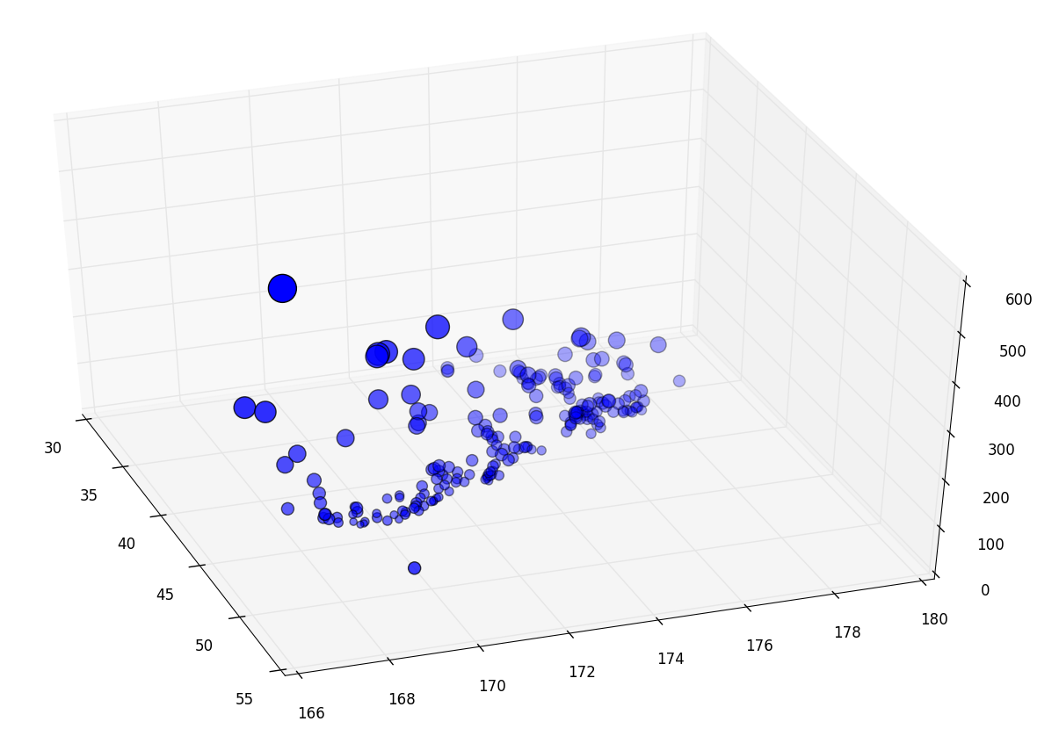
Rainfall Information
The rainfall information is sourced from The National Climate Database (http://cliflo.niwa.co.nz/ ).
The Data used is limited to the set of weather stations that have complete or nearly complete data and are current active.
The data queried was average rainfall for each month over the past 5 years.
The graph on the side was generated by plotting the latitude and longitude in X and Y and the mean rainfall over the entire data period as the Z height and size of points on a scatter graph with matplotlib (http://matplotlib.org/ ) and mplot3d.

Slide 4
Street Address Data
Latitude | Longitude | Address
-44.399 | 168.047 | 104 Lake Street
-44.4014 | 168.049 | 64 Lake Street
-44.4013 | 168.049 | 66 Lake Street
-44.3993 | 168.048 | 94 Lake Street
-44.3992 | 168.048 | 96 Lake Street
-44.7597 | 168.139 | 805 Lower Hollyford Road
-44.7412 | 168.314 | 314 Routeburn Road
-44.7639 | 168.342 | 404 Glenorchy-Routeburn Road
-44.7724 | 168.342 | 399 Glenorchy-Routeburn Road
-44.7796 | 168.349 | 325 Glenorchy-Routeburn Road
-44.8275 | 168.353 | 668 Kinloch Road
-44.8424 | 168.349 | 846 Kinloch Road
-44.8424 | 168.349 | 848 Kinloch Road
-44.8425 | 168.349 | 850 Kinloch Road
The Street Address database comes from the LINZ Electoral Street Address layer (https://data.linz.govt.nz/layer/779-nz-street-address-electoral/data/ ).
Because of the size of the dataset it was imported into a MySQL database to make querying easier.

Slide 5
Problems encountered initially
Without a interpolating data there’s a massive gap in resolution between the street address data and weather station rainfall data.
select count(*) from weatherStation where YEAR(end_date) = 2015 and percent_complete > 90;
The above SQL query was used to filter weather stations to ones with a useful amount of data and returns 219 stations.
select count(*) from streetAddress;
The above query returns the total number of street address’s in the country and returns 1,865,589 results.
This difference in data results in a predictable result for the question. What’s the wettest weather station in the country and what which street addresses are closest to that station.

Slide 6
The solution.
Climate data can be interpolated to results over a wider area if you have enough computational power to overcome inaccuracies caused by the landmass, New Zealand is not a flat plane so you need to make a full climate model to get accurate results.
NIWA already does this with the VCSN (Virtual Climate Station Network). Public access to that network was suspended on 13-Oct-2014 so I can’t use that information for Govhack2015.
A naive approach to the same problem is just to weight all data points based on distance to stations to provide a better map.

Slide 7
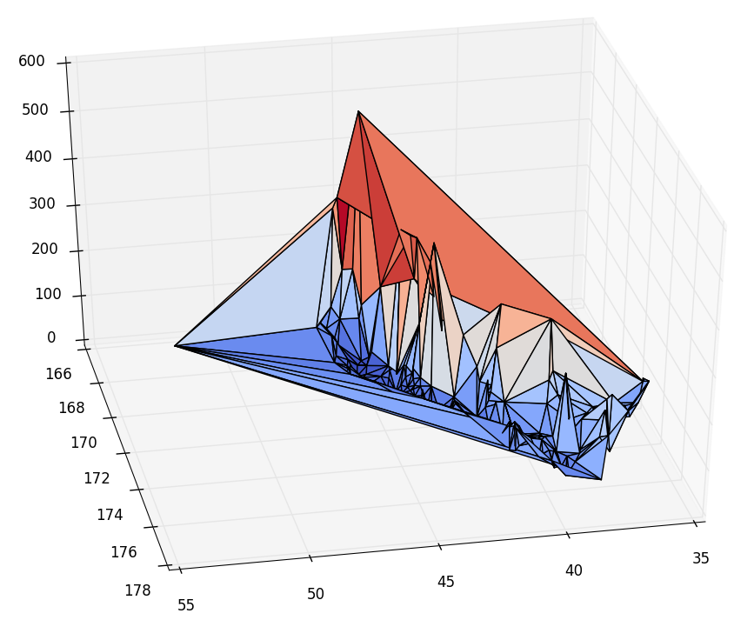
The Solution (Cont.)
This solution fixes the problem but remains a computationally expensive solution. There are 1.8 Million addresses to calculate and tally the results of, although my code makes use of cached function results even the mean rainfall information for streets takes at least 1 hour to run, changing it to the interpolated approach would mean caching would just eat memory without providing any benefit.
I felt that the presentation could do with another graph so here’s a surface plot of the same data from the first slide.

Slide 8
Results
A process and code for acquiring data from the national climate database and inserting it into MySQL.
A library for resolving address’s to a latitude and longitude based on government data and vice versa.
A database schema for connecting the data and reading connected information with MySQL.
Oh and the wettest street name is Sinbad Drive, the weather station that contributes that result is the one in Milford Sound Airport. Because google maps doesn't have a street name for that address the Latitude and Longitude is (-44.6737, 167.922)

Slide 9
