Slide 1

Predator Software (Spyware)
Cybersecurity Technologies & Management
Botsos Vasilis Lapakis Gerasimos
2022-2023

Slide 2

Predator
Mercenary spyware-for-hire developed by Cytrox (commercial surveillance company), sold for 13.600.000€.
Remote and stealthy data extraction from mobile devices (Full Tracking).
One Click infection via multiple attack vectors and data extraction solutions.
Predator contract includes Training, Warranty and Maintenance.
Compromises the Confidentiality, Integrity and Availability (C.I.A.) of a device.
Targets journalists, dissidents, critics of authoritarian regimes, families of opposition and human rights activists.
Has political motives (government-backed actors).
Customized for different OS and different versions of same OS.
Can coexist with Pegasus spyware.
Geographical limitations (only inside the country for local SIM cards).
This technical analysis is based on Ayman Nour’s and an Egyptian exiled journalist’s smartphones

Slide 3
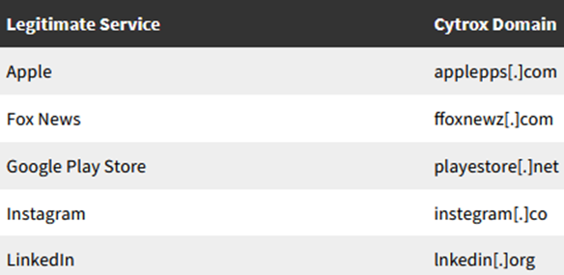
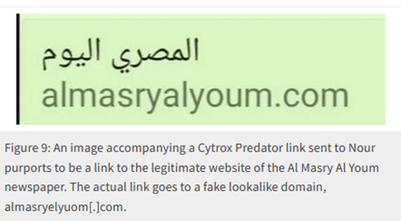
Stage 1: Phishing
Reconnaissance (least visible to targets)
Automate data collection from across the internet.
Pull information about targets from all available online records.
Impersonate someone of a high profile with OSINT.
Use of Surveillanceware
Fake accounts on social media (search profile interactions, interests, connections)
Engagement (most visible to targets and most critical to spot to prevent compromise)
Build trust, solicit information, and trick targets into clicking on links or downloading files.
Single click links hidden in pictures sent on Social Media apps (ex. WhatsApp).
Social engineering tactics
Impersonation and mimicking of URL shortener services and legitimate websites.
Use of country-specific links
Exploitation (hacking for hire)
Phishing domains and then redirections to legitimate websites.
Typosquatting of known domains (Command and Control Server Domains).
Spoofing of domains of legitimate organizations.
Use of custom-built exploits or purchase them from other vendors.

Slide 4
Stage 2: 0-day Exploits
0-day Vulnerabilities
Redirecting to SBrowser from Chrome (CVE-2021-38000 - Chrome)
Chrome sandbox escape (CVE-2021-37973 - Chrome, CVE-2021-37976 - Chrome)
Full Android 0-day exploit chain (CVE-2021-38003 - Chrome, CVE-2021-1048 - Android)
N-day Exploits
Used alongside 0-day vulnerabilities.
Exploited the timeframe of critical bugs that were patched, but not flagged as security issues.
As well as the full deployment of these patches in the Android Ecosystem.

Slide 5
Stage 3: Initialization
Executable binary (64-bit Mach-O for iOS) expects 2 arguments - a kernel process task port and a pid value.
Main function calls kmem_init function with these values.
Proceeds to enable Predator stage 1 for continued execution.
Arguments passed to shared constants SHMEMFD_VSS and SHMEMFD_VSS (Android).
startPy function loads a bundled Python 2.7 runtime.
predutils and predconfig at runtime (iOS)
injector, pc2, recorder, and voip_recorder (Android)
Loads a frozen Python module (Loader) - Imports the Predator config from the interpreter’s predconfig module.

Slide 6
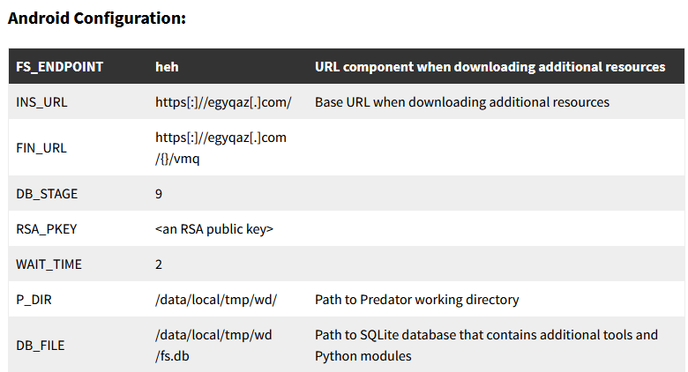
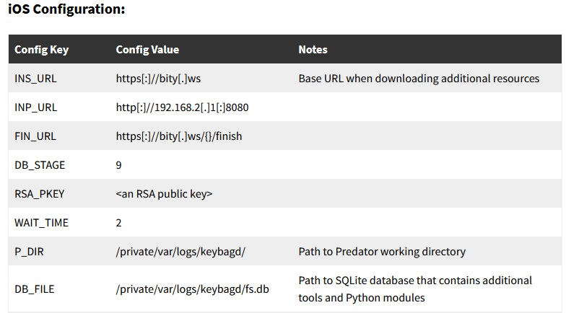
Stage 3: Initialization
(iOS specific)
Loads another frozen Python module (km_ios)
Provides kernel memory management helper functions
Additional Predator module capabilities
_check function
Queries phone’s number and current locale country code (CTSettingCopyMyPhoneNumber - May no longer work in recent iOS).
Checks country code or phone number (Terminates for Israel).

Slide 7
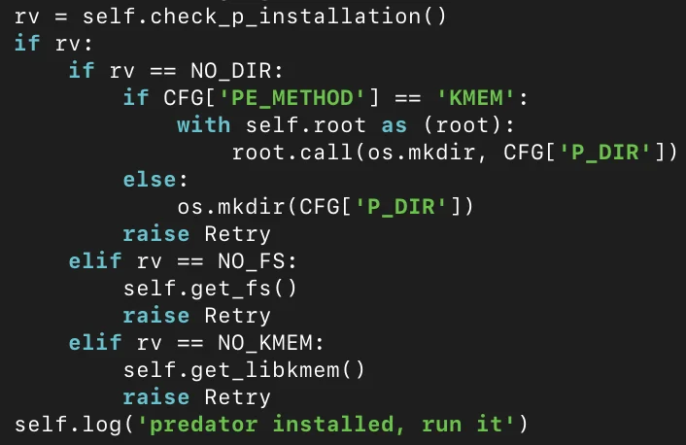
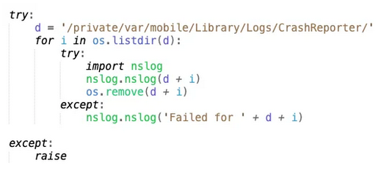
Stage 4: Loader
Predator was mentioned on previous loader files (src/loader2.py, src/loader_real.py, src/loaderBackup03).
iOS loader wipes the device’s crash logs by removing their related files.
Downloads a configuration file and additional stages of the spyware from the server (https://bity[.]ws and https://egyqaz[.]com - Android).
ALIEN, a malware that loads Predator
Resides inside multiple privileged processes.
Receives commands from Predator over IPC.

Slide 8
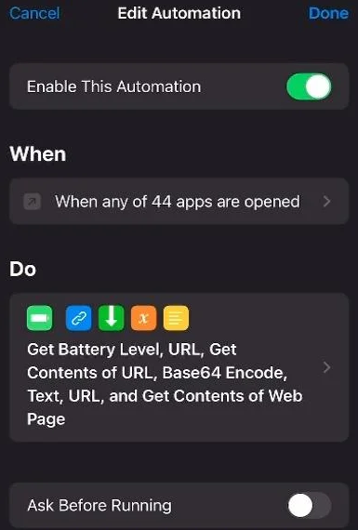
Stage 5: Persistence (iOS)
Loader calls get_configuration_persistency function.
Downloads shortcuts automation from the spyware server to ensure persistence (Nahum).
iOS automation is triggered when certain apps are executed (Built-in and Messaging Apps).
Allows Predator to survive phone shutdown and reboot.
Predator will NOT survive factory reset.
iOS version updates will NOT be prevented.

Slide 9
Stage 5.1: Triggering Predator
Checks if phone’s battery level is greater than 9%.
Downloads JavaScript code from the spyware server.
Substitutes JS code into a block of HTML contained in the shortcut.
make_bogus_transform function - creates an XSLT transformation.
HTML code with the substituted JavaScript is Base64-encoded and prepended with “data:text/html”.
The automation passes this URL for rendering to WebKit.
This process triggers the exploit and installs the Predator spyware

Slide 10
Stage 5.2: Disabling automatation notifications
Predator shortcut runs entirely in the background, invisible to the user.
Predator disables automations from triggering notifications.
get_configuration_persistency function downloads:
com.[name redacted].disable-shortcuts-notifications
Prevents iOS from displaying notifications when an automation is run.
Customized not only for different OS but even for same OS:
Binaries “takePhoto,” “agent.dylib,” “inject,” and “hooker” (iOS 14 – latest at the time version)
Displays message: “iOS 13, don’t need hooker.” (iOS 13)

Slide 11
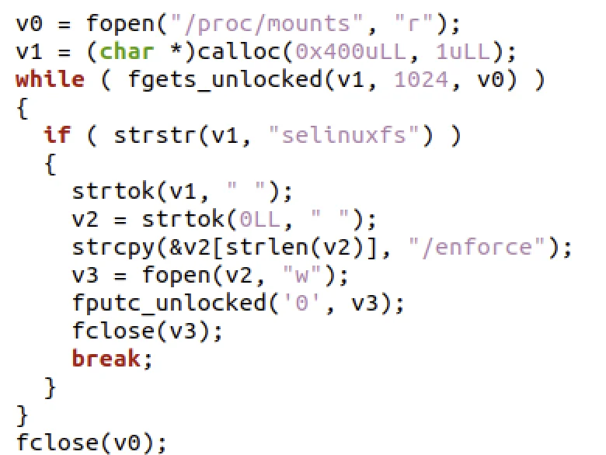
Android Specifics
More robust spying capabilities but lacks persistence.
Additional Python modules are stored.
Native ELF binaries saved in the fs.db SQLite file.
Frozen module (sqlimper) for interactions with the database.
Table called files - has a column called file_hash and a column called file_data.
Function that disables SELinux enforcement via the SELinuxFS.
Inject function - injects a shared object into a running process.
Artifacts found that RKP can be defeated by stomping on the SELinux access vector cache entries to grant the needed permissions.

Slide 12
Android Specifics (Recording Modules)
pc2 module contains pc2_send_command function IPC mechanism to send commands to Predator’s audio recording component.
These commands include recording audio, adding CA Certificates and hiding apps
(e.g., START_VOIP, STOP_VOIP, START_MICRORECORDER).
recorder module and voip_recorder module
Start and stop function to start/stop the recording (Predator’s hot mic (recorder) - call recording (voip_recorder)).
Stores MP3 files in “/data/local/tmp/wd/r/”.

Slide 13
Detection and Prevention
Check if you are infected
Protect yourself
Decreased device performance (slow or device running hot)
Unknown programs and features appear
Increased data usage
Antivirus is working incorrectly
Analyze phone’s logs
Use Antivirus, firewalls, VPNs, Ad Blockers
Do not jailbreak or root your device
Use legitimate software
Install latest updates and patches
Do not trust links or files from unknown sources
Use Safe Mode to remove potential spyware

Slide 14
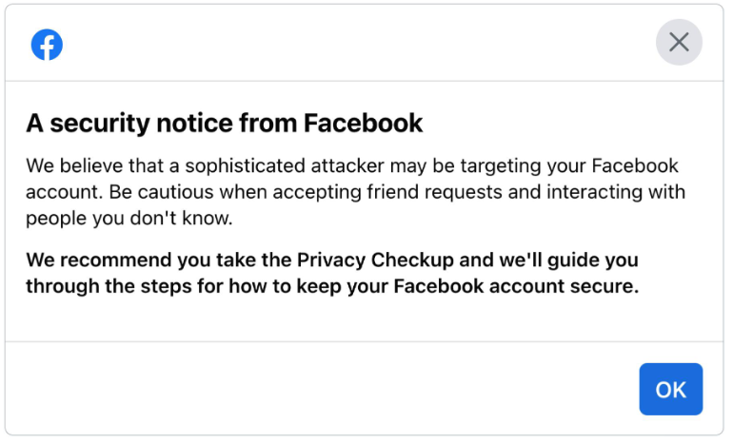
Conclusion
300 Facebook and Instagram accounts linked to Cytrox were terminated by META.
META alert system notified around 50,000 people who were targeted by these malicious activities worldwide.
International, domestic regulations and safeguards must take place to stop present and future actors' criminal activities.
An important preventive measure in cybersecurity is the awareness and education of users.

Slide 15
Bibliography
Marczak, B et al (2021). Pegasus vs. Predator: Dissident’s Doubly-Infected iPhone Reveals Cytrox Mercenary Spyware - The Citizen Lab. [online] citizenlab.ca. Available at: https://citizenlab.ca/2021/12/pegasus-vs-predator-dissidents-doubly-infected-iphone-reveals-cytrox-mercenary-spyware/. [Accessed 10 Dec. 2022].
‌Lecigne, C. and Resell, C. (2022). Protecting Android users from 0-Day attacks. [online] Google. Available at: https://blog.google/threat-analysis-group/protecting-android-users-from-0-day-attacks/ [Accessed 10 Dec. 2022].
Danchev, D. (2022). Predator Surveillance Software May Not Be Lawful at All | WhoisXML API. [online] main.whoisxmlapi.com. Available at: https://main.whoisxmlapi.com/threat-reports/predator-surveillance-software-may-not-be-lawful-at-all?mc=socialmedia [Accessed 11 Dec. 2022].
‌RealTime Cyber (2022). Predator Spyware, the Pegasus Competitor Explained - Technical. [online] www.youtube.com. Available at: https://www.youtube.com/watch?v=QA-GuTeUPos [Accessed 11 Dec. 2022].
‌Greg (2022). What Is Predator Spyware? How to Check Your Device | ExpressVPN Blog. [online] ExpressVPN Blog. Available at: https://www.expressvpn.com/blog/how-to-detect-predator-spyware/ [Accessed 11 Dec. 2022].
‌Read the Intellexa Pitch on Its Spyware Tool. (2022). The New York Times. [online] 8 Dec. Available at: https://www.nytimes.com/interactive/2022/12/08/us/politics/intellexa-commercial-proposal.html?searchResult [Accessed 11 Dec. 2022].
‌Dvilyanski, M., Agranovich, D. and Gleicher, N. (2021). Threat Report on the Surveillance-for-Hire Industry. [online] Meta. Available at: https://about.fb.com/wp-content/uploads/2021/12/Threat-Report-on-the-Surveillance-for-Hire-Industry.pdf [Accessed 11 Dec. 2022].
‌Gritzalis, D. (2022). Cyberspace: A merciless digital universe. Dell Technologies Forums 2022, 3 November, Athens Conservatoire, Athens.
‌

