Slide 1
Aplicar
To experience the learnings

Slide 2

Introduction
Problem Statement
Provide a platform to new learners to try and apply their knowledge…

Slide 3

Goal
Develop a web application for learning purpose which can provide small real world projects to the learners, where learners can act as a volunteer and use their skills to complete given projects and have practicality on a particular stream and improve their skills.

Slide 4
Project overview
The purpose of ‘Aplicar’ is to provide a platform to students to apply their skills to solve a real world problem.
This web application is aimed to provide a free online platform where students can practice their learned things.

Slide 5
This achieves following –
Better knowledge of the field.
Industrial level project work.
Better prepared for the world of work.

Slide 6
Why a web application
Self study is the key to success.
One can focus on his/her work without distractions from my classmates.
One can move at his/her own pace.
One can learn with a schedule that meets his/her needs.

Slide 7
Hardware Specification
Any processor that is SSE2(Streaming SIMD extensions 2) capable
4GB of RAM or above.
Internet connectivity.

Slide 8
Software specification
Operating system: Windows, Macintosh or Linux.
Database: MySQL.
Apache-tomcat version 9.0.
Java 1.8.
IDE: any of eclipse photon, NetBeans 8.2, IntelliJ idea.
Microsoft Visio.
Web browser (HTML5, CSS3 and javaScript5 supported).

Slide 9
Literature survey
Need analysis:
While reviewing different domains, we found a problem in our education system which causes lack of confidence towards learned things in students that is the having less practical knowledge of the subject. Hence this application is aimed to provide students a way or a platform where they can choose their desired domain, technology to apply their skills.

Slide 10
Engineering:
The application has 4 modules.
1. Database design.
2. Prototyping user interface.
3. Coding (Back end)
User interface design (Front end)

Slide 11
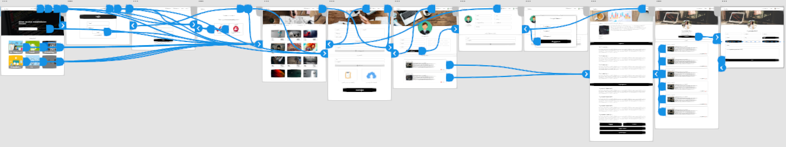
UX/UI Design
UX/UI design in adobe XD

Slide 12
User interface
Index.html

Slide 13

System analysis & Design
Getting theoretical knowledge has no value until students can apply it for practical purposes.

Slide 14
Today, everything has gone digital. But the education system has not matched the pace of change. Students don’t get to choose what subjects they want to study. In fact, the education system decides what thousands of students are going to have to learn.
Hence, individuals are preferring online education because they can pursue their passions, they can focus on their work without distractions from any classmates, they can move at their own pace, they can learn with a schedule that meets their needs and having more options, but apart from these numerous advantages, lack of the practical knowledge of something is still the problem for a student.

Slide 15
By doing this project our goal is to provide a platform where they can choose between varieties of projects of their domain.
Where developers and project workers can share their part of work to manage their busy schedule.
Completed projects can be optionally rated.

Slide 16
Functional Requirements
Registration is offered to new user. Then a registered user logs into our site.
Project managers can see how many volunteers have taken their posted project and each volunteer’s status.
Volunteers can see their previous and on-going projects.
Session based web page so users don’t require to login every time.

Slide 17
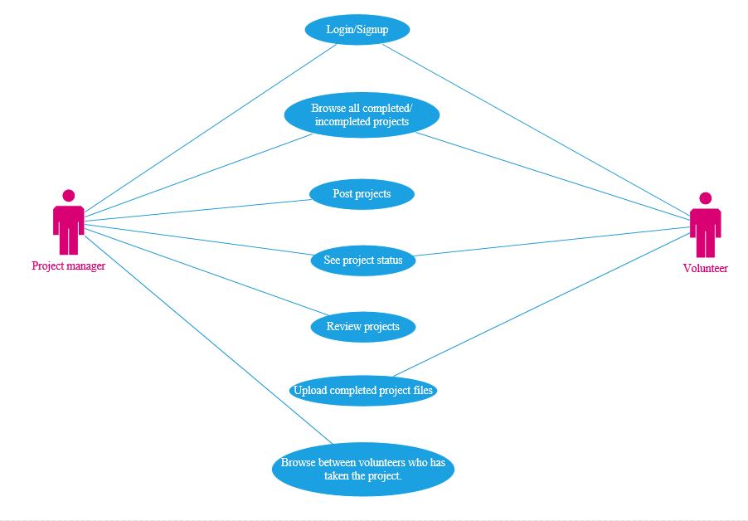
Use case

Slide 18
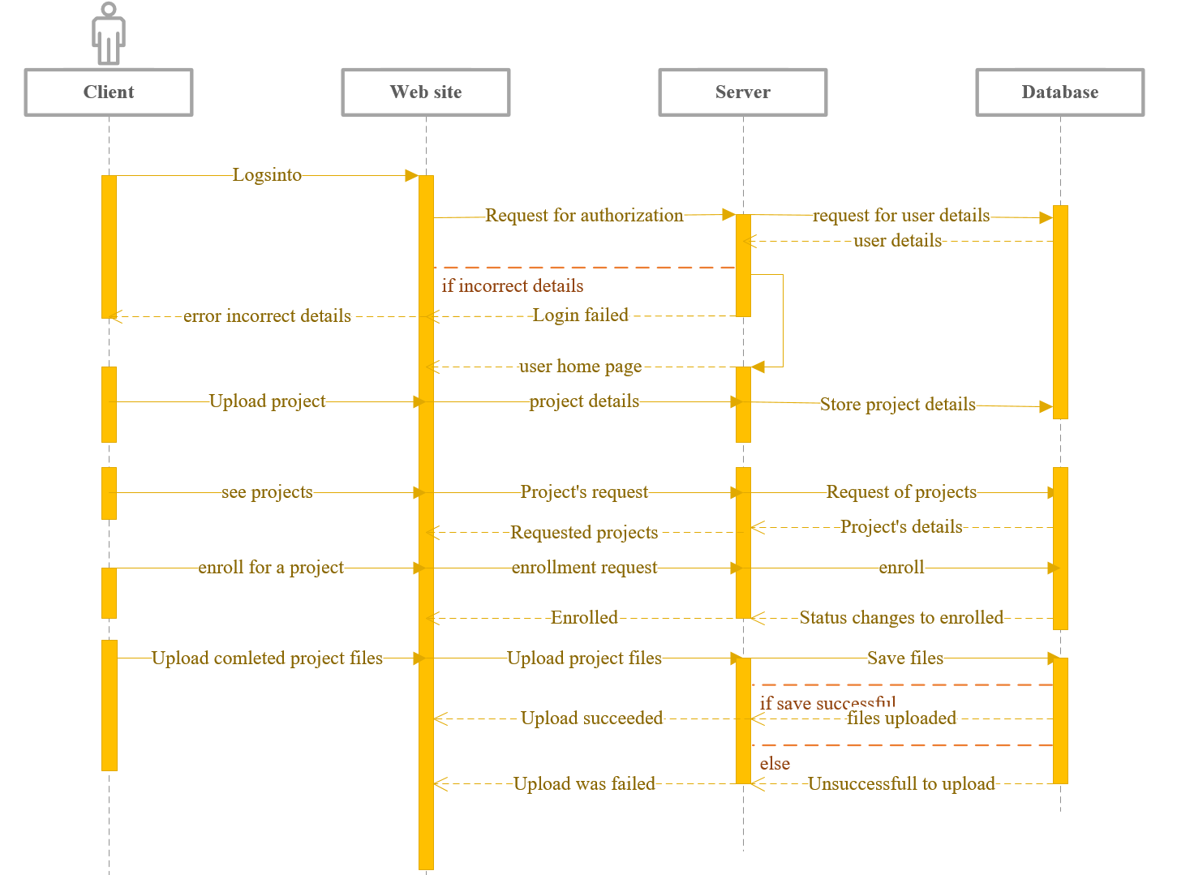
Sequence diagram

Slide 19
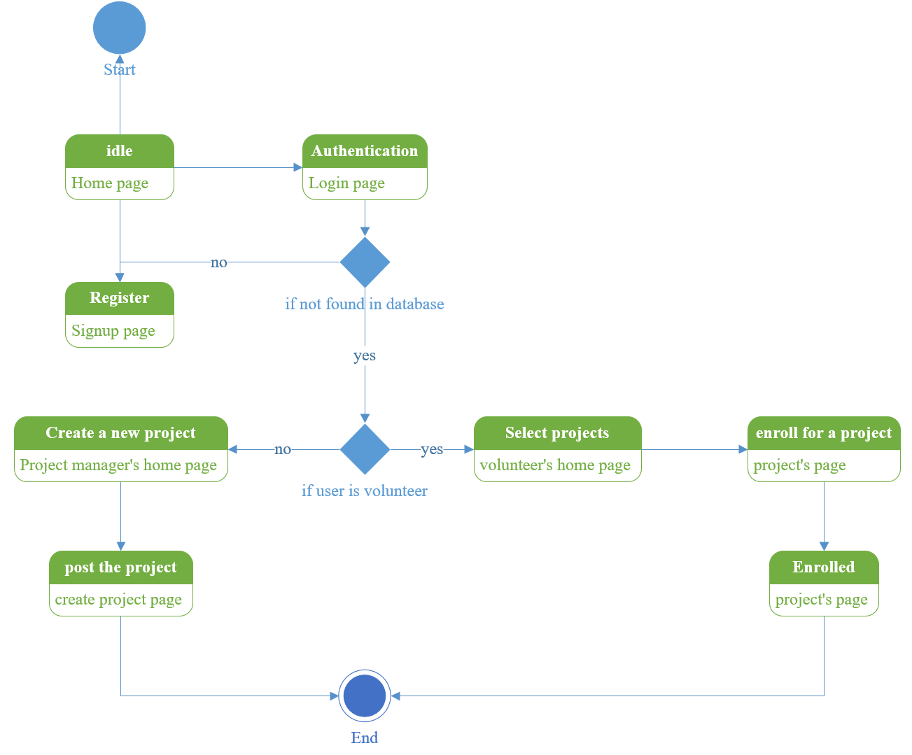
State chart diagram

Slide 20
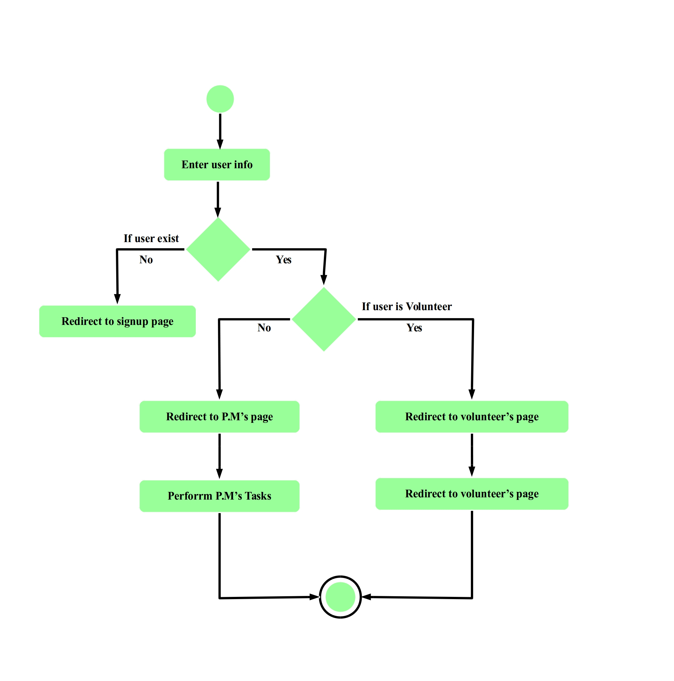
Activity diagram

Slide 21
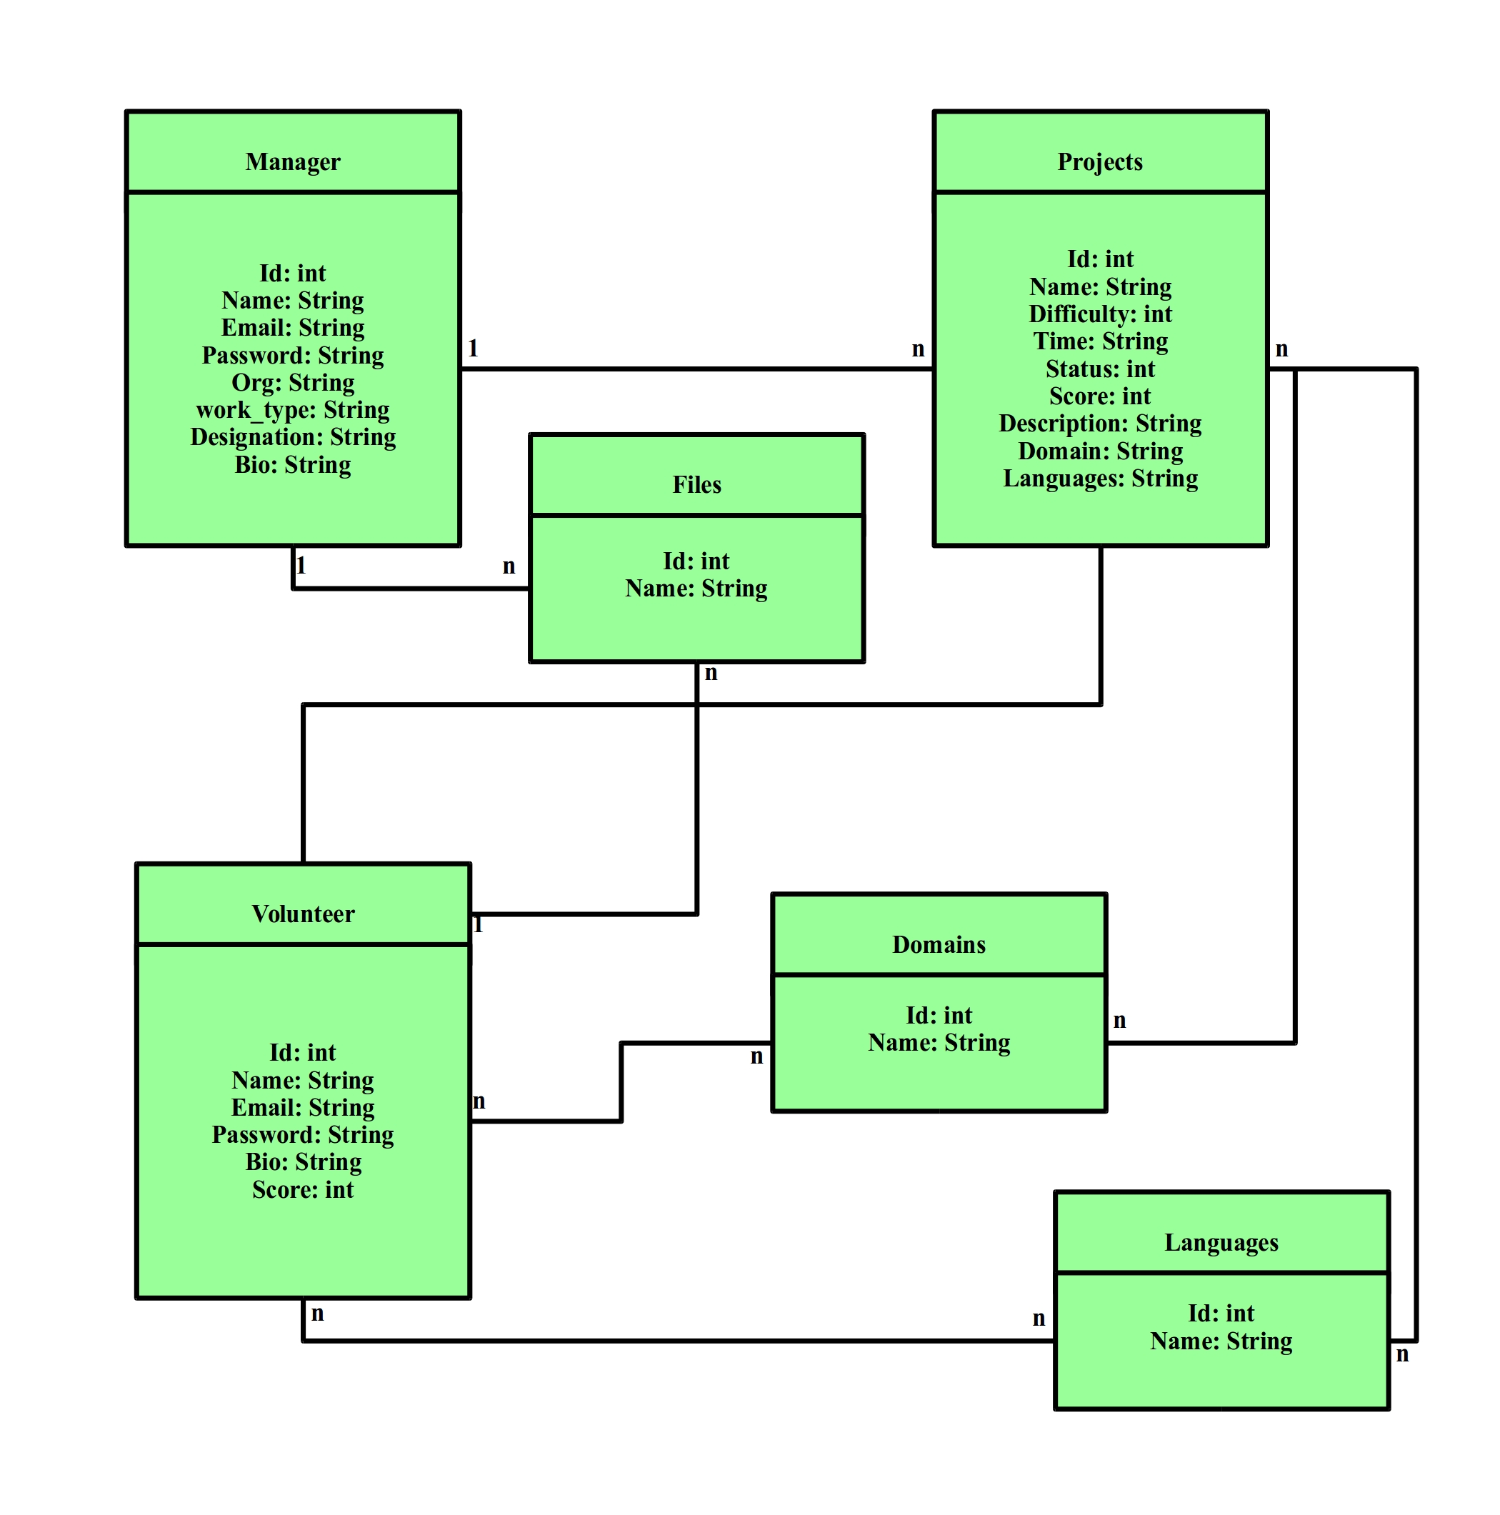
Class diagram

