Slide 1

High Quality Code
Coding & Design Guidelines

Slide 2
Contents
Introduction
Complexity in Software
Code Formatting
Comments & Documentation
Names
Variables
… + attributes, constants, literals…
Expressions
Control Structures
Conditionals
Loops

Slide 3
Contents
Functions
Classes
Resource Management
Error Handling
Software Design
Conclusion
Appendix 1: General Guidelines
Appendix 2: Code / Design Smells
References

Slide 4
Introduction Complexity in Software
“Make things as simple as possible, but no simpler.”
A. Einstein

Slide 5
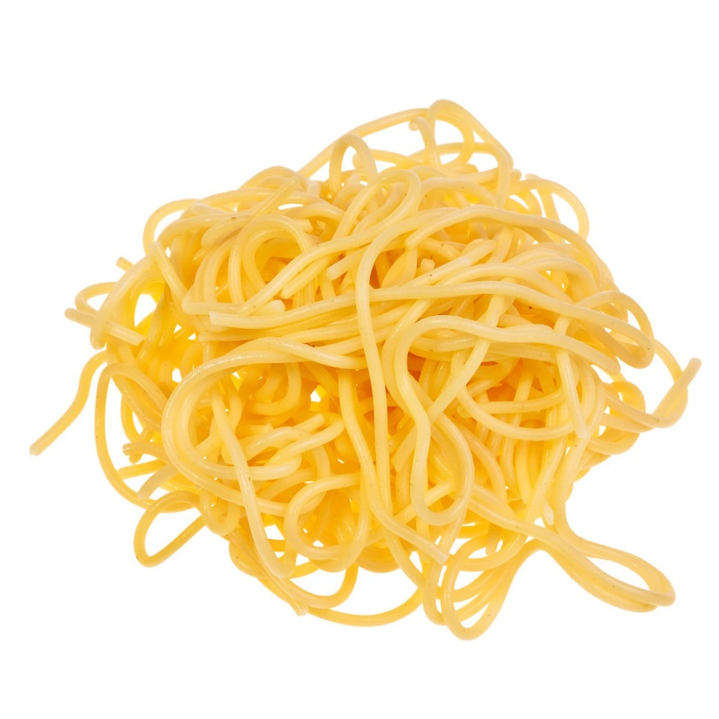
Primary Imperative
“Software’s primary technical imperative: managing complexity”
McConnell, Steve. Code Complete

Slide 6
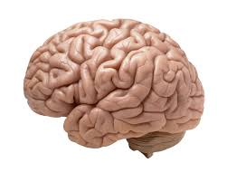
Complexity
What is Complexity?
Brain can handle a limited number of items simultaneously
The number of off-screen items one needs to consider/look up in order to write/change a piece of code increases complexity
Number of dependencies, parameters, considerations, etc.
Number of factors contributing to an outcome
Example: globals; “goto” code; how they are alike
While reading / writing code, strive to:
Reduce scrolling & look-ups needed to understand the code
Reduce number of items tracked simultaneously
Code should be easily readable & comprehensible
All “modern” design & coding techniques are centered around complexity management!

Slide 7
Code Structure & Formatting
More than appearance

Slide 8
Code Structure & Format
Folders & Files
1 class per header!
Exception: nested classes (use rarely)
Don’t pour everything into 1 source folder
Group logically by “module” boundary
File extensions
.cpp, .hpp
.h usually for C interfaces
Formatting styles
Follow the logical structure of the code
Follow project conventions & formatting guidelines
Where (not) to put spaces
Be consistent

Slide 9
Comments & Documentation
No comment

Slide 10
Comments & Documentation
Prefer to write clear, readable code instead of more comments.
The best documentation is code itself!
Example: AStar_fixme.cpp
Prefer commenting why you do it to what you do
Prefer commenting what you do to how you do it
Except for specifying a certain (non-obvious) algorithm
Example: // Midpoint algorithm for drawing a circle
Use multi-line comments primarily above functions / classes
Often in conjunction with special annotations to document the code (i.e. Doxygen)
Use single-line comments inside your functions to make necessary clarifications
Don’t repeat what the code already says!

Slide 11
High Quality Names
Je m’appelle… i.

Slide 12
Names
Common guideline: invest much (time, effort) in proper naming! It will quickly pay off.
Names are for developers, not for compilers!
Relation with SRP
Attempt to give descriptive name to a function/class/variable etc. may reveal multiple responsibilities
Ex. readAndLogConfiguration()
Don’t just ignore/abbreviate that – it’s an important symptom! Reveals 2 responsibilities
Don’t automatically select more general name (i.e. temp or processData())
Fix the root cause – i.e. split to several functions/classes, use several variables, etc.

Slide 13
Names
Avoid abbreviations
Except for popular ones, such as usb
Always consider context (class / namespace you are in)
Helps avoid duplications, such as Phone::PhoneError, Contact::setContactName() etc.
Avoid too general names
For types (classes, interfaces, structures, enums, typedefs) – use PascalCase
Use Noun or Adjective+Noun
Bad names: Draw, Generate, Find, Small, Big, Translate
Good names: HashGenerator, ContactFinder, Translator, …

Slide 14
Names
Functions / methods
camelCase() or PascalCase() – check with your project coding guidelines
Usually Verb, Verb + Noun, Verb + Adj + Noun
Whether Noun is added depends on context
generateMap() vs MapGenerator::generate()
Bad names: length(), shape(), …
Good names: getLength(), setLength(), findContact(), …
Be consistent
follow the same convention for a group of logically related operations
Use good pairs (open-close, read-write, load-unload, etc.)

Slide 15
High Quality Variables … + attributes, constants, literals…
+ other mischief

Slide 16
Variables, Constants, Literals
Case conventions
Variables (local, parameters, class members) – camelCase, considering the context:
isBufferFull / Buffer::isFull, contactName, Contact::name
Don’t use type prefix (“Hungarian notation”) – it is an obsolete practice
bOutputBufferEmpty, iArrayIndex, etc.
Symbolic constants – ALL_CAPITALS:
#define MAX_FILENAME_LENGTH 255
const int MAX_USERS_COUNT = 5;
enum Color {RED, GREEN, BLUE};
(C++11 and above) prefer enum class

Slide 17
Variables, Constants, Literals
SRP for variables
Each variable should have only 1 purpose
Avoid variable “reuse”
Avoid “temp” variables
Use good descriptive names, and if they reveal multiple responsibilities – split into several variables!
Names should reflect variable’s purpose, not implementation details
std::string myString = …;
std::string userName = …;
Avoid abbreviations unless widely accepted
usbPortNumber is OK, conPredNum is not
Avoid very similar names: user, users, user1
Given a choice, name Boolean variables positively, instead of negatively
bufferFull / bufferEmpty
bufferNotFull / bufferNotEmpty

Slide 18
Variables, Constants, Literals
Boolean variables should have names that correspond directly to “true” or “false”:
bool status = remove(contact); if (status) // ?!?!
bool success = remove(contact); if (success) // OK!
bool removeSuccessful = remove(contact);
if (removeSuccessful ) // Even better readability
Use (or create) the most correct type for a variable
Avoid too low abstraction
Primitive obsession is a code smell, i.e. using int for coordinate, angle, speed, weight, energy, volume, …
typedef does not create a new type!
Avoid too high abstraction
void* (C++), Object (C#/Java), …

Slide 19
Variables, Constants, Literals
Don’t overuse typedef
typedef does not create a new type! (example/exercise T/L)
typedef-ing primitive types is often useless and even harmful:
typedef char Char;
typedef bool Bool;
There are (rare!) occasions when a certain width/signedness has to be enforced. Only then it’s OK to do that:
U8 receivedByte = 0;
S32 currentAudioSample = 0;
For C++11 and above, use auto wherever you can!
It is definitely a good practice:
auto contactIterator = contacts.find(contactName);
Sometimes however you need to stick with a type:
Shape* shape = new Rectangle(); // OK

Slide 20
Variables, Constants, Literals
Always initialize variables!
int bufferIndex;
auto bufferIterator = std::begin(buffer);
For data members, C++ initializer lists are the true place of initialization
class Star {Star() {brightness = 0;} }; // BAD
class Star {Star() : brightness(0) {} }; // GOOD
Avoid magic numbers (with a few exceptions)
0, 1, -1, “”, nullptr – OK
if (“New folder” == name) {…} // NOK
if (DEFAULT_FOLDER_NAME == name) {…} // OK

Slide 21
Variables, Constants, Literals
Scope & lifetime
Avoid globals & static non-const variables
Span (Lines of Code, LoC)
Keep as small as possible
Declare as close to the first use as possible
std::string name;
/*… Multiple lines of code …*/
name = generateUniqueName(); // NOK!
std::string name = generateUniqueName(); // OK!
Access (for class attributes)
Ideally, keep variables private
Exercise on AStar_fixme.cpp – make ALL data members private!
const may be public (part of an interface)
In simplest cases you can afford public attributes:
struct Point {double x; double y;}; // Maybe OK… depends!
What about protected attributes?
Bridge example

Slide 22
High Quality Expressions
Express yourself

Slide 23
Expressions
Extract complex expressions as separate, well-named functions / methods
if (T > 20 && T < 28 && relativeHumidity > 50 && relativeHumidity < 75 && dust < 30 && ion > 900 && ion < 1100) …
if (airConditionsOK()) … // extracted to bool function
Extracting intermediate results as separate values makes debugger your friend
Try De Morgan’s laws to rework complex Boolean expressions
if (!(!isDaytime() || !outsideAirOK())) { /* open windows */ }
if (isDaytime() && outsideAirOK()) { /* open windows */ }
Never make exact floating point comparisons
Exercise: 3 * 0.3 = ?
Use auto (C++11 and above)

Slide 24
High Quality Control Structures Conditionals & Loops
for you…

Slide 25
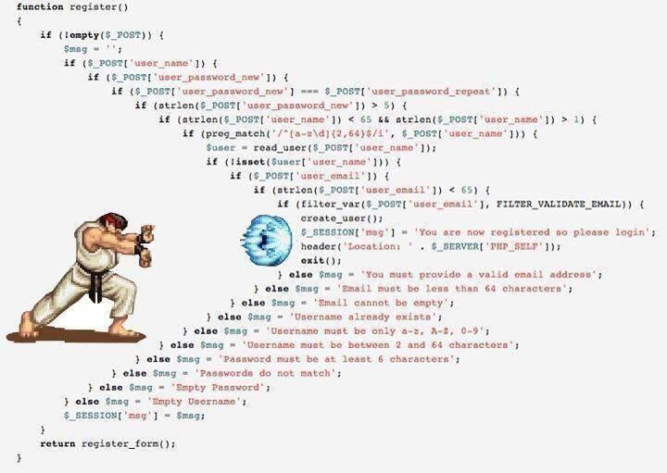
Control Structures Conditionals
Readability
Implicit bool checks
if (!bufferIsFull) {…} // OK
if (false == bufferIsFull) // NOK - makes you stumble
Explicit non-bool checks
if (!status) {} // What?!
if (STATUS_OK == status) // OK
Avoid double negations: if (! bufferNotFull())
Avoid deeply nested conditionals
Arrow(head) antipattern
XP experts (Fred George): “avoid else”
Too extreme?
Check errors first, return success value last – avoids nested conditionals

Slide 26
Control Structures Conditionals (2)
Avoid switch-case
When switching on type – rework to polymorphism
Most other cases can be replaced by a LUT (Look-Up Table) i.e. std::map<Key, Value>, dictionary or similar container
If absolutely unavoidable, then shorten to an elegant switch with 1-line case-s calling functions / methods
Never allow switch-case to span across multiple pages!
Avoid fall-throughs
Cyclomatic complexity
Avoid writing code that isn’t needed (general recommendation)

Slide 27
Control Structures Loops
Use the proper loop type
for(;;) → while (true)
Minimize loop block’s length
Must fit in 1 screen
Ideally, a few lines
Extract logical portions as separate functions/methods
Avoid / Rework nested loops (similarly to nested conditionals)
Name control variables descriptively, except for the simplest loops
Avoid modifying loop’s control variable in for’s body
Except when removing elements while iterating - containers’ erase() methods that return iterator to the next element (C++11 and above)
Avoid for initialization section overuse
Avoid putting excessive statements in for’s header
Avoid hacks / “smart code” / “write-only code” altogether!

Slide 28
Control Structures goto
Discussion about using goto
What are its downsides?
Spaghetti code
Are there any upsides to using goto?
Tricks to avoid / replace goto
Example: do {// use break to leave scope early} while(0);
Don’t get too attached to similar tricks!
They have their downsides, too
Don’t replace with flags
Example: 2 nested loops for 2D array processing
Show “solution” to early leave problem: flag
There’s always a better way

Slide 29
High Quality Functions
A matter of method…

Slide 30
Functions
SRP for functions:
A function should do one thing only and do it well!
Even printing/logging can be viewed as additional responsibility!
Where & how to log
Propagate error information through exceptions
Basic rule
A function / method should do what its name says or indicate an error!
Implications:
Functions must not ignore silently any error condition
if (shape) {shape->draw();} // NOK if shape should be != nullptr by construction
Functions must not let irrelevant errors propagate to their callers (errors that no caller up the stack should understand).
I.e. handle errors that are in your Responsibility to handle and let others propagate up.

Slide 31
Functions Cohesion
Cohesion
How closely related different parts of the function are
Strive for high cohesion
Explain
If SRP is broken, there are multiple logically separated parts in a function -> low cohesion (BAD)
”You can’t have empty lines in your methods” (Fred George) is a little too extreme, but you get the idea…
Multiple “sections” usually hint to multiple logically separated parts, candidates for extraction.
“Code speaks to you” (same author)

Slide 32
Functions Coupling
Coupling
Dependencies on other functions / methods – how close / strong they are
Strive for loose coupling
Explain
A function should ideally depend on its parameters only
Depending on globals / static variables is the worst violation of this rule. This is the birth of so-called “spaghetti code”. It couples the function to undetermined (possibly increasing) number of other entities influencing each other via that global state and makes the system behave unpredictably
Even dependency on non-static attribute of the same class couples the method to neighbouring methods, but often it can’t be avoided
Dependency on other functions/methods is best, because it relies on (hopefully) stable interfaces, not on implementation details
Functions MUST NOT talk to each other via any kind of unencapsulated variable / state!

Slide 33
Functions Side Effects
What is a side effect?
CS definition vs. working definition
Functions must not have side effects
Functions must not rely on side effects or undocumented features of other functions
Pure functions

Slide 34
Functions Dependency Injection
Functions should not have hidden dependencies
Functions must clearly express their input and output
No talking via variables, remember?

Slide 35
Functions const & const correctness
Avoid output parameters
If a function/method needs to return more than 1 value, they either can be combined in a class or there is a violation of SRP
Don’t modify input parameters
Copy in other variable, if necessary
Parameters should reliably have their value across the entire function’s scope
const and const correctness
Use const to better communicate your intentions to the compiler:
Pass input parameters by (preferrably) const reference or pointer-to-const wherever possible
Declare methods const wherever possible
Example benefits
Calling methods on const objects
Binding references to temporary objects
Example: MessageBus, Message with dispatch() const method

Slide 36
Functions Misc
Prefer pass by (const) reference when you can
Beware not to return reference or pointer to stack object!
(C++11 and above) never use raw pointers or references to transfer ownership!
Factories should return either std::unique_ptr or std::shared_ptr
Private methods can omit some runtime checks if public methods guard object’s state (as they should)
Multiple exit points – discussion
Use early return if it improves readability!
Beware with recursion
Can always be reworked iteratively – trade heap for stack space

Slide 37
Functions Exercises
fixme_temp_measure.cpp
fixme_complex.cpp
fixme_AStar.cpp

Slide 38
Error Handling
If assert, throw except catch errno!

Slide 39
Error Handling Conditionals
Use conditionals (if, while, etc.) for normal code flow normal circumstances. Use them also when validating user input, data from external source, etc.
Example: Too short string entered for a new password.
This should not be treated neither as a program error nor as runtime exceptional condition: not under your control! (neither developers’ nor integrators’). It can’t be prevented
Example: User enters arbitrary symbols instead of a number (when the input widget doesn’ have built-in control)
Incorrect handling: throw an exception
Correct handling: (for a console application) this could be a do / while loop with proper prompt (i.e. “Please enter an integer:”)
Example: Phonebook class with findContact() method returning a list of Contacts matching the criteria. Situation: no contacts are found.
Incorrect handling: throw an exception
Correct handling: return empty list (it’s a perfectly normal situation)
Never silently ignore an error!
Example: A Widget has a Shape: if (shape != nullptr) {//use shape}

Slide 40
Error Handling Exceptions
Use exceptions for errors / abnormal circumstances that:
Are not signs of bad / broken program
Can be handled by some higher layer
Example:
void loadConfiguration(path)
Situation: File not found
Throw an exception!
Handling in the caller: load default values
It should always be possible to write a unit test that causes your exceptions to be thrown
Throw by value, catch by reference (possibly const)!
Exceptions vs. Error codes (discussion)

Slide 41
Error Handling Asserts
Check with your coding guideline first.
If allowed, use them for:
Conditions that, if broken, clearly indicate program error / bugs in the code
Conditions that, if broken, can’t possibly be handled in runtime
Conditions that must always be true (when the opposite just “cannot happen”)
Example: passing an object by reference and storing a pointer to it. Later when looping through pointers, they cannot be null!
Example: For a doubly linked list
assert(p->successor == nullptr || p->successor->predecessor == p)
If the above condition is broken, what can we do?
It must not be possible to write a unit test that causes assert. If it happens - fix the bug!

Slide 42
High Quality Classes
Not from our class…

Slide 43
Classes Names
Never use incomprehensible names!
class ABCASMAZ {…} // VERY bad
Use mainly nouns
Avoid verbs for names
class GenerateMap {}; // NOK – looks like method name
class MapGenerator {}; // OK
Avoid plural
class Students {}; // NOK
Be descriptive and watch for multiple responsibilities
class ShapeDrawerAndSaver {}; // Split into 2 classes!
Don’t hide the problem by selecting shorter/abbreviated name!

Slide 44
Classes Encapsulation
Encapsulation is about hiding implementation details from client code
Allows users of a class to treat it as a “black box”
Of course, don’t expose public attributes, but…
…encapsulation is much more than that!
There are multiple ways a class can “leak” unnecessary details to its users

Slide 45
Classes Encapsulation – Exercise
Find and fix encapsulation errors in the example below
#include <string>
#include <dlfcn.h>
class DynamicLibrary {
public:
DynamicLibrary(const std::string& path) : path(path) {
}
void* load(int flags) {
return dlopen(path.c_str(), flags);
}
void unload(void* handle) {
dlclose(handle);
}
void* getSymbolAddress(void *handle, const std::string& symbolName) const {
return dlsym(handle, symbolName.c_str());
}
private:
const std::string path;
};

Slide 46
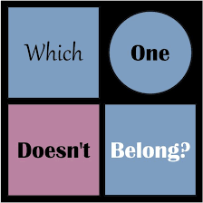
Classes Cohesion
How strong is the relation between different parts of the same class
Strive for high cohesion – classes should not “fall apart” logically
This is closely related to SRP
“Which one doesn’t belong?”
Sometimes ambiguous…
Symptoms of low cohesion
Parts of your class live their own life
In terms of changes, fixes, etc.
It makes sense to reuse some part of your class
External classes/functions depend on small portion of your class

Slide 47
Classes Cohesion & SRP
SRP for classes – even more important!
Closely related to Cohesion
Can easily be broken:
class Shape {
public:
virtual void draw() const = 0; // 2nd
virtual void save(File& file) const = 0; // 3rd
virtual void load(const File& file) = 0; // 4th
virtual std::string serialize() const = 0; // 5th
}; // Breaks SRP – multiple responsibilities!
If things stopped at draw() it might be perfectly OK
Another phrasing of SRP: “A class should have only one reason to change”

Slide 48
Classes Coupling
How strong is the relation between different classes
Strive for loose coupling to other classes
Symptoms of tight coupling
Bugs in one class require fixes in other classes too
Changes/extension in one class require corresponding changes in another class

Slide 49
Classes Coupling (2)
Sources of tight coupling
Dependency on global state – global / static variables, Singletons, etc.
Hidden dependencies (again, Singletons & global variables)
Public data members
Classes that exposes public/protected data members
Classes that depend directly on other classes’ public / protected data members
Classes that depend on other concrete classes
In most cases it’s OK to depend on value classes such as std::string, std::vector<>, std::map<>, Coord2D, etc
Still, if you can, prefer to depend on their base classes / interfaces
In C++ standard containers don’t have common base, but in other languages they do (i.e. Collection in Java) – then prefer Collection to i.e. List when possible
Another example: prefer to depend on Shape rather than Rectangle (provided that Rectangle inherits from Shape)
It’s NOK to depend on concrete service classes

Slide 50
Classes Constructors
Don’t call virtual methods from the same object’s constructor
Use initialization lists for initialization!
Person::Person() { age = 0; // NOK. This is assignment! }
Person::Person() : age(0) {} // OK!
Sometimes you don’t have a choice (otherwise it won’t compile):
Const attributes
Reference attributes
Attributes of types that don’t have default constructors
… but even when you do, prefer initializer lists except if you have a very strong reason to prefer assignment in constructor’s body
Always initialize explicitly attributes of primitive types
Attributes of user-defined types will get their constructors called
Which constructors?
If a constructor fails, prefer throwing an exception rather than leaving the object in a “zombie” state / setting internal flags, etc.
Work that should (not) be done in constructors
Do: bring the object to a valid state / ensure class invariants
Don’t: perform heavy tasks, construct other objects, etc.

Slide 51
Classes Destructors
Never let exception propagate out of a destructor!
Log a message, signal something, … but don’t throw
Internally exceptions may be thrown, but must be caught before leaving the destructor
Destructors are meant for resource cleanup (RAII concept)
Close connections, unlock mutexes, free memory, …
Cleanup only what is this class’s responsibility
… and let members (attributes), base classes and descendants clean up for themselves!
Don’t call virtual methods from the same object’s destructor
Make destructors of base classes virtual!

Slide 52
Classes Inheritance
Public inheritance should correspond to “is-a” relationship
Other types (rarely used). Private: “Implement in terms of”
Don’t create deep inheritance hierarchies
It’s easy to run into dreaded diamond problem
Use Inheritance mainly as a tool for polymorphism, not for code reuse
This is an implication of DI principle
You can’t Dependency-Inject Base classes in runtime, inheritance is static
Use Multiple Inheritance mainly with Interfaces / pure Abstract classes (“implements / realizes” relationship)
Move repeating methods, interfaces, data members, etc. up the hierarchy
DRY principle
Think before you act: what you move up the hierarchy must apply to all descendants!
Base classes must never know about their descendants!
Avoid downcasts!

Slide 53
Classes Virtual Methods. Polymorphism
What is Polymorphism?
Use virtual to achieve run-time polymorphism
Make virtual destructors for base classes!
Beware of hiding (instead of overriding) a base virtual method
Always follow the exact virtual method signature!
(C++11 and above) Use override specifier
Beware with overloads
Example with virtual method in Base and overload in Derived
Template Method pattern

Slide 54
Classes Inheritance or Aggregation
Is-a vs. has-a
Example: class Phone using class Display
Prefer code reuse via aggregation

Slide 55
Classes Dependency Injection
“Ask for your collaborators” (usually in the constructor)
Don’t create them, don’t search them, don’t use them secretly
It is a powerful technique to achieve loose coupling which leads to higher reusability, maintainability, testability, etc.
Exercise (draw UML and implement):
class Widget creating its Rectangle shape (fixme_shapes1.cpp)
class Widget asking for its Shape in the constructor (OK!)
With DI, users have choice / control over Widget’s collaborator (Shape)!
DI makes class dependencies explicit!
No hidden communication!
In this light, discuss Singleton (and other forms of global state)

Slide 56
Classes Interfaces
In C++ Interfaces are not a separate construct
Use pure abstract classes instead
Resist the temptation to provide implementations in them

Slide 57
Resource Management
“Last one turn off the lights”

Slide 58
Resource Management
Rule of thumb: Manage one Resource per class!
Except container (collection) classes such as std::vector<> or class Phonebook
Know the RAII concept
Utilizing constructors & destructors
Implication: each class must clean its own mess (and not that of others)
Resource ownership. Sources & sinks
Ownership transfer. Shared ownership
In C++11 and above – use smart pointers!
Use std::unique_ptr (or equivalent) for exclusive ownership & ownership transfer
Use std::shared_ptr for shared ownership
Using raw pointers and references for resource ownership is ambiguous and error-prone
Do use them for giving (non-owning) access (calling non-sink functions/methods)
Pre-11 advice: beware with auto_ptr<> (or forget about it altogether)
Very limited use. Find alternatives!
Can’t be used within containers, within objects that are stored in a container, etc.
Can do more harm than good. Search for alternatives
Boost? Other frameworks’ smart pointers?

Slide 59
Resource Management
Resource leaks & how to avoid them
Mostly solved by smart pointers (but not entirely)
Lapsed listener problem
Circlular references & how to break them
Raw pointers / references – when & how
Example: tree data structure, parent/child relationship
Weak pointers – when & how

Slide 60
High Quality Software Design
Trust me, I’m an engineer…

Slide 61
SOLID Principles
(external slides)

Slide 62
High Quality Interfaces
The Most Important Design Guideline: “Make interfaces easy to use correctly and hard to use incorrectly”

Slide 63
Conclusion
“You say goodbye, and I say hello”
Beatles

Slide 64
Conclusion
Much more time is spent maintaining your code than initially writing it
Proofread your code, think for its users
Last (but not least) – if some principle / pattern / refactoring would make code harder to read/understand and/or worsens performance significantly – don’t do it!

Slide 65
Appendix 1 General Guidelines
For reference

Slide 66
Guidelines for High-Quality Design & Implementation Rules of Thumb
Follow project & language conventions
They are not perfect. Justify deviations
Get approval for serious violations
Propose changes
Strive for high cohesion in function / class / module
Strive for loose coupling b/w classes / modules
Depend on abstractions, not on concrete classes
Law of Demeter
Principle of least knowledge
Prefer delegation (aggregation/composition) to inheritance

Slide 67
Guidelines for High-Quality Design & Implementation Principles & Techniques
DRY – Don’t Repeat Yourself
YAGNI – You Ain’t Gonna Need It
KISS – Keep It Simple and Short
SOLID
Single Responsibility Principle (SRP)
Open-Closed Principle (OCP)
Liskov Substitution Principle (LSP)
Interface Segregation Principle (ISP)
Dependency Inversion Principle (DIP)
Dependency Injection
Don’t create your collaborators, ask for them in the constructor!

Slide 68
Guidelines for High-Quality Design & Implementation Tools
Compiler is your friend!
Express your intentions as best as you can
Use maximum warning flags (for gcc: -Wall, -Wextra, -pedantic)
Debugger is your friend!
Write debugger-friendly code
Often readability goes hand in hand with debuggability
IDE / code editor is your friend!
Make use of tooltips in Eclipse (comments above functions/classes)
Static code analysis tools
TODO: Examples of useful lightweight checkers
Code Generators
Not always your friend, but get to know them well
Loose coupling b/w generated and manually-written code

Slide 69
Guidelines for High-Quality Design & Implementation Performance
Know your collections
For linear collections - use std::vector unless proven otherwise
For dictionaries / sets:
(C++11 and above) use std::unordered_map (_set)
(C++98/03) either boost unordered_ equivalents or std::map/set
Know your algorithms
Use standard ones i.e. std::find_if instead of manual loops
Know Locality of Reference
Cache locality & other buzzwords
Avoid premature optimization
Usually makes readability a lot worse
Sometimes makes size/speed worse!
Well-designed code can be optimized later. Example: change containers
Profiling is your friend
Design & write with good performance in mind and later optimize
Optimize proven (measured) bottlenecks!

Slide 70
Guidelines for High-Quality Design & Implementation Tests
Unit tests
Code that is unit-test-friendly is project-friendly
Dependency Injection is your friend

Slide 71
Guidelines for High-Quality Design & Implementation Refactoring
Refactor when the code is ready
Ideal situation: factor in exactly the right patterns from the beginning and then be able to extend functionality by only adding new classes (without changing existing ones)
In reality, existing code needs refactoring from time to time
Existing code tends to degrade in quality – refactoring fixes that
Refactoring helps avoid over-engineering at the beginning
Prefer smaller, lower-risk refactoring more often rather than big, high-risk reworks late in the project
Refactoring is a process, not one-time event
Refactor easiest / smallest risk first
“Low-hanging fruits”

Slide 72
Appendix 2 Code / Design Smells
Don’t do that at work

Slide 73
Code / Design Smells General
Global state
Global variables
Static variables
Static data members
Consider replacing with non-static data member in the container!
Singletons – considered anti-pattern last 10-15 years
Strive to be able to instantiate a portion of the application/component in isolation
void foo(void); or void foo(input)
Too many control structures
Nesting if/switch/loops
“goto”-like / “spaghetti” code (can exist even without a goto statement!)
Duplications or near-duplications
Code reuse vs repetition
Duplications that are perfect or can be parameterized become methods with respective parameters
Duplications in high-level steps can be refactored to Template method pattern

Slide 74
Code / Design Smells General (2)
Too long functions/methods
Split into smaller well-named functions, even if they end up used only once
Too many function/method parameters
Group them into classes. Example:
void drawLine(double x1, double y1, double x2, double y2);
void drawLine(const Coord2D& from, const Coord2D& to);
Consider SRP
Raw arrays
Writing code that isn’t needed
Writing code with the sole purpose to “silence” the compiler / Coverity
Preparing to call a function/method
Always (nearly) the same code called before calling a function/method

Slide 75
Code / Design Smells General (3)
Exact floating(double) checks
Using == or != to compare floats/doubles Dead code, commented-out code, etc.
Relying on indirect #include-s for types we directly use
The header that includes them may stop doing so and our code might break!
Exception to this rule is types of parameters/return values in overridden virtual methods
using-directives in headers (i.e. using namespace std;)
Checking for null pointer before delete
Multiple classes per translation unit
Too many comments
Usually a symptom of hard-to-understand, hard-to-maintain code
Too few comments

Slide 76
Code / Design Smells OOP / Class Design
Lack of virtual destructors for base classes / interfaces
Base classes depending on their descendants
Large classes
Many attributes/methods probably mean SRP violation
“Data classes” – that have only data members (not to confuse with value classes like std::string)
Except simplest cases like struct Coord (double x, double y) but even then we might want to add constructors, overloaded operators, etc. Indication is repeating user code to clear, verify, operate on those objects – make that repeating user code methods of the class!
Classes with only / mainly static methods in them
Exporting class’s internals to the user
Public non-const data members
Protected non-const data members (less evil, but still not good)
Leaking unnecessary details to the user (example)

Slide 77
Code / Design Smells OOP / Class Design
Type checking, no matter the form (switching on type or using dynamic_cast etc.)
Rework to subclasses & use polymorphism
“For-tests only” methods in production classes
Accessors (getters and setters)
Having public accessors for private data fields (attributes) negates encapsulation/data hiding
Usually a sign of bad design, except in i.e. Data Access Layer
Methods that make more use of another class than their own
Move to the other class/restructure classes
A class that changes for many different reasons
Fixes / changes frequently requiring changes in multiple classes
“Change class A and don’t forget to change class B also”

Slide 78
Code / Design Smells OOP / Class Design
Using union
Classes that just pass data around without any added value
Primitive obsession
Passing / containing set of variables/types that often go together (i.e. drawPoint(int x, int y);)
Using primitive types for everything (i.e. double for coordinates, lengths, frequencies, volumes, angles…)
new all over the code
Use some kind of Factory or Builder – encapsulate object creation
Exposed raw collections (i.e. vector<Contact*> instead of class Phonebook)
Circular dependencies
Show method to rework them
Forward declarations (class X;)
Usually part of circular dependency (see above), but sometimes on their own

Slide 79
Code / Design Smells OOP / Class Design
Depending on concrete classes
Depending on value classes is usually OK!
Creating your own collaborators (objects you work with)
Ask for them (in the constructor or corresponding methods that work with them)
Using.long.chains->of.member->access()
Law of Demeter
Class / method depending on a very small portion of another class
Over-engineering
YAGNI principle
The least dangerous for those who aren’t used to OO Design
Find balance between over- and under- engineering

Slide 80
Code / Design Smells Error Handling
Throwing by pointer
Who deletes it?
Catching by value
Slicing problem. Catch by (const) reference!
Using exceptions for normal code flow
Using exceptions for situations that cannot be handled
Example: you add an element to a container and then it turns out to be empty
Use assert for detecting broken code
std::bad_alloc can be handled, ex. parachute strategy
Silently ignoring an error
Catching exceptions thrown in the same function/method
Excessive checks
Checking whether “the world still works”
Checking more than once preconditions/postconditions

Slide 81
Code / Design Smells Performance, efficiency, build times
Parameters/return values passed by value
Given a choice, pass by (const) reference!
Sometimes it’s inevitable, i.e. return value from operator+
Large objects / data structures in stack
Copying large objects / data structures
Unused #include or using-directives
Bad locality
Data locality (i.e. using linked list or set instead of vector)
Processing (Exercise: loop on 2D array by col-row vs. row-col)
(C++11 and above) Use of std::map, std::set instead of their std::unordered_xxx counterparts
Writing virtual destructors for classes not intended to be inherited (i.e. value classes)

Slide 82
References

Slide 83
References
McConnell, Steve (2004). Code Complete 2nd edition
Kerievsky, Joshua. Refactoring to Patterns
George, Fred. The Secret Assumption of Agile
Hevery, Miško. Global State and Singletons
Meyers, Scott. The Most Important Design Guideline
http://cpp-today.blogspot.com/2010/02/asserts-vs-exceptions.html

