Slide 1
Part 1: Introduction
Notes:
Page <number>

Slide 2
Summary
Contact information
Course objective and topics
Course workload
The layering principle of network protocols
Connection-oriented and connectionless services
Service primitives
The relationship of services to protocols
Reference models

Slide 3
(1) Contact Information
Course/lab web page: connex.csc.uvic.ca.
  After you log in connex, you should be able to see the course tab of CSC 361. If not, please send email to wkui@uvic.ca and I will add you manually into the system.
Instructor: Kui Wu
Email: wkui@uvic.ca

Slide 4
(2.1) Course Objectives
To help you gain a general understanding of the principles and concepts governing the operations of computer networks;
To provide you with the opportunity to become skillful in the implementation and use of communication protocols;
To help you grasp the basic research methodologies in the field of computer networks.

Slide 5
(2.2) Topics
Introduction
  Internet overview;
  Access network technologies: basics;
  Backbone network technologies and structures: basics;
  Network architectures, services and protocols
Application layer
  Client-server model;
  World-Wide Web (WWW);
  Hyper-Text Transfer Protocol (HTTP);
  Domain Name System (DNS);
  Socket Application Programming Interface
Transport layer
  Transport layer services;
  User Datagram Protocol (UDP);
  Transmission Control Protocol (TCP);
  TCP connection management techniques;
  TCP flow, error and congestion control basics
Network layer
  Network layer services;
  Internet Protocol (IP);
  Basic routing algorithms: distance vector and link state;
  Internet routing protocols: basics
Link layer
  Link layer services;
  Link layer error and flow control techniques;
  Medium Access Control (MAC) techniques;
  Link layer interworking techniques;
  IEEE 802.3 and 802.11 basics

Slide 6
(3)Course Workload
Assignment/Exams | Weight
Assignment 1 | 15%
Midterm 1 | 15%
Assignment 2 | 20%
Midterm 2 | 20%
Assignment 3 | 15%
Midterm 3 | 15%

Slide 7
(4.1) Protocols
Basically, a protocol is an agreement between the communicating peers on how communication is to proceed.

Slide 8
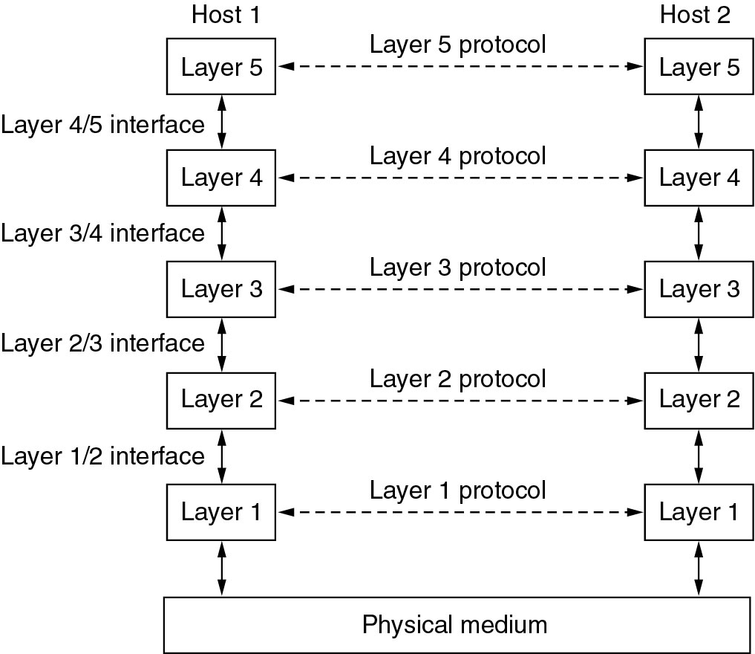
(4.2) The layering Principle (1)

Slide 9
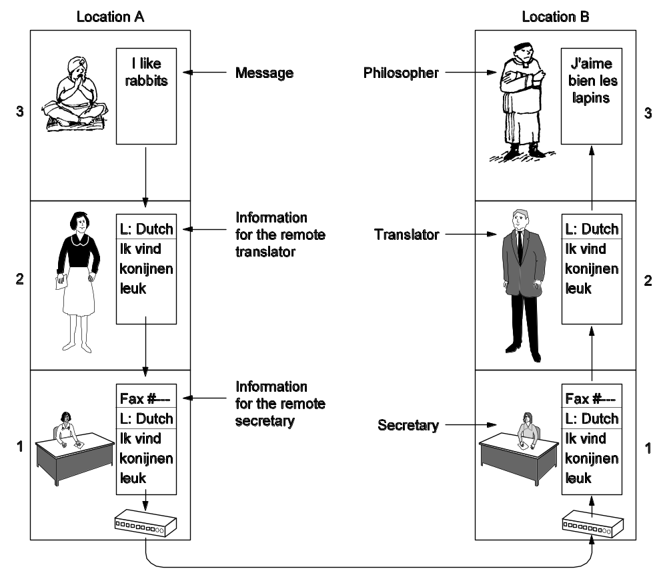
(4.2) The layering Principle (2)

Slide 10
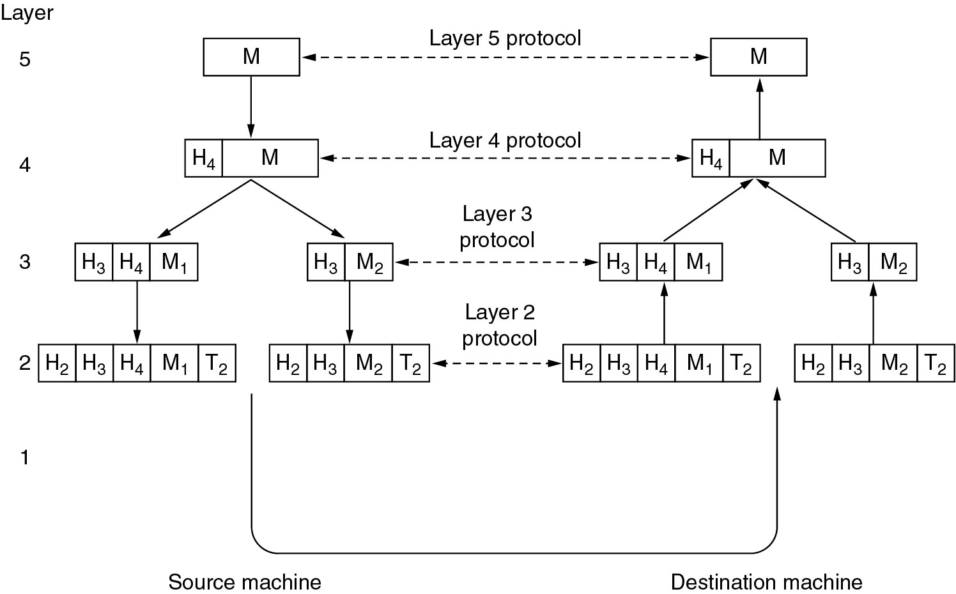
(4.2) The layering Principle (3)

Slide 11
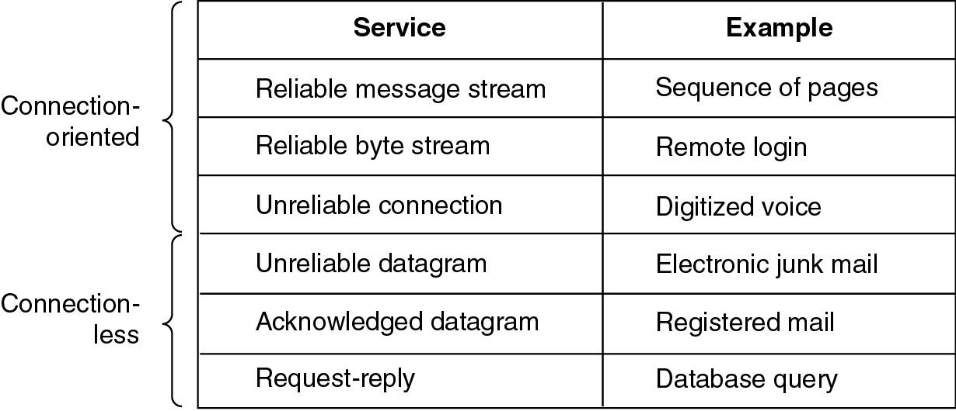
(5) Connection-Oriented vs. Connectionless

Slide 12
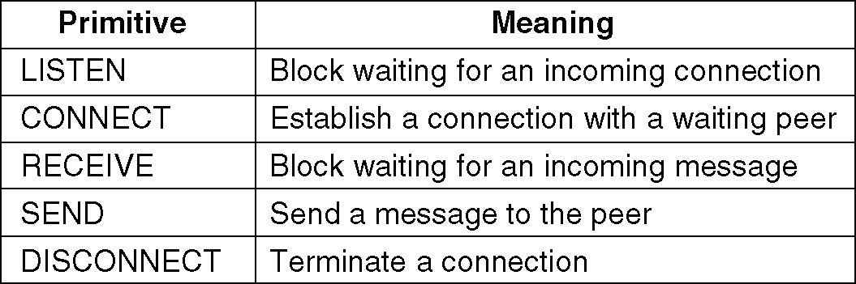
(6) Service Primitives
A service is formally specified by a set of primitives (basic operations) available to a user or other entity to access the service.
Example: five service primitives for implementing a simple connection-oriented service.
Notes:
Page <number>
Another example with html

Slide 13
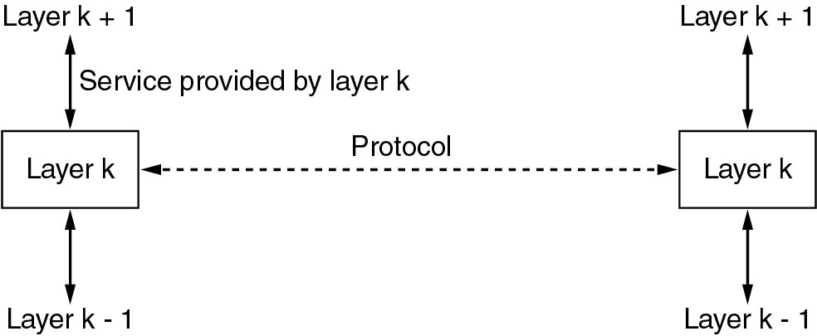
(7) The relationship of Service

Slide 14
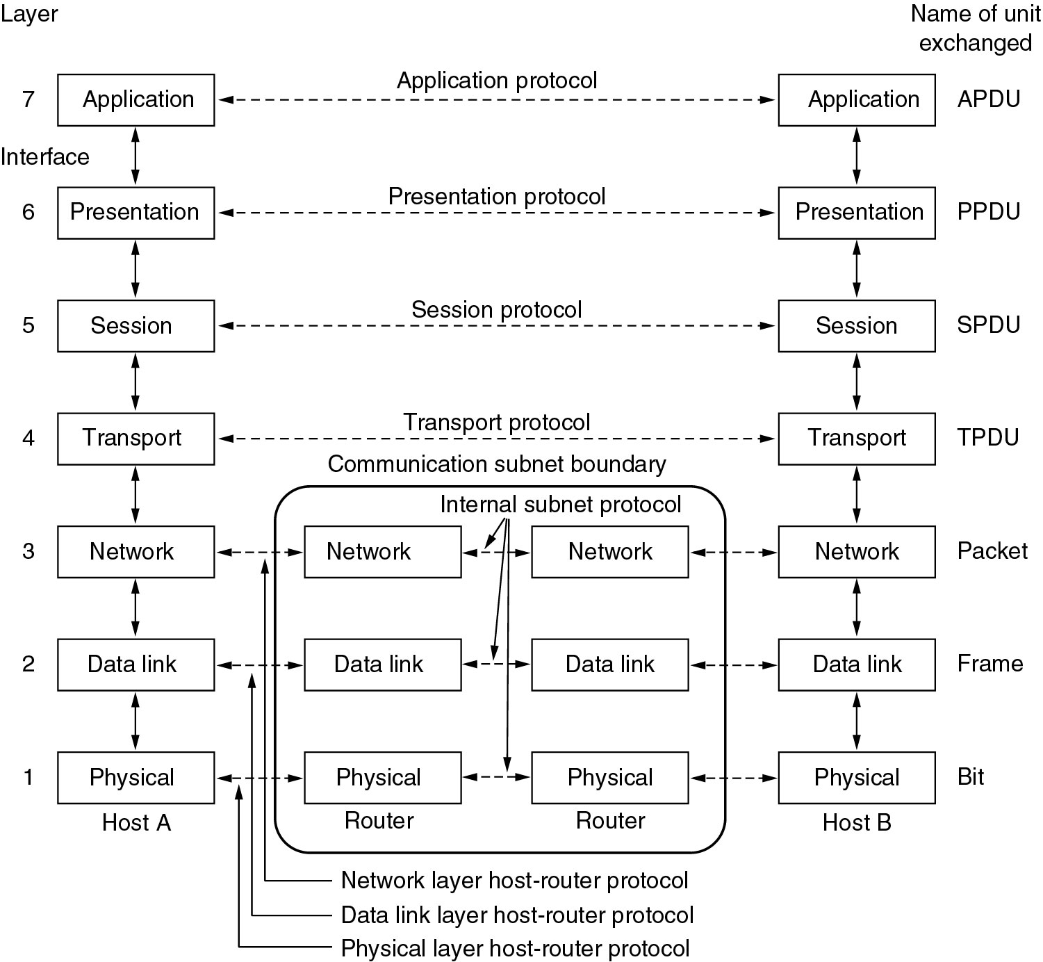
(8.1) The OSI Reference Model

Slide 15
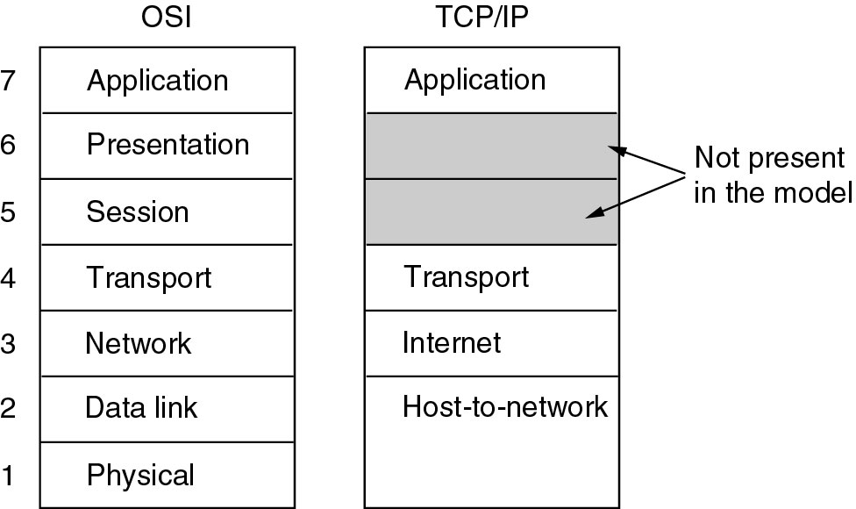
(8.2) The TCP/IP Reference Model (1)

Slide 16
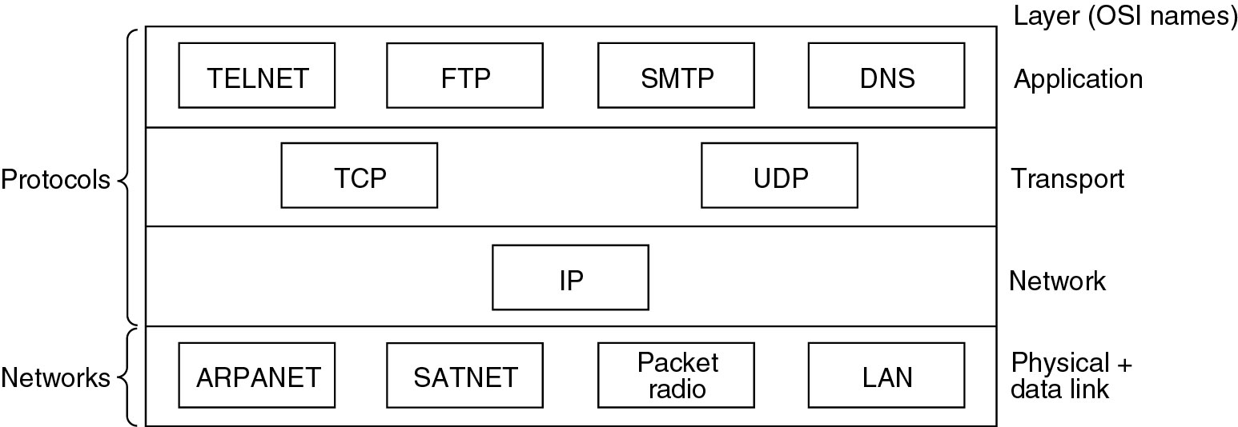
(8.2) The TCP/IP Reference Model (2)
Protocols and networks in the TCP/IP model initially.

Slide 17
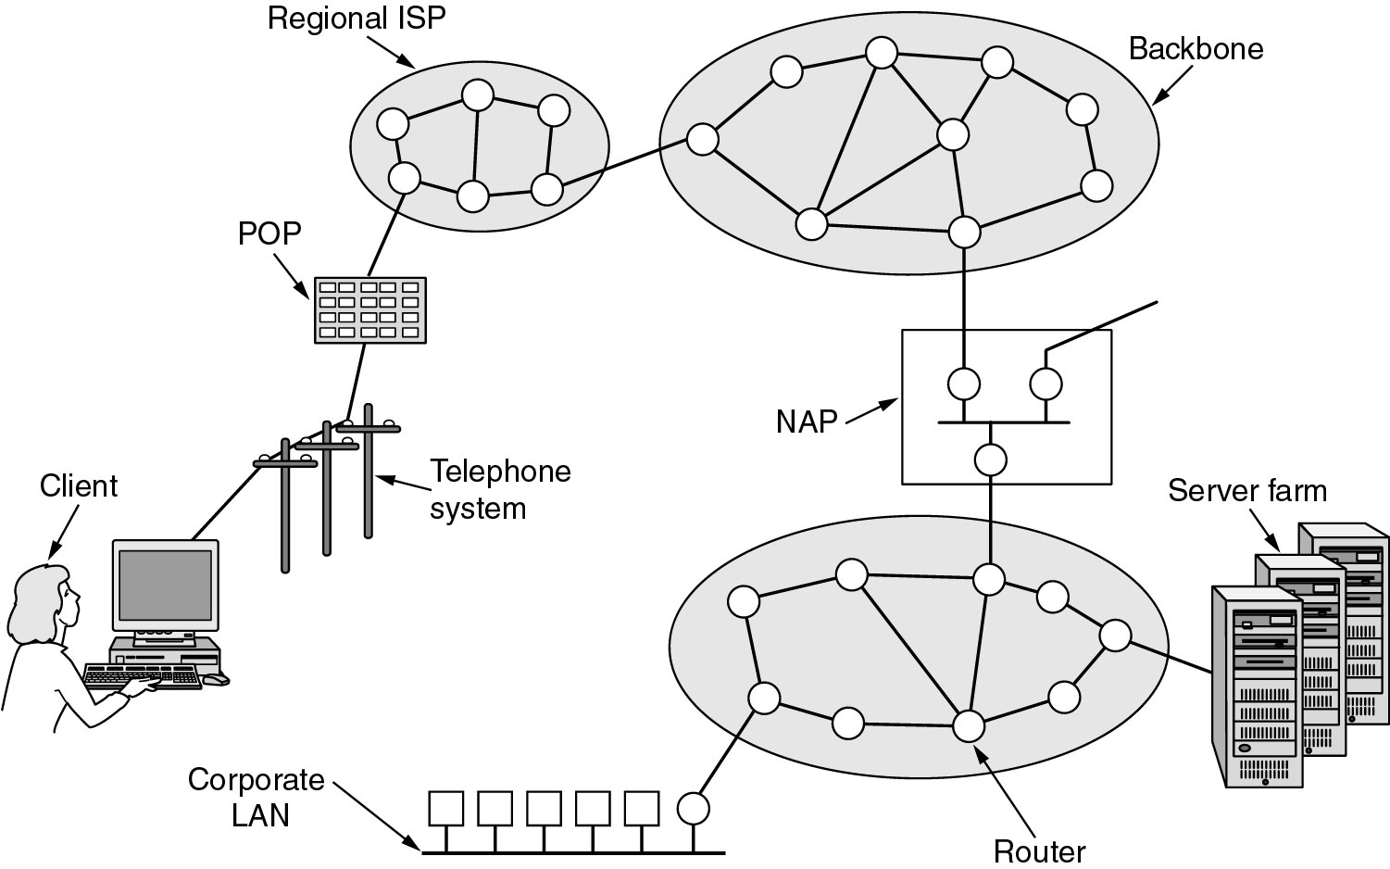
(8.2) The TCP/IP Reference Model (3)
Overview of the Internet.
Notes:
Page <number>
Add a logical view

