Slide 1
Part II: The Application Layer
Example: The World Wide Web
Notes:
Page <number>

Slide 2
Summary
Architecture
The Client Side
The Server Side
URL
HTTP
HTML

Slide 3
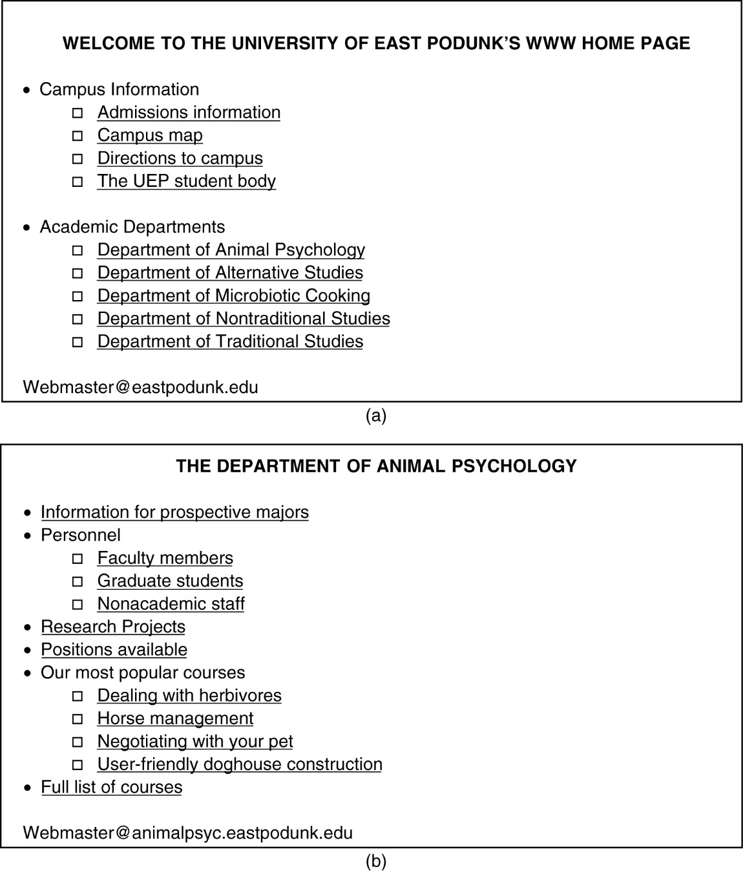
1. Architectural Overview (1)
(a) A Web page (b) The page reached by clicking on
Department of Animal Psychology.

Slide 4
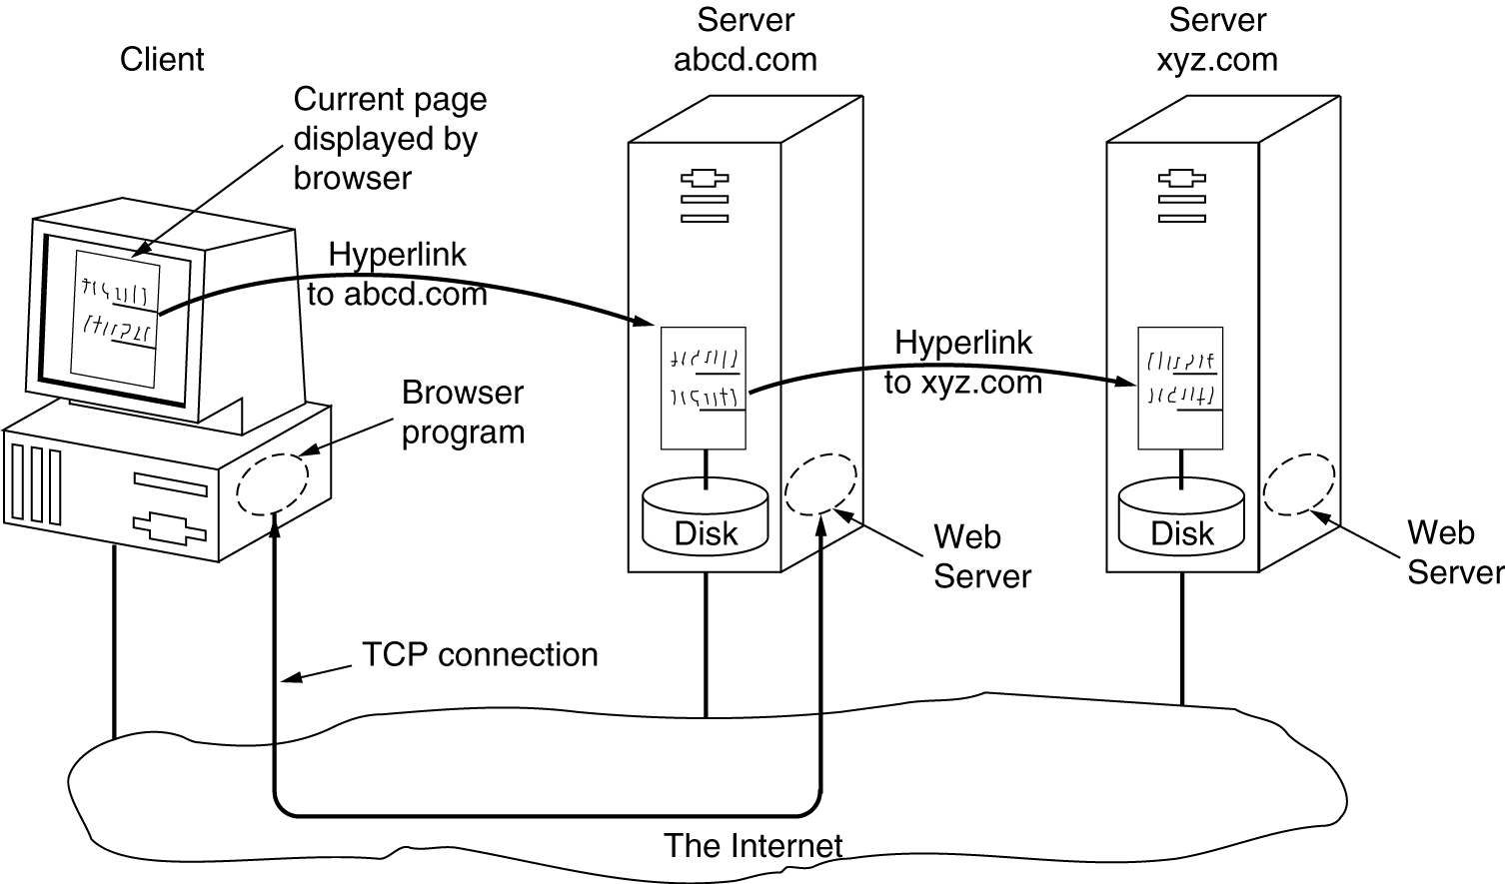
1. Architectural Overview (2)
The parts of the Web model.

Slide 5
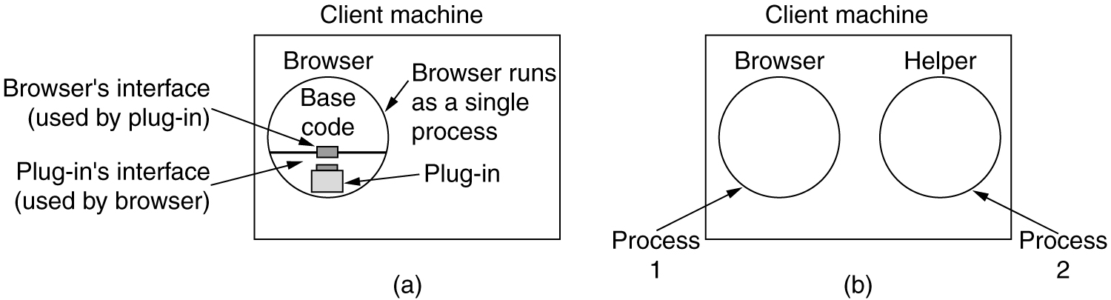
2. The Client Side
(a) A browser plug-in. (b) A helper application.

Slide 6
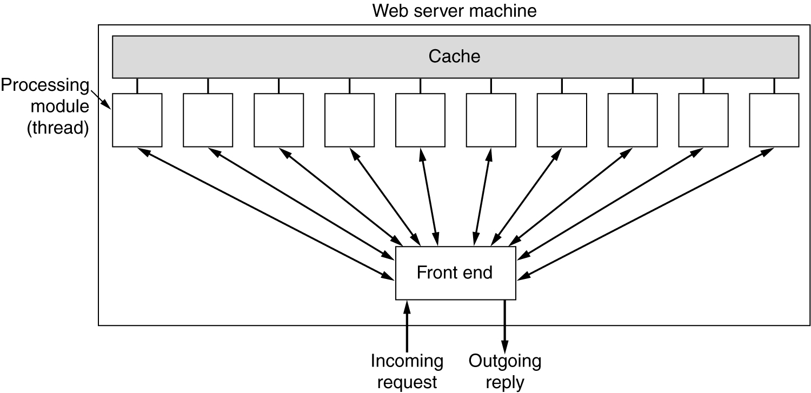
3. The Server Side (1)
A multithreaded Web server with a front end and processing modules.

Slide 7
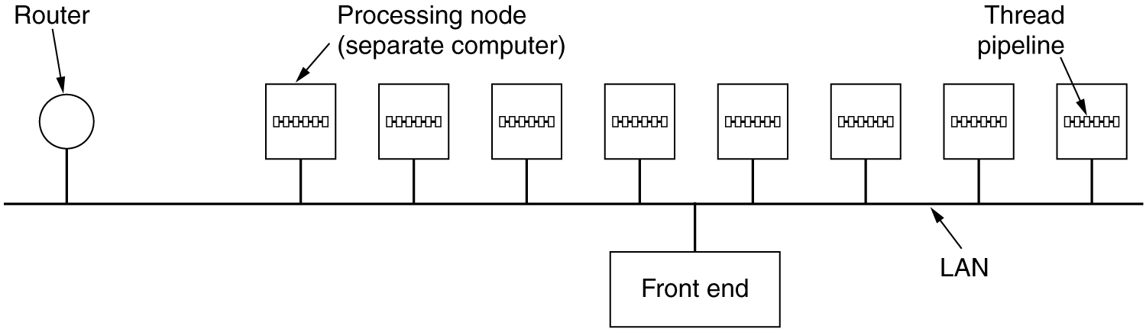
3. The Server Side (2)
A server farm.

Slide 8
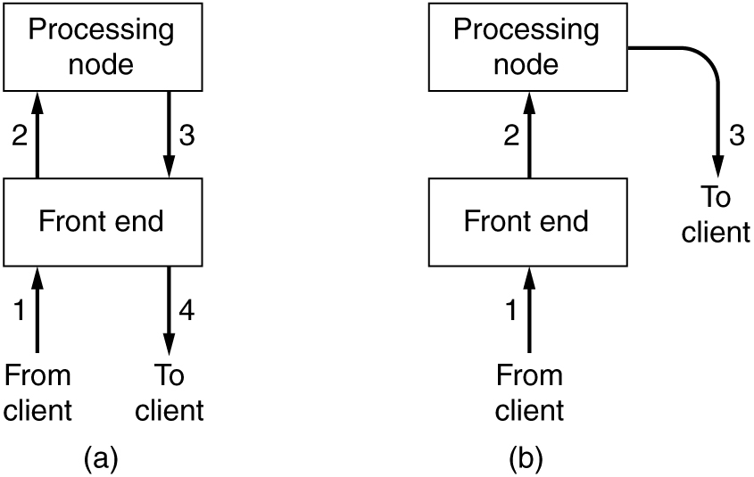
3. The Server Side (3)
(a) Normal request-reply message sequence.
(b) Sequence when TCP handoff is used.

Slide 9
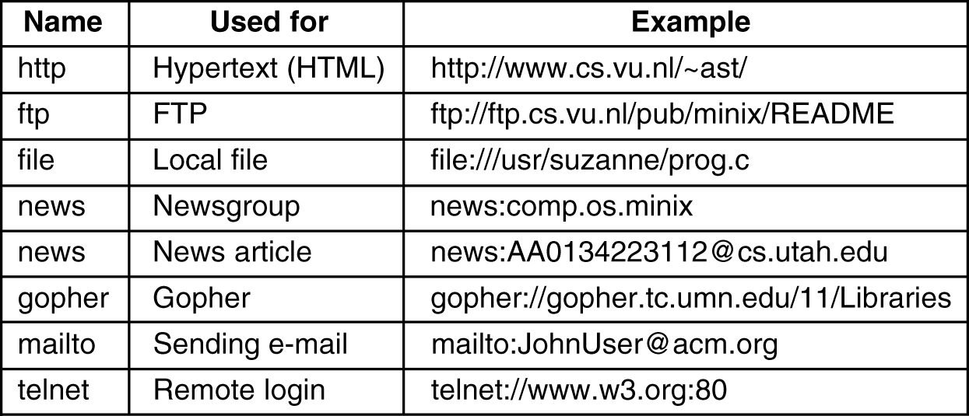
4. URLs – Uniform Resource Locaters
Some common URLs.

Slide 10
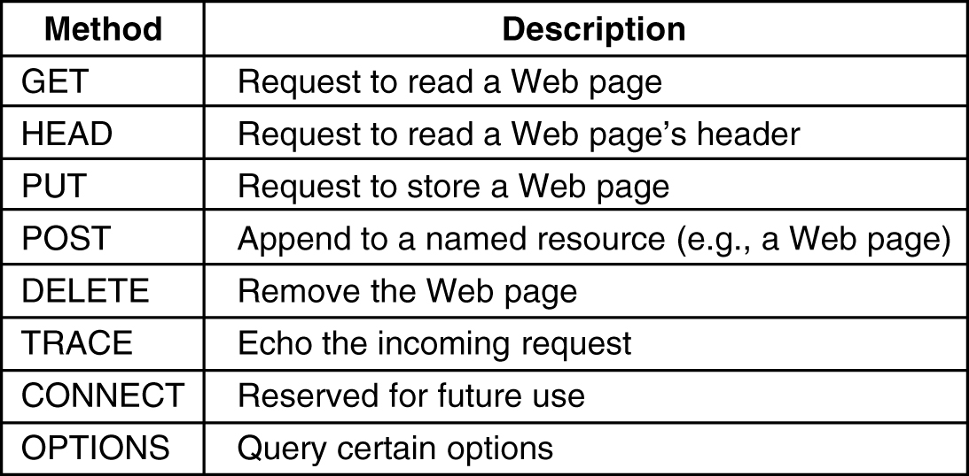
5. HTTP Methods (1)
The built-in HTTP request methods.

Slide 11
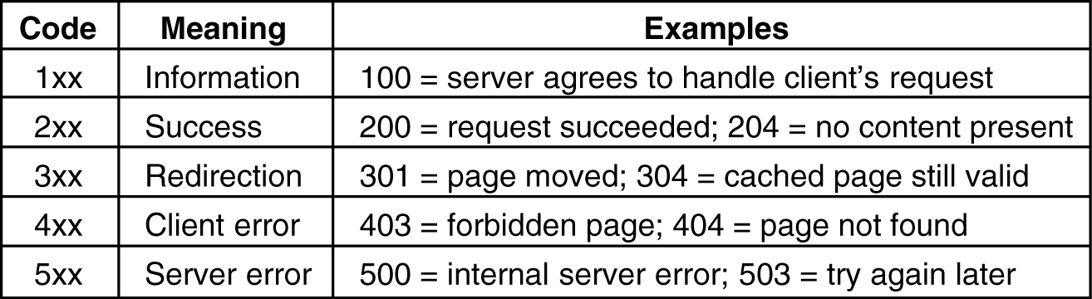
5. HTTP Methods (2)
The status code response groups.

Slide 12
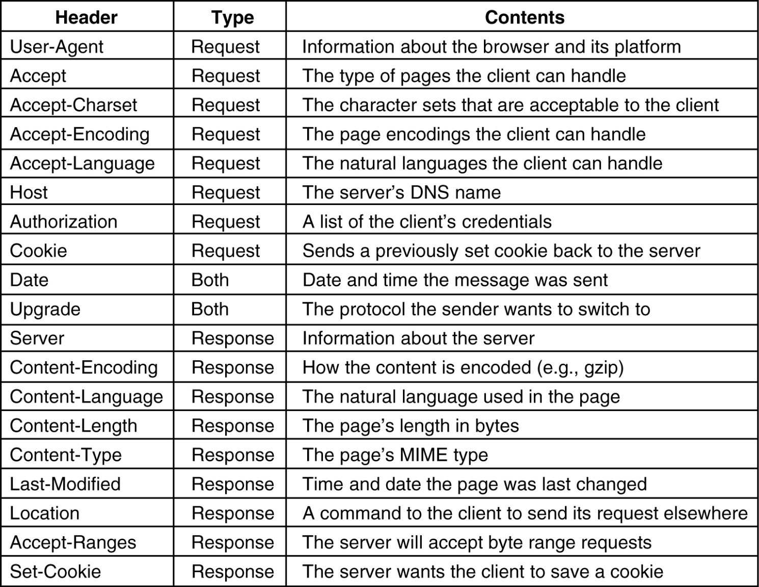
5. HTTP Message Headers (3)
Some HTTP message headers.

Slide 13
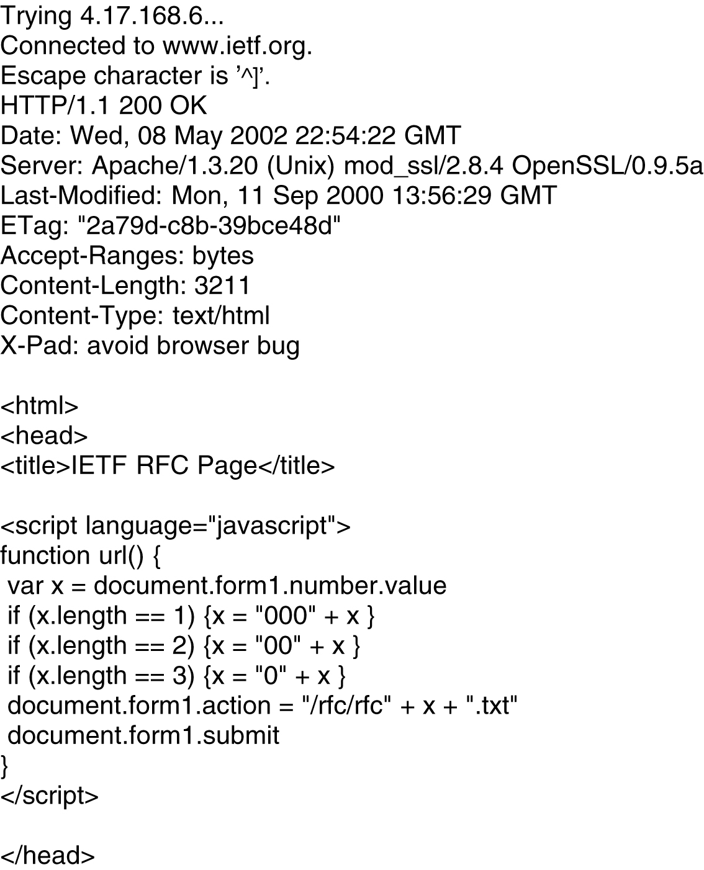
5. Example HTTP Usage (4)
The start of the output of www.ietf.org/rfc.html.

Slide 14
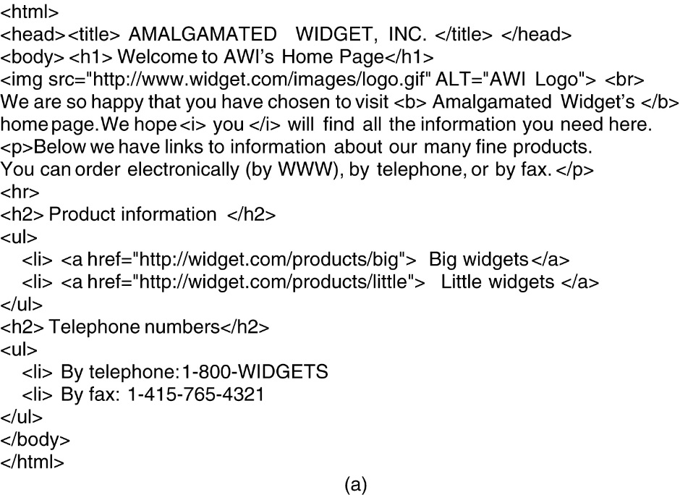
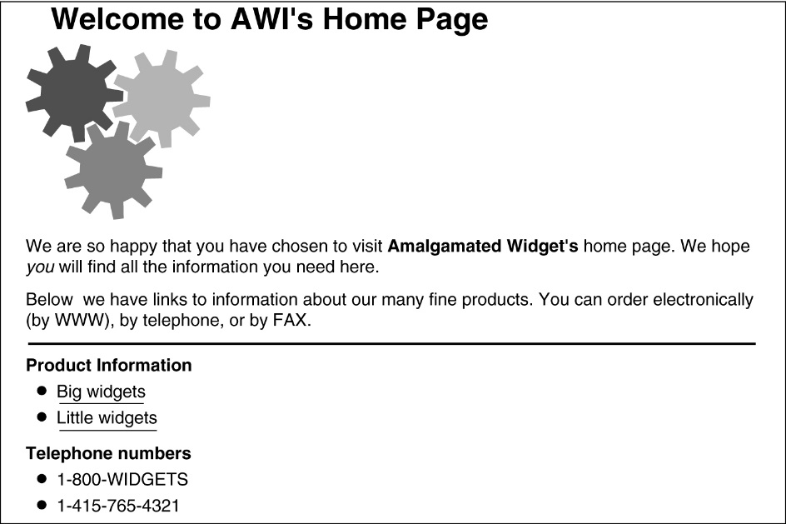
6. HTML – HyperText Markup Language (1)
(b)
(a) The HTML for a sample Web page. (b) The formatted page.

Slide 15
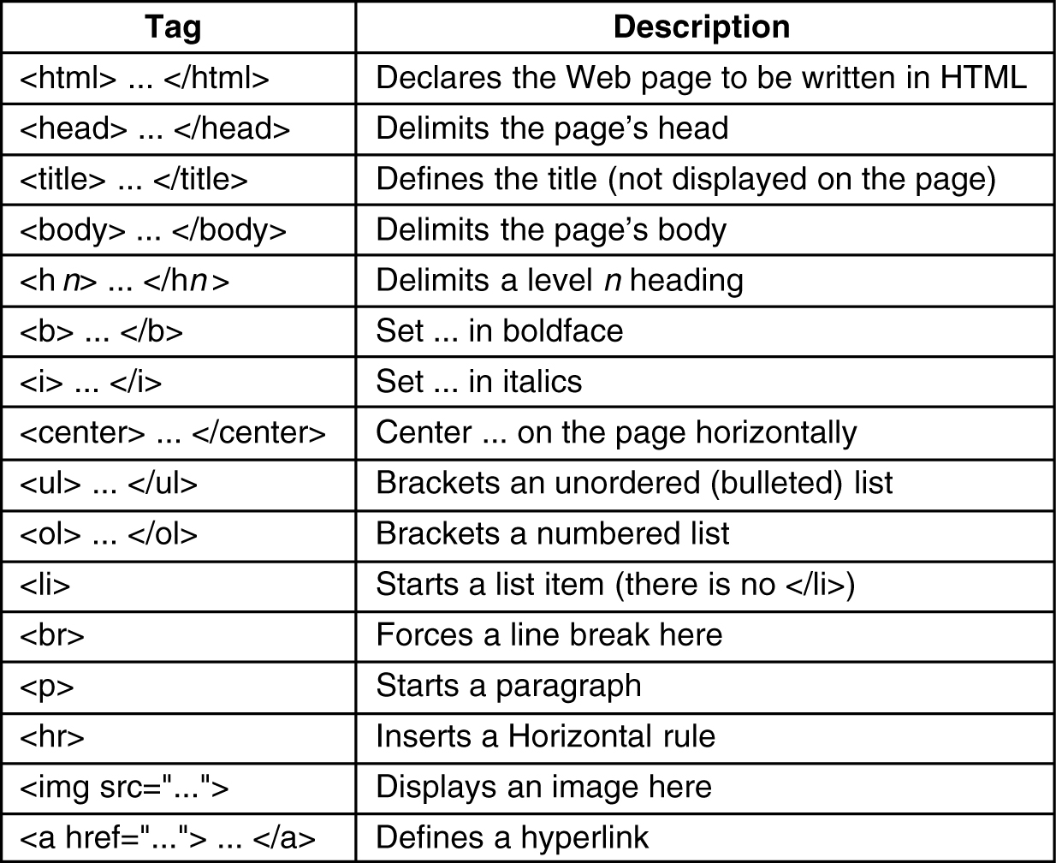
6. HTML (2)
A selection of common HTML tags. some can have additional parameters.

