Slide 1
Part 3: Transport Layer
Notes:
Page <number>

Slide 2
Summary
Part A: Introduction
Part B: Socket
Part C: TCP
Part D: UDP

Slide 3
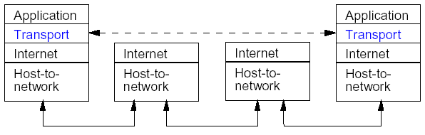
Part A: Introduction
The transport layer is an end-to-end layer – this means that nodes within the subnet do not participate in transport layer protocols – only the end hosts.
As with other layers, transport layer protocols send data as a sequence of packets (segments).
Notes:
Page <number>
In order to implement this algorithm we had to address these six issues.

Slide 4
2. Multiplexing (1)
The network layer provides communication between two hosts.
The transport layer provides communication between two processes running on different hosts.
A process is an instance of a program that is running on a host.
There may be multiple processes communicating between two hosts – for example, there could be a FTP session and a Telnet session between the same two hosts.
Notes:
Page <number>
In order to implement this algorithm we had to address these six issues.

Slide 5
3. Multiplexing (2)
The transport layer provides a way to multiplex / demultiplex communication between various processes.
To provide multiplexing, the transport layer adds an address to each segment indicating the source and destination processes.
Note these addresses need only be unique locally on a given host.
In TCP/IP these transport layer addresses are called port-numbers.
Notes:
Page <number>
In order to implement this algorithm we had to address these six issues.

Slide 6
4. Multiplexing (3)
The 5-tuple: (sending port, sending IP address, destination port, destination IP address, transport layer protocol) uniquely identifies a process-to-process connection in the Internet.
Notes:
Page <number>
In order to implement this algorithm we had to address these six issues.

Slide 7
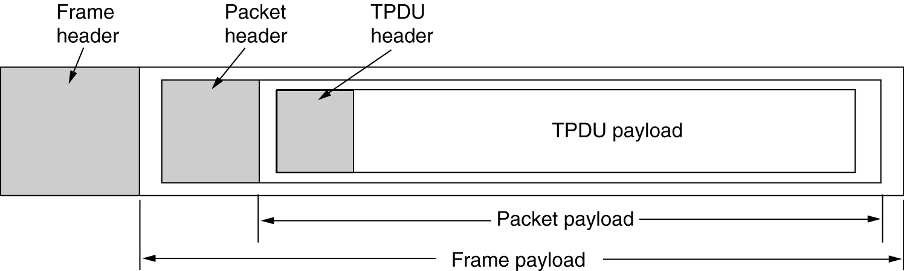
5. TPDU
Nesting of Transport Protocol Data Unit (TPDU), packets, and frames.

Slide 8
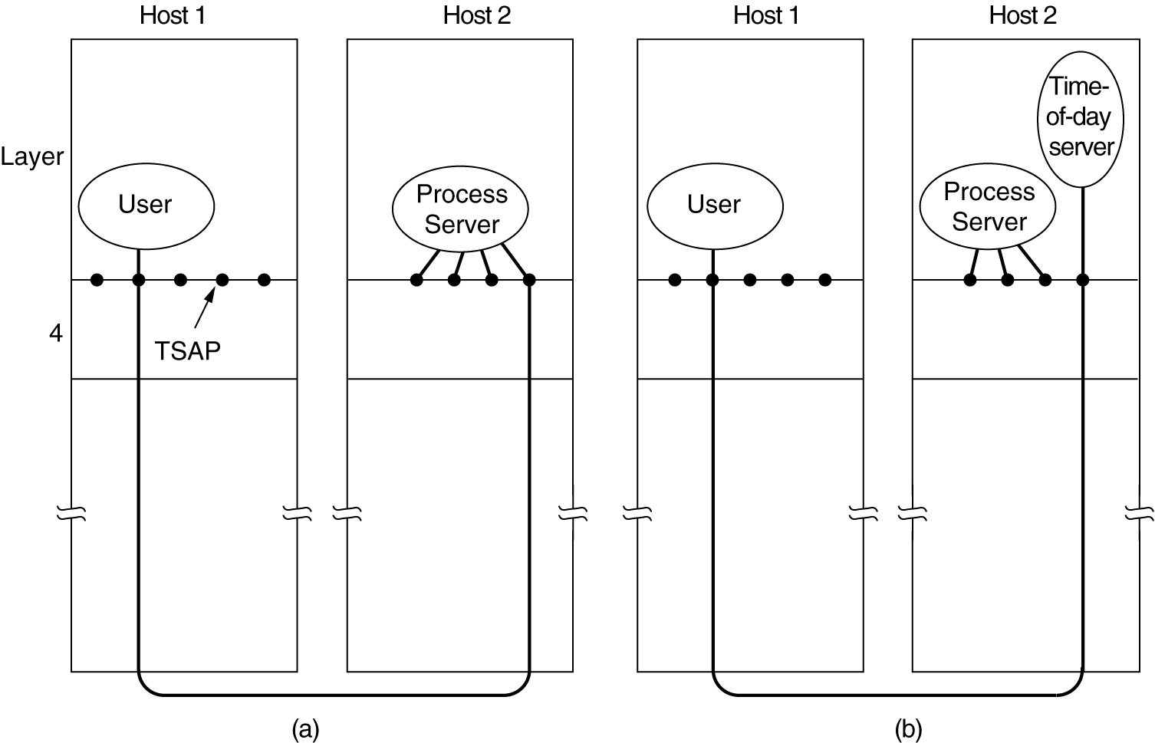
6. Connection Establishment
How a user process in host 1 establishes a connection with a time-of-day server in host 2.

Slide 9
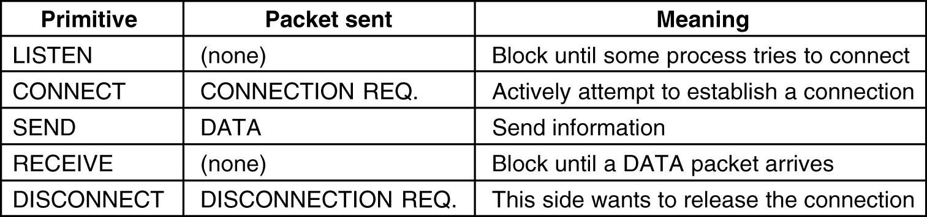
7. Transport Service Primitives
The primitives for a simple transport service.

Slide 10
8. Transport Service Primitives
connum = LISTEN (local)
connum = CONNECT(local, remote)
status = SEND (connum, buffer, bytes)
status = RECEIVE(connum, buffer,bytes)
status = DISCONNECT(connum)
The primitives for a simple transport service.

Slide 11
9. Protocol Stacks
Node
Application
AP
Creates a new end point; allocates table space for it within the transport layer
Socket
interface
Identification of application (port #)
Transport
Network
Identifies the node
Data Link
Frames
NA
NIC card; identified by NIC card address
Notes:
Page <number>
In order to implement this algorithm we had to address these six issues.

Slide 12
PART B: SOCKET
Software interface designed to communicate between the user program and TCP/IP protocol stack
Implemented by a set of library function calls
Socket is a data structure inside the program
Both client and server programs communicate via a pair of sockets

Slide 13
2. Socket Framework
Application Program
User Space
Socket Layer
Kernel Space
TCP
UDP
IP
Physical Network (driver)

Slide 14
3. Socket Families
There are several significant socket domain families:
  Internet Domain Sockets (AF_INET)
    implemented via IP addresses and port numbers
  Unix Domain Sockets (AF_UNIX)
    implemented via filenames (think “named pipe”)
  Novell IPX (AF_IPX)
  AppleTalk DDS (AF_APPLETALK)

Slide 15
4. Type of Socket
Stream (SOCK_STREAM) Uses TCP protocol. Connection-oriented service
Datagram (SOCK_DGRAM) Uses UDP protocol. Connectionless service
Raw (SOCK_RAW) Used for testing

Slide 16
5. Creating a Socket
#include <sys/types.h>
#include <sys/socket.h>
int socket(int domain, int type, int protocol);
domain is one of the Protocol Families (PF_INET, PF_UNIX, etc.)
type defines the communication protocol semantics, usually defines either:
  SOCK_STREAM: connection-oriented stream (TCP)
  SOCK_DGRAM: connectionless, unreliable (UDP)
protocol specifies a particular protocol, just set this to 0 to accept the default
Notes:
Page <number>
In order to implement this algorithm we had to address these six issues.

Slide 17
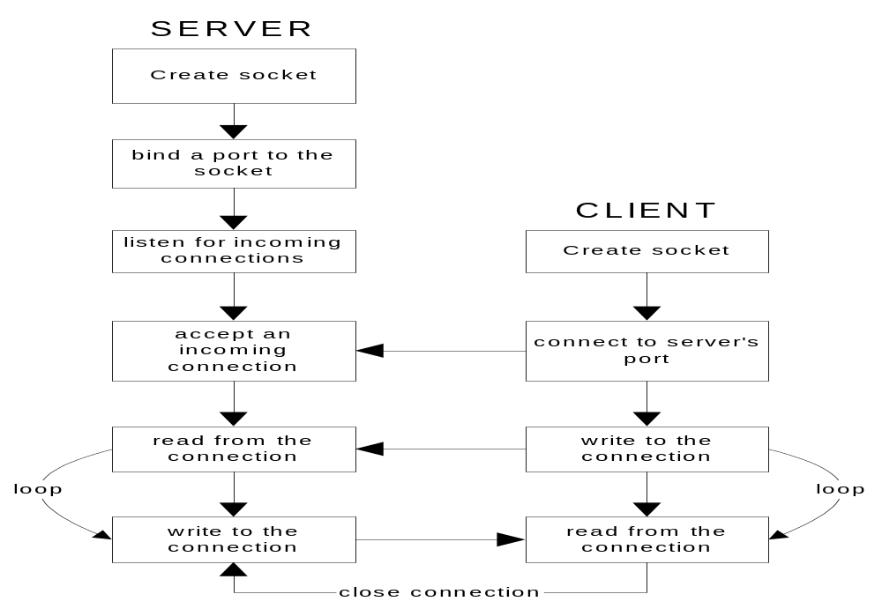
6. TCP Client/Server
Notes:
Page <number>
In order to implement this algorithm we had to address these six issues.

Slide 18
7. TCP Server
Sequence of calls
sock_init() Create the socket
bind() Register port with the system
listen() Establish client connection
accept() Accept client connection
read/write read/write data
close() shutdown

Slide 19
8. TCP Client
Sequence of calls
sock_init () Create socket
connect() Set up connection
write/read write/read data
close() Shutdown

Slide 20
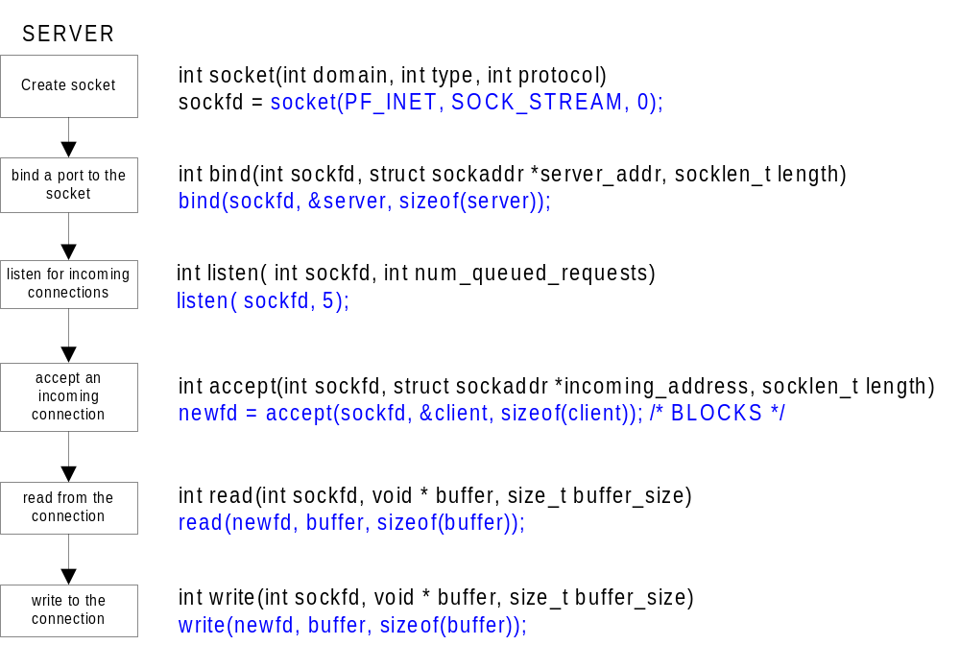
9. Server Side Socket Details
Notes:
Page <number>
In order to implement this algorithm we had to address these six issues.

Slide 21
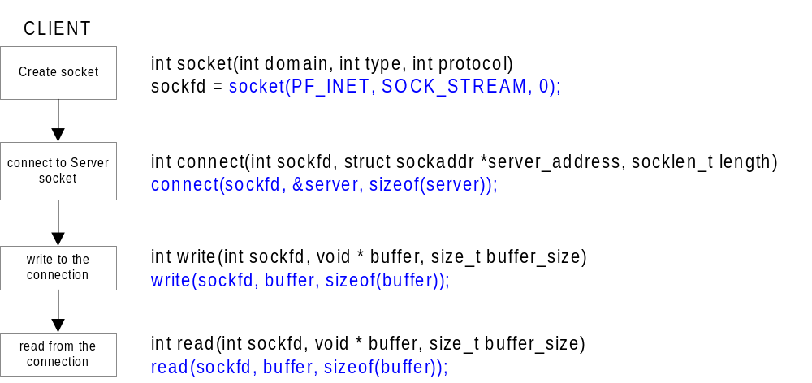
10. Client Side Socket Details
Notes:
Page <number>
In order to implement this algorithm we had to address these six issues.

Slide 22
11. UDP Clients and Servers
Connectionless clients and servers create a socket using SOCK_DGRAM instead of SOCK_STREAM
Connectionless servers do not call listen() or accept(), and usually do not call connect()
Since connectionless communications lack a sustained connection, several methods are available that allow you to specify a destination address with every call:
  sendto(sock, buffer, buflen, flags, to_addr, tolen);
  recvfrom(sock, buffer, buflen, flags, from_addr, fromlen);

Slide 23
12. UDP Server
Sequence of calls
sock_init() Create socket
bind() Register port with the system
recfrom/sendto Receive/send data
close() Shutdown

Slide 24
13. UDP Client
Sequence of calls
socket_init() Create socket
sendto/recfrom send/receive data
close() Shutdown

Slide 25
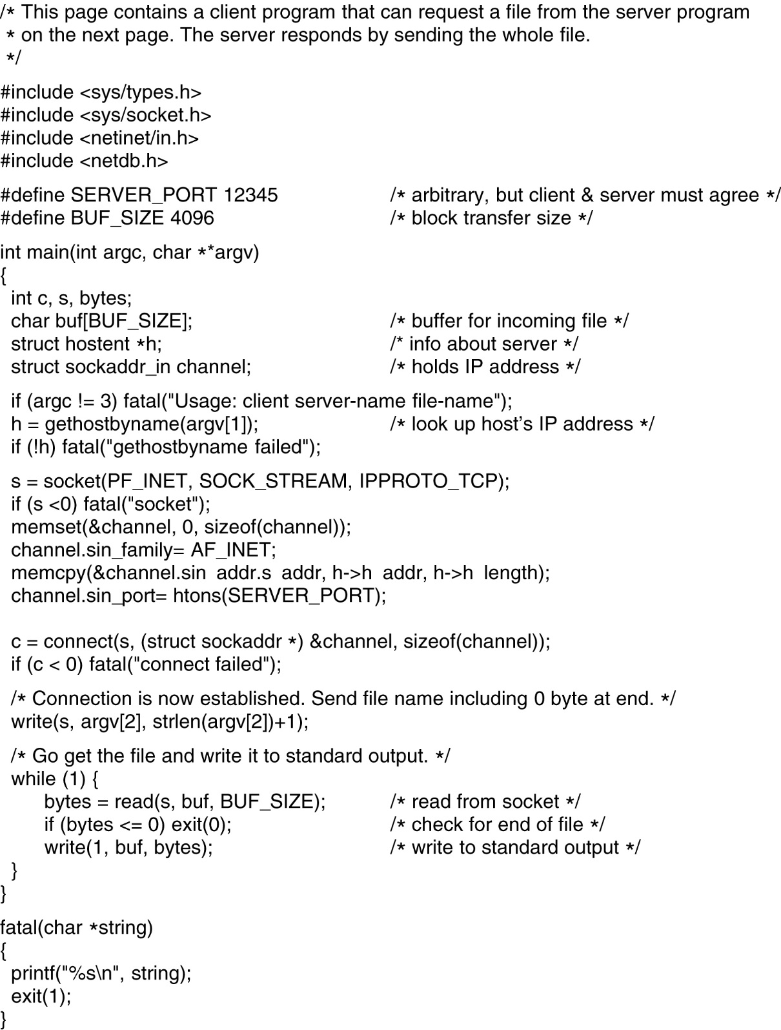
14. Socket Programming Example:
Internet File Server
6-6-1
Client code using sockets.

Slide 26
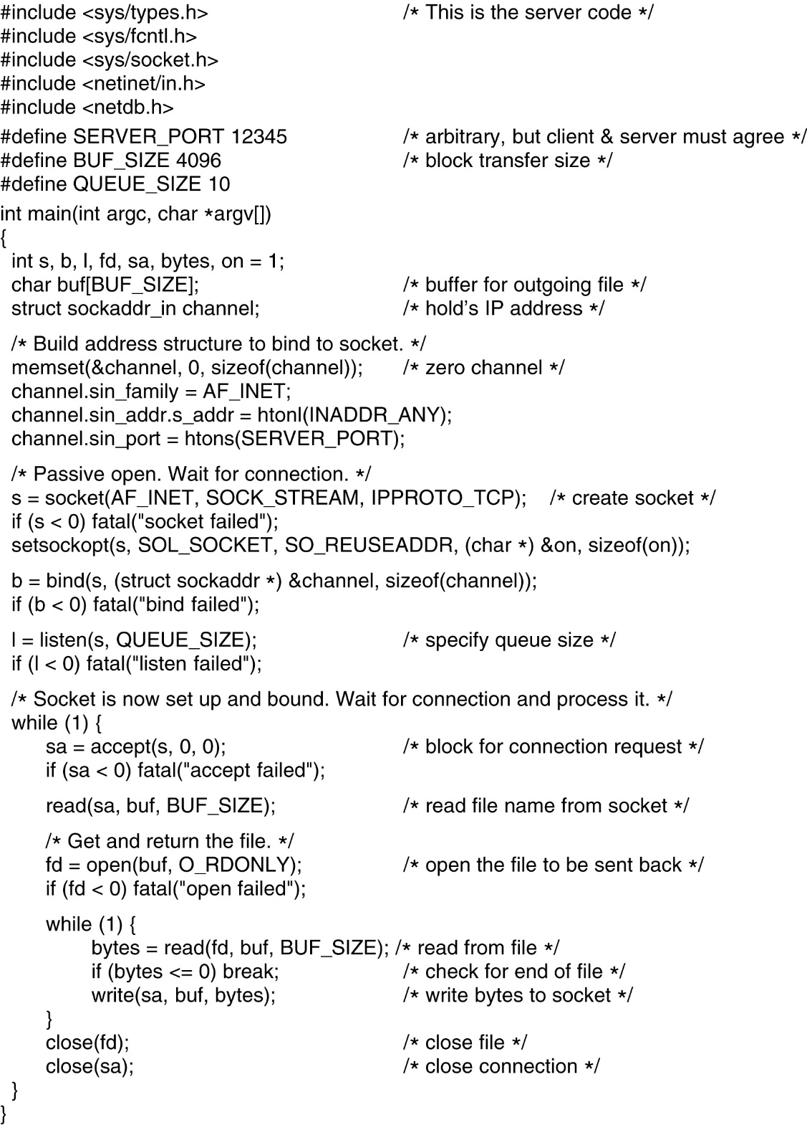
15. Socket Programming Example:
Internet File Server (2)
Server code using sockets.

Slide 27
PART C: TCP

Slide 28
2. Introduction
connection oriented.
full duplex.
TCP Services:
Reliable transport
Flow control
Congestion control
UDP does not provide any of these services
Notes:
Page <number>
In order to implement this algorithm we had to address these six issues.

Slide 29
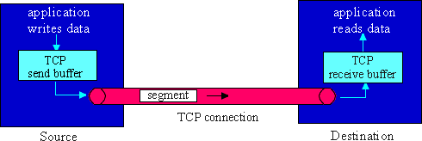
3. Flow of TCP Segments
Notes:
Page <number>
In order to implement this algorithm we had to address these six issues.

Slide 30
4. TCP Services (1)
TCP converts the unreliable, best effort service of IP into a reliable service, i.e., it ensures that each segment is delivered correctly, only once, and in order.
Converting an unreliable connection into a reliable connection is basically the same problem we have considered at the data link layer, and essentially the same solution is used:
TCP numbers each segment and uses an ARQ protocol to recover lost segments.
→Some versions of TCP implement Go Back N and other versions implement Selective Repeat.
Notes:
Page <number>
In order to implement this algorithm we had to address these six issues.

Slide 31
5. TCP Services (2)
However, there are a few important differences between the transport layer and the data link layer.
→ At the data link layer, we viewed an ARQ protocol as being operated between two nodes connected by a point-to-point link.
→ At the transport layer, this protocol is implemented between two hosts connected over network.
→ Packets can arrive out-of-order, and packets may also be stored in buffers within the network and then arrive at much later times.
→ The round-trip time will change with different connections and connection establishment is more complicated.
Notes:
Page <number>
In order to implement this algorithm we had to address these six issues.

Slide 32
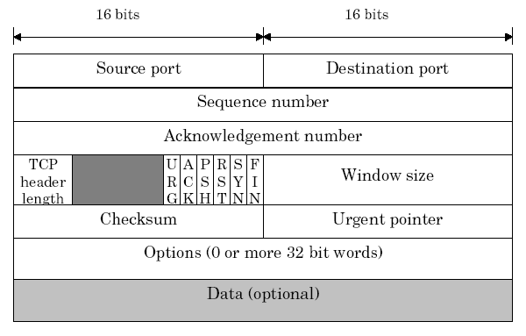
6. TCP Header
Notes:
Page <number>
In order to implement this algorithm we had to address these six issues.

Slide 33
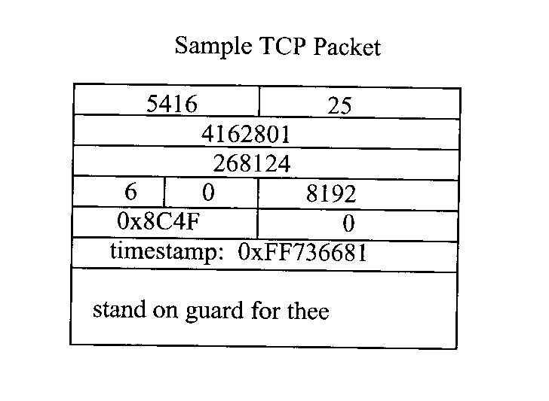
7. Sample TCP Packet

Slide 34
8. TCP Connection Establishment
Active participant
Passive participant
(client)
(server)
SYN, SequenceNum =
x
SYN+ACK, SequenceNum=y,
Acknowledgment =x+1
ACK, Acknowledgment =y+1

Slide 35

9. Closing a TCP Connection (1)
client closes socket: clientSocket.close();
Step 1: client end system sends TCP FIN control segment to server
Step 2: server receives FIN, replies with ACK. Closes connection, sends FIN.
client
server
close
FIN
ACK
close
FIN
ACK
timed wait
closed

Slide 36
10. Closing a TCP Connection (2)
Step 3: client receives FIN, replies with ACK.
  Enters “timed wait” - will respond with ACK to received FINs
Step 4: server, receives ACK. Connection closed.
Note: with small modification, can handle simultaneous FINs.
client
server
closing
FIN
ACK
closing
FIN
ACK
timed wait
closed
closed

Slide 37
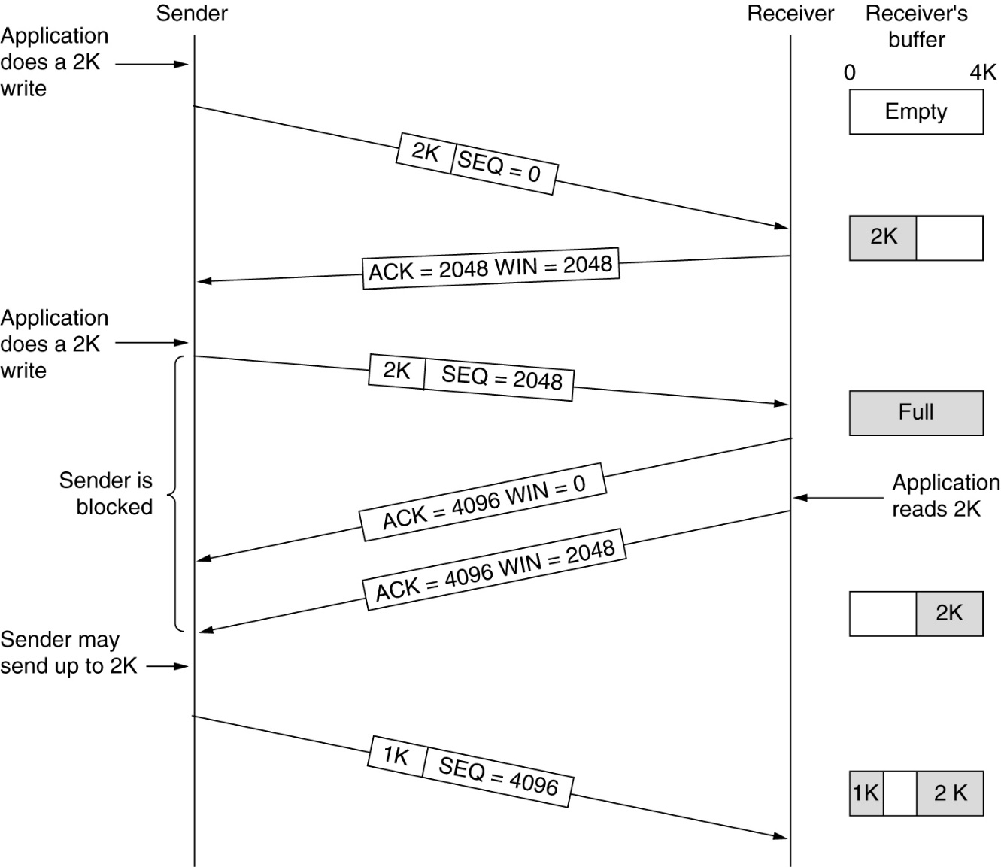
11. TCP Transmission Policy
Window management in TCP.

Slide 38
12. Flow Control and Congestion Control (1)
In a network, it is often desirable to limit the rate at which a source can send traffic into the subnet.
If this is not done and sources send at too high of a rate, then buffers within the network will fill-up resulting in long delays and eventually packets being dropped.
Moreover as packets gets dropped, retransmission may occur, leading to even more traffic.
When sources are not regulated this can lead to congestion collapse of the network, where very little traffic is delivered to the destination.
Notes:
Page <number>
In order to implement this algorithm we had to address these six issues.

Slide 39
13. Flow Control and Congestion Control (2)
Two different factors can limit the rate at which a source sends data.
→ the inability of the destination to accept new data.
Techniques that address this are referred to as
flow control.
the number of packets within the subnet.
Techniques that address this are referred to as
congestion control.
Notes:
Page <number>
In order to implement this algorithm we had to address these six issues.

Slide 40
14. Flow Control and Congestion Control (3)
Flow control and congestion control can be addressed at the transport layer, but may also be addressed at other layers.
For example, some DLL protocols perform flow control on each link. And some congestion control approaches
are done at the network layer.
Both flow control and congestion control are part of TCP.
Notes:
Page <number>
In order to implement this algorithm we had to address these six issues.

Slide 41
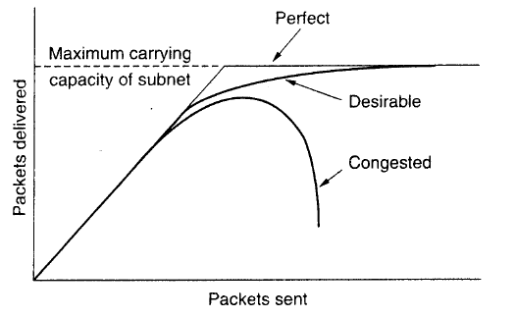
15. Congestion (1)
Congestion arises when the total load on the network becomes too large. This
leads to queues building up and to long delays (recall the M/G/1 model). If
sources retransmit messages, then this can lead to even more congestion and
eventually to congestion collapse. This is illustrated in the figure below.
Notice, as the offered load increase, the number of packets delivered at first
increases, but at high enough loads, this rapidly decreases.
Notes:
Page <number>
In order to implement this algorithm we had to address these six issues.

Slide 42
16. Congestion (2)
Notice, as the offered load increase, the number of packets delivered at first increases, but at high enough loads, this rapidly decreases.
Notes:
Page <number>
In order to implement this algorithm we had to address these six issues.

Slide 43
17. Approaches to Congestion Control (1)
Congestion control may be addressed at both the network level and the transport layer.
At the network layer possible approaches include
Packet dropping → when a buffer becomes full a router can drop waiting packets - if not coupled with some other technique, this can lead to greater congestion through retransmissions.
Packet scheduling → certain scheduling policies may help in avoiding congestion - in particular scheduling can help to isolate users that are transmitting at a high rate.
Notes:
Page <number>
In order to implement this algorithm we had to address these six issues.

Slide 44
18. Approaches to Congestion Control (2)
Dynamic routing → when a link becomes congested, change the routing to avoid this link - this only helps up to a point (eventually all links become congested) and can lead to instabilities
Admission control/Traffic policing - Only allow connections in if the network can handle them and make sure that admitted sessions do not send at too high of a rate - only useful for connection-oriented
networks.
Notes:
Page <number>
In order to implement this algorithm we had to address these six issues.

Slide 45
19. Approaches to Congestion Control (3)
An approach that can be used at either the network or transport layers is
Rate control → this refers to techniques where the source rate is explicitly controlled based on feedback from either the network and/or the receiver.
For example, routers in the network may send a source a "choke packet" upon becoming congested. When receiving such a packet, the source should
lower it rate.
Notes:
Page <number>
In order to implement this algorithm we had to address these six issues.

Slide 46
20. Approaches to Congestion Control (4)
These approaches can be classified as either "congestion avoidance" approaches, if they try to prevent congestion from ever occurring, or as "congestion recovery" approaches, if they wait until congestion occurs and then react to it. In general, “better to prevent than to recover."
Different networks have used various combinations of all these approaches.
Traditionally, rate control at the transport layer has been used in the Internet, but new approaches are beginning to be used that incorporate some of the network layer techniques discussed above.
Notes:
Page <number>
In order to implement this algorithm we had to address these six issues.

Slide 47
21. Congestion Control in TCP
TCP implements end-to-end congestion control. TCP detects congestion via the ACK's from the sliding-window ARQ algorithm used for providing reliable service.
When the source times out before receiving an ACK, the most likely reason is because a link became congested. TCP uses this as an indication of congestion. In this case, TCP will slow down the transmission rate.
TCP controls the transmission rate of a source by varying the window size used in the sliding window protocol.
Notes:
Page <number>
In order to implement this algorithm we had to address these six issues.

Slide 48
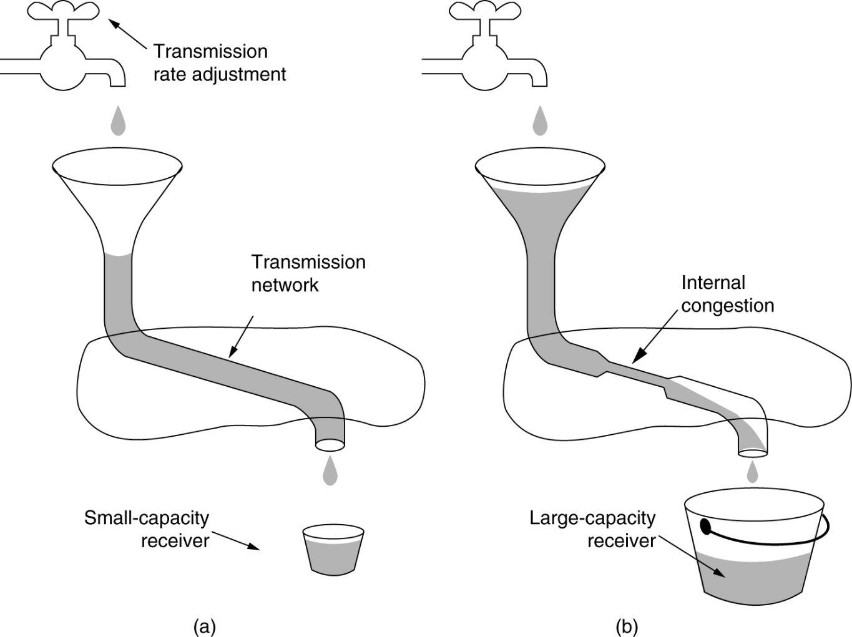
22. TCP Flow control versus Congestion Control

Slide 49


23. Slow Start
Initial CW = 1.
After each ACK, CW += 1;
Continue until:
  Loss occurs OR
  CW > slow start threshold
Then switch to congestion avoidance
If we detect loss, cut CW in half
Exponential increase in window size per RTT
sender
receiver
one segment
RTT
two segments
four segments
time

Slide 50
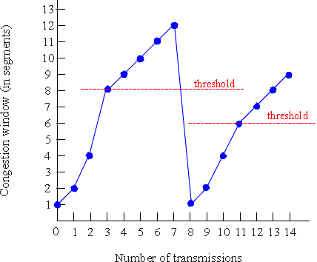
24. Congestion Avoidance
Until (loss) {
after CW packets ACKed:
CW += 1;
}
ssthresh = CW/2;
Depending on loss type:
SACK/Fast Retransmit:
CW/= 2; continue;
Course grained timeout:
CW = 1; go to slow start.
(This is for TCP Reno/SACK: TCP Tahoe always sets CW=1 after a loss)

Slide 51
25. How are losses recovered?
Say packet is lost (data or ACK!)
Coarse-grained Timeout:
  Sender does not receive ACK after some period of time
  Event is called a retransmission time-out (RTO)
  RTO value is based on estimated round-trip time (RTT)
  RTT is adjusted over time using exponential weighted moving average:
  RTT = (1-x)*RTT + (x)*sample
  (x is typically 0.1)
  First done in TCP Tahoe
sender
receiver
Seq=92, 8 bytes data
timeout
ACK=100
X
loss
Seq=92, 8 bytes data
ACK=100
time
lost ACK scenario

Slide 52
26. Fast Retransmit
Receiver expects N, gets N+1:
  Immediately sends ACK(N)
  This is called a duplicate ACK
  Does NOT delay ACKs here!
  Continue sending dup ACKs for each subsequent packet (not N)
Sender gets 3 duplicate ACKs:
  Infers N is lost and resends
  3 chosen so out-of-order packets don’t trigger Fast Retransmit accidentally
  Called “fast” since we don’t need to wait for a full RTT
sender
receiver
ACK 3000
SEQ=3000, size=1000
X
SEQ=4000
SEQ=5000
SEQ=6000
ACK 3000
ACK 3000
ACK 3000
SEQ=3000, size=1000
time
Introduced in TCP Reno

Slide 53
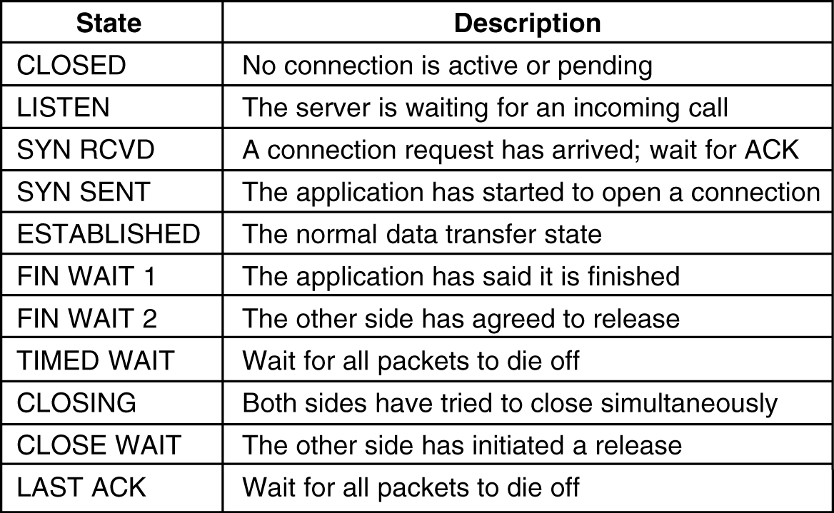
TCP Connection Management Modeling
The states used in the TCP connection management finite state machine.

Slide 54
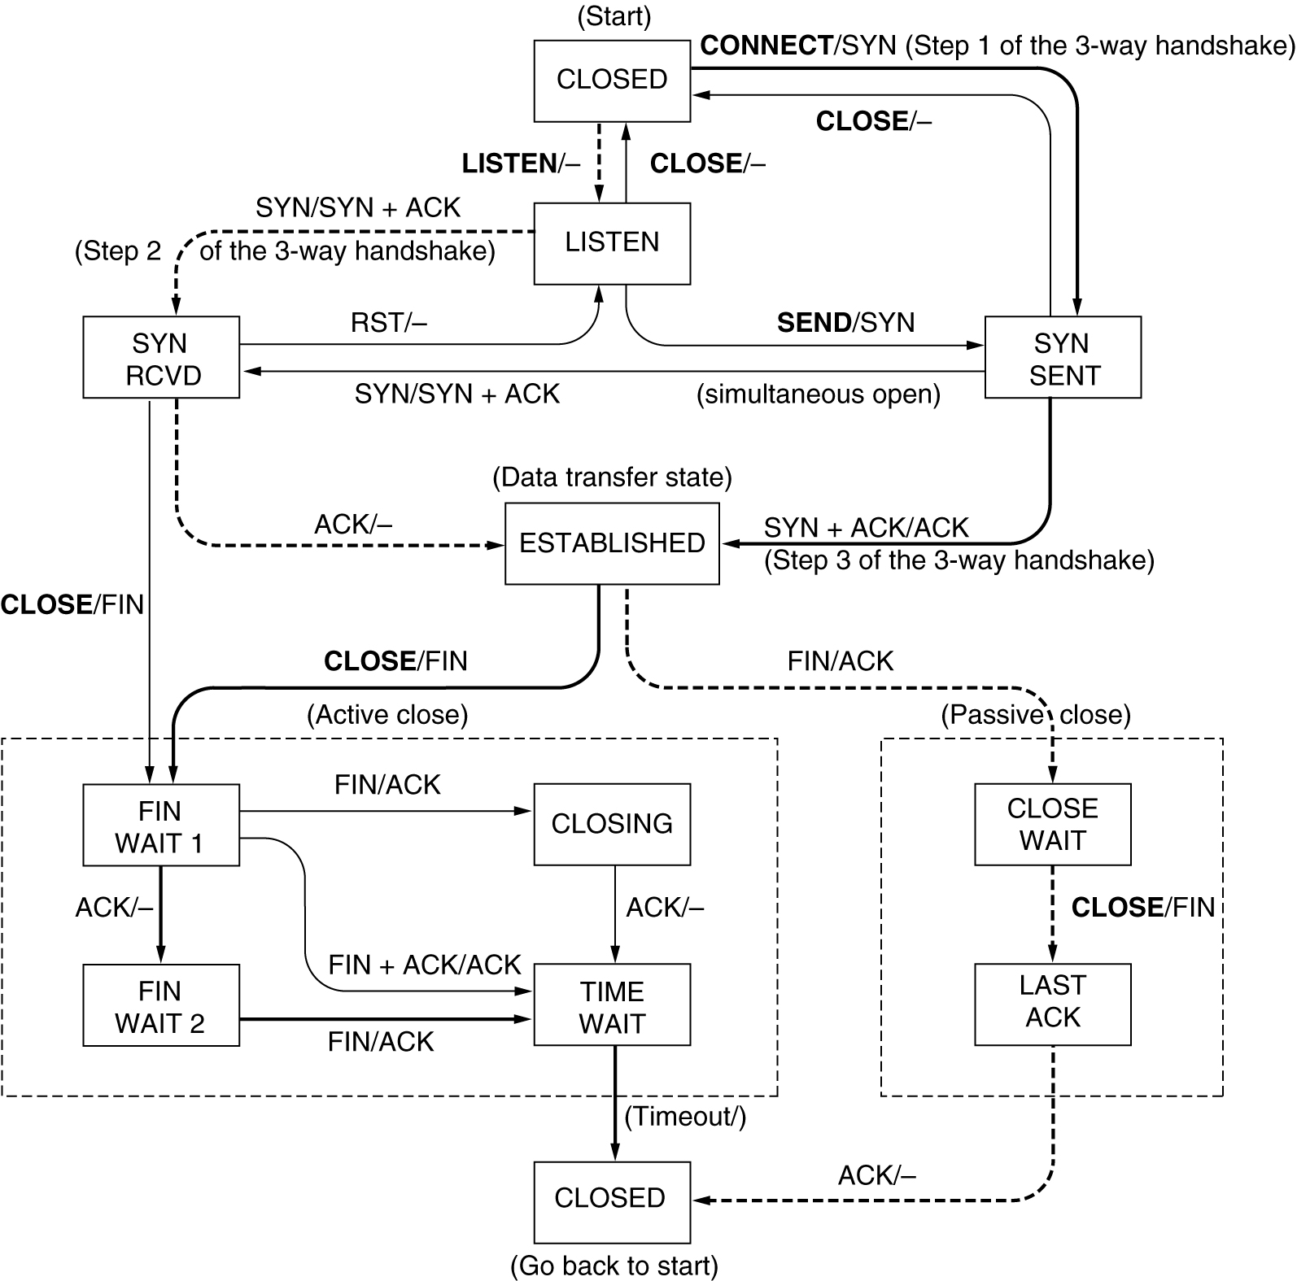
TCP Connection Management Modeling (2)

Slide 55
PART D: UDP
UDP (User Datagram Protocol) → unreliable, connectionless; No TCP’s flow control; applications where prompt delivery more important than accurate delivery (speech, video, …)
(Metaphor: postal service)

Slide 56
2. UDP (2)
Datagram protocol → it does not have to establish a connection to another machine before sending data.
Takes the data an application provides,
Packs it into a UDP packet
Hands it to the IP layer.
The packet is then put on the wire, and that is where it ends.
There is no way to guarantee that the packet will reach its destination.
Notes:
Page <number>
In order to implement this algorithm we had to address these six issues.

Slide 57
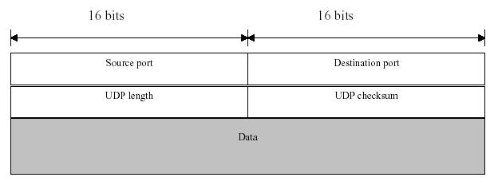
3. UDP Packet
Basically all UDP provides is a multiplexing capability on top of IP.
The length field gives the length of the entire packet including the header.
The checksum is calculated on the entire packet
(and also on part of the IP header).
Calculating the checksum is optional, and if an error is detected the packet may be discarded or may be passed on to the application with an error flag.
Notes:
Page <number>
In order to implement this algorithm we had to address these six issues.

