Slide 1
SIMULATION OF A TIRE USING PARTICLES
Jeroen Huisen
Navid Saremi

Slide 2
Initial modeling
Tire with deformation based on air pressure
Solid wheel base with attachments to the inside of the tire
Spring connecting the tire system to the body of the car
Removing collision between wheel-base, axel, and the tire
The tire is the only object that interacts with the environment

Slide 3
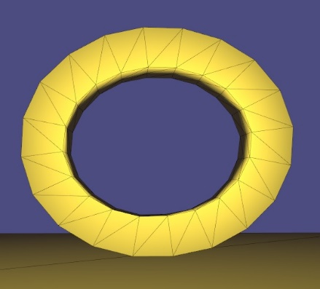
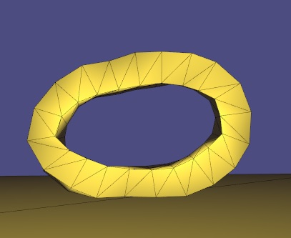
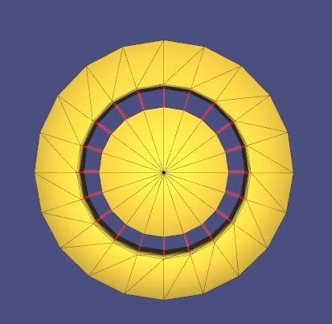
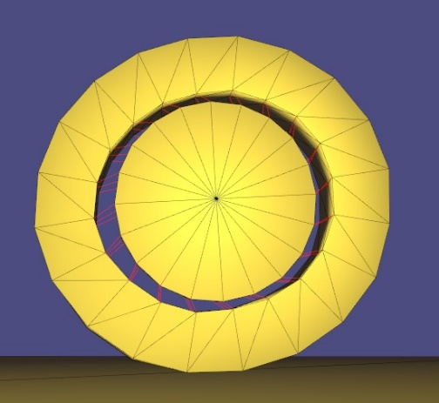
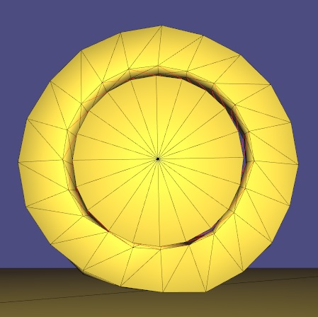
Connections
Intra-Tire : rigidity based on tire pressure
Simulating pressure
No expansion allowed only compression
Attachments to the axel

Slide 4
Tire pressure
Limiting the maximum length based on pressure
Using air particles in the middle of tire
Using rigidity as a pressure presentation
Restricting expansion
Inner circle should not compress ( attachments )

Slide 5
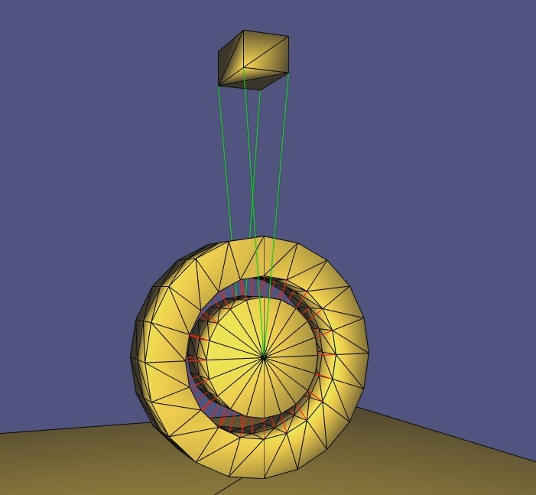
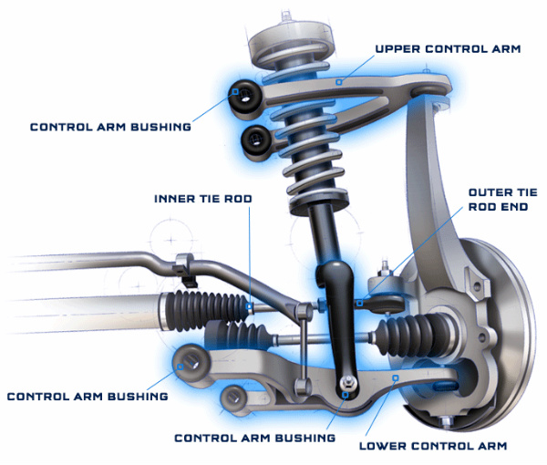
Spring simulation
4 springs all with dampening (theoretically)
1 object to represent the mass of the car

Slide 6




Spring
Formula
Convert

Slide 7
Spring damping
Infinitely oscillating
Fdamp = C * (V1 – V2)
Amplitude sinus decrease over time

Slide 8

Questions?

