Slide 1
Secure File Transfer Monitoring System
Defensive file activity monitoring
Internship Project — [Your Name]
[Company] · [Supervisor] · [Date]

Slide 2
Problem
File movement can be hard to audit across local folders.
Sensitive files need clear path policy and integrity checks.
This project creates readable local evidence for review.

Slide 3
Objectives
Log create, copy-like, move, delete, and modify events.
Alert on sensitive and external-zone movement.
Compare hashes and report audit results.

Slide 4
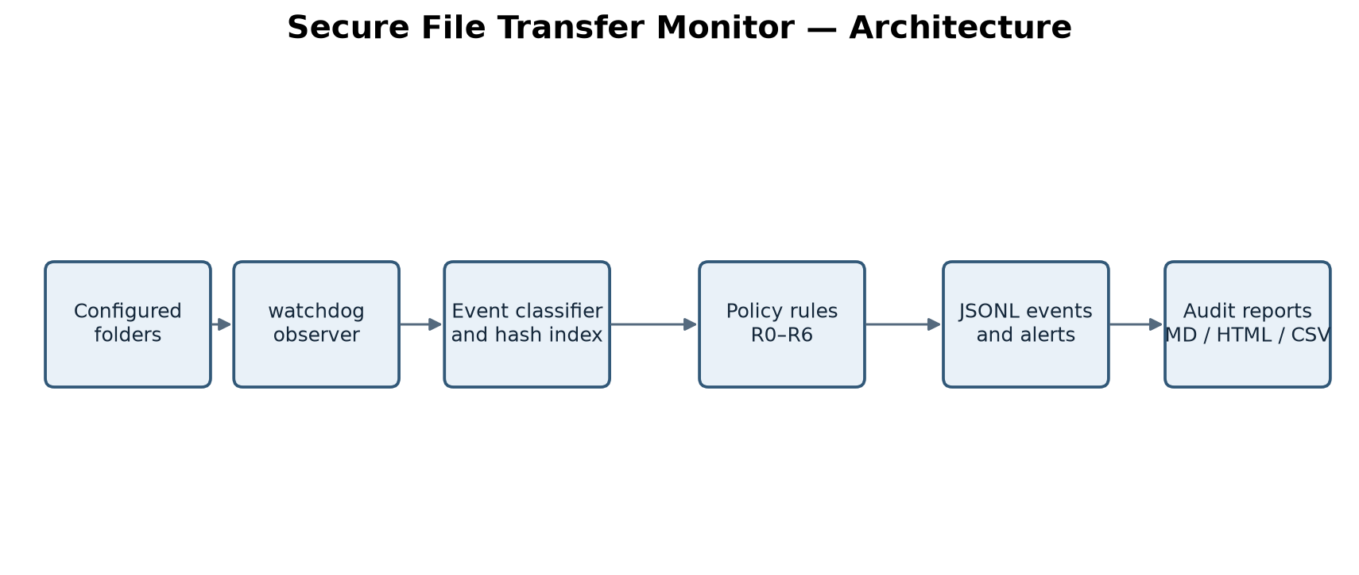
Architecture

Slide 5
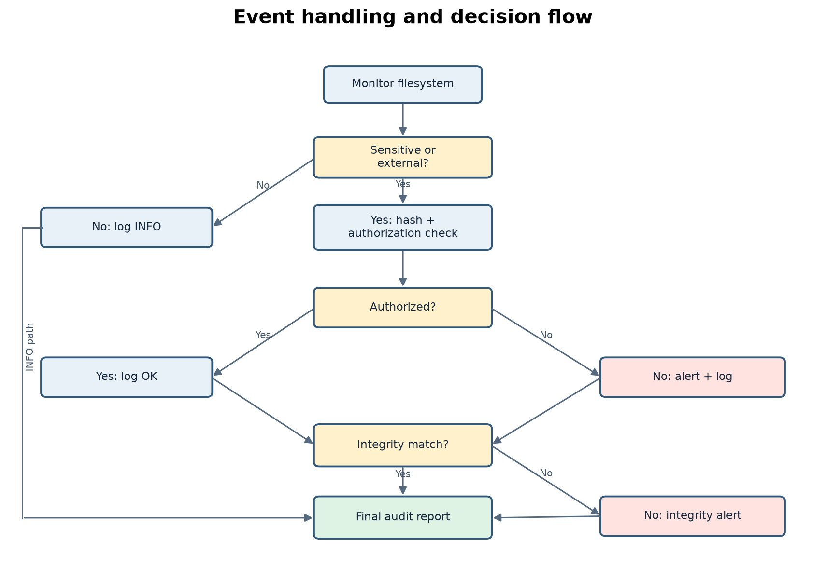
Workflow

Slide 6
Detection rules
R1/R2: unapproved and external-zone movement.
R3: SHA-256 mismatch; R4: bulk transfer window.
R5/R6: sensitive deletion and unauthorized user.
R0: ordinary or approved activity.

Slide 7
Demo scenarios
Approved backup and ordinary internal copy.
USB, cloud, network share, and unknown-folder movement.
Changed copy, in-place tamper, and sensitive deletion.
Two hundred tiny files in one destination window.

Slide 8
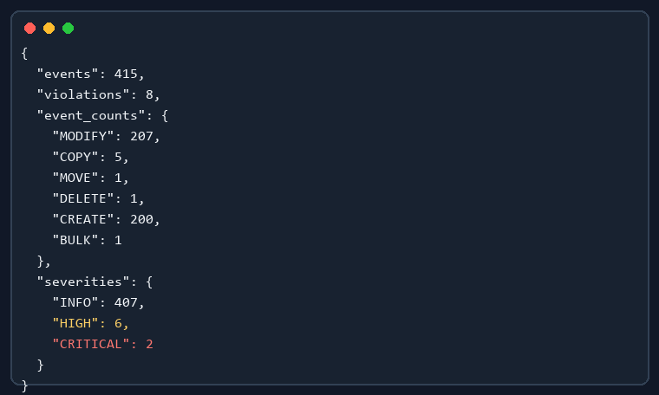
Observed results
415 event records in the latest clean run.
Required USB, integrity, and bulk alerts appeared.
Markdown, standalone HTML, and CSV reports were generated.

Slide 9
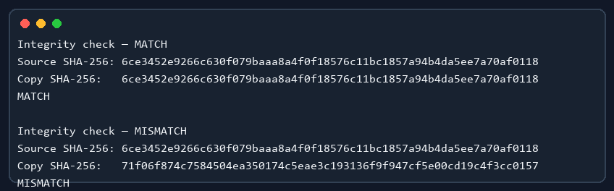
Integrity evidence
MATCH: correct copy has the same SHA-256.
MISMATCH: altered dummy copy has a different SHA-256.
Before/after values are saved in evidence/integrity.

Slide 10
Testing
Automated suite covers hash, policy, rules, copy inference, reports, and watchdog events.
Two test transcripts and two clean demo runs are kept under evidence/.
Acceptance checklist verifies 14 scenarios/objective checks.

Slide 11
Limitations and conclusion
Path-based external zones; no network-protocol inspection.
Process attribution and filesystem events vary by platform.
Windows verified here; Linux/macOS need their own run.
A small, explainable monitor with repeatable audit evidence.

