Slide 1
OrderManager
A Database for Managing Products and Orders - JDBC
By: Yongliang(Sean) Tan & Yuzhou Wu
https://github.ccs.neu.edu/seantanty/cs5200_OrderManager_Project_Yongliang_Tan_and_Yuzhou_Wu

Slide 2
Agenda
1. Design(Data Definition Language)
Requirements
Decisions and assumptions
Specific design issues
Functions
Data Manipulate Language
Data Query Language
Testing
Top Level Document
Future: Issues and Improvements

Slide 3
Design - Requirements
Background : This is project is a database portion of a an application for managing products, product inventory, and customer orders for an online store.
Database system used: JDBC – Derby.
Key aspects:
manage information about products that can be sold to customers
track current inventories of products
process orders for products from customers

Slide 4
Design - Requirements
Product: SKU is a 12-character value of the form AA-NNNNNN-CC where A is an upper-case letter, N is a digit from 0-9, and C is either a digit or an upper case letter. For example, "AB-123456-0N“
InventoryRecord: price per unit for the current inventory is a positive number with 2 digits after the decimal place
Customer: payment information is not part of this database
Order:
shipment date(date format, null means not shipped yet)
All items must be available in a single transaction to place an order**
OrderRecord: the item must be available and the inventory is automatically reduced when an order record is created for an order

Slide 5
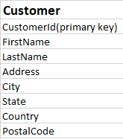
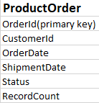

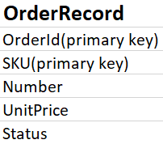

Design - Decisions and assumptions
Table Relations
On delete cascade
On delete cascade
On delete cascade
On delete cascade

Slide 6
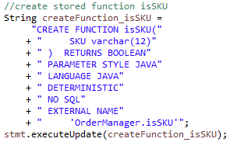

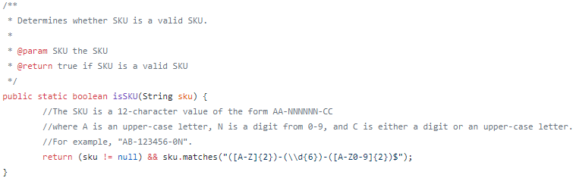
Design - Decisions and assumptions
Data type and stored functions

Slide 7
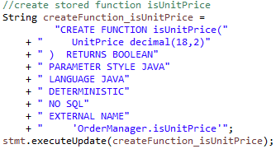
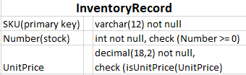
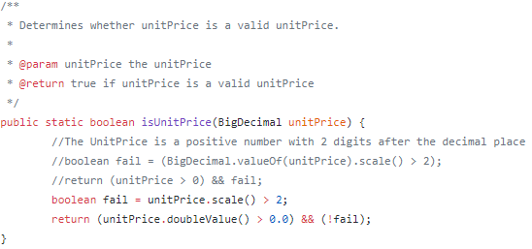
Design - Decisions and assumptions
Data type and stored functions
Unit price: default in USD

Slide 8
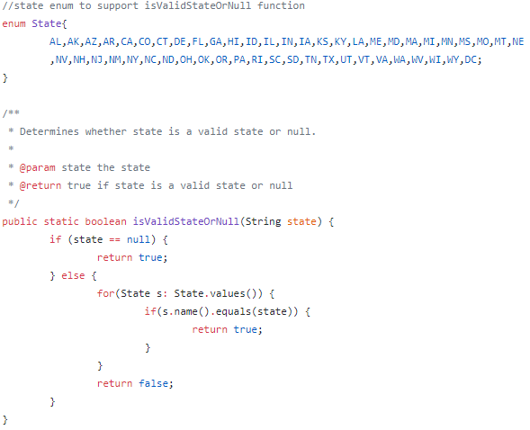
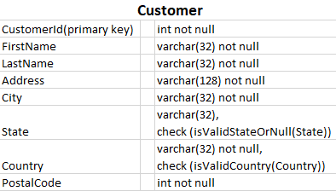
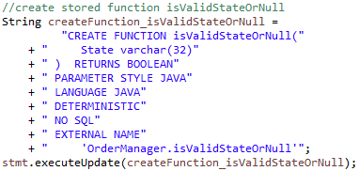
Design - Decisions and assumptions
Data type and stored functions

Slide 9
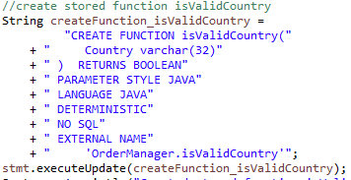
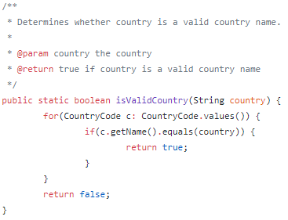
Design - Decisions and assumptions
Data type and stored functions
https://github.com/TakahikoKawasaki/nv-i18n

Slide 10
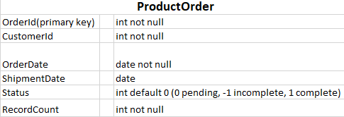
Design - Decisions and assumptions
Data type and stored functions

Slide 11
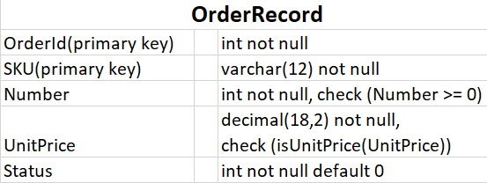
Design - Decisions and assumptions
Data type and stored functions

Slide 12
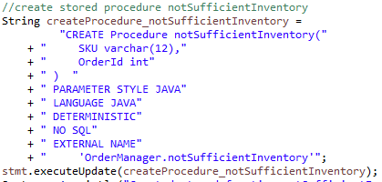
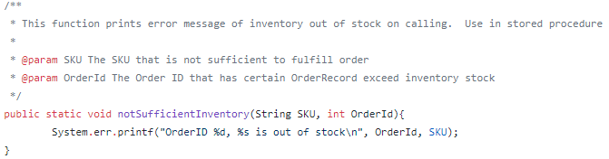
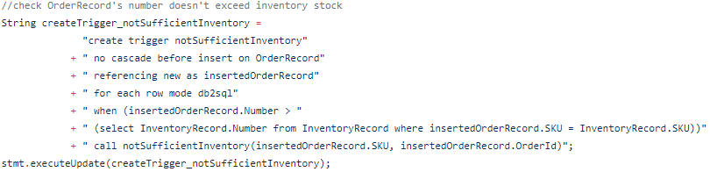
Design - Decisions and assumptions
Triggers & Stored procedure
https://db.apache.org/derby/docs/10.2/ref/

Slide 13
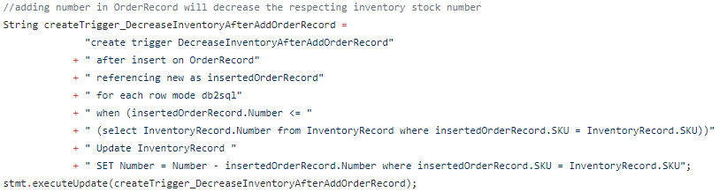
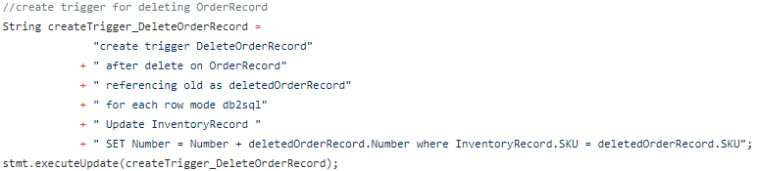
Design - Decisions and assumptions
Triggers & Stored procedure

Slide 14
Design - Specific design issues
Restrictions:
Deleting of Products, Inventory, and Customer should be strictly restricted
Order: All items must be available in a single transaction to place an order
Decided to add status field instead, let customer could order the products with sufficient inventory
The orderrecords which exceed current inventory stock will store in system, but that order will be marked as incompelte
Could add an email notification function later to enhance the sale

Slide 15
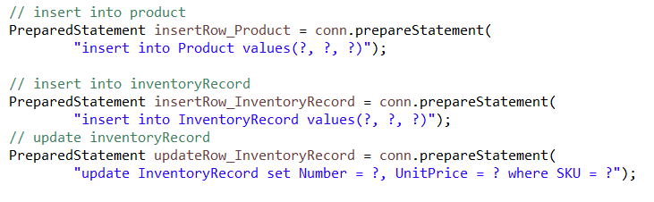
Function - Data Manipulate Language
Product aspect
addProduct: Insert data into table ‘Product’
addInventory: Insert data into table ‘InventoryRecord’
updateInventory: Update data in the table ‘InventoryRecord’
eg. Change price, add inventory number

Slide 16
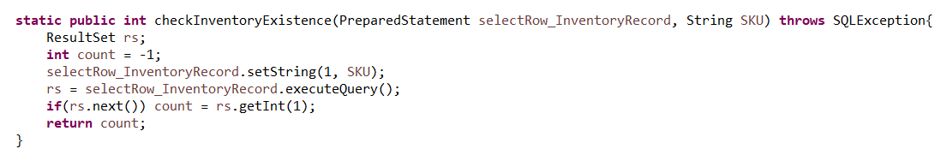

Function - Data Manipulate Language
Product aspect
checkInventoryExistence
Three types of return
-1: means there is no record in inventory record before, so we should insert
0: means it was in the inventory record but it is now out of store
Other: the count of number present in the inventory record.

Slide 17
Function - Data Manipulate Language
Customer aspect
addCustomer
updateCustomer
FirstName
LastName
Address
City
State
Country
Postalcode
CustomerId

Slide 18
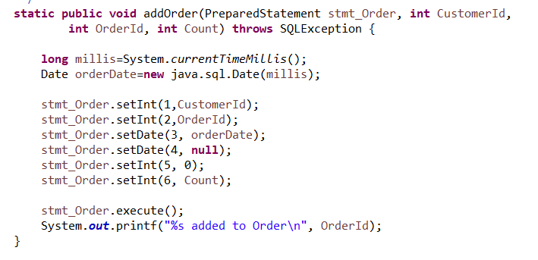

Function - Data Manipulate Language
Order aspect
CustomerId
OrderId
OrderDate
ShipmentDate
Status
Count
addOrder
Add data to table ‘ProductOrder’
First set shipmentDate to null and status to 0 (pending)
These two parameter will change after we load all OrderRecord
Count: the number of orderRecords related to this order

Slide 19

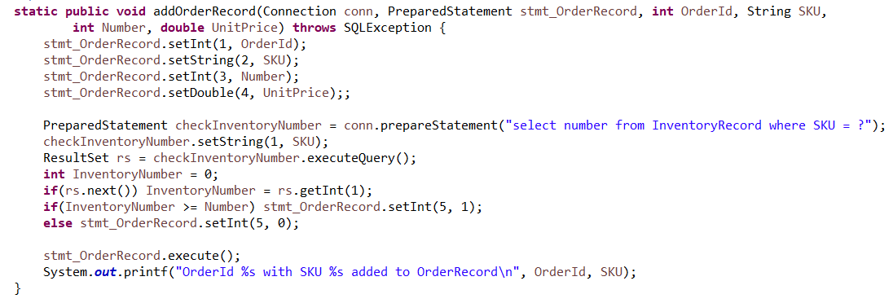
Function - Data Manipulate Language
Order aspect
addOrderRecord
Status: if number is larger than the inventory number, Status
will be 0 (fail). Otherwise, status will be 1(success).
OrderId
SKU
Number
UnitPrice
Status

Slide 20
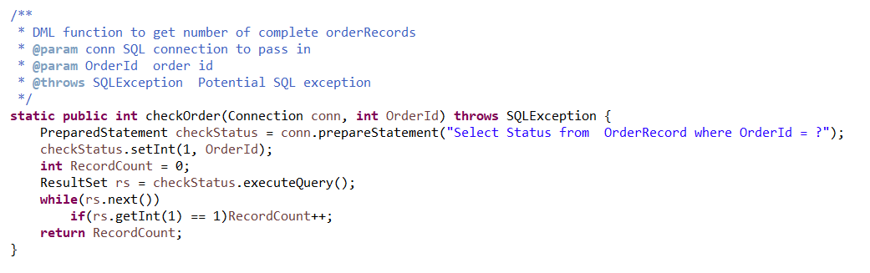
Function - Data Manipulate Language
Order aspect
Get number of records whose status is 1 for a specific order
CancelOrder
After we load all order records, we scan Order for another time. We will compare attribute ‘Count’ to this number of complete records. If not equal, we will cancel it.
PlaceOrder
Then for the rest orders, it means that they are all complete and we should place these orders. So we need to set the ‘status’ in table ‘Order’ to 1(complete).

Slide 21
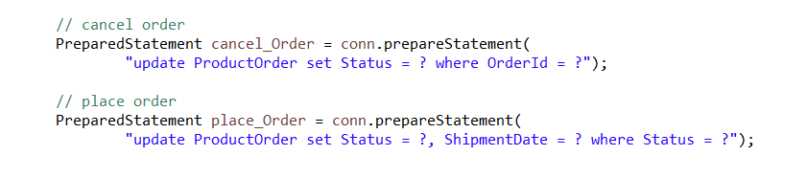
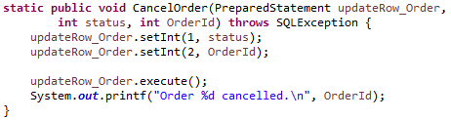
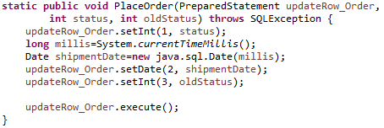
Function - Data Manipulate Language
Order aspect

Slide 22
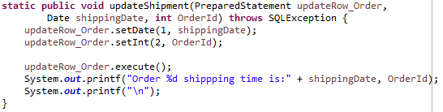
Function - Data Manipulate Language
Order aspect

Slide 23
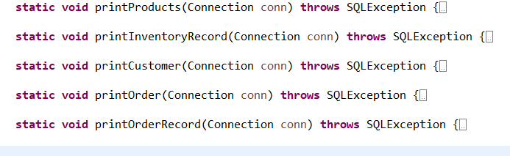
Function - Data Query Language
Print all table

Slide 24
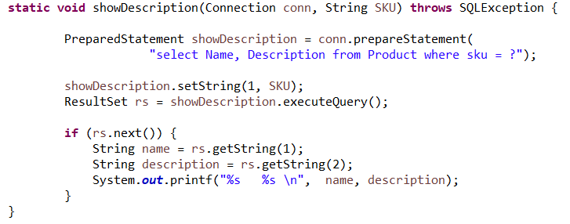
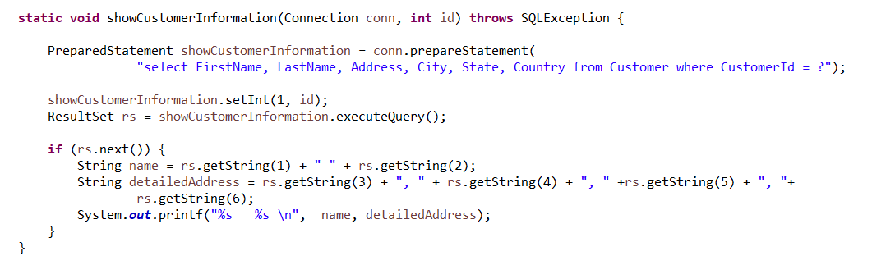
Function - Data Query Language
Example:
Show the information about product & show customer information
Example:

Slide 25
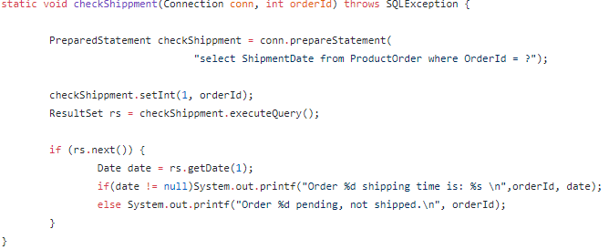

Function - Data Query Language
Check shipment date
Example:

Slide 26
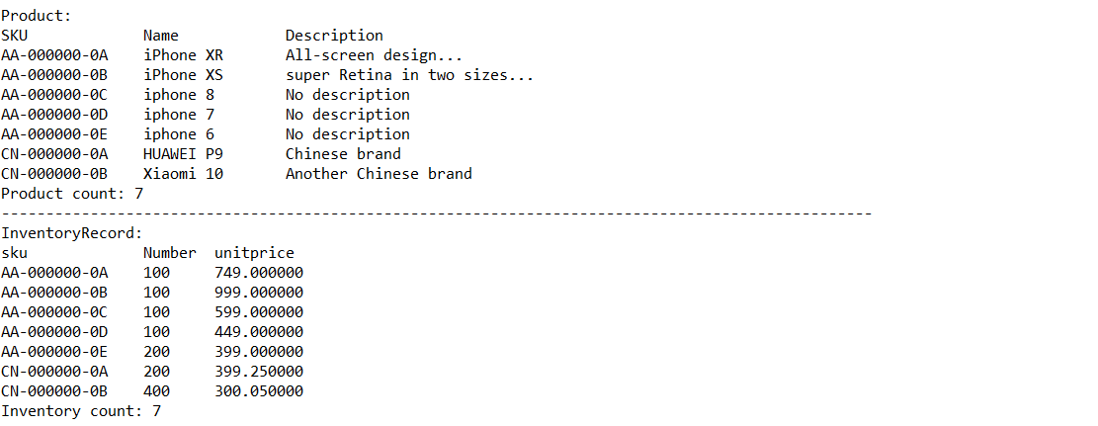
Testing
Product and product inventory information before processing order

Slide 27
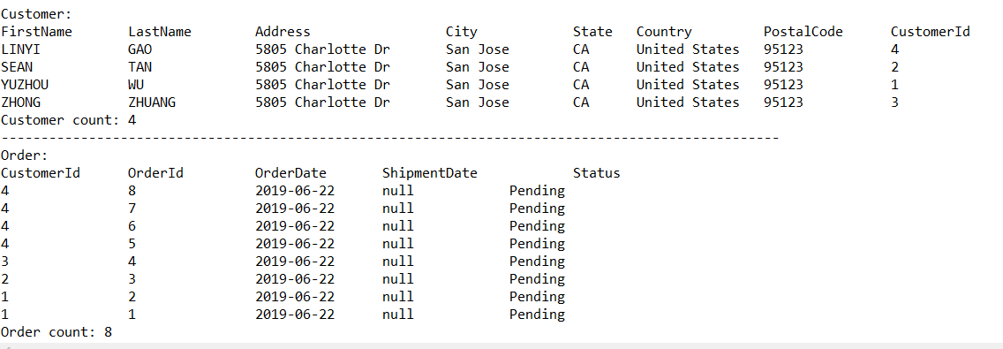
Testing
Customer and order information before processing order

Slide 28
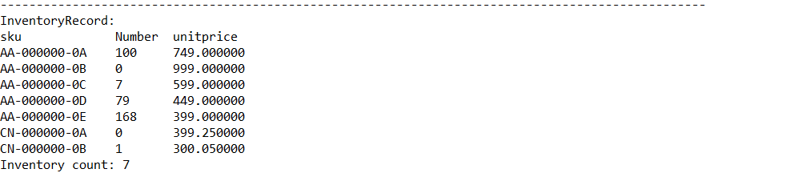
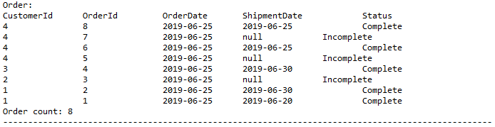
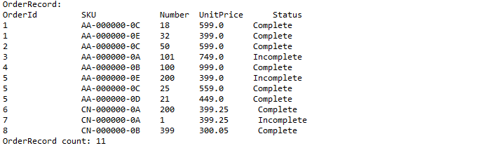
Testing
After processing order

Slide 29
Top Level Document
ReadMe file to give brief description of this project
Java Docs:
https://pages.github.ccs.neu.edu/seantanty/cs5200_OrderManager_Project_Yongliang_Tan_and_Yuzhou_Wu/
Referencing using other’s work, their Java Docs:
http://takahikokawasaki.github.io/nv-i18n/

Slide 30
Future - Issues and Improvements
Order/OrderRecords
Current:
use a status field, need to call CancelOrder and PlaceOrder function
When order created, the order date is set as the system time
Concern: need to discuss with client about the business side’s decision
Update Order/OrderRecords
Current: didn’t implement update function
Concern: Once order been placed, the customer could only cancel the whole order
Back-ordering items:
Improvement: When adding inventory, we should first fulfill those incomplete OrderRecords
Considering convert to use MySQL database instead

Slide 31

Q&A

