Slide 1
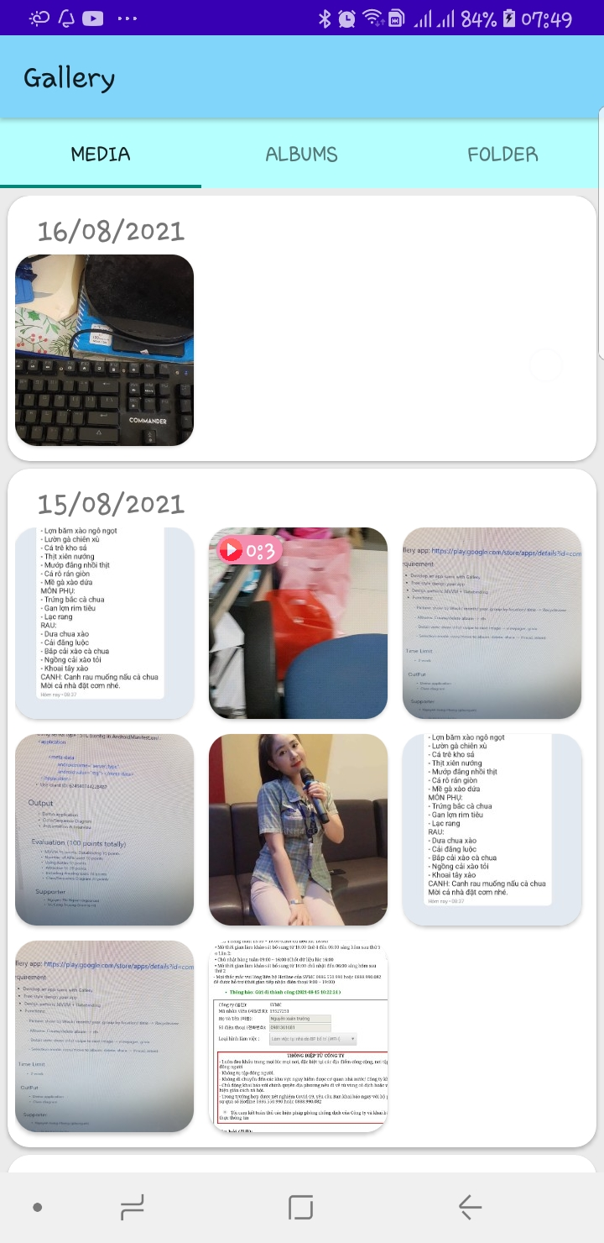
Gallery
Training project

Slide 2
Main class diagram
Bộ nhớ máy (Media store)
ExternalStorageResponsitory
Activity
ViewModel
MediaConverter
RoomResponsitory
Room database

Slide 3
Basic feature
All media (image, video, gif), group by time

Slide 4
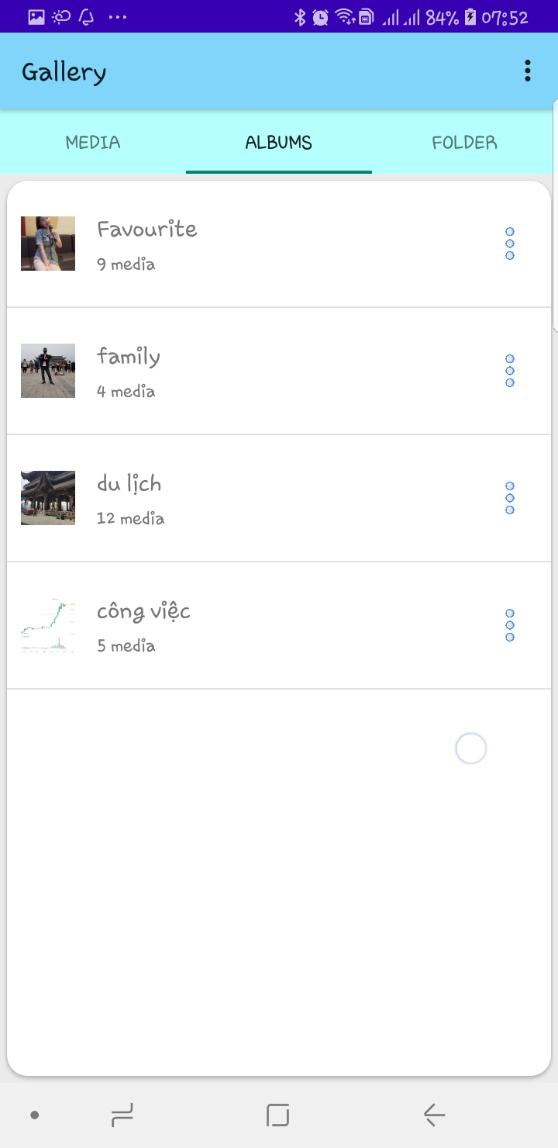
Basic feature
Group image by album, one file can belongs in many albums (Room)

Slide 5
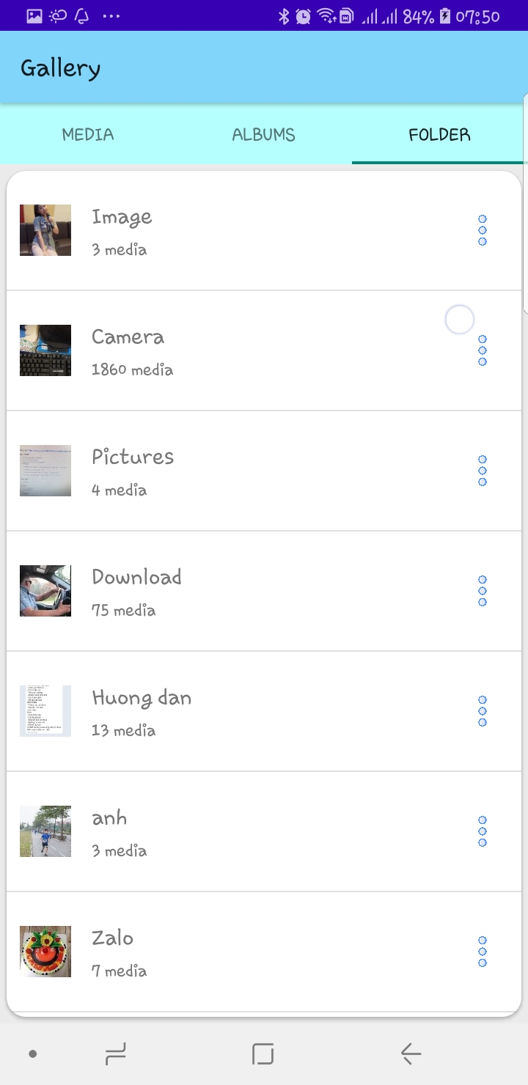
Basic feature
Group image by folder, that actually exist in Phone storage

Slide 6
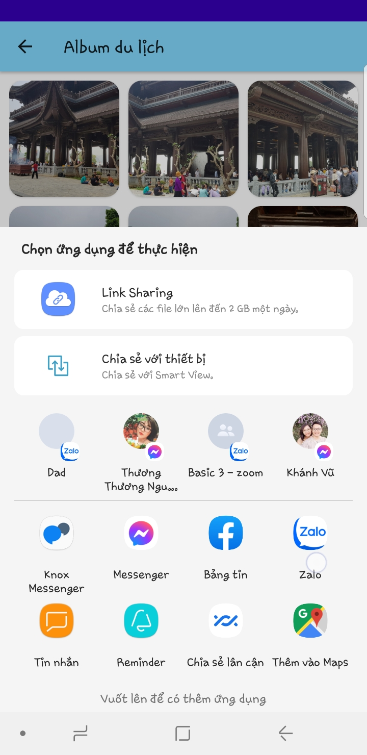
Basic feature
Share multi media vie intent

Slide 7
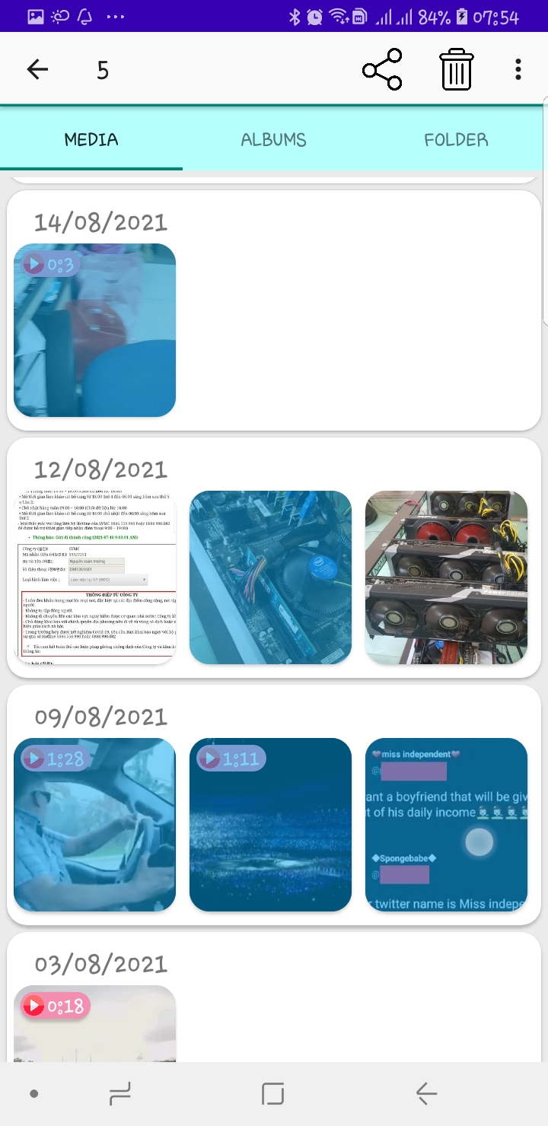
Basic feature
- Delete image from Phone store(Media and folder Fragment) - Remove image from album(Album Fragment)

Slide 8
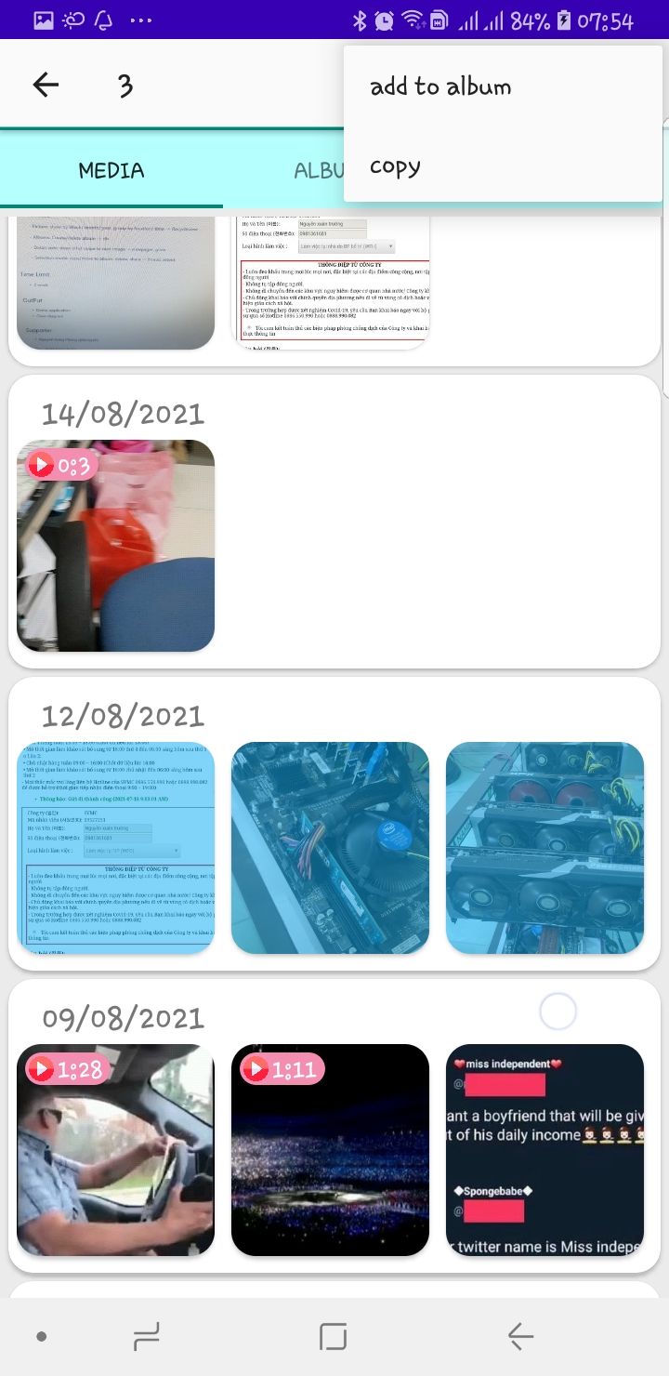
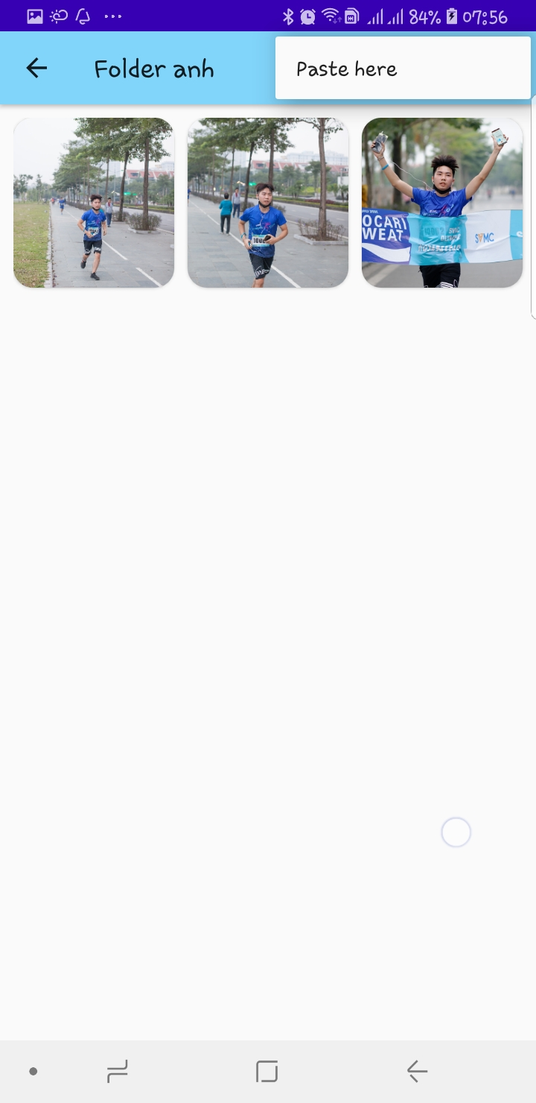
Basic feature
Copy -> paste (Create new file in phone storage, AsyncTask)

Slide 9
Advance feature
RecycleView inside RecycleView and Multi-select

Slide 10
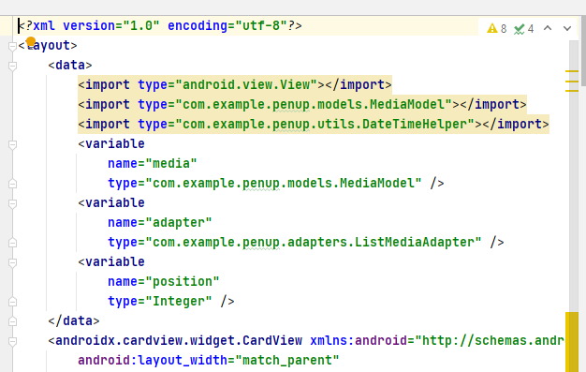
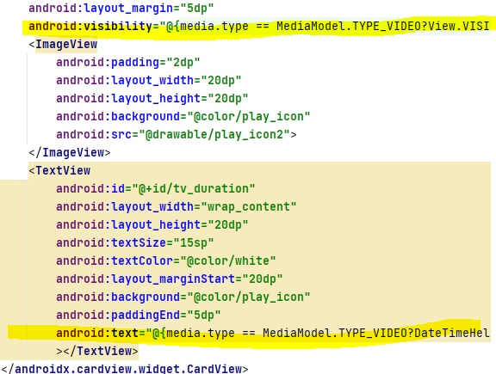
Advance feature
Databinding

Slide 11
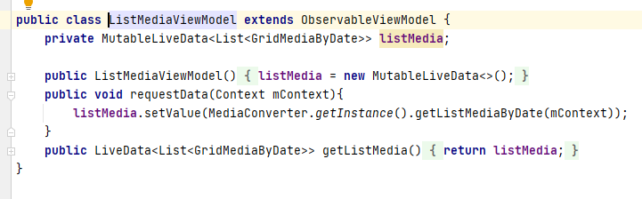
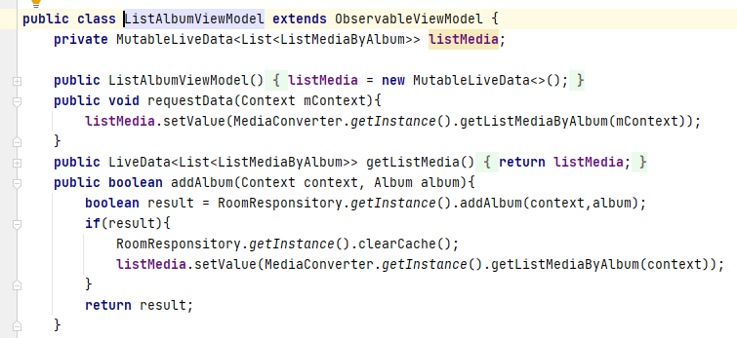
Advance feature
MVVM with Livedata

Slide 12
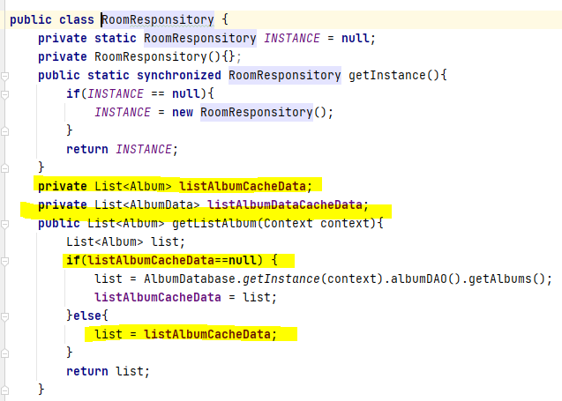
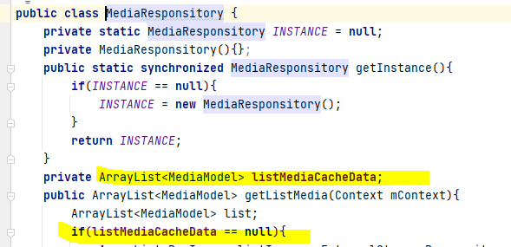
Advance feature
Cache data to reduce query to database

