Slide 1
SenseCore AI Cloud Computing Services (Elementary)
AI Cloud Uni-Management Platform - Higgs
Portal
IAM
BOSS
Ticket
Resource Manager
Cloud Manager
Dashboard
Cloud Security
- Gluon
SenseParrots Enterprise Cloud
AI Studio
AI Toolbox
Cloud Management
AI Pipeline Orchestrator
Open Source
OpenMMLab
/OpenDILab/...
Proprietary
Science/Industry
Model Zoo
Foundation/Pretrain Models
AI Asset Manager
AI Training Visualizer
AI Model
Quantizer
AutoML
Tools
Third-Party
Integration
KMS
Registry
Workload Audit
AI Data Services - Graviton
AI Platform Services
AI Developer Tools
DCOS
Collect
Annotate
ETL
AI Training
Parrots2/PyTorch
/Tensorflow/…
AI Serving
PPL/ONNX/…
Data Processing
Others
VM/CloudXR/Render
Developer Machine
CLI Tools
native/slurm
IDS/IPS
Container
Platform
AI Data Management
Smart Job Scheduler & Manager
Cloud IDE
VSCode/JupyterLab
AI Boosters
DataLoader/MPI/…
OS Security
AI-Native Cloud Infrastructure
Logging
Fortress Machine
AI Compute Services - Lepton
AI Storage Services - Quark
AI Network Services - Boson
AI+HPC Pool
Offline Processing
FaaS Pool
Online Processing
Edge Pool
Edge Computing
Object Storage
File
Storage
Block
Storage
AI Fabric
NIC
Communication Primitives
VPN Gateway
Metrics
WAF
Containerized Compute
Distributed Storage
Multi-tenant RDMA
SDN Controller
Classical VPC
Alert
CPU
GPU/vGPU
FPGA
TPU
HDD
SSD
NVMe
RAM/PMem
RoCE
InfiniteBand
SenseTime AI Data Center (AIDC)
AIDC Infrastructure Design & Construction
Management Consulting
AIDC Infrastructure Operation & Maintenance Management Consulting
AIDC Construction & Operation Management AI Toolkit
AIDC Construction & Operation Standardization System

Slide 2
SenseCore AI云计算产品与服务 (Elementary)
AI云统一管理平台 - Higgs
门户入口
身份认证
运营与计费
工单系统
资源管理
多云管理
展示大屏
云安全
- Gluon
SenseParrots Enterprise Cloud
AI Studio
AI工具箱
云管理
AI 流水线编排
开源算法库
OpenMMLab
/OpenDILab/...
私有算法库
Science/Industry
模型库
大模型/行业模型
密钥管理
AI 资产管理
AI 训练
可视化
AI 模型量化
AutoML
工具
第三方集成
Registry
负载审计
AI 数据服务 - Graviton
AI 平台服务
AI 开发者工具
DCOS
收集
标注
ETL
AI 训练
Parrots2/PyTorch
/Tensorflow/…
AI 推理
PPL/ONNX/…
数据处理
其他
VM/CloudXR/Render
开发机
CLI 工具
native/slurm
深包分析
容器平台
AI 数据管理
智能任务调度与管理器
云 IDE
VSCode/JupyterLab
AI 加速库
DataLoader/MPI/…
OS安全
日志
AI原生云基础设施
堡垒机
AI 计算服务 - Lepton
AI 存储服务 - Quark
AI 网络服务 - Boson
监控
AI+HPC 计算池
Offline Processing
FaaS 计算池
Online Processing
边缘计算池
Edge Computing
对象存储
文件存储
块存储
AI Fabric
NIC
Communication Primitives
VPN
网关
WAF
多租户 RDMA
SDN 控制器
经典 VPC
告警
容器化计算
分布式存储
CPU
GPU/vGPU
FPGA
TPU
HDD
SSD
NVMe
RAM/PMem
RoCE
InfiniteBand
商汤人工智能数据中心（AIDC）
AIDC 基础设施设计施工管理与咨询
AIDC建维管理AI产品工具箱
AIDC基础设施运营维护管理与咨询
AIDC建维管理标准化体系
Notes:
存储是否需要KV？各个存储类型之间的整体架构与关系？是否走统一存储架构还是同类存储pattern单独设计？
日志/监控/告警，算Cloud Governance（实际在Higgs里头）

Slide 3
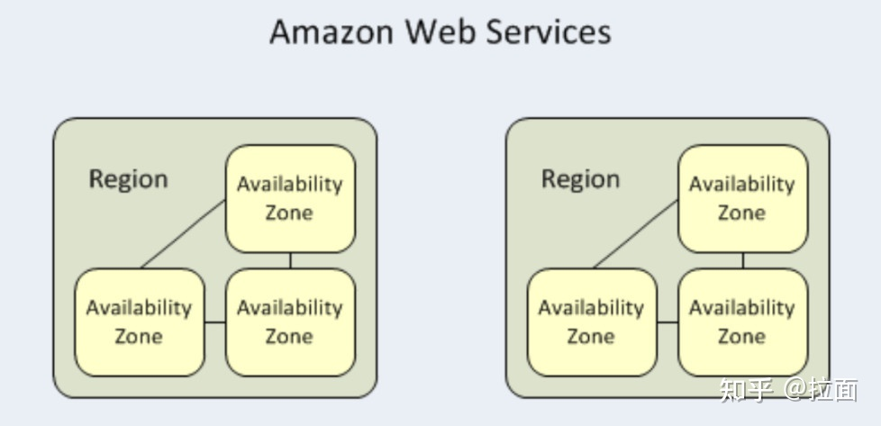

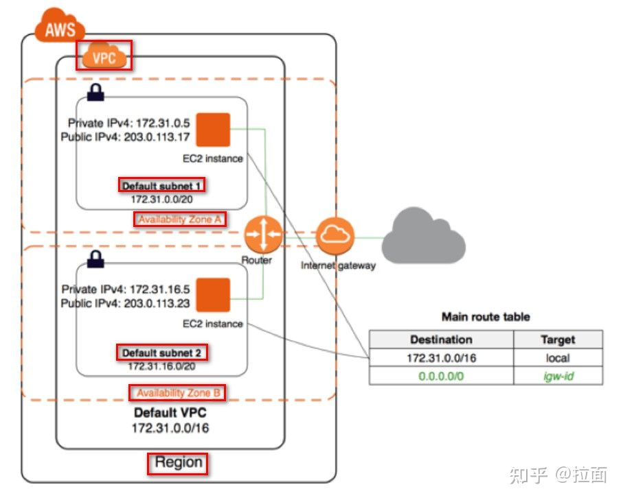
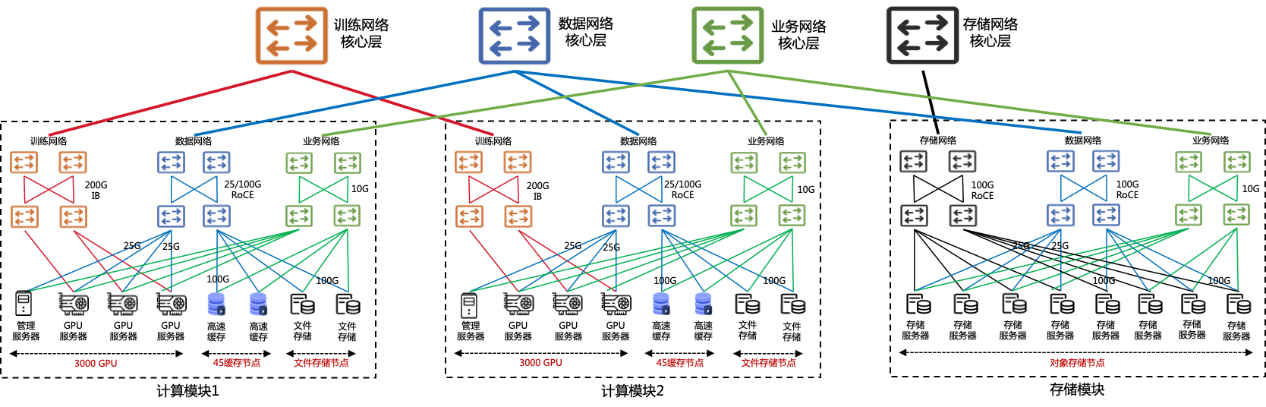
SenseCore Region-AZ Multi-Site 架构 （v0.1-draft）
aidc.sensetime.com
cn-sh-1.console.aidc.sensetime.com
cn-xx-1.console.aidc.sensetime.com
Control Panel
Region 1 – Main Site (Max. ? AZs)
Region 2 – Backup Site
Region Control Panel & Product Deployments
Region Control Panel & Product Deployments
Higgs
Gluon
SRE
…
Products
Service
Data Panel
Higgs
Gluon
SRE
…
Products
AZ-0 Control Panel
Container Platform
Block Storage
AZ-0 Control Panel
Container Platform
Block Storage
AZ-1 Control Panel
Compute-Pool-1
Max. 500 Nodes, 4000 GPU
Block & File(Cache) Storage
AZ-1 Control Panel
Compute-Pool-1
Max. 500 Nodes, 4000 GPU
Block & File(Cache) Storage
Security
Network Fabrics
Security
Network Fabrics
AZ-2 Control Panel
Compute-Pool-2
CPU/Edge/WindowsContainer/KVM
Block & File(Cache) Storage
IAM
global config
…
AZ-2 Control Panel
Compute-Pool-2
Block & File(Cache) Storage
Shared Storage
Control Panel
Shared Storage Pool – Object, KV
Shared Storage
Control Panel
Shared Storage Pool – Object, KV
Object
Data Panel

Slide 4
SenseCore 多租户架构（v0.1-draft）
Region 1
Region Control Panel & Product Deployments
Higgs
Gluon
SRE
…
Products
AZ-0 Control Panel
Container Platform
Block Storage
Service
Data Panel
AZ-1 Control Panel
Compute-Pool-1
Max. 500 Nodes, 4000 GPU
Block & File(Cache) Storage
Security
Network Fabrics
AZ-2 Control Panel
Compute-Pool-2
CPU/Edge/WindowsContainer/KVM
Block & File(Cache) Storage
Shared Storage
Control Panel
Shared Storage Pool – Object, KV
Object
Data Panel

