Slide 1
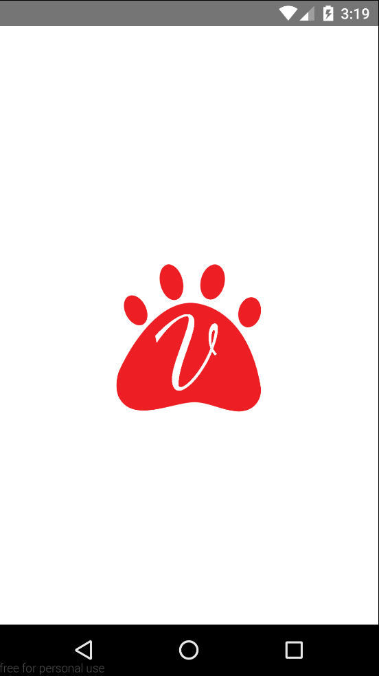
XML <android:windowBackground>
XML <android:bitmap>
< PNG Image in ‘android\app\src\
main\res\mipmap-*’ >
XML <android:color>

Slide 2
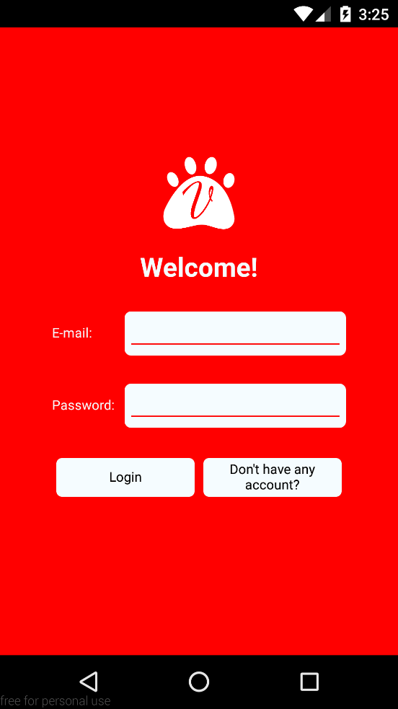
Modal
< style={{flex: 1}} >
TextInput
Provide
Login/Register
< Depending on the state >
< signInWithEmailAndPassword /
createUserWithEmailAndPassword >
< AsyncStorage.setItem(key,value) >
TouchableOpacity
< setState({isShowLogin})>

Slide 3
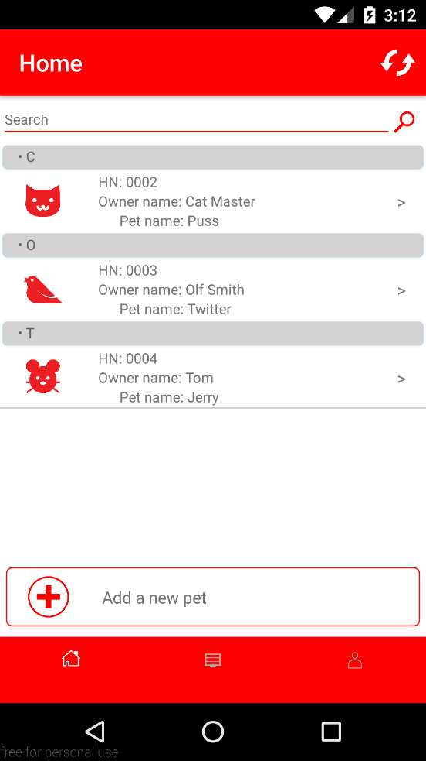
React-native-navigation
Listen to firebase if pressed,
used for refreshing
TextInput
< if (searchKey==itemKeys)
array.push(item) >
Convert
Listview
< cloneWithRowsAndSections >
< push(DetailScreen) >
TouchableOpacity
< push(AddScreen) >
React-native-navigation

Slide 4
Firebase Structure
Root (vitality-pet-edtion)
User (unique firebase ID)
Pet Data
Pet (unique firebase ID)
Pet’s attributes
Report Data
Report (unique firebase ID)
Report’s attributes
User Data
User’s attributes

Slide 5
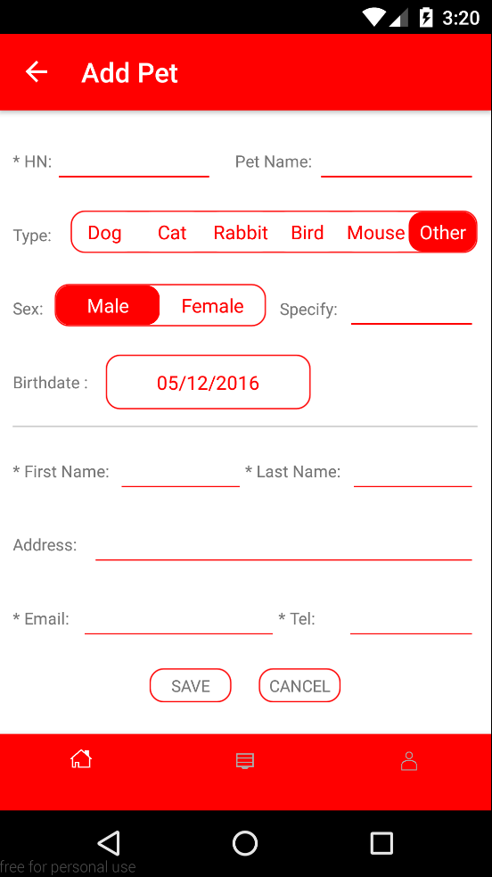
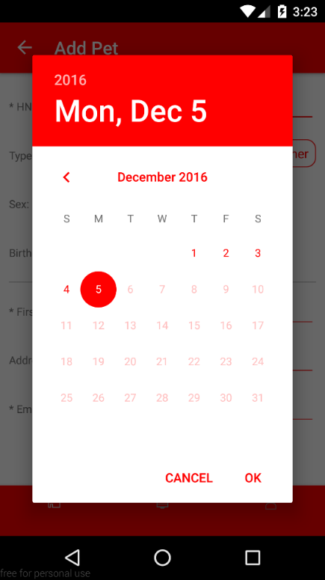
React-native-datepicker
React-native-radio-buttons
TouchableOpacity
< database.ref(userID/Pet Data/petID)
.set({key: value}) >
< pop() >
TouchableOpacity
< pop() >

Slide 6
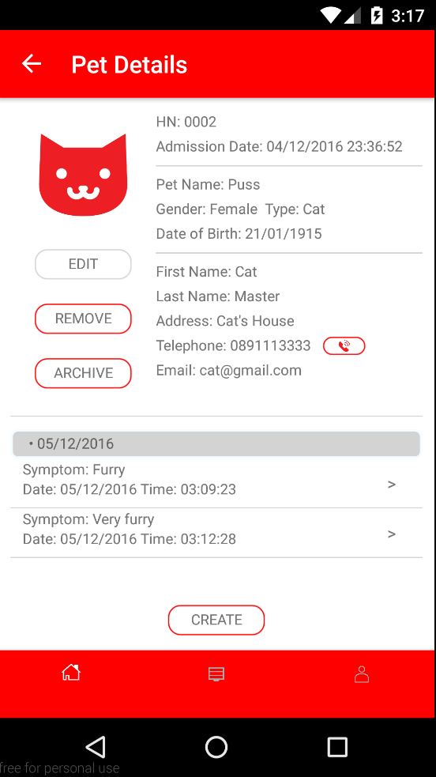
MomentJS
TouchableOpacity
< dialogbox >
< database.ref(userID/Pet Data/petID).set(null) >
TouchableOpacity
< database.ref(userID/Pet Data/petID)
.update({key: value}) > (unfinished)
TouchableOpacity
< call number > (unfinished)
TouchableOpacity
< dialogbox >
< database.ref(userID/Pet Data/petID)
.update({key: value}) >
Listview
< cloneWithRowsAndSections >
< push(ReportScreen) >
TouchableOpacity
< push(AddReportScreen) >

Slide 7
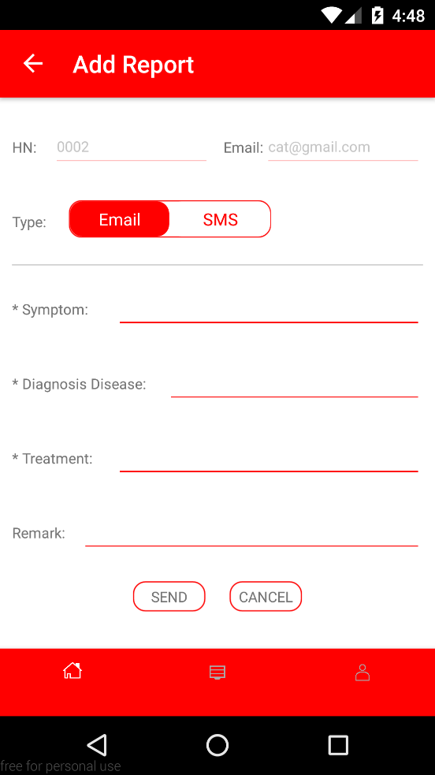
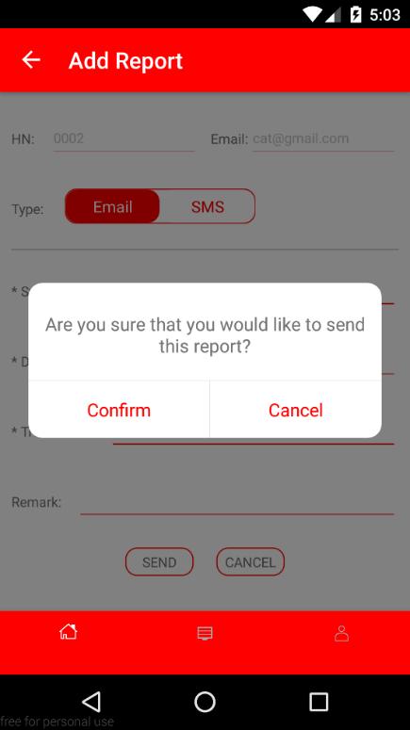
React-native-dialogbox
TouchableOpacity
Depending on the state
< dialogbox >
< send SMS / send Email >
< pop() >
TouchableOpacity
< pop() >

Slide 8
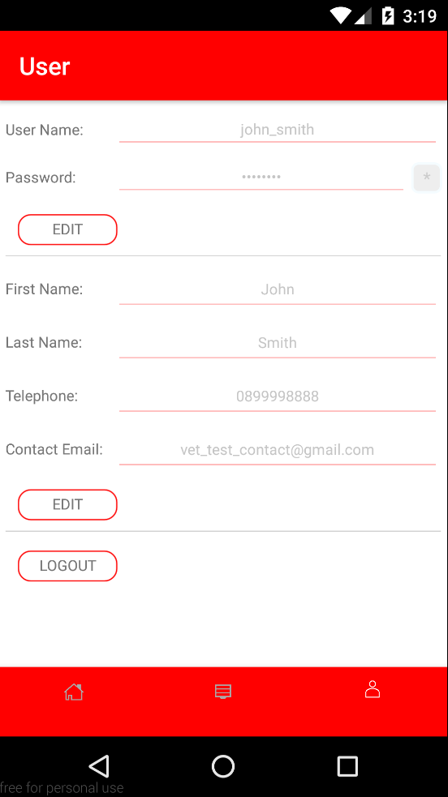
TouchableOpacity
< setState(securePassword) >
TouchableOpacity
< Depending on the state >
< setState({isUserInfoEditable}) /
database.ref(userID/User Data)
.set({key: value}) >
Similar
TouchableOpacity
< signOut() >
< AsyncStorage.removeItem(key) >
< push(WelcomeModal) >

