Slide 1


ARAVALLI BUILD CHALLENGE · Organised by GDG Udaipur
UFO
– Unified Fraud Observer
Detect the Risk.
Before the Money Moves.
An AI-powered real-time UPI fraud detection and prevention system that analyses transaction behaviour, suspicious activities and beneficiary risk to identify potentially fraudulent payments.
TEAM
TRACK
Vector Void
FinTech & Consumer Rights
MEMBERS
Original illustration: payment protection, before the PIN
Dhawal Menaria — Team Lead · Ansh Chauhan · Nirbhay Singh Parmar · Yashank Sharma
VECTOR VOID
ARAVALLI BUILD CHALLENGE · GDG UDAIPUR
01 / 07
Notes:
Welcome. We are Team Vector Void, building UFO for the FinTech and Consumer Rights track at the Aravalli Build Challenge by GDG Udaipur. UFO is an Android-based UPI fraud detection and warning system: it analyses the payment and the suspicious circumstances around it, then warns the user before the money moves. The artwork is an original illustration.

Slide 2



THE PROBLEM
Fraud Doesn't Start at the Payment Screen.
01
Social Engineering
ILLUSTRATIVE SCENARIO
Fraudsters manipulate victims through fake bank calls, digital arrest threats and urgent payment requests.
Caller says
“I’m the Commissioner. Transfer ₹5,000 immediately for official verification.”
02
Suspicious Payment Behaviour
Sudden high-value transfers, rapid transactions and unfamiliar beneficiaries can indicate potential fraud.
Payment screen
Pay ₹5,000 to unknown.caller@ybl
03
Delayed Fraud Awareness
Users may realise they are being manipulated only after initiating or completing a payment.
Unfamiliar beneficiary
Active call
Traditional beneficiary reputation checks alone cannot explain every suspicious payment situation.
UFO detects suspicious payment behaviour and warns before the PIN is entered.
VECTOR VOID
ARAVALLI BUILD CHALLENGE · GDG UDAIPUR
02 / 07
Notes:
Fraud begins before the payment screen. Three problems: social engineering through fake bank calls and digital arrest threats; suspicious payment behaviour such as sudden high-value or rapid transfers to unfamiliar beneficiaries; and delayed awareness, where users realise too late. The scenario on the right is illustrative. Beneficiary reputation alone cannot explain every suspicious payment.

Slide 3
OUR SOLUTION
From Payment Activity to Real-Time Risk Awareness.
1
2
3
4
5
Transaction Signals
Fast Risk Evaluation
Composite Risk Scoring
Risk Classification
Warning / Async Investigation
ANDROID
BACKEND · SYNC
BACKEND
BACKEND
ANDROID + BACKEND
Payee, amount, time, call state and behavioural telemetry from the app.
FastAPI runs rules, velocity and blacklist checks without an LLM.
Rules, ML probability and receiver reputation merge into one score.
Below 0.30 SAFE. 0.30–0.59 WARNING. 0.60 and above FRAUD.
User is warned. FRAUD cases also start an async AI investigation.
THREE RISK COMPONENTS
RISK SCALE
Rule-based behavioural analysis · 60%
ML fraud probability · 25%
Receiver reputation scoring · 15%
SAFE
<0.30
WARNING
0.30–0.59
FRAUD
≥0.60
UFO analyses not only the payment, but also the suspicious circumstances surrounding it.
VECTOR VOID
ARAVALLI BUILD CHALLENGE · GDG UDAIPUR
03 / 07
Notes:
The backend workflow has five stages. Transaction signals arrive from the Android app. A fast risk evaluation runs rules, velocity and blacklist checks without a language model. A composite score merges three components: rule-based behavioural analysis, machine-learning fraud probability and receiver reputation (documented weights 60%, 25% and 15%). The score is classified: below 0.30 SAFE, 0.30 to 0.59 WARNING, 0.60 and above FRAUD. The user is warned, and FRAUD cases also start an asynchronous AI investigation. UFO analyses the circumstances, not just the payment.

Slide 4
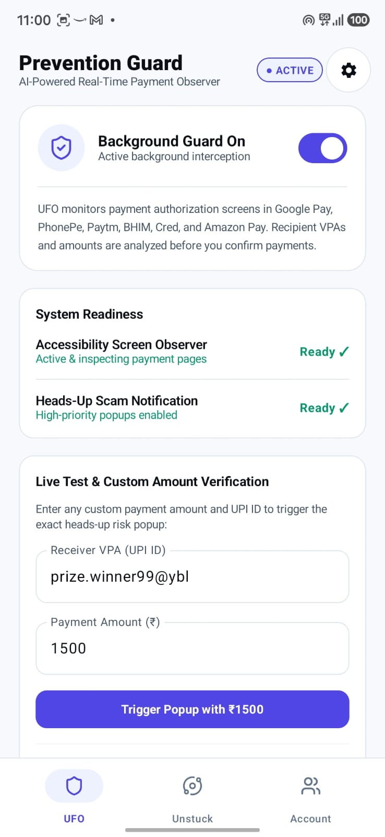
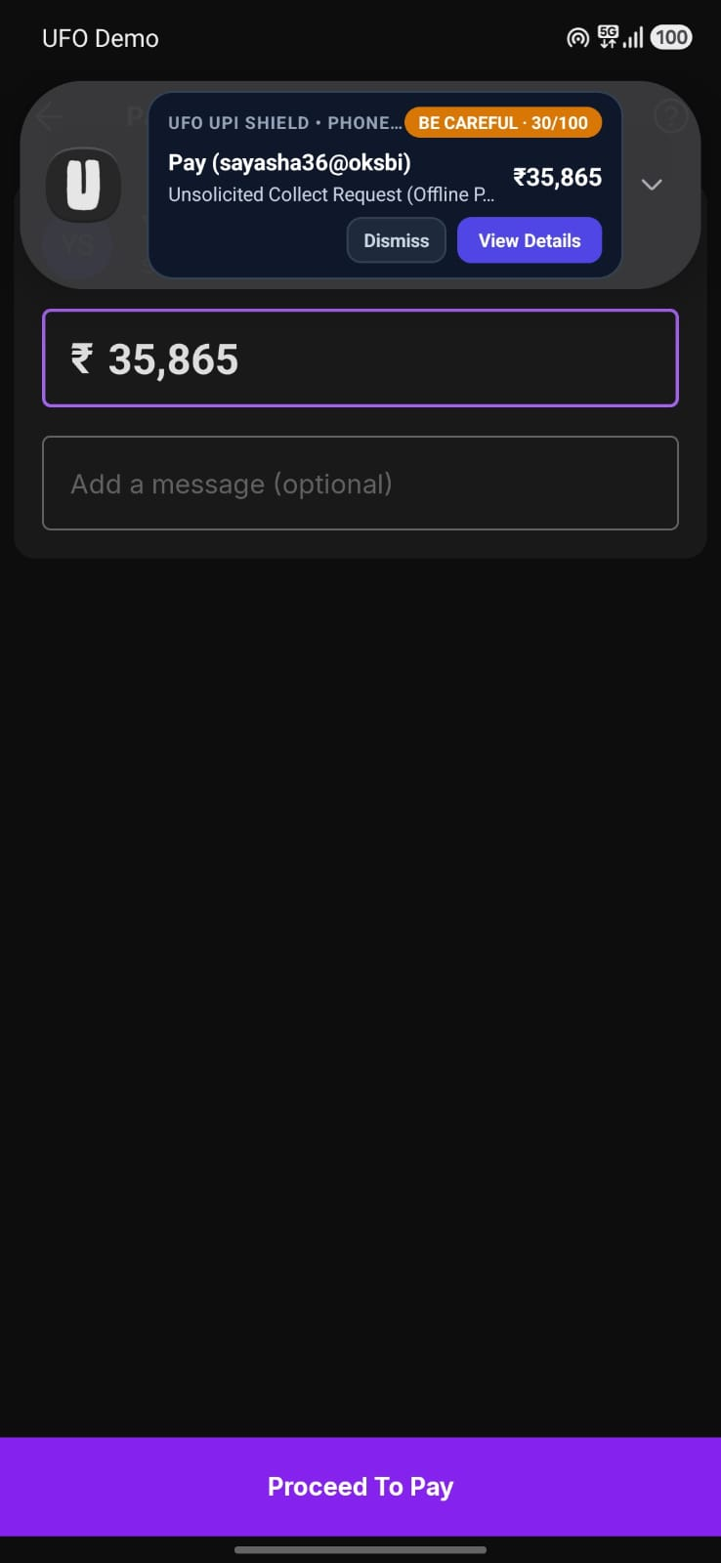
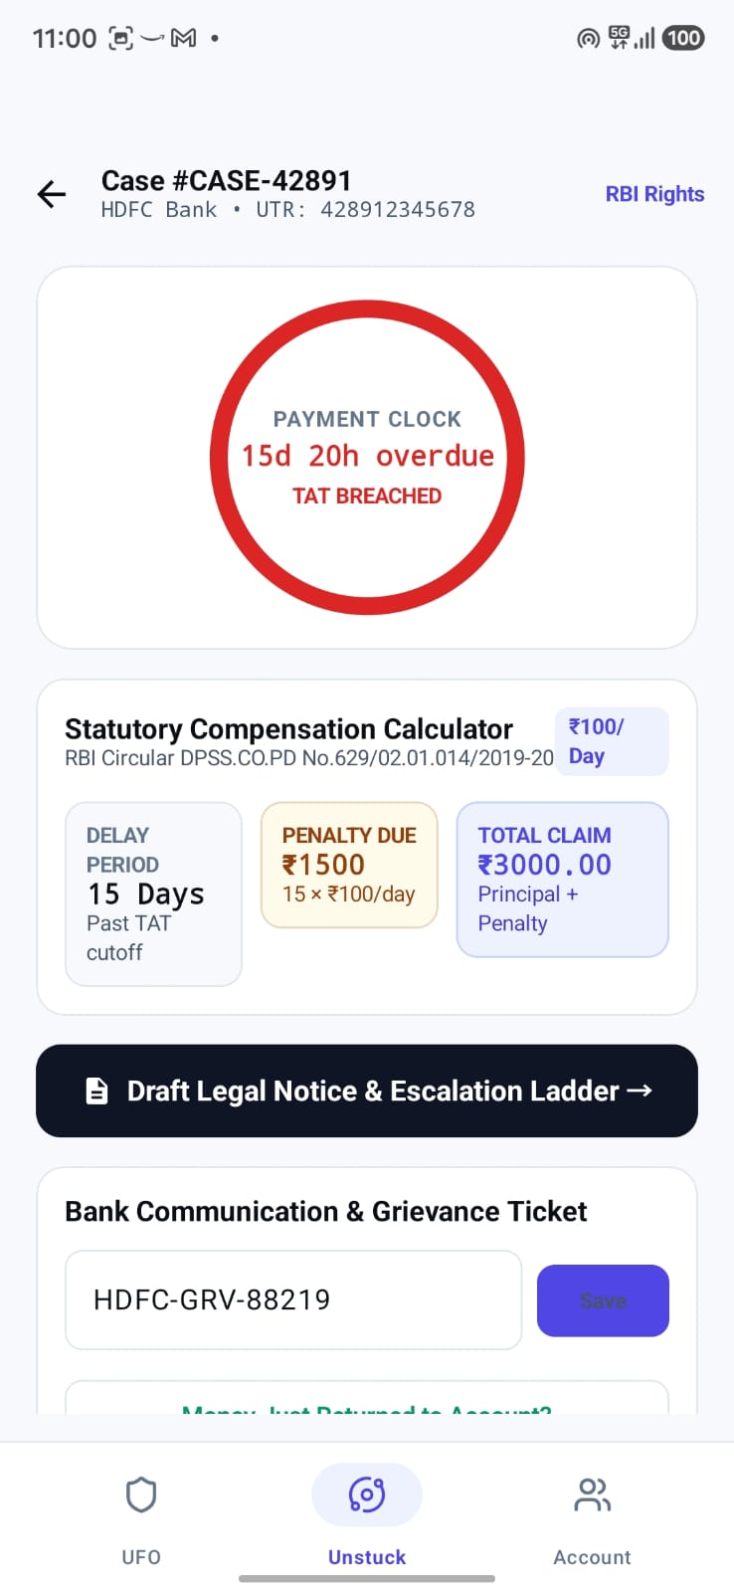
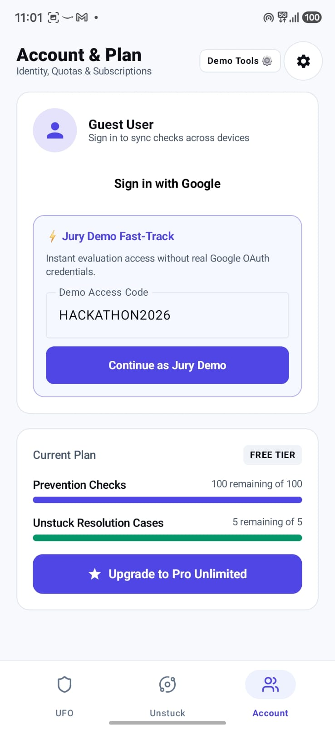
PRODUCT EXPERIENCE
Protection That Appears When It Matters.
01
02
03
04
Prevention Guard
Risk Alert
Unstuck Case Tracker
Account & Plan
Background Guard is on, readiness is checked, and a live test accepts any VPA and amount.
A heads-up popup over the payment screen shows score, payee, Dismiss and View Details.
For a stuck payment: a payment clock, compensation calculator and grievance draft.
Guest sign-in with a jury demo option, plus plan quotas for checks and cases.
Screenshots of the UFO prototype app with demo data. UFO warns the user; it does not cancel or control payments inside other UPI apps.
VECTOR VOID
ARAVALLI BUILD CHALLENGE · GDG UDAIPUR
04 / 07
Notes:
Four screens from the UFO prototype app, using demo data. 1: Prevention Guard dashboard with Background Guard on, readiness checks and a live test that accepts any VPA and amount. 2: the heads-up risk popup over a payment screen, with a risk score, the payee, and Dismiss and View Details. 3: the Unstuck case tracker for stuck payments, with a payment clock, a compensation calculator based on an RBI circular, and a grievance draft. 4: account and plan screen with guest sign-in, a jury demo option and plan quotas. UFO warns; it does not cancel or control transactions inside third-party UPI apps.

Slide 5





TECHNOLOGY & ARCHITECTURE
Built for Real-Time Fraud Intelligence.
ANDROID APPLICATION
PROTOTYPE
SYNCHRONOUS · FAST RISK CHECK
Kotlin · Android SDK · Retrofit (API communication)
ANDROID
Android App
LAYER 1
FastAPI Gateway
LAYER 1
Risk Engine
LAYER 1
Risk Response
ANDROID
Warning Interface
BACKEND
IMPLEMENTED
Python · FastAPI · REST APIs
PROTOTYPE
IMPLEMENTED
IMPLEMENTED
IMPLEMENTED
PROTOTYPE
FRAUD cases queue async
DATABASE & STORAGE
IMPLEMENTED
MongoDB · Local JSON-based fallback persistence
ASYNCHRONOUS · AI INVESTIGATION
LAYER 2
Privacy Layer
LAYER 3
AI Investigation Engine
LAYER 5
Policy Guardrails
LAYER 4
Banking / NPCI Tools
LAYER 5
HITL + Dead Letter Queue
FRAUD DETECTION & ML
IMPLEMENTED
Rule-Based Risk Engine · Velocity Tracker · Random Forest Classifier · Calibrated Logistic / Interaction Ensemble · VPA Reputation Scoring · Bloom Filter (on-device prototype)
TESTED
IMPLEMENTED
TESTED
SIMULATED
TESTED
NPCI and bank action tools are simulated. No live NPCI or bank integration.
AI INVESTIGATION
IMPLEMENTED
LAYER 1
Gateway, Rule Engine & Fast ML
LAYER 2
Privacy Vault & OCR Security
LAYER 3
AI Agent, Semantic Cache & Router
LAYER 4
Banking / NPCI Tools (simulated)
LAYER 5
Policy Guardrails, HITL & Resilience
Gemini 2.5 Flash · Groq Llama 3.1 8B Instant · Ollama Qwen 2.5 3B · RBI/NPCI Regulatory RAG · Semantic Cache · Complexity Router
IMPLEMENTED
TESTED
PROTOTYPE
SIMULATED
PLANNED
VECTOR VOID
ARAVALLI BUILD CHALLENGE · GDG UDAIPUR
05 / 07
Notes:
Five technology groups on the left; the five-layer backend on the right. The fast synchronous path (Android app, FastAPI gateway, risk engine, response) is separate from the asynchronous AI investigation, which only starts for FRAUD-class cases. Layer order in code: privacy, AI investigation, policy guardrails, then banking tools or the human review queue. Banking and NPCI tools are simulated; there is no live NPCI or bank connection, and the RBI/NPCI RAG uses a stored corpus of circulars. Tested means covered by the documented 8 of 8 backend test report. The Bloom filter is an on-device prototype component from the Android design. Backend latency figures in the documents are design targets, not independent benchmarks. API surface: POST /predict (pre-payment risk), POST /transaction (evaluate and record), POST /behavior (telemetry), POST /privacy/redact-ocr (masking), POST /dispute/investigate, GET /hitl/queue, GET /hall-of-shame. Data: 12,000 synthetic training transactions, 300 fraud-related VPAs, 100 instruction-tuning pairs.

Slide 6




INTELLIGENCE, SAFETY & TRUST
AI Assists. Deterministic Guardrails Protect.
01
02
ILLUSTRATIVE RISK ASSESSMENT
Behavioural Intelligence
Privacy Protection
Unfamiliar beneficiary
Velocity, active-call, screen-share and reputation signals feed the score. ML on 12,000 synthetic samples: 93.71% accuracy, 77.05% precision, 87.15% recall, 81.79% F1. Not real-world accuracy.
HMAC-SHA256 tokens replace Aadhaar, PAN, IFSC, phone, bank account and UPI ID before AI sees the text. OCR prompt-injection text is stripped.
Active phone call
Unusually high payment
03
04
Recent suspicious activity
Deterministic Guardrails
Human Oversight
3-loop reasoning limit, 4,096-token request budget, ₹5,000 auto-refund cap and UTR verification. Idempotency keys block duplicate bank operations.
Low-confidence, high-value and bank API timeout cases go to a human review queue (HITL) and a dead letter queue for recovery.
HIGH RISK — HOLD AND INVESTIGATE
Risk indicators do not independently prove fraud.
8/8 TESTS PASSED
in the documented backend security and resilience report
No guarantee of fraud prevention, refunds, or control over third-party UPI apps.
VECTOR VOID
ARAVALLI BUILD CHALLENGE · GDG UDAIPUR
06 / 07
Notes:
AI assists, but fixed policies decide. Behavioural intelligence combines velocity, active-call, screen-share and reputation signals with ML fraud probability. The documented model metrics (93.71% accuracy, 77.05% precision, 87.15% recall, 81.79% F1) come from a synthetic training dataset of 12,000 transactions and are not real-world accuracy. Supporting data: 300 fraud-related VPAs and 100 instruction-tuning pairs. Privacy: HMAC-SHA256 tokenisation of Aadhaar, PAN, IFSC, phone, bank account and UPI ID, plus OCR prompt-injection sanitisation. Guardrails: 3-loop circuit breaker, 4,096-token request budget, 5,000 rupee auto-refund cap, UTR verification, and idempotency keys against duplicate banking operations. Low-confidence, high-value and bank-timeout cases go to the human review and dead letter queue. The backend report records 8 of 8 tests passed. Banking tools are simulated. Risk indicators do not prove fraud, and nothing here guarantees prevention, refunds or control over third-party UPI apps.

Slide 7
ROADMAP
Building Safer Digital Payments.
TODAY
PROTOTYPE
NEXT
PLANNED
FUTURE
EXPLORING
CURRENT PROTOTYPE
VALIDATION & IMPROVEMENT
EXPANSION
FastAPI backend with REST APIs
MongoDB + local JSON persistence
Fraud scoring and model training pipeline
AI-assisted dispute investigation
Privacy and resilience guardrails
Android integration via Retrofit API client
Android compatibility testing
ML model evaluation
Improved temporal behavioural analysis
False-positive reduction
Privacy and performance testing
Wider UPI application compatibility
Authorized banking/payment-provider integrations
Advanced fraud network analysis
Expanded fraud intelligence ecosystem
Detect the Risk. Before the Money Moves.
→
VECTOR VOID Dhawal Menaria · Ansh Chauhan · Nirbhay Singh Parmar · Yashank Sharma
ARAVALLI BUILD CHALLENGE · GDG UDAIPUR
07 / 07
Notes:
Today: a working prototype built on a FastAPI backend with REST APIs, dual-mode MongoDB and local JSON persistence, a fraud scoring and model training pipeline, AI-assisted dispute investigation, privacy and resilience guardrails, and an Android client integration specified with Retrofit. Banking and NPCI tools are simulated, not live. Next: validation and improvement. Future: wider UPI app compatibility and authorised provider integrations, which are not operational today. Detect the Risk. Before the Money Moves.

